Slide 1
Health Data Analysis
Done by
Anirudh Reddy Jillela

Slide 2
Business Understanding:
A healthcare organization is mentioned in the dataset that was utilized for the analysis.
It includes facts on the patient's appointment scheduling as well as other information about the patient, such as age, gender, and medical issues.
It also includes information on the organization's scholarship programs and reminder services.

Slide 3
Overview:
Exploratory Data Analysis (EDA) was used to gather important information and make inferences regarding the causes of patients' cancellations of appointments.
Future steps are advised in order to address the problem of patients missing appointments and make ongoing adjustments to the clinical workflow process.

Slide 4
Understanding the data

Slide 5
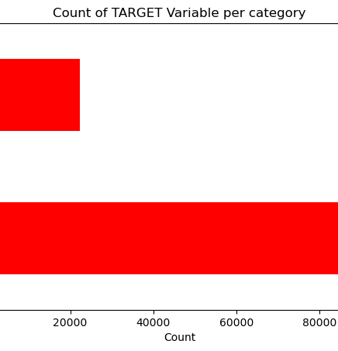
Target Variable:
"No show" was the goal variable in this EDA.
The ratio of the data was determined to be 80:20, which is quite unbalanced.
To analyze target variable in greater depth, both univariate and bivariate analysis was done to acquire some important insights regarding causes behind missed visits, so as to allow the healthcare organization to plan suitable future measures.

Slide 6
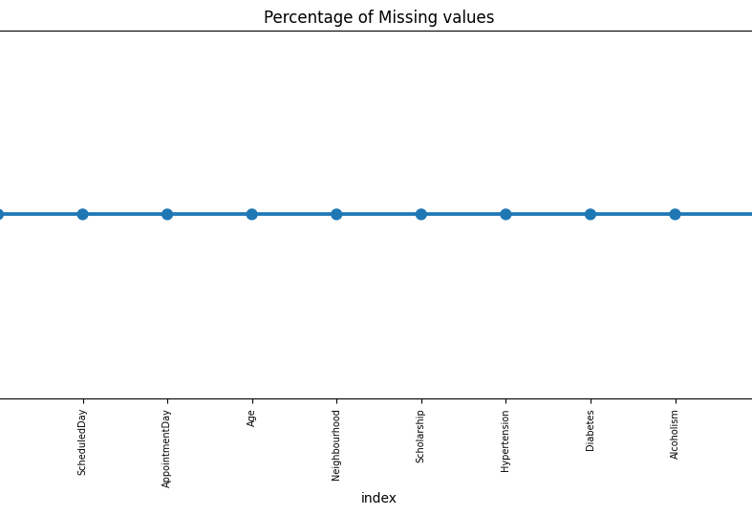
Missing Data: No missing values were found in the dataset

Slide 7
Data Cleaning:
A few columns that have no bearing on analysis, such as "Patient Id," "Appointment Id," "Scheduled Day," and "Appointment Day," were eliminated.
For simplicity of analysis, bins were made for the column "Age," and then the "Age" column was eliminated. A new column named "Age group" was formed by grouping the data in bins of 1 to 17 years.
When analyzing patient data, it was simple to distinguish between children and adults by constructing bins for "Age."

Slide 8
Univariate Analysis

Slide 9
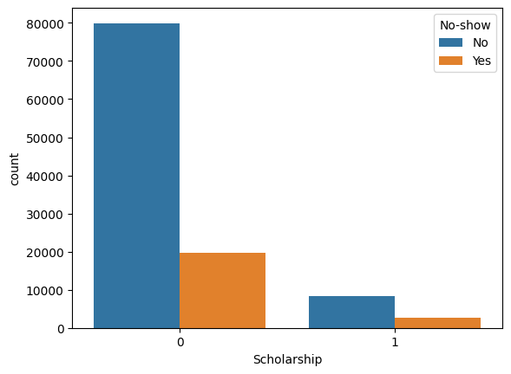
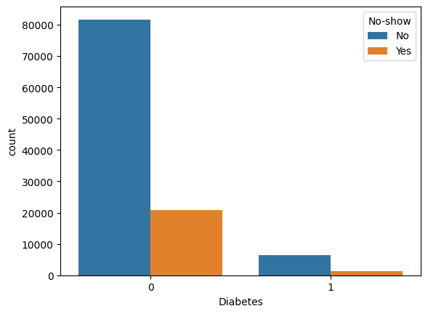
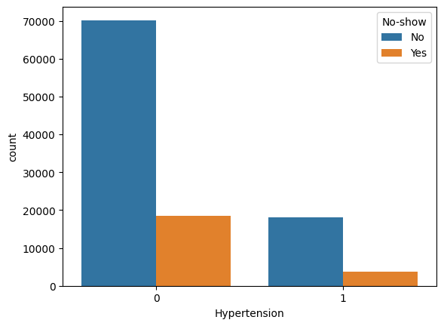
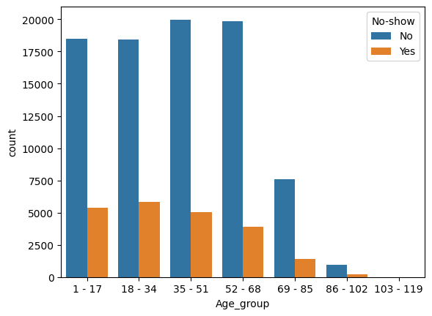
No show %
Hypertension-17.30%
Without hypertension-21%
Higher no-show ups seen in 18 - 34 (years): 24%
No show %
Diabetes-18%
Without Diabetes-20.36%
Patients above 52 and below 103 are most likely to show up for appointments.
Churn rate among people receiving Reminder SMS:27.57%

Slide 10
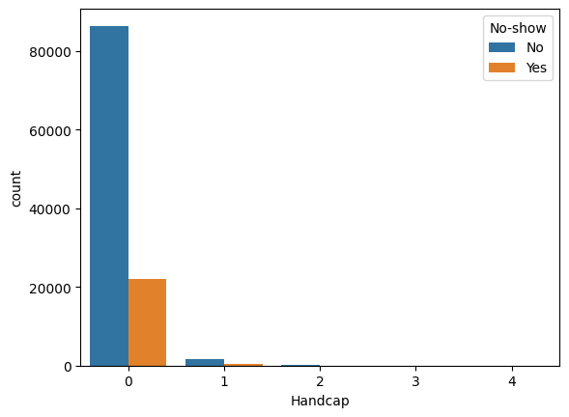
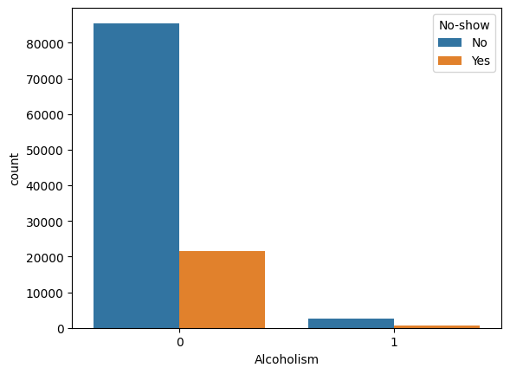
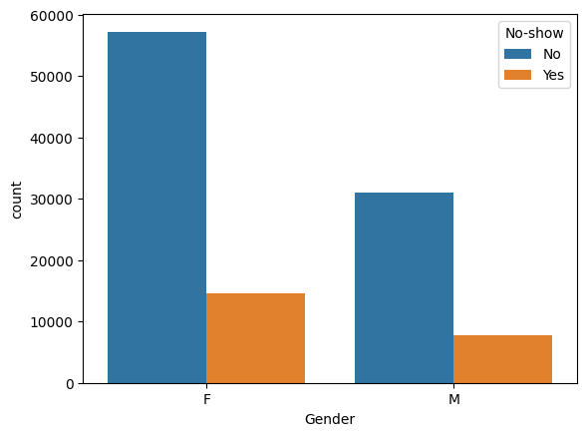
In a univariate study, gender, alcoholism, and disability do not appear to have a meaningful effect.

Slide 11
Univariate Analysis Findings:
Due to the fact that both men and women have an equal tendency to skip appointments, a univariate analysis reveals that gender has no discernible influence.
Patients who are part of the scholarship program have a greater churn rate.
Patients who do not have hypertension are more prone to miss appointments.
Patients without diabetes are more prone to miss appointments.
Alcoholism appears to have little effect on missed appointments, since alcoholic patients have the same turnover rate as non-alcoholics.
As the amount of disability grows, the likelihood of not attending the appointment increases.
Another unexpected finding: those who get SMS reminders are more likely to skip appointments.
The majority of patients who are over 52 and under 103 are likely to arrive for visits.

Slide 12
Bivariate Analysis

Slide 13
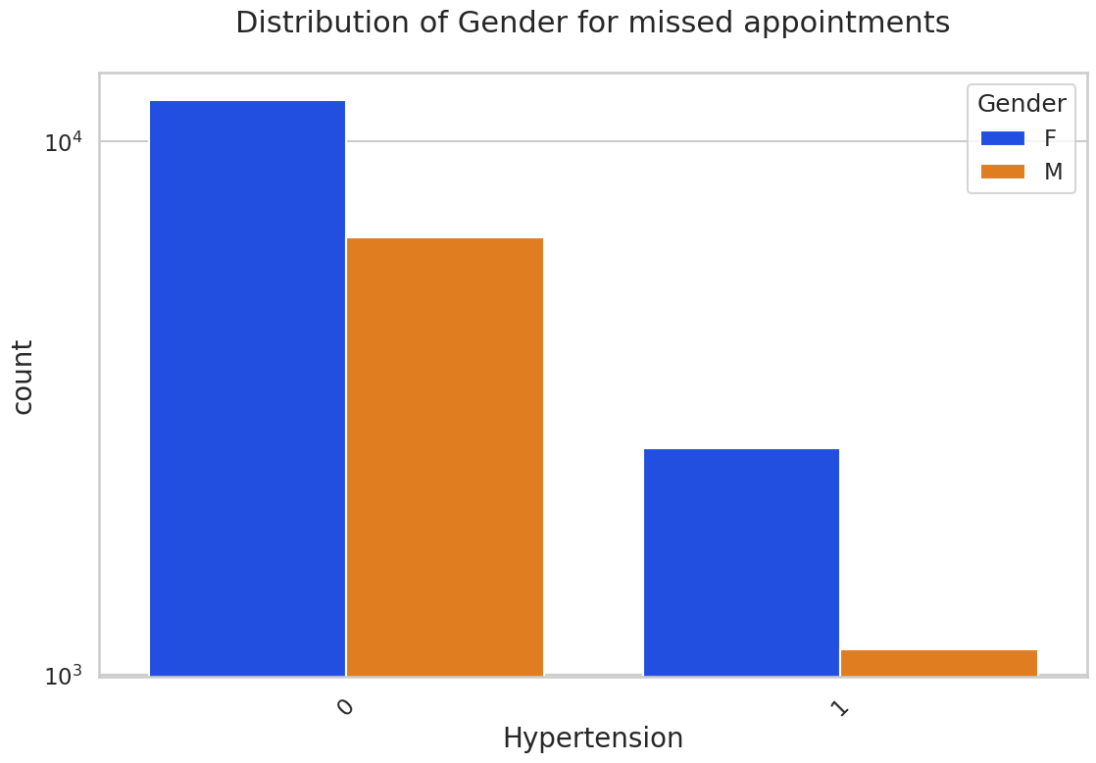
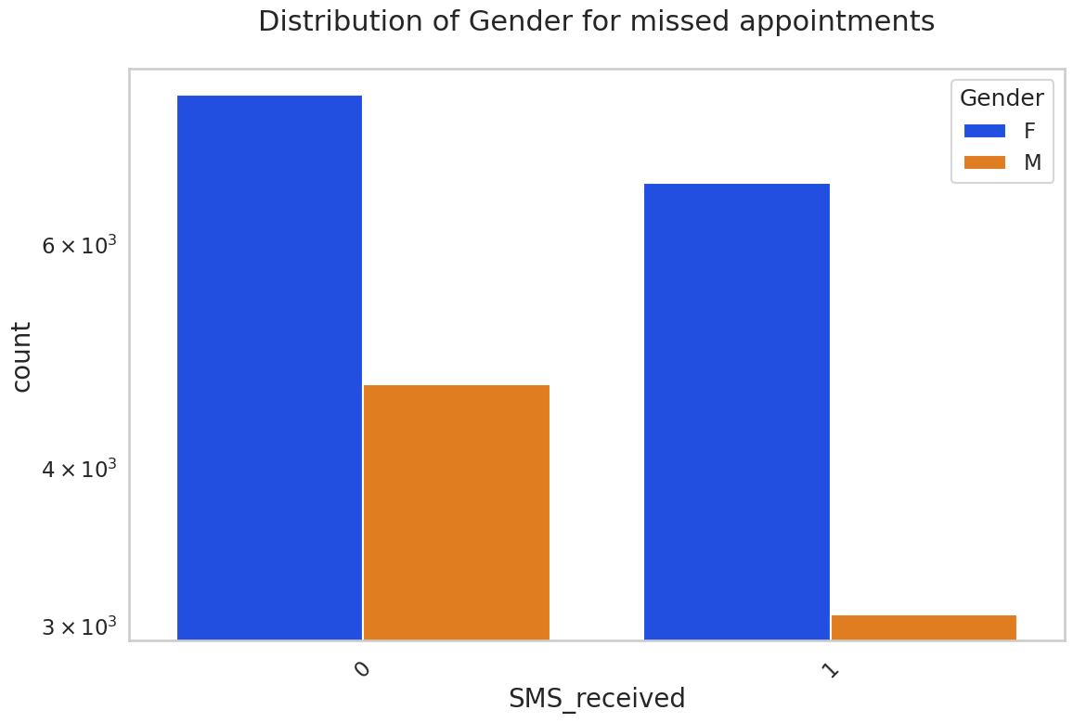
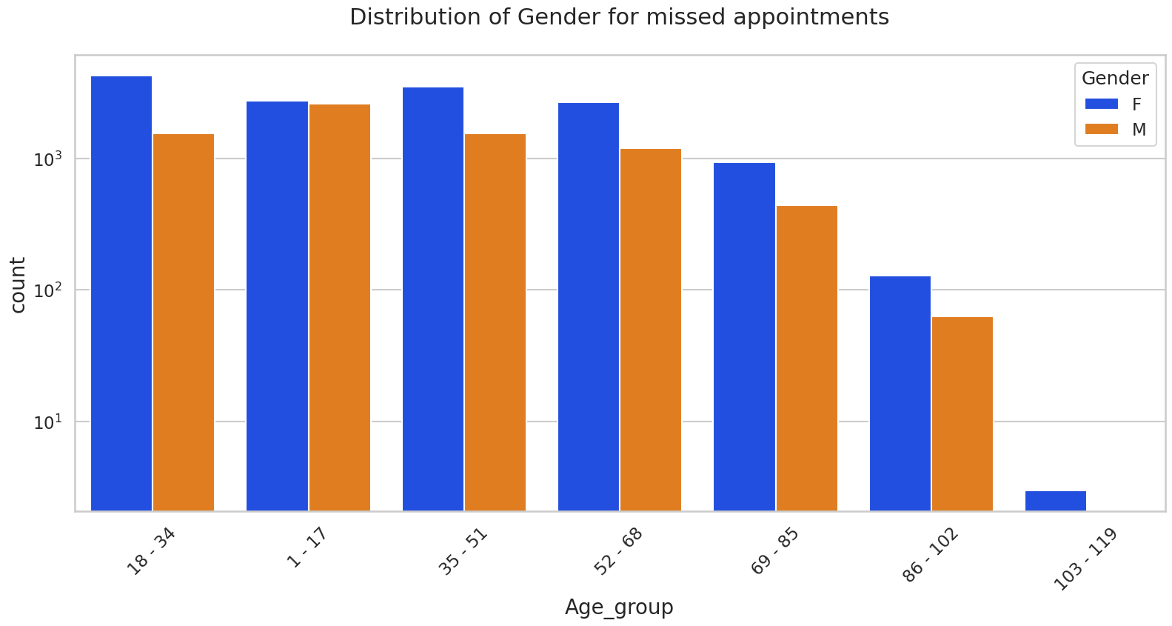
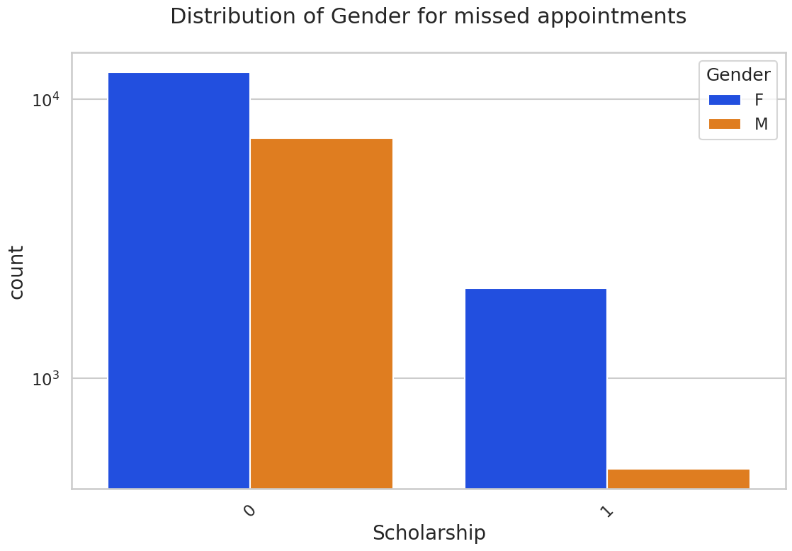
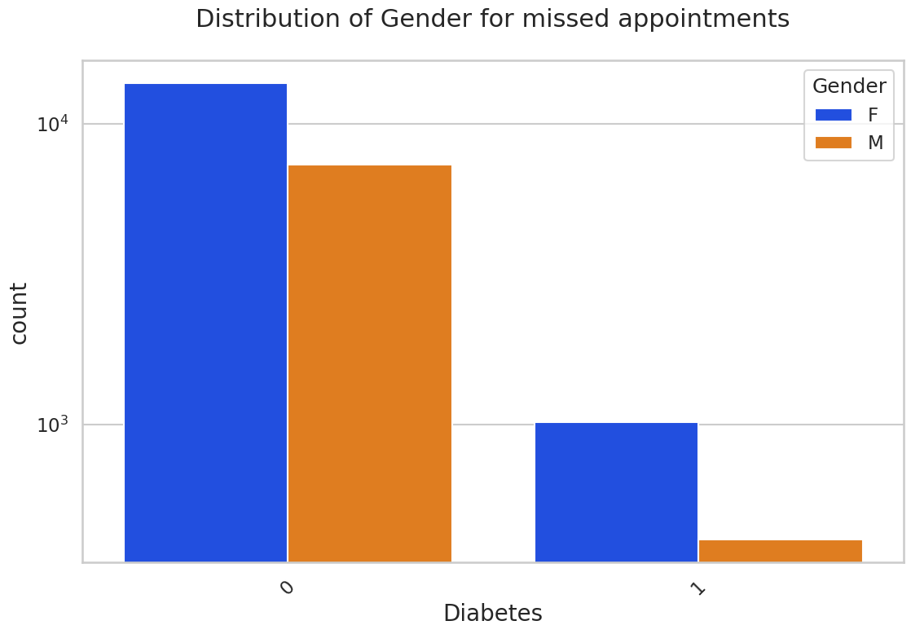
Females who get scholarships are more prone to skip appointments.

Slide 14
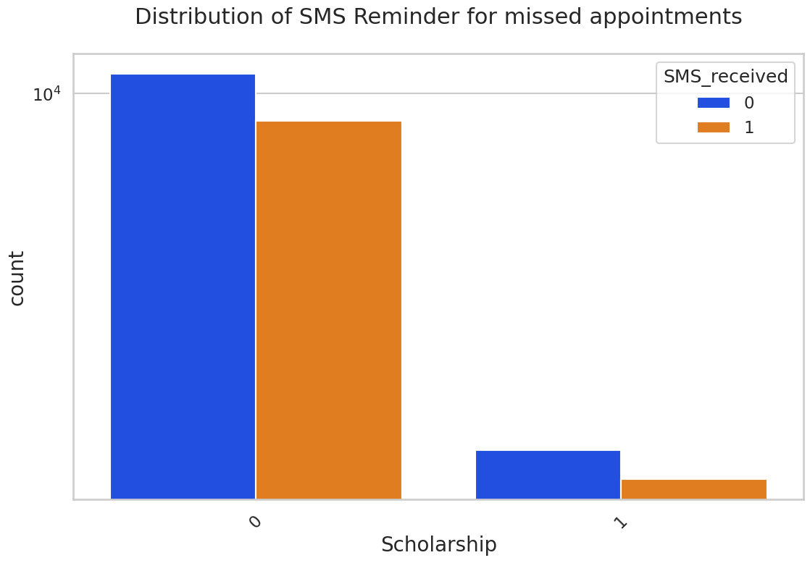
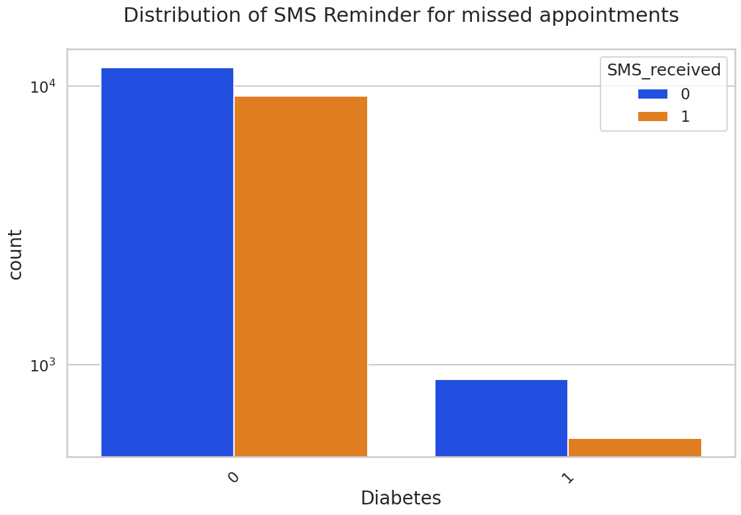
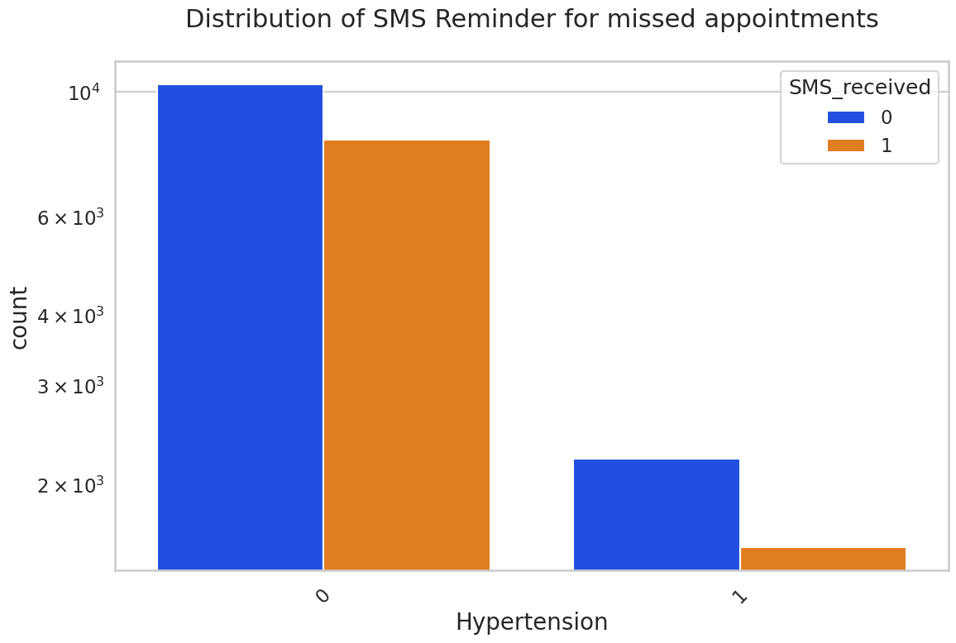
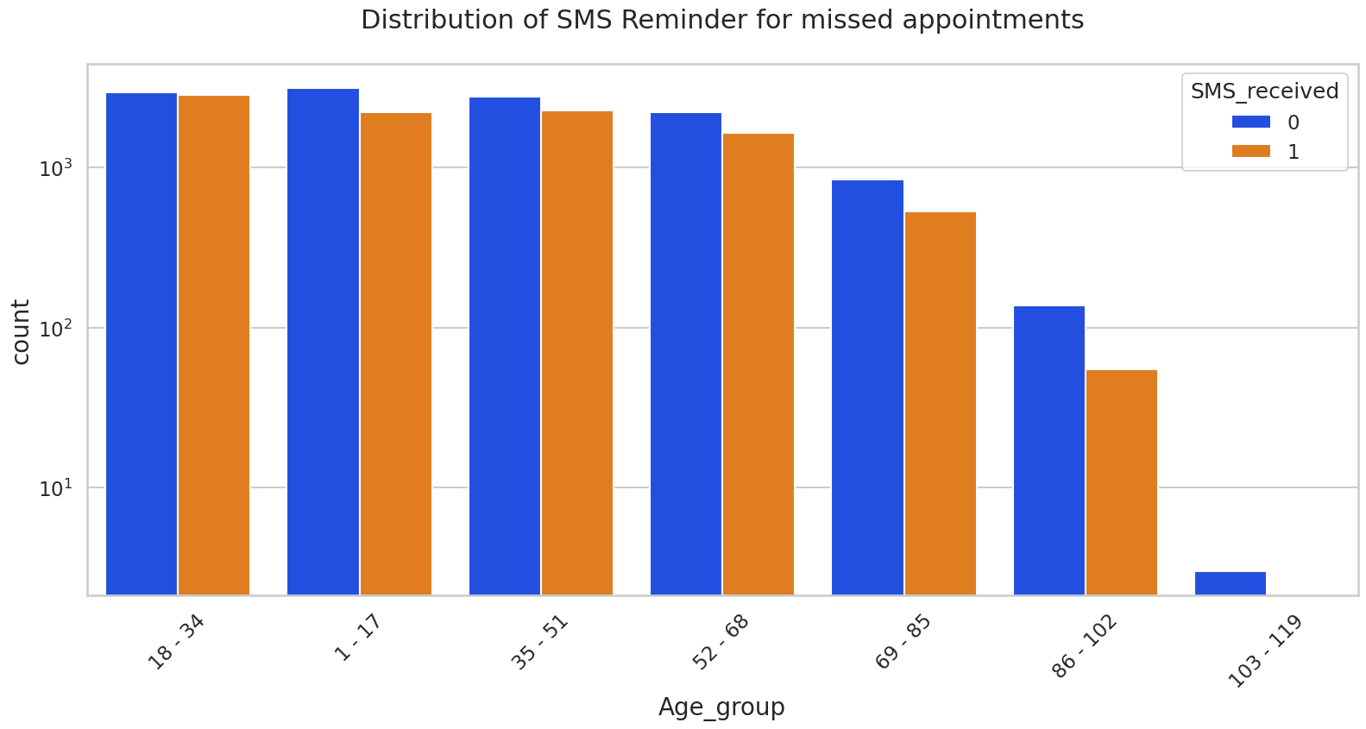
Patients are more likely to skip appointments if they do not receive SMS reminders.
Reminders are not being sent to a sizable majority of patients.

Slide 15
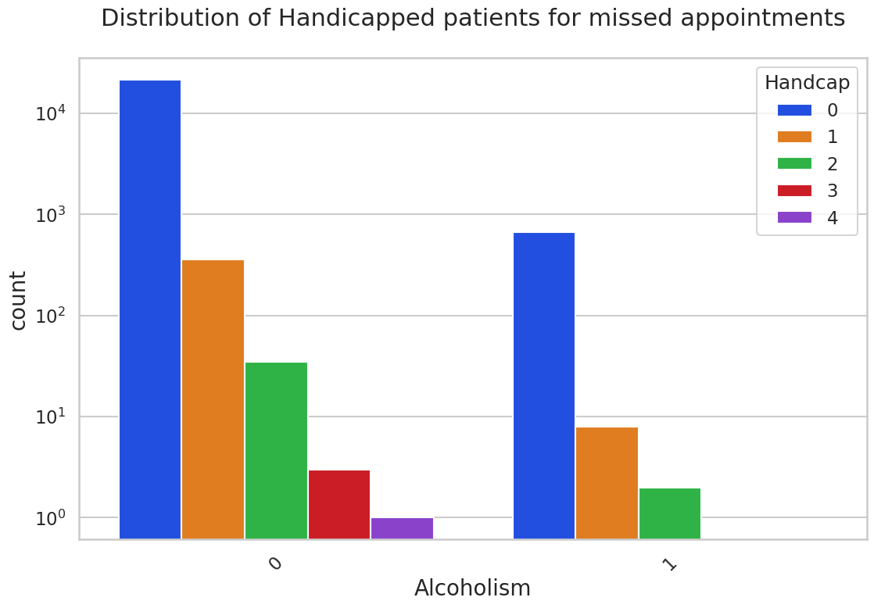
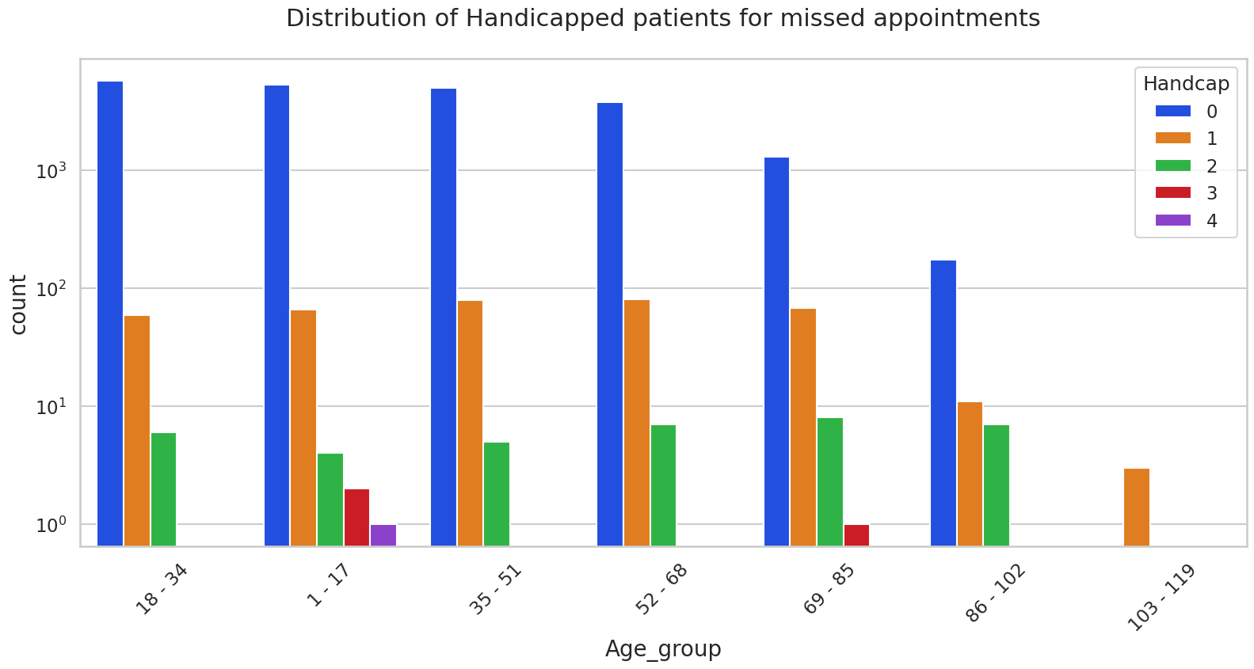
Patients with severe disabilities are not alcoholics.
The prevalence of disability level 3 is higher in the pediatric (1–17) and senior elderly (69–85) groups.

Slide 16
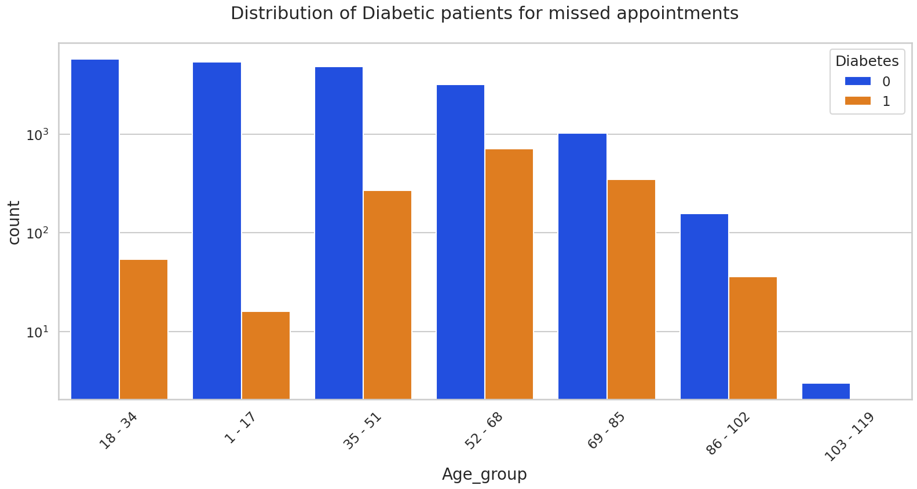
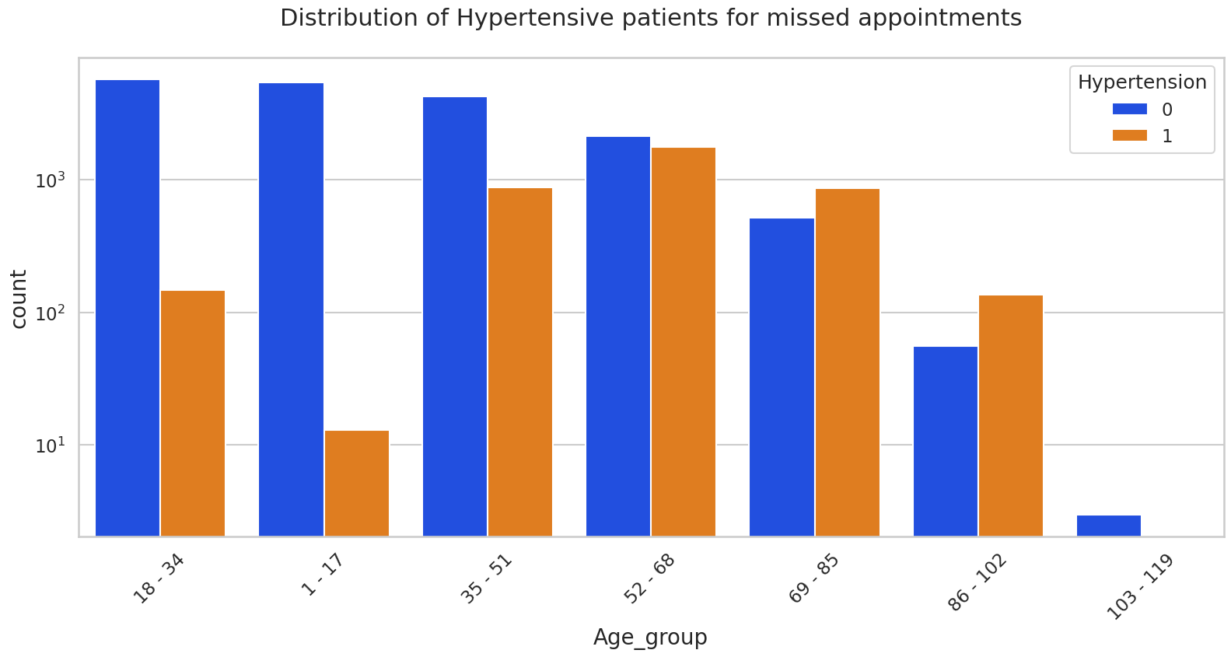
- Patients with these disorders are more likely to develop *hypertension* and ‘Diabetes’ as they become older, especially beyond the age of 55.
- Diabetes and hypertension coexist in the majority of instances.

Slide 17
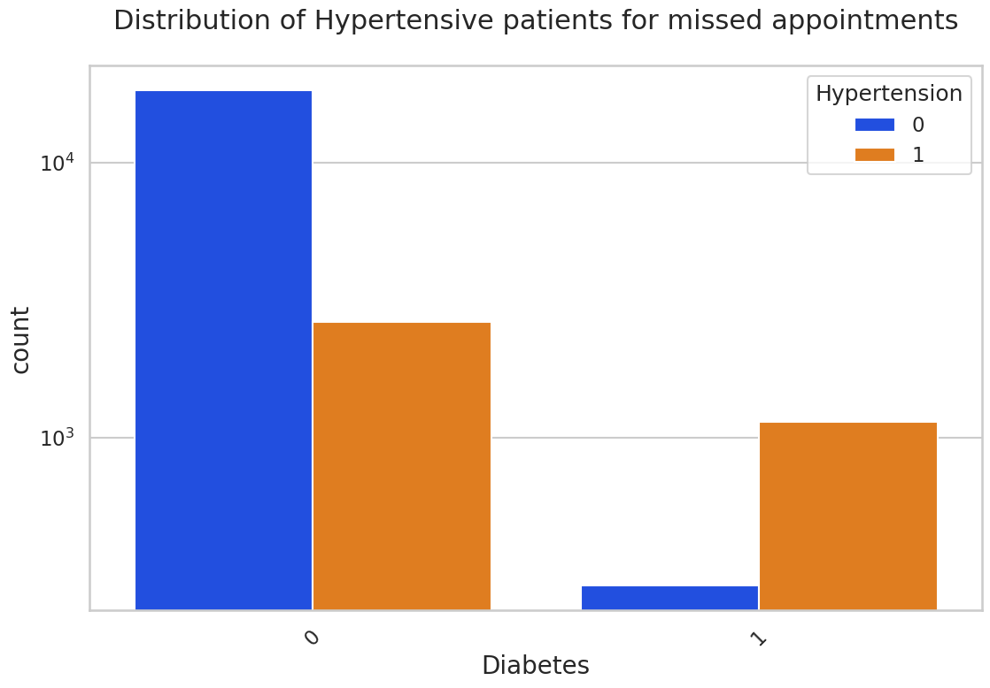
Most diabetes patients also have hipertension, which increases their likelihood of missing appointments.

Slide 18
Bivariate Analysis Findings:
Females who get scholarships are more prone to skip appointments.
Females with hypertension are more likely to skip appointments.
Diabetes in female increases the likelihood of appointment cancellations.
Males who consume alcohol are somewhat more likely to miss appointments.
Since patients with severe disabilities are few, disability seems to have little effect on missing appointments depending on gender, and the significance of gender in that situation is unclear.
Even after receiving an SMS appointment reminder, female are more likely to not show up.
Overall, females appear to miss more appointments across all age categories.
Patients who do not receive SMS reminders, whether with or without a scholarship, are more likely to skip appointments.
The majority of patients do not have hypertension and do not receive SMS reminders. Even among hypertensive patients, the vast majority do not receive SMS reminders.
A greater number of diabetes patients are not receiving SMS reminders.
Regardless of the severity of the patient's disability, SMS reminder services are insufficient for impaired patients.
Patients who are younger or older are less likely to get SMS reminders.
Patients who are alcoholics have extremely little chance of receiving SMS reminders.
The prevalence of disability level 3 is higher in the pediatric (1–17) and senior elderly (69–85) groups.
Patients with severe disabilities are not alcoholics.
The majority of diabetic and hypertensive individuals have a greater propensity to miss appointments.
Patients above the age of 35 have a substantial rise in hypertension.
Patients beyond the age of 35 are more likely to develop diabetes cases. Child diabetes prevalence is low.

Slide 19
Conclusion:
The following observations show that the SMS reminder service is ineffective:
A considerable proportion of patients do not receive SMS appointment reminders.
Although a large number of young individuals receive SMS reminders, their low frequency of chronic conditions such as Diabetes and Hypertension makes them more likely to skip appointments.
Males are significantly more likely than females to miss appointments when they consume alcohol, and they are the least likely to get SMS reminders.
The majority of patients, regardless of their medical condition or handicap status, do not receive SMS reminders about impending appointments.
Patients participating in scholarship programs have additional issues with SMS reminders, since a greater percentage of them do not receive notifications and are more likely to miss appointments.

Slide 20

Gender's Role:
Females, regardless of age, have a larger proclivity to skip appointments, even when they have:
Medical problems that are ongoing.
Participation in scholarship programs.
SMS reminders were sent.

Slide 21
Highly Disregarded Groups:
Pediatric, extremely old, and disabled patients are the most neglected categories when it comes to appointment attendance, and some prevalent explanations are as follows:
absence of SMS appointment reminders.
Rarely do pediatric children have chronic illnesses.
When the impairment level is level 3 or higher, there is a higher likelihood of missed appointments. Children (1–17) and older age groups (69–85) are typically affected by this level of impairment.

Slide 22
Regular Patients:
Patients who regularly keep their visits are above 50 in a sizable majority (75%) of cases.
Patients in the age range of 50 to 100 years are less likely to miss appointments because they require active medical treatment and follow-ups for conditions like Hypertension and Diabetes.

Slide 23
THANK YOU

