Slide 1
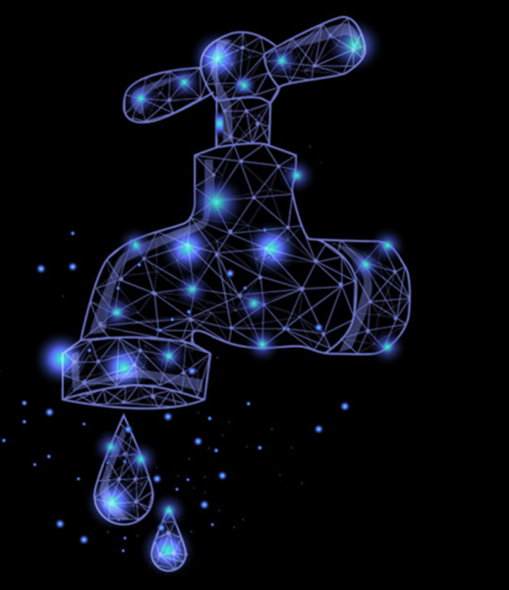
Team IoTa of Effort
flow sense
using IoT to prevent wastage and monitor usage

Slide 2
motivation
water wastage is rampant, one such example is overflowing containers…
manually observing the water filling in time consuming and impractical in certain situations…
our goal is to save water and gain useful insights into how we use water…

Slide 3
what it is
you clip our device to the edge of a bucket, calibrate it and walk away…
our device will notify you with a buzzer when it is time to turn the faucet off…
we save your data and help you monitor your water consumption over time…

Slide 4
what it does
we utilize an accurate ultrasonic sensor to measure the water level in real time…
we analyse the data in real time and save it using ThingSpeak and oneM2M…
we use linear regression on our saved data to predict the flow and amount wasted…

Slide 5
alternative use cases
in industrial setups this can be a cheap and efficient way of measuring any fluid, especially dangerous ones...
by meteorology departments to measure rain gauges in remote locations…
in collision avoidance systems, by measuring lateral distance instead of vertical depth…

Slide 6
alternative use cases
by municipalities to monitor how full garbage disposal sites are across the city...
by maintenance services to check whether water tanks for buildings are full to save water during dry periods
to check whether social distancing is maintained b/w people…

Slide 7
alternative use cases
in construction projects to measure without tapes, safely at a distance...
As an early warning systems for areas prone to floods
essentially anywhere where measurement is required…

Slide 8
how it works
first we measure the depth...
then we measure the diameter…
we dynamically calculate the flow to measure the water wastage…

Slide 9
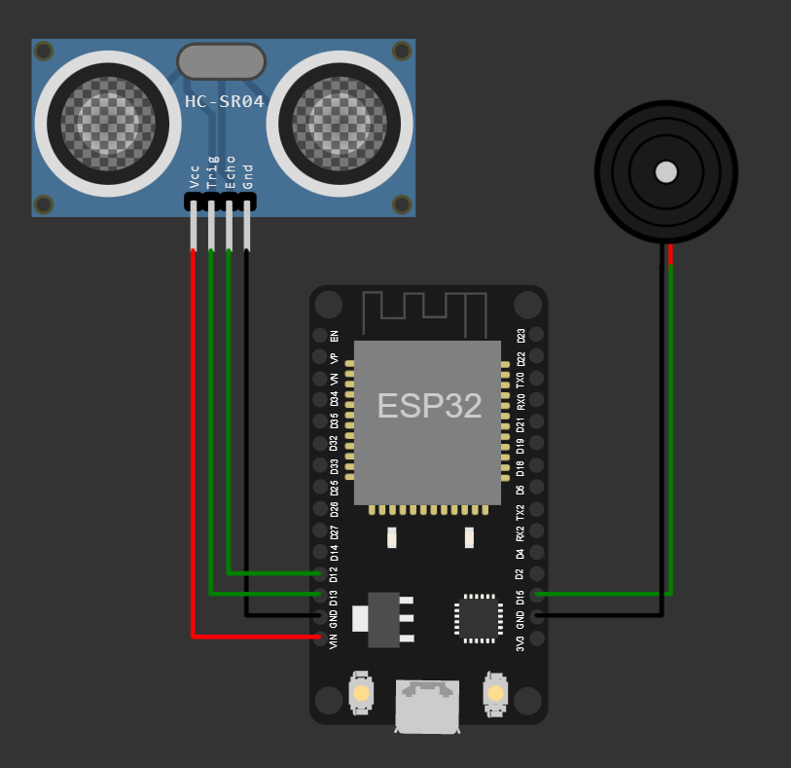
circuit diagram

Slide 10
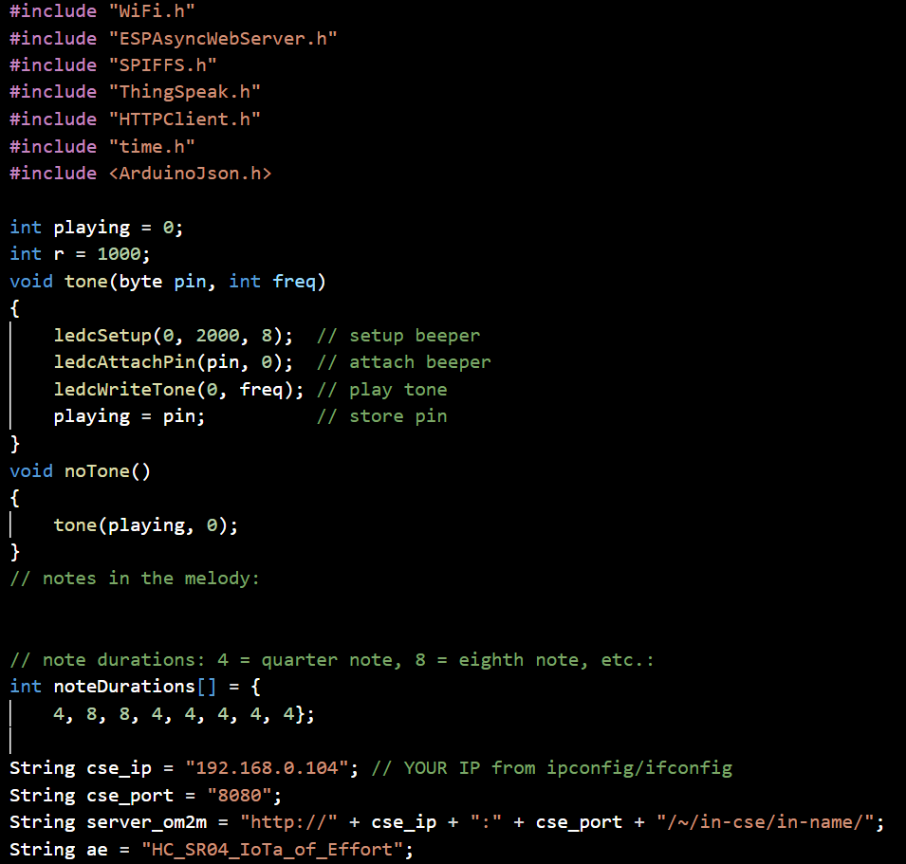

code flow
setup

Slide 11
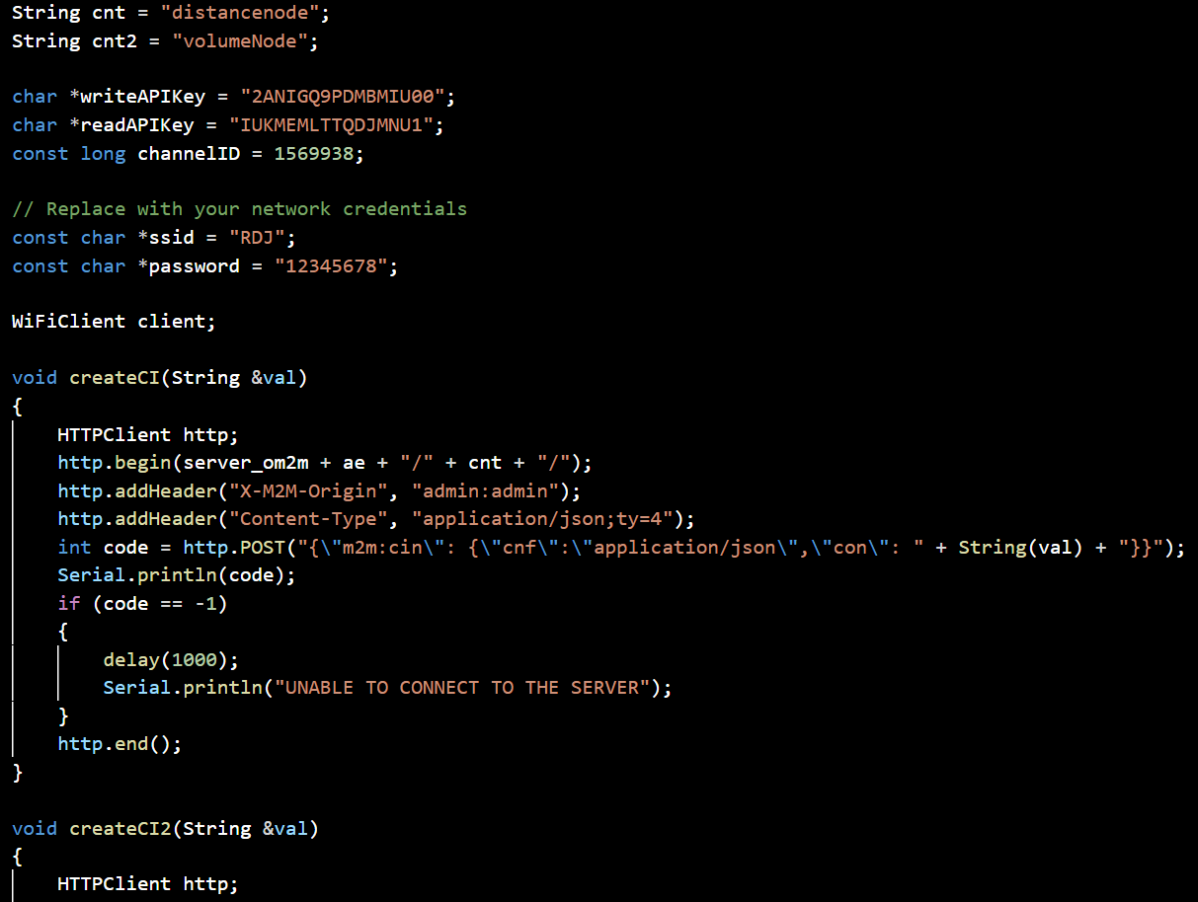
code flow
setup

Slide 12
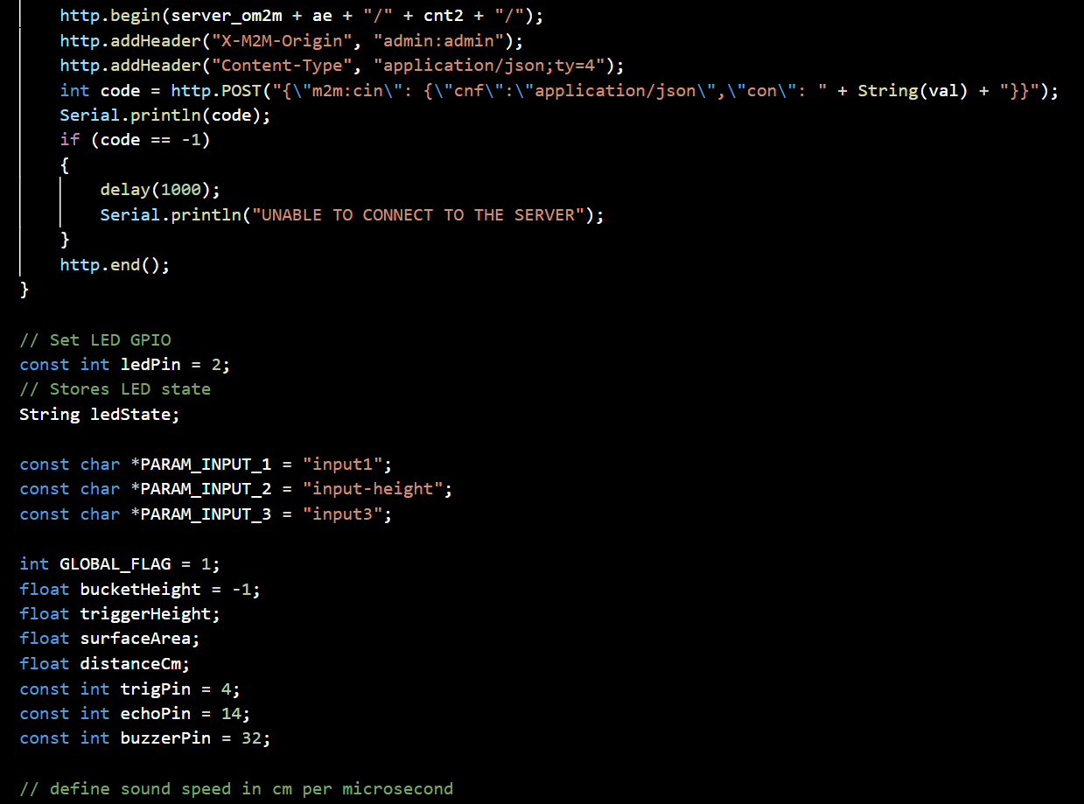
code flow
setup

Slide 13
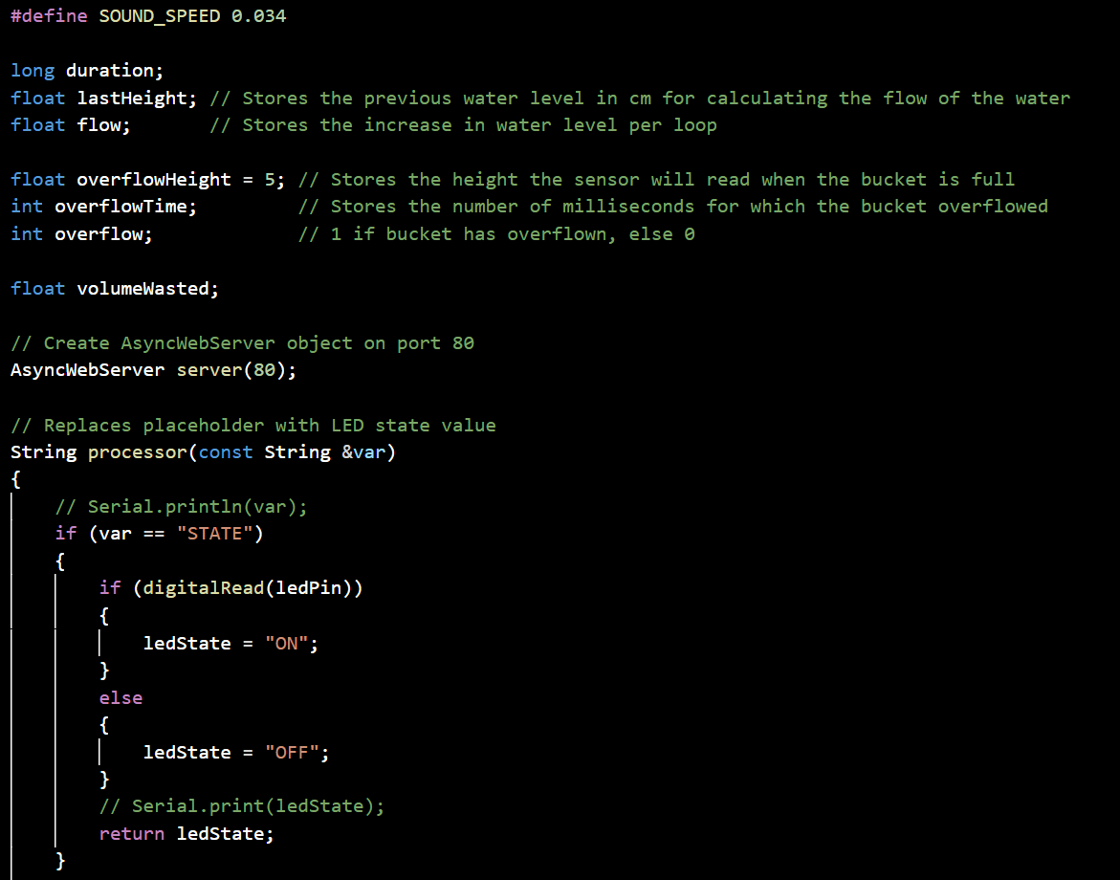
code flow
setup

Slide 14
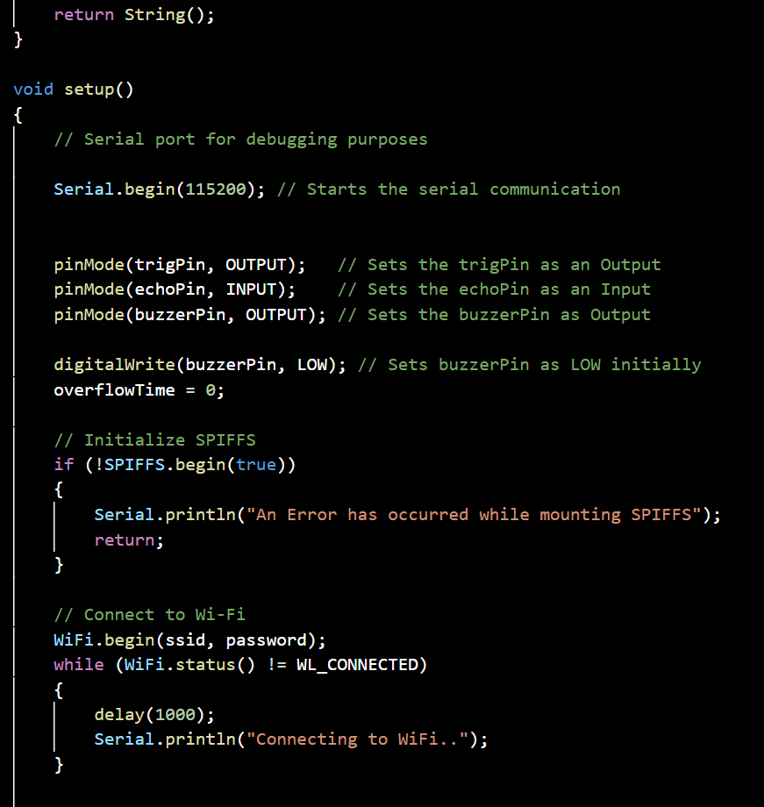
code flow
setup

Slide 15
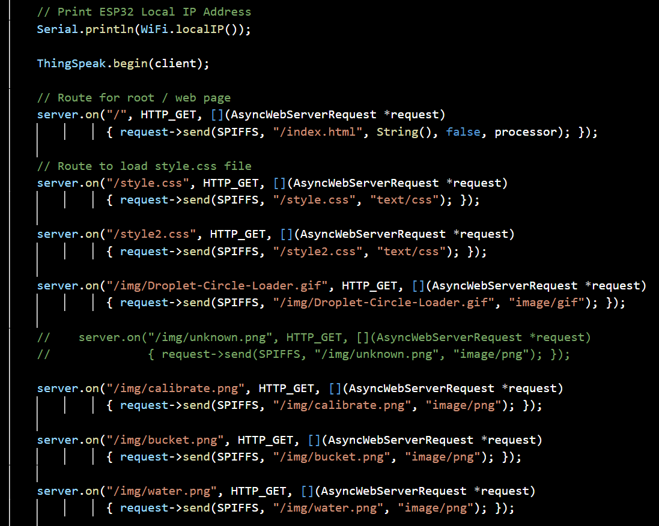

code flow
prepare
webpage

Slide 16
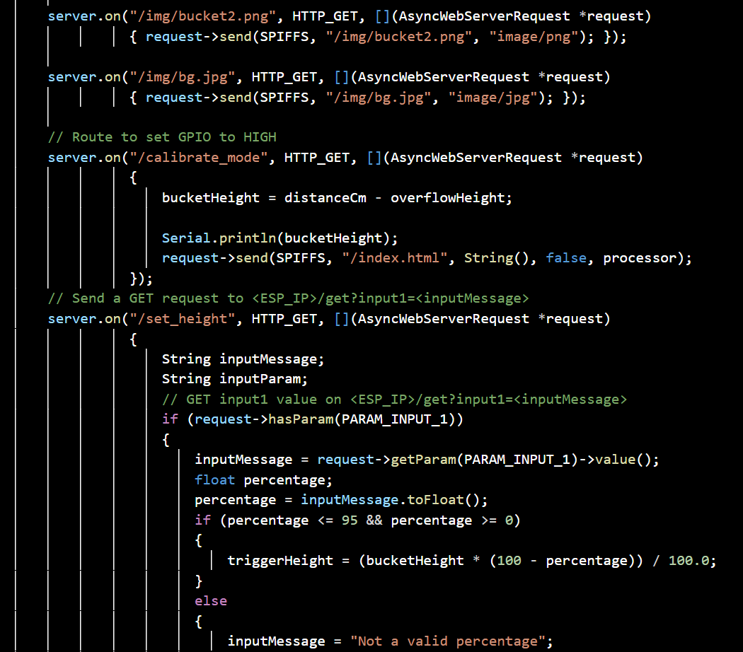
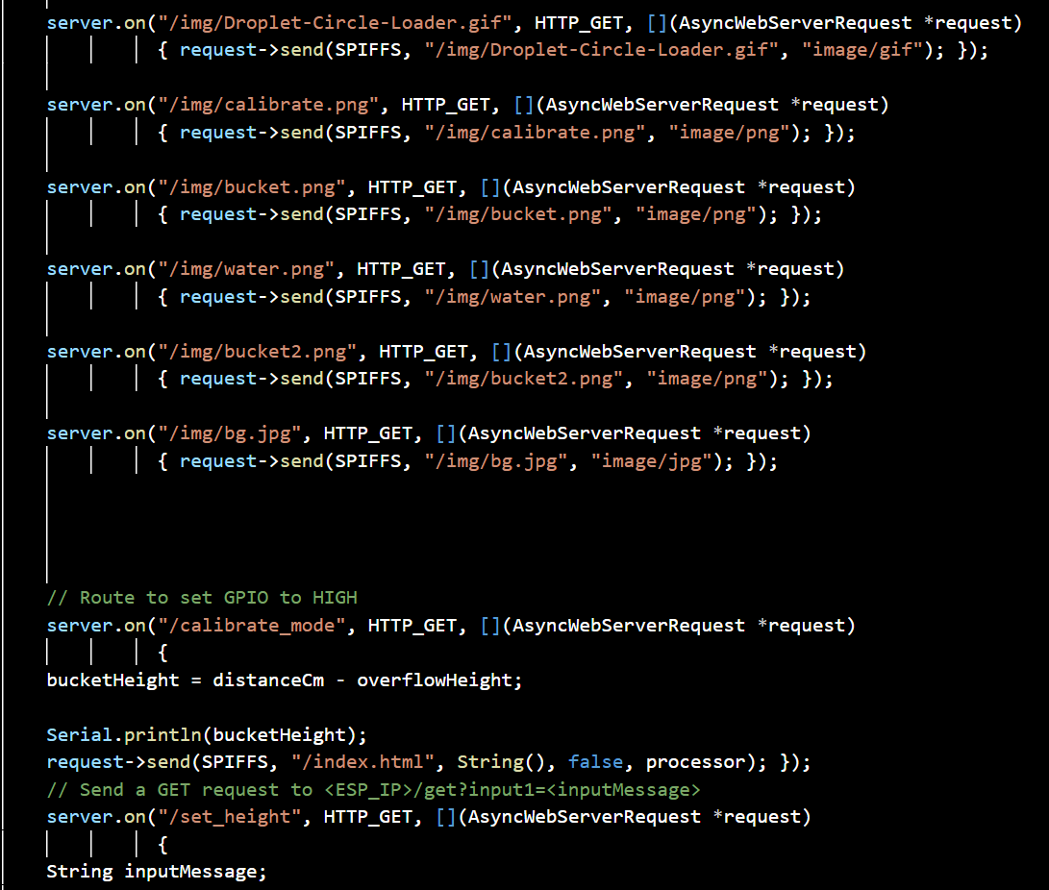
code flow
prepare
webpage

Slide 17
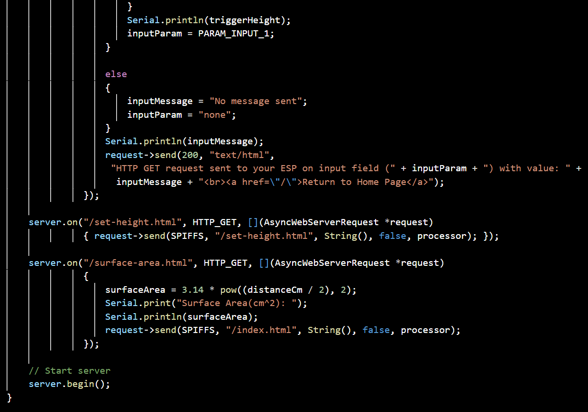
code flow
prepare
webpage

Slide 18
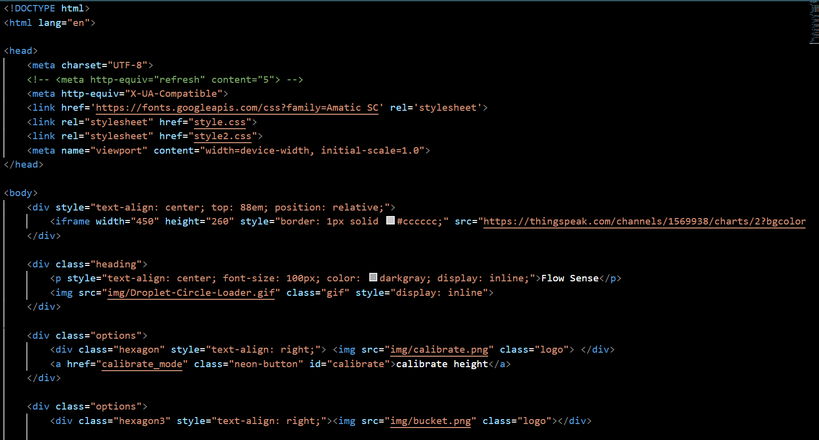

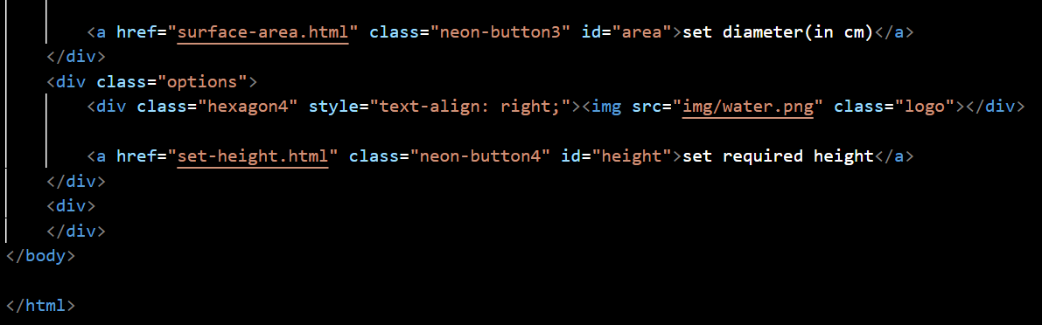
code flow
calibrate from webpage

Slide 19
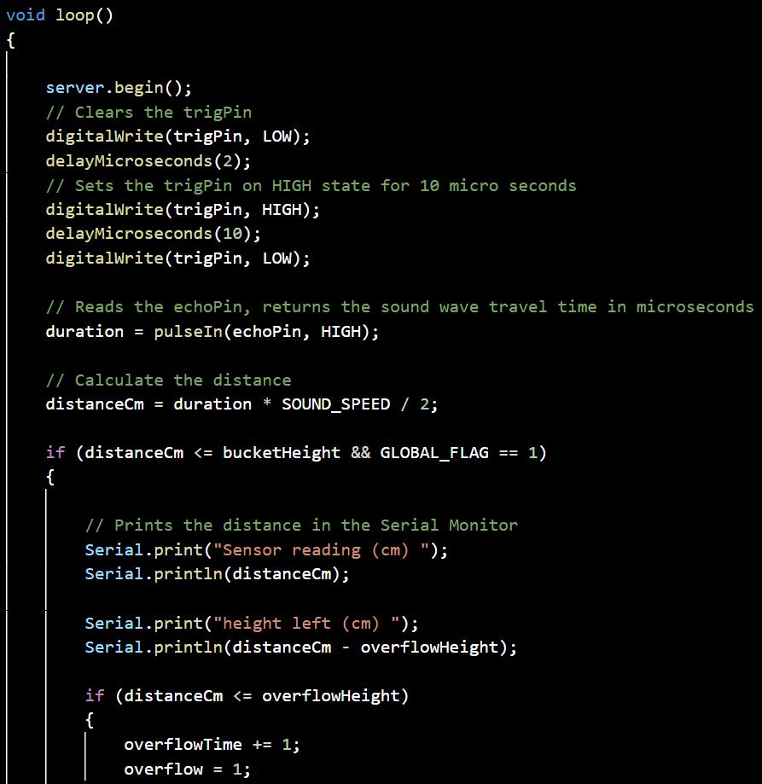
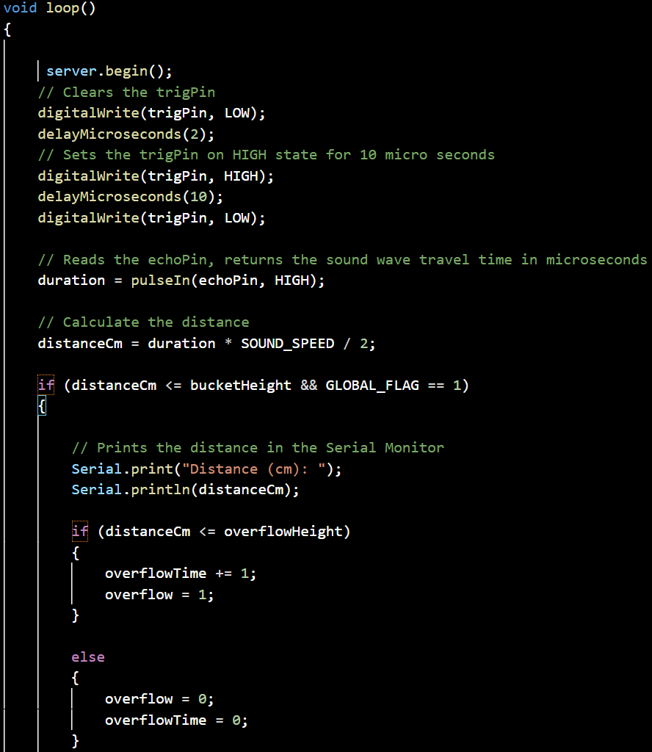

code flow
measure

Slide 20
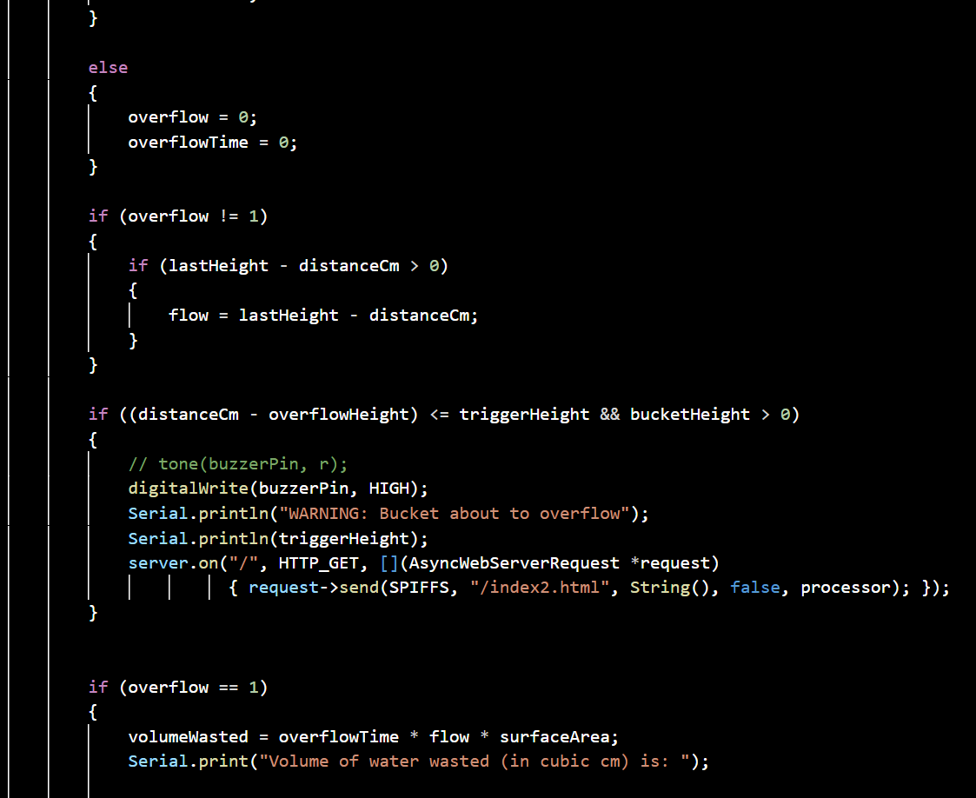
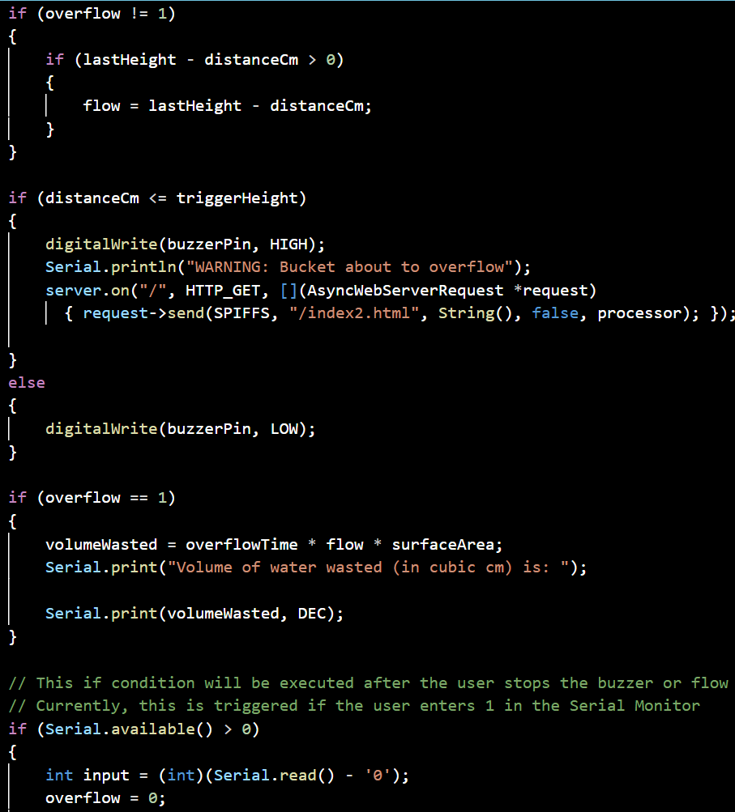

code flow
alert

Slide 21
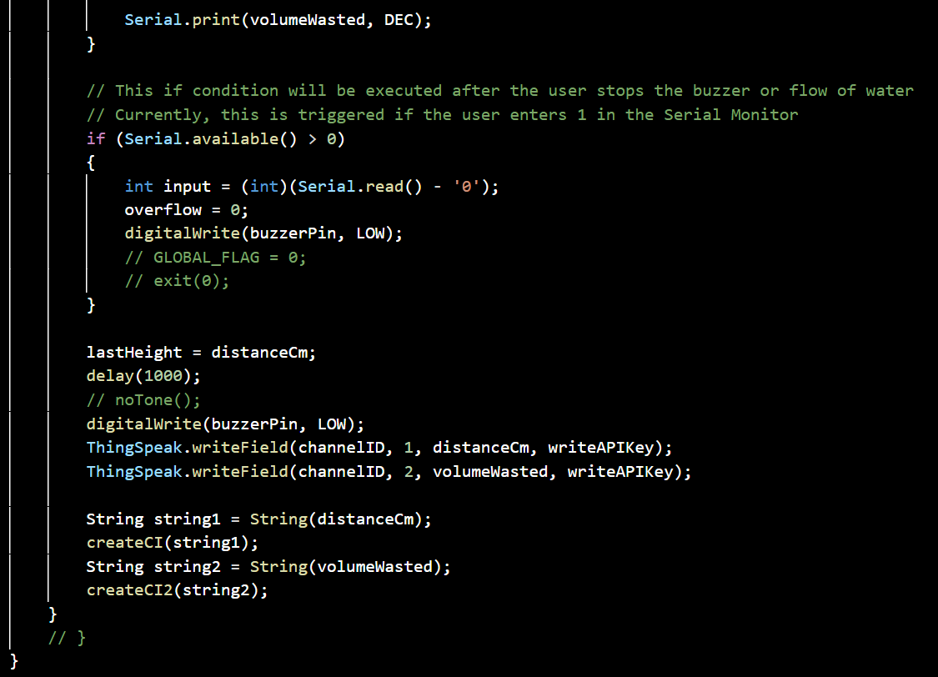
code flow
alert

Slide 22
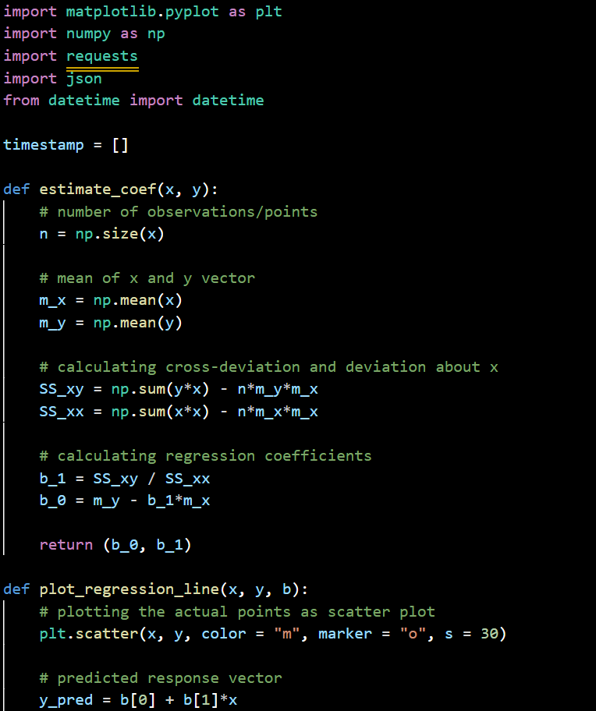

code flow
analysis

Slide 23
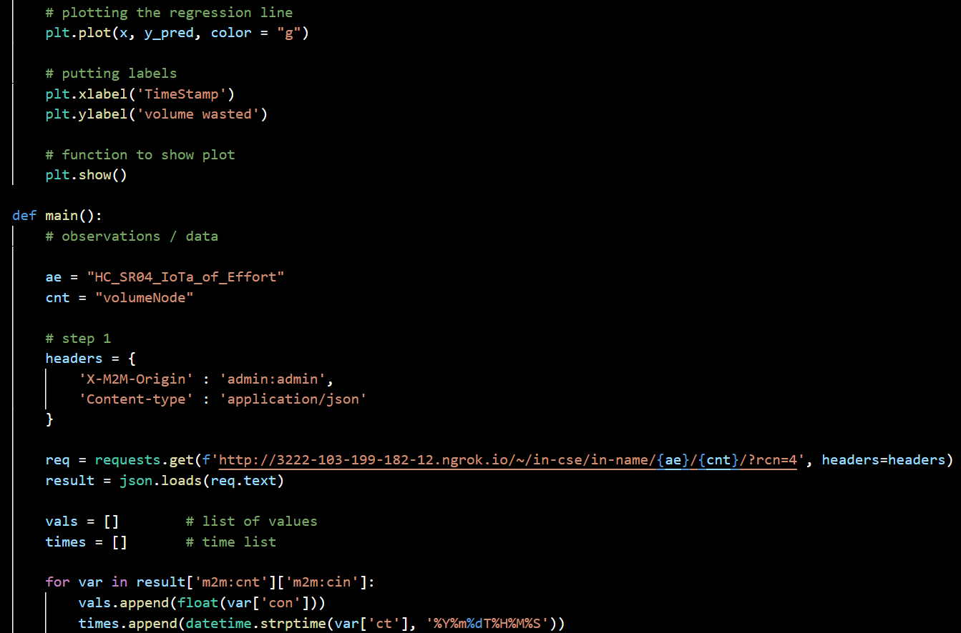
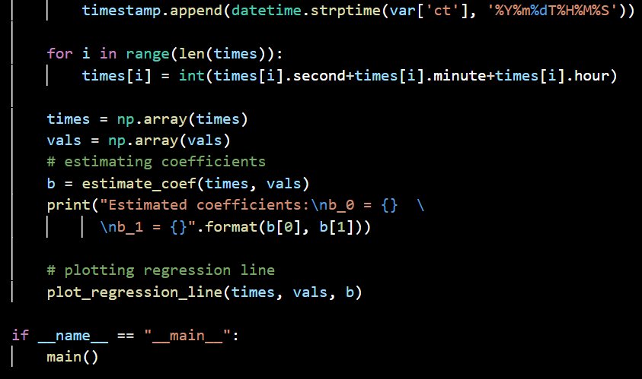
code flow
analysis

Slide 24
contributions
Anirudh Govil: Primary Project Design, oneM2M Integration, ThingSpeak Integration, debugging Measurement Code, debugging Website Code, Presentations
Anirudh Kaushik: Primary Website Design, debugging Website Code, Website integration, Measurement Code integration, Website Data Analysis code, ThingSpeak Integration Jatin Agarwala: Primary Measurement Code, Measurement Code integration, debugging Measurement Code, Data Analysis Code, Measurement Data Analysis, Website Integration
Naimeesh Tiwari: Primary Hardware Integration, Measurement Code integration, Website debugging, Website Integration, oneM2M Integration, ThingSpeak Integration

