Slide 1
Hospital Re-Admission Analysis
Advaith Auron Suresh(800943085)
Anirudh Lakshminarayanan(800964326)
Kandasamy Kishore(800941654)
Sriram Subramanian(800959758)
Shiva Vandana Nayakanti(800951756)

Slide 2
Introduction
A managed healthcare organization believes they suffer from over $25 million in preventable losses annually due to the readmission of patients who are discharged from the hospital too soon.
Reducing re-hospitalizations among Medicare beneficiaries has taken high priority.

Slide 3
Objective
To develop a model of readmission risk that doctors can consider when determining when to discharge a patient.
The following attributes are used in relation to readmission attribute
Race
Age
A1C result
Change in Medication

Slide 4
Technical Specifications
R Version: 3.3.2
Platform: x86_64-apple-darwin13.4.0 (64-bit)
Data Structures used:
Lists
Vector

Slide 5
Programming Language Used
The R language is widely used among statisticians and data miners for developing statistical software and data analysis
R has become the preferred computing environment for a large part of the statistical community

Slide 6
Major Data Structures
In R programming, variables are assigned with R-objects and the data type of the variable depends on the data type of the R-object.
The commonly used data structures in R programming are:
Arrays
Lists
Vectors
Matrices
Factors

Slide 7
Why R?
R has a fantastic mechanism for creating data structures.
It is easy to produce graphs for exploring data.
It is extremely easy for people to add their own functionality.
There are thousands of packages that do all sorts of extraordinary things.

Slide 8
Datasets Used
The initial dataset used contained over 10000 records.
The dataset is refined by removing patient entries that resulted in deaths or home discharges by using the following commands:
Patients ← subset(patients, discharge, disposition_id != “Hospice” )
Patients ← subset(patients, discharge, disposition_id!=“Expired”)

Slide 9
Drawbacks
Memory management
Speed, and efficiency
Security For Instance: R is not used in back-end server to do calculations because of its lack of security

Slide 10
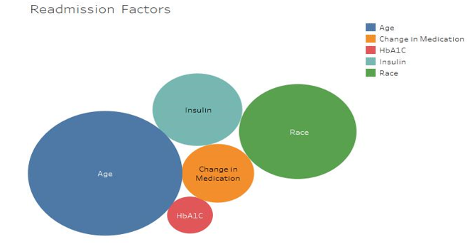
Fig: Colors indicate factors and chi-squared values indicate impact on readmission rate

Slide 11
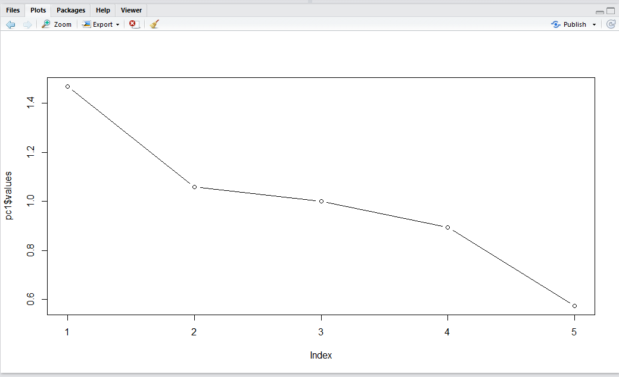
Plot Graph

Slide 12
Challenges
Multiple Collinearity
Removing duplicate observations
Getting familiar with R

