Slide 1
Accelerating Decision-Making in AI: Parallelizing Monte Carlo Tree Search for Connect 4 Using CPU and GPU
Anirudh Nayaka, P.C.Nissimagoudara, Rutvi Revankara, Prerana Giraddia, Swaraj Hosamania, Nalini.C.Iyera, Suneeta.V.Budihala, Baswaraj
Anirudh Nayak
Anirudh.nayak.ubl@gmail.com

Slide 2
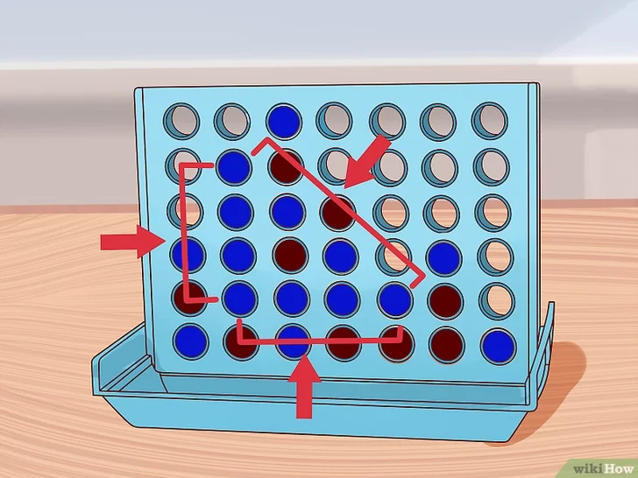
Accelerating Decision-Making in AI: Parallelizing Monte Carlo Tree Search for Connect 4 Using CPU and GPU
Context:
Artificial Intelligence (AI) has rapidly advanced, enhancing decision-making across diverse domains, from game-playing algorithms to strategic real-world applications. However, a major challenge AI faces is the significant computational power required to make quick and accurate decisions, particularly in complex environments.
Introduction:
In this study, we focus on the Monte Carlo Tree Search (MCTS) algorithm, a popular method in AI for decision-making tasks, especially in game environments.
We applied MCTS to the game of Connect 4, exploring how parallel computing on both CPU and GPU platforms can accelerate the decision-making process.
Figure 1: Connect 4 game board
(ref:https://www.wikihow.com/Play-Connect-4)

Slide 3
Accelerating Decision-Making in AI: Parallelizing Monte Carlo Tree Search for Connect 4 Using CPU and GPU
Context:
Artificial Intelligence (AI) has rapidly advanced, enhancing decision-making across diverse domains, from game-playing algorithms to strategic real-world applications. However, a major challenge AI faces is the significant computational power required to make quick and accurate decisions, particularly in complex environments.
Introduction:
In this study, we focus on the Monte Carlo Tree Search (MCTS) algorithm, a popular method in AI for decision-making tasks, especially in game environments.
We applied MCTS to the game of Connect 4, exploring how parallel computing on both CPU and GPU platforms can accelerate the decision-making process.
By leveraging parallelization techniques like OpenMP for CPUs and CUDA for GPUs, this research compares the performance improvements that can be achieved through efficient resource utilization on different hardware architectures.

Slide 4

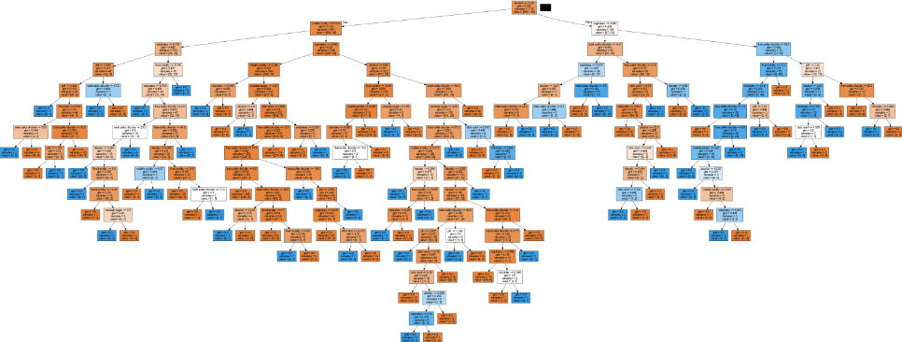
Accelerating Decision-Making in AI: Parallelizing Monte Carlo Tree Search for Connect 4 Using CPU and GPU
What is AI-Driven Decision Making?
Figure 2: AI Decision-Making according to people meme.
(ref:https://www.reddit.com/r/ProgrammerHumor/comments/15t7vie/youknowitstrue/)
Figure 3: Complex Decision Tree example.
(ref:https://www.machinelearningnuggets.com/decision-trees-and-random-forests/)
AI-driven decision-making refers to the process where artificial intelligence (AI) systems analyze data, recognize patterns, and make decisions or recommendations based on that analysis, often without human intervention.
These systems leverage algorithms, machine learning, and data processing techniques to assess complex situations, weigh different outcomes, and select the best course of action.

Slide 5
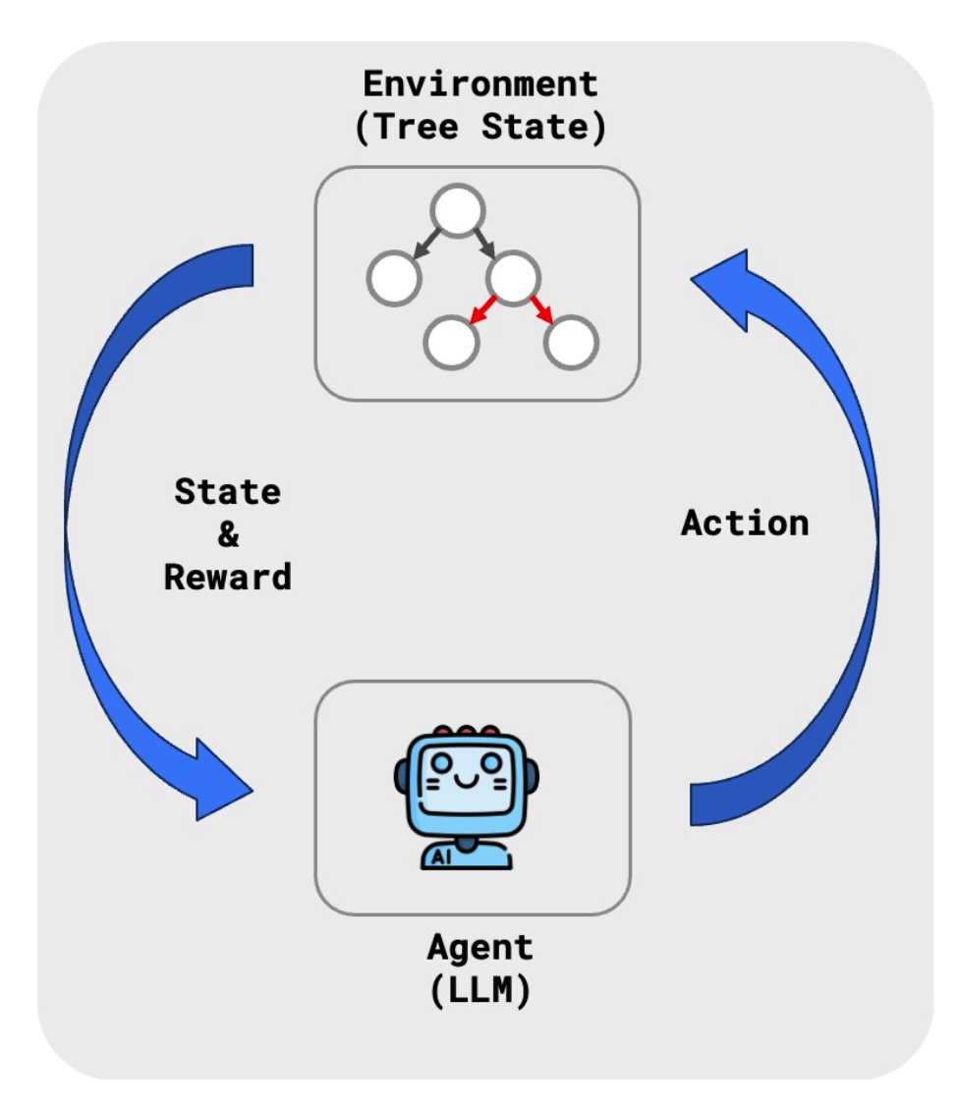
Accelerating Decision-Making in AI: Parallelizing Monte Carlo Tree Search for Connect 4 Using CPU and GPU
Why MCTS?
MCTS is highly effective at handling large, complex decision spaces without the need for extensive domain-specific knowledge. Its ability to balance exploration (trying new moves) and exploitation (focusing on known good strategies) makes it a powerful tool for decision-making under uncertainty.
This flexibility, along with its capability to deliver strong results even in scenarios with incomplete information, makes MCTS a preferred algorithm in AI for games and broader strategic tasks.
Figure 4: MCTS use-case for tree-based LLM.
(ref: https://www.inovex.de/de/blog/mcts-meets-llms-enabling-complex-reasoning-and-strategic-planning/)

Slide 6
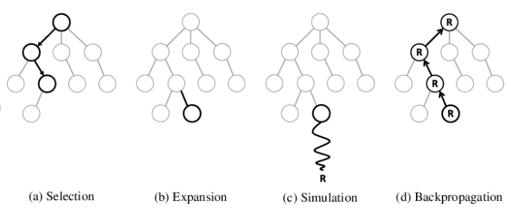
Accelerating Decision-Making in AI: Parallelizing Monte Carlo Tree Search for Connect 4 Using CPU and GPU
How does MCTS work?
Figure 5: Phases of Monte Carlo Tree Search.
(ref: https://spl.hevs.io/spl-docs/computerscience/algorithms/mcts.html)
Monte Carlo Tree Search (MCTS) is a heuristic search algorithm that uses random sampling and tree-based exploration to make decisions in strategic environments.

Slide 7
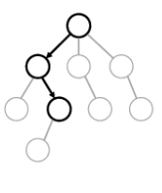
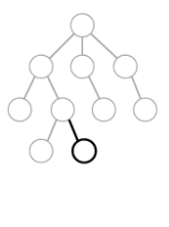
Accelerating Decision-Making in AI: Parallelizing Monte Carlo Tree Search for Connect 4 Using CPU and GPU
Selection:
The algorithm starts at the root node, which represents the current state of the game. It traverses down the existing tree by selecting child nodes based on a specific policy, such as Upper Confidence Bound (UCT).
This process continues until a leaf node is reached. The goal is to balance exploration of new possibilities and exploitation of known good moves by selecting the most promising nodes along the path.
Expansion:
Once a leaf node is reached, the algorithm checks if all possible moves from that state have been explored.
If not, one or more child nodes are added to the tree, representing previously unexplored game states.
These new nodes expand the search tree, allowing the algorithm to explore additional potential decisions or moves that were not previously considered.

Slide 8
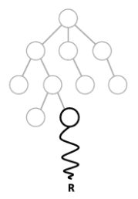
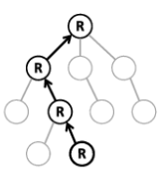
Accelerating Decision-Making in AI: Parallelizing Monte Carlo Tree Search for Connect 4 Using CPU and GPU
Simulation (Rollout):
After the expansion phase, the algorithm runs a random simulation from the newly added node to a terminal state (the end of the game).
The random playthrough simulates the remainder of the game to provide an estimate of the outcome.
This helps the algorithm understand the potential success of moves from the new node, even though it relies on random, non-optimized actions.
Backpropagation:
The simulation result (win, loss, or draw) is propagated back up through the nodes leading to the root.
The statistics of each node on the path, such as the number of simulations and win rates, are updated.
This allows the algorithm to refine its understanding of the value of each move, improving future decision-making as it gathers more data from simulations.

Slide 9
Accelerating Decision-Making in AI: Parallelizing Monte Carlo Tree Search for Connect 4 Using CPU and GPU
Methodology:
To implement and evaluate the performance of MCTS, we developed a Connect 4 game environment.
We developed the MCTS algorithm in both serial and parallel versions. The serial version served as a baseline for comparison, while the parallel versions used OpenMP for CPU-based parallelism and CUDA for GPU-based parallelism.
CPU Parallelization: We used OpenMP to parallelize the simulation phase of MCTS, distributing simulations across multiple threads to improve decision speed. Dynamic scheduling was used to ensure balanced workload distribution among threads.
GPU Parallelization: We leveraged CUDA to exploit the massive parallelism of GPUs. The game state and simulation logic were adapted to CUDA kernels, which allowed thousands of simulations to run concurrently. Special care was taken to optimize memory access by using shared memory for frequently accessed data, reducing latency.
Our goal was to compare how parallelizing MCTS on CPU and GPU platforms enhances decision-making efficiency.

Slide 10
Accelerating Decision-Making in AI: Parallelizing Monte Carlo Tree Search for Connect 4 Using CPU and GPU
Experimental Setup:
To test the performance of our MCTS implementations, we conducted experiments on different hardware setups:
CPU Experiments: We used a virtual machine running on a MacBook Pro with a 2.2 GHz Intel Core i7 processor (4 cores) and 12GB of RAM. The serial and parallel implementations of MCTS were run with 2 and 4 threads.
GPU Experiments: For the GPU implementation, we used a Tesla T4 GPU with 2560 CUDA cores, available through Google Colab. The MCTS simulations were adapted to run as CUDA kernels, allowing us to fully utilize the GPU’s parallel computing power.
We ran experiments with varying numbers of MCTS iterations (ranging from 1,000 to 100,000) and rollouts (from 1 to 500) to evaluate performance under different computational loads. The goal was to measure how the execution time and speedup change across different configurations and platforms.

Slide 11
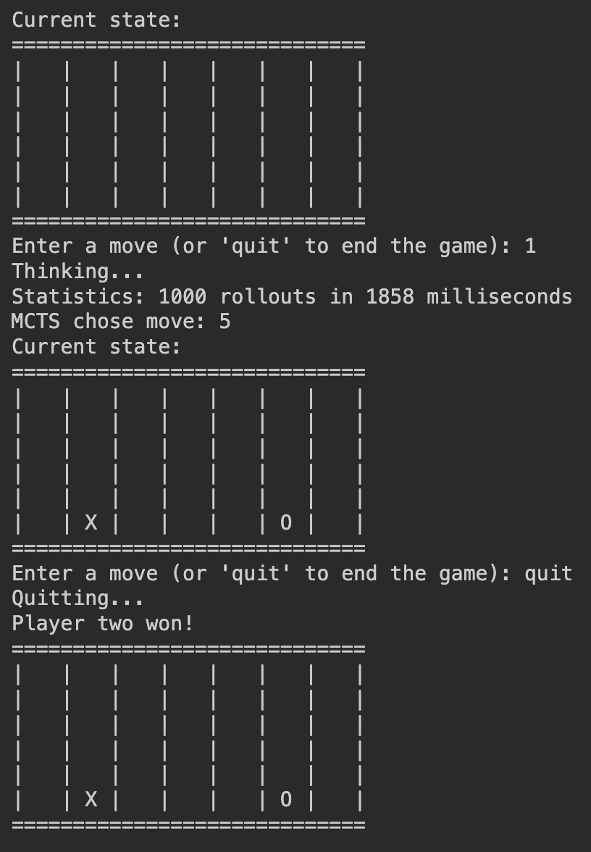
Accelerating Decision-Making in AI: Parallelizing Monte Carlo Tree Search for Connect 4 Using CPU and GPU
Results:
Figure 6: Final Look of the Game.

Slide 12
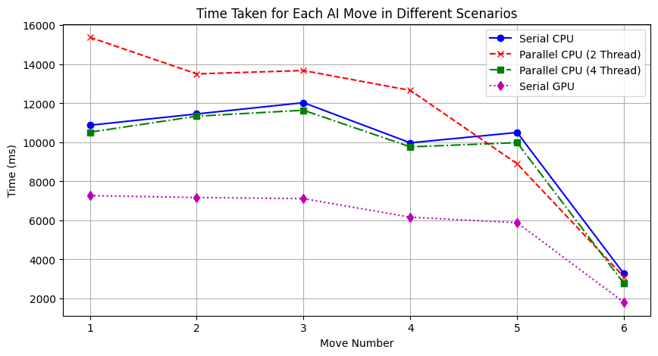
Accelerating Decision-Making in AI: Parallelizing Monte Carlo Tree Search for Connect 4 Using CPU and GPU
Results:
Figure 7: Time taken for each AI move in different scenarios.

Slide 13
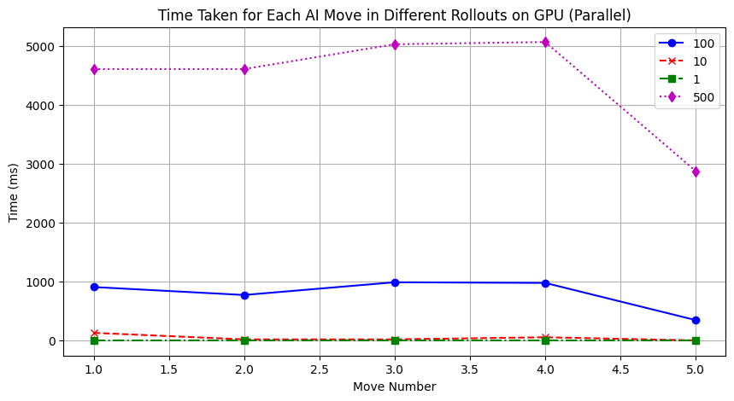
Accelerating Decision-Making in AI: Parallelizing Monte Carlo Tree Search for Connect 4 Using CPU and GPU
Results:
Figure 8: Time taken for each AI move in different rollouts on GPU(parallel).

Slide 14

Accelerating Decision-Making in AI: Parallelizing Monte Carlo Tree Search for Connect 4 Using CPU and GPU
Results:
Speedup is used to quantify the performance improvement achieved by parallelizing an algorithm. It is calculated as the ratio of the execution time of the serial version of the algorithm to the execution time of the parallel version:
Figure 9: Speedup Formula.
This helps determine how much faster the algorithm runs when parallelized compared to its serial implementation.

Slide 15
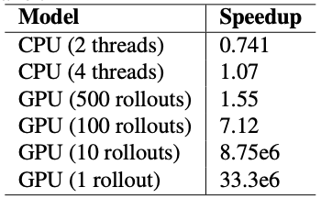
Accelerating Decision-Making in AI: Parallelizing Monte Carlo Tree Search for Connect 4 Using CPU and GPU
Results:
The results of our experiments reveal clear differences in performance between the serial and parallel implementations of MCTS on both CPU and GPU platforms.
Figure 10: Table of Speedup achieved by different models and configurations.

Slide 16
Accelerating Decision-Making in AI: Parallelizing Monte Carlo Tree Search for Connect 4 Using CPU and GPU
Results:
CPU Performance: Parallelizing MCTS with OpenMP showed moderate performance gains, with a speedup of about 1.07 when using 4 threads compared to the serial CPU implementation. However, the speedup was relatively small, showing that while parallelization on the CPU can improve performance, it is limited by the number of cores available and the overhead of thread management.
GPU Performance: The GPU implementation, on the other hand, exhibited much more significant speedups. With 1 rollout, the GPU achieved a speedup of 33.3 million times compared to the serial CPU implementation. Even with higher numbers of rollouts (500), the GPU showed substantial improvements, with a speedup of 1.55. The dramatic gains in performance on the GPU demonstrate its advantage in handling large-scale parallel tasks like MCTS simulations.
These results highlight the effectiveness of GPU parallelization in accelerating decision-making processes, especially when the number of rollouts is small. The trade-off between speed and decision quality becomes critical as the number of rollouts increases, with GPUs handling this balance more efficiently than CPUs.

Slide 17
Accelerating Decision-Making in AI: Parallelizing Monte Carlo Tree Search for Connect 4 Using CPU and GPU
Conclusion :
This study highlights the significant benefits of parallel computing, especially GPU parallelization, in speeding up AI decision-making processes like Monte Carlo Tree Search (MCTS). Using CUDA on GPUs, we achieved notable speedups compared to both serial and parallel CPU implementations, demonstrating the GPU’s effectiveness for tasks that demand large-scale parallelism.
However, the observed performance gains are hardware-specific, and results may vary across different CPU and GPU architectures. Additionally, as the number of rollouts increases, memory bottlenecks become a challenge, particularly on GPUs.
While this study focused on improving execution speed, future research should investigate the trade-off between speed and decision quality more thoroughly. Optimizing memory management techniques and exploring larger, more complex scenarios could further enhance performance.
Finally, applying the parallelized MCTS algorithm to real-world problems like resource allocation and logistics could extend the impact of these findings beyond gaming.

Slide 18
iSCSi 2023 official Sponsors

Slide 19
Accelerating Decision-Making in AI: Parallelizing Monte Carlo Tree Search for Connect 4 Using CPU and GPU
THANK YOU
Any questions?
I love to discuss any thoughts or clarify any points!

