Slide 1

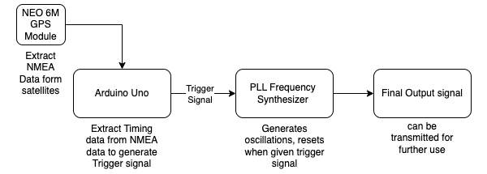
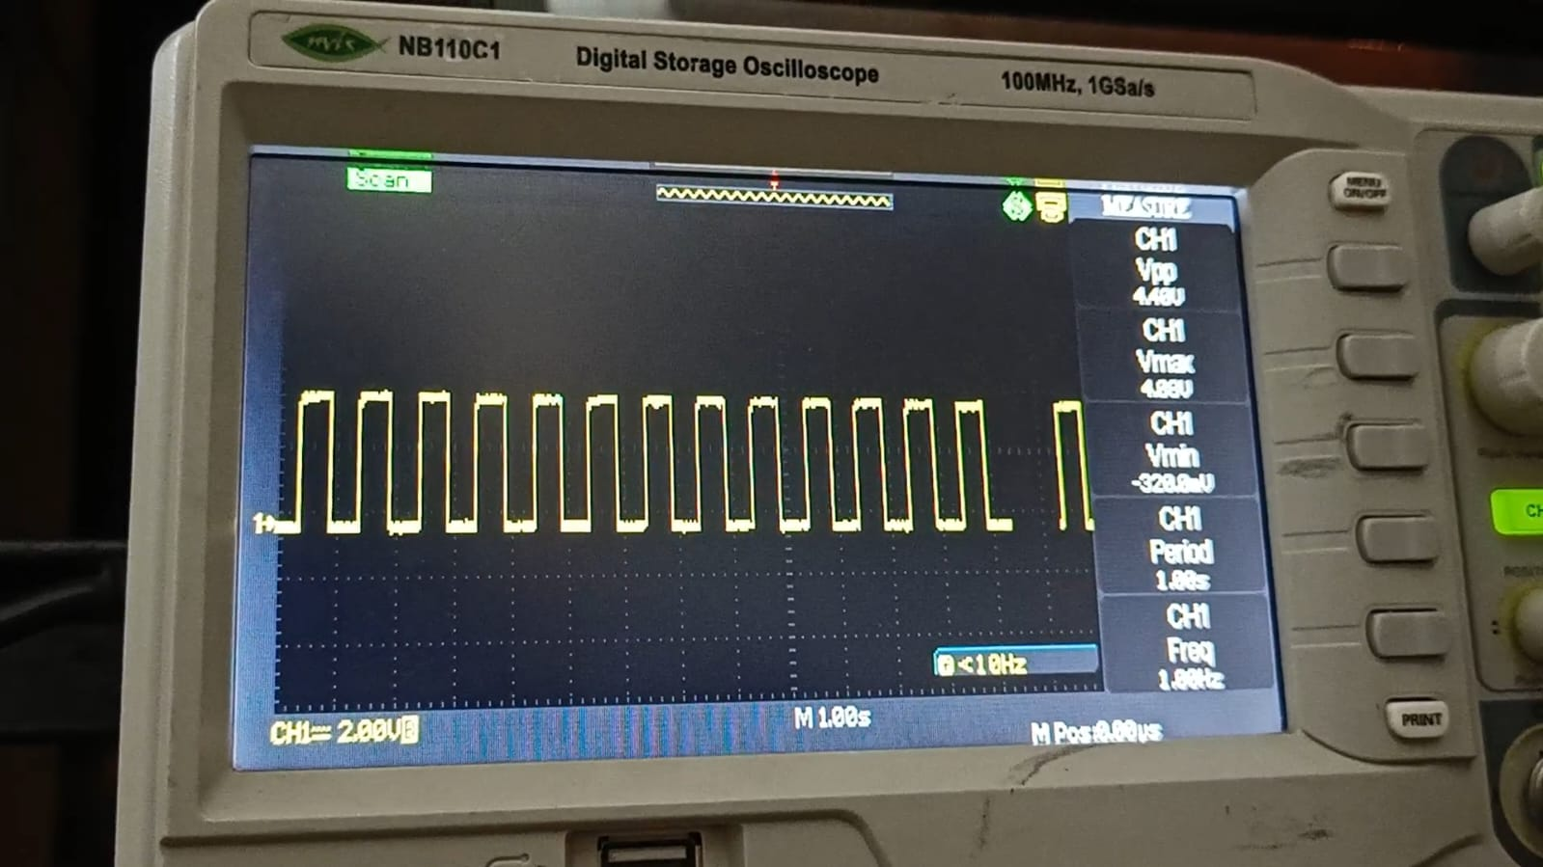
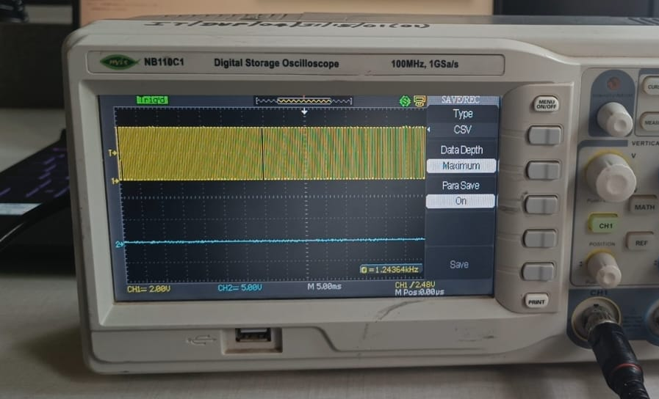
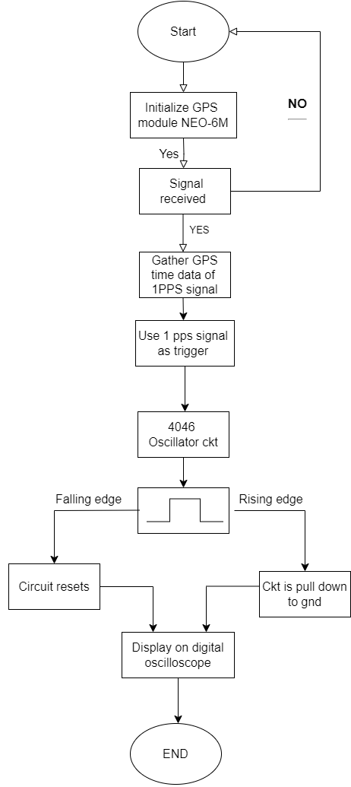
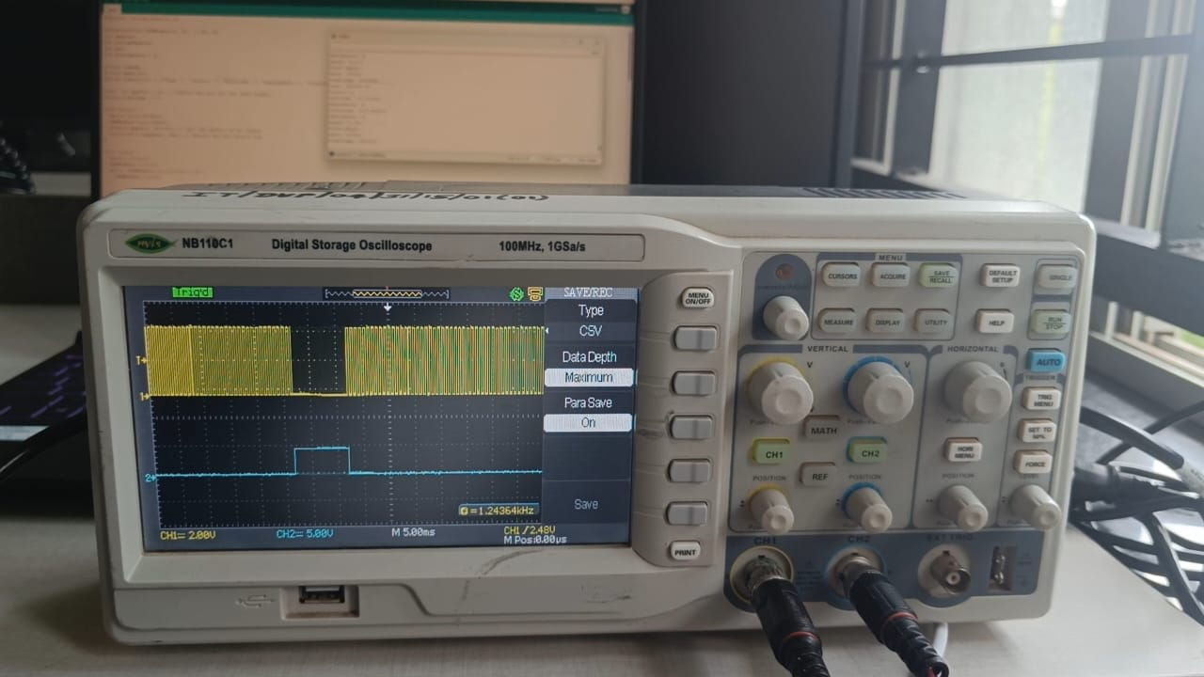
GPS DISCIPLINED OSCILLATOR
Rahul Hegde, Anirudh Nayak, Tarun Divatagi, Rahul Katigar
Guide: Akash Kulkarni School Of Electronics and Communication Engineering
Problem statement
Proposed Framework
Results and Discussion
Develop a system to extract 1PPS signals from a NEO-6M GPS module and utilize them to stabilize a Phase-Locked Loop (PLL) oscillator. Analyze and verify the synchronization accuracy and timing precision across multiple replicated units for high-accuracy timekeeping applications.
Fig 3: 1 PPS signal from
GPS
Objectives
Extract a 1PPS (pulse per second) signal from a GPS module (NEO-6M).
Design and implement a frequency oscillator using a PLL (Phase-Locked Loop) IC.
Trigger the PLL circuit using the extracted 1PPS signal.
Accurately analyze the timing data obtained from the NEO-6M GPS sensor.
Fig 1: Block Diagram
Fig 4: Oscillation Generated by PLL IC
Contributions
Extracted NMEA data from the GPS module and generated a 1PPS triggering signal.
Designed and implemented a PLL frequency synthesizer using the CD4046 IC.
Analyzed the signals by replicating the system and checked for synchronization.
Fig 5: Final Output
Conclusions
Literature survey
The NEO-6M GPS module provided a reliable 1PPS signal, crucial for synchronizing the PLL system.
A frequency synthesizer using the CD4046 IC was designed and implemented, achieving stable oscillations and accurate frequency control.
The extracted 1PPS signal triggered the PLL, with timing data confirming precise synchronization and consistent signal behavior.
The PLL system demonstrated stable performance, suitable for applications requiring precise frequency control, such as communication systems and clock recovery circuits.
The literature highlights advancements in GPS-disciplined oscillators and clocks for achieving high-accuracy timing with low power consumption. Key developments include cost-effective designs using temperature-compensated crystal oscillators, methodologies for evaluating GPS timing uncertainty, and innovative approaches for synchronization and calibration in harsh environments. These innovations enhance the reliability and precision of timing signals for various applications, from metrology to geodetic measurements.
Fig 2: Flow Chart
Minor Project-2: 2023-24

