Slide 1

A “Hands-on” Introduction to
OpenMP*
* The name “OpenMP” is the property of the OpenMP Architecture Review Board.

Slide 2
Introduction
OpenMP is one of the most common parallel programming models in use today.
It is relatively easy to use which makes a great language to start with when learning to write parallel software.
Assumptions:
  We assume you know C. OpenMP supports Fortran
and C++, but we will restrict ourselves to C.
  We assume you are new to parallel programming.
  We assume you have access to a compiler that
supports OpenMP (more on that later).

Slide 3
Outline
Unit 1: Getting started with OpenMP
  Mod1: Introduction to parallel programming
  Mod 2: The boring bits: Using an OpenMP compiler (hello world)
  Disc 1: Hello world and how threads work
Unit 2: The core features of OpenMP
  Mod 3: Creating Threads (the Pi program)
  Disc 2: The simple Pi program and why it sucks
  Mod 4: Synchronization (Pi program revisited)
  Disc 3: Synchronization overhead and eliminating false sharing
  Mod 5: Parallel Loops (making the Pi program simple)
  Disc 4: Pi program wrap-up
Unit 3: Working with OpenMP
  Mod 6: Synchronize single masters and stuff
  Mod 7: Data environment
  Disc 5: Debugging OpenMP programs
  Mod 8: Skills practice … linked lists and OpenMP
  Disc 6: Different ways to traverse linked lists
Unit 4: a few advanced OpenMP topics
  Mod 8: Tasks (linked lists the easy way)
  Disc 7: Understanding Tasks
  Mod 8: The scary stuff … Memory model, atomics, and flush (pairwise synch).
  Disc 8: The pitfalls of pairwise synchronization
  Mod 9: Threadprivate Data and how to support libraries (Pi again)
  Disc 9: Random number generators
Unit 5: Recapitulation
5

Slide 4
Outline
Unit 1: Getting started with OpenMP
  Mod1: Introduction to parallel programming
  Mod 2: The boring bits: Using an OpenMP compiler (hello world)
  Disc 1: Hello world and how threads work
Unit 2: The core features of OpenMP
  Mod 3: Creating Threads (the Pi program)
  Disc 2: The simple Pi program and why it sucks
  Mod 4: Synchronization (Pi program revisited)
  Disc 3: Synchronization overhead and eliminating false sharing
  Mod 5: Parallel Loops (making the Pi program simple)
  Disc 4: Pi program wrap-up
Unit 3: Working with OpenMP
  Mod 6: Synchronize single masters and stuff
  Mod 7: Data environment
  Disc 5: Debugging OpenMP programs
  Mod 8: Skills practice … linked lists and OpenMP
  Disc 6: Different ways to traverse linked lists
Unit 4: a few advanced OpenMP topics
  Mod 8: Tasks (linked lists the easy way)
  Disc 7: Understanding Tasks
  Mod 8: The scary stuff … Memory model, atomics, and flush (pairwise synch).
  Disc 8: The pitfalls of pairwise synchronization
  Mod 9: Threadprivate Data and how to support libraries (Pi again)
  Disc 9: Random number generators
Unit 5: Recapitulation
6

Slide 5
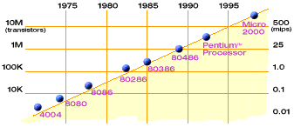
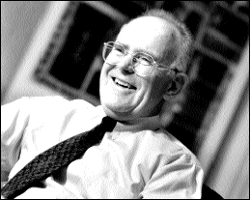
Moore's Law
Moore’s Law
In 1965, Intel co-founder Gordon Moore predicted (from just 3 data points!) that semiconductor density would double every 18 months.
  He was right! Transistors are still shrinking as he projected.
Slide source: UCB CS 194 Fall’2010

Slide 6
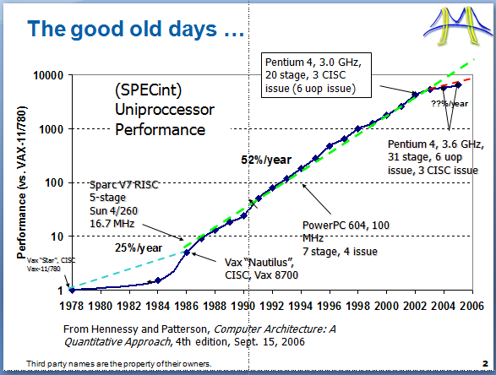
Consequences of Moore’s law…

Slide 7
The Hardware/Software contract
Write your software as you choose and we HW-geniuses will take care of performance.
The result: Generations of performance ignorant software engineers using performance-handicapped languages (such as
Java) … which was OK since performance was a HW job.
Third party names are the property of their owners.
9

Slide 8




… Computer architecture and the power wall
30
Pentium 4 (Psc)
25
Pentium 4 (Wmt)
20
Power
power = perf ^ 1.74
15
Growth in power is unsustainable
10
Pentium Pro
5
Pentium M
i486
Pentium
0
0
2
4
Scalar Performance
6
8
Source: E. Grochowski of Intel
8

Slide 9





… partial solution: simple low power cores
Eventually Pentium 4 used
30
over 30 pipeline stages!!!!
Pentium 4 (Psc)
25
Pentium 4 (Wmt)
20
Mobile CPUs with shallow pipelines use less
Power
power = perf ^ 1.74
15
power
10
Pentium Pro
Pentium M
5
i486
Pentium
0
0
2
4
Scalar Performance
6
8
Source: E. Grochowski of Intel
9

Slide 10

For the rest of the solution
consider power in a chip …
C = capacitance … it measures the
ability of a circuit to store energy:
C = q/V → q = CV
Work is pushing something (charge or q) across a “distance” … in electrostatic terms pushing q from 0 to V:
Input
Processor
Output
f
Capacitance = C Voltage = V Frequency = f Power = CV²f
V * q = W.
But for a circuit q = CV so
W = CV²
power is work over time … or how many
times in a second we oscillate the circuit
Power = W* F → Power = CV²f

Slide 11
... The rest of the solution
add cores
Processor
Input
Processor
Output
Output
f/2
Input
f
Processor
f
Capacitance = C Voltage = V Frequency = f Power = CV²f
f/2
Capacitance = 2.2C Voltage = 0.6V Frequency = 0.5f Power = 0.396CV²f
Chandrakasan, A.P.; Potkonjak, M.; Mehra, R.; Rabaey, J.; Brodersen, R.W., "Optimizing power using transformations," IEEE Transactions on Computer-Aided Design of Integrated Circuits and Systems,, vol.14, no.1, pp.12-31, Jan 1995
Source: Vishwani Agrawal

Slide 12
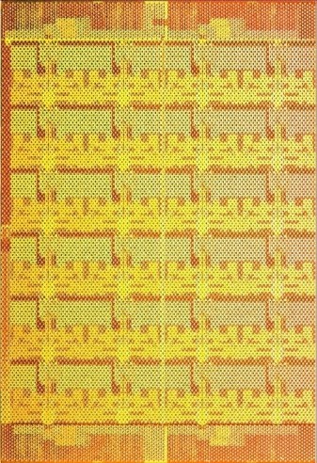
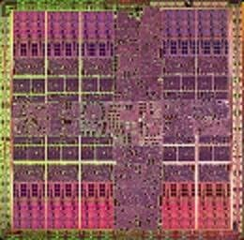

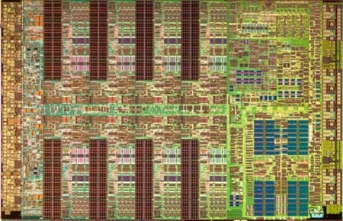
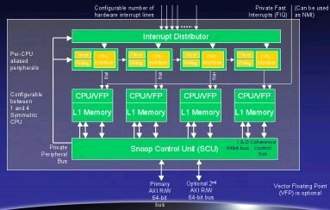
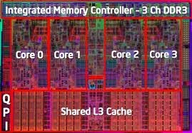
Microprocessor trends
Individual processors are many core (and often heterogeneous) processors.
48 cores
30 cores
8 wide SIMD
10 cores
16 wide SIMD
80 cores
AMD ATI RV770
NVIDIA Tesla C1060
Intel SCC Processor
1 CPU + 6 cores
4 cores
4 cores
IBM Cell
Intel® Xeon® processor
ARM MPCORE
Source: OpenCL tutorial, Gaster, Howes, Mattson, and Lokhmotov, HiPEAC 2011
3rd party names are the property of their owners.

Slide 13
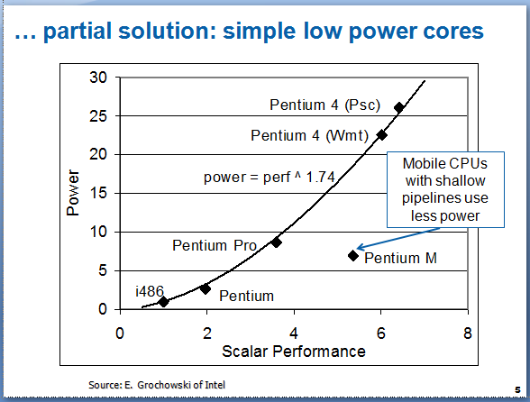
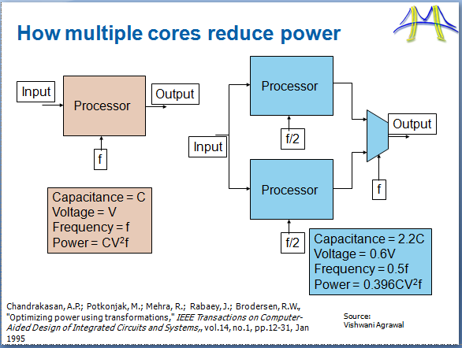
The result…
+
A new contract … HW people will do what’s natural for them (lots of simple cores) and SW people will have to adapt (rewrite everything)
=
The problem is this was presented as an ultimatum … nobody asked us if we were OK with this new contract … which is kind of rude.
15

Slide 14
Concurrency vs. Parallelism
Two important definitions:
  Concurrency: A condition of a system in which multiple tasks are logically active at one time.
  Parallelism: A condition of a system in which multiple tasks are actually active at one time.
Concurrent, non-parallel Execution
Concurrent, parallel Execution
Figure from “An Introduction to Concurrency in Programming Languages” by J. Sottile, Timothy G. Mattson, and Craig E Rasmussen, 2010

Slide 15
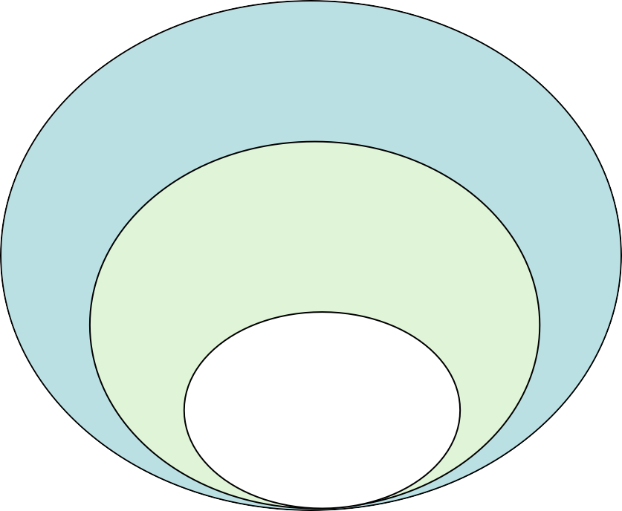
Concurrency vs. Parallelism
Two important definitions:
  Concurrency: A condition of a system in which multiple tasks are logically active at one time.
  Parallelism: A condition of a system in which multiple tasks are actually active at one time.
Programs
Concurrent Programs
Parallel Programs
Figure from “An Introduction to Concurrency in Programming Languages” by J. Sottile, Timothy G. Mattson, and Craig E Rasmussen, 2010

Slide 16
Concurrent vs. Parallel applications
We distinguish between two classes of applications that exploit the concurrency in a problem:
  Concurrent application: An application for which computations logically execute simultaneously due to the semantics of the application.
The problem is fundamentally concurrent.
Parallel application: An application for which the computations actually execute simultaneously in order to complete a problem in less time.
The problem doesn’t inherently require concurrency … you can state it sequentially.

Slide 17

The Parallel programming process:
Find Concurrency (
Original Problem
Tasks, shared and local data
Program SPMD_Emb_Par () Program SPMD_Emb_Par ()
Program SPMD_Emb_Par () Program SPMD_Emb_Par ()
{
TYPE *tmp, *func();
global_array Data(TYPE); global_array Res(TYPE); int Num = get_num_procs(); int id = get_proc_id();
if (id==0) setup_problem(N, Data); for (int I= ID; I<N;I=I+Num){
tmp = func(I, Data); Res.accumulate( tmp);
}
}
{
TYPE *tmp, *func(); global_array Data(TYPE); global_array Res(TYPE); int N = get_num_procs(); int id = get_proc_id();
if (id==0) setup_problem(N,DATA); for (int I= 0; I<N;I=I+Num){
tmp = func(I); Res.accumulate( tmp);
}
}
{
TYPE *tmp, *func(); global_array Data(TYPE); global_array Res(TYPE); int N = get_num_procs(); int id = get_proc_id();
if (id==0) setup_problem(N,DATA); for (int I= 0; I<N;I=I+Num){
tmp = func(I); Res.accumulate( tmp);
}
}
{
TYPE *tmp, *func(); global_array Data(TYPE);
global_array Res(TYPE); int N = get_num_procs(); int id = get_proc_id();
if (id==0) setup_problem(N,DATA); for (int I= 0; I<N;I=I+Num){
tmp = func(I); Res.accumulate( tmp);
}
}
Implementation strategy
Units of execution + new shared data for extracted dependencies
Corresponding source code

Slide 18
OpenMP* Overview:
C$OMP FLUSH
#pragma omp critical
C$OMP THREADPRIVATE(/ABC/)
CALL OMP_SET_NUM_THREADS(10)
OpenMP: An API for Writing Multithreaded
C$OM
P parallel do shared(a, b, c) _{call omp_test_lock(jlok)}
call OMP_INIT_LOCK (ilok) _{C$OMP ATOMIC C$OMP MASTER}
^{P SINGLE PRIVATE(X)} setenv OMP_SCHEDULE “dynamic”
OMP PARALLEL DO ORDERED PRIVATE (A, B, C) _{C$OMP ORDERE}
$OMP PARALLEL REDUCTION (+: A, B) _{C$OMP SECTIONS}
ragma omp parallel for private(A, B) _{!$OMP BARRIER}
Applications
C$O
M
A set of compiler directives and library
routines for parallel application programmers
C$
D
Greatly simplifies writing multi-threaded (MT)
C
programs in Fortran, C and C++
#p
Standardizes last 20 years of SMP practice
C$OMP PARALLEL COPYIN(/blk/)
C$OMP DO lastprivate(XX)
Nthrds = OMP_GET_NUM_PROCS()
omp_set_lock(lck)
* The name “OpenMP” is the property of the OpenMP Architecture Review Board.
20

Slide 19

OpenMP Basic Defs: Solution Stack
End User
Application
Directives, Compiler
OpenMP library
Environment variables
OpenMP Runtime library
OS/system support for shared memory and threading
Proc1 |  | Proc₂ |  | Proc₃ |  | ProcN
Shared Address Space
19

Slide 20
OpenMP core syntax
Most of the constructs in OpenMP are compiler directives.
#pragma omp construct [clause [clause]…]
  Example
#pragma omp parallel num_threads(4)
Function prototypes and types in the file: #include <omp.h>
Most OpenMP* constructs apply to a
“structured block”.
  Structured block: a block of one or more statements with one point of entry at the top and one point of exit at the bottom.
  It’s OK to have an exit() within the structured block.
20

Slide 21
Outline
Unit 1: Getting started with OpenMP
  Mod1: Introduction to parallel programming
  Mod 2: The boring bits: Using an OpenMP compiler (hello world)
  Disc 1: Hello world and how threads work
Unit 2: The core features of OpenMP
  Mod 3: Creating Threads (the Pi program)
  Disc 2: The simple Pi program and why it sucks
  Mod 4: Synchronization (Pi program revisited)
  Disc 3: Synchronization overhead and eliminating false sharing
  Mod 5: Parallel Loops (making the Pi program simple)
  Disc 4: Pi program wrap-up
Unit 3: Working with OpenMP
  Mod 6: Synchronize single masters and stuff
  Mod 7: Data environment
  Disc 5: Debugging OpenMP programs
  Mod 8: Skills practice … linked lists and OpenMP
  Disc 6: Different ways to traverse linked lists
Unit 4: a few advanced OpenMP topics
  Mod 8: Tasks (linked lists the easy way)
  Disc 7: Understanding Tasks
  Mod 8: The scary stuff … Memory model, atomics, and flush (pairwise synch).
  Disc 8: The pitfalls of pairwise synchronization
  Mod 9: Threadprivate Data and how to support libraries (Pi again)
  Disc 9: Random number generators
Unit 5: Recapitulation
23

Slide 22
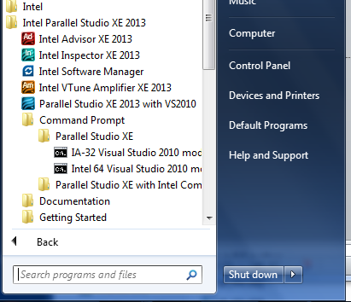
Compiler notes: Intel on Windows
Launch SW dev environment
cd to the directory that
holds your source code
Build software for program
foo.c
  icl /Qopenmp foo.c
Set number of threads environment variable
  set OMP_NUM_THREADS=4
Run your program
  foo.exe

Slide 23
Compiler notes: Visual Studio
Start “new project”
Select win 32 console project
  Set name and path
  On the next panel, Click “next” instead of finish so you can
select an empty project on the following panel.
  Drag and drop your source file into the source folder on the visual studio solution explorer
  Activate OpenMP
– Go to project properties/configuration
properties/C.C++/language … and activate OpenMP
Set number of threads inside the program
Build the project
Run “without debug” from the debug menu.

Slide 24
Compiler notes: Other
Linux and OS X with gcc:
  gcc -fopenmp foo.c
for the Bash shell
export OMP_NUM_THREADS=4
./a.out
Linux and OS X with PGI:
  pgcc -mp foo.c
  export OMP_NUM_THREADS=4
  ./a.out

Slide 25
Exercise 1, Part A: Hello world
Verify that your environment works
Write a program that prints “hello world”.
int main()
{
int ID = 0;
printf(“ hello(%d) ”, ID);;
printf(“ world(%d) \n”, ID);;
}
int main()
{
int ID = 0;
printf(“ hello(%d) ”, ID);;
printf(“ world(%d) \n”, ID);;
}

Slide 26
Exercise 1, Part B: Hello world
Verify that your OpenMP environment works
Write a multithreaded program that prints “hello world”.
#include <omp.h>
int main()
{
#pragma omp parallel
{
int ID = 0;
printf(“ hello(%d) ”, ID);;
printf(“ world(%d) \n”, ID);;
}
}
Linux and OS X | gcc -fopenmp
PGI Linux | pgcc -mp
Intel windows | icl /Qopenmp
Intel Linux and OS X | icpc –openmp
int main()
{
int ID = 0;
printf(“ hello(%d) ”, ID);;
printf(“ world(%d) \n”, ID);;
}

Slide 27
Outline
Unit 1: Getting started with OpenMP
  Mod1: Introduction to parallel programming
  Mod 2: The boring bits: Using an OpenMP compiler (hello world)
  Disc 1: Hello world and how threads work
Unit 2: The core features of OpenMP
  Mod 3: Creating Threads (the Pi program)
  Disc 2: The simple Pi program and why it sucks
  Mod 4: Synchronization (Pi program revisited)
  Disc 3: Synchronization overhead and eliminating false sharing
  Mod 5: Parallel Loops (making the Pi program simple)
  Disc 4: Pi program wrap-up
Unit 3: Working with OpenMP
  Mod 6: Synchronize single masters and stuff
  Mod 7: Data environment
  Disc 5: Debugging OpenMP programs
  Mod 8: Skills practice … linked lists and OpenMP
  Disc 6: Different ways to traverse linked lists
Unit 4: a few advanced OpenMP topics
  Mod 8: Tasks (linked lists the easy way)
  Disc 7: Understanding Tasks
  Mod 8: The scary stuff … Memory model, atomics, and flush (pairwise synch).
  Disc 8: The pitfalls of pairwise synchronization
  Mod 9: Threadprivate Data and how to support libraries (Pi again)
  Disc 9: Random number generators
Unit 5: Recapitulation
29

Slide 28
Exercise 1: Solution
A multi-threaded “Hello world” program
Write a multithreaded program where each
thread prints “hello world”.
#include “omp.h”
int main()
{
#pragma omp parallel
{
int ID = omp_get_thread_num();
printf(“ hello(%d) ”, ID);;
printf(“ world(%d) \n”, ID);;
}
}
OpenMP include file
#include “omp.h”
int main()
{
#pragma omp parallel
{
int ID = omp_get_thread_num();
printf(“ hello(%d) ”, ID);;
printf(“ world(%d) \n”, ID);;
}
}
Parallel region with default
number of threads
Runtime library function to return a thread ID.
End of the Parallel region
30

Slide 29



Shared memory Computers
Shared memory computer : any computer composed of multiple processing elements that share an address space. Two Classes:
  Symmetric multiprocessor (SMP): a shared address space with “equal-time” access for each processor, and the OS treats every processor the same way.
  Non Uniform address space multiprocessor (NUMA): different memory regions have different access costs … think of memory segmented into “Near” and “Far” memory.
Proc₁
Proc₂
Proc₃
Proc_{N}
Shared Address Space
31/36

Slide 30

Shared memory machines: SMP
Cray-2 … the last large
scale SMP computer.
Released in 1985 with 4 “heads”, 1.9 GFLOPS peak performance (fasted supercomputer in the world until 1990).
The vector units in each “head” had equal-time access to the memory organized into banks to support high- bandwidth parallel memory access
Third party names are the property of their owners
32/36

Slide 31
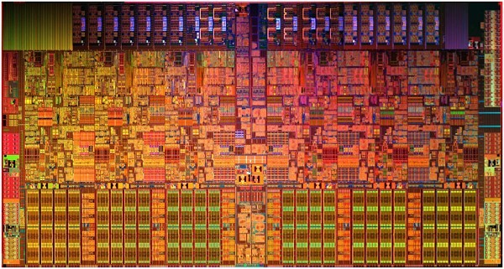
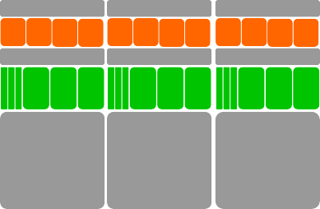
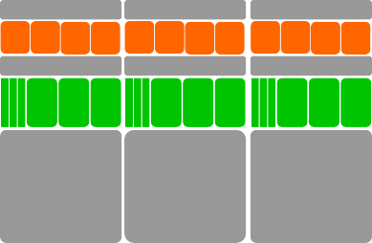
Shared memory machines: SMP
Intel® Core™ i7-970 processor: Often called an SMP, but is it?
Memory Controller
L2
L2
L2
L2
L2
L2
L3
6 cores, 2-way multithreaded, 6-wide superscalar, quad-issue, 4-wide SIMD (on 3 of 6 pipelines)
4.5 KB (6 x 768 B) “Architectural” Registers, 192 KB (6 x 32 KB) L1
Cache, 1.5 MB (6 x 256 KB) L2 cache, 12 MB L3 Cache
MESIF Cache Coherence, Processor Consistency Model
1.17 Billion Transistors on 32 nm process @ 2.6 GHz
Cache hierarchy means different processors have different
costs to access different address ranges …. It’s NUMA
33/
36

Slide 32


Shared memory computers
Shared memory computers are everywhere … most laptops and
servers have multicore multiprocessor CPUs
The shared address space and (as we will see) programming models encourage us to think of them at SMP systems.
Reality is more complex … any multiprocessor CPU with a cache is a NUMA system. Start out by treating the system as an SMP and just accept that much of your optimization work will address cases where that case breaks down.
PPrroocc₁
PPrroocc₂
PPrroocc₃
Proc_{N}
Proc_{N}
S
hared Address Sp
ace
h
d Addre
pace
32/36

Slide 33
Programming shared memory computers
Stack
funcA()
var1
var2
Stack Pointer Program Counter Registers
Process
An instance of a
program execution.
The execution context of a running program … i.e. the resources associated with a program’s execution.
text
main()
funcA()
funcB()
. . . . .
Process ID User ID Group ID
data
array1
array2
Files Locks Sockets
heap
33/36

Slide 34
Programming shared memory computers
Thread 0
Stack
funcA()
var1
var2
Stack Pointer Program Counter Registers
Threads:
Threads are "light
weight processes”
Threads share Process state among multiple threads … this greatly reduces the cost of switching context.
Thread 1 Stack
funcB()
var1 var2 var3
Stack Pointer Program Counter Registers
text
main()
funcA()
funcB()
. . . . .
Process ID User ID Group ID
data
array1
array2
Files Locks Sockets
heap
34/36

Slide 35
A shared memory program
An instance of a program:
One process and lots of
threads.
Threads interact through reads/writes to a shared address space.
OS scheduler decides when to run which
threads … interleaved
for fairness.
Synchronization to assure every legal order results in correct results.
Private
thread
Private
thread
Shared Address
Private
Space
thread
Private
thread
Private
thread
35/36

Slide 36
Exercise 1: Solution
A multi-threaded “Hello world” program
Write a multithreaded program where each
thread prints “hello world”.
#include “omp.h”
int main()
{
#pragma omp parallel
{
int ID = omp_get_thread_num();
printf(“ hello(%d) ”, ID);;
printf(“ world(%d) \n”, ID);;
}
}
OpenMP include file
#include “omp.h”
int main()
{
#pragma omp parallel
{
int ID = omp_get_thread_num();
printf(“ hello(%d) ”, ID);;
printf(“ world(%d) \n”, ID);;
}
}
Parallel region with default
number of threads
Sample Output:
hello(1) hello(0) world(1) world(0)
hello (3) hello(2) world(3) world(2)
Sample Output:
hello(1) hello(0) world(1) world(0)
hello (3) hello(2) world(3) world(2)
Runtime library function to return a thread ID.
End of the Parallel region

Slide 37
OpenMP Overview:
How do threads interact?
OpenMP is a multi-threading, shared address model.
  Threads communicate by sharing variables.
Unintended sharing of data causes race conditions:
  race condition: when the program’s outcome
changes as the threads are scheduled differently.
To control race conditions:
  Use synchronization to protect data conflicts.
Synchronization is expensive so:
  Change how data is accessed to minimize the need
for synchronization.

Slide 38
Outline
Unit 1: Getting started with OpenMP
  Mod1: Introduction to parallel programming
  Mod 2: The boring bits: Using an OpenMP compiler (hello world)
  Disc 1: Hello world and how threads work
Unit 2: The core features of OpenMP
  Mod 3: Creating Threads (the Pi program)
  Disc 2: The simple Pi program and why it sucks
  Mod 4: Synchronization (Pi program revisited)
  Disc 3: Synchronization overhead and eliminating false sharing
  Mod 5: Parallel Loops (making the Pi program simple)
  Disc 4: Pi program wrap-up
Unit 3: Working with OpenMP
  Mod 6: Synchronize single masters and stuff
  Mod 7: Data environment
  Disc 5: Debugging OpenMP programs
  Mod 8: Skills practice … linked lists and OpenMP
  Disc 6: Different ways to traverse linked lists
Unit 4: a few advanced OpenMP topics
  Mod 8: Tasks (linked lists the easy way)
  Disc 7: Understanding Tasks
  Mod 8: The scary stuff … Memory model, atomics, and flush (pairwise synch).
  Disc 8: The pitfalls of pairwise synchronization
  Mod 9: Threadprivate Data and how to support libraries (Pi again)
  Disc 9: Random number generators
Unit 5: Recapitulation
40

Slide 39
Outline
Unit 1: Getting started with OpenMP
  Mod1: Introduction to parallel programming
  Mod 2: The boring bits: Using an OpenMP compiler (hello world)
  Disc 1: Hello world and how threads work
Unit 2: The core features of OpenMP
  Mod 3: Creating Threads (the Pi program)
  Disc 2: The simple Pi program and why it sucks
  Mod 4: Synchronization (Pi program revisited)
  Disc 3: Synchronization overhead and eliminating false sharing
  Mod 5: Parallel Loops (making the Pi program simple)
  Disc 4: Pi program wrap-up
Unit 3: Working with OpenMP
  Mod 6: Synchronize single masters and stuff
  Mod 7: Data environment
  Disc 5: Debugging OpenMP programs
  Mod 8: Skills practice … linked lists and OpenMP
  Disc 6: Different ways to traverse linked lists
Unit 4: a few advanced OpenMP topics
  Mod 8: Tasks (linked lists the easy way)
  Disc 7: Understanding Tasks
  Mod 8: The scary stuff … Memory model, atomics, and flush (pairwise synch).
  Disc 8: The pitfalls of pairwise synchronization
  Mod 9: Threadprivate Data and how to support libraries (Pi again)
  Disc 9: Random number generators
39

Slide 40
OpenMP Programming Model:
Fork-Join Parallelism:
Master thread spawns a team of threads as needed.
Parallelism added incrementally until performance goals are met: i.e. the sequential program evolves into a parallel program.
Parallel Regions
A Nested Parallel region
A Nested
Parallel region
Master
Thread in red
Sequential Parts
40

Slide 41
Thread Creation: Parallel Regions
You create threads in OpenMP* with the parallel construct.
For example, To create a 4 thread Parallel region:
double A[1000]; omp_set_num_threads(4); #pragma omp parallel
Runtime function to request a certain number of threads
Runtime function to
request a certain number of threads
Each thread executes a copy of the
code within the structured block
Each thread
executes a copy of the
code within the structured block
{
int ID = omp_get_thread_num();
pooh(ID,A);
Runtime function returning a thread ID
Runtime function
returning a thread ID
}
Each thread calls pooh(ID,A) for ID = 0 to 3
* The name “OpenMP” is the property of the OpenMP Architecture Review Board

Slide 42
Thread Creation: Parallel Regions
You create threads in OpenMP* with the parallel construct.
For example, To create a 4 thread Parallel region:
clause to request a certain
number of threads
clause to request a certain
number of threads
double A[1000];
Each thread executes a copy of the
code within the structured block
Each thread
executes a copy of the
code within the structured block
#pragma omp parallel num_threads(4)
{
int ID = omp_get_thread_num();
pooh(ID,A);
Runtime function returning a thread ID
Runtime function
returning a thread ID
}
Each thread calls pooh(ID,A) for ID = 0 to 3
* The name “OpenMP” is the property of the OpenMP Architecture Review Board

Slide 43
Thread Creation: Parallel Regions
double A[1000];
#pragma omp parallel num_threads(4)
{
int ID = omp_get_thread_num();
pooh(ID, A);
}
printf(“all done\n”);;
Each thread executes the same code redundantly.
double A[1000];
omp_set_num_threads(4)
A single copy of A is shared between all threads.
A single
copy of A is shared between all threads.
pooh(0,A)
pooh(1,A)
pooh(2,A)
pooh(3,A)
printf(“all done\n”);;
Threads wait here for all threads to finish before proceeding (i.e. a barrier)
Threads wait here for all threads to finish
before proceeding (i.e. a barrier)
* The name “OpenMP” is the property of the OpenMP Architecture Review Board

Slide 44
OpenMP: what the compiler does
#pragma omp parallel num_threads(4)
{
foobar ();
}
The OpenMP compiler generates code logically analogous to that on the right of this slide, given an OpenMP pragma such as that on the top-left
All known OpenMP implementations use a thread pool so full cost of threads creation and destruction is not incurred for reach parallel region.
Only three threads are created because the last parallel section will be invoked from the parent thread.
void thunk ()
{
foobar ();
}
pthread_t tid[4];
for (int i = 1; i < 4; ++i)
pthread_create (
&tid[i],0,thunk, 0);
thunk();
for (int i = 1; i < 4; ++i) pthread_join (tid[i]);

Slide 45

Exercises 2 to 4:
Numerical Integration
Mathematically, we know that:
1
4.0
∫
4.0
dx = π
(1+x²)
0
We can approximate the integral as a sum of rectangles:
2.0
N
∑ F(x_{i})Δx ≈ π
i = 0
Where each rectangle has
0.0
1.0
width Δx and height F(x ) at
X
i
the middle of interval i.
45

Slide 46
Exercises 2 to 4: Serial PI Program
static long num_steps = 100000;
double step; int main ()
{ int i; double x, pi, sum = 0.0;
step = 1.0/(double) num_steps; for (i=0;i< num_steps; i++){
x = (i+0.5)*step;
sum = sum + 4.0/(1.0+x*x);
}
pi = step * sum;
}
46

Slide 47
Exercise 2
Create a parallel version of the pi program using a parallel construct.
Pay close attention to shared versus private variables.
In addition to a parallel construct, you will need the runtime library routines
int omp_get_num_threads();
int omp_get_thread_num();
double omp_get_wtime();
Number of threads in the team
Thread ID or rank
Time in Seconds since a fixed point in the past
49

Slide 48
Outline
Unit 1: Getting started with OpenMP
  Mod1: Introduction to parallel programming
  Mod 2: The boring bits: Using an OpenMP compiler (hello world)
  Disc 1: Hello world and how threads work
Unit 2: The core features of OpenMP
  Mod 3: Creating Threads (the Pi program)
  Disc 2: The simple Pi program and why it sucks
  Mod 4: Synchronization (Pi program revisited)
  Disc 3: Synchronization overhead and eliminating false sharing
  Mod 5: Parallel Loops (making the Pi program simple)
  Disc 4: Pi program wrap-up
Unit 3: Working with OpenMP
  Mod 6: Synchronize single masters and stuff
  Mod 7: Data environment
  Disc 5: Debugging OpenMP programs
  Mod 8: Skills practice … linked lists and OpenMP
  Disc 6: Different ways to traverse linked lists
Unit 4: a few advanced OpenMP topics
  Mod 8: Tasks (linked lists the easy way)
  Disc 7: Understanding Tasks
  Mod 8: The scary stuff … Memory model, atomics, and flush (pairwise synch).
  Disc 8: The pitfalls of pairwise synchronization
  Mod 9: Threadprivate Data and how to support libraries (Pi again)
  Disc 9: Random number generators
Unit 5: Recapitulation
50

Slide 49
Serial PI Program
static long num_steps = 100000;
double step; int main ()
{ int i; double x, pi, sum = 0.0;
step = 1.0/(double) num_steps; for (i=0;i< num_steps; i++){
x = (i+0.5)*step;
sum = sum + 4.0/(1.0+x*x);
}
pi = step * sum;
}
51

Slide 50
Example: A simple Parallel pi program
#include <omp.h>
Promote scalar to an array dimensioned by number of threads to avoid race condition.
static long num_steps = 100000; double step; #define NUM_THREADS 2
void main ()
{
int i, nthreads; double pi, sum[NUM_THREADS];
step = 1.0/(double) num_steps;
omp_set_num_threads(NUM_THREADS);
#pragma omp parallel
{
int i, id,nthrds;
Only one thread should copy the number of threads to the global value to make sure multiple threads writing to the same address don’t conflict.
double x;
id = omp_get_thread_num(); nthrds = omp_get_num_threads();
if (id == 0) nthreads = nthrds;
for (i=id, sum[id]=0.0;i< num_steps; i=i+nthrds) { x = (i+0.5)*step;
sum[id] += 4.0/(1.0+x*x);
}
for(i=0, pi=0.0;i<nthreads;i++)pi += sum[i] * step;
This is a common trick in SPMD programs to create a cyclic distribution of loop iterations
}
}
52

Slide 51
Algorithm strategy:
The SPMD (Single Program Multiple Data) design pattern
Run the same program on P processing elements where P can be arbitrarily large.
Use the rank … an ID ranging from 0 to (P-1) … to select between a set of tasks and to manage any shared data structures.
This pattern is very general and has been used to support most (if not all) the algorithm strategy patterns.
MPI programs almost always use this pattern … it is probably the most commonly used pattern in the history of parallel programming.
This pattern is very general and has been used to support
most (if not all) the algorithm strategy patterns.
MPI programs almost always use this pattern … it is probably the most commonly used pattern in the history of parallel programming.
53

Slide 52
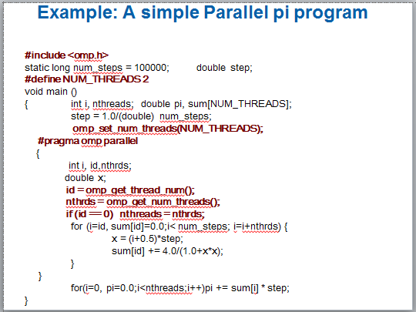
Results*
Original Serial pi program with 100000000 steps ran in 1.83 seconds.
threads | ₁st SPMD
1 | 1.86
2 | 1.03
3 | 1.08
4 | 0.97
*Intel compiler (icpc) with no optimization on Apple OS X 10.7.3 with a dual core (four HW
thread) Intel® CoreTM i5 processor at 1.7 Ghz and 4 Gbyte DDR3 memory at 1.333 Ghz.
54

Slide 53
Why such poor scaling? False sharing
If independent data elements happen to sit on the same cache line, each
update will cause the cache lines to “slosh back and forth” between threads
… This is called “false sharing”.
HW thrd. 0
HW thrd. 1
HW thrd. 2
HW thrd. 3
L1 $ lines
L1 $ lines
Sum[0] Sum[1] Sum[2] Sum[3] Sum[0] Sum[1] Sum[2] Sum[3]
Core 0 Core 1
Shared last level cache and connection to I/O and DRAM
If you promote scalars to an array to support creation of an SPMD program, the array elements are contiguous in memory and hence share cache lines
… Results in poor scalability.
Solution: Pad arrays so elements you use are on distinct cache lines.
55

Slide 54
Example: eliminate False sharing by padding the sum array
#include <omp.h>
static long num_steps = 100000; double step;
#define PAD 8 // assume 64 byte L1 cache line size #define NUM_THREADS 2
void main ()
{
int i, nthreads; double pi, sum[NUM_THREADS][PAD]; step = 1.0/(double) num_steps;
omp_set_num_threads(NUM_THREADS); #pragma omp parallel
Pad the array so each sum value is in a different cache line
{
int i, id,nthrds; double x;
id = omp_get_thread_num(); nthrds = omp_get_num_threads(); if (id == 0) nthreads = nthrds;
for (i=id, sum[id]=0.0;i< num_steps; i=i+nthrds) { x = (i+0.5)*step;
sum[id][0] += 4.0/(1.0+x*x);
}
for(i=0, pi=0.0;i<nthreads;i++)pi += sum[i][0] * step;
}
}
56

Slide 55
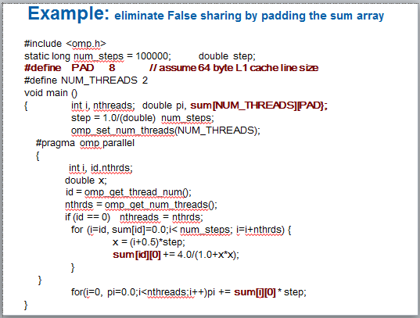
Results*: pi program padded accumulator
Original Serial pi program with 100000000 steps ran in 1.83 seconds.
threads | ₁st SPMD | ₁st SPMD padded
1 | 1.86 | 1.86
2 | 1.03 | 1.01
3 | 1.08 | 0.69
4 | 0.97 | 0.53
*Intel compiler (icpc) with no optimization on Apple OS X 10.7.3 with a dual core (four HW thread) Intel® CoreTM i5 processor at 1.7 Ghz and 4 Gbyte DDR3 memory at 1.333 Ghz.
55

Slide 56
Do we really need to pad our arrays?
Padding arrays requires deep knowledge of the cache architecture. Move to a machine with different sized cache lines and your software performance falls apart.
There has got to be a better way to deal with false sharing.
56

Slide 57
Outline
Unit 1: Getting started with OpenMP
  Mod1: Introduction to parallel programming
  Mod 2: The boring bits: Using an OpenMP compiler (hello world)
  Disc 1: Hello world and how threads work
Unit 2: The core features of OpenMP
  Mod 3: Creating Threads (the Pi program)
  Disc 2: The simple Pi program and why it sucks
  Mod 4: Synchronization (Pi program revisited)
  Disc 3: Synchronization overhead and eliminating false sharing
  Mod 5: Parallel Loops (making the Pi program simple)
  Disc 4: Pi program wrap-up
Unit 3: Working with OpenMP
  Mod 6: Synchronize single masters and stuff
  Mod 7: Data environment
  Disc 5: Debugging OpenMP programs
  Mod 8: Skills practice … linked lists and OpenMP
  Disc 6: Different ways to traverse linked lists
Unit 4: a few advanced OpenMP topics
  Mod 8: Tasks (linked lists the easy way)
  Disc 7: Understanding Tasks
  Mod 8: The scary stuff … Memory model, atomics, and flush (pairwise synch).
  Disc 8: The pitfalls of pairwise synchronization
  Mod 9: Threadprivate Data and how to support libraries (Pi again)
  Disc 9: Random number generators
Unit 5: Recapitulation
59

Slide 58
OpenMP Overview:
Recall our high level overview of OpenMP?
How do threads interact?
OpenMP is a multi-threading, shared address model.
  Threads communicate by sharing variables.
Unintended sharing of data causes race conditions:
  race condition: when the program’s outcome
changes as the threads are scheduled differently.
To control race conditions:
  Use synchronization to protect data conflicts.
Synchronization is expensive so:
  Change how data is accessed to minimize the need
for synchronization.
60

Slide 59

Synchronization:
Synchronization: bringing one or more threads to a well defined and
known point in their execution.
The two most common forms of synchronization are:
Barrier: each thread wait at the barrier until all threads arrive.
Mutual exclusion: Define a block of code that only one thread at a time can execute.
61/61

Slide 60
Synchronization
Synchronization is used to impose order constraints and to protect access to shared data
High level synchronization:
  critical
  atomic
  barrier
– ordered
Low level synchronization | Disc la | ussed ter
flush locks (both simple and nested)

Slide 61
Synchronization: Barrier
Barrier: Each thread waits until all threads arrive.
#pragma omp parallel
{
int id=omp_get_thread_num(); A[id] = big_calc1(id);
#pragma omp barrier
B[id] = big_calc2(id, A);
}

Slide 62
Synchronization: critical
Mutual exclusion: Only one thread at a time can enter a critical region.
float res;
#pragma omp parallel
{ float B; int i, id, nthrds;
id = omp_get_thread_num(); nthrds = omp_get_num_threads(); for(i=id;i<niters;i+=nthrds){
B = big_job(i); #pragma omp critical
res += consume (B);
}
}
Threads wait their turn – only one at a time calls consume()
Threads wait
their turn – only one at a time calls consume()

Slide 63
Synchronization: Atomic (basic form)
Atomic provides mutual exclusion but only applies to the update of a memory location (the update of X in the following example)
The statement inside the atomic must be one of the following forms:
x binop= expr
x++
• ++x
x—
--x
X is an lvalue of scalar type and binop is a non-overloaded built in operator.
#pragma omp parallel
{
double tmp, B;
B = DOIT();
tmp = big_ugly(B);
#pragma omp atomic
X += tmp;
}
Additional forms of atomic were added in OpenMP 3.1.
We will discuss these later.
65

Slide 64
Exercise 3
In exercise 2, you probably used an array to create space for each thread to store its partial sum.
If array elements happen to share a cache line, this leads to false sharing.
– Non-shared data in the same cache line so each update invalidates the cache line … in essence “sloshing independent data” back and forth between threads.
Modify your “pi program” from exercise 2 to
avoid false sharing due to the sum array.
66

Slide 65
Outline
Unit 1: Getting started with OpenMP
  Mod1: Introduction to parallel programming
  Mod 2: The boring bits: Using an OpenMP compiler (hello world)
  Disc 1: Hello world and how threads work
Unit 2: The core features of OpenMP
  Mod 3: Creating Threads (the Pi program)
  Disc 2: The simple Pi program and why it sucks
  Mod 4: Synchronization (Pi program revisited)
  Disc 3: Synchronization overhead and eliminating false sharing
  Mod 5: Parallel Loops (making the Pi program simple)
  Disc 4: Pi program wrap-up
Unit 3: Working with OpenMP
  Mod 6: Synchronize single masters and stuff
  Mod 7: Data environment
  Disc 5: Debugging OpenMP programs
  Mod 8: Skills practice … linked lists and OpenMP
  Disc 6: Different ways to traverse linked lists
Unit 4: a few advanced OpenMP topics
  Mod 8: Tasks (linked lists the easy way)
  Disc 7: Understanding Tasks
  Mod 8: The scary stuff … Memory model, atomics, and flush (pairwise synch).
  Disc 8: The pitfalls of pairwise synchronization
  Mod 9: Threadprivate Data and how to support libraries (Pi again)
  Disc 9: Random number generators
Unit 5: Recapitulation
67

Slide 66
Pi program with false sharing*
Original Serial pi program with 100000000 steps ran in 1.83 seconds.
Recall that promoting sum to an array made the coding easy, but led to false sharing and poor performance.
threads | ₁st SPMD
1 | 1.86
2 | 1.03
3 | 1.08
4 | 0.97
*Intel compiler (icpc) with no optimization on Apple OS X 10.7.3 with a dual core (four HW
thread) Intel® CoreTM i5 processor at 1.7 Ghz and 4 Gbyte DDR3 memory at 1.333 Ghz.
68

Slide 67
Example: Using a critical section to remove impact of false sharing
#include <omp.h>
static long num_steps = 100000; double step; #define NUM_THREADS 2
void main ()
{ double pi; step = 1.0/(double) num_steps;
omp_set_num_threads(NUM_THREADS);
#pragma omp parallel
Create a scalar local to each thread to accumulate partial sums.
{
int i, id,nthrds; double x, sum;
id = omp_get_thread_num();
nthrds = omp_get_num_threads(); if (id == 0) nthreads = nthrds;
id = omp_get_thread_num();
nthrds = omp_get_num_threads();
for (i=id, sum=0.0;i< num_steps; i=i+nthreads){ x = (i+0.5)*step;
No array, so no false sharing.
No array, so no false sharing.
No array, so no false sharing.
sum += 4.0/(1.0+x*x);
}
#pragma omp critical
pi += sum * step;
Sum goes “out of scope” beyond the parallel region … so you must sum it in here. Must protect summation into pi in a critical region so updates don’t conflict
}
}
69

Slide 68
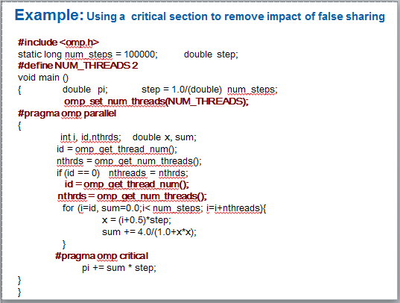
Results*: pi program critical section
Original Serial pi program with 100000000 steps ran in 1.83 seconds.
threads | ₁st SPMD | ₁st SPMD padded | SPMD critical
1 | 1.86 | 1.86 | 1.87
2 | 1.03 | 1.01 | 1.00
3 | 1.08 | 0.69 | 0.68
4 | 0.97 | 0.53 | 0.53
*Intel compiler (icpc) with no optimization on Apple OS X 10.7.3 with a dual core (four HW thread) Intel® CoreTM i5 processor at 1.7 Ghz and 4 Gbyte DDR3 memory at 1.333 Ghz.
70

Slide 69
Example: Using a critical section to remove impact of false sharing
#include <omp.h>
static long num_steps = 100000; double step; #define NUM_THREADS 2
void main ()
{ double pi; step = 1.0/(double) num_steps;
omp_set_num_threads(NUM_THREADS);
#pragma omp parallel
{
Be careful where you put a critical section
int i, id,nthrds; double x; id = omp_get_thread_num();
nthrds = omp_get_num_threads(); if (id == 0) nthreads = nthrds;
id = omp_get_thread_num();
nthrds = omp_get_num_threads();
for (i=id, sum=0.0;i< num_steps; i=i+nthreads){ x = (i+0.5)*step;
#pragma omp critical
pi += 4.0/(1.0+x*x);
}
What would happen if you put the critical section inside the loop?
What would happen if you put the critical section inside the loop?
What would happen if you put the critical section inside the loop?
}
pi *= step;
}
71

Slide 70
Example: Using an atomic to remove impact of false sharing
#include <omp.h>
static long num_steps = 100000; double step; #define NUM_THREADS 2
void main ()
{ double pi; step = 1.0/(double) num_steps;
omp_set_num_threads(NUM_THREADS);
#pragma omp parallel
Create a scalar local to each thread to accumulate partial sums.
{
int i, id,nthrds; double x, sum;
id = omp_get_thread_num();
nthrds = omp_get_num_threads(); if (id == 0) nthreads = nthrds;
id = omp_get_thread_num();
nthrds = omp_get_num_threads();
for (i=id, sum=0.0;i< num_steps; i=i+nthreads){ x = (i+0.5)*step;
No array, so no false sharing.
No array, so no false sharing.
No array, so no false sharing.
sum += 4.0/(1.0+x*x);
}
sum = sum*step;
Sum goes “out of scope” beyond the parallel region … so you must sum it in here. Must protect summation into pi so updates don’t conflict
#pragma atomic
pi += sum ;
}
72

Slide 71
Outline
Unit 1: Getting started with OpenMP
  Mod1: Introduction to parallel programming
  Mod 2: The boring bits: Using an OpenMP compiler (hello world)
  Disc 1: Hello world and how threads work
Unit 2: The core features of OpenMP
  Mod 3: Creating Threads (the Pi program)
  Disc 2: The simple Pi program and why it sucks
  Mod 4: Synchronization (Pi program revisited)
  Disc 3: Synchronization overhead and eliminating false sharing
  Mod 5: Parallel Loops (making the Pi program simple)
  Disc 4: Pi program wrap-up
Unit 3: Working with OpenMP
  Mod 6: Synchronize single masters and stuff
  Mod 7: Data environment
  Disc 5: Debugging OpenMP programs
  Mod 8: Skills practice … linked lists and OpenMP
  Disc 6: Different ways to traverse linked lists
Unit 4: a few advanced OpenMP topics
  Mod 8: Tasks (linked lists the easy way)
  Disc 7: Understanding Tasks
  Mod 8: The scary stuff … Memory model, atomics, and flush (pairwise synch).
  Disc 8: The pitfalls of pairwise synchronization
  Mod 9: Threadprivate Data and how to support libraries (Pi again)
  Disc 9: Random number generators
Unit 5: Recapitulation
73

Slide 72
SPMD vs. worksharing
A parallel construct by itself creates an SPMD or “Single Program Multiple Data” program … i.e., each thread redundantly executes the same code.
How do you split up pathways through the code between threads within a team?
  This is called worksharing
– Loop construct
Sections/section constructs
Single construct
Task construct
Discussed later

Slide 73
The loop worksharing Constructs
The loop worksharing construct splits up loop iterations among the threads in a team
#pragma omp parallel
{
#pragma omp for
for (I=0;I<N;I++){
NEAT_STUFF(I);
}
}
Loop construct name:
C/C++: for
Fortran: do
The variable I is made “private” to each thread by default. You could do this explicitly with a “private(I)” clause

Slide 74
Loop worksharing Constructs
A motivating example
for(i=0;i<N;i++) { a[i] = a[i] + b[i];}
Sequential code
for(i=0;i<N;i++) { a[i] = a[i] + b[i];}
#pragma omp parallel
{
int id, i, Nthrds, istart, iend;
id = omp_get_thread_num(); Nthrds = omp_get_num_threads(); istart = id * N / Nthrds;
iend = (id+1) * N / Nthrds;
if (id == Nthrds-1)iend = N;
#pragma omp parallel
{
int id, i, Nthrds, istart, iend;
id = omp_get_thread_num(); Nthrds = omp_get_num_threads(); istart = id * N / Nthrds;
iend = (id+1) * N / Nthrds;
if (id == Nthrds-1)iend = N;
for(i=istart;i<iend;i++) { a[i] = a[i] + b[i];}
}
OpenMP parallel region
for(i=istart;i<iend;i++) { a[i] = a[i] + b[i];}
}
OpenMP parallel region and a worksharing for construct
#pragma omp parallel
#pragma omp for
for(i=0;i<N;i++) { a[i] = a[i] + b[i];}
#pragma omp parallel
#pragma omp for
for(i=0;i<N;i++) { a[i] = a[i] + b[i];}
76

Slide 75
loop worksharing constructs:
The schedule clause
The schedule clause affects how loop iterations are mapped onto
threads
  schedule(static [,chunk])
    Deal-out blocks of iterations of size “chunk” to each thread.
  schedule(dynamic[,chunk])
    Each thread grabs “chunk” iterations off a queue until all iterations
have been handled.
  schedule(guided[,chunk])
    Threads dynamically grab blocks of iterations. The size of the block starts large and shrinks down to size “chunk” as the calculation proceeds.
  schedule(runtime)
    Schedule and chunk size taken from the OMP_SCHEDULE environment variable (or the runtime library).
  schedule(auto)
    Schedule is left up to the runtime to choose (does not have to be any of the above).

Slide 76
loop work-sharing constructs:
The schedule clause
Schedule Clause When To Use
Least work at runtime : scheduling done at compile-time
Least work at
runtime : scheduling done at compile-time
STATIC
Pre-determined and predictable by the programmer
DYNAMIC
Unpredictable, highly variable work per iteration
Most work at runtime : complex scheduling logic used at run-time
Most work at
runtime : complex scheduling logic used at run-time
GUIDED
Special case of dynamic to reduce scheduling overhead
AUTO
When the runtime can “learn” from previous executions of the same loop

Slide 77
Combined parallel/worksharing construct
OpenMP shortcut: Put the “parallel” and the
worksharing directive on the same line
double res[MAX]; int i;
#pragma omp parallel
{
#pragma omp for
for (i=0;i< MAX; i++) {
res[i] = huge();
}
}
double res[MAX]; int i; #pragma omp parallel for for (i=0;i< MAX; i++) {
res[i] = huge();
}
These are equivalent
79

Slide 78
Working with loops
Basic approach
  Find compute intensive loops
  Make the loop iterations independent .. So they can safely execute in any order without loop-carried dependencies
  Place the appropriate OpenMP directive and test
Note: loop index “i” is private by default
int i, j, A[MAX]; j = 5;
for (i=0;i< MAX; i++) {
j +=2;
A[i] = big(j);
}
int i, A[MAX];
#pragma omp parallel for
for (i=0;i< MAX; i++) { int j = 5 + 2*(i+1); A[i] = big(j);
}
Remove loop carried dependence
78

Slide 79
Nested loops
For perfectly nested rectangular loops we can parallelize
multiple loops in the nest with the collapse clause:
#pragma omp parallel for collapse(2) for (int i=0; i<N; i++) {
for (int j=0; j<M; j++) {
.....
}
Number of
Number of
loops to be parallelized, counting from the outside
loops to be
parallelized,
counting from
}
the outside
Will form a single loop of length NxM and then parallelize that.
Useful if N is O(no. of threads) so parallelizing the outer loop makes balancing the load difficult.
79

Slide 80
Reduction
How do we handle this case?
double ave=0.0, A[MAX]; int i;
for (i=0;i< MAX; i++) {
ave + = A[i];
}
ave = ave/MAX;
We are combining values into a single accumulation variable (ave) … there is a true dependence between loop iterations that can’t be trivially removed
This is a very common situation … it is called a
“reduction”.
Support for reduction operations is included in most parallel programming environments.
80

Slide 81
Reduction
OpenMP reduction clause: reduction (op : list)
Inside a parallel or a work-sharing construct:
  A local copy of each list variable is made and initialized
depending on the “op” (e.g. 0 for “+”).
  Updates occur on the local copy.
  Local copies are reduced into a single value and combined with the original global value.
The variables in “list” must be shared in the enclosing
parallel region.
double ave=0.0, A[MAX]; int i; #pragma omp parallel for reduction (+:ave) for (i=0;i< MAX; i++) {
ave + = A[i];
}
ave = ave/MAX;
81

Slide 82
OpenMP: Reduction operands/initial-values
Many different associative operands can be used with reduction:
Initial values are the ones that make sense mathematically.
Operator | Initial value
+ | 0
* | 1
- | 0
min | Largest pos. number
max | Most neg. number
Fortran Only
Operator | Initial value
.AND. | .true.
.OR. | .false.
.NEQV. | .false.
.IEOR. | 0
.IOR. | 0
.IAND. | All bits on
.EQV. | .true.
C/C++ only
Operator | Initial value
& | ~0
| | 0
^ | 0
&& | 1
|| | 0
82

Slide 83
Exercise 4: Pi with loops
Go back to the serial pi program and parallelize it with a loop construct
Your goal is to minimize the number of changes made to the serial program.
83

Slide 84
Outline
Unit 1: Getting started with OpenMP
  Mod1: Introduction to parallel programming
  Mod 2: The boring bits: Using an OpenMP compiler (hello world)
  Disc 1: Hello world and how threads work
Unit 2: The core features of OpenMP
  Mod 3: Creating Threads (the Pi program)
  Disc 2: The simple Pi program and why it sucks
  Mod 4: Synchronization (Pi program revisited)
  Disc 3: Synchronization overhead and eliminating false sharing
  Mod 5: Parallel Loops (making the Pi program simple)
  Disc 4: Pi program wrap-up
Unit 3: Working with OpenMP
  Mod 6: Synchronize single masters and stuff
  Mod 7: Data environment
  Disc 5: Debugging OpenMP programs
  Mod 8: Skills practice … linked lists and OpenMP
  Disc 6: Different ways to traverse linked lists
Unit 4: a few advanced OpenMP topics
  Mod 8: Tasks (linked lists the easy way)
  Disc 7: Understanding Tasks
  Mod 8: The scary stuff … Memory model, atomics, and flush (pairwise synch).
  Disc 8: The pitfalls of pairwise synchronization
  Mod 9: Threadprivate Data and how to support libraries (Pi again)
  Disc 9: Random number generators
Unit 5: Recapitulation
86

Slide 85
Serial PI Program
static long num_steps = 100000;
double step; int main ()
{ int i; double x, pi, sum = 0.0;
step = 1.0/(double) num_steps; for (i=0;i< num_steps; i++){
x = (i+0.5)*step;
sum = sum + 4.0/(1.0+x*x);
}
pi = step * sum;
}

Slide 86
Example: Pi with a loop and a reduction
#include <omp.h>
static long num_steps = 100000; void main ()
{ int i; double x, pi, sum = 0.0; step = 1.0/(double) num_steps; #pragma omp parallel
double step;
Create a team of threads … without a parallel construct, you’ll never have more than one thread
{
Create a scalar local to each thread to hold value of x at the center of each interval
double x;
#pragma omp for reduction(+:sum)
for (i=0;i< num_steps; i++){ x = (i+0.5)*step;
sum = sum + 4.0/(1.0+x*x);
}
Break up loop iterations and assign them to threads … setting up a reduction into sum.
Note … the loop indix is local to a thread by default.
}
pi = step * sum;
}

Slide 87
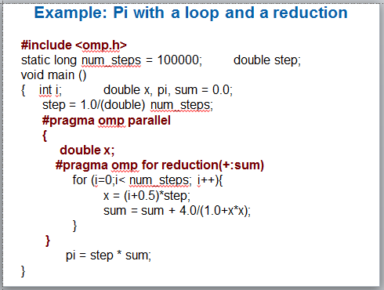
Results*: pi with a loop and a reduction
Original Serial pi program with 100000000 steps ran in 1.83 seconds.
threads | ₁st SPMD | ₁st SPMD padded | SPMD critical | PI Loop
1 | 1.86 | 1.86 | 1.87 | 1.91
2 | 1.03 | 1.01 | 1.00 | 1.02
3 | 1.08 | 0.69 | 0.68 | 0.80
4 | 0.97 | 0.53 | 0.53 | 0.68
*Intel compiler (icpc) with no optimization on Apple OS X 10.7.3 with a dual core (four HW thread) Intel® CoreTM i5 processor at 1.7 Ghz and 4 Gbyte DDR3 memory at 1.333 Ghz.
87

Slide 88
Parallel loops
OpenMP 3.0 guarantees that this works … i.e. that the same
schedule is used in the two loops:
!$omp do schedule(static) do i=1,n
a(i) = ....
end do
!$omp end do nowait
!$omp do schedule(static) do i=1,n
.... = a(i)
end do
88

Slide 89
Loops (cont.)
Made schedule(runtime) more useful
  can get/set it with library routines
omp_set_schedule() omp_get_schedule()
  allow implementations to implement their own schedule kinds
Added a new schedule kind AUTO which gives full freedom to the runtime to determine the scheduling of iterations to threads.
Allowed C++ Random access iterators as loop control
variables in parallel loops
89

Slide 90
Outline
Unit 1: Getting started with OpenMP
  Mod1: Introduction to parallel programming
  Mod 2: The boring bits: Using an OpenMP compiler (hello world)
  Disc 1: Hello world and how threads work
Unit 2: The core features of OpenMP
  Mod 3: Creating Threads (the Pi program)
  Disc 2: The simple Pi program and why it sucks
  Mod 4: Synchronization (Pi program revisited)
  Disc 3: Synchronization overhead and eliminating false sharing
  Mod 5: Parallel Loops (making the Pi program simple)
  Disc 4: Pi program wrap-up
Unit 3: Working with OpenMP
  Mod 6: Synchronize single masters and stuff
  Mod 7: Data environment
  Disc 5: Debugging OpenMP programs
  Mod 8: Skills practice … linked lists and OpenMP
  Disc 6: Different ways to traverse linked lists
Unit 4: a few advanced OpenMP topics
  Mod 8: Tasks (linked lists the easy way)
  Disc 7: Understanding Tasks
  Mod 8: The scary stuff … Memory model, atomics, and flush (pairwise synch).
  Disc 8: The pitfalls of pairwise synchronization
  Mod 9: Threadprivate Data and how to support libraries (Pi again)
  Disc 9: Random number generators
Unit 5: Recapitulation
92

Slide 91
Outline
Unit 1: Getting started with OpenMP
  Mod1: Introduction to parallel programming
  Mod 2: The boring bits: Using an OpenMP compiler (hello world)
  Disc 1: Hello world and how threads work
Unit 2: The core features of OpenMP
  Mod 3: Creating Threads (the Pi program)
  Disc 2: The simple Pi program and why it sucks
  Mod 4: Synchronization (Pi program revisited)
  Disc 3: Synchronization overhead and eliminating false sharing
  Mod 5: Parallel Loops (making the Pi program simple)
  Disc 4: Pi program wrap-up
Unit 3: Working with OpenMP
  Mod 6: Synchronize single masters and stuff
  Mod 7: Data environment
  Disc 5: Debugging OpenMP programs
  Mod 8: Skills practice … linked lists and OpenMP
  Disc 6: Different ways to traverse linked lists
Unit 4: a few advanced OpenMP topics
  Mod 8: Tasks (linked lists the easy way)
  Disc 7: Understanding Tasks
  Mod 8: The scary stuff … Memory model, atomics, and flush (pairwise synch).
  Disc 8: The pitfalls of pairwise synchronization
  Mod 9: Threadprivate Data and how to support libraries (Pi again)
  Disc 9: Random number generators
Unit 5: Recapitulation
93

Slide 92
Synchronization: Barrier
Barrier: Each thread waits until all threads arrive.
#pragma omp parallel shared (A, B, C) private(id)
{
id=omp_get_thread_num();
A[id] = big_calc1(id);
implicit barrier at the end of a
#pragma omp barrier
#pragma omp for
implicit barrier at the end of a
for worksharing construct
for worksharing construct
for(i=0;i<N;i++){C[i]=big_calc3(i,A);} #pragma omp for nowait
for(i=0;i<N;i++){ B[i]=big_calc2(C, i); }
A[id] = big_calc4(id);
}
no implicit barrier
due to nowait
implicit barrier at the end of a parallel region
no implicit barrier
due to nowait
implicit barrier at the end
of a parallel region
9
4

Slide 93
Master Construct
The master construct denotes a structured block that is only executed by the master thread.
The other threads just skip it (no synchronization is implied).
#pragma omp parallel
{
do_many_things(); #pragma omp master
{ exchange_boundaries(); } #pragma omp barrier
do_many_other_things();
}

Slide 94
Single worksharing Construct
The single construct denotes a block of code that is executed by only one thread (not necessarily the master thread).
A barrier is implied at the end of the single block (can remove the barrier with a nowait clause).
#pragma omp parallel
{
do_many_things(); #pragma omp single
{ exchange_boundaries(); }
do_many_other_things();
}

Slide 95
Sections worksharing Construct
The Sections worksharing construct gives a different structured block to each thread.
#pragma omp parallel
{
#pragma omp sections
{
#pragma omp section X_calculation(); #pragma omp section y_calculation(); #pragma omp section z_calculation();
}
}
#pragma omp parallel
{
#pragma omp sections
{
#pragma omp section X_calculation(); #pragma omp section y_calculation(); #pragma omp section z_calculation();
}
}
By default, there is a barrier at the end of the “omp sections”. Use the “nowait” clause to turn off the barrier.
97

Slide 96
Synchronization: Lock routines
Simple Lock routines:
  A simple lock is available if it is unset.
– omp_init_lock(), omp_set_lock(), omp_unset_lock(), omp_test_lock(), omp_destroy_lock()
Nested Locks
A lock implies a memory fence (a “flush”) of all thread visible variables
A nested lock is available if it is unset or if it is set but owned by the thread executing the nested lock function
– omp_init_nest_lock(), omp_set_nest_lock(), omp_unset_nest_lock(), omp_test_nest_lock(), omp_destroy_nest_lock()
Note: a thread always accesses the most recent copy of the
lock, so you don’t need to use a flush on the lock variable.

Slide 97
Synchronization: Simple Locks
Example: conflicts are rare, but to play it safe, we must assure mutual exclusion for updates to histogram elements.
#pragma omp parallel for
for(i=0;i<NBUCKETS; i++){
One lock per element of hist
One lock per element of hist
omp_init_lock(&hist_locks[i]);
hist[i] = 0;
}
#pragma omp parallel for for(i=0;i<NVALS;i++){
ival = (int) sample(arr[i]);
omp_set_lock(&hist_locks[ival]);
hist[ival]++; omp_unset_lock(&hist_locks[ival]);
Enforce mutual
Enforce mutual
exclusion on update to hist array
exclusion on
update to hist array
}
Free-up storage when done.
for(i=0;i<NBUCKETS; i++)
Free-up storage when done.
omp_destroy_lock(&hist_locks[i]);

Slide 98
Runtime Library routines
Runtime environment routines:
  Modify/Check the number of threads
    omp_set_num_threads(), omp_get_num_threads(),
omp_get_thread_num(), omp_get_max_threads()
  Are we in an active parallel region?
    omp_in_parallel()
  Do you want the system to dynamically vary the number of threads from one parallel construct to another?
    omp_set_dynamic, omp_get_dynamic();
  How many processors in the system?
    omp_num_procs()
…plus a few less commonly used routines.

Slide 99
Runtime Library routines
To use a known, fixed number of threads in a program,
  tell the system that you don’t want dynamic adjustment of the number of threads, (2) set the number of threads, then (3) save the number you got.
Disable dynamic adjustment of the
#include <omp.h>
number of threads.
void main()
{ int num_threads; omp_set_dynamic( 0 );
Request as many threads as
you have processors.
omp_set_num_threads( omp_num_procs() );
#pragma omp parallel
Protect this op since Memory
{ int id=omp_get_thread_num();
stores are not atomic
#pragma omp single
num_threads = omp_get_num_threads(); do_lots_of_stuff(id);
} |  | Even in this case, the system may give you fewer threads than requested. If the precise # of threads matters, test
 |  | for it and respond accordingly.

Slide 100
Environment Variables
Set the default number of threads to use.
  OMP_NUM_THREADS int_literal
OpenMP added an environment variable to control the size of
child threads’ stack
  OMP_STACKSIZE
Also added an environment variable to hint to runtime how to
treat idle threads
  OMP_WAIT_POLICY
ACTIVE
PASSIVE
keep threads alive at barriers/locks
try to release processor at barriers/locks
Process binding is enabled if this variable is true … i.e. if true
the runtime will not move threads around between processors.
– OMP_PROC_BIND true | false

Slide 101
Outline
Unit 1: Getting started with OpenMP
  Mod1: Introduction to parallel programming
  Mod 2: The boring bits: Using an OpenMP compiler (hello world)
  Disc 1: Hello world and how threads work
Unit 2: The core features of OpenMP
  Mod 3: Creating Threads (the Pi program)
  Disc 2: The simple Pi program and why it sucks
  Mod 4: Synchronization (Pi program revisited)
  Disc 3: Synchronization overhead and eliminating false sharing
  Mod 5: Parallel Loops (making the Pi program simple)
  Disc 4: Pi program wrap-up
Unit 3: Working with OpenMP
  Mod 6: Synchronize single masters and stuff
  Mod 7: Data environment
  Disc 5: Debugging OpenMP programs
  Mod 8: Skills practice … linked lists and OpenMP
  Disc 6: Different ways to traverse linked lists
Unit 4: a few advanced OpenMP topics
  Mod 8: Tasks (linked lists the easy way)
  Disc 7: Understanding Tasks
  Mod 8: The scary stuff … Memory model, atomics, and flush (pairwise synch).
  Disc 8: The pitfalls of pairwise synchronization
  Mod 9: Threadprivate Data and how to support libraries (Pi again)
  Disc 9: Random number generators
Unit 5: Recapitulation
103

Slide 102
Data environment:
Default storage attributes
Shared Memory programming model:
  Most variables are shared by default
Global variables are SHARED among threads
  Fortran: COMMON blocks, SAVE variables, MODULE variables
  C: File scope variables, static
  Both: dynamically allocated memory (ALLOCATE, malloc, new)
But not everything is shared...
  Stack variables in subprograms(Fortran) or functions(C) called from parallel regions are PRIVATE
  Automatic variables within a statement block are PRIVATE.
102

Slide 103
Data sharing: Examples
double A[10];
int main() { int index[10];
#pragma omp parallel work(index);
printf(“%d\n”, index[0]);;
}
extern double A[10];
void work(int *index) { double temp[10];
static int count;
...
}
A, index, count
A, index and count are shared by all threads.
temp is local to each thread
A, index and count are
shared by all threads.
temp is local to each thread
temp
temp
temp
A, index, count
103

Slide 104
Data sharing:
Changing storage attributes
One can selectively change storage attributes for constructs using the following clauses*
SHARED
PRIVATE
FIRSTPRIVATE
All the clauses on this page apply to the OpenMP construct NOT to the entire region.
All the clauses on this page
apply to the OpenMP construct NOT to the entire region.
The final value of a private inside a parallel loop can be
transmitted to the shared variable outside the loop with:
  LASTPRIVATE
The default attributes can be overridden with:
  DEFAULT (PRIVATE | SHARED | NONE)
DEFAULT(PRIVATE) is Fortran only
*All data clauses apply to parallel constructs and worksharing constructs
except “shared” which only applies to parallel constructs.
104

Slide 105
Data Sharing: Private Clause
private(var) creates a new local copy of var for each thread.
  The value of the private copies is uninitialized
  The value of the original variable is unchanged after the region
void wrong() { int tmp = 0;
#pragma omp parallel for private(tmp)
for (int j = 0; j < 1000; ++j)
tmp += j; printf(“%d\n”, tmp);
}
tmp was not
initialized
tmp is 0 here
105

Slide 106
Data Sharing: Private Clause
When is the original variable valid?
The original variable’s value is unspecified if it is
referenced outside of the construct
  Implementations may reference the original variable or a
copy ….. a dangerous programming practice!
  For example, consider what would happen if the compiler inlined
work()?
int tmp;
void danger() { tmp = 0;
#pragma omp parallel private(tmp) work();
printf(“%d\n”, tmp);;
}
extern int tmp; void work() {
tmp = 5;
}
unspecified which copy of tmp
tmp has unspecified value
106

Slide 107
Firstprivate Clause
Variables initialized from shared variable
C++ objects are copy-constructed
incr = 0;
#pragma omp parallel for firstprivate(incr) for (i = 0; i <= MAX; i++) {
if ((i%2)==0) incr++; A[i] = incr;
}
Each thread gets its own copy
of incr with an initial value of 0
incr = 0;
#pragma omp parallel for firstprivate(incr) for (i = 0; i <= MAX; i++) {
if ((i%2)==0) incr++; A[i] = incr;
}
107

Slide 108
Lastprivate Clause
Variables update shared variable using value from last iteration
C++ objects are updated as if by assignment
void sq2(int n, double *lastterm)
{
double x; int i;
#pragma omp parallel for lastprivate(x) for (i = 0; i < n; i++){
x = a[i]*a[i] + b[i]*b[i];
void sq2(int n, double *lastterm)
{
double x; int i;
#pragma omp parallel for lastprivate(x) for (i = 0; i < n; i++){
x = a[i]*a[i] + b[i]*b[i]; b[i] = sqrt(x);
}
*lastterm = x;
}
b[i] = sqrt(x);
}
“x” has the value it held
*lastterm = x;
for the “last sequential”
}
iteration (i.e., for i=(n-1))
108

Slide 109
Data Sharing:
A data environment test
Consider this example of PRIVATE and FIRSTPRIVATE
variables: A = 1,B = 1, C = 1
#pragma omp parallel private(B) firstprivate(C)
Are A,B,C local to each thread or shared inside the parallel region?
What are their initial values inside and values after the parallel region?
Inside this parallel region ...
  “A” is shared by all threads;; equals 1
  “B” and “C” are local to each thread.
    B’s initial value is undefined
    C’s initial value equals 1
Following the parallel region ...
  B and C revert to their original values of 1
  A is either 1 or the value it was set to inside the parallel region
109

Slide 110
Data Sharing: Default Clause
Note that the default storage attribute is DEFAULT(SHARED) (so
no need to use it)
  Exception: #pragma omp task
To change default: DEFAULT(PRIVATE)
  each variable in the construct is made private as if specified in a private clause
  mostly saves typing
DEFAULT(NONE): no default for variables in static extent. Must list storage attribute for each variable in static extent. Good programming practice!
Only the Fortran API supports default(private).
C/C++ only has default(shared) or default(none).
110

Slide 111
Data Sharing: Default Clause Example
itotal = 1000
C$OMP PARALLEL PRIVATE(np, each)
np = omp_get_num_threads() each = itotal/np
………
C$OMP END PARALLEL
These two code fragments are equivalent
itotal = 1000
C$OMP PARALLEL DEFAULT(PRIVATE) SHARED(itotal)
np = omp_get_num_threads() each = itotal/np
………
C$OMP END PARALLEL
111

Slide 112
Exercise 5: Mandelbrot set area
The supplied program (mandel.c) computes the area of a Mandelbrot set.
The program has been parallelized with OpenMP, but we were lazy and didn’t do it right.
Find and fix the errors (hint … the problem is
with the data environment).
112

Slide 113
Exercise 5 (cont.)
Once you have a working version, try to optimize the program?
  Try different schedules on the parallel loop.
  Try different mechanisms to support mutual exclusion.
113

Slide 114
Outline
Unit 1: Getting started with OpenMP
  Mod1: Introduction to parallel programming
  Mod 2: The boring bits: Using an OpenMP compiler (hello world)
  Disc 1: Hello world and how threads work
Unit 2: The core features of OpenMP
  Mod 3: Creating Threads (the Pi program)
  Disc 2: The simple Pi program and why it sucks
  Mod 4: Synchronization (Pi program revisited)
  Disc 3: Synchronization overhead and eliminating false sharing
  Mod 5: Parallel Loops (making the Pi program simple)
  Disc 4: Pi program wrap-up
Unit 3: Working with OpenMP
  Mod 6: Synchronize single masters and stuff
  Mod 7: Data environment
  Disc 5: Debugging OpenMP programs
  Mod 8: Skills practice … linked lists and OpenMP
  Disc 6: Different ways to traverse linked lists
Unit 4: a few advanced OpenMP topics
  Mod 8: Tasks (linked lists the easy way)
  Disc 7: Understanding Tasks
  Mod 8: The scary stuff … Memory model, atomics, and flush (pairwise synch).
  Disc 8: The pitfalls of pairwise synchronization
  Mod 9: Threadprivate Data and how to support libraries (Pi again)
  Disc 9: Random number generators
Unit 5: Recapitulation
116

Slide 115
The Mandelbrot Area program
#include <omp.h>
# define NPOINTS 1000 # define MXITR 1000 void testpoint(void); struct d_complex{
void testpoint(void){
struct d_complex z;
int iter; double temp;
double r; double i;
};
struct d_complex c; int numoutside = 0;
z=c;
for (iter=0; iter<MXITR; iter++){
temp = (z.r*z.r)-(z.i*z.i)+c.r;
z.i = z.r*z.i*2+c.i;
z.r = temp;
if ((z.r*z.r+z.i*z.i)>4.0) { numoutside++; break;
}
}
int main(){ int i, j;
double area, error, eps = 1.0e-5;
#pragma omp parallel for default(shared) private(c,eps)
for (i=0; i<NPOINTS; i++) { for (j=0; j<NPOINTS; j++) {
c.r = -2.0+2.5*(double)(i)/(double)(NPOINTS)+eps;
c.i = 1.125*(double)(j)/(double)(NPOINTS)+eps;
testpoint();
}
}
area=2.0*2.5*1.125*(double)(NPOINTS*NPOINTS- numoutside)/(double)(NPOINTS*NPOINTS);
error=area/(double)NPOINTS;
}
}
When I run this program, I get a different incorrect answer each time I run it … there is a race
condition!!!!
117

Slide 116
Debugging parallel programs
Find tools that work with your environment and learn to use them. A good parallel debugger can make a huge difference.
But parallel debuggers are not portable and you will
assuredly need to debug “by hand” at some point.
There are tricks to help you. The most important is to use the default(none) pragma
#pragma omp parallel for default(none) private(c, eps) for (i=0; i<NPOINTS; i++) {
for (j=0; j<NPOINTS; j++) {
c.r = -2.0+2.5*(double)(i)/(double)(NPOINTS)+eps;
c.i = 1.125*(double)(j)/(double)(NPOINTS)+eps; testpoint();
}
}
}
Using default(none) generates a compiler error that j is unspecified.
118

Slide 117
The Mandelbrot Area program
#include <omp.h>
# define NPOINTS 1000 # define MXITR 1000 struct d_complex{
void testpoint(struct d_complex c){
struct d_complex z;
int iter; double temp;
double r; double i;
};
void testpoint(struct d_complex); struct d_complex c;
int numoutside = 0;
z=c;
for (iter=0; iter<MXITR; iter++){
temp = (z.r*z.r)-(z.i*z.i)+c.r;
z.i = z.r*z.i*2+c.i;
z.r = temp;
if ((z.r*z.r+z.i*z.i)>4.0) { #pragma omp atomic numoutside++;
break;
}
}
int main(){ int i, j;
double area, error, eps = 1.0e-5;
#pragma omp parallel for default(shared) private(c, j) \
firstpriivate(eps)
for (i=0; i<NPOINTS; i++) { for (j=0; j<NPOINTS; j++) {
c.r = -2.0+2.5*(double)(i)/(double)(NPOINTS)+eps;
c.i = 1.125*(double)(j)/(double)(NPOINTS)+eps;
testpoint(c);
}
}
area=2.0*2.5*1.125*(double)(NPOINTS*NPOINTS- numoutside)/(double)(NPOINTS*NPOINTS);
error=area/(double)NPOINTS;
}
Other errors found using a
debugger or by inspection:
eps was not initialized
Protect updates of numoutside
Which value of c die testpoint()
see? Global or private?
119

Slide 118
Serial PI Program
Now that you understand how to modify the data environment, let’s take one last look at our pi program.
static long num_steps = 100000; double step;
int main ()
{ int i; double x, pi, sum = 0.0;
step = 1.0/(double) num_steps;
What is the minimum change I can make to this code to parallelize it?
for (i=0;i< num_steps; i++){ x = (i+0.5)*step;
sum = sum + 4.0/(1.0+x*x);
}
pi = step * sum;
}
118

Slide 119
Example: Pi program … minimal changes
#include <omp.h>
static long num_steps = 100000;
double step;
For good OpenMP implementations, reduction is more scalable than critical.
For good OpenMP
implementations, reduction is more scalable than critical.
void main ()
{ int i; double x, pi, sum = 0.0;
step = 1.0/(double) num_steps;
#pragma omp parallel for private(x) reduction(+:sum)
for (i=0;i< num_steps; i++){
x = (i+0.5)*step;
sum = sum + 4.0/(1.0+x*x);
i private by default
i private by default
}
pi = step * sum;
Note: we created a parallel program without changing any executable code and by adding 2 simple lines of text!
}
119

Slide 120
Outline
Unit 1: Getting started with OpenMP
  Mod1: Introduction to parallel programming
  Mod 2: The boring bits: Using an OpenMP compiler (hello world)
  Disc 1: Hello world and how threads work
Unit 2: The core features of OpenMP
  Mod 3: Creating Threads (the Pi program)
  Disc 2: The simple Pi program and why it sucks
  Mod 4: Synchronization (Pi program revisited)
  Disc 3: Synchronization overhead and eliminating false sharing
  Mod 5: Parallel Loops (making the Pi program simple)
  Disc 4: Pi program wrap-up
Unit 3: Working with OpenMP
  Mod 6: Synchronize single masters and stuff
  Mod 7: Data environment
  Disc 5: Debugging OpenMP programs
  Mod 8: Skills practice … linked lists and OpenMP
  Disc 6: Different ways to traverse linked lists
Unit 4: a few advanced OpenMP topics
  Mod 8: Tasks (linked lists the easy way)
  Disc 7: Understanding Tasks
  Mod 8: The scary stuff … Memory model, atomics, and flush (pairwise synch).
  Disc 8: The pitfalls of pairwise synchronization
  Mod 9: Threadprivate Data and how to support libraries (Pi again)
  Disc 9: Random number generators
Unit 5: Recapitulation
122

Slide 121
Major OpenMP constructs we’ve covered so far
To create a team of threads
  #pragma omp parallel
To share work between threads:
  #pragma omp for
  #pragma omp single
To prevent conflicts (prevent races)
  #pragma omp critical
  #pragma omp atomic
  #pragma omp barrier
  #pragma omp master
Data environment clauses
  private (variable_list)
  firstprivate (variable_list)
  lastprivate (variable_list)
  reduction(+:variable_list)
Where variable_list is a comma separated list of variables
Print the value of the macro
_OPENMP
And its value will be
yyyymm
For the year and month of the
spec the implementation used

Slide 122
Consider simple list traversal
Given what we’ve covered about OpenMP, how would you process this loop in Parallel?
p=head;
while (p) { process(p);
p = p->next;
}
Remember, the loop worksharing construct only works with loops for which the number of loop iterations can be represented by a closed-form expression at compiler time. While loops are not covered.

Slide 123
Exercise 6: linked lists the hard way
Consider the program linked.c
  Traverses a linked list computing a sequence of Fibonacci numbers at each node.
Parallelize this program using constructs described so far (i.e. even if you already know about them, don’t use tasks).
Once you have a correct program, optimize it.

Slide 124
Outline
Unit 1: Getting started with OpenMP
  Mod1: Introduction to parallel programming
  Mod 2: The boring bits: Using an OpenMP compiler (hello world)
  Disc 1: Hello world and how threads work
Unit 2: The core features of OpenMP
  Mod 3: Creating Threads (the Pi program)
  Disc 2: The simple Pi program and why it sucks
  Mod 4: Synchronization (Pi program revisited)
  Disc 3: Synchronization overhead and eliminating false sharing
  Mod 5: Parallel Loops (making the Pi program simple)
  Disc 4: Pi program wrap-up
Unit 3: Working with OpenMP
  Mod 6: Synchronize single masters and stuff
  Mod 7: Data environment
  Disc 5: Debugging OpenMP programs
  Mod 8: Skills practice … linked lists and OpenMP
  Disc 6: Different ways to traverse linked lists
Unit 4: a few advanced OpenMP topics
  Mod 8: Tasks (linked lists the easy way)
  Disc 7: Understanding Tasks
  Mod 8: The scary stuff … Memory model, atomics, and flush (pairwise synch).
  Disc 8: The pitfalls of pairwise synchronization
  Mod 9: Threadprivate Data and how to support libraries (Pi again)
  Disc 9: Random number generators
Unit 5: Recapitulation
126

Slide 125
list traversal
When we first created OpenMP, we focused on common use cases in HPC … Fortran arrays processed over “regular” loops.
Recursion and “pointer chasing” were so far removed from our Fortan focus that we didn’t even consider more general structures.
Hence, even a simple list traversal is exceedingly difficult with the original versions of OpenMP.
p=head;
while (p) {
process(p); p = p->next;
}
127

Slide 126
Linked lists without tasks
See the file Linked_omp25.c
while (p != NULL) { p = p->next; count++;
}
p = head;
for(i=0; i<count; i++) { parr[i] = p;
p = p->next;
}
#pragma omp parallel
{
#pragma omp for schedule(static,1)
for(i=0; i<count; i++)
processwork(parr[i]);
Count number of items in the linked list
Copy pointer to each node into an array
Process nodes in parallel with a for loop
}
 | Default schedule | Static,1
One Thread | 48 seconds | 45 seconds
Two Threads | 39 seconds | 28 seconds
Results on an Intel dual core 1.83 GHz CPU, Intel IA-32 compiler 10.1 build 2

Slide 127
Linked lists without tasks: C++ STL
See the file Linked_cpp.cpp
std::vector<node *> nodelist;
for (p = head; p != NULL; p = p->next)
nodelist.push_back(p);
Copy pointer to each node into an array
int j = (int)nodelist.size();
Count number of items in the linked list
#pragma omp parallel for schedule(static,1)
for (int i = 0; i < j; ++i)
processwork(nodelist[i]);
Process nodes in parallel with a for loop
 | C++, default sched. | C++, (static,1) | C, (static,1)
One Thread | 37 seconds | 49 seconds | 45 seconds
Two Threads | 47 seconds | 32 seconds | 28 seconds
Results on an Intel dual core 1.83 GHz CPU, Intel IA-32 compiler 10.1 build 2

Slide 128
Conclusion
We were able to parallelize the linked list traversal … but it was ugly and required multiple passes over the data.
To move beyond its roots in the array based world of scientific computing, we needed to support more general data structures and loops beyond basic for loops.
To do this, we added tasks in OpenMP 3.0
130

Slide 129
Outline
Unit 1: Getting started with OpenMP
  Mod1: Introduction to parallel programming
  Mod 2: The boring bits: Using an OpenMP compiler (hello world)
  Disc 1: Hello world and how threads work
Unit 2: The core features of OpenMP
  Mod 3: Creating Threads (the Pi program)
  Disc 2: The simple Pi program and why it sucks
  Mod 4: Synchronization (Pi program revisited)
  Disc 3: Synchronization overhead and eliminating false sharing
  Mod 5: Parallel Loops (making the Pi program simple)
  Disc 4: Pi program wrap-up
Unit 3: Working with OpenMP
  Mod 6: Synchronize single masters and stuff
  Mod 7: Data environment
  Disc 5: Debugging OpenMP programs
  Mod 8: Skills practice … linked lists and OpenMP
  Disc 6: Different ways to traverse linked lists
Unit 4: a few advanced OpenMP topics
  Mod 8: Tasks (linked lists the easy way)
  Disc 7: Understanding Tasks
  Mod 8: The scary stuff … Memory model, atomics, and flush (pairwise synch).
  Disc 8: The pitfalls of pairwise synchronization
  Mod 9: Threadprivate Data and how to support libraries (Pi again)
  Disc 9: Random number generators
Unit 5: Recapitulation
131

Slide 130
Outline
Unit 1: Getting started with OpenMP
  Mod1: Introduction to parallel programming
  Mod 2: The boring bits: Using an OpenMP compiler (hello world)
  Disc 1: Hello world and how threads work
Unit 2: The core features of OpenMP
  Mod 3: Creating Threads (the Pi program)
  Disc 2: The simple Pi program and why it sucks
  Mod 4: Synchronization (Pi program revisited)
  Disc 3: Synchronization overhead and eliminating false sharing
  Mod 5: Parallel Loops (making the Pi program simple)
  Disc 4: Pi program wrap-up
Unit 3: Working with OpenMP
  Mod 6: Synchronize single masters and stuff
  Mod 7: Data environment
  Disc 5: Debugging OpenMP programs
  Mod 8: Skills practice … linked lists and OpenMP
  Disc 6: Different ways to traverse linked lists
Unit 4: a few advanced OpenMP topics
  Mod 8: Tasks (linked lists the easy way)
  Disc 7: Understanding Tasks
  Mod 8: The scary stuff … Memory model, atomics, and flush (pairwise synch).
  Disc 8: The pitfalls of pairwise synchronization
  Mod 9: Threadprivate Data and how to support libraries (Pi again)
  Disc 9: Random number generators
Unit 5: Recapitulation
132

Slide 131
OpenMP Tasks
Tasks are independent units of work.
Tasks are composed of:
  code to execute
  data environment
  internal control variables (ICV)
Threads perform the work of each task.
The runtime system decides when tasks are executed
  Tasks may be deferred
  Tasks may be executed immediately
Serial
Parallel

Slide 132
Definitions
Task construct – task directive plus structured block
Task – the package of code and instructions for allocating data created when a thread encounters a task construct
Task region – the dynamic sequence of instructions produced by the execution of a task by a thread

Slide 133
When are tasks guaranteed to complete
Tasks are guaranteed to be complete at thread barriers:
#pragma omp barrier
or task barriers
#pragma omp taskwait
Multiple foo tasks created here – one for each thread
All foo tasks guaranteed to
be completed here
#pragma { | omp |  | parallel
#pragma |  | omp |  | task
foo();
#pragma |  | omp |  | barrier
#pragma |  | omp |  | single
{
#pragma omp task
bar();
One bar task created here
}
}
bar task guaranteed to be
completed here

Slide 134
Data Scoping with tasks: Fibonacci example.
This is an instance of the
divide and conquer design pattern
int fib ( int n )
{
n is private in both tasks
int x,y;
if ( n < 2 ) return n;
#pragma omp task
x = fib(n-1); #pragma omp task
y = fib(n-2);
#pragma omp taskwait return x+y
x is a private variable y is a private variable
}
What’s wrong here?
A task’s private variables are
undefined outside the task

Slide 135
Data Scoping with tasks: Fibonacci example.
int fib ( int n )
{
int x,y;
if ( n < 2 ) return n;
#pragma omp task shared (x)
x = fib(n-1);
#pragma omp task shared(y) y = fib(n-2);
#pragma omp taskwait
return x+y;
}
n is private in both tasks
x & y are shared
Good solution
we need both values to compute the sum

Slide 136
Data Scoping with tasks: List Traversal example
List ml; //my_list
Element *e; #pragma omp parallel |  | What’s wrong here?
#pragma omp single { for(e=ml->first;e;e=e->next) #pragma omp task process(e); }
Possible data race !
Shared variable e updated by multiple tasks

Slide 137
Data Scoping with tasks: List Traversal example
List ml; //my_list Element *e; #pragma omp parallel #pragma omp single { for(e=ml->first;e;e=e->next) #pragma omp task firstprivate(e) process(e); }
 | Good solution – e is firstprivate

Slide 138
Exercise 7: tasks in OpenMP
Consider the program linked.c
  Traverses a linked list computing a sequence of Fibonacci numbers at each node.
Parallelize this program using tasks.
Compare your solution’s complexity to an
approach without tasks.
140

Slide 139
Outline
Unit 1: Getting started with OpenMP
  Mod1: Introduction to parallel programming
  Mod 2: The boring bits: Using an OpenMP compiler (hello world)
  Disc 1: Hello world and how threads work
Unit 2: The core features of OpenMP
  Mod 3: Creating Threads (the Pi program)
  Disc 2: The simple Pi program and why it sucks
  Mod 4: Synchronization (Pi program revisited)
  Disc 3: Synchronization overhead and eliminating false sharing
  Mod 5: Parallel Loops (making the Pi program simple)
  Disc 4: Pi program wrap-up
Unit 3: Working with OpenMP
  Mod 6: Synchronize single masters and stuff
  Mod 7: Data environment
  Disc 5: Debugging OpenMP programs
  Mod 8: Skills practice … linked lists and OpenMP
  Disc 6: Different ways to traverse linked lists
Unit 4: a few advanced OpenMP topics
  Mod 8: Tasks (linked lists the easy way)
  Disc 7: Understanding Tasks
  Mod 8: The scarey stuff … Memory model, atomics, and flush (pairwise synch).
  Disc 8: The pitfalls of pariwise synchronization
  Mod 9: Threadprivate Data and how to support libraries (Pi again)
  Disc 9: Random number generators
Unit 5: Recapitulation
141

Slide 140
Exercise 7: tasks in OpenMP
Consider the program linked.c
  Traverses a linked list computing a sequence of Fibonacci numbers at each node.
Parallelize this program using tasks.
Compare your solution’s complexity to an
approach without tasks.
142

Slide 141
Task Construct – Explicit Tasks
1. Create
a team of
#pragma omp parallel
{
threads.
#pragma omp single
2. One thread executes the single construct
{
3. The “single” thread
creates a task with its own
value for the pointer p
node * p = head; while (p) {
… other threads
wait at the implied
#pragma omp task firstprivate(p) process(p);
p = p->next;
barrier at the end of the single construct
}
}
4. Threads waiting at the barrier execute
tasks.
}
Execution moves beyond the barrier once all the tasks are complete

Slide 142



Execution of tasks
Have potential to parallelize irregular patterns and recursive function calls
#pragma omp parallel
{
#pragma omp single
Single
Threaded
Thr1 Thr2 Thr3 Thr4
Block 1
Block 2
Task 1
Block 1
{ //block 1
node * p = head; while (p) { // block 2 #pragma omp task
process(p);
p = p->next; //block 3
}
Block 2
Task 1
Block 2
Task 2
Block 3
Block 2
Task 3
Idle
Idle
Block 2
Task 2
Time
}
Block 3
Time Saved
}
Block 2
Task 3

Slide 143

A real example: Symmetric rank-k update
Add A₁A^{T}₀
Add A₀A^{T}₀
A₀
A₁
_{A}T 0 | _{A}T 1
^{C}11
+=
^{C}10
C
A
_{A}T
Note: the iteration sweeps through C and A, creating a new block of rows to be updated with new parts of A. These updates are completely independent.
Tze Meng Low, Kent Milfeld, Robert van de Geijn, and Field Van Zee. “Parallelizing FLAME Code with OpenMP Task Queues.” TOMS , submitted.
145

Slide 144
146

Slide 145
#pragma omp parallel
{
#pragma omp single
{
#pragma omp task firstprivate(A0, A1, C10, C11)
} // end of task-queue
} // end of parallel region
147

Slide 146



4
x 10
2
1.5
1
0.5
0
0
200
400
600
800
1200
1400
1600
1800
2000
148

Slide 147
Outline
Unit 1: Getting started with OpenMP
  Mod1: Introduction to parallel programming
  Mod 2: The boring bits: Using an OpenMP compiler (hello world)
  Disc 1: Hello world and how threads work
Unit 2: The core features of OpenMP
  Mod 3: Creating Threads (the Pi program)
  Disc 2: The simple Pi program and why it sucks
  Mod 4: Synchronization (Pi program revisited)
  Disc 3: Synchronization overhead and eliminating false sharing
  Mod 5: Parallel Loops (making the Pi program simple)
  Disc 4: Pi program wrap-up
Unit 3: Working with OpenMP
  Mod 6: Synchronize single masters and stuff
  Mod 7: Data environment
  Disc 5: Debugging OpenMP programs
  Mod 8: Skills practice … linked lists and OpenMP
  Disc 6: Different ways to traverse linked lists
Unit 4: a few advanced OpenMP topics
  Mod 8: Tasks (linked lists the easy way)
  Disc 7: Understanding Tasks
  Mod 8: The scary stuff … Memory model, atomics, and flush (pairwise synch).
  Disc 8: The pitfalls of pairwise synchronization
  Mod 9: Threadprivate Data and how to support libraries (Pi again)
  Disc 9: Random number generators
Unit 5: Recapitulation
149

Slide 148
OpenMP memory model
OpenMP supports a shared memory model.
All threads share an address space, but it can get complicated:
Shared memory
a
cache1 cache2 cache3
cacheN
. . .
proc1 proc2 proc3 procN
a
A memory model is defined in terms of:
  Coherence: Behavior of the memory system when a single
address is accessed by multiple threads.
  Consistency: Orderings of reads, writes, or synchronizations (RWS) with various addresses and by multiple threads.
150

Slide 149
OpenMP Memory Model: Basic Terms
Program order
W_{a} W_{b} R_{a} R_{b} . . .
Source code
compiler
Code order
RW’s in any semantically equivalent order
W_{b} R_{b} W_{a} R_{a} . . .
Executable code
thread
thread
private view
private view
a b
threadprivate
b a
threadprivate
memory
a
b Commit order
151

Slide 150
Consistency: Memory Access Re-ordering
Re-ordering:
  Compiler re-orders program order to the code order
  Machine re-orders code order to the memory commit order
At a given point in time, the “private view” seen by a thread may be different from the view in shared memory.
Consistency Models define constraints on the orders of Reads (R), Writes (W) and Synchronizations (S)
  … i.e. how do the values “seen” by a thread change as you
change how ops follow (→) other ops.
  Possibilities include:
– R→R, W→W, R→W, R→S, S→S, W→S

Slide 151
Consistency
Sequential Consistency:
  In a multi-processor, ops (R, W, S) are sequentially consistent if:
    They remain in program order for each
processor.
    They are seen to be in the same overall order by each of the other processors.
  Program order = code order = commit order
Relaxed consistency:
  Remove some of the ordering constraints for memory ops (R, W, S).

Slide 152
OpenMP and Relaxed Consistency
OpenMP defines consistency as a variant of weak consistency:
  Can not reorder S ops with R or W ops on the same thread
– Weak consistency guarantees
S→W, S→R , R→S, W→S, S→S
The Synchronization operation relevant to this discussion is flush.

Slide 153
Flush
Defines a sequence point at which a thread is guaranteed to see a consistent view of memory with respect to the “flush set”.
The flush set is:
  “all thread visible variables” for a flush construct without an
argument list.
  a list of variables when the “flush(list)” construct is used.
The action of Flush is to guarantee that:
All R,W ops that overlap the flush set and occur prior to the flush complete before the flush executes
All R,W ops that overlap the flush set and occur after the
flush don’t execute until after the flush.
Flushes with overlapping flush sets can not be reordered.
Memory ops: R = Read, W = write, S = synchronization

Slide 154
Synchronization: flush example
Flush forces data to be updated in memory so other
threads see the most recent value
double A;
A = compute();
flush(A); // flush to memory to make sure other
// threads can pick up the right value
Note: OpenMP’s flush is analogous to a fence in other shared memory API’s.
Note: OpenMP’s flush is analogous to a fence in
other shared memory API’s.
156

Slide 155
Flush and synchronization
A flush operation is implied by OpenMP synchronizations, e.g.
  at entry/exit of parallel regions
  at implicit and explicit barriers
  at entry/exit of critical regions
  whenever a lock is set or unset
….
(but not at entry to worksharing regions or entry/exit of master regions)

Slide 156
What is the Big Deal with Flush?
Compilers routinely reorder instructions implementing a program
  This helps better exploit the functional units, keep machine
busy, hide memory latencies, etc.
Compiler generally cannot move instructions:
  past a barrier
  past a flush on all variables
But it can move them past a flush with a list of variables so long as those variables are not accessed
Keeping track of consistency when flushes are used
can be confusing … especially if “flush(list)” is used.
Note: the flush operation does not actually synchronize different threads. It just ensures that a thread’s values are made consistent with main memory.

Slide 157
Exercise 8: producer consumer
Parallelize the “prod_cons.c” program.
This is a well known pattern called the producer consumer pattern
  One thread produces values that another thread
consumes.
  Often used with a stream of produced values to
implement “pipeline parallelism”
The key is to implement pairwise synchronization between threads.

Slide 158
Outline
Unit 1: Getting started with OpenMP
  Mod1: Introduction to parallel programming
  Mod 2: The boring bits: Using an OpenMP compiler (hello world)
  Disc 1: Hello world and how threads work
Unit 2: The core features of OpenMP
  Mod 3: Creating Threads (the Pi program)
  Disc 2: The simple Pi program and why it sucks
  Mod 4: Synchronization (Pi program revisited)
  Disc 3: Synchronization overhead and eliminating false sharing
  Mod 5: Parallel Loops (making the Pi program simple)
  Disc 4: Pi program wrap-up
Unit 3: Working with OpenMP
  Mod 6: Synchronize single masters and stuff
  Mod 7: Data environment
  Disc 5: Debugging OpenMP programs
  Mod 8: Skills practice … linked lists and OpenMP
  Disc 6: Different ways to traverse linked lists
Unit 4: a few advanced OpenMP topics
  Mod 8: Tasks (linked lists the easy way)
  Disc 7: Understanding Tasks
  Mod 8: The scary stuff … Memory model, atomics, and flush (pairwise synch).
  Disc 8: The pitfalls of pairwise synchronization
  Mod 9: Threadprivate Data and how to support libraries (Pi again)
  Disc 9: Random number generators
Unit 5: Recapitulation
160

Slide 159
Example: prod_cons.c
Parallelize a producer consumer program
– One thread produces values that another thread consumes.
int main()
{
double *A, sum, runtime;
Often used with a stream of produced values to implement “pipeline parallelism”
The key is to implement pairwise synchronization between threads.
int flag = 0;
A = (double *)malloc(N*sizeof(double));
runtime = omp_get_wtime();
fill_rand(N, A); // Producer: fill an array of data
sum = Sum_array(N, A); // Consumer: sum the array
runtime = omp_get_wtime() - runtime;
printf(" In %lf secs, The sum is %lf \n",runtime,sum);
}

Slide 160
Pair wise synchronizaion in OpenMP
OpenMP lacks synchronization constructs that work between pairs of threads.
When this is needed you have to build it yourself.
Pair wise synchronization
  Use a shared flag variable
  Reader spins waiting for the new flag value
  Use flushes to force updates to and from memory

Slide 161
Example: producer consumer
int main()
{
double *A, sum, runtime;
int numthreads, flag = 0;
A = (double *)malloc(N*sizeof(double)); #pragma omp parallel sections
{
#pragma omp section
{
fill_rand(N, A); #pragma omp flush flag = 1;
#pragma omp flush (flag)
}
#pragma omp section
Use flag to Signal when the
“produced” value is ready
Flush forces refresh to memory. Guarantees that the other thread sees the new value of A
{
#pragma omp flush (flag)
while (flag == 0){
#pragma omp flush (flag)
}
#pragma omp flush sum = Sum_array(N, A);
Flush needed on both “reader” and “writer”
sides of the communication
Notice you must put the flush inside the while loop to make sure the updated flag variable is seen
}
}
The problem is this program technically has
}
a race … on the store and later load of flag.
16
3

Slide 162
The OpenMP 3.1 atomics (1 of 2)
Atomic was expanded to cover the full range of common scenarios where you need to protect a memory operation so it occurs atomically:
# pragma omp atomic [read | write | update | capture]
Atomic can protect loads
# pragma omp atomic read
v = x;
Atomic can protect stores
# pragma omp atomic write
x = expr;
Atomic can protect updates to a storage location (this is the default
behavior … i.e. when you don’t provide a clause)
# pragma omp atomic update
x++; or ++x; or x--; or –x; or
x binop= expr; or x = x binop expr;
This is the original OpenMP atomic
162

Slide 163
The OpenMP 3.1 atomics (2 of 2)
Atomic can protect the assignment of a value (its capture) AND an associated update operation:
# pragma omp atomic capture
statement or structured block
Where the statement is one of the following forms:
v = x++; v = ++x; v = x--; v = –x; v = x binop expr;
Where the structured block is one of the following forms:
{v = x; {v=x; {v = x; | x binop = expr;} x=x binop expr;} x++;} | {x binop = expr; {X = x binop expr; {v=x; ++x:} | v = x;} v = x;}
{++x; | v=x:} | {x++; v = x;}
{v = x; | x--;} | {v= x; --x;}
{--x; | v = x;} | {x--; v = x;}
The capture semantics in atomic were added to map onto common hardware supported atomic ops and to support modern lock free algorithms.
163

Slide 164
Atomics and synchronization flags
int main()
{ double *A, sum, runtime;
int numthreads, flag = 0, flg_tmp;
A = (double *)malloc(N*sizeof(double)); #pragma omp parallel sections
{
#pragma omp section
{ fill_rand(N, A); #pragma omp flush #pragma atomic write
flag = 1;
#pragma omp flush (flag)
}
#pragma omp section
{ while (1){
#pragma omp flush(flag) #pragma omp atomic read
flg_tmp= flag;
if (flg_tmp==1) break;
}
#pragma omp flush
sum = Sum_array(N, A);
}
}
}
This program is truly race free … the reads and writes of flag are protected so the two threads can not conflict.
166

Slide 165
Outline
Unit 1: Getting started with OpenMP
  Mod1: Introduction to parallel programming
  Mod 2: The boring bits: Using an OpenMP compiler (hello world)
  Disc 1: Hello world and how threads work
Unit 2: The core features of OpenMP
  Mod 3: Creating Threads (the Pi program)
  Disc 2: The simple Pi program and why it sucks
  Mod 4: Synchronization (Pi program revisited)
  Disc 3: Synchronization overhead and eliminating false sharing
  Mod 5: Parallel Loops (making the Pi program simple)
  Disc 4: Pi program wrap-up
Unit 3: Working with OpenMP
  Mod 6: Synchronize single masters and stuff
  Mod 7: Data environment
  Disc 5: Debugging OpenMP programs
  Mod 8: Skills practice … linked lists and OpenMP
  Disc 6: Different ways to traverse linked lists
Unit 4: a few advanced OpenMP topics
  Mod 8: Tasks (linked lists the easy way)
  Disc 7: Understanding Tasks
  Mod 8: The scary stuff … Memory model, atomics, and flush (pairwise synch).
  Disc 8: The pitfalls of pairwise synchronization
  Mod 9: Threadprivate Data and how to support libraries (Pi again)
  Disc 9: Random number generators
Unit 5: Recapitulation
167

Slide 166
Data sharing: Threadprivate
Makes global data private to a thread
  Fortran: COMMON blocks
  C: File scope and static variables, static class members
Different from making them PRIVATE
  with PRIVATE global variables are masked.
  THREADPRIVATE preserves global scope within each thread
Threadprivate variables can be initialized using COPYIN or at time of definition (using language- defined initialization capabilities).
166

Slide 167
A threadprivate example (C)
Use threadprivate to create a counter for each thread.
int counter = 0;
#pragma omp threadprivate(counter)
int increment_counter()
{
counter++;
return (counter);
}
int counter = 0;
#pragma omp threadprivate(counter)
int increment_counter()
{
counter++;
return (counter);
}
167

Slide 168
Data Copying: Copyin
You initialize threadprivate data using a copyin clause.
parameter (N=1000)
common/buf/A(N)
!$OMP THREADPRIVATE(/buf/)
C Initialize the A array call init_data(N,A)
!$OMP PARALLEL COPYIN(A)
… Now each thread sees threadprivate array A initialied
… to the global value set in the subroutine init_data()
!$OMP END PARALLEL
end
parameter (N=1000)
common/buf/A(N)
!$OMP THREADPRIVATE(/buf/)
C Initialize the A array call init_data(N,A)
!$OMP PARALLEL COPYIN(A)
… Now each thread sees threadprivate array A initialied
… to the global value set in the subroutine init_data()
!$OMP END PARALLEL
end
168

Slide 169
Data Copying: Copyprivate
Used with a single region to broadcast values of privates from one member of a team to the rest of the team.
#include <omp.h>
void input_parameters (int, int); // fetch values of input parameters void do_work(int, int);
void main()
{
int Nsize, choice;
#pragma omp parallel private (Nsize, choice)
{
#pragma omp single copyprivate (Nsize, choice) input_parameters (Nsize, choice);
do_work(Nsize, choice);
}
}
#include <omp.h>
void input_parameters (int, int); // fetch values of input parameters void do_work(int, int);
void main()
{
int Nsize, choice;
#pragma omp parallel private (Nsize, choice)
{
#pragma omp single copyprivate (Nsize, choice) input_parameters (Nsize, choice);
do_work(Nsize, choice);
}
}
169

Slide 170
Exercise 9: Monte Carlo Calculations
Using Random numbers to solve tough problems
Sample a problem domain to estimate areas, compute probabilities, find optimal values, etc.
Example: Computing π with a digital dart board:
2 * r
Throw darts at the circle/square.
Chance of falling in circle is
proportional to ratio of areas:
A_{c} = r² * π
A_{s} = (2*r) * (2*r) = 4 * r² P = A_{c}/A_{s} = π /4
Compute π by randomly choosing points, count the fraction that falls in the circle, compute pi.
N= 10 N=100 N= 1000
π = 2.8
π = 3.16
π = 3.148

Slide 171
Exercise 9
We provide three files for this exercise
  pi_mc.c: the monte carlo method pi program
  random.c: a simple random number generator
  random.h: include file for random number generator
Create a parallel version of this program without
changing the interfaces to functions in random.c
  This is an exercise in modular software … why should a user of your parallel random number generator have to know any details of the generator or make any changes to how the generator is called?
  The random number generator must be threadsafe.
Extra Credit:
  Make your random number generator numerically correct (non-
overlapping sequences of pseudo-random numbers).

Slide 172
Outline
Unit 1: Getting started with OpenMP
  Mod1: Introduction to parallel programming
  Mod 2: The boring bits: Using an OpenMP compiler (hello world)
  Disc 1: Hello world and how threads work
Unit 2: The core features of OpenMP
  Mod 3: Creating Threads (the Pi program)
  Disc 2: The simple Pi program and why it sucks
  Mod 4: Synchronization (Pi program revisited)
  Disc 3: Synchronization overhead and eliminating false sharing
  Mod 5: Parallel Loops (making the Pi program simple)
  Disc 4: Pi program wrap-up
Unit 3: Working with OpenMP
  Mod 6: Synchronize single masters and stuff
  Mod 7: Data environment
  Disc 5: Debugging OpenMP programs
  Mod 8: Skills practice … linked lists and OpenMP
  Disc 6: Different ways to traverse linked lists
Unit 4: a few advanced OpenMP topics
  Mod 8: Tasks (linked lists the easy way)
  Disc 7: Understanding Tasks
  Mod 8: The scary stuff … Memory model, atomics, and flush (pairwise synch).
  Disc 8: The pitfalls of pairwise synchronization
  Mod 9: Threadprivate Data and how to support libraries (Pi again)
  Disc 9: Random number generators
Unit 5: Recapitulation
174

Slide 173
Computers and random numbers
We use “dice” to make random numbers:
  Given previous values, you cannot predict the next value.
  There are no patterns in the series … and it goes on forever.
Computers are deterministic machines … set an initial state, run a sequence of predefined instructions, and you get a deterministic answer
  By design, computers are not random and cannot produce
random numbers.
However, with some very clever programming, we can make “pseudo random” numbers that are as random as you need them to be … but only if you are very careful.
Why do I care? Random numbers drive statistical
methods used in countless applications:
  Sample a large space of alternatives to find statistically good answers (Monte Carlo methods).

Slide 174
Monte Carlo Calculations:
Using Random numbers to solve tough problems
Sample a problem domain to estimate areas, compute probabilities, find optimal values, etc.
Example: Computing π with a digital dart board:
2 * r
Throw darts at the circle/square.
Chance of falling in circle is
proportional to ratio of areas:
A_{c} = r² * π
A_{s} = (2*r) * (2*r) = 4 * r² P = A_{c}/A_{s} = π /4
Compute π by randomly choosing points, count the fraction that falls in the circle, compute pi.
N= 10 N=100 N= 1000
π = 2.8
π = 3.16
π = 3.148

Slide 175
Parallel Programmers love Monte Carlo
algorithms
#include “omp.h”
static long num_trials = 10000;
int main ()
{
Embarrassingly parallel: the parallelism is so easy its
embarrassing.
Add two lines and you have a parallel program.
long i; long Ncirc = 0; double pi, x, y;
double r = 1.0; // radius of circle. Side of squrare is 2*r seed(0,-r, r); // The circle and square are centered at the origin
#pragma omp parallel for private (x, y) reduction (+:Ncirc) for(i=0;i<num_trials; i++)
{
x = random(); y = random();
if ( x*x + y*y) <= r*r) Ncirc++;
}
pi = 4.0 * ((double)Ncirc/(double)num_trials); printf("\n %d trials, pi is %f \n",num_trials, pi);
}

Slide 176
Linear Congruential Generator (LCG)
LCG: Easy to write, cheap to compute, portable, OK quality
random_next = (MULTIPLIER * random_last + ADDEND)% PMOD; random_last = random_next;
If you pick the multiplier and addend correctly, LCG has a
period of PMOD.
Picking good LCG parameters is complicated, so look it up (Numerical Recipes is a good source). I used the following:
  MULTIPLIER = 1366
  ADDEND = 150889
  PMOD = 714025

Slide 177
LCG code
static long MULTIPLIER = 1366;
static long ADDEND static long PMOD long random_last = 0;
double random ()
{
long random_next;
= 150889;
= 714025;
Seed the pseudo random sequence by setting random_last
random_next = (MULTIPLIER * random_last + ADDEND)% PMOD; random_last = random_next;
return ((double)random_next/(double)PMOD);
}

Slide 178

Running the PI_MC program with LCG generator
Log₁₀ number of samples
1
Log
1
2
3
4
5
6
Run the same program the same way and get different answers!
That is not acceptable!
Issue: my LCG generator is not threadsafe
10
0.1
Relative error
LCG - one thread
0.01
0.001
LCG, 4 threads,
trail 1
LCG 4 threads,
trial 2
LCG, 4 threads,
trial 3
0.0001
0.00001
Program written using the Intel C/C++ compiler (10.0.659.2005) in Microsoft Visual studio 2005 (8.0.50727.42) and running on a dual-core
laptop (Intel T2400 @ 1.83 Ghz with 2 GB RAM) running Microsoft Windows XP.
180

Slide 179
LCG code: threadsafe version
static long MULTIPLIER = 1366;
random_last carries state between random number computations,
To make the generator threadsafe, make random_last threadprivate so each thread has its own copy.
static long ADDEND static long PMOD long random_last = 0;
= 150889;
= 714025;
#pragma omp threadprivate(random_last) double random ()
{
long random_next;
random_next = (MULTIPLIER * random_last + ADDEND)% PMOD; random_last = random_next;
return ((double)random_next/(double)PMOD);
}
181

Slide 180




Thread safe random number generators
Log₁₀ number of samples
Thread safe version gives the same answer each time you run the program.
But for large number of samples, its quality is lower than the one thread result!
Why?
1
1 2 3 4 5 6
LCG - one thread
LCG 4 threads,
trial 1
LCT 4 threads, trial 2
LCG 4 threads, trial 3
LCG 4 threads, thread safe
Log₁₀ Relative error
0.1
0.01
0.001
0.0001
0.00001
182

Slide 181
Pseudo Random Sequences
Random number Generators (RNGs) define a sequence of pseudo-random numbers of length equal to the period of the RNG
In a typical problem, you grab a subsequence of the RNG range
Seed determines starting point
Grab arbitrary seeds and you may generate overlapping sequences
  E.g. three sequences … last one wraps at the end of the RNG period.
Thread 1
Thread 2
Thread 3
Overlapping sequences = over-sampling and bad statistics … lower
quality or even wrong answers!

Slide 182
Parallel random number generators
Multiple threads cooperate to generate and use random numbers.
Solutions:
  Replicate and Pray
Give each thread a separate, independent generator
Have one thread generate all the numbers.
Leapfrog … deal out sequence values “round
robin” as if dealing a deck of cards.
Block method … pick your seed so each
threads gets a distinct contiguous block.
Other than “replicate and pray”, these are difficult to implement. Be smart … buy a math library that does it right.
If done right, can generate the same sequence regardless of the number of threads …
Nice for debugging, but not really needed scientifically.

Slide 183
Leap Frog method
Interleave samples in the sequence of pseudo random numbers:
  Thread i starts at the i^{th} number in the sequence
  Stride through sequence, stride length = number of threads.
Result … the same sequence of values regardless of the number
of threads.
#pragma omp single
{ nthreads = omp_get_num_threads();
iseed = PMOD/MULTIPLIER; // just pick a seed pseed[0] = iseed;
mult_n = MULTIPLIER;
One thread computes offsets and strided multiplier
for (i = 1; i < nthreads; ++i)
{
iseed = (unsigned long long)((MULTIPLIER * iseed) % PMOD);
pseed[i] = iseed;
LCG with Addend = 0 just
to keep things simple
mult_n = (mult_n * MULTIPLIER) % PMOD;
}
}
random_last = (unsigned long long) pseed[id];
Each thread stores offset starting
point into its threadprivate “last
random” value
185

Slide 184
Same sequence with many threads.
We can use the leapfrog method to generate the same answer for any number of threads
Steps | One thread | 2 threads | 4 threads
1000 | 3.156 | 3.156 | 3.156
10000 | 3.1168 | 3.1168 | 3.1168
100000 | 3.13964 | 3.13964 | 3.13964
1000000 | 3.140348 | 3.140348 | 3.140348
10000000 | 3.141658 | 3.141658 | 3.141658
186

Slide 185
Outline
Unit 1: Getting started with OpenMP
  Mod1: Introduction to parallel programming
  Mod 2: The boring bits: Using an OpenMP compiler (hello world)
  Disc 1: Hello world and how threads work
Unit 2: The core features of OpenMP
  Mod 3: Creating Threads (the Pi program)
  Disc 2: The simple Pi program and why it sucks
  Mod 4: Synchronization (Pi program revisited)
  Disc 3: Synchronization overhead and eliminating false sharing
  Mod 5: Parallel Loops (making the Pi program simple)
  Disc 4: Pi program wrap-up
Unit 3: Working with OpenMP
  Mod 6: Synchronize single masters and stuff
  Mod 7: Data environment
  Disc 5: Debugging OpenMP programs
  Mod 8: Skills practice … linked lists and OpenMP
  Disc 6: Different ways to traverse linked lists
Unit 4: a few advanced OpenMP topics
  Mod 8: Tasks (linked lists the easy way)
  Disc 7: Understanding Tasks
  Mod 8: The scary stuff … Memory model, atomics, and flush (pairwise synch).
  Disc 8: The pitfalls of pairwise synchronization
  Mod 9: Threadprivate Data and how to support libraries (Pi again)
  Disc 9: Random number generators
Unit 5: Recapitulation
187

Slide 186
Summary
We have now covered the most commonly used features of OpenMP.
To close, let’s consider some of the key parallel design patterns we’ve discussed..
186

Slide 187
SPMD: Single Program Mulitple Data
Run the same program on P processing elements where P can be arbitrarily large.
Use the rank … an ID ranging from 0 to (P-1) … to select between a set of tasks and to manage any shared data structures.
This pattern is very general and has been used to support most (if not all) the algorithm strategy patterns.
MPI programs almost always use this pattern … it is probably the most commonly used pattern in the history of parallel programming.
This pattern is very general and has been used to support
most (if not all) the algorithm strategy patterns.
MPI programs almost always use this pattern … it is probably the most commonly used pattern in the history of parallel programming.
187

Slide 188

OpenMP Pi program: SPMD pattern
#include <omp.h>
void main (int argc, char *argv[])
{
int i, pi=0.0, step, sum = 0.0; step = 1.0/(double) num_steps ;
#pragma omp parallel firstprivate(sum) private(x, i)
{ int id = omp_get_thread_num();
int numprocs = omp_get_num_threads(); int step1 = id *num_steps/numprocs ;
int stepN = (id+1)*num_steps/numprocs;
if (stepN != num_steps) stepN = num_steps; for (i=step1; i<stepN; i++)
{
x = (i+0.5)*step;
sum += 4.0/(1.0+x*x);
}
#pragma omp critical
pi += sum *step ;
}
}
190

Slide 189
Loop parallelism
Collections of tasks are defined as iterations of one or more loops.
Loop iterations are divided between a collection of processing elements to compute tasks in parallel.
#pragma omp parallel for shared(Results) schedule(dynamic)
for(i=0;i<N;i++){
Do_work(i, Results);
}
This design pattern is heavily used with data parallel design patterns.
OpenMP programmers commonly use this pattern.
189

Slide 190
OpenMP PI Program:
Loop level parallelism pattern
#include <omp.h>
static long num_steps = 100000;
#define NUM_THREADS 2
double step;
void main ()
{ int i; double x, pi, sum =0.0; step = 1.0/(double) num_steps;
omp_set_num_threads(NUM_THREADS);
#pragma omp parallel for private(x) reduction (+:sum) for (i=0;i< num_steps; i++){
x = (i+0.5)*step;
sum += 4.0/(1.0+x*x);
}
pi = sum * step;
}
190

Slide 191
Divide and Conquer Pattern
Use when:
  A problem includes a method to divide into subproblems and a way to recombine solutions of subproblems into a global solution.
Solution
  Define a split operation
  Continue to split the problem until subproblems are
small enough to solve directly.
  Recombine solutions to subproblems to solve original global problem.
Note:
  Computing may occur at each phase (split, leaves, recombine).

Slide 192
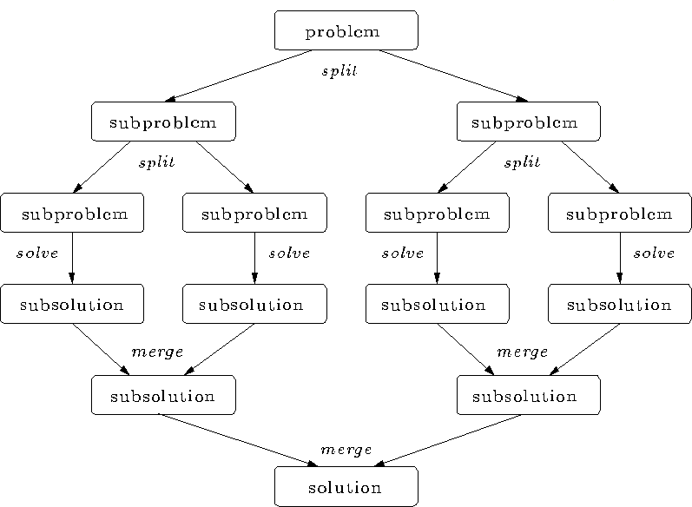
Divide and conquer
Split the problem into smaller sub-problems. Continue until the sub-problems can be solve directly.
  3 Options:
    Do work as you split
into sub-problems.
    Do work only at the leaves.
    Do work as you
recombine.

Slide 193
Program: OpenMP tasks (divide and conquer pattern)
#include <omp.h>
static long num_steps = 100000000; #define MIN_BLK 10000000 double pi_comp(int Nstart,int Nfinish,double step) { int i,iblk; double x, sum = 0.0,sum1, sum2; if (Nfinish-Nstart < MIN_BLK){ for (i=Nstart;i< Nfinish; i++){ x = (i+0.5)*step; sum = sum + 4.0/(1.0+x*x); } } else{ iblk = Nfinish-Nstart; | int ma { int i doub step #pr { #p } pi } | in () ; le step, pi, sum; = 1.0/(double) num_steps; agma omp parallel ragma omp single sum = pi_comp(0,num_steps,step); = step * sum;
#pragma omp task shared(sum1) sum1 = pi_comp(Nstart, Nfinish-iblk/2,step); #pragma omp task shared(sum2) sum2 = pi_comp(Nfinish-iblk/2, Nfinish, step); #pragma omp taskwait sum = sum1 + sum2; }return sum; }
19

Slide 194
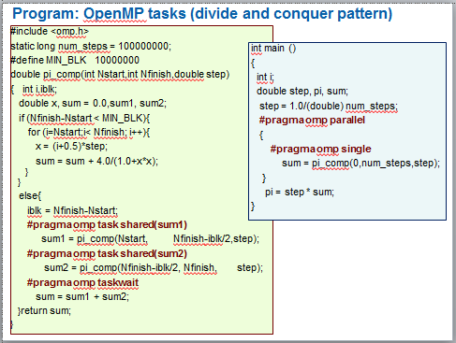
Results*: pi with tasks
Original Serial pi program with 100000000 steps ran in 1.83 seconds.
threads | ₁st SPMD | SPMD critical | PI Loop | Pi tasks
1 | 1.86 | 1.87 | 1.91 | 1.87
2 | 1.03 | 1.00 | 1.02 | 1.00
3 | 1.08 | 0.68 | 0.80 | 0.76
4 | 0.97 | 0.53 | 0.68 | 0.52
*Intel compiler (icpc) with no optimization on Apple OS X 10.7.3 with a dual core (four HW thread) Intel® CoreTM i5 processor at 1.7 Ghz and 4 Gbyte DDR3 memory at 1.333 Ghz.
194

Slide 195
Learning more about OpenMP:
OpenMP Organizations
OpenMP architecture review board URL, the
“owner” of the OpenMP specification:
www.openmp.org
OpenMP User’s Group (cOMPunity) URL:
www.compunity.org
Get involved, join compunity and help define the future of OpenMP
195

Slide 196
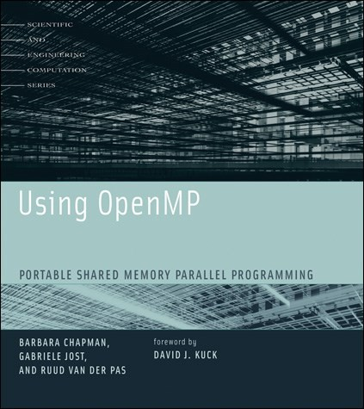
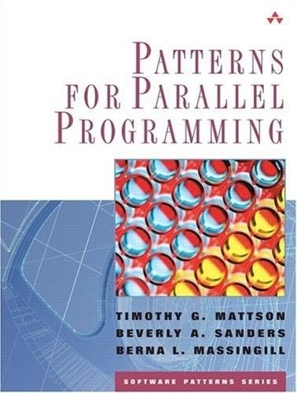
Books about OpenMP
An excellent book about using OpenMP
… though out of date (OpenMP 2.5)
A book about how to “think parallel” with examples in OpenMP, MPI and Java
196

Slide 197

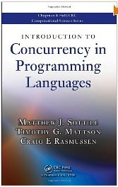

Background references
A general reference that puts languages such as OpenMP in perspective (by Sottile, Mattson, and Rasmussen)
An excellent introduction and overview of multithreaded programming (by Clay Breshears)
199

Slide 198
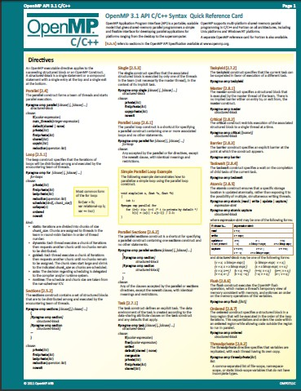
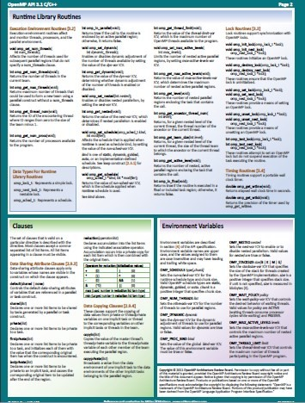
The OpenMP reference card
A two page summary of all the OpenMP constructs … don’t write OpenMP code without it.
http://openmp.org/mp-documents/OpenMP3.1-CCard.pdf

