Slide 1
Helping Hand For The Homeless for the Application Engineering and Development INFO5100 Final Project (Fall 2018)

Slide 2
Who are we?
int elligence;
Introducing to you:
AMAN GUPTA
VARADA DHARMADHIKARI
YASH LEKHWANI
WE LOVE TO INNOVATE.

Slide 3
Current Problem:
You've seen them sleeping on city streets and huddled over grates, or maybe in doorways: Boston's homeless. Lack of medical help, days of hunger and sleeping rough on the bitter, cold streets causes the homeless to die at a rate of nearly three times of those living in shelters, and almost ten times the rate of the general population in Massachusetts. Not just this, homelessness has now become a global problem.

Slide 4
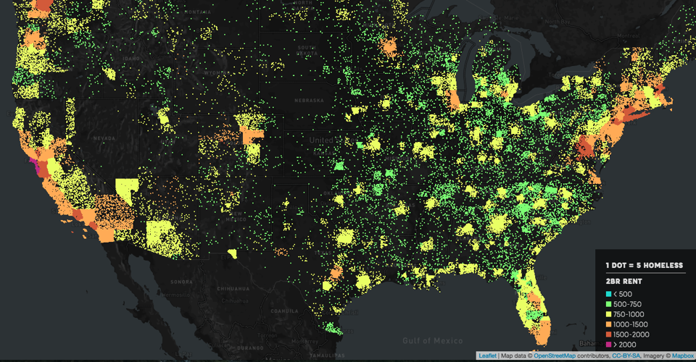

Slide 5
What are we bringing to the society?
Food, Medical Care and Housing Services For The Homeless.
We help the helpless.

Slide 6
Help is here…
Using the ecosystem model, we have integrated our homeless help system to form a network of seamless communication between the Food, Housing, Medical and our Help Center Enterprise.

Slide 7
Why use the “Helping Hand for the Homeless” ?
It supports and uplifts the homeless and improves their standard of living, understands their needs, and provides them with basic utilities all under one roof, our help center kiosk.
It provides them with proper housing, food and medical care so that they don’t have to resort to unfair means to claim these resources and hamper the safety of the society.
Relocates and provides them with mental support and helps them come back on track, thus stabilizing them and uplifting the society, as a whole.

Slide 8
What is the secret of our energy?
We create a network of the Help Centre Enterprise that pushes work requests to the shelter, food and medical enterprises.
We have clearly defined multiple roles for the functioning of our Help Center and have created a flow between these and the roles of other enterprises.

Slide 9
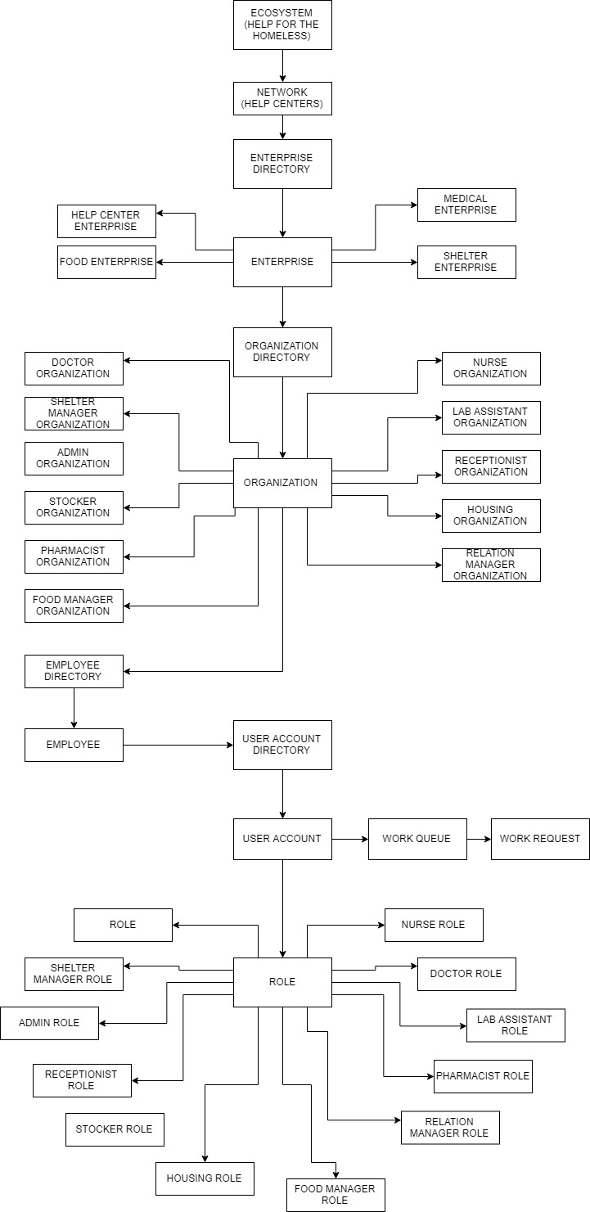
Our Object Model

Slide 10
The Use Cases
Provide Medical Care
Diagnose and prescribe medicines to individuals in need
Request a Lab Test for further investigation
Prescribe medicines based on the lab test results

Slide 11
The Use Cases
Provide Housing
Assign accommodation to each individual
Generate tickets that provide temporary accommodation for a period of 2 days

Slide 12
The Use Cases
Provide Food
Issue left over food packets from different enterprises to the Help Center
Make the food available to each individual upon request

Slide 13
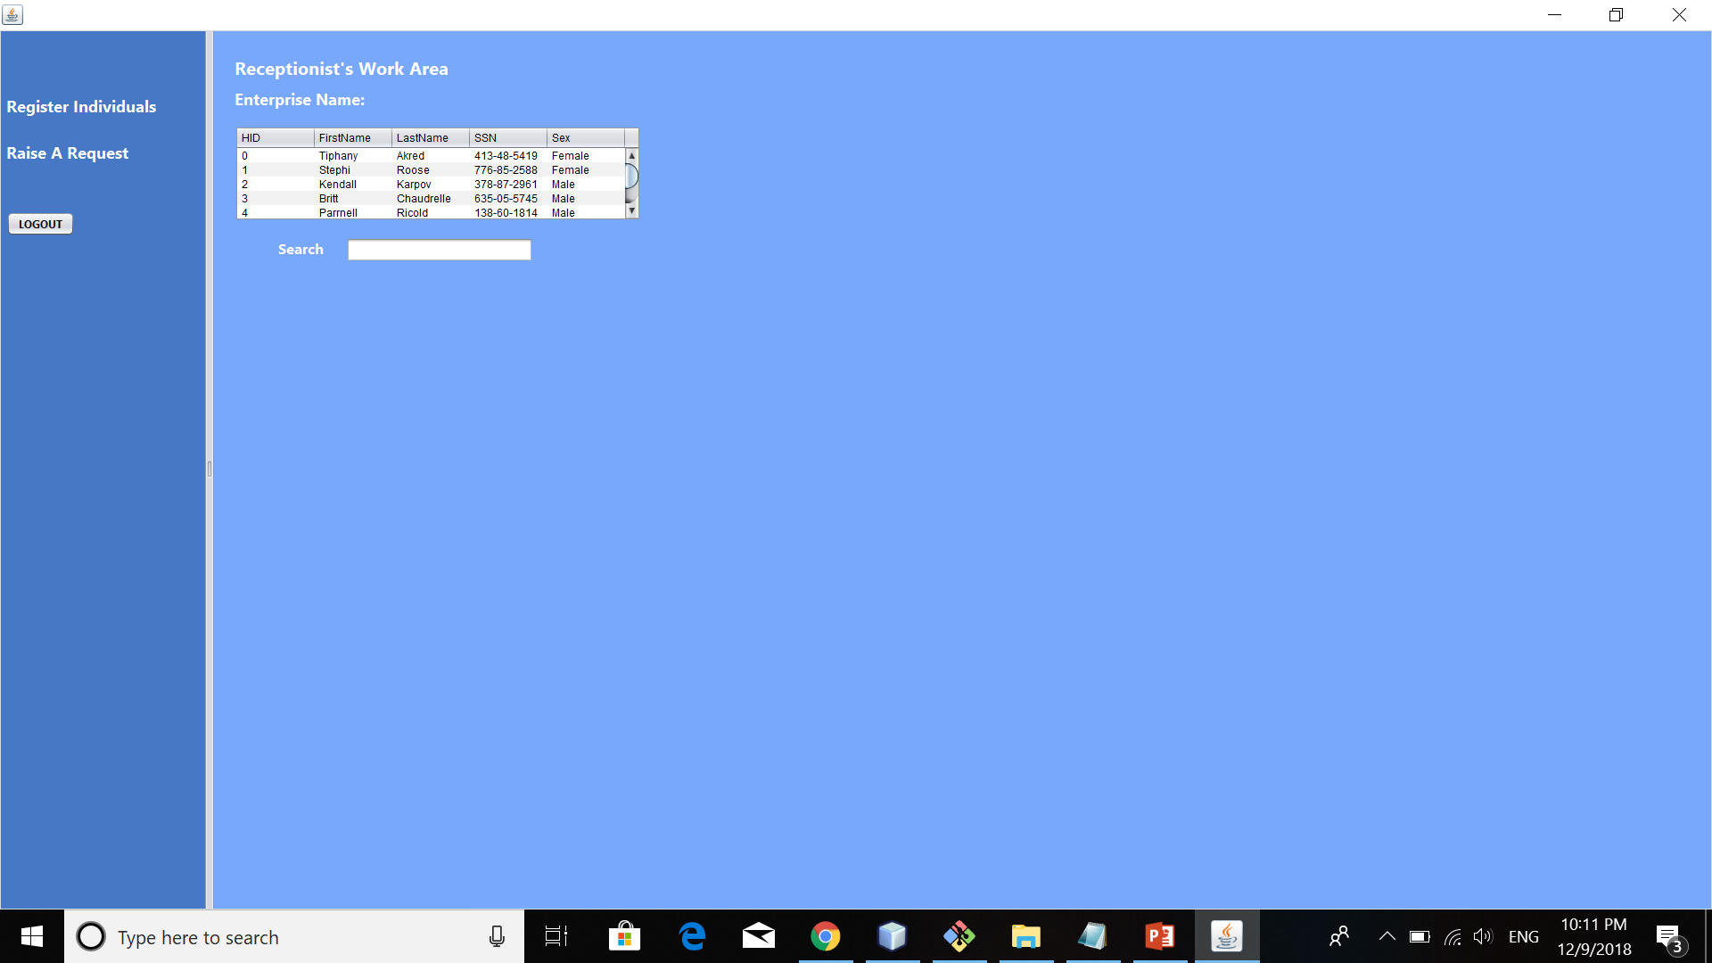
The Roles: Receptionist Role

Slide 14
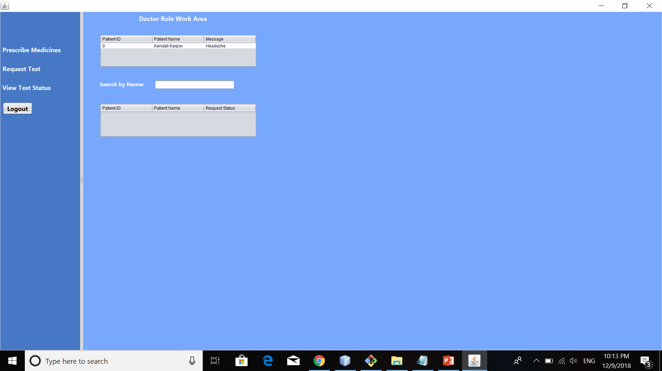
Doctor Role

Slide 15
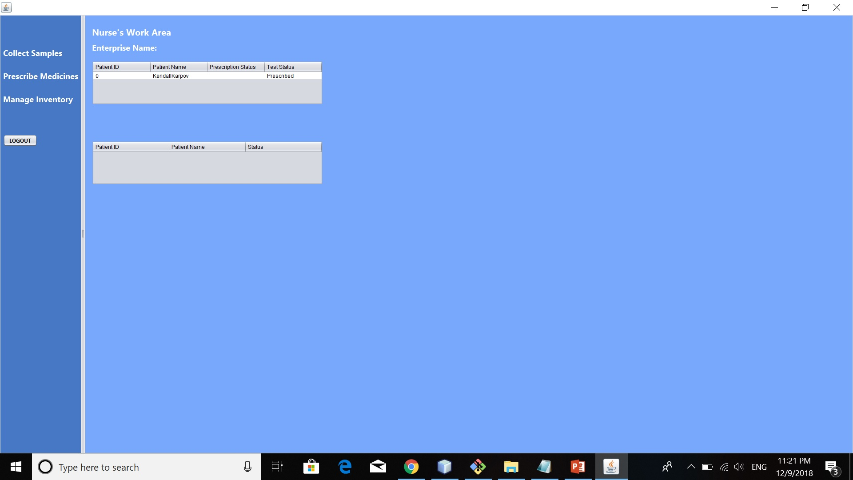
Nurse Role

Slide 16
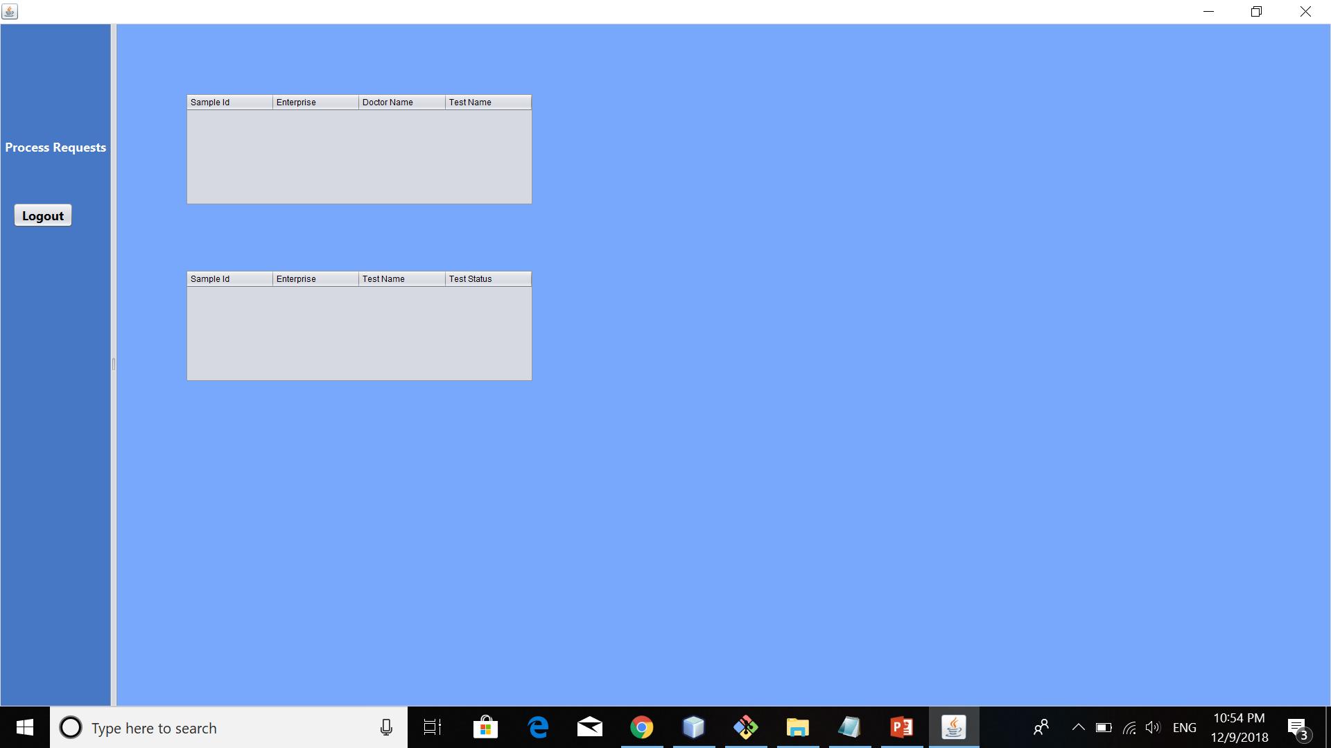
Lab Assistant Role
.

Slide 17
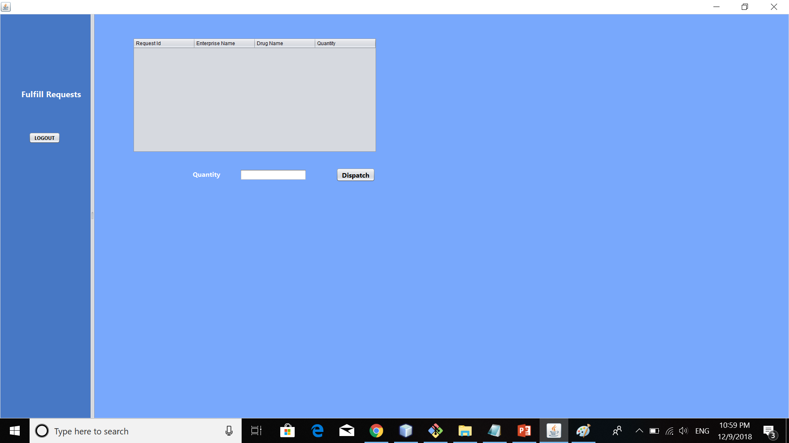
Pharmacist Role

Slide 18
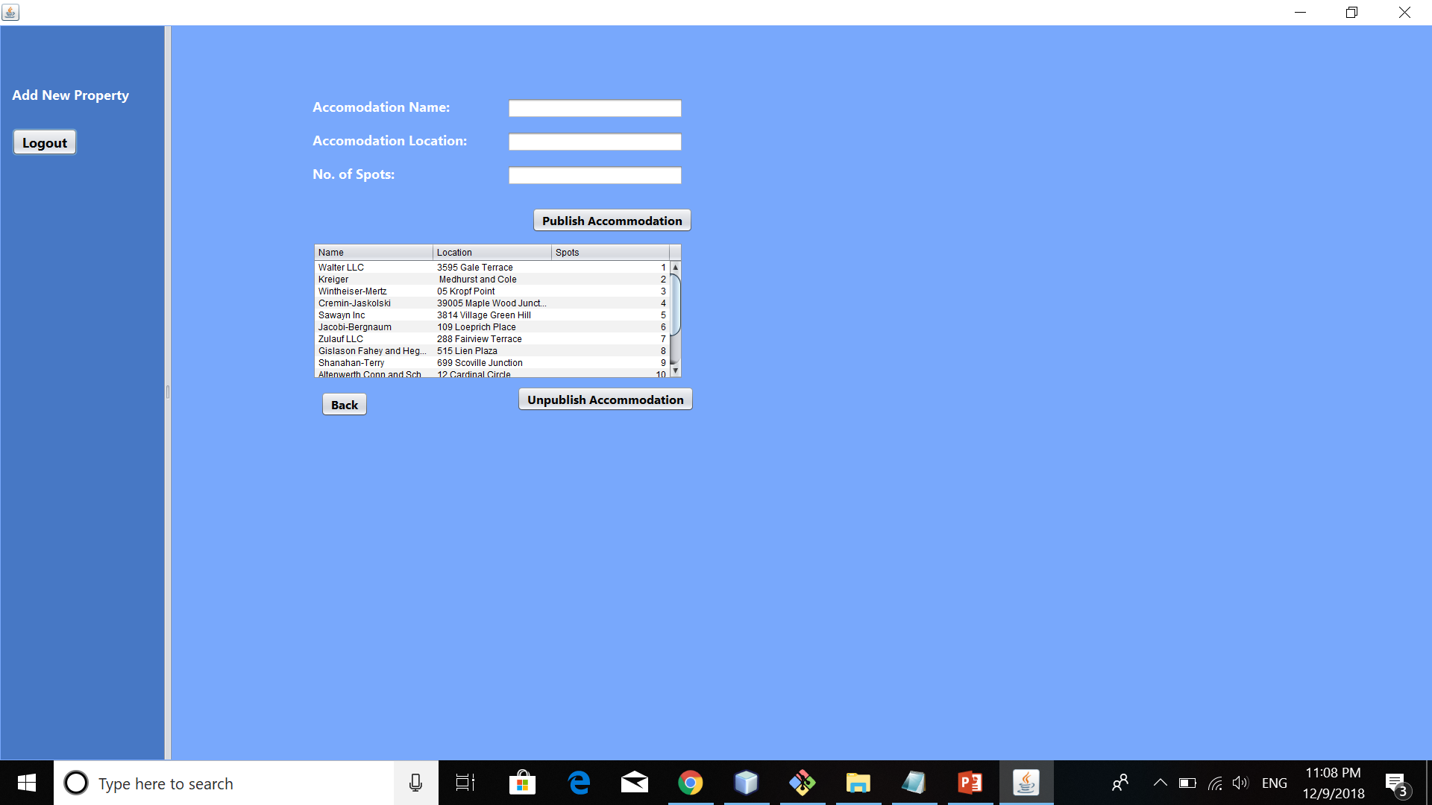
Shelter Home Manager

Slide 19
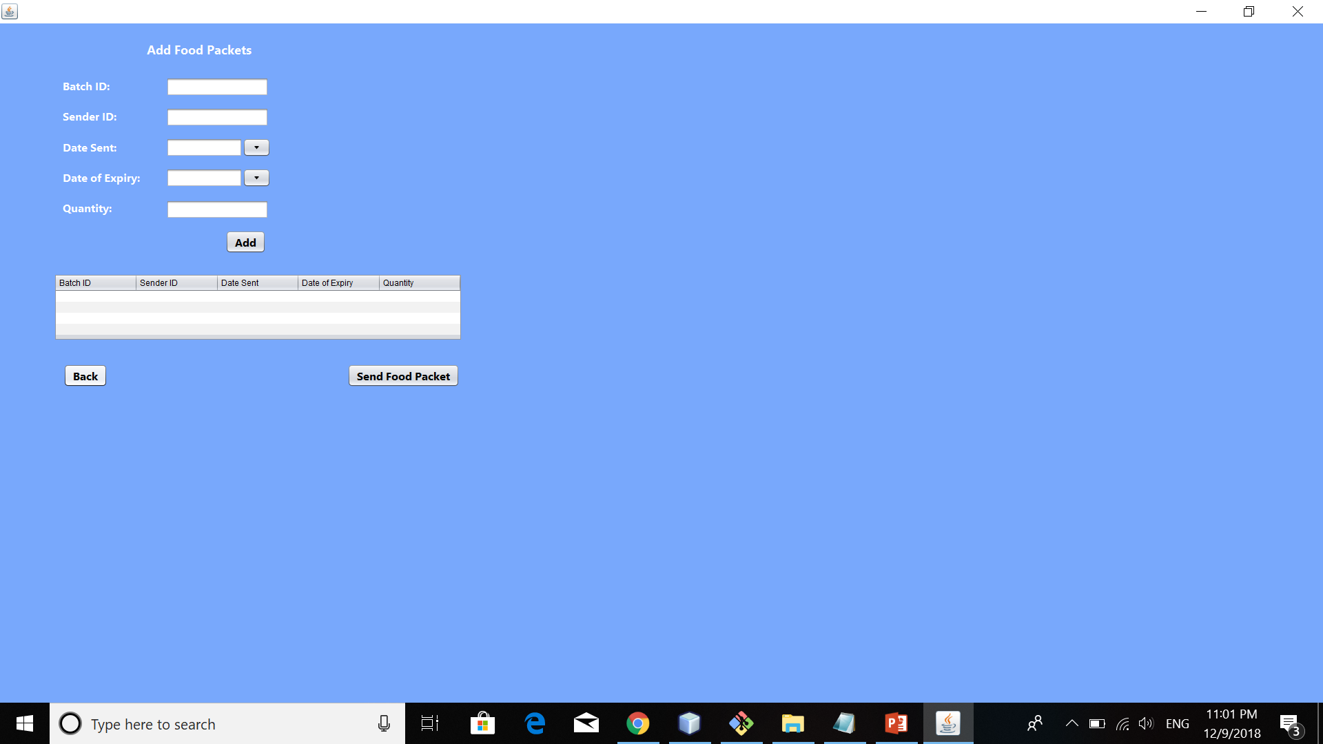
Food Manager Role

Slide 20
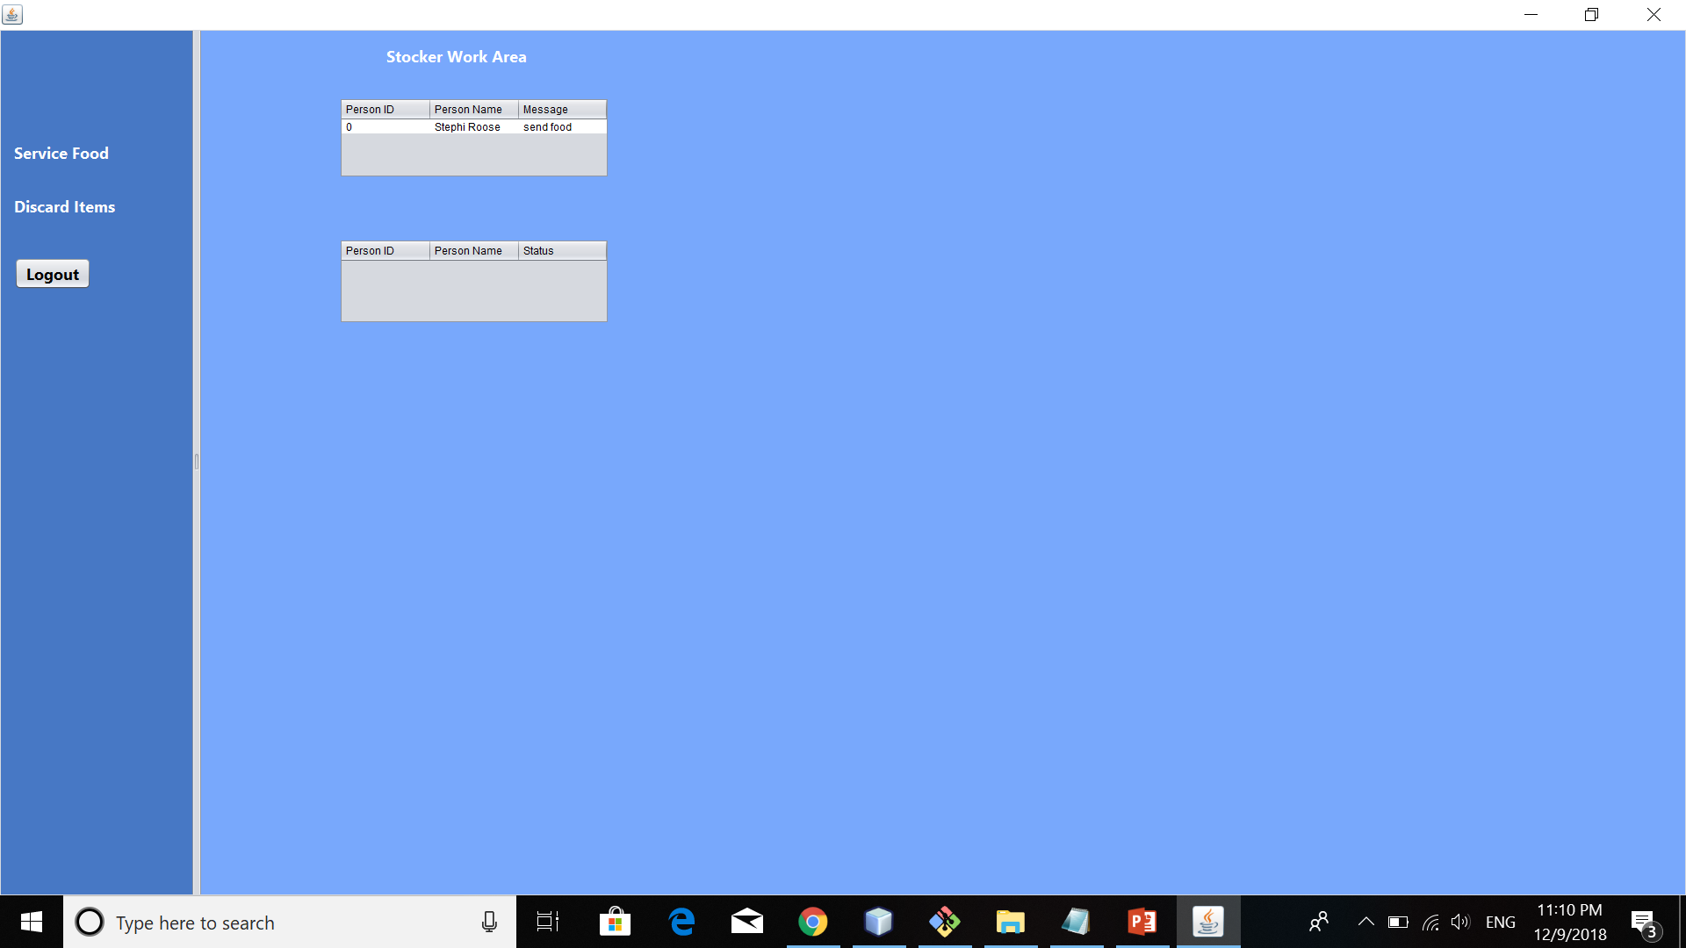
Stocker Role

Slide 21
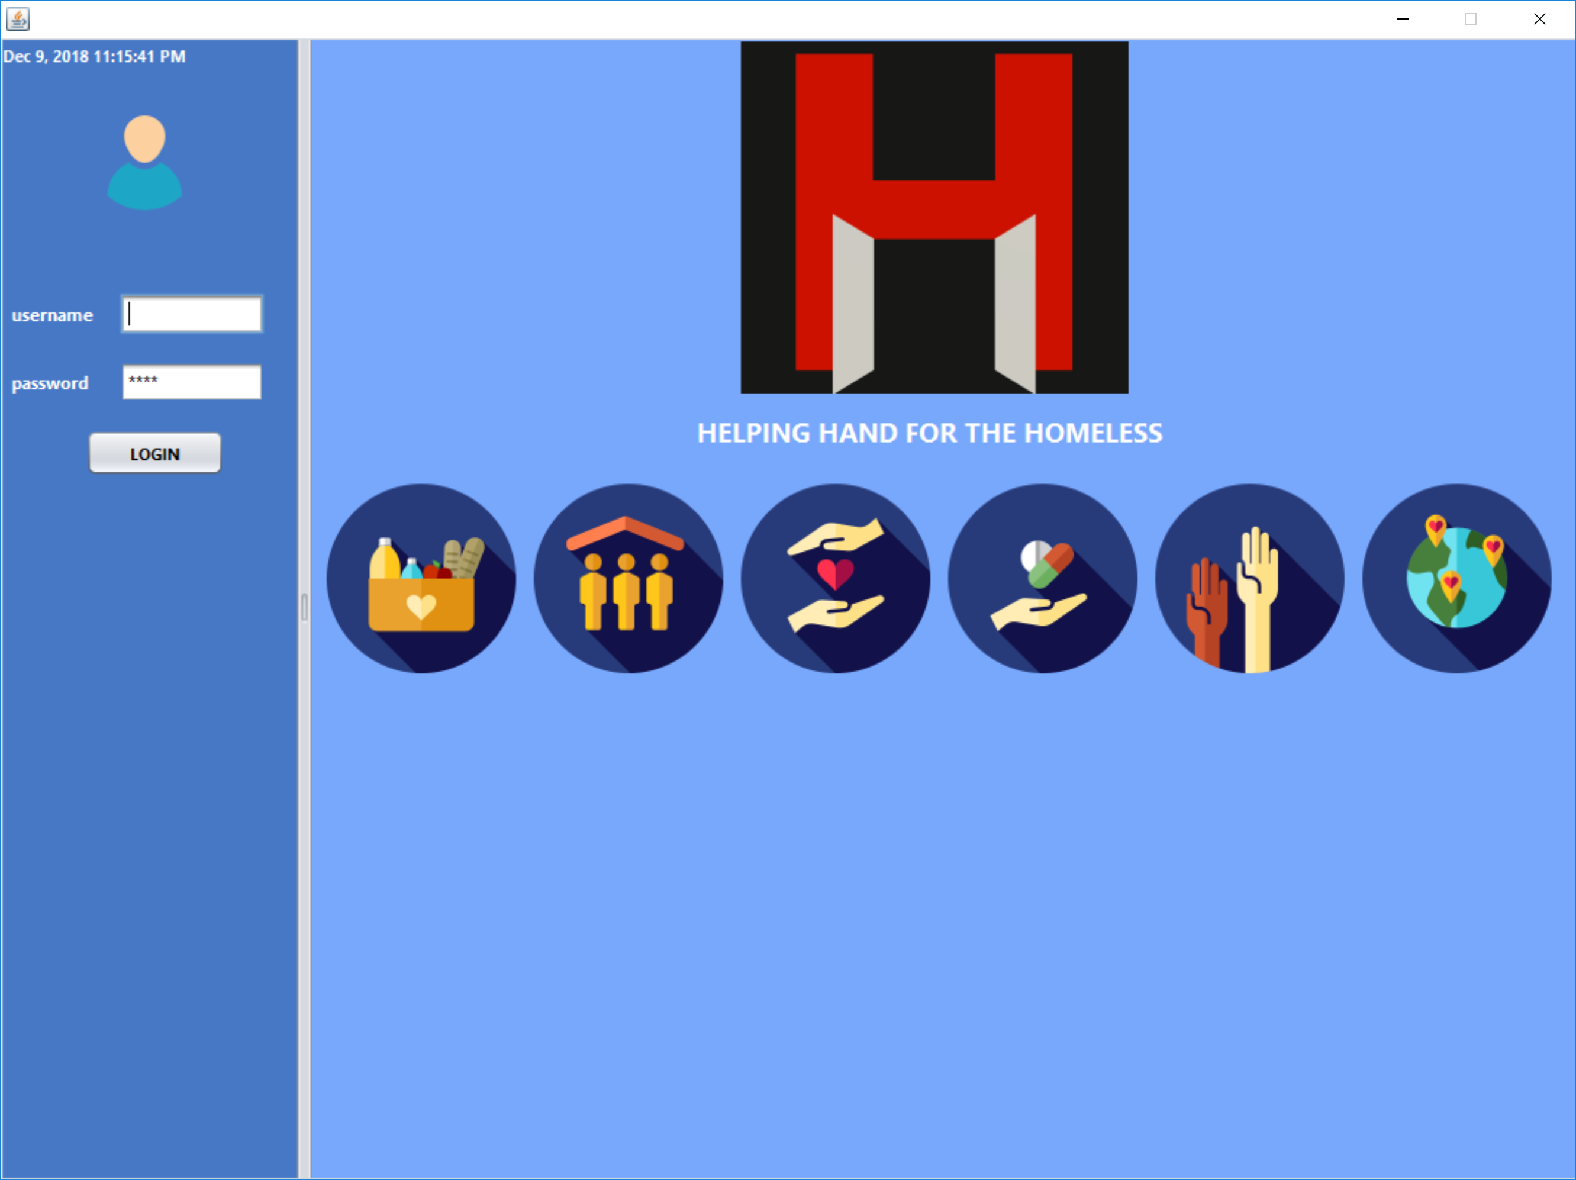
Helping Hand for the Homeless
Show me a demo please?

Slide 22
Thank You!

