Slide 1
AquaGuard AI
Smart Protection System for Three-Phase Agricultural Induction Motors
N. Anirudh
V. Ranjith Kumar
A. Karthik
R. Mahesh Babu
ESP32
ACS712 x3
ZMPT101B
HC-SR04
I2C LCD
WiFi Dashboard

Slide 2
Contents
01
Abstract
08
Fault Discrimination Algorithm
02
Introduction
09
System Operation Flowchart
03
Problem Statement
10
Hardware & Software Description
04
Motivation / Research Gap
11
Results & Discussion
05
Literature Survey
12
Conclusion & Future Scope
06
Objectives
13
References
07
System Design & Methodology
AquaGuard AI | Smart Borewell Motor Protection System
2

Slide 3
Abstract
AquaGuard AI is an ESP32-based smart borewell monitoring and motor protection system for 415V three-phase induction motors. Three ACS712 current sensors and a ZMPT101B voltage sensor continuously compute phase-wise RMS current and voltage, applying adaptive thresholds and Trip Delay Logic to distinguish genuine faults from normal startup inrush transients — preventing nuisance tripping.
An HC-SR04 ultrasonic sensor provides real-time water level monitoring for dry-run prevention and borewell recovery tracking. On fault detection, a relay-driven contactor disconnects the motor; the system automatically restarts once conditions stabilise for 30 seconds, with repeated failures triggering a safety lockout.
Status is displayed locally on a 16×2 I2C LCD with buzzer alerts, and remotely via a WiFi cloud dashboard or offline hotspot at 192.168.4.1 (SSID: AquaGuard_AI). This solution provides Indian farmers with a low-cost, intelligent platform protecting borewell motors and conserving water.
Adaptive RMS Thresholds
Trip Delay Logic
Auto-Restart
Water Level Monitoring
Dual-Mode Connectivity
AquaGuard AI | Smart Borewell Motor Protection System
3

Slide 4
Introduction
Three-phase induction motors power borewell and submersible pumps across rural India, but unstable rural power grids and lack of water-level visibility lead to motor burnout, dry-running, and water wastage.
AquaGuard AI combines an ESP32-based water level and motor health monitoring system with an intelligent multi-layered fault discrimination algorithm for three-phase motor protection.
Continuously measures phase currents (ACS712), supply voltage (ZMPT101B), and water level (HC-SR04) to protect against phase loss, overload, dry-run, under-voltage, and over-voltage conditions.
Conventional approaches using single-function relays or fixed-threshold microcontrollers cannot adapt to startup inrush transients, cause nuisance tripping, and provide no water-level visibility or remote access.
AquaGuard AI directly addresses these gaps by providing an integrated, adaptive, and remotely accessible protection and monitoring platform tailored to Indian agricultural users.
AquaGuard AI | Smart Borewell Motor Protection System
4

Slide 5
Problem Statement
01
Motor Vulnerability
03
No Remote Access
Rural power suffers frequent voltage fluctuations, phase loss, and overloads — causing overheating and insulation damage. Fixed-threshold relays cause nuisance tripping or miss genuine faults.
Farmers must be physically present to assess motor status — impractical in large farms. Most deployed systems offer no remote visibility or control.
02
Dry-Run Risk
04
No Integrated Solution
Submersible pumps run dry due to no borewell water-level visibility, causing severe pump and winding damage. No low-cost system integrates water intelligence with motor protection.
Existing systems are motor-protection-only or water-monitoring-only. No affordable unified platform exists. SCADA systems cost lakhs and are impractical for small farms.
AquaGuard AI | Smart Borewell Motor Protection System
5

Slide 6
Literature Survey
Singh & Verma (2019)
Relay-based single-fault protection — simple but cannot handle combined faults or startup inrush transients.
Sharma et al. (2020)
IoT water-level indicator — provides remote alerts but decoupled from motor protection; no automatic control.
Kumar & Reddy (2021)
Voltage-based under/over protection — fast voltage-fault response but ignores phase current correlation.
Patel et al. (2022)
Microcontroller motor guard — low-cost single-fault protection but lacks adaptive RMS thresholding and dry-run detection.
Rajan & Nair (2023)
IoT motor monitoring dashboard — improved visibility but no auto-restart, local fallback, or water-level integration.
Research Gap:
No existing system integrates phase-wise RMS discrimination, adaptive trip-delay, HC-SR04 water intelligence, auto-restart, and dual-mode connectivity in a single low-cost ESP32 platform. AquaGuard AI addresses this gap.
AquaGuard AI | Smart Borewell Motor Protection System
6

Slide 7
Objectives
01
Design an ESP32-based system that continuously monitors three-phase current, voltage, and borewell water level in real time.
02
Implement adaptive RMS-based fault discrimination distinguishing genuine faults (phase loss, overload, dry-run, under/over-voltage) from startup inrush transients.
03
Provide automatic conditional restart after fault clearance and grid stabilisation, with safety lockout for repeated faults.
04
Enable local monitoring through a 16×2 I2C LCD and buzzer, and remote monitoring via cloud and offline hotspot dashboard.
05
Deliver a low-cost, farmer-friendly solution protecting motor health and conserving water in agricultural irrigation systems.
06
Log fault events sequentially for maintenance planning and historical analysis.
AquaGuard AI | Smart Borewell Motor Protection System
7

Slide 8
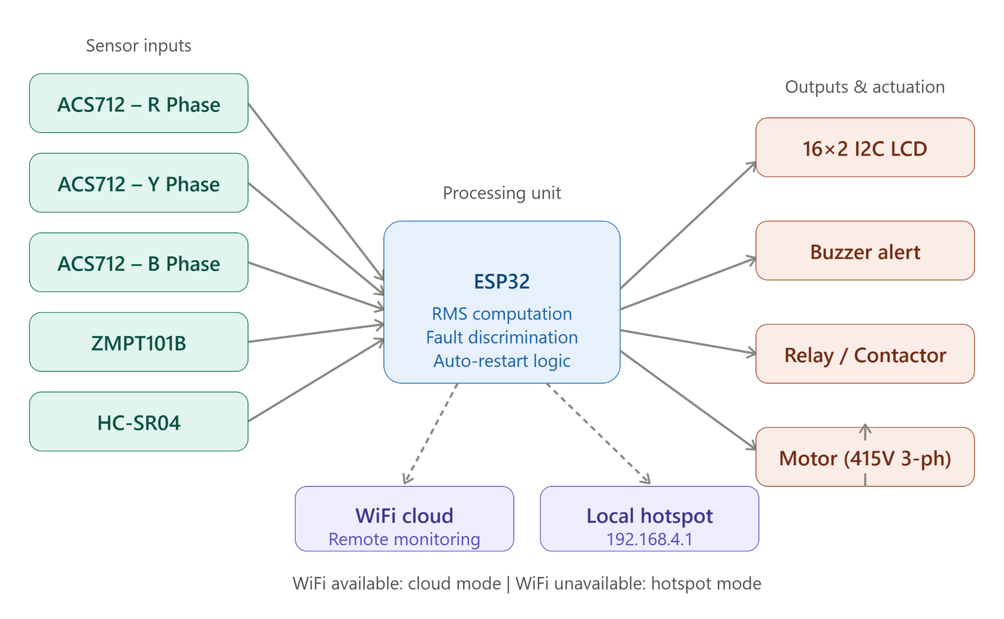
System Design & Methodology
Central Unit:
ESP32 DevKit V1 — 240 MHz dual-core, built-in WiFi, sensing + fault control
Current Sensing:
3× ACS712 (20A) on R, Y, B phases — Hall-effect, 100 mV/A sensitivity
Voltage Sensing:
ZMPT101B — isolated transformer, safe 0–3.3V analog output for ESP32 ADC
Water Level:
HC-SR04 ultrasonic — measures distance to water; computes height, %, volume
Local Output:
16×2 I2C LCD (3 rotating screens) + active buzzer for audible fault alerts
Motor Switch:
Active-LOW relay + magnetic contactor for 415V three-phase isolation
Connectivity:
WiFi cloud dashboard (primary) or AquaGuard_AI hotspot at 192.168.4.1
AquaGuard AI | Smart Borewell Motor Protection System
8

Slide 9
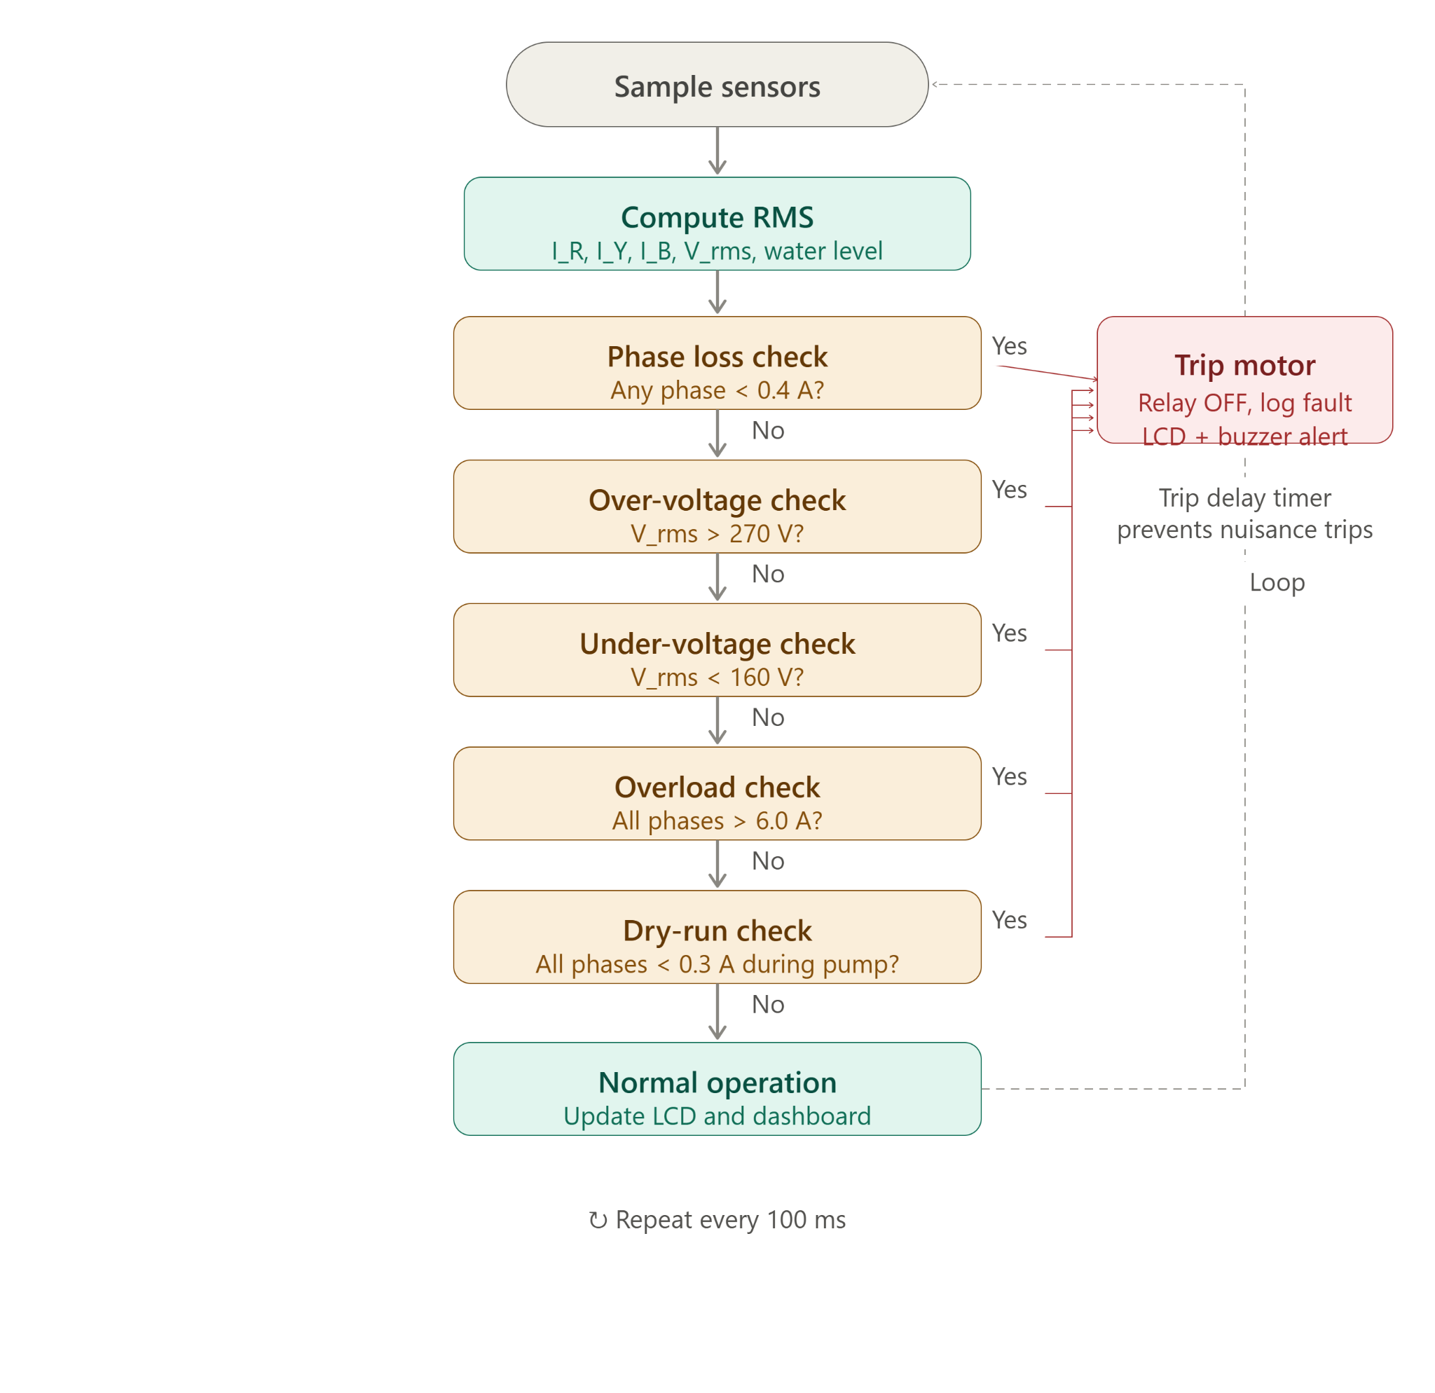
Fault Discrimination Algorithm
Priority Order → Evaluation Sequence
1
Phase Loss
100 ms
Any phase I_RMS < 0.4A
2
Over-Voltage
500 ms
V_RMS > 270V
3
Under-Voltage
500 ms
V_RMS < 160V
4
Overload
500 ms
All phases I_RMS > 6.0A
5
Dry-Run
3.5 s
All phases I_RMS < 0.3A
⟳ Auto-restart after 30 s stable | Safety lockout after 3 consecutive faults
AquaGuard AI | Smart Borewell Motor Protection System
9

Slide 10
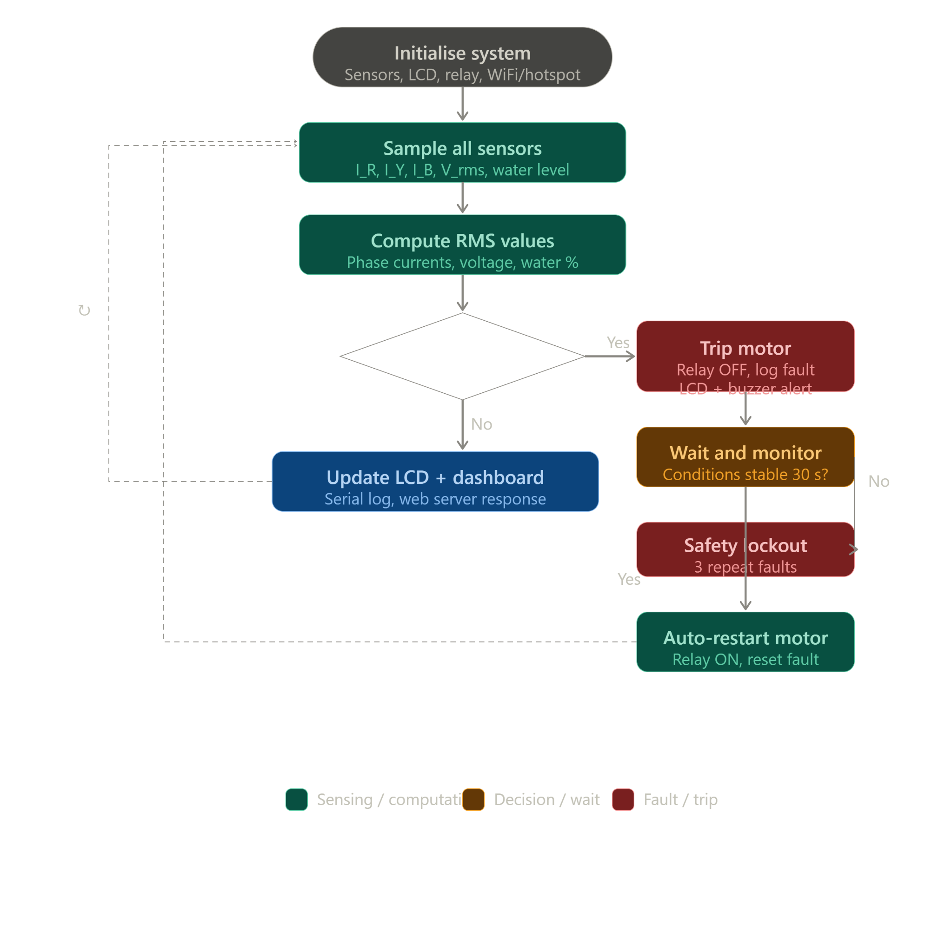
System Operation Flowchart
01
Initialise
Sensors, LCD, relay (motor ON), WiFi/hotspot, web server
02
Sample
R, Y, B currents at 2 kHz + voltage; water level at 1 Hz
03
Compute RMS
Phase-wise I_RMS over 20ms window; V_RMS; water height, %, volume
04
Evaluate
Fault conditions in priority order: Phase Loss → OV → UV → OL → Dry-Run
05
Trip / Clear
If fault persists beyond trip-delay: relay OFF, log fault, alert LCD + buzzer
06
Auto-Restart
30 s stable → restart motor; 3 faults → safety lockout
AquaGuard AI | Smart Borewell Motor Protection System
10

Slide 11
Hardware & Software Description
HARDWARE
SOFTWARE
ESP32 DevKit V1
240 MHz dual-core, 520KB SRAM, WiFi/BT
Arduino IDE 2.x
ESP32 firmware development in C/C++
ACS712 (20A) ×3
Hall-effect current sensing, 100 mV/A, 5V
LiquidCrystal_I2C
LCD control via I2C interface
ZMPT101B
Isolated AC voltage sensor, 0–3.3V output
ESPAsyncWebServer
Offline hotspot HTTP dashboard
HC-SR04
Ultrasonic water level, 2–400 cm range
Blynk / ThingSpeak
WiFi cloud remote monitoring
16×2 I2C LCD (0x27)
Local status, 3 rotating screens
ACS712 RMS Library
Phase current computation
Relay + Contactor
Active-LOW; 415V three-phase isolation
ZMPT101B Driver
Calibrated AC voltage sensing
Buzzer
Audible fault alert on GPIO 26
HC-SR04 Lib
Distance → water % → volume calc
AquaGuard AI | Smart Borewell Motor Protection System
11

Slide 12

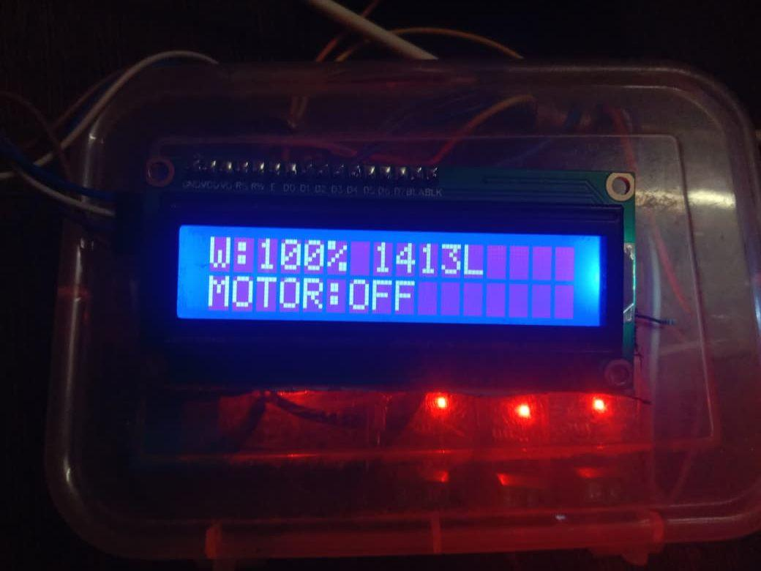
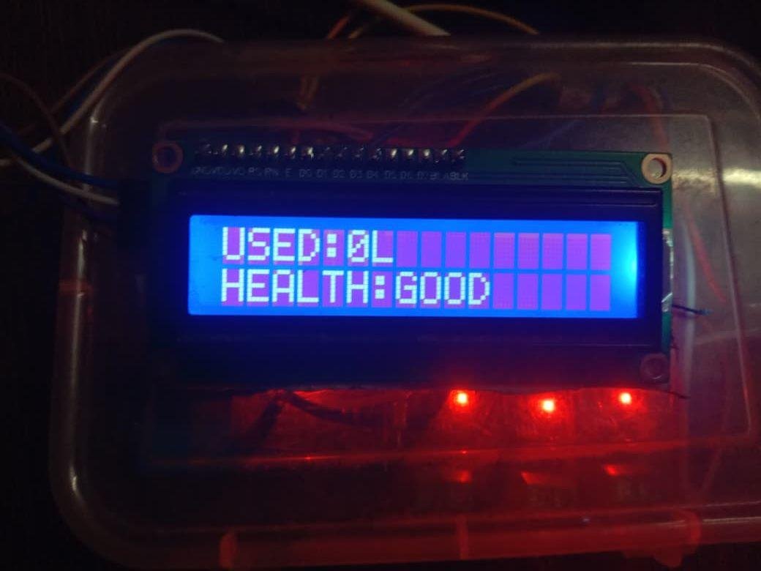
Results & Discussion
All 7 test scenarios PASSED ✓
Phase Loss
R-phase open-circuited
1.2 s
Overload
150% rated current
2.0 s
Dry-Run
Auto-restart blocked till water
3.5 s
Under-Voltage
Supply at 150V AC
0.8 s
Over-Voltage
Supply at 285V AC
0.8 s
Normal Startup
300% inrush for ~800ms
No trip
Auto-Restart
30s stable conditions
✓
Water Level Accuracy: within 2% error across full range (0–100%)
AquaGuard AI | Smart Borewell Motor Protection System
12

Slide 13
Conclusion & Future Scope
Conclusion
AquaGuard AI successfully demonstrates that a single low-cost ESP32-based platform can integrate adaptive RMS-based three-phase fault discrimination, HC-SR04 water-level intelligence, automatic conditional restart, dual-mode connectivity, and local display. All seven fault detection scenarios passed with no nuisance trips. The system provides Indian farmers with an intelligent, affordable alternative to expensive SCADA systems.
Future Scope
GSM/4G integration for connectivity in areas without WiFi coverage
Solar-powered operation for remote off-grid borewell installations
AI/ML-based predictive maintenance using historical fault logs
Multi-motor management from a single centralised cloud dashboard
Soil moisture sensing integration for comprehensive agricultural IoT platform
AquaGuard AI | Smart Borewell Motor Protection System
13

Slide 14
References
[1]
Singh, R. & Verma, A. (2019). Review of relay-based motor protection for agricultural applications. IJEE, 12(3), 45–52.
[2]
Sharma, P. et al. (2020). IoT-based borewell water-level indicator system. IJCA, 8(4), 23–29.
[3]
Kumar, S. & Reddy, K. (2021). Voltage-based protection for induction motors in rural feeders. IJEEE, 9(2), 78–85.
[4]
Patel, M. et al. (2022). Microcontroller-based motor guard system for agricultural pumps. IJECS, 11(1), 34–41.
[5]
Rajan, T. & Nair, S. (2023). IoT-based motor monitoring dashboard using ESP32. IJIOT, 5(3), 102–109.
[6]
Benbouzid, M.E.H. (2000). Review of induction motor signature analysis as a medium for faults detection. IEEE Trans. Ind. Electron., 47(5), 984–993.
[7]
Gubbi, J. et al. (2013). Internet of Things (IoT): A vision, architectural elements, and future directions. Future Gen. Comput. Syst., 29(7), 1645–1660.
[8]
Goap, A. et al. (2018). An IoT-based smart irrigation management system using machine learning. Computers and Electronics in Agriculture, 155, 41–49.
AquaGuard AI | Smart Borewell Motor Protection System
14

Slide 15
Thank You
AquaGuard AI — Smart Protection System for Three-Phase Agricultural Induction Motors
N. Anirudh
V. Ranjith Kumar
A. Karthik
R. Mahesh Babu

