Slide 1
ONE STOP SOLUTION FOR INFORMATION ON INSTITUTIONS FOR THE PEOPLE WITH SPECIAL NEEDS.
Team members: Anirudh u parvatikar, Sarvesh M
Guide: DR. M SRIDEVI
Date:8-07-2023

Slide 2
Introduction
Problem statement-
One stop solution for all help required for people with special needs.
Objectives/Features-
It provides platform consisting of all information that will be required for people in need.
Targeted beneficiaries (user description)-
This website is made to be beneficial to the people who are differently abled.

Slide 3
Existing System
The current system heavily relies on word-of-mouth and personal connections to obtain information. There are only a limited number of portals that offer information about the services available to people in need.
The problems of this system are:
Fragmented Information: Information is scattered across various platforms, making it difficult to find comprehensive and up-to-date information.
Lack of centralized database: There is no centralized and easily accessible database with comprehensive details of institutions, leading to inefficiency and confusion in finding suitable options.
Lack of User Reviews and Feedback: Absence of a platform for sharing and accessing user reviews and feedback hinders informed decision-making.

Slide 4
Proposed System
We both plan to propose a place in internet where all the information can be found in 1 place irrespective of the domain of problem.
Types of domain where people might find It difficult to approach are:
Finding school for people with special needs.
Finding place to provide therapy sessions to the needed one.
Finding recreational places for people who are differently abled.
Finding place of support group for people in need.

Slide 5
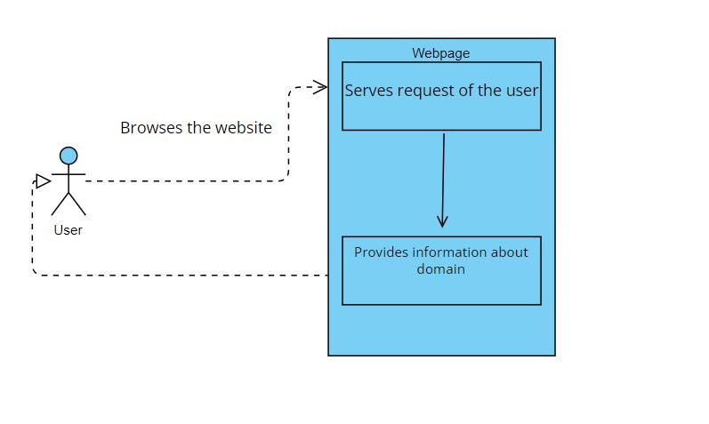
System Architecture

Slide 6
Functional Requirements
centralized database
Search and filtering
Detailed institution profiles
Communication channels

Slide 7
Tools/Technologies
Browsers: chrome, Firefox, Safari
languages used:
frontend- html, css , javascript
software used- visual studio code
Operating system- windows 7 or above

Slide 8
Conclusion
In conclusion, the implementation of a one-stop solution for information on institutions for people with special needs can address the existing challenges and bring numerous benefits. By centralizing and organizing comprehensive information, providing robust search and filtering capabilities, incorporating user reviews, and emphasizing accessibility information, this solution empowers individuals and caregivers to make informed decisions. It saves time, enhances accessibility, promotes inclusivity, and fosters seamless communication between all stakeholders. With a user-friendly interface and multi-language support, it ensures that everyone can access the information they need.

