Slide 1

Your pitch time is for 10 Mins.
This included 7 mins of presentation and 3 mins of Q&A.
The presentation will be in person
Keep it crisp, clear and concise.
Demo is mandatory. (Video or Live demo)
After pitch, there will be questions from Jury.

Slide 2

Team Name :BMSIT MCA
Problem Statement :Financial Inclusion in Remote Areas: Digital Financial Services for Unconnected Regions

Slide 3
Brief about the Idea
The Idea is to create a mobile application which is based on both internet and SMS communication.
The main goal is to create a user friendly Mobile Application which can be useful for the people from rural areas to perform financial transactions.
The User Interface is simple yet self explanatory which even people without literacy can easily access.
The remote villages will be divided into nodal points and each point will have it’s own database. This database will be used to update the transactions on an hourly basis.
The Mobile Application will be able to update the transaction history every hour assuming that 15 minutes of internet might be available at that certain point in time since there are connectivity issues in rural areas.
If we are not able to access internet over a period of time(say 2 hours) the Mobile Application will be updating the transaction details through the SMS feature available in the application

Slide 4
Opportunity :
Our project aims at the problem of connectivity in rural areas through two paths.
Internet communication is utilized when there is availability of network.
SMS communication is used when Internet Communication is not available for a prolongated period of time.
When it comes to useability, a user friendly UI with simple symbols that represent the functionalities offered in a simple and easy to understand manner.
Although Internet Communication and SMS Communication exists on their own, we are trying to bring the two worlds together in order to increase efficiency.

Slide 5
List of features offered by the solution :
Internet Connectivity
SMS Connectivity
Nodal databases
User friendly UI

Slide 6
Proposed Solution

Slide 7
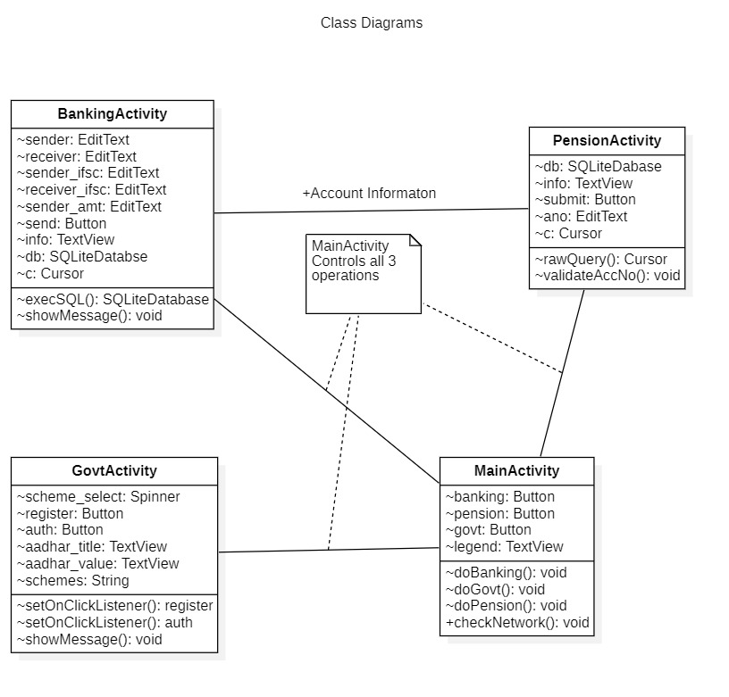
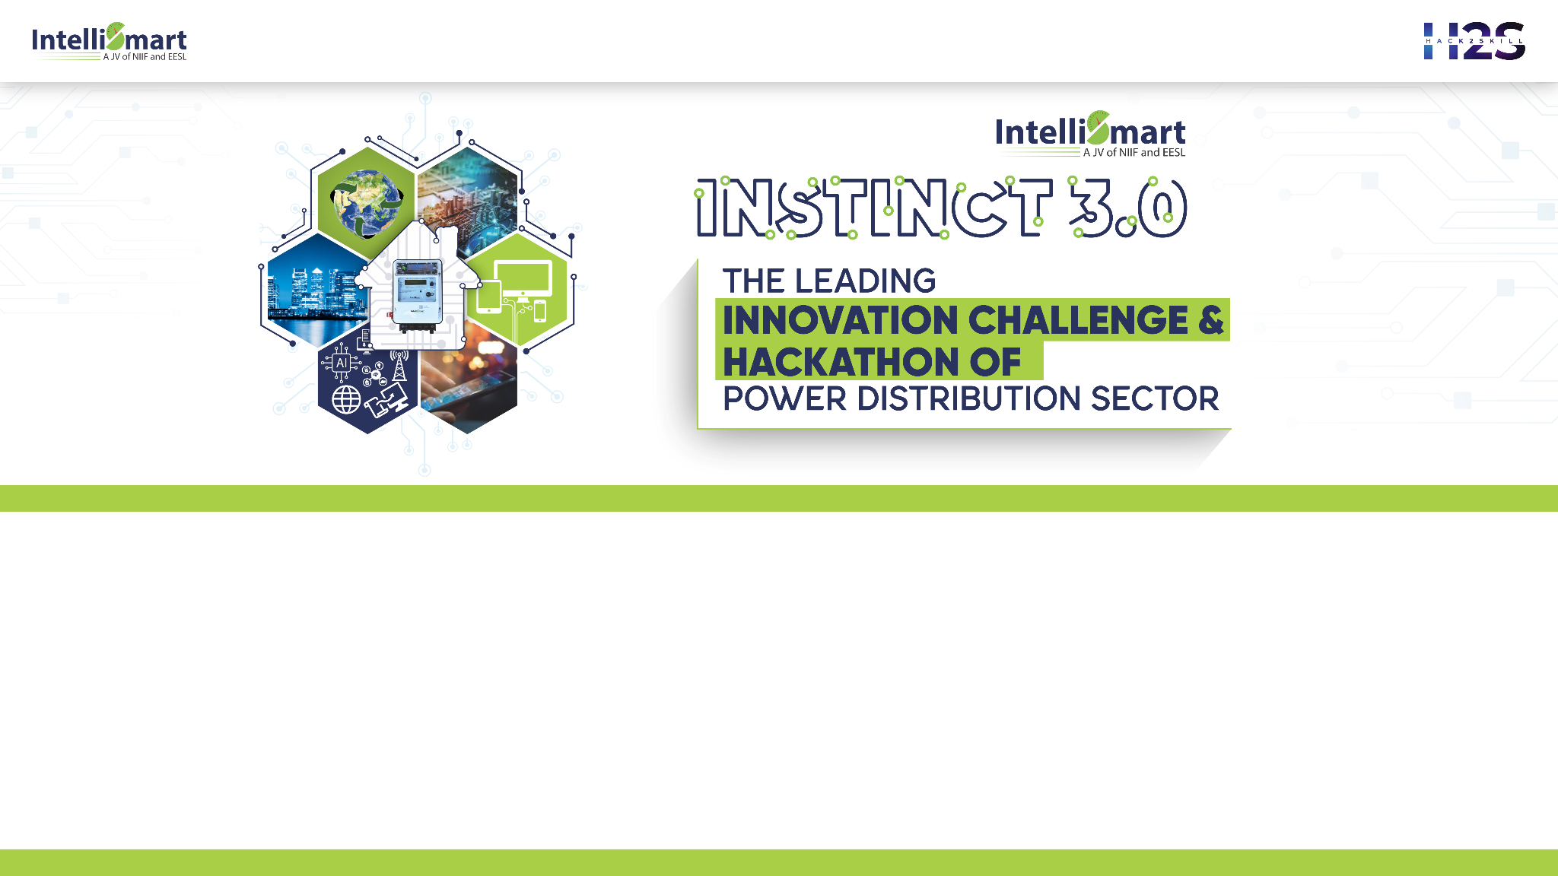
Class Diagram

Slide 8
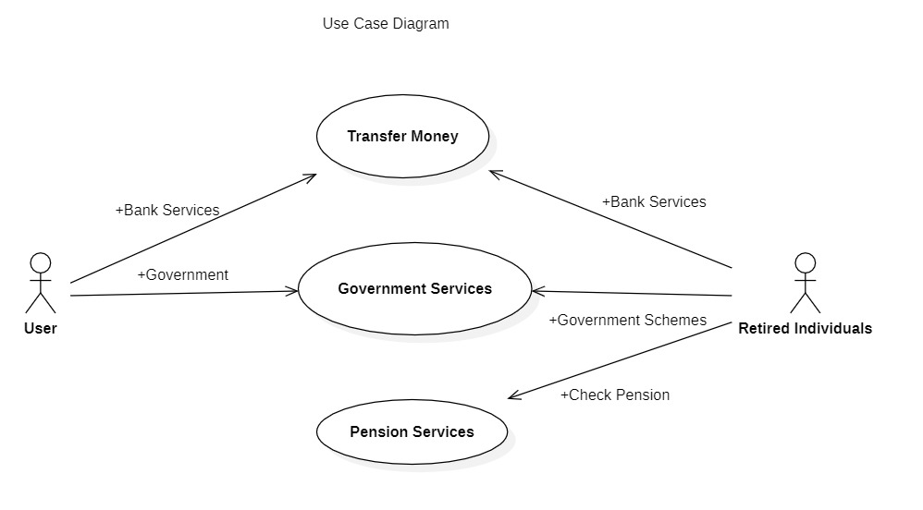
Use case Diagram

Slide 9
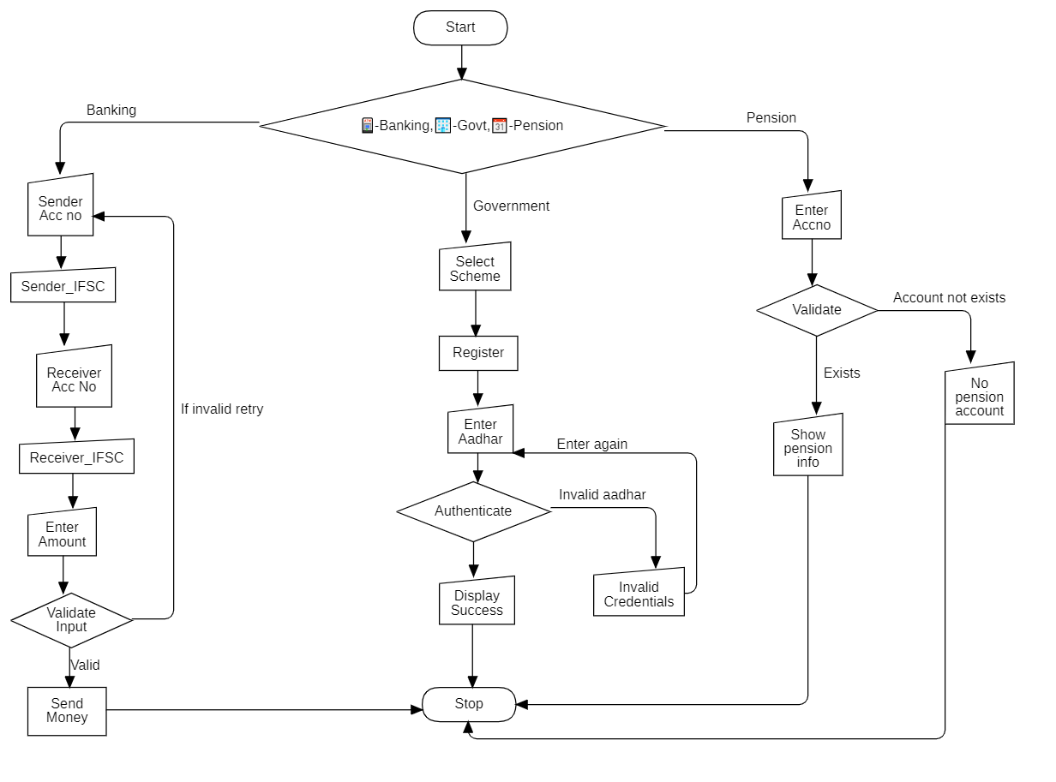
Flow chart of process

Slide 10
Architecture

Slide 11
Business Logic of the solution :

Slide 12
Technology used :

Slide 13
Estimated cost of/after implementing the solution :

Slide 14
Demo Video/Live Demo

Slide 15
GitHub Link (Codes should be public and available after hackathon also)

Slide 16
Results Summary

Slide 17


