Slide 1
Module-3
Research Design

Slide 2
Topics to be Covered
Meaning of Research Design,
Need for Research Design,
Features of a Good Design,
Important Concepts Relating to Research Design,
Different Research Designs,
Design of Sample Surveys:

Slide 3
Meaning of Research Design
Decisions regarding what, where, when, how much, by what means concerning an inquiry or a research study constitute a research design.
“A research design is the arrangement of conditions for collection and analysis of data in a manner that aims to combine relevance to the research purpose with economy in procedure.”
In fact, the research design is the conceptual structure within which research is conducted; it constitutes the blueprint for the collection, measurement and analysis of data.
As such the design includes an outline of what the researcher will do from writing the hypothesis and its operational implications to the final analysis of data.

Slide 4
More explicitly, the design decisions happen to be in respect of:
(i) What is the study about?
(ii) Why is the study being made?
(iii) Where will the study be carried out?
(iv) What type of data is required?
(v) Where can the required data be found?
(vi) What periods of time will the study include?
(vii) What will be the sample design?
(viii) What techniques of data collection will be used?
(ix) How will the data be analysed?
(x) In what style will the report be prepared?

Slide 5
Keeping in view the above stated design decisions, one may split the overall research design into the following parts:
(a) the sampling design which deals with the method of selecting items to be observed for the given study;
(b) the observational design which relates to the conditions under which the observations are to be made;
(c) the statistical design which concerns with the question of how many items are to be observed and how the information and data gathered are to be analysed; and
(d) the operational design which deals with the techniques by which the procedures specified in the sampling, statistical and observational designs can be carried out.

Slide 6
The important features of a research design as under:
(i) It is a plan that specifies the sources and types of information relevant to the research problem.
(ii) It is a strategy specifying which approach will be used for gathering and analysing the data.
(iii) It also includes the time and cost budgets since most studies are done under these two constraints.

Slide 7
In brief, research design must, at least, contain—
(a) a clear statement of the research problem;
(b) procedures and techniques to be used for gathering information;
(c) the population to be studied; and
(d) methods to be used in processing and analysing data.

Slide 8
Need for Research Design
Research design is needed because it facilitates the smooth sailing of the various research operations, thereby making research as efficient as possible yielding maximal information with minimal expenditure of effort, time and money.
For Example: Economical and attractive construction of a house, we need a blueprint (or what is commonly called the map of the house) well thought out and prepared by an expert architect,
Research design stands for advance planning of the methods to be adopted for collecting the relevant data and the techniques to be used in their analysis, keeping in view the objective of the research and the availability of staff, time and money.
Preparation of the research design should be done with great care as any error in it may upset the entire project.

Slide 9
Features of a Good Design,
The design which minimises bias and maximises the reliability of the data collected and analysed is considered a good design. The design which gives the smallest experimental error is supposed to be the best design in many investigations.
Similarly, a design which yields maximal information and provides an opportunity for considering many different aspects of a problem is considered most appropriate and efficient design in respect of many research problems.
One single design cannot serve the purpose of all types of research problems.

Slide 10
Features of a Good Design continued..,
A research design appropriate for a particular research problem, usually involves the consideration of the following factors:
(i) the means of obtaining information;
(ii) the availability and skills of the researcher and his staff, if any;
(iii) the objective of the problem to be studied;
(iv) the nature of the problem to be studied; and
(v) the availability of time and money for the research work.

Slide 11
Important Concepts Relating to Research Design,
1. Dependent and independent variables:
A concept which can take on different quantitative values is called a variable.
As such the concepts like weight, height, income are all examples of variables.
Qualitative phenomena (or the attributes) are also quantified on the basis of the presence
or absence of the concerning attribute(s). Phenomena which can take on quantitatively different values even in decimal points are called ‘continuous variables’.* But all variables are not continuous. If they can only be expressed in integer values, they are non-continuous variables or in statistical language ‘discrete variables’.** Age is an example of continuous variable, but the number of children is an example of non-continuous variable.

Slide 12
Important Concepts Relating to Research Design continued..
If one variable depends upon or is a consequence of the other variable, it is termed as a dependent variable, and the variable that is antecedent to the dependent variable is termed as an independent variable.
For instance, if we say that height depends upon age, then height is a dependent variable and age is an independent variable.
Similarly, readymade films and lectures are examples of independent variables, whereas behavioural changes, occurring as a result of the environmental manipulations, are examples of dependent variables.

Slide 13
Important Concepts Relating to Research Design continued..2
2. Extraneous variable:
Independent variables that are not related to the purpose of the study, but may affect the dependent variable are termed as extraneous variables.
Suppose the researcher wants to test the hypothesis that there is a relationship between children’s gains in social studies achievement and their self-concepts. In this case self-concept is an independent variable and social studies achievement is a dependent variable. Intelligence may as well affect the social studies achievement, but since it is not related to the purpose of the study undertaken by the researcher, it will be termed as an extraneous variable. Whatever effect is noticed on dependent variable as a result of extraneous variable(s) is technically described as an ‘experimental error’. A study must always be so designed that the effect upon the dependent variable is attributed entirely to the independent variable(s), and not to some extraneous variable or variables.

Slide 14
Important Concepts Relating to Research Design continued..3
3. Control:
One important characteristic of a good research design is to minimise the influence or effect of extraneous variable(s). The technical term ‘control’ is used when we design the study minimising the effects of extraneous independent variables. In experimental researches, the term ‘control’ is used to refer to restrain experimental conditions.

Slide 15
Important Concepts Relating to Research Design continued..4
4. Confounded relationship:
When the dependent variable is not free from the influence of extraneous variable(s), the relationship between the dependent and independent variables is said to be confounded by an extraneous variable(s).

Slide 16
Important Concepts Relating to Research Design continued..5
5. Research hypothesis:
When a prediction or a hypothesised relationship is to be tested by scientific methods, it is termed as research hypothesis. The research hypothesis is a predictive statement that relates an independent variable to a dependent variable. Usually a research hypothesis must contain, at least, one independent and one dependent variable. Predictive statements which are not to be objectively verified or the relationships that are assumed but not to be tested, are not termed research hypotheses.

Slide 17
Important Concepts Relating to Research Design continued..6
6. Experimental and non-experimental hypothesis-testing research:
When the purpose of research is to test a research hypothesis, it is termed as hypothesis-testing research. It can be of the experimental design or of the non-experimental design. Research in which the independent variable is manipulated is termed ‘experimental hypothesis-testing research’ and a research in which an independent variable is not manipulated is called ‘non-experimental hypothesis-testing research’.

Slide 18
Important Concepts Relating to Research Design continued..7
7. Experimental and control groups:
In an experimental hypothesis-testing research when a group is exposed to usual conditions, it is termed a ‘control group’, but when the group is exposed to some novel or special condition, it is termed an ‘experimental group’. In the above illustration, the Group A can be called a control group and the Group B an experimental group. If both groups A and B are exposed to special studies programmes, then both groups would be termed ‘experimental groups.’ It is possible to design studies which include only experimental groups or studies which include both experimental and control groups.

Slide 19
Important Concepts Relating to Research Design continued..8
8. Treatments:
The different conditions under which experimental and control groups are put are usually referred to as ‘treatments’. In the illustration taken above, the two treatments are the usual studies programme and the special studies programme. Similarly, if we want to determine through an experiment the comparative impact of three varieties of fertilizers on the yield of wheat, in that case the three varieties of fertilizers will be treated as three treatments.

Slide 20
Important Concepts Relating to Research Design continued..9
9. Experiment:
The process of examining the truth of a statistical hypothesis, relating to some research problem, is known as an experiment.
For example, we can conduct an experiment to examine the usefulness of a certain newly developed drug.
Experiments can be of two types viz., absolute experiment and comparative experiment.
If we want to determine the impact of a fertilizer on the yield of a crop, it is a case of absolute experiment; but if we want to determine the impact of one fertilizer as compared to the impact of some other fertilizer, our experiment then will be termed as a comparative experiment. Often, we undertake comparative experiments when we talk of designs of experiments.

Slide 21
Important Concepts Relating to Research Design continued..10
10. Experimental unit(s):
The pre-determined plots or the blocks, where different treatments are used, are known as experimental units. Such experimental units must be selected (defined) very carefully.

Slide 22
Different Research Designs
(1) research design in case of exploratory research studies;
(2) research design in case of descriptive and diagnostic research studies, and
(3) research design in case of hypothesis-testing research studies.

Slide 23
1. Research design in case of exploratory research studies:
Exploratory research studies are also termed as formulative research studies. The main purpose of such studies is that of formulating a problem for more precise investigation or of developing the working hypotheses from an operational point of view.
The major emphasis in such studies is on the discovery of ideas and insights.
Generally, the following three methods in the context of research design for such studies are talked about:
(a) the survey of concerning literature;
(b) the experience survey and
(c) the analysis of ‘insight-stimulating’ examples.

Slide 24
2. Research design in case of descriptive and diagnostic research studies:
Descriptive research studies are those studies which are concerned with describing the characteristics of a particular individual, or of a group, whereas diagnostic research studies determine the frequency with which something occurs or its association with something else.
The studies concerning whether certain variables are associated are examples of diagnostic research studies. As against this, studies concerned with specific predictions, with narration of facts and characteristics concerning individual, group or situation are all examples of descriptive research studies.
The research design must make enough provision for protection against bias and must maximise reliability

Slide 25
2. Research design in case of descriptive and diagnostic research studies: continued...
The design in such studies must be rigid and not flexible and must focus attention on the following:
(a) Formulating the objective of the study (what the study is about and why is it being made?)
(b) Designing the methods of data collection (what techniques of gathering data will be adopted?)
(c) Selecting the sample (how much material will be needed?)
(d) Collecting the data (where can the required data be found and with what time period should the data be related?)
(e) Processing and analysing the data.
(f) Reporting the findings.

Slide 26
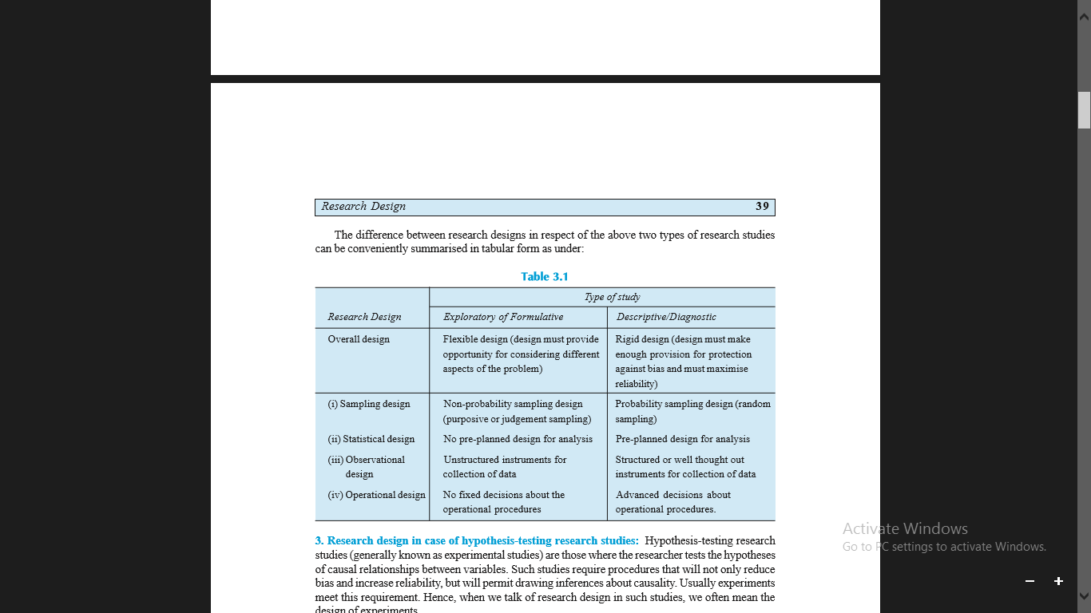

Slide 27
3. Research design in case of hypothesis-testing research studies:
Hypothesis-testing research studies (generally known as experimental studies) are those where the researcher tests the hypotheses of causal relationships between variables.
Such studies require procedures that will not only reduce bias and increase reliability, but will permit drawing inferences about causality. Usually experiments meet this requirement. Hence, when we talk of research design in such studies, we often mean the design of experiments.

Slide 28
Sampling Design
CENSUS AND SAMPLE SURVEY
CENSUS SURVEY:
All items in any field of inquiry constitute a ‘Universe’ or ‘Population.’
A complete enumeration of all items in the ‘population’ is known as a census inquiry.
It can be presumed that in such an inquiry, when all items are covered, no element of chance is left and highest accuracy is obtained.
But in practice this may not be true
Even the government adopts this in very rare cases such as population census conducted once in a decade. Further, many a time it is not possible to examine every item in the population, and sometimes it is possible to obtain sufficiently accurate results by studying only a part of total population. In such cases there is no utility of census surveys.

Slide 29
CENSUS AND SAMPLE SURVEY continued...
SAMPLE SURVEY:
It needs to be emphasised that when the universe is a small one, it is no use resorting to a sample survey. When field studies are undertaken in practical life, considerations of time and cost almost invariably lead to a selection of respondents i.e., selection of only a few items. The respondents selected should be as representative of the total population as possible in order to produce a miniature cross-section.
The selected respondents constitute what is technically called a ‘sample’ and the selection process is called ‘sampling technique.’ The survey so conducted is known as ‘sample survey’.

Slide 30
In General,
Algebraically, let the population size be N and if a part of size n (which is < N) of this population is selected according to some rule for studying some characteristic of the population, the group consisting of these n units is known as ‘sample’. Researcher must prepare a sample design for his study i.e., he must plan how a sample should be selected and of what size such a sample would be.

Slide 31
IMPLICATIONS OF A SAMPLE DESIGN:
A sample design is a definite plan for obtaining a sample from a given population. It refers to the technique or the procedure the researcher would adopt in selecting items for the sample.
Sample design may as well lay down the number of items to be included in the sample i.e., the size of the sample. Sample design is determined before data are collected.
There are many sample designs from which a researcher can choose. Some designs are relatively more precise and easier to apply than others.
Researcher must select/prepare a sample design which should be reliable and appropriate for his research study.

Slide 32
STEPS IN SAMPLE DESIGN
While developing a sampling design, the researcher must pay attention to the following points:
(i) Type of universe:
The first step in developing any sample design is to clearly define the set of objects, technically called the Universe, to be studied. The universe can be finite or infinite. In finite universe the number of items is certain, but in case of an infinite universe the number of items is infinite, i.e., we cannot have any idea about the total number of items. The population of a city, the number of workers in a factory and the like are examples of finite universes, whereas the number of stars in the sky, listeners of a specific radio programme, throwing of a dice etc. are examples of infinite universes.

Slide 33
STEPS IN SAMPLE DESIGN Continued...
(ii) Sampling unit:
A decision has to be taken concerning a sampling unit before selecting sample. Sampling unit may be a geographical one such as state, district, village, etc., or a construction unit such as house, flat, etc., or it may be a social unit such as family, club, school, etc., or it may be an individual. The researcher will have to decide one or more of such units that he has to select for his study.

Slide 34
STEPS IN SAMPLE DESIGN Continued...
(iii) Source list:
It is also known as ‘sampling frame’ from which sample is to be drawn. It contains the names of all items of a universe (in case of finite universe only). If source list is not available, researcher has to prepare it. Such a list should be comprehensive, correct, reliable and appropriate. It is extremely important for the source list to be as representative of the population as possible.

Slide 35
STEPS IN SAMPLE DESIGN Continued...
(iv) Size of sample:
This refers to the number of items to be selected from the universe to constitute a sample. This a major problem before a researcher. The size of sample should neither be excessively large, nor too small. It should be optimum. An optimum sample is one which fulfills the requirements of efficiency, representativeness, reliability and flexibility. While deciding the size of sample, researcher must determine the desired precision as also an acceptable confidence level for the estimate.

Slide 36
STEPS IN SAMPLE DESIGN Continued...
(v) Parameters of interest:
In determining the sample design, one must consider the question of the specific population parameters which are of interest. For instance, we may be interested in estimating the proportion of persons with some characteristic in the population,

Slide 37
STEPS IN SAMPLE DESIGN Continued...
(vi) Budgetary constraint:
Cost considerations, from practical point of view, have a major impact upon decisions relating to not only the size of the sample but also to the type of sample. This fact can even lead to the use of a non-probability sample.

Slide 38
STEPS IN SAMPLE DESIGN Continued...
(vii) Sampling procedure:
Finally, the researcher must decide the type of sample he will use i.e., he must decide about the technique to be used in selecting the items for the sample. In fact, this technique or procedure stands for the sample design itself. There are several sample design out of which the researcher must choose one for his study.
Obviously, he must select that design which, for a given sample size and for a given cost, has a smaller sampling error.

Slide 39
CRITERIA OF SELECTING A SAMPLING PROCEDURE
one must remember that two costs are involved in a sampling analysis viz., the cost of collecting the data and the cost of an incorrect inference resulting from the data.
Researcher must keep in view the two causes of incorrect inferences viz., systematic bias and sampling error. A systematic bias results from errors in the sampling procedures, and it cannot be reduced or eliminated by increasing the sample size.
At best the causes responsible for these errors can be detected and corrected.
Usually a systematic bias is the result of one or more of the following factors:

Slide 40
CRITERIA OF SELECTING A SAMPLING PROCEDURE continued..
1. Inappropriate sampling frame: If the sampling frame is inappropriate i.e., a biased representation of the universe, it will result in a systematic bias.
2. Defective measuring device: If the measuring device is constantly in error, it will result in systematic bias. In survey work, systematic bias can result if the questionnaire or the interviewer is biased. Similarly, if the physical measuring device is defective there will be systematic bias in the data collected through such a measuring device.

Slide 41
CRITERIA OF SELECTING A SAMPLING PROCEDURE continued..
3. Non-respondents:
If we are unable to sample all the individuals initially included in the sample, there may arise a systematic bias. The reason is that in such a situation the likelihood of establishing contact or receiving a response from an individual is often correlated with the measure of what is to be estimated.

Slide 42
CRITERIA OF SELECTING A SAMPLING PROCEDURE continued..
4. Indeterminancy principle:
Sometimes we find that individuals act differently when kept under observation than what they do when kept in non-observed situations. For instance, if workers are aware that somebody is observing them in course of a work study on the basis of which the average length of time to complete a task will be determined and accordingly the quota will be set for piece work, they generally tend to work slowly in comparison to the speed with which they work if kept unobserved. Thus, the indeterminancy principle may also be a cause of a systematic bias.

Slide 43
CRITERIA OF SELECTING A SAMPLING PROCEDURE continued..
5. Natural bias in the reporting of data:
Natural bias of respondents in the reporting of data is often the cause of a systematic bias in many inquiries. There is usually a downward bias in the income data collected by government taxation department, whereas we find an upward bias in the income data collected by some social organisation. People in general understate their incomes if asked about it for tax purposes, but they overstate the same if asked for social status or their affluence. Generally in psychological surveys, people tend to give what they think is the ‘correct’ answer rather than revealing their true feelings.

Slide 44
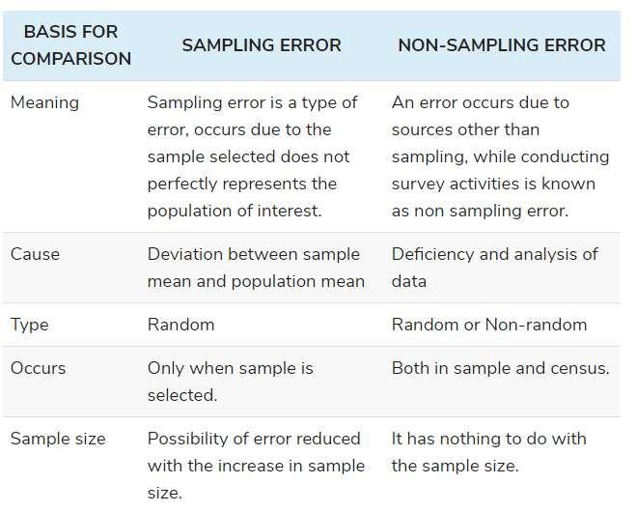
Sampling and Non-sampling Errors
Reference: https://keydifferences.com/difference-between-sampling-and-non-sampling-error.html
https://keydifferences.com/difference-between-sampling-and-non-sampling-error.html

Slide 45
Experimental and Surveys
The differences between survey and experiment can be drawn clearly on the following grounds:
A technique of gathering information regarding a variable under study, from the respondents of the population, is called survey. A scientific procedure wherein the factor under study is isolated to test hypothesis is called an experiment.
Surveys are performed when the research is of descriptive nature, whereas in the case of experiments are conducted in experimental research.
The survey samples are large as the response rate is low, especially when the survey is conducted through mailed questionnaire. On the other hand, samples required in the case of experiments is relatively small.

Slide 46
Experimental and Surveys continued….
4. Surveys are considered suitable for social and behavioural science. As against this, experiments are an important characteristic of physical and natural sciences.
5. Field research refers to the research conducted outside the laboratory or workplace. Surveys are the best example of field research. On the contrary, Experiment is an example of laboratory research. A laboratory research is nothing but research carried on inside the room equipped with scientific tools and equipment.
6. In surveys, the data collection methods employed can either be observation, interview, questionnaire, or case study. As opposed to experiment, the data is obtained through several readings of the experiment.

Slide 47
Collection of Primary data and secondary data
The task of data collection begins after a research problem has been defined and research design/ plan chalked out. There are two types of data collection viz,
The primary data are those which are collected afresh and for the first time, and thus happen to be original in character. The
secondary data, on the other hand, are those which have already been collected by someone else and which have already been passed through the statistical process.

Slide 48
Collection of Primary data
We collect primary data during the course of doing experiments in an experimental research.
But in case we do research of the descriptive type and perform surveys, whether sample surveys or census surveys, then we can obtain primary data either through observation or through direct communication with respondents in one form or another or through personal interviews..

Slide 49
Tthere are several methods of collecting primary data
Particularly in surveys and descriptive researches. Important ones are:
(i) observation method,
(ii) interview method,
(iii) through questionnaires,
(iv) through schedules, and

Slide 50
Tthere are several methods of collecting primary data continued
(v) other methods which include
(a) warranty cards;
(b) distributor audits;
(c) pantry audits;
(d) consumer panels;
(e) using mechanical devices;
(f) through projective techniques;
(g) depth interviews, and
(h) content analysis.

Slide 51
Collection of Secondary Data
Secondary data means data that are already available i.e., they refer to the data which have already been collected and analysed by someone else.
Secondary data may either be published data or unpublished data.
Usually published data are available in:
(a) various publications of the central, state are local governments;
(b) various publications of foreign governments or of international bodies and their subsidiary organisations;
(c) technical and trade journals;
(d) books, magazines and newspapers;
(e) reports and publications of various associations connected with business and industry, banks, stock exchanges, etc.;
(f) reports prepared by research scholars, universities, economists, etc. in different fields; and
(g) public records and statistics, historical documents, and other sources of published information.

Slide 52
Collection of Secondary Data continued...
The sources of unpublished data are many;
Diaries, letters, unpublished biographies and autobiographies and also may be available with scholars and research workers,
trade associations, labour bureaus and other public/ private individuals and organisations.
Note: Dr. A.L. Bowley very aptly observes that it is never safe to take published statistics at their face value without knowing their meaning and limitations and it is always necessary to criticise arguments that can be based on them.

Slide 53
Collection of Secondary Data continued...
By way of caution, the researcher, before using secondary data, must see that they possess following characteristics:
1. Reliability of data:
The reliability can be tested by finding out such things about the said data:
(a) Who collected the data? (b) What were the sources of data? (c) Were they collected by using proper methods (d) At what time were they collected?(e) Was there any bias of the compiler? (t) What level of accuracy was desired? Was it achieved ?
2. Suitability of data: The data that are suitable for one enquiry may not necessarily be found suitable in another enquiry.
3. Adequacy of data: If the level of accuracy achieved in data is found inadequate for the purpose of the present enquiry, they will be considered as inadequate and should not be used by the researcher.

Slide 54
Selection of Appropriate method for data collection
The researcher must judiciously select the method/methods for his own study. keeping in view the following factors:
1. Nature, scope and object of enquiry:
2. Availability of funds:
3. Time factor:
4. Precision required: Precision required is yet another important factor to be considered at the time of selecting the method of collection of data.
Telephone Interview - if funds are restricted, time is also restricted and the data is to be collected in respect of few items with or without a certain degree of precision.

Slide 55
Selection of Appropriate method for data collection continued
Personal Interview Method - In case funds permit and more information is desired
Mail-questionnaire method - In case time is ample, funds are limited and much information is to be gathered with no precision
Note: When funds are ample, time is also ample and much information with no precision is to be collected, then either personal interview or the mail-questionnaire or the joint use of these two methods may be taken as an appropriate method of collecting data. Where a wide geographic area is to be covered, the use of mail-questionnaires supplemented by personal interviews will yield more reliable results per rupee spent than either method alone.
The secondary data may be used in case the researcher finds them reliable, adequate and appropriate for his research.

Slide 56
Case study method
The object of the case study method is to locate the factors that account for the behaviour-patterns of the given unit as an integrated totality.
According to H. Odum, “The case study method is a technique by which individual factor whether it be an institution or just an episode in the life of an individual or a group is analysed in its relationship to any other in the group.
Burgess has used the words “the social microscope” for the case study method.”

Slide 57
Case study method continued
Pauline V. Young describes case study as “a comprehensive study of a social unit be that unit a person, a group, a social institution, a district or a community.”
In brief, we can say that case study method is a form of qualitative analysis where in careful and complete observation of an individual or a situation or an institution is done; efforts are made to study each and every aspect of the concerning unit in minute details and then from case data generalisations and inferences are drawn.

Slide 58
Characteristics of Case study method
In the context of this method we make complete study of the social unit covering all facets.
Under this method the approach happens to be qualitative and not quantitative. Mere quantitative information is not collected.
Study how many crimes a man has done but shall peep into the factors that forced him to commit crimes when we are making a case study of a man as a criminal. The objective of the study may be to suggest ways to reform the criminal.

Slide 59
Characteristics of Case study method continued
In respect of the case study method an effort is made to know the mutual inter-relationship of causal factors.
Under case study method the behaviour pattern of the concerning unit is studied directly and not by an indirect and abstract approach.
Case study method results in fruitful hypotheses along with the data which may be helpful in testing them, and thus it enables the generalised knowledge to get richer and richer. In its absence, generalised social science may get handicapped.

Slide 60
Characteristics of Case study method continued
Evolution and scope:
The case study method is a widely used systematic field research technique in sociology these days.
Examples:
Studies of family budgets.
Comparative study of different cultures
Event management experts use case study methods for getting clues to several management problems.
case study method is being used in several disciplines. Not only this, its use is increasing day by day.

Slide 61
Characteristics of Case study method continued
Assumptions:
The case study method is based on several assumptions. The important assumptions may be listed as follows:
(i) The assumption of uniformity in the basic human nature in spite of the fact that human behaviour may vary according to situations.
(ii) The assumption of studying the natural history of the unit concerned.
(iii) The assumption of comprehensive study of the unit concerned.

Slide 62
Characteristics of Case study method continued
Major phases involved
Major phases involved in case study are as follows:
(i) Recognition and determination of the status of the phenomenon to be investigated or the unit of attention.
(ii) Collection of data, examination and history of the given phenomenon.
(iii) Diagnosis and identification of causal factors as a basis for remedial or developmental treatment.
(iv) Application of remedial measures i.e., treatment and therapy (this phase is often characterised as case work).
(v) Follow-up programme to determine effectiveness of the treatment applied.

Slide 63
Characteristics of Case study method continued
Advantages
(i) enables us to understand fully the behaviour pattern of the concerned unit
(ii) enables the researcher to trace out the natural history of the social unit and its relationship with the social factors
(iii) It helps in formulating relevant hypotheses along with the data which may be helpful in testing them. Case studies, thus, enable the generalised knowledge to get richer and richer.

Slide 64
Characteristics of Case study method continued
Limitations
(i) Case situations are seldom comparable and as such the information gathered in case studies is often not comparable
(ii) Real information is often not collected because the subjectivity of the researcher does enter in the collection of information in a case study.
(iii) The danger of false generalisation is always there in view of the fact that no set rules are followed in collection of the information and only few units are studied
(iv) It consumes more time and requires lot of expenditure. More time is needed under case study method since one studies the natural history cycles of social units and that too minutely.

Slide 65
Sampling and Non-sampling Errors
Reference: https://www.scribbr.com/methodology/sampling-methods/

