Slide 1
Necessity is the Mother of
Invention

Slide 2
Anything that won’t sell,
I don’t want to invent.
Its sale is proof of utility and
utility is success
- Thomas Edison

Slide 3

Research Methodology and Intellectual Property Rights (RM & IPR) – 22MCA107
Course Coordinator:
Shivakumara Tuppada
Assistant Professor,
Department of MCA,
BMSITM
shivakumarat@bmsit.in, 9060900986
Characteristic of Good Researcher is: Continuous and Consistent Effort

Slide 4
Course Details
Course Title: Research Methodology and Intellectual Property Rights (RM & IPR)
Course Code: 22MCA107 , Credits – 02
Total Number of Teaching Hours: 25
Teaching Learning Process (TLP) – 25 Hours
Course internal Examination (CIE)– 50 Marks
Semester End Examination (SEE) – 50 Marks
Internal test:
The question paper will have 8 questions. With Part A and Part B.
Each full question has weightage of 8 marks with a maximum up to 4 sub questions.
There will be two questions of higher level, k4-k6. (Innovative/ case study) in Part B which are compulsory.

Slide 5
Reference Material slide-1
Text Books:
1. C.R. Kothari, Gaurav Garg, “Research Methodology: Methods and Techniques”, New Age International 4th Edition, 2018.
2. Ranjit Kumar, “Research Methodology a step-by- step guide for beginners”, SAGE Publications Ltd 3rd Edition, 2011 Study Material.
3. Debirag E. Bouchoux, “Intellectual property”, Cengage learning, 2013.
References:
1. Trochim. “Research Methods: the concise knowledge base”, Atomic Dog Publishing, 2005.
2. Fink A, “Conducting Research Literature Reviews: From the Internet to Paper”, Sage Publications, 2009.

Slide 6
Reference Material slide-2
Web Reference (Scientific and Reputed sites):
https://ieeexplore.ieee.org/Xplore/home.jsp
https://www.sciencedirect.com/
https://clarivate.com/webofsciencegroup/solutions/web-of-science/
https://www.elsevier.com/en-in
https://www.nature.com/
https://www.springer.com/in

Slide 7
Reference Material slide-3
DATA SETS Websites:
https://nvd.nist.gov/
https://www.kaggle.com/
https://data.gov.in/
National Digital Libraries:
https://ndl.iitkgp.ac.in/
Massive Open Online Courses:
https://atalacademy.aicte-india.org/
https://www.mooc.org/
https://nptel.ac.in/

Slide 8
Reference Material slide-4
Funding Agencies to carryout research in India:
https://www.aicte-india.org/opportunities/students/research-funds
https://www.nitt.edu/home/icsr/funding_agencies.pdf
https://www.meity.gov.in/
https://www.tifr.res.in/
https://www.ncbs.res.in/rdo/sponsor-grants
https://aim.gov.in/aatmanirbhar-bharat-arise-anic.php
https://www.serbonline.in/SERB/HomePage
https://www.dbtctep.gov.in/
http://dst.gov.in/sites/default/files/rfbr-interdisciplinary-call-05-feb-2016_0.pdf
http://www.cefipra.org/Collaborative_Research.aspx
https://dst.gov.in/scientific-programmes/scientific-engineering-research/fund-improvement-st-infrastructure-higher-educational-institutions-fist
https://csirhrdg.res.in/Home/Index/1/Default/581/63

Slide 9
Reference Material slide-5
Government websites for Innovation and Challenges:
https://www.india.gov.in/
https://aim.gov.in/
http://www.niti.gov.in/
https://www.makeinindia.com/atmanirbhar-bharat-abhiyaan
Recognitions, Awards & Accolades :
https://www.rolex.org/rolex-awards
Patents websites:
http://www.ipindia.nic.in/patents.htm
https://www.uspto.gov/patents-application-process/search-patents
https://www.epo.org/
IP Cell India: https://www.ipindia.gov.in/

Slide 10
Module-1 – Research Methodology – 06 Hours
Hour | Topics will be Covered
1 | Implication and Scope of RM & IPR concepts and its Importance in Economic growth of Nation, Impact of the course on Societal Problems / Sustainable Solutions / National Economy, Career Perspective, Overview of the course in current Innovations and Research Trends.
2 | Introduction, Meaning of Research, Objectives of Research
3 | Motivation in Research, Types of Research, Research Approaches
4 | Significance of Research, Research methods versus methodology
5 | Research and Scientific method
6 | Criteria of Good Research

Slide 11
Module-2 – Defining the Research problem – 05 Hours
Hour | Topics will be Covered
1 | Research Problem,
2 | Selecting the problem,
3 | necessity of defining the problem
4 | Techniques involved in defining a problem
5 | an illustration

Slide 12
Module-3 – Reviewing the Literature – 05 Hours
Hour | Topics will be Covered
1 | Bringing clarity and focus to your research problem
2 | Improving research methodology, broadening knowledge base in research area
3 | How to review the literature, searching the existing literature
4 | Reviewing the selected literature, developing a theoretical framework
5 | Developing a conceptual framework, writing about the literature reviewed.

Slide 13
Module-4 – Research Design and Data Collection –05 Hours
Hour | Topics will be Covered
1 | Important concepts relating to Research Design
2 | Different Research Designs
3 | Experimental and Surveys
4 | Collection of Primary Data, Collection of Secondary Data
5 | Selection of appropriate method for Data collection

Slide 14
Module-5 – Interpretation and Report Writing, Intellectual Property (IP) Acts – 06 Hours
Hour | Topics will be Covered
1 | Meaning, Technique and Precaution in Interpretation, Significance of Report Writing
2 | Different steps in Writing Report
3 | Layouts, Mechanics, and Precautions of writing a Research Reports
4 | Different types of IPs and its importance in the present scenario.
5 | Patent Acts: Indian Patent Acts 1970, Design Act, Industrial design act 2000
6 | Copyrights Act 1957, Trademark act 1999, and Summary of RM & IPR Concepts

Slide 15
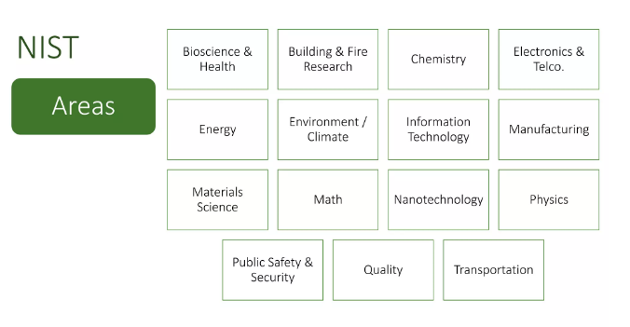
DOMAINS

Slide 16



Meaning of Re+search: Research refers to a search for knowledge. It is a movement from known to unknown or Research is an art of scientific investigation or Research is an academic activity and as such the term should be used in a technical sense. According to Clifford Woody, Research comprises defining and redefining problems, formulating hypothesis or suggested solutions; collecting, organizing, and evaluating data; making deductions and reaching conclusions to determine whether they fit the formulating hypothesis
Introduction: Drawing new knowledge in favor of well being of society
Source of images: shutterstock.com, shashitek
Curiosity leads to Re+search

Slide 17
Objectives of Re+search:
Re+search is an organized investigation of a problem where an investigator attempts to gain solution to a problem.
So, every research starts with a problem and this becomes the first step of the research that is defining and formulating a research problem which is followed by extensive literature survey, preparing research design, determining sample and its design, data collection and so on.
Note: Each and every one of us makes use of research at some point or the other in his / her life, hence a clear and accurate knowledge of research methods and methodology is a must for everyone.

Slide 18
Objectives of Research – The purpose of research is to discover answers to questions through the application of scientific procedures
To gain familiarity with a phenomenon or to achieve new insights into it (studies with this object in view are termed as exploratory or formulative research studies)
To portray accurately the characteristics of a particular individual, situation or a group (studies with this object in view are known as descriptive research studies)
To determine the frequency with which something occurs or with which it is associated with something else (studies with this object in view are known as diagnostic research studies)
To test a hypothesis of a causal relationship between variables (such studies are known as hypothesis-testing research studies).

Slide 19
Types of Research
Descriptive vs Analytical: It includes surveys and fact-finding enquiries of different kinds. Major purpose of this is description of the state of affairs as it exists at present.
Example1: Social science research
Example2: Business research (Ex post facto research)
The main characteristics of this method is that the researcher has no control over the variables; he can only report what has happened or what is happening.
For example: Frequency of shopping, preferences of people, or similar data
Usually, in this type, the methods of research utilized are survey methods of all kinds.
In analytical research, the researcher has to use facts or information already available, and analyze these to make a critical evaluation of the material.

Slide 20
Types of Research Continued
(ii) Applied vs. Fundamental: Applied research aims at finding a solution for an immediate problem facing a society or an industrial/business organization.
Example:
Research aimed at certain conclusions facing a concrete social or business problem is an example of applied research.
Research to identify social, economic or political trends that may affect a particular institution, marketing research, evaluation research.
Fundamental research is mainly concerned with generalizations and with the formulation of a theory. Gathering knowledge for knowledge’s sake is termed fundamental research.
Example:
Research concern some natural phenomenon
Pure mathematics
Human behavior carried on with a view to make generalizations about human behavior

Slide 21
Types of Research Continued
(iii) Quantitative vs. Qualitative:
Quantitative research is based on the quantitative measurements of some characteristics. It is applicable to phenomena that can be expressed in terms of quantities.
Example:
(a) Quantities / Numbers / Measurements
Qualitative research is concerned with qualitative phenomenon, i.e., phenomena relating to or involving quality or kind.
Example:
Investigating the reasons for human behavior (why people think or do certain things)
Motivation research / attitude research / opinion research – word association tests, sentence completion tests, story completion tests and similar other projective techniques

Slide 22
Types of Research Continued
(iv) Conceptual vs. Empirical:
Conceptual research is that related to some abstract idea (s) or theory. It is generally used by philosophers and thinkers to develop new concepts or to reinterpret existing ones.
Example:
God is existing?
Empirical (Experimental ) Research is relies on experience or observation alone. It is data-based research, coming up with conclusions where are capable of being verified by observation or experiment.
In such a research the researcher must first provide himself with a working hypothesis or guess as to the probable results.
He then works to get enough facts (data) to prove or disprove his hypothesis. He then sets up experimental designs which he thinks will manipulate the persons or the materials concerned experimenter’s control over the variables under study and his deliberate manipulation of one of them to study its effects.

Slide 23
Types of Research Continued
Empirical (Experimental ) Research is appropriate when proof is sought that certain variables affect other variables in some way. Evidence gathered through experiments or empirical studies are considered to be the most powerful support possible for testing a given hypothesis.
Other Types of Researches are as below:
One-time research – confined to a single time-period
Longitudinal research – Research is carried on over several time-periods.
Field-setting research / Laboratory research / Simulation research – depending upon the environment in which it is to be carried out.
Clinical or diagnostic research – follows case study methods or indepth approaches to reach the basic casual relations.
Exploratory research – is the development of hypothesis rather than their testing
Formalized research – studies are those with substantial structure and with specific hypotheses to be tested.

Slide 24
Other Types of Researches are as below continued:
Historical research – which utilizes historical sources like documents, remains etc to study events or ideas of the past, including the philosophy of persons and groups at any remote point of time.
Conclusion oriented research – a researcher is free to pick up a problem, redesign the enquiry as he proceeds and is prepared to conceptualize as he wishes.
Decision oriented research – Is always for the need of a decision maker and the researcher in this case is not free to embark upon research according to his own inclination. Operations research is an example of decision oriented research.

Slide 25
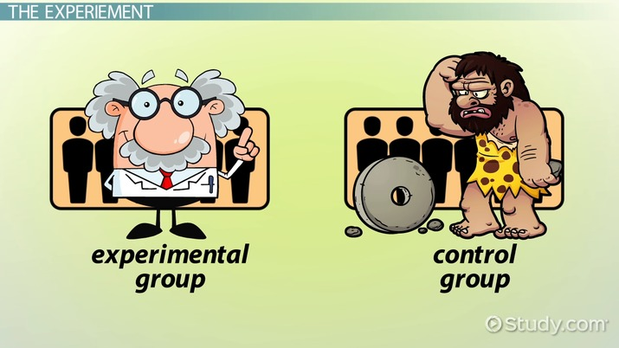

Slide 26
Research Approaches – There are two basic approaches
Quantitative approach – This involves the generation of data in quantitative form which can be subjected to rigorous quantitative analysis in a formal and rigid fashion. It is sub classified into inferential, experimental and simulation approaches to research.
Inferential – it is to form a data base to infer characteristics or relationships of population. This usually means survey research where a sample of population is studied (Questioned or observed) to determine its characteristics, and it is then inferred that the population has the same characteristics.
Experimental – Is characterized by much greater control over the research environment and in this case some variables are manipulated to observe their effect on other variables.
Simulation – Involves the construction of an artificial environment within which relevant information and data can be generated. This permits an observation of the dynamic behavior of a system (or its sub-system) under controlled conditions. Alternatively, “the operation of a numerical model that represents the structure of a dynamic process”. Simulation approach can also be useful building models for understanding future conditions.

Slide 27
Significance of Research
(ii) Qualitative approach – It is subjective assessment of attitudes, opinions and behavior. Generally, the techniques of focus group interviews, projective techniques and depth interviews are used.
All progress is born of inquiry. Doubt is often better than overconfidence, for it leads to inquiry, and inquiry leads to invention
- Hudson Maxim
Research inculcates scientific and inductive thinking and it promotes the development of logical habits of thinking and organization.

Slide 28
Research Methods versus Methodology
Research methods may be understood as all those methods / techniques that are used for conduction of research.
Research methods, can be put into the following three groups:
Group-1: We include those methods which are concerned with the collection of data. These methods will be used where the data already available is not sufficient to arrive at the required solution.
Group-2: Consists of those statistical techniques which are used for establishing relationships between the data and the unknowns.
Group-3: Consists of those methods which are used to evaluate the accuracy of the results obtained
Group-2 and Group-3 are generally taken as the analytical tools of research

Slide 29
Research Techniques: Refer to the behavior and instruments we use in performing research operations such as making observations, recording data, techniques of processing data and the like. Research Methods: Refer to the behavior and instruments used in selecting and constructing research technique

Slide 30
Type | Methods | Techniques
1. Library Research | Analysis of historical records Analysis of documents | Recording of notes, content analysis, Tape and Film listening and analysis. Statistical compilation, and manipulations, reference and abstract guides, content analysis, Observational behavioural scales, use of score cards, etc.
2. Field Research | Non- participant direct observation Participant observation Mass observation Mail questionnaire Opinionaire Personal interview Focussed interview Group interview Telephone survey Case study and life history
3. Laboratory Research | Small group study of random behavior, play and role analysis

Slide 31
Research Methodology: It is a way to systematically solve the research problem. It may be understood as a science of studying how research is done scientifically. Note: It is necessary for the researcher to know not only the research methods/techniques but also the methodology. It is necessary for the researcher to design his methodology for his problem as the same may differ from problem to problem. In research the scientist/researcher/student/faculty has to expose the research decisions to evaluation before they are implemented.

Slide 32
Research methodology has many dimensions and research methods do constitute a part of the research methodology. The scope of research methodology is wider than that of research methods. Thus, when we talk of research methodology we not only talk of the research methods but also consider the logic behind the methods we use in the context of our research study and explain why we are using a particular method or technique and why we are not using others so that research results are capable of being evaluated either by the researcher himself or by others.

Slide 33
1) Why a research study has been undertaken? 2) How the research problem has been defined ? 3) In what way and why the hypothesis has been formulated? 4) What data have been collected ? 5) What particular method has been adopted? 6) Why particular technique of analysing data has been used and a host of similar other questions are usually answered when we talk of research methodology concerning a research problem or study.

Slide 34
Research and Scientific Method
“The scientific method is one and same in the branches (of science) and that method is the method of all logically trained minds … the unity of all sciences consists alone in its methods, not its material; the man who classifies facts of any kind whatever, who sees their mutual relation and describes their sequences, is applying the Scientific Method and is a man of science.
- Karl Pearson writes

Slide 35
Research and Scientific Method continued…
The scientific method is, thus, based on certain basic postulates which can be stated as under:
It relies on empirical evidence;
It utilizes relevant concepts;
It is committed to only objective considerations;
It presupposes ethical neutrality, i.e., it aims at nothing but making only adequate and correct statements about population objects;
It results into probabilistic predictions;
Its methodology is made known to all concerned for critical scrutiny are for use in testing the conclusions through replication;
It aims at formulating most general axioms or what can be termed as scientific theories.

Slide 36
Importance of Knowing How Research is Done
The knowledge of methodology provides good training specially to the new research worker and enables him to do better research. Those aspiring for careerism in research must develop the skill of using research techniques and must thoroughly understand the logic behind them.
Knowledge of research methodology is helpful in various fields such as government or business administration, community development and social work where persons are increasingly called upon to evaluate and use research results for action.
The satisfaction of acquiring a new intellectual tool which can become a way of looking at the world and of judging every day experience.
It enables use to make intelligent decisions concerning problems facing us in practical life at different points of time.
In this scientific age, all of us are in many ways consumers of research results and we can use them intelligently provided we are able to judge the adequacy of the methods by which they have been obtained. The knowledge of methodology helps the consumer of research results to evaluate them and enables him to take rational decisions.

Slide 37
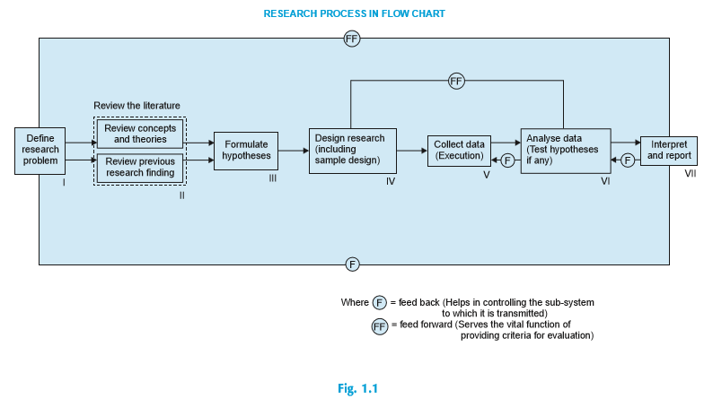
Research Process
Research process consists of series of actions or steps necessary to effectively carry out research and the desired sequencing of these steps.
Source: Research Methodology – C R Kothari

Slide 38
Steps provides a useful procedural guideline regarding the research process
Formulating the research problem;
(2) extensive literature survey;
(3) developing the hypothesis;
(4) preparing the research design;
(5) determining sample design;
(6) collecting the data;
(7) execution of the project;
(8) analysis of data;
(9) hypothesis testing;
(10) Generalisations and interpretation, and
(11) preparation of the report or presentation of the results, i.e., formal write-up of conclusions reached.

Slide 39

1. Formulating the research problem:
Basically, there are two types of research problems
Relate to state of nature and
Those which relate to relationship between variables
Note:
Initially the problem may be stated in a broad general way and then the ambiguities, if any, relating to the problem be resolved.
the feasibility of a particular solution has to be considered before a working formulation of the problem can be set up. The formulation of a general topic into a specific research problem, thus, constitutes the first step in a scientific enquiry.
Essentially two steps are involved in formulating the research problem, viz., understanding the problem thoroughly, and rephrasing the same into meaningful terms from an analytical point of view.
The best way of understanding the problem is to discuss it with one’s own colleagues or with those having some expertise in the matter or research guide.

Slide 40
The researcher must at the same time examine all available literature to get himself acquainted with the selected problem. He may review two types of literature. The conceptual literature concerning the concepts and theories The empirical literature consisting of studies made earlier which are similar to the one proposed. The researcher rephrases the problem into analytical or operational terms i.e., to put the problem in as specific terms as possible. This task of formulating, or defining, a research problem is a step of greatest importance in the entire research process
The statement of the objective is of basic importance because it determines the data which are to be collected, the characteristics of the data which are relevant, relations which are to be explored, the choice of techniques to be used in these explorations and the form of the final report.
- Professor W.A. Neiswanger

Slide 41
2. Extensive literature survey:
Once the problem is formulated, a brief summary of it should be written down. It is compulsory for a research worker writing a thesis for a Ph.D. degree to write a synopsis of the topic and submit it to the necessary Committee or the Research Board for approval.
At this juncture the researcher should undertake extensive literature survey connected with the problem.
For this purpose, the abstracting and indexing journals and published or unpublished bibliographies are the first place to go to. Academic journals, conference proceedings, government reports, books etc., must be tapped depending on the nature of the problem.
In this process, it should be remembered that one source will lead to another.
A good library will be a great help to the researcher at this stage.

Slide 42
3. Development of working hypotheses:
After extensive literature survey, researcher should state in clear terms the working hypothesis or hypotheses.
Working hypothesis is tentative assumption made in order to draw out and test its logical or empirical consequences.
As such the manner in which research hypotheses are developed is particularly important since they provide the focal point for research.
In most types of research, the development of working hypothesis plays an important role. Hypothesis should be very specific and limited to the piece of research in hand because it has to be tested.

Slide 43
How does one go about developing working hypotheses? The answer is by using the following approach:
Discussions with colleagues and experts about the problem, its origin and the objectives in seeking a solution;
(b) Examination of data and records, if available, concerning the problem for possible trends, peculiarities and other clues;
(c) Review of similar studies in the area or of the studies on similar problems; and
(d) Exploratory personal investigation which involves original field interviews on a limited scale with interested parties and individuals with a view to secure greater insight into the practical aspects of the problem.

Slide 44
4. Preparing the research design:
The researcher will have to state the conceptual structure within which research would be conducted.
The preparation of such a design facilitates research to be as efficient as possible yielding maximal information.
In other words, the function of research design is to provide for the collection of relevant evidence with minimal expenditure of effort, time and money.

Slide 45
There are several research designs, such as, experimental and non-experimental hypothesis testing.
Experimental designs can be either informal designs (such as before-and-after without control, after-only with control, before-and-after with control) or
formal designs (such as completely randomized design, randomized block design, Latin square design, simple and complex factorial designs), out of which the researcher must select one for his own project.

Slide 46
5. Determining sample design:
All the items under consideration in any field of inquiry constitute a ‘universe’ or ‘population’.
A complete enumeration of all the items in the ‘population’ is known as a census inquiry.
Census inquiry is not possible in practice under many circumstances.
For instance, blood testing is done only on sample basis
Hence, quite often we select only a few items from the universe for our study purposes.
The items so selected constitute what is technically called a sample.

Slide 47
The researcher must decide the way of selecting a sample or what is popularly known as the sample design.
In other words, a sample design is a definite plan determined before any data are actually collected for obtaining a sample from a given population. Thus, the plan to select 12 of a city’s 200 drugstores in a certain way constitutes a sample design.
Probability samples are those based on simple random sampling, systematic sampling, stratified sampling, cluster/area sampling whereas
non-probability samples are those based on convenience sampling, judgement sampling and quota sampling techniques.

Slide 48
Deliberate sampling: Deliberate sampling is also known as purposive or non-probability sampling. This sampling method involves purposive or deliberate selection of particular units of the universe for constituting a sample which represents the universe.
When population elements are selected for inclusion in the sample based on the ease of access, it can be called convenience sampling.
judgement sampling the researcher’s judgement is used for selecting items which he considers as representative of the population. For example, a judgement sample of college students might be taken to secure reactions to a new method of teaching. Judgement sampling is used quite frequently in qualitative research where the desire happens to be to develop hypotheses rather than to generalise to larger populations.

Slide 49
Simple random sampling: This type of sampling is also known as chance sampling or probability sampling where each and every item in the population has an equal chance of inclusion in the sample and each one of the possible samples, in case of finite universe, has the same probability of being selected.
For example, if we have to select a sample of 300 items from a universe of 15,000 items

Slide 50
Systematic sampling: In some instances the most practical way of sampling is to select every 15th name on a list, every 10th house on one side of a street and so on. Sampling of this type is known as systematic sampling.
An element of randomness is usually introduced into this kind of sampling by using random numbers to pick up the unit with which to start. This procedure is useful when sampling frame is available in the form of a list. In such a design the selection process starts by picking some random point in the list and then every nth element is selected until the desired number is secured.

Slide 51
Stratified sampling: If the population from which a sample is to be drawn does not constitute a homogeneous group, then stratified sampling technique is applied so as to obtain a representative sample.
In this technique, the population is stratified into a number of nonoverlapping subpopulations or strata and sample items are selected from each stratum. If the items selected from each stratum is based on simple random sampling the entire procedure, first stratification and then simple random sampling, is known as stratified random sampling.

Slide 52
Quota sampling: In stratified sampling the cost of taking random samples from individual strata is often so expensive that interviewers are simply given quota to be filled from different strata, the actual selection of items for sample being left to the interviewer’s judgement. This is called quota sampling.
The size of the quota for each stratum is generally proportionate to the size of that stratum in the population. Quota sampling is thus an important form of non-probability sampling. Quota samples generally happen to be judgement samples rather than random samples.

Slide 53
Cluster sampling: Cluster sampling involves grouping the population and then selecting the groups or the clusters rather than individual elements for inclusion in the sample.
Suppose some departmental store wishes to sample its credit card holders. It has issued its cards to 15,000 customers. The sample size is to be kept say 450. For cluster sampling this list of 15,000 card holders could be formed into 100 clusters of 150 card holders each.
The clustering approach can, however, make the sampling procedure relatively easier and increase the efficiency of field work, specially in the case of personal interviews.

Slide 54
Area sampling is quite close to cluster sampling and is often talked about when the total geographical area of interest happens to be big one. Under area sampling we first divide the total area into a number of smaller non-overlapping areas, generally called geographical clusters, then a number of these smaller areas are randomly selected, and all units in these small areas are included in the sample. Area sampling is specially helpful where we do not have the list of the population concerned.
It also makes the field interviewing more efficient since interviewer can do many interviews at each location.

Slide 55
Multi-stage sampling:
This is a further development of the idea of cluster sampling. This technique is meant for big inquiries extending to a considerably large geographical area like an entire country.
Under multi-stage sampling the first stage may be to select large primary sampling units such as states, then districts, then towns and finally certain families within towns.
If the technique of random-sampling is applied at all stages, the sampling procedure is described as multi-stage random sampling.

Slide 56
Sequential sampling: This is somewhat a complex sample design where the ultimate size of the sample is not fixed in advance but is determined according to mathematical decisions on the basis of information yielded as survey progresses.
This design is usually adopted under acceptance sampling plan in the context of statistical quality control.
Note: The sample design to be used must be decided by the researcher taking into consideration the nature of the inquiry and other related factors.

Slide 57
6. Collecting the data:
There are several ways of collecting the appropriate data which differ considerably in context of money costs, time and other resources at the disposal of the researcher.
Primary data can be collected either through experiment or through survey. If the researcher conducts an experiment, he observes some quantitative measurements, or the data, with the help of which he examines the truth contained in his hypothesis.

Slide 58
But in the case of a survey, data can be collected by any one or more of the following ways:
By observation;
Through personal interview;
Through telephone interviews;
By mailing of questionnaires;
Through schedules;
The researcher should select one of these methods of collecting the data taking into consideration the nature of investigation, objective and scope of the inquiry, finanical resources, available time and the desired degree of accuracy.

Slide 59
7. Execution of the project:
Execution of the project is a very important step in the research process. If the execution of the project proceeds on correct lines, the data to be collected would be adequate and dependable.

Slide 60
8. Analysis of data:
The analysis of data requires a number of closely related operations such as establishment of categories, the application of these categories to raw data through coding, tabulation and then drawing statistical inferences.
The unwieldy data should necessarily be condensed into a few manageable groups and tables for further analysis. Thus, researcher should classify the raw data into some purposeful and usable categories.
Coding operation is usually done at this stage through which the categories of data are transformed into symbols that may be tabulated and counted.
Editing is the procedure that improves the quality of the data for coding. With coding the stage is ready for tabulation.

Slide 61
Tabulation is a part of the technical procedure wherein the classified data are put in the form of tables.
The mechanical devices can be made use of at this juncture. A great deal of data, specially in large inquiries, is tabulated by computers.
Computers not only save time but also make it possible to study large number of variables affecting a problem simultaneously.
Analysis work after tabulation is generally based on the computation of various percentages, coefficients, etc., by applying various well defined statistical formulae.
In the process of analysis, relationships or differences supporting or conflicting with original or new hypotheses should be subjected to tests of significance to determine with what validity data can be said to indicate any conclusion(s).

Slide 62
9. Hypothesis-testing:
After analysing the data as stated above, the researcher is in a position to test the hypotheses, if any, he had formulated earlier.
Do the facts support the hypotheses or they happen to be contrary? This is the usual question which should be answered while testing hypotheses.
Various tests, such as Chi square test, t-test, F-test, have been developed by statisticians for the purpose. The hypotheses may be tested through the use of one or more of such tests, depending upon the nature and object of research inquiry.
Hypothesis-testing will result in either accepting the hypothesis or in rejecting it. If the researcher had no hypotheses to start with, generalisations established on the basis of data may be stated as hypotheses to be tested by subsequent researches in times to come.

Slide 63
10. Generalisations and interpretation:
If a hypothesis is tested and upheld several times, it may be possible for the researcher to arrive at generalisation, i.e., to build a theory. As a matter of fact, the real value of research lies in its ability to arrive at certain generalisations.
If the researcher had no hypothesis to start with, he might seek to explain his findings on the basis of some theory. It is known as interpretation. The process of interpretation may quite often trigger off new questions which in turn may lead to further researches.

Slide 64
11. Preparation of the report or the thesis:
Finally, the researcher has to prepare the report of what has been done by him. Writing of report must be done with great care keeping in view the following:
The layout of the report should be as follows:
the preliminary pages: In its preliminary pages the report should carry title and date followed by acknowledgements and foreword. Then there should be a table of contents followed by a list of tables and list of graphs and charts, if any, given in the report.

Slide 65
(ii) The main text of the report should have the following parts:
Introduction: It should contain a clear statement of the objective of the research and an explanation of the methodology adopted in accomplishing the research. The scope of the study along with various limitations should as well be stated in this part.
Summary of findings: After introduction there would appear a statement of findings and recommendations in non-technical language. If the findings are extensive, they should be summarised.
Main report: The main body of the report should be presented in logical sequence and broken-down into readily identifiable sections.
Conclusion: Towards the end of the main text, researcher should again put down the results of his research clearly and precisely. In fact, it is the final summing up.

Slide 66
(iii) At the end of the report,
appendices should be enlisted in respect of all technical data.
Bibliography, i.e., list of books, journals, reports, etc., consulted, should also be given in the end.
Index should also be given specially in a published research report.
2. Report should be written in a concise and objective style in simple language avoiding vague expressions such as ‘it seems,’ ‘there may be’, and the like.
3. Charts and illustrations in the main report should be used only if they present the information more clearly and forcibly.
4. Calculated ‘confidence limits’ must be mentioned and the various constraints experienced in conducting research operations may as well be stated.

Slide 67
Criteria of Good Research
1. The purpose of the research should be clearly defined and common concepts be used.
2. The research procedure used should be described in sufficient detail to permit another researcher to repeat the research for further advancement, keeping the continuity of what has already been attained.
3. The procedural design of the research should be carefully planned to yield results that are as objective as possible.
4. The researcher should report with complete frankness, flaws in procedural design and estimate their effects upon the findings.
5. The analysis of data should be sufficiently adequate to reveal its significance and the methods of analysis used should be appropriate. The validity and reliability of the data should be checked carefully.
6. Conclusions should be confined to those justified by the data of the research and limited to those for which the data provide an adequate basis.
7. Greater confidence in research is warranted if the researcher is experienced, has a good reputation in research and is a person of integrity.

Slide 68
Criteria of Good Research Alternatively
In other words, we can state the qualities of a good research as under:
Good research is systematic: It means that research is structured with specified steps to be taken in a specified sequence in accordance with the well defined set of rules. Systematic characteristic of the research does not rule out creative thinking but it certainly does reject the use of guessing and intuition in arriving at conclusions.
Good research is logical: This implies that research is guided by the rules of logical reasoning and the logical process of induction and deduction are of great value in carrying out research. Induction is the process of reasoning from a part to the whole whereas deduction is the process of reasoning from some premise to a conclusion which follows from that very premise. In fact, logical reasoning makes research more meaningful in the context of decision making.
Good research is empirical: It implies that research is related basically to one or more aspects of a real situation and deals with concrete data that provides a basis for external validity to research results.
Good research is replicable: This characteristic allows research results to be verified by replicating the study and thereby building a sound basis for decisions.

Slide 69
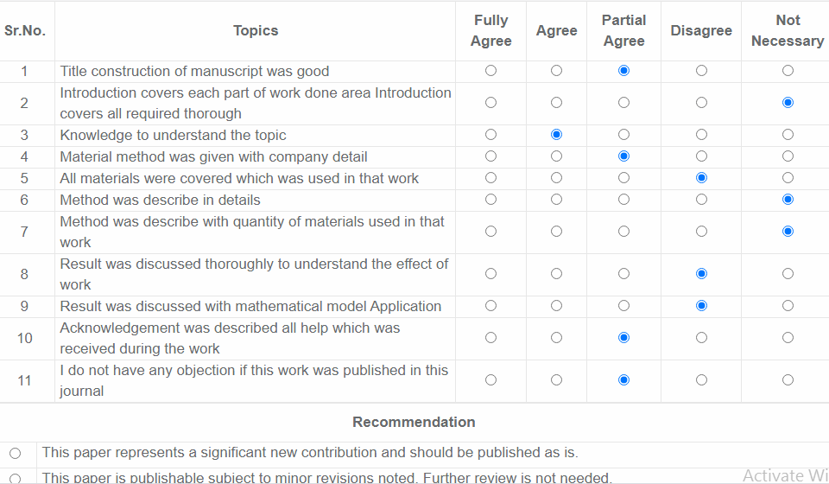
Sample Journal Reviewer Points to be noted while preparing Journals

Slide 70
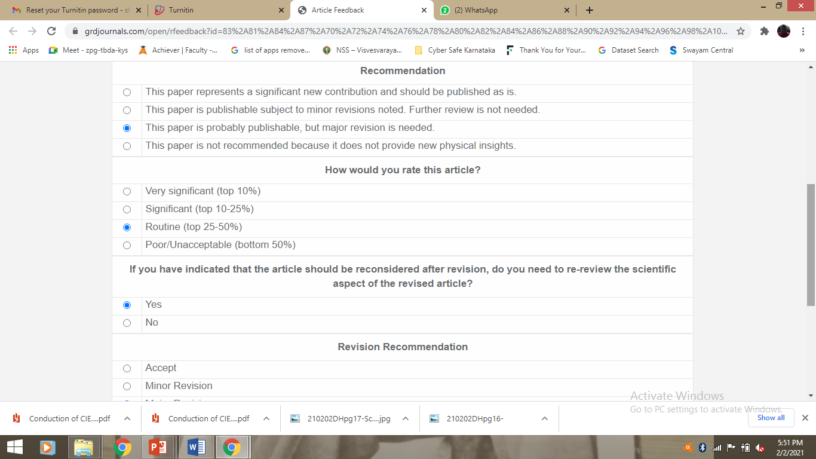

Slide 71

Open for Discussion

