Slide 1
COMP204P
Scenario Week 3

Slide 2
What is a Scenario Week?
One week dedicated to working on a related set of problems.
Completed and assessed within the week.
Connected to the modules you are taking this year.
Scenario 3: COMP204P - Configure, build, deploy
Scenario 4: COMP203P - HCI, OO modelling and design
Scenario 5: COMP205P - Security
Scenario 6: COMP203P - Maths challenge
Each week is worth 15% of the module mark it is connected to.
Scenario 4 15% is made up of 10% + part of the HCI coursework mark.
(Scenarios 1 & 2 were in the first year.)

Slide 3
Scenario 3
Overview: This week is about Configuration, Deployment and Automation.
Your scenario is that you need to provide the infrastructure to develop and deploy a web application.
As much of the build process and deployment as possible should be automated.
Learning outcomes:
An understanding and practical experience of configuring a virtual machine on Amazon Web Services for specific roles.
An understanding and practical experience of deploying an application.
An appreciation of how automation can be achieved and some of the tools available.

Slide 4
Configuration
Many developers now make use of virtual machines (VMs) for both their development environment and the deployment environments. Most cloud services (e.g., Amazon EC2 or Azure) are VM based.
VM roles include:
The development platform.
Precisely configured with a specific set of tools and versions. Easily reproducible.
A staging platform to confirm that application can be deployed.
Mimics the production environment but also configured for testing and logging.
Avoids risks of direct deployment to production.
A production platform to run an application for general use.
Needs to be stripped down to the essential software and everything else removed.

Slide 5
Configuration (2)
Version control is part of configuration and development.
For this scenario you should use git and a service like GitHub, Bitbucket to host your repository (free versions) or the CS GitLab gitlab.cs.ucl.ac.uk.
All source code, and other artefacts needed for development and deployment, should be in the repository.
For an excellent tutorial on Git see UCL lynda.com
Git Essential Training with Kevin Skoglund

Slide 6
Deployment
Getting an application from version control onto a staging or production VM, and getting the application running.
This should all be automated.
Deployment can be a complex process and needs to be easily repeatable.
It can include configuration of the target VM as well as putting the application into place.

Slide 7
Automation
Automate everything you can!
Manual processes are error prone, boring, and unreliable.
There are many scripting and deployment automation tools available.
Automation includes building the application on the development machine.
Should be able to build independently of any IDE.

Slide 8
The Application
The scenario assumes the development and deployment of a web application.
But This Is Not Another Build a Web App Project!!
The web app serves two purposes:
To explore one of the well known web application frameworks.
To provide the app for the main goals of automation and deployment.
Think tools and processes.

Slide 9
Goals (Specification document on Moodle)
Configure two servers - staging and production.
Production should be stripped down to essential software.
Create a web app with the given basic specification - includes a database.
Script the deployment of the app to the servers.
Support automatic restart if the server restarts/crashes.
Devise a way to backup and restore the database on the production server.
Aim to minimise loss of data.

Slide 10
Amazon AWS
AWS is fully scriptable.
Use the AWS and AWS educate resources to find out more.
You have limited credit – use it well.
If it runs out, no extension is available.
Keep all your resources in the same zone.
Shut down services when not using them.
Use minimal VM and DB configurations.
Increase only if you hit a limit first.
Beware of expensive storage options.

Slide 11
Architecture
The basic server configuration is a Linux VM running both the web server and database (e.g., MySQL).
Use an EC2 instance, with Amazon Linux.
Don’t need to create a scalable cluster.
Ideally creating and configuring the server should be scripted.
Look at the security issues.
Restricting root access to a limited IP range.
Explore what AWS provides.

Slide 12
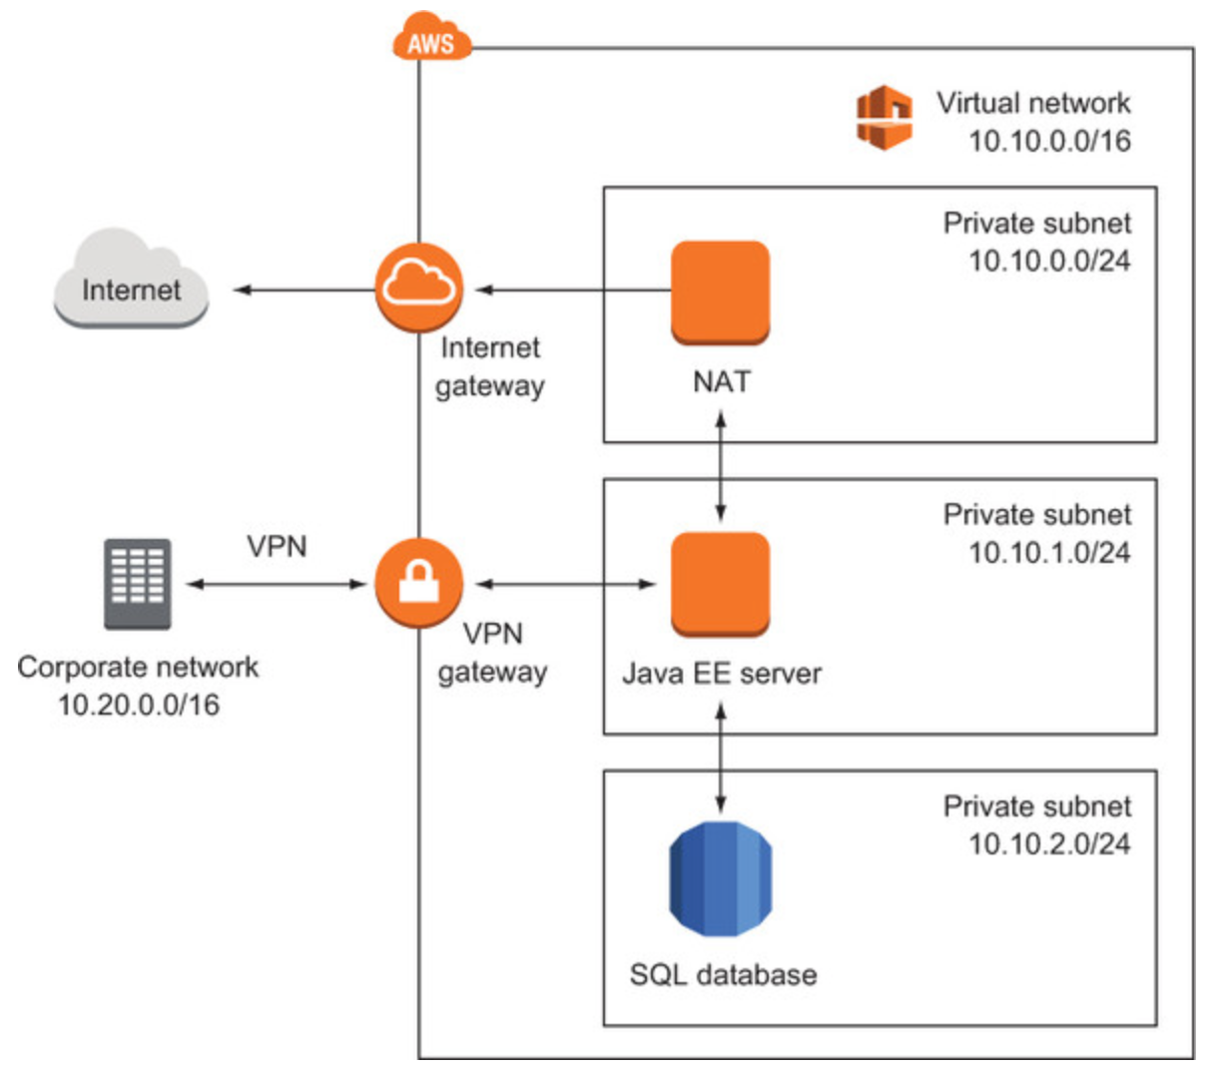
A More Advanced Architecture
If you have time look at
an architecture like this.
But get the basic version
working first.
Use the book Amazon Web Services in Action or the Lynda.com course (see Moodle).

Slide 13
Week Timetable
Full timetable on Moodle (COMP204P).
Help and check-in session during Tuesday, Wednesday, Thursday, Friday morning.
Assessment on Friday.
Booked rooms are available for group use.
CS labs will be available depending on how they are booked for other classes.

Slide 14
Tools
Each team member should by now have an AWS account
Must use git for version control.
And a web application framework.
More info in guidelines document.

Slide 15
Assessment
All done on Friday (book a slot).
A demo of the deployment and application.
A git repository.
Plus 100 points to be divided amongst the group members.
Even split not allowed!
Group must decide.
70% Group work, 30% points.

