Slide 1
Assignment V DATABASE DESIGN Z511
FNU ANIRUDH

Slide 2
Description
Aim of this project is to design Cricket database with ranking of teams, top 10 batsman, bowlers and different continents where teams come from and then perform information retrieval and find patterns or perform data analysis.
My Database contains list of nations that play cricket, their ranking, matches played, total points and ratings (Ratings= Points/Matches), list of Top 10 Batsman and Bowlers with their team ratings and style of playing. My database also contains capitals of countries and continent they are part of.

Slide 3
BUSINESS RULE
One country can have many batsman. One batsman can only be from one country.
One country can have many bowlers. One bowler can only be from one country.
One continent can have many countries. One country can only be part of one continent.

Slide 4
E-R DIAGRAM

Slide 5
TABLES
Team: - This table contains list of cricket playing nations, their ranking, number of matches played, total points and their ratings.
Batsman: - This table contains list of top 10 batsman, their batting style and their team ratings.
Bowler: - This table contains list of top 10 bowlers, their bowling style and their team ratings.
Continent: - This table contains capitals of cricket playing nations and continent they are in.

Slide 6
TABLE | ATTRIBUTE | KEY | REF TABLE OF FK
Nations | Country
 | Rank | PK
 | Matches
 | Points
 | Ratings =(Points/Matches)
Batsman | Batsman Name | PK
 | Batsman Type
 | Ratings | FK | Nations
Bowler | Bowler Name | PK
 | Bowler Type
 | Ratings | FK | Nations
Continent | Country | FK | Nations
 | Capital | PK
 | Continent

Slide 7
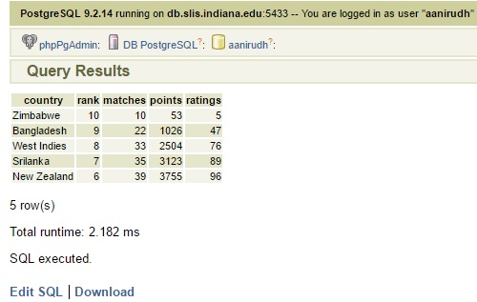
1. All the Teams that have ratings less than 100 arranged in ascending order of their ratings
select *FROM Nations
WHERE Ratings<100
ORDER BY Ratings ASC;

Slide 8
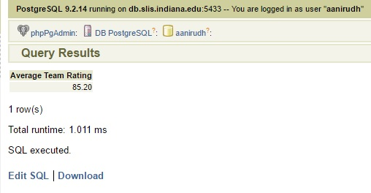
2. Calculating Average Team Rating upto 2 decimal places From Table Nations
SELECT ROUND(AVG(Ratings),2) AS "Average Team Rating" FROM Nations;

Slide 9
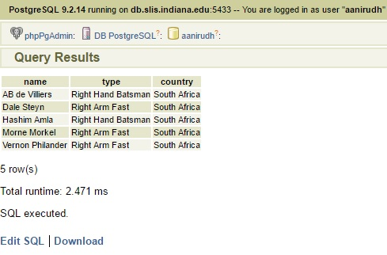
3. List All the Batsman and Bowlers with their playing style who play for South Africa
SELECT Name,Type,n.Country FROM Batsman
FULL JOIN Nations n
USING (Ratings)
WHERE Ratings=109
UNION
SELECT Name,Type,n.Country FROM Bowler
FULL JOIN Nations n
USING (Ratings)
WHERE Ratings=109;

Slide 10
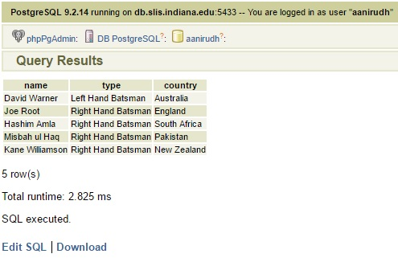
4. List Name of all Batsman,their style and country whose name lies between ‘C’ and ‘O’
SELECT Name,Type,n.Country FROM Batsman
INNER JOIN Nations n
USING (Ratings)
WHERE Name BETWEEN 'C' AND 'O';

Slide 11
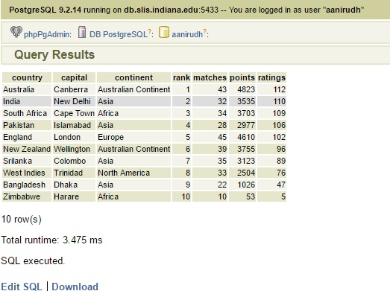
5. Right Outer Join Continent with Nations to display Countries, Capitals, Continents with their statistics
(This Query works only in MYSQL
and fetches same result as query
Below)
SELECT *FROM Nations
RIGHT OUTER JOIN Continent
USING (Country)
ORDER BY Rank;
(POST GRE SQL QUERY)
SELECT Country,c.Capital,c.Continent,
rank,matches,points,ratings FROM Nations
RIGHT OUTER JOIN Continent c
USING (Country)
ORDER BY Rank;

Slide 12
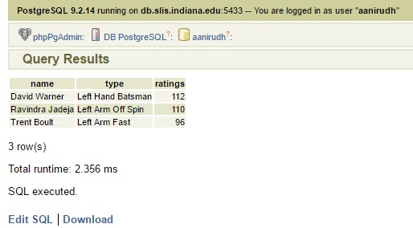
6. List All the Players from Batsman and Bowler who are Left Handed
SELECT *FROM Bowler
WHERE Type LIKE 'Left%'
UNION
SELECT *FROM Batsman
WHERE Type LIKE 'Left%'
ORDER BY Name;

Slide 13
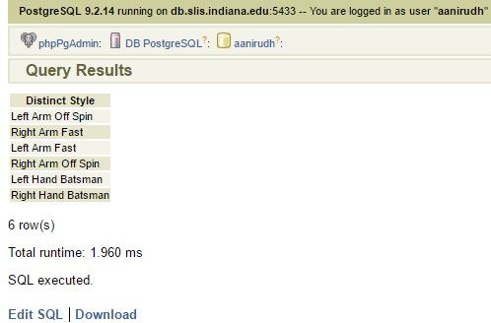
7. List Distinct Batting and Bowling Style
SELECT Distinct Type AS "Distinct Style" FROM Batsman
UNION
SELECT Distinct Type FROM Bowler;

Slide 14
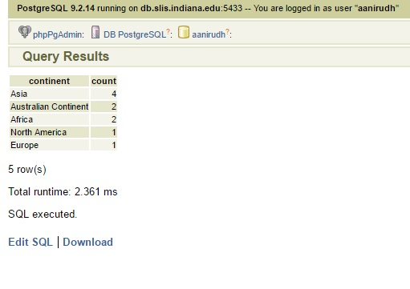
8. Count the total number of cricket playing nation in each continent in descending order
SELECT c.Continent, count(*) FROM Nations
RIGHT OUTER JOIN Continent c
USING (Country) GROUP BY c.Continent
ORDER BY count DESC;

Slide 15
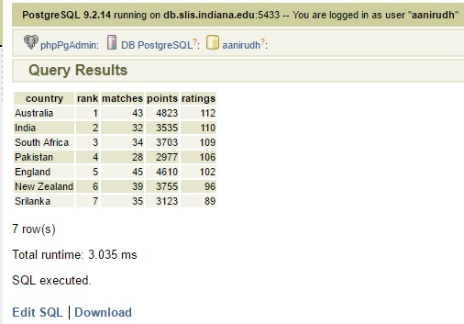
9. List of team whose ratings are greater than average rating
SELECT *FROM Nations
WHERE Ratings >(SELECT AVG(Ratings) FROM Nations);

Slide 16
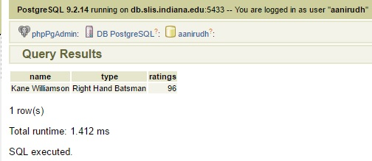
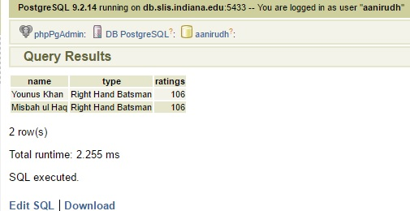
10. Nth Maximum in Batsman Table
SELECT * FROM Batsman b
WHERE (5-1)= (select count(distinct(c.Ratings))
FROM Batsman c
WHERE c.Ratings>b.Ratings);
SELECT * FROM Batsman b
WHERE (3-1)= (select count(distinct(c.Ratings))
FROM Batsman c
WHERE c.Ratings>b.Ratings);
Note:- In this query we can find nth maximum
just by changing n value under where clause.

