Slide 1
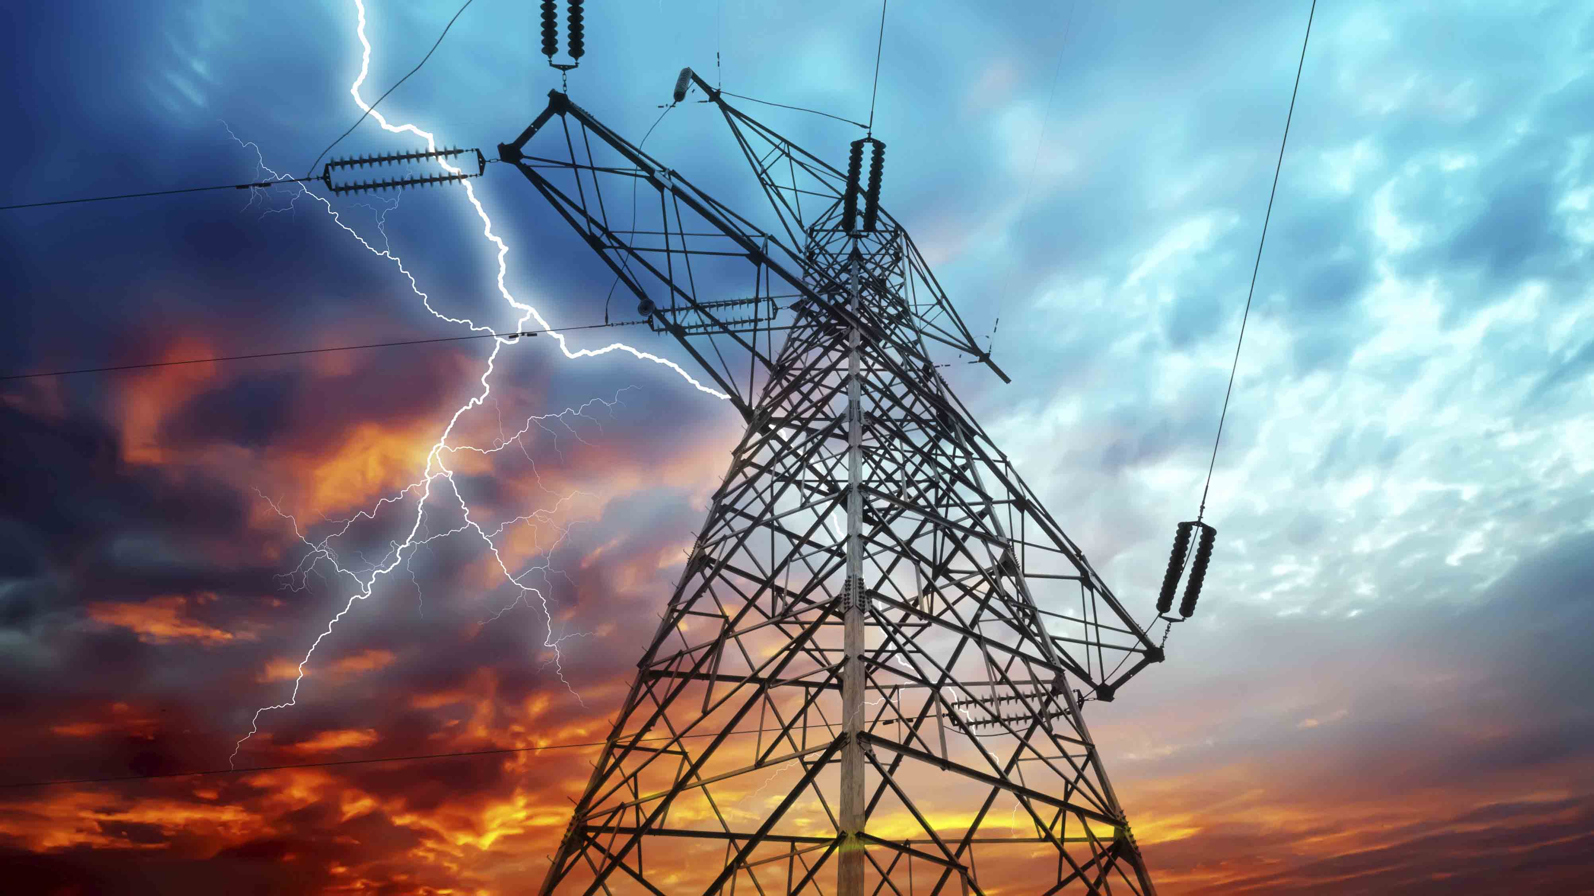

Electricity and Water Consumption in Los Angeles
By
Anirudh Pillai

Slide 2
Purpose of Analysis
Uncover pattern and report insights
How did total units vary over the years?
How did drought in 2011 change consumption of water?
Figure out areas which consume most units of water and electricity
How government restrictions and policies effected consumption?

Slide 3
Introduction
Obtained Data from data.gov and data.lacity.org
8 years of Data from 2005-06 to 2012-13
Dataset contains average unit consumed for 125 areas across LA (Zip code)
Electricity consumed is expressed in kWh and Hundred cubic feet for Water consumed

Slide 4
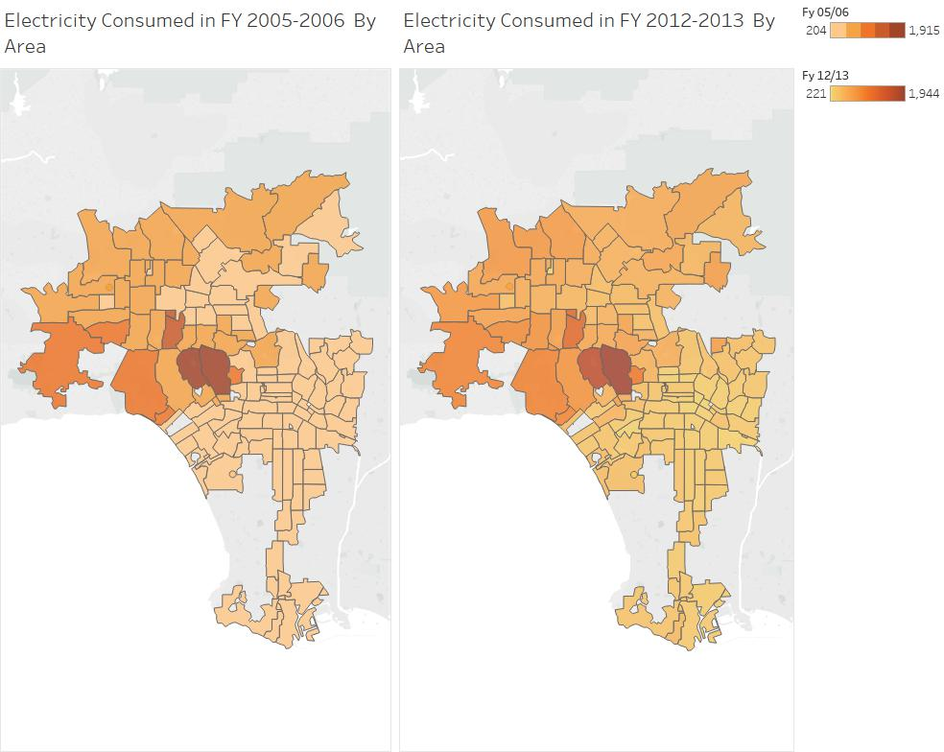
Comparison of Electricity Consumption between 2005-06 and 2012-13

Slide 5
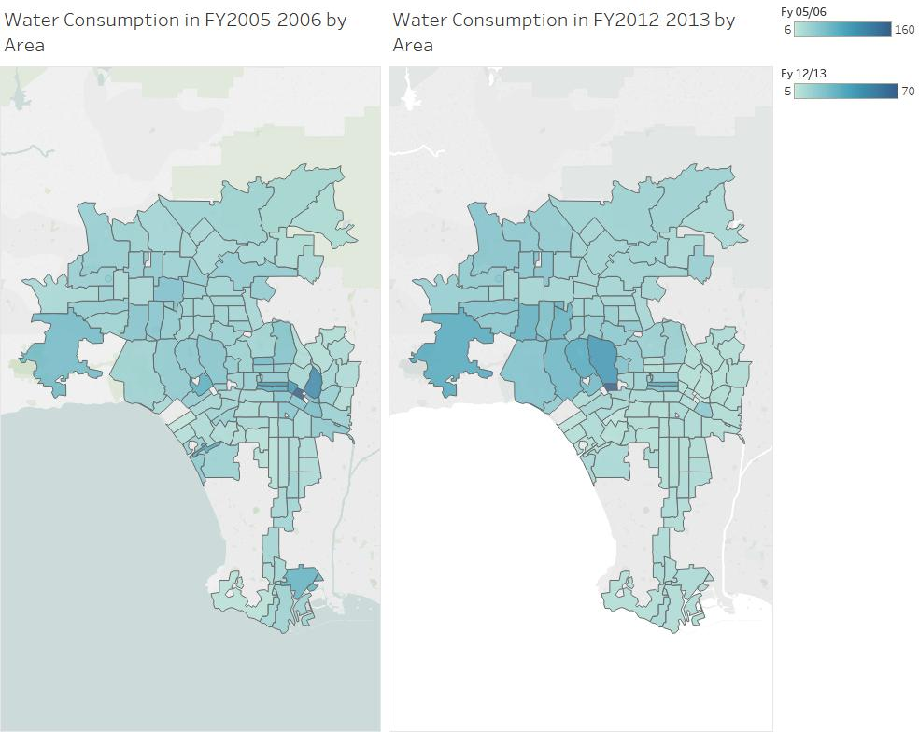
Comparison of Water Consumption between 2005-06 and 2012-13

Slide 6
Outliers
Zip code | Units of Electricity Consumed in kWh
West Hollywood (90069) | 1026
Bel Air (90077) | 1674
Beverly Hills (90210) | 1915
Encino (91436) | 1318
Pacific Palisades(90272) | 980
Zip code | Units of Electricity Consumed in kWh
West Hollywood (90069) | 1102
Bel Air (90077) | 1678
Beverly Hills (90210) | 1944
Encino (91436) | 1279
Pacific Palisades (90272) | 1002
Outliers in 2005-06
Outliers in 2012-13

Slide 7
Outliers …
Zip code | Units of Water Consumed in CCF
Koreatown (90010) | 138
Chinatown (90012) | 117
Financial District (90017) | 160
Central LA (90020) | 98
Mac Arthur Park (90057) | 102
Zip code | Units of Water Consumed in CCF
Central LA (90020) | 37
Bel Air (90077) | 36
Beverly Hills (90210) | 45
Beverly Hills (90212) | 70
Calabasas (91302) | 36
Outliers in 2005-06
Outliers in 2012-13

Slide 8
Total Units Consumed Annually

Slide 9
Reasons for reduced water consumption
Emergency declared in 2011.
Stricter laws related to water like irrigation restriction and higher charges for farmers.
Surface water regulated by the state.
Percolating groundwater regulated by local/judicial management

Slide 10
THANK YOU

