Slide 1
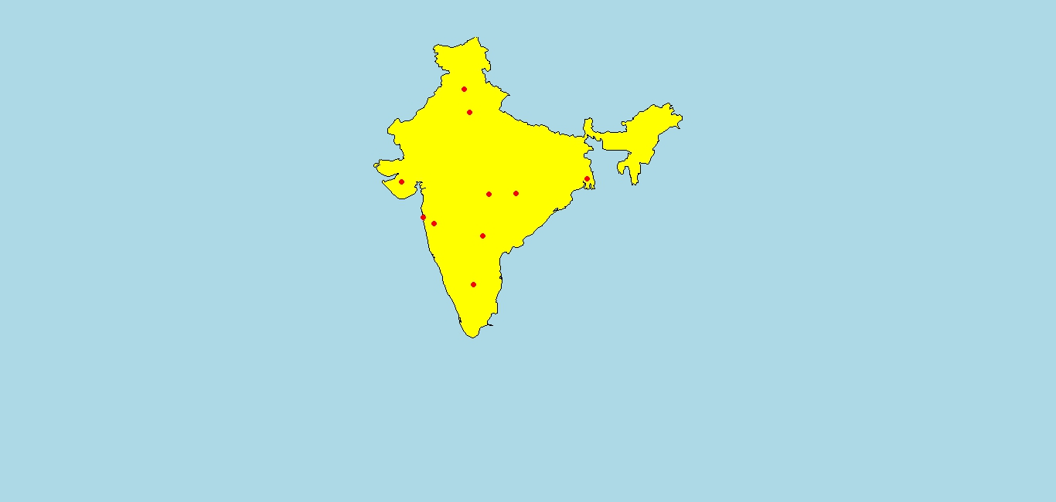
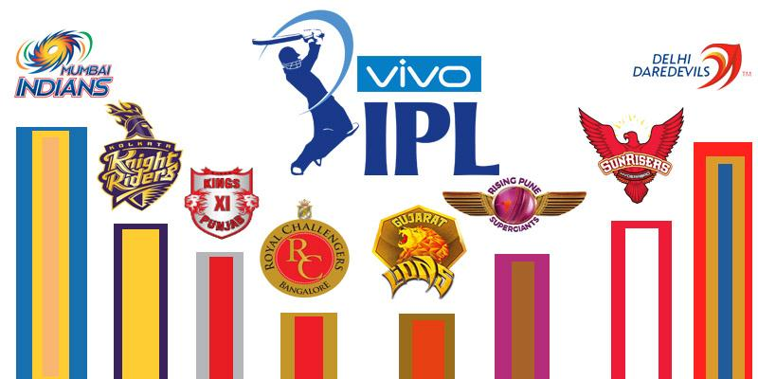

Text and sentiment analysis on tweets- Indian premier league (IPL)
By:
Vishwas, Anirudh, Gautham

Slide 2
MOTIVATION
The most popular communication tool to share everyday opinions and life events is social media. Twitter, an online social networking service, can be used to analyze sports-related tweets in real time, and infer meaningful relationships.
These tweets reflect public sentiment towards Sports when aggregated. We can extract the sentiment and look at the general correlation between these sentiments and a sports event. A large collection of such tweets could be leveraged to provide a useful reflection of public sentiment towards sports events. We have chosen the “Indian Premier League (IPL)” as our event.

Slide 3

WHAT IS THE “IPL” ?
The ”Indian Premier League (IPL)” is a professional Twenty20 cricket league in India contested annually by franchise teams representing Indian cities. The league, founded by the Board of Control for Cricket in India (BCCI) member Lalit Modi in 2007, is scheduled over April and May of every year. The current title sponsor of IPL is Vivo Electronics, thus the league is now officially known as the “Vivo Indian Premier League”.

Slide 4
COLLECTING DATA
The first task is to build a data set. Twitter provides APIs that we can use to interact with their service. We used the ‘Tweepy” library for this purpose.
The Twitter streaming API was made use of to download the tweets in real time. In tweepy, an instance of ‘tweepy.Stream’ establishes a streaming session and routes all messages to the ‘StreamListener’ instance. The ‘on_data’ method of a stream listener receives all messages and calls functions according the message type.
We ran the program for 3 entire days in order to collect the Twitter data related to IPL 2016.

Slide 5


DESIGN
Streaming API
Pre-Process
Sentiment Analyzer

Slide 6
TEXT PRE-PROCESSING
(1) Data Cleaning:
We did data cleanup and the pre-processing of the twitter data by tokenizing the tweets and making use of a list of “stopwords” (and removing the same).
(2) Data Transformation:
We performed the normalization and aggregation of the data which were further used to create our data visualization (Word Clouds).

Slide 7
IMPLEMENTATION
Used Twitter streaming API to retrieve tweets in real time.
Imported stop words and punctuations list to clean data.
Imported lexicons.
Assigned weightage to each word based on intensity.
Used R in conjunction with Python to develop a sentiment classifier which predicts scores.

Slide 8
SENTIMENT ANALYSIS
Bayes classifier.
Classification of words using ‘Bayes Theorem’
It’s a ‘Bag of words’ approach (text represented as collection of words, discarding grammar) for subjective analysis of content
Emotion classifier trained on NRC Emotion Lexicon
Polarity classifier trained on Janyce Wiebe’s subjectivity lexicon;
Notes:
A Naive bayes classifier is a simple probabilistic model based on the Bayes rule along with an independence assumption.
That is given a class (positive or negative), the words are conditionally independent of each other.
the maximum likelihood probability of a word belonging to a particular class

Slide 9
DATA VISUALIZATION

Slide 10
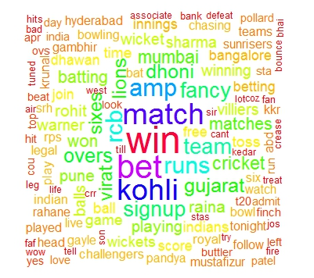
Trending

Slide 11
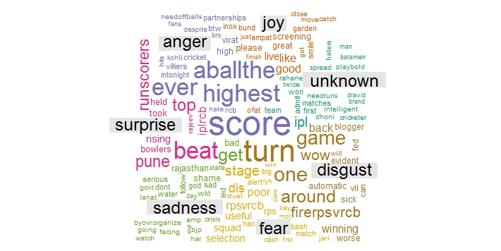
Emotion word cloud

Slide 12
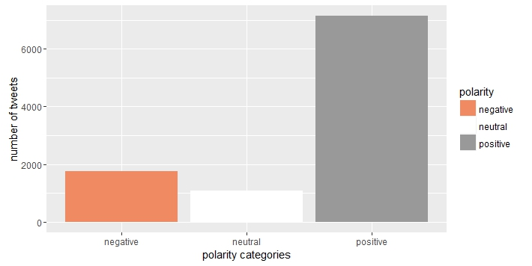
Polarity

Slide 13
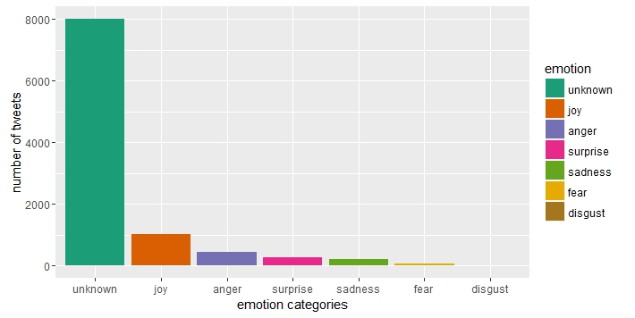
Sentiment analysis

Slide 14


