Slide 1
Agenda
Introduction
Terminology
Pseudo code
Attribute Selection
Result ,Inferences and Reference

Slide 2

The problem
Predicting whether the student would pass or not in secondary education of two schools.
This data contains student achievement in two school which includes student grades, demographic and personal data.

Slide 3
Why decision tree?
Decision Tree Classifier is a supervised learning algorithm used to solve classification and regression problems.
Decision trees are powerful and popular tools for classification and prediction.
Decision trees represent rules, which can be understood by humans and used in knowledge system such as database.

Slide 4
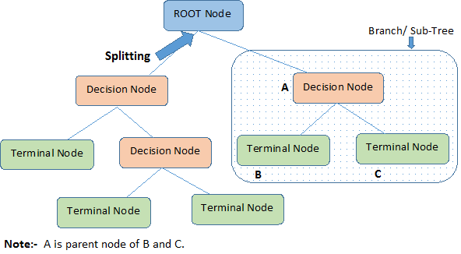
Terminologies
Important Terminology related to Decision Trees

Slide 5
Continued..
1) Root Node - It represents the entire population or sample
2) Splitting - It is process of dividing node into more sub nodes
3) Decision Node - When a sub-node splits into further sub-nodes. then it is called decision node.

Slide 6
Continued..
4) Leaf/Terminal Node - Nodes do not split and is the final node
5) Pruning - when we remove sub-nodes of a decision node, the process is called pruning.

Slide 7
How it works?
How Decision Tree Algorithm works
(recursive partitioning algorithm)
Decision tree algorithm tries so solve a problem, by using tree representation.
Each Internal node of the tree represent an attribute(in our model:G1,G2,Absences,etc..) and each leaf node corresponds to class label(in our model: pass/fail)

Slide 8
Pseudocode
Decision Tree Algorithm Pseudocode:
Place the best Attribute of the data set at the root of the tree.
Eg: The important feature of the dataset would be usually sit at the root (in our example G2)
Note: information gain plays a pivot role in understanding the importance of features for predicting final grade.

Slide 9
Pseudocode
2) Split the training set into subsets based on the several necessary attribute
3) Repeat step1 and step2 until the leaf node is found (i.e in our model: pass/fail percentage)

Slide 10
Attribute Selection
Popular Attribute Selection Measures:
1) Information gain - It is used to select the best combination of attributes required for best model accuracy.
The Information gain function is used here to know the best combination of attributes found in the data set.

Slide 11
Attribute Selection
Gini Index - It is a metric to measure how often a randomly chosen element would be incorrectly identified.It means an attribute with lower Gini index should be preferred.
We will later look into constructing a decision tree using “Information gain” and “Gini index” as a criteria.

Slide 12
Implementations of decision trees
Packages in R for modeling decision trees:
1) C50
2) rpart
3) CART

Slide 13
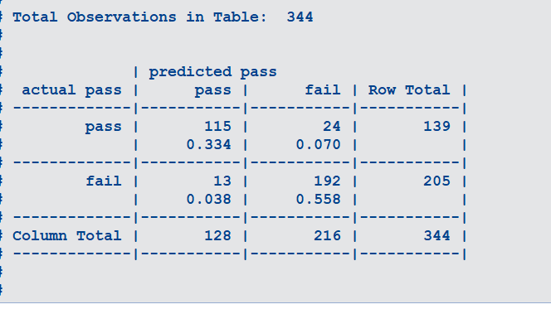
Result,Inference and Reference
1)C50 Model Result and Inference: Model incorrectly predicted total 37 outcomes out of 344 observation using Test Data.

Slide 14
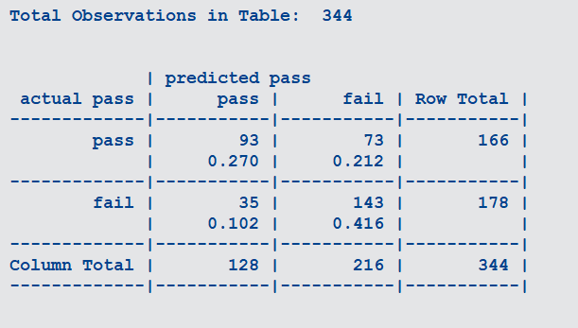
Inference
2) C50 Model Result – Model incorrectly predicted total 108 outcomes out of 344 observation using Test Data when we exclude G1,G2 as well.

Slide 15
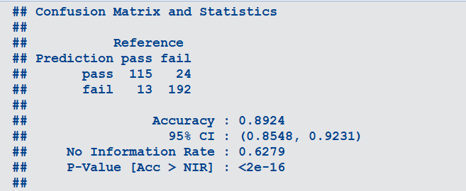
Inference
Accuracy:
CART- Using information gain we get an accuracy of 89.24%.

Slide 16
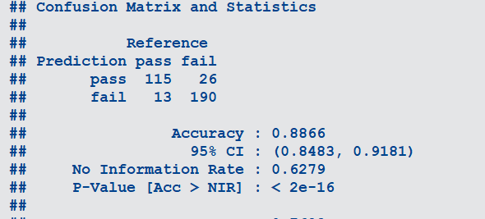
Inference
Accuracy: CART-Using gini index, we get an accuracy of 88.66%.

Slide 17
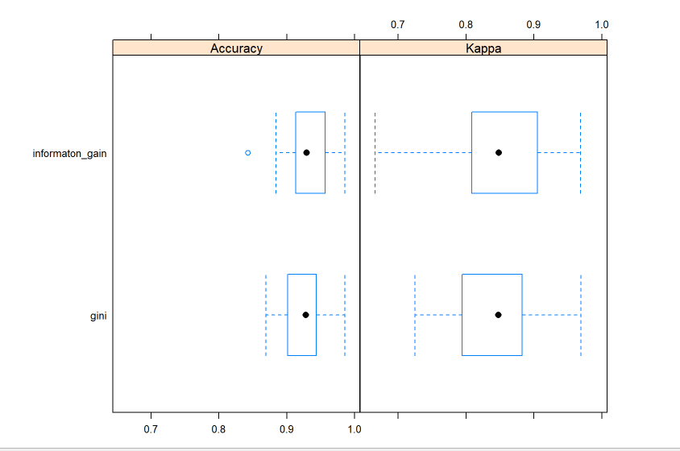
Comparison
Comparing the results of Gini index and Information gain

Slide 18
References
Reference: UCI Repository
https://rpubs.com/saad_slaoui/modeling_student_performance

