Slide 1
Data Pre-Processing
And
Data Visualization
Anirudh R

Slide 2
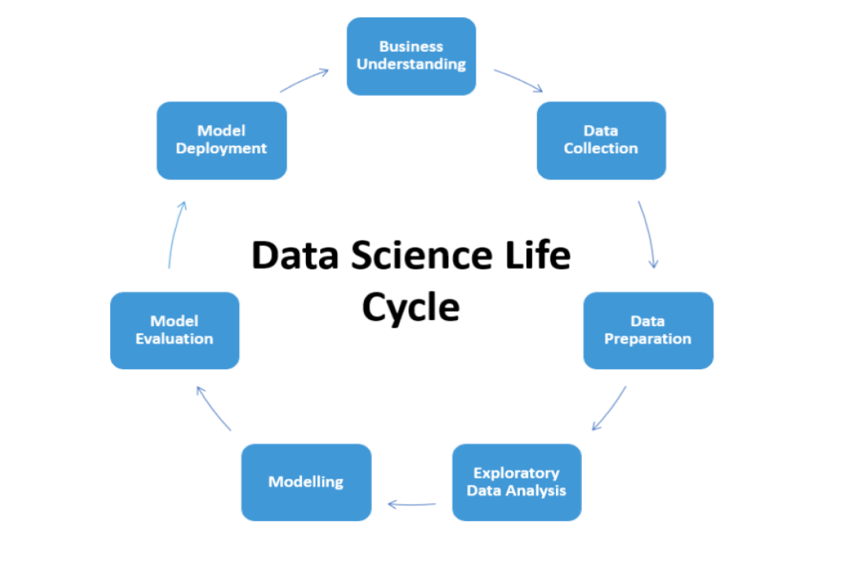
Data Science Life Cycle

Slide 3
Data Science “Process”
Understanding what and how of the project
Retrieving Data
Data Preparation
Data Visualization
Building the Model
Deployment

Slide 4
Step -1 Understanding what and how of the project
Developing a good understanding on business goals.
Plan of action.
Making a list of resources that can be of great use to the project.

Slide 5
Step-2 Data Retrieval
Listing out a couple of sources that can fetch you data.
Certain data is restricted or sensitive, so necessary permissions are required to acquire it.
Correctness of data format.
Validity of data types.
Checking whether the data matches the source document.

Slide 6
Step-3 Data Preparation
Data preparation has 3 sub steps
3.1- Cleaning Data
3.2-Data Transformation
3.3-Data Merging

Slide 7
3.1 Data Cleansing
A dataset may have many types of errors some of which are:-
Impossible values
Outliers
Typographical errors
Missing or null values
Varied units of measurements
Various levels of aggregation
Inconsistent values

Slide 8
Handling Missing Values
Error | Pros | Cons
Setting a value to 0 | Information from other variable will not be lost | Very few machine learning algorithms can only handle null values
Removing an entire row | Easy | Information from other variables that aren’t faulty is lost
Replacing it with mean or median for continuous data and with mode for categorical data. | Easy | Sometimes replacing missing data with statistical values might lead to false conclusions.
Predicting the missing value using a model | The value that is obtained would be more accurate | It’s a time taking and a complex process
Filling a value based on its preceding or succeeding value. | Value might be accurate. | Mostly its not possible as there might not be any relationship between two consecutive observation.

Slide 9
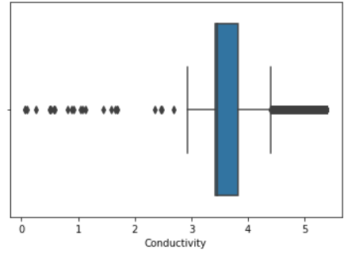
Outlier Analysis
In statistical term, outliers are those values that might be either greater than the higher quartile or lower than the lower quartile.

Slide 10
Handling Outliers
Some outlier handling methods are:-
Using natural log of the variable to reduce variations
Imputing the outlier values from other values
Binning
Deleting an entire observation that contains outlier values.

Slide 11
3.2 Data Transformation
Turning variables like gender, payments etc. into binary i.e. 1 or 0
Converting categorical variables into indicator variables.
Reducing the skewness of the variable by using log of the value
Applying binning to categorize a range of values. (Like for income, amount, marks etc.)
Reducing the number of variables.
Feature selection is a very important step as we can decide what all variables can be considered.

Slide 12
Categorical Variable Encoding
One- Hot – encoding
Creating multiple columns where each is an indicator variable with either 1 or 0.
Name | GRE | IELTS
Arun | Yes | No
Arjun | No | Yes
Name | GRE_Yes | GRE_No | IELTS_YES | IELTS_NO
Arun | 1 | 0 | 0 | 1
Arjun | 0 | 1 | 1 | 0

Slide 13
Label Encoding
In this method, each value in a column is converted into a number.
As a result, there will be an increase in the number of columns in the dataset.
Generally used when there or more categorical values.
Color | Assigned_code
Red | 0
Blue | 1
Green | 2
Yellow | 3

Slide 14
Binary encoding
As the name suggests, categorical variable is encoded with 1 and 0 since there are only two possibilities.
Example:-
Loan_ID | Loan_Status
12131415 | Paid
12131416 | Not paid
Loan_ID | Loan_Status
12131415 | 1
12131416 | 0

Slide 15
Step 3.3 Data Merging
Combining data coming from various number of sources.
Data might be coming from two different source, one from one database and another from another database.
Set operators like union can be used to append one table to another.
Duplication of data can be avoided by using views.

Slide 16
Step 4 Data Visualization
The most important step in the data science cycle.
It basically involves a very good understanding about data.
Scatter plots, bar plots, violin plots, boxplots etc. can be drawn in ordered to understand the variable.
There are a few statistical correlation methods like Pearson, Kendall, Spearman correlations can be used to get an understanding about the relationship between the variables.

Slide 17
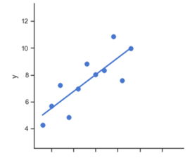
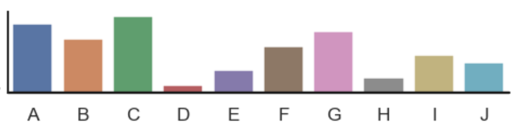
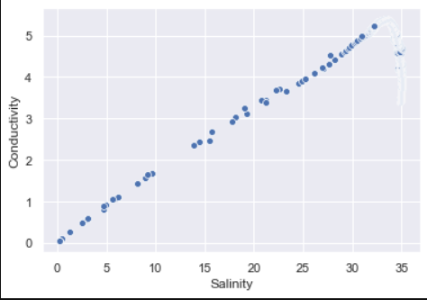
Graphs
Lm plot-
Bar plot-
Scatter Plot-

Slide 18
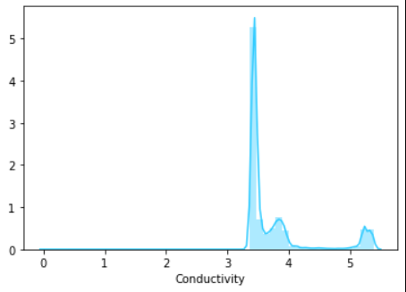
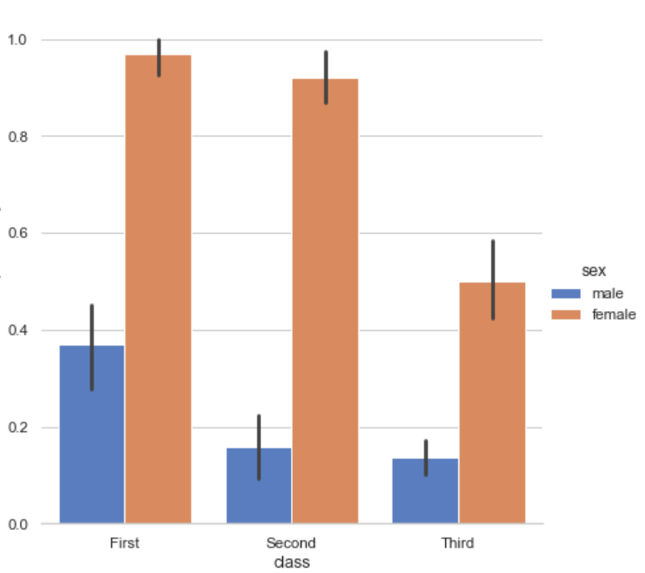
Box plot-
Distribution Plot-
Categorical Plot
(Cat-Plot)

Slide 19
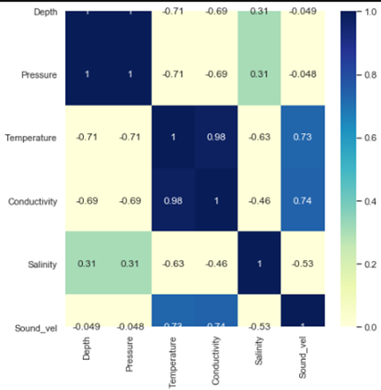
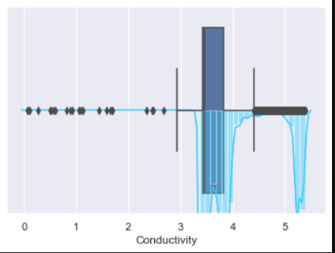
Heat map-

Slide 20
Univariate Analysis
Univariate analysis is all about examining each variable one by one.
For continuous variables, we must understand the measures of central tendency and spread of a variable.
For categorical variables, we find out the frequency of each value to get an idea on the distribution of the data.
Various kinds of graphs can be implemented to understand the distributions etc.

Slide 21
Bivariate Analysis
Bivariate analysis is for finding out the realtionship between two variables.
Combination of variables may be continuous and continuous or continuous and categorical or categorical and categorical.
Different types of graphs are used to understand the relationships.
For analysis between continuous and continuous, we use scatter plot.
For analysis between continuous and categorical, we use boxplot for each value of categorical variable.
For analysis between categorical and categorical, we use two way table to get count at the intersection of column and row.

Slide 22
Thank You

