Slide 1
Mini Project CNN MODEL FOR PLATE NUMBER RECONGITION
PROJECT GUIDE:DR. J SRINIVAS TEAM:
N.Sushanth(1608-21-737-002)
G.Karthik(1608-21-737-025)
R.Venkata Anirudh(1608-21-737-054)

Slide 2
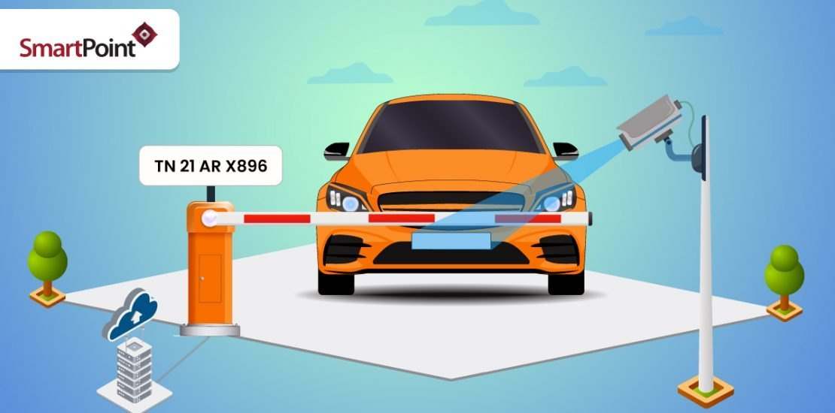

Slide 3
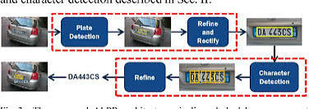
Abstract:
Project Aim: Develop a Convolutional Neural Network (CNN) model for license plate number recognition.
Technology: Utilize deep learning techniques.
Objective: Create a robust system for accurate detection and recognition of license plate numbers from images.
Target Users:
Law enforcement agencies
Parking management systems
Toll Collection and Access Control

Slide 4
Background Knowledge of the Project and Topic:
License Plate Recognition (LPR) Systems:LPR systems are used globally in various applications such as traffic management, toll collection, parking access control, and law enforcement. These systems automate the process of recognizing vehicle license plates, enhancing efficiency and accuracy compared to manual methods
Convolutional Neural Networks (CNNs):CNNs are a class of deep learning algorithms specifically designed for image recognition and processing. They are highly effective in detecting and recognizing patterns in images, making them suitable for tasks such as license plate recognition.
Deep Learning Techniques: Deep learning involves training neural networks with multiple layers to perform complex tasks. In the context of LPR, deep learning models can learn to identify license plate numbers from vast amounts of image data, improving recognition accuracy over time.
Challenges in LPR: Recognizing license plates accurately can be challenging due to varying lighting conditions, plate angles, occlusions, and different plate designs. A robust CNN model can address these challenges by learning from diverse image datasets.

Slide 5
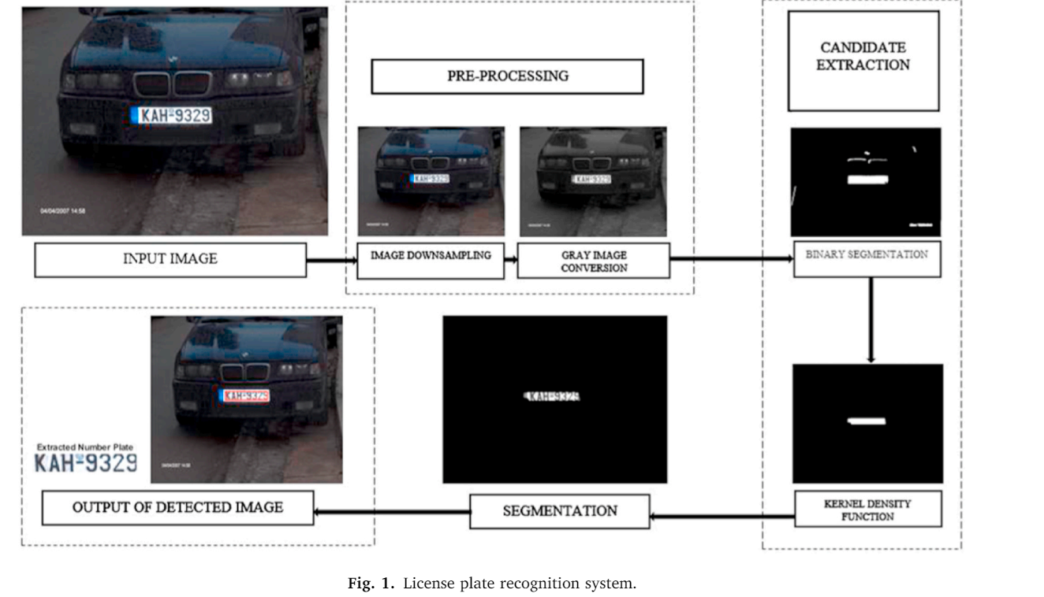

Slide 6
LITERATURE SURVEY:
Prevalence and Applications: License Plate Recognition (LPR) systems are widely used in law enforcement, traffic management, and parking systems.
Early LPR Systems: Initially relied on traditional image processing techniques like edge detection, morphological operations, and template matching, which struggled with varying lighting, occlusions, and plate formats.
Machine Learning Advancements: The advent of machine learning introduced classifiers like Support Vector Machines (SVM) and K-Nearest Neighbors (KNN) for character recognition, though their performance was limited by feature extraction quality.
Revolution with CNNs: Convolutional Neural Networks (CNNs) have transformed LPR systems by automating feature extraction and improving recognition accuracy, making them robust against variations in lighting, angles, and occlusions

Slide 7
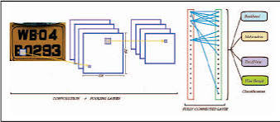
Superior Performance: Studies indicate that CNNs, trained on extensive and diverse datasets, outperform traditional methods and earlier machine learning models in detection and recognition tasks.
Deep Learning Frameworks: The use of frameworks like TensorFlow and PyTorch has enabled the development of sophisticated LPR systems, offering tools for model training, optimization, and deployment, leading to efficient and scalable end-to-end solutions

Slide 8
Project specific Goals:
Develop a Convolutional Neural Network (CNN) Model:Create a CNN model specifically designed for the recognition of license plate numbers from images.
Achieve High Accuracy in Detection and Recognition:Ensure the model accurately detects and recognizes license plate numbers under various conditions, including different lighting, angles, and occlusions.
Cater to Diverse Applications:Develop a web application interface that allows users to easily interact with the system, providing necessary inputs and retrieving outputs effectively.

Slide 9
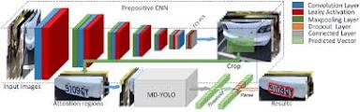
Ensure System Robustness and Reliability: Implement measures to ensure the system is robust, reliable, and capable of handling real-world scenarios and diverse image datasets.
Optimize Performance for Real-Time Use: Optimize the CNN model and system architecture to enable real-time license plate recognition and processing

Slide 10
Project planning:
Project Initiation: July 1, 2024 - July 10, 2024
Data Preprocessing: July 11, 2024 - July 20, 2024
Integration and Deployment: July 21, 2024 - August 5, 2024
Evaluation and Testing: August 6, 2024 - August 15, 2024

Slide 11
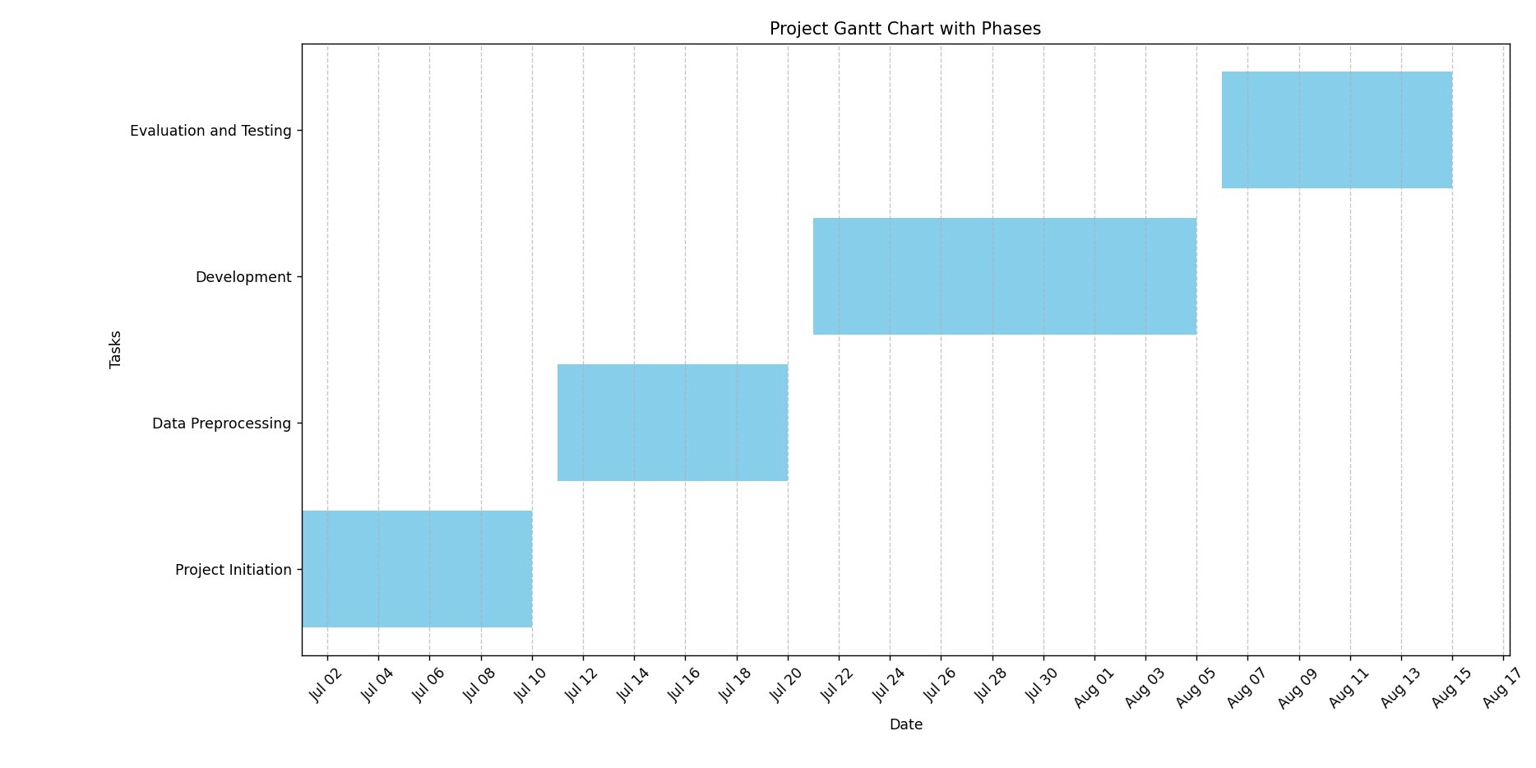

Slide 12
Modules:
Data Collection and Preprocessing: Module for gathering and pre-processing license plate images.
Model Development: Module for designing and training the CNN model.
Integration and Deployment: Module for integrating the trained model into a deployable platform.
Evaluation and Testing: Module for evaluating and testing the performance of the system.

Slide 13
MINIMUM SYSTEM REQUIREMENTS :
Hardware device | Configuration
RAM | 8 GB
Hard Disk | 100GB
Processor | Intel Core i5

Slide 14
References:
[1] X. Ascar Davix, C. Seldev Christopher, D. Judson, Detection of the vehicle License Plate using a kernel density with default search radius algorithm filter, in: International Journal of Light and Electron Optics, Optik, Elsevier, 2018, pp. 1–8, 2020
P. Ravi Kiran Varma, Srikanth Ganta, B. Hari Krishna, S.V.S.R.K. Praveen, A novel method for Indian vehicle registration Number Plate Detection and recognition using image processing techniques detection and recognition using image processing techniques, in: International Conference on Computational Intelligence and Data Science (ICCIDS 2019) vol. 167, Elsevier, Procedia Computer Science, 2020, pp. 2623–2633.
M.A. Jawale a , P. William a,* , A.B. Pawar b , Nikhil Marriwala Implementation of number plate detection system for vehicle registration using IOT and recognition using CNN

Slide 15


Slide 16


