Slide 1
Predicting Fake News Articles
Momin Asadullah Khan

Slide 2
ABSTRACT
Living in the age where information quickly accessible on social media platforms exposes us and makes us susceptible to believing fake news articles. These articles underlying tone incites xenophobia and racism leading to polarized views fueled by lies. This problem is plentiful on this social media platform, the needs of which require us to experiment with machine learning and deep learning models to classify fake news to enhance user experience. This paper explores the methods, results and conclusions drawn from the analysis. It also makes recommendations for the future.

Slide 3
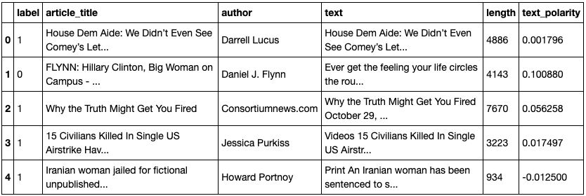
Introduction
Social Media companies need to have satisfied customers for it to be successful and this report looks at our ability to predict fake news articles on a social media platform and flag them as fake or real.
The social media platform is the client and they are concerned about potentially losing current users from their platform.
The client is interested in predicting which news articles circulating on their platform are real or fake, and to flag the fake articles so users on the platform are aware of whether the article they are reading is real or fake
A snapshot of the dataset below!

Slide 4
Methods
Data Wrangling
Exploring the data
Inferential Statistical Analysis
Modeling

Slide 5
Data Wrangling
Changing column names.
Removing articles with less than 50 characters.
Removing articles with null values.
Adding text_polarity column with values ranging between -1 and +1.

Slide 6
ng the data
Exploring the Data
In all news articles, without removal of stop words, the top word that occured was ‘the’. With the removal of stop words, the top word that occured was ‘said’. Similarly, without removal of stop words, the top bigram that occured was ‘of the’. With removal of stop words, the top bigram that occured was ‘mr trump’. Lastly, in all news articles, without removal of stop words the top trigram that occured was ‘the united states’. With the removal of stop words, the top trigram that occured was ‘new york times’.
In all fake articles, without removal of stop words, the top word that occured was ‘the’. With the removal of stop words, the top word that occured was ‘said’. Similarly, without removal of stop words, the top bigram that occured was ‘of the’. With removal of stop words, the top bigram that occured was ‘mr trump’. Lastly, in all news articles, without removal of stop words the top trigram that occured was ‘the united states’. With the removal of stop words, the top trigram that occured was ‘new york times’.
For all (real and fake) articles, text polarity seemed normally distributed and had articles of values -1 and +1.
Fake articles text polarity seemed normally distributed but did not contain articles with extreme values of -1 and +1.
There was no correlation between the features in the dataset.
Found the top unigram, bigrams and trigrams in all, real and fake articles.

Slide 7

Inferential Statistical Analysis
Hypothesis Testing: Is there significant difference in the means of text polarity between articles that are fake and all text articles?
Null Hypothesis: The null hypothesis would be there there is no difference in text polarity between articles that are fake and all text articles.
Alternate Hypothesis: The alternative hypothesis would be that there is a difference in text polarity between fake articles and all articles.
The low P-value of 0.0025 at a 5% confidence interval is a good indicator to reject the null hypothesis.

Slide 8
Modeling
CountVectorizer and TF-IDF Vectorizer to convert into input data for modeling
Predicted with Logistic Regression and Multinomial Naive Bayes classifier
Predicted with deep learning technique called Long Short Term Memory Neural Networks

Slide 9
Results
Model Evaluation

Slide 10
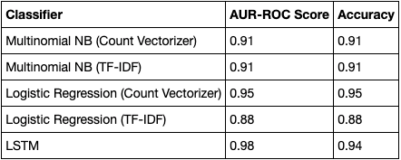
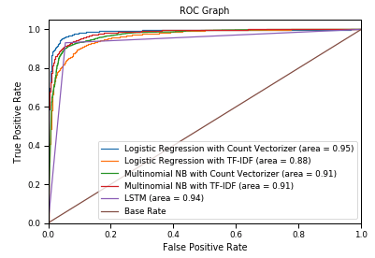
Results
Logistic Regression gave best result with 95% accuracy and 95% AUC-ROC score.
LSTM model second best with 94% each in accuracy and AUC-ROC score.
The worst model performance was also by Logistic Regression with TF-IDF Vectorizer achieving an accuracy and AUC-ROC score of 0.88.

Slide 11
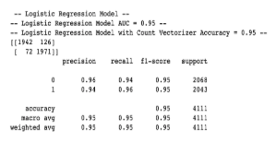
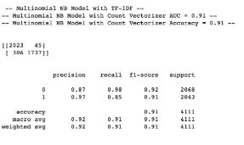
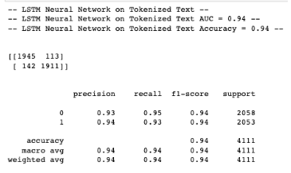
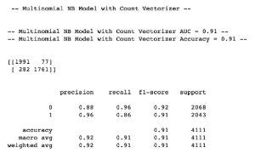
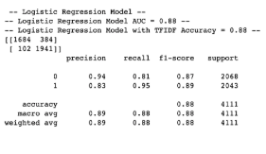
Model Evaluation
Use Accuracy
Use the AUC-ROC score which plots the True Positive Rate against the False Positive Rate.
Take into consideration the False Positive and False Negative Errors to evaluate our models' performances.
False Positives (Type I Error): You predict that the article is Fake but is Real.
False Negatives (Type II Error): You predict that the article is Real but is Fake.

Slide 12
Conclusion
Potential Solutions
Where do we go from here?

Slide 13
Potential Solutions:
Solution 1:
We can rank the articles with a probability estimate of it being real or fake, indicating how confident we think a particular article is real or fake. This will provide the readers some context and enough to decide for themselves to be skeptical of the news or not. The social media platform isn't making the decision for their users but giving them the information to decide for themselves so it does not feel like the user is being coerced into believing something or not.
Solution 2:
Provide free training to the users of the social media platform to identify fake news. For example, tips and resources can be shared that discuss common ways one can fact check a news article. It can be as simple as copy pasting information from the article into google, and seeing if the information adds up.

Slide 14
Where do we go from here?
This problem is about equipping the social media company with actionable knowledge regarding their ability to identify fake news on their platform and countering it. When modeling the data, we should not use the predictive metric as our final solution. Instead, we should use the information we get from modeling and arm the social media platform users so they can carry out informed decision making.
Once the model is deployed, as more and more articles get shared on the platform, our dataset will grow. This will help make our model more accurate over time by allowing us to even test out different techniques or other models that may perform better or are more computationally efficient for our use case. For now, this model will do as it is better to have some knowledge about an article's validity than to be completely in the dark in this age of misinformation.

