Slide 1
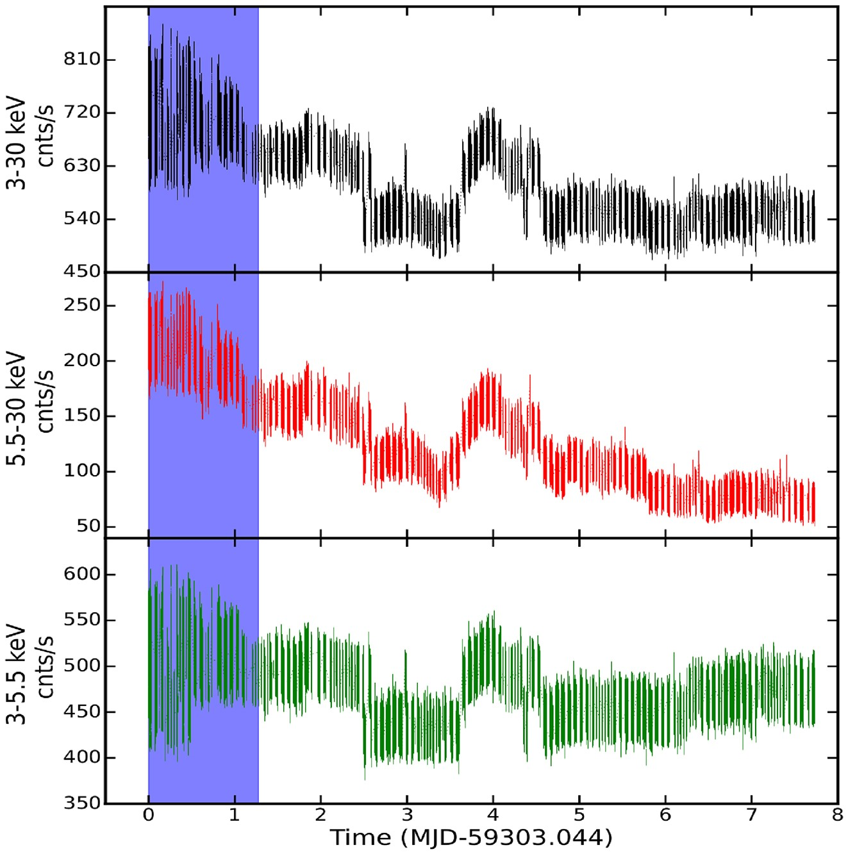

Figure 1. AstroSat/LAXPC20 light curves of GX 339-4 in different energy bands for all 74 orbits, from the top, ...
Notes:
Figure 1. AstroSat/LAXPC20 light curves of GX 339-4 in different energy bands for all 74 orbits, from the top, 3.0−30.0 keV (top panel), 5.5−30.0 keV (middle panel), and 3.0−5.5 keV (bottom panel), respectively. The bottom panel shows the hardness ratio (5.5−30.0 keV/3.0−5.5 keV). The vertical shaded region shows the 11 orbits in which QPOs are observed. The ‘0’ (zero) in the X-axis represents MJD = 59303.044.
Unless provided in the caption above, the following copyright applies to the content of this slide: © 2023 The Author(s). Published by Oxford University Press on behalf of Royal Astronomical Society.This is an Open Access article distributed under the terms of the Creative Commons Attribution License (https://creativecommons.org/licenses/by/4.0/), which permits unrestricted reuse, distribution, and reproduction in any medium, provided the original work is properly cited.

