Slide 1
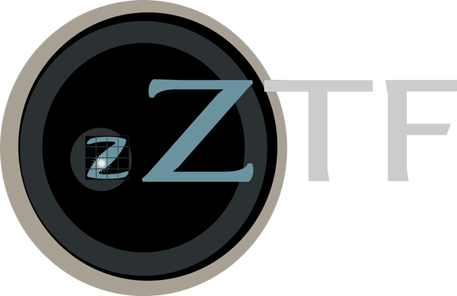




Kowalski
Alert query for
short-duration
sources
Candidates and alerts added to ZTFReST database
Alert light curve
Finding rise and decay rates via linear fit
Fades
< 0.3 mag/d?
yes
Reject
Quality check
Based on nearby alerts (optional)
Update database
Select from database
those candidates that need new forced phot
no/ambiguous
yes
Reject
Trigger forced photometry
Light curves added to the database
Light curve fitting
Fades
< 0.3 mag/d?
no/ambiguous
Stack flux
Kilonova fitting
(optional)
CLU
galaxy crossmatch
Trigger LCOGT
Daily candidate scanning
Check
LCOGT status
Update database
SEDM
P200
Keck
Gemini
LT
GROWTH
India
KPED

