Slide 1
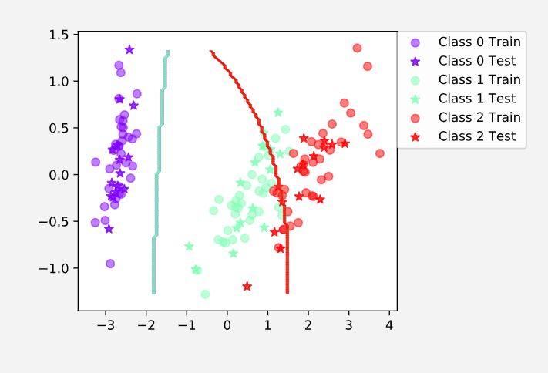
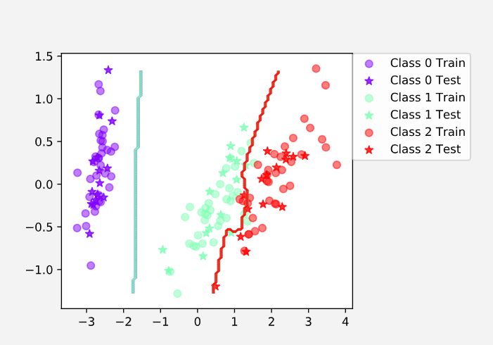
Bayes Classifier
Iris Dataset (Without Boosting)
Iris Dataset (With Boosting)
DATASET | Mean Classification Accuracy | Standard Deviation | Mean Classification Accuracy | Standard Deviation
 | WITHOUT BOOSTING |  | WITH BOOSTING
IRIS | 89 | 4.16 | 94.1 | 6.72
VOWEL | 64.7 | 4.03 | 80.2 | 3.52

Slide 2
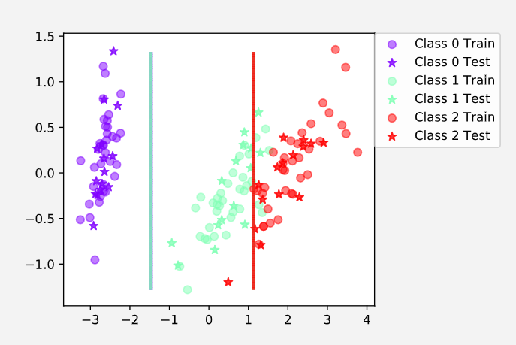
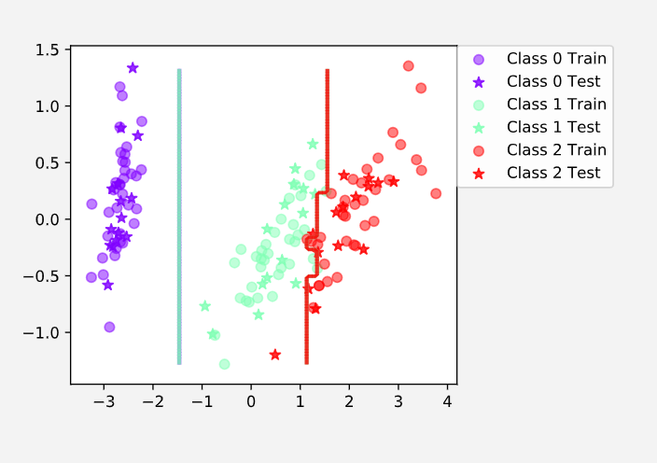
Decision Tree Classifier
Iris Dataset (Without Boosting)
Iris Dataset (With Boosting)
DATASET | Mean Classification Accuracy | Standard Deviation | Mean Classification Accuracy | Standard Deviation
 | WITHOUT BOOSTING |  | WITH BOOSTING
IRIS | 92.4 | 3.71 | 94.6 | 3.65
VOWEL | 64.1 | 4 | 86.9 | 3.06

