Slide 1

Hotel Management System
By,
Manoj Reddy Amireddy
Janhavi Swapnil Patil
Nikhil Bindal
Anirudh Sampath Kumar
Siddhant Nagraj

Slide 2
Objectives
Streamline Operations
Enhance Customer Experience
Improve Revenue Management
Reduce Costs
Real Time Reporting
Improved Analytics

Slide 3
High Level Design
We have designed a Hotel Management System which tracks the customer repeat rate and revenue generated from the database and optimizes the resources effectively
Using the data, we created dashboards which gave us an overview of the current functioning and the insights of usage.
Also, Efficiently tracks the activities and events hosted by the hotel.
Store information safely and encrypt on disk at all times.
Reports to provide insights on the customer data about reservations and revenue generated.

Slide 4
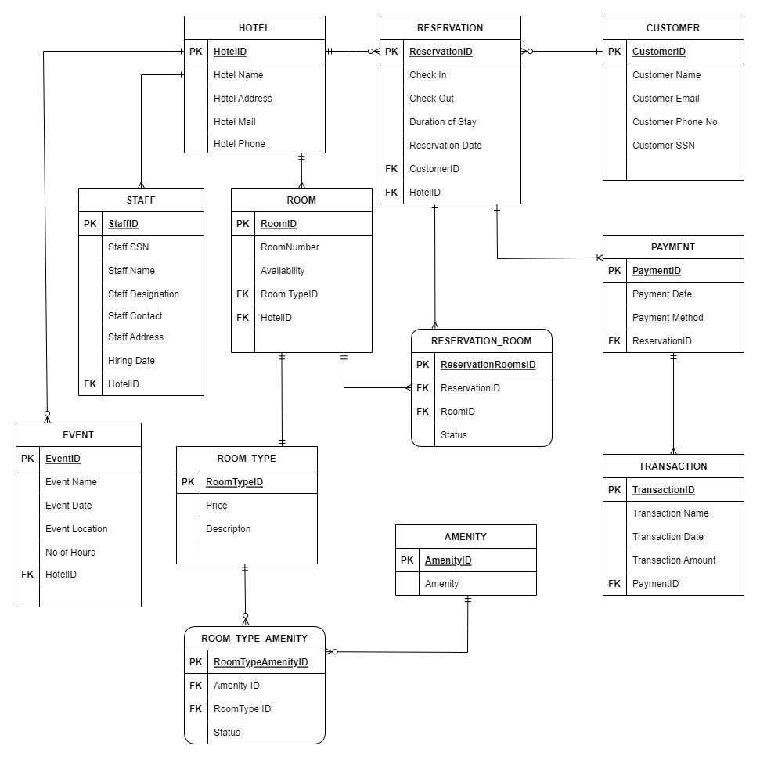
ER Diagram
Entities
Hotel Reservation Customer Staff Room Payment Event Amenity Room Type Transaction RoomType_Amenity Reservation_Room

Slide 5
Database Objects
Stored Procedures
sp_CalcuateRevenue
sp_GetAvailableRooms
sp_getStaffDetails
sp_getCustomerDetails
Views
vw_GetAvailableRooms
vw_GetCustomerReservationHistory
vw_ActiveCustomers
vw_ActiveDefaulterCustomers
Triggers active_customers_in_hotel_insert active_customers_in_hotel_update insert_staff_details insert_customer_details
User Defined Functions
calculateDuration
getHotelNameByHotelId

Slide 6
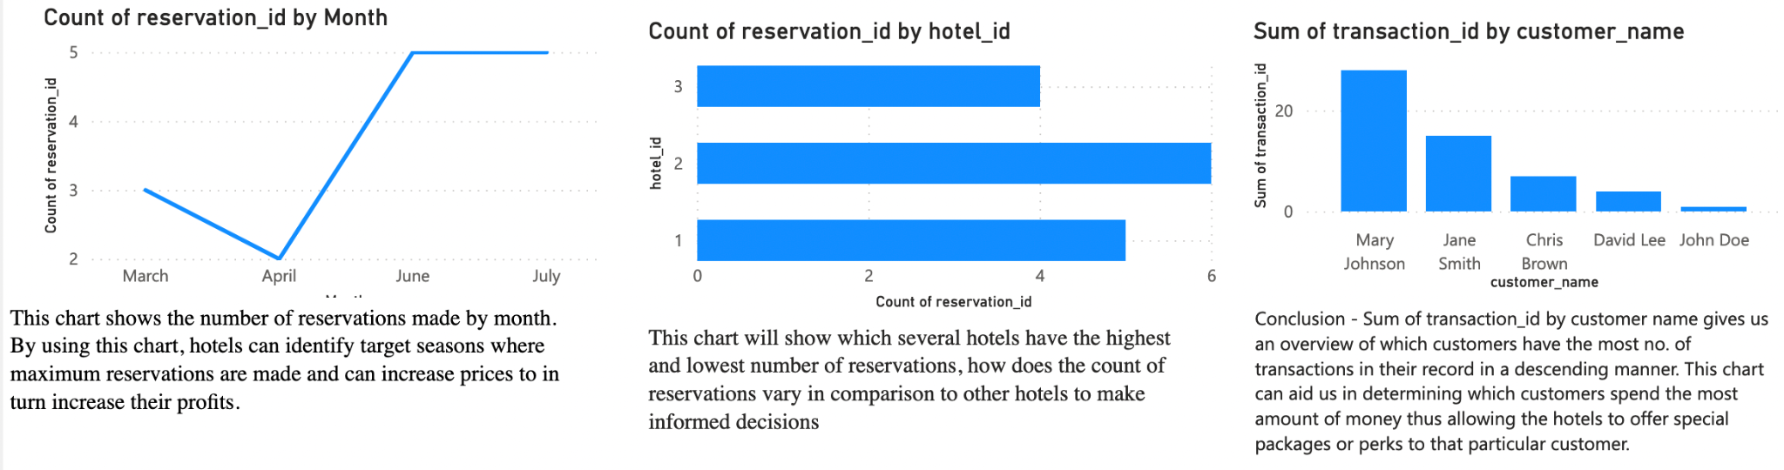
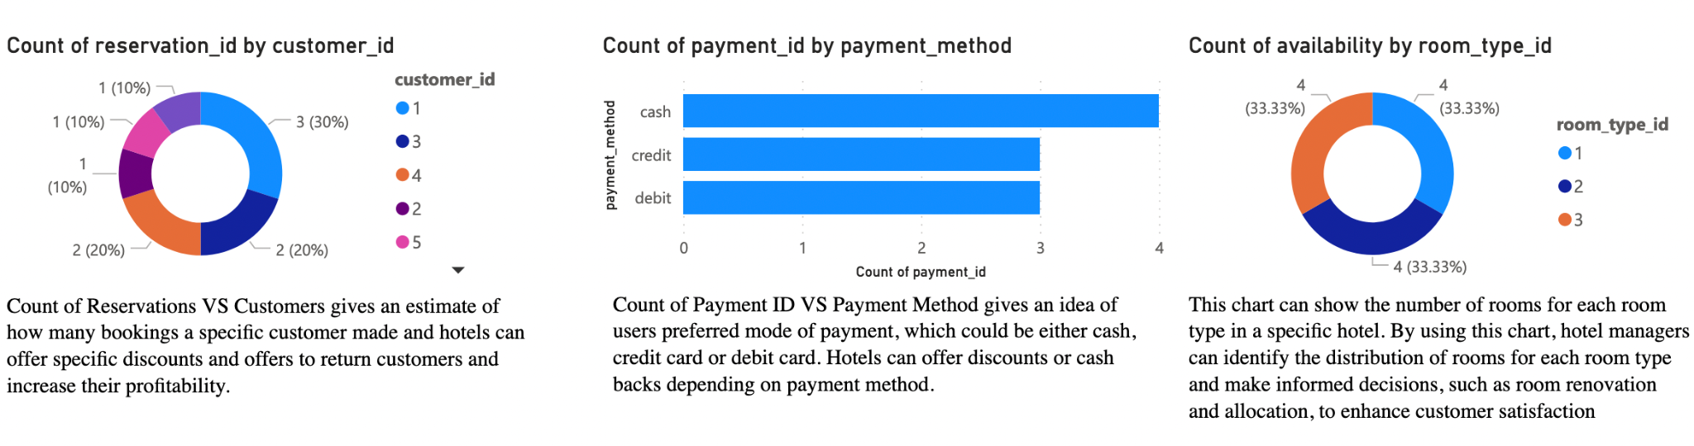
Dashboard

Slide 7
Data Population
Added the data using a SQL script(db_insert.sql) that maintains referential integrity
Some columns are populated by UDF's and Triggers which are essential for meeting business rules
Personal sensitive customer data like SSN is encrypted in the columns by using triggers on insert. So the data is encrypted on disk at all times.
Retrieval of sensitive data happens when it's requested by decrypting the data.
Computed columns are populated automatically by using database objects.

Slide 8
References
https://www.w3schools.com/sql/
https://databasefaqs.com/azure-sql-database-column-encryption/
https://learn.microsoft.com/en-us/sql/t-sql/language-reference?view=sql-server-ver16
https://en.wikipedia.org/wiki/Database_schema
https://en.wikipedia.org/wiki/Relational_database
https://en.wikipedia.org/wiki/Database_trigger
https://en.wikipedia.org/wiki/Stored_procedure

