Slide 1
Anirudh Srinivas J P
Final Project
3/21/2024 Annual Review

Slide 2
Detecting SMS spam using Machine Learning
3/21/2024 Annual Review

Slide 3


AGENDA
PROBLEM STATEMENT
PROJECT OVERVIEW
WHO ARE THE END USERS?
YOUR SOLUTION AND ITS VALUE PROPOSITION
THE WOW IN YOUR SOLUTION
MODELLING
RESULTS
3/21/2024 Annual Review

Slide 4

PROBLEM STATEMENT
Problem: The increasing volume of SMS spam is causing inconvenience and potential harm to mobile users.
Challenge: Traditional rule-based spam filters are limited and often ineffective against evolving spam techniques.
Objective: Develop a machine learning model to accurately detect SMS spam, reducing the impact on end users.
.
3/21/2024 Annual Review

Slide 5

PROJECT OVERVIEW
Scope: Building a machine learning system to classify SMS messages as spam or legitimate (ham).
Goal: Enhance user experience by minimizing exposure to unwanted SMS content.
Approach: Leveraging machine learning algorithms to automate the detection process with high accuracy.
3/21/2024 Annual Review

Slide 6

WHO ARE THE END USERS?
End Users: Mobile phone users across all demographics who receive SMS messages.
Beneficiaries:
Everyday consumers: Protection from annoying and potentially fraudulent SMS spam.
Telecom companies: Improve customer satisfaction and reduce customer support requests related to spam.
3/21/2024 Annual Review

Slide 7

YOUR SOLUTION AND ITS VALUE PROPOSITION
Solution: A machine learning-based SMS spam detection system.
Value Proposition:
Efficiency: Automates spam detection, saving users' time and frustration.
Accuracy: Offers a higher accuracy rate than traditional rule-based filters.
Adaptability: Can continuously learn and adapt to new spam patterns.
Privacy: Ensures user privacy by processing messages locally on the device (if applicable).
3/21/2024 Annual Review

Slide 8

THE WOW IN YOUR SOLUTION
The "wow" factor in your solution could be its accuracy, efficiency, ease of use, or any unique features or techniques employed in the model development process. For example, if your model achieves state-of-the-art performance on the dataset or if you incorporate advanced natural language processing techniques for better text representation, these could be considered as "wow" factors.
3/21/2024 Annual Review

Slide 9
MODELLING
Approach: Used a combination of:
Feature Engineering: BoW (Bag-of-Words), TF-IDF (Term Frequency-Inverse Document Frequency).
Algorithm: Chose a Logistic Regression model for its balance of simplicity and effectiveness.
Hyperparameter Tuning: Utilized GridSearchCV to optimize model parameters.
3/21/2024 Annual Review

Slide 10
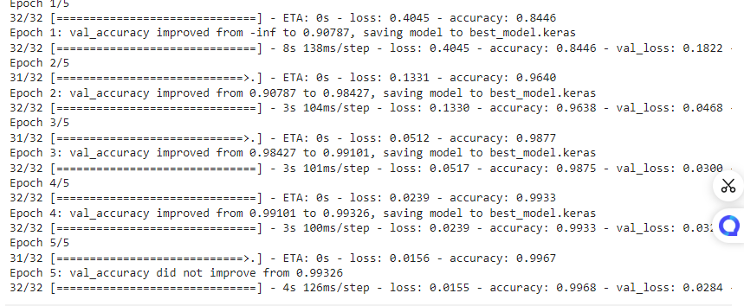

RESULTS
Demo Link
https://colab.research.google.com/drive/1QAZ7cA8GQtDRh6z_yru_y5MrF2IKP1ZI?authuser=1#scrollTo=GAh50QmylEg6

