Slide 1
Device Capability Based Multimedia Transcoding Over Network
Project Team:
Ananya Anurag
Anirudh Tomer
Toshish Jawale
Project Guides:
Kapil Agrawal, CEO Media Magic Technologies, Pune Prof. S.S. Paygude, Dept. of Computer Engineering, MIT Pune Special Thanks to:
Vaibhav Ingale
Shyam Kundapurkar

Slide 2
Contents of presentation
Problem Statement
Our Solution
Implementation of solution

Slide 3
Problem statement
Every device needs plug-ins to play multimedia content.
Hundreds of format in the market
Not possible to install plug-ins for every media format.
The problem gets bigger when it comes to mobile devices.

Slide 4
Our solution
Detect what the client can play
Trans-code multimedia stream before it reaches the client
Stream the trans-coded contents to the client

Slide 5
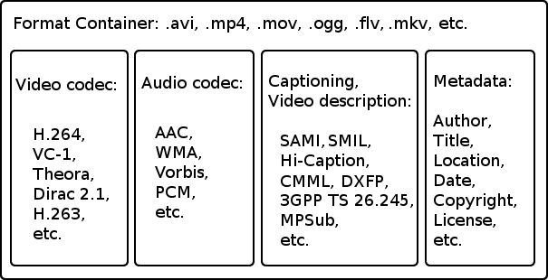
Multimedia formats for video
Container format = audio format + video format

Slide 6
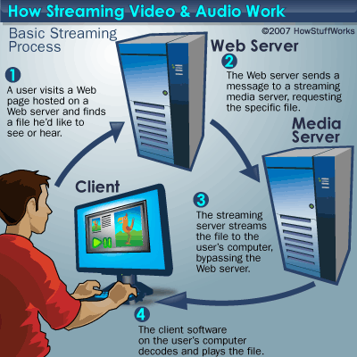
Multimedia stream
Streaming media is multimedia that is constantly received by and presented to an end-user while being delivered by a streaming provider.

Slide 7
Trans-coding
Trans-coding is the digital-raw-digital conversion of one encoding to another
Format A
Raw Format
Format B

Slide 8

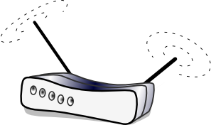
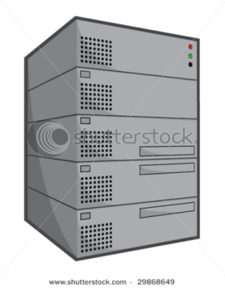
Flow of working
Request sent to Server
Gateway stores and forwards the request
Gateway checks for the format of the reply and transocdes the stream if needed
Server Responds back

Slide 9
Step1: Working as a proxy server
Client sets the software as a proxy server by changing the settings of the browser it is using.
Software proxy module receives the request and forwards it to actual server after storing session state
After sending request, Software is waiting for the reply.

Slide 10
Step 2: adding an entry for the client…saving multimedia playing capabilities of the client
Software sends capability finding JavaScript to the client.
JS gets executed on the client browser and sends the capabilities to the software.
The software creates an entry for the client capabilities in the database for further use. (valid only for 30 mins)
Software then sends the actual page to the client.

Slide 11
Step 3: transcoding if needed
If request for any video goes through the software it checks the database to check if the client would be able to play the video
If it finds that the client would be incapable then it transcodes the incoming stream and sends the transcoded stream to the client.

Slide 12
How We did it (sub-index)
1. Modules
2. Explanation of the role of each modules
3. Communication between the modules
4. Implementation of each module

Slide 13
Modules
Controller
Trans-code Handler
Trans-coder

Slide 14
Controller
Proxy Server
Thread for communication between controller and transcode handler
Help And quit
A reply handler

Slide 15
Proxy server
A proxy server which keeps on listening to requests and invoke a new thread for sending the reply for each request.

Slide 16
Reply handler
A reply handler invoked by the proxy server for each request. It does the communication between the actual server and the client. It parses the requests, forwards them, waits for the reply, maintains the database, acts as a live streaming server and invokes the process of transcoding.

Slide 17
Thread for communication between controller and transcode handler
Thread for communication between controller and the process which handles the job of transcoding (we call it trancode handler).
Whenever controller requires a video to be transcoded it sends the parameters to the transcode handler.

Slide 18
Trans-code handler
A thread for communication with controller.
Thread for communication with the transcoder process.

Slide 19
Trans-coder
It uses gstreamer for transcoding purpose.
There may be many such processes working simultaneously.
gst-launch-0.10 webmmux name=mux ! filesink location=newfile.webm uridecodebin uri=http://localhost:81/av.ogg name=demux demux. ! ffmpegcolorspace ! vp8enc ! queue ! mux.video_0 demux. ! progressreport ! audioconvert ! audiorate ! vorbisenc ! queue ! mux.audio_0

Slide 20
Implementation of the 3 modules
Multithreading used (libpthread used)
IPC done via pipe
Transcoding is done via gstreamer
libmysqlclient used for communicating with mysql 5.0
Live streaming and proxy written by us in C

Slide 21
Technology Used
C++
Javascript
Html 5
Gstreamer 0.10
Mysql 5.0
Linux ubuntu 10.10

Slide 22
Features
Written our own proxy server in C
Written our own Live Streaming Server in C
VOD and HTTP chunked encoding in C
Can be provided as an application or a web service

Slide 23
Usefulness and business perspective
Online News(various news channels stream the news online)
Live cricket, football etc. matches
On-Demand videos from sites like youtube
Video chatting

Slide 24
Future enhancement
Cluster of machines can be used.
Load balancing can be done.
Peer to peer network can be designed.
Some sort of artificial intelligence can be given to the software to increase efficiency.
The number of formats supported can be increased.

Slide 25
references
Online references
1. gstreamer Documentation (http://gstreamer.freedesktop.org/documentation/)
2. www.stackoverflow.com
3. Survey literature from www.google.com
4. Survey literature from www.wikipedia.com
5. MySQL documentation (http://dev.mysql.com/doc/)
6. RFC-2616 (HTTP protocol)
Books
1. Beginning Linux Programming – Neil Matthew, Richard Stones,
Wiley Publishing
2. Linux System Programming – Robert Love, O’Reilly
3. Unix Network Programming – W. Richard Stevens, Prentice Hall
4. The Design of Unix Operating System – Maurice Bach, Prentice Hall
5. Debugging with GDB – Richard Stallman, Roland Pesch, Stan Shebs, et al,
GNU Press
6. The fundamentals of Multimedia – ze-Nian Lee, Mark S. Drew, Prentice Hall

Slide 26
For further information
https://sites.google.com/site/beproj2011mitpune/
http://systemsdaemon.blogspot.com

Slide 27
Thank You!!

