Slide 1

FLYCYCLE PROJECT PROPOSAL Phase - 2
University of Maryland
Team: MRE (Medical Robotics and Equipment) Lab
Team Lead: Dr. Axel Krieger
Graduate Student: Anirudh Topiwala

Slide 2
Overview
Phase 1 Accomplishments:
Mechanical design improvements
Upgrading the electronics hardware and software
Integrating virtual reality
Integrating games with the flycycle
Phase 1 Remaining Improvements:
Fix the solenoid valve for the piston braking system
Fix the pedaling system to have variable resistance.
Phase 2 Objectives and Plans:
A: Integrate the Flycycle into the teaching curriculum at UMD to engage students. The Flycycle course will be offered at three levels of difficulty:
High School Students: Women in Computing
Freshmen/Sophomore year students
Junior and Senior Capstone Design Projects.
B: Investigate the efficacy of the Flycycle in Stroke Rehabilitation

Slide 3
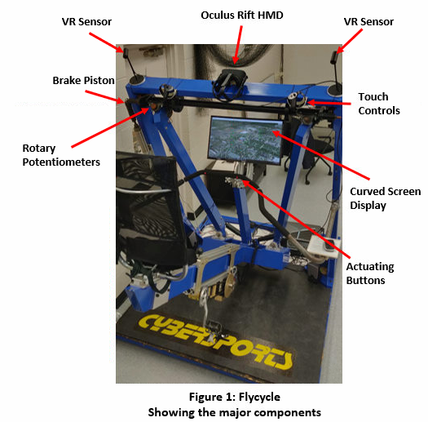

Slide 4
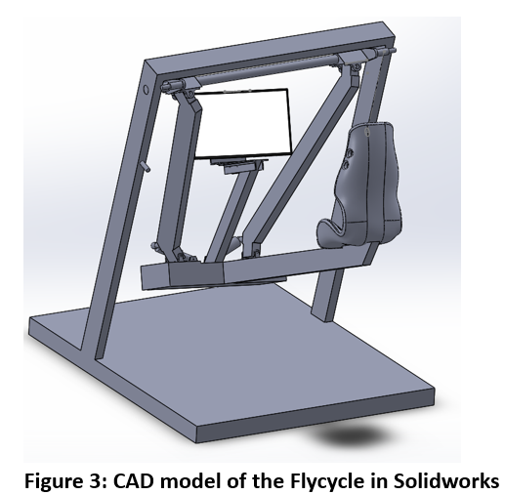
Phase 1 Accomplishments
Mechanical Design Improvements:
CAD Development:
Entire Flycycle is modeled in Solidworks.
The dimensions are taken hands on from
the flycycle as well as from the datasheets
provided.
b) Refilling of Hydraulic fluid in the Braking System
The hydraulic fluid in the pistons is refilled
and the system was bleeded to remove
air bubbles.
This added dynamic resistance to the entire
system.
Modernizing the Flycycle:
Changed the electronics to modern microcontrollers like arduino.
Made mechanical changes to account for the new curved monitor screen.
Changed the hydraulic fluid in the Piston braking system.
Rewiring the potentiometers on the Flycycle.
The Flycycle outputs are now hooked to a game controller and therefore essentially opening a widely available game pool.

Slide 5
c) Fixing the belt for the pedalling system:
The pulley to restraint the belt attached to the pedals was broken. This was fixed by 3D printing supports and restraining the belt.
This enabled measuring the RPM while pedaling.
Variable resistance to the pedals will be enabled once the alternator is fixed.
d) Integrating Supports and Stands for the Virtual Reality Hardware:
Supports for VR sensors were designed and mounted onto the Flycycle.
Remote Holders and HMD supports were also 3D printed and fixed onto the flycycle.

Slide 6
2) Upgrading the Electronics hardware and Software:
A record of previous electronics connections was documented for future references.
The entire system was replaced by using Arduino Mega Controller.
The Potentiometers were rewired to give an input voltage equivalent of the game controller voltage.
DAC (Digital to Analog) boards were used to map the flycycle potentiometer readings to the game controller’s potentiometer.
A relay system can be easily integrated with these arduino board to actuate the braking system (Solenoid Valve) of the flycycle.
A Windows 10 operating system is used to manage all applications and game development. The computer is equipped with 2TB of memory and a 11GB graphics card which is liquid cooled for increased performance.
The game used right now are through the Oculus support.

Slide 7
3) Integrating Virtual Reality:
Oculus Rift was used to integrate virtual reality with the Flycycle.
As oculus supports the use of game controllers for almost all games, the Flcycle can also be used to play a variety of games.
Steam which is another VR development community is also installed onto the system. This will support the integration of Unity at a later stage.
The VR software also has the ability to duplicate the desktop and therefore all 2D games without VR support can also be played using oculus in 3D
The sensors were mounted and calibrated to track the HMD (head mount display) and therefore can also be used as another input during game development.

Slide 8
4) Integrating Games with the Flycycle
The buttons on the flycycle are hooked to the joystick controller enabling more ways to actuate the games. The games configure so far are:
Flight Simulator:
Pitch and Roll of the plane are mapped to the flycycle with the actuating buttons giving more camera view options.
The simulator is equipped with information like the elevation of the plane, eye height, the roll and the pitch angle with respect to the ground.
Moreover, the flight simulator is integrated with google earth and therefore you could even fly over your own house.
b) Asphalt 8 (Racing Game):
This is a racing game and it is chosen as the game in 2D itself is very immersive. This opens an avenue for students to compete in.
The direction of the motion of the car is controlled by the roll of the Flycycle while the pitch controls the barking. The different buttons mounted on the Flycycle actuate the nitro and the different camera angles.

Slide 9
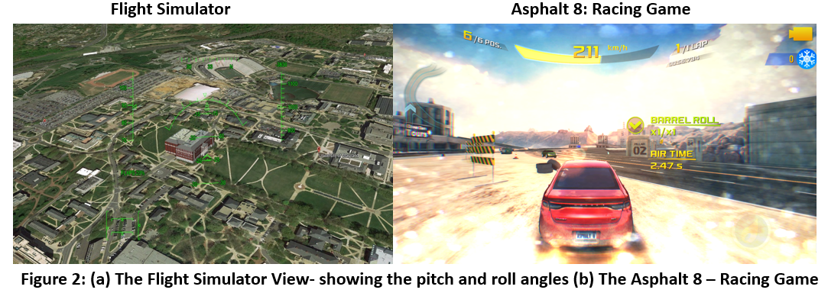

Slide 10
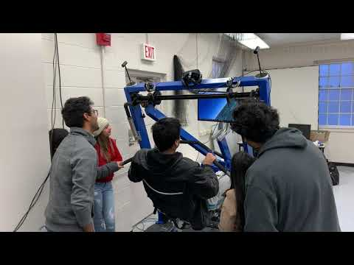
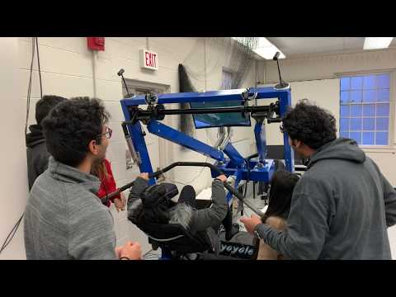
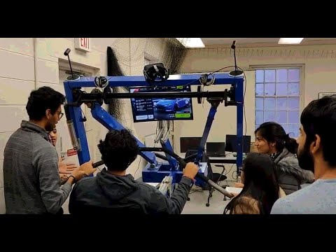
All the games when integrated with VR give a 360 ` immersion and was the popular vote by everyone who tested the games.
Flight Simulator Flight Simulator with VR Integration Asphalt 8

Slide 11
Phase 1 Remaining Improvements
The mechanical improvements planned for the rest of this semester are:
Braking System:
The solenoid valve in the current braking system is stuck. The problem is with the actuating pin as the valve is able to produce enough magnetic force to trigger the actuation.
Change in Resistance in Pedaling:
After fixing the pulley on which the pedaling belt rests, we came to know that the alternator to produce the voltage is not working. This is will be fixed by diagnosing the problem by dismounting and opening it.
Once fixed, we will be able to get variable resistance in pedaling.

Slide 12
Phase 2A: Course Integration
The primary objective here is to integrate the Flycycle into coursework to engage students in robotics and programming.
Flycycle courses will be offered at three different levels of difficulty. They would be categorized as:
Introductory Course for High School Students
Course for Freshmen / Sophomore students
Capstone Design project for Junior/ Senior year students.
The courses in general would cover the following key points at various level of involvement and difficulty:
Introduction to the Flycycle system
Overview of the mechanical design and electrical components being used.
Exhaustive tutorial on getting started and developing games in Unity.
Students from underrepresented communities will be engaged like MCWIC (Maryland Center for Women in Computing)

Slide 13
Breakdown of the Three Tier Coursework
Introductory Course for High School Students:
This would be more of an introductory course to the Flycycle.
Students will be allowed to play on the already developed games to bring the excitement level up and get an understanding of the system.
An Electronics and Mechanical component overview will be given.
Unity will be Introduced and a beginner level game development will be taught.
Students would then be coached to improve and develop simple games for the Flycycle such as 2D games.
In case we would get the second Flycycle, we would organize racing games between the two flycycles.

Slide 14
2) Course for Freshmen / Sophomore students
Here a more in depth introduction on a component level will be given to the students.
After getting familiar with the system they will have an opportunity to choose a project between three areas : Mechanical Design, Electronics and Programming.
Mechanically one of the possible areas of improvements would be to have a an updated variable resistance pedaling system.
On the Electronics side, students can integrate more sensors, such as heart rate monitor and watt meter, update the existing micro controllers to make the design more compact, and integrate Head Mount Display tracking.
On the Programming side, students will be able to develop games for the Flycycle using Unity, including VR game development in 3D.

Slide 15
3) Capstone Design project for Junior/ Senior year students.
Here again, an in depth introduction to the flycycle would be given.
After that, students will carry out research projects or major improvements in any of the three areas mentioned before, which are Mechanical, Electronics and Programming.
Some Mechanical ideas, would be to add more controller buttons and another potentiometer to the flycycle handlebar. Also making the flycycle entirely actuated for use as a flight simulator and to support weaker users and patients.
On the Electronics side, heart rate sensor and facial expression tracking can be carried out to study the behaviour of other students while playing.
On the Programming and VR side, sensor readings from additional sensors can be integrated in the VR games. The games designed here would have high end graphics and as there will be more controllability from additional potentiometers and the games can get more complex and immersive.

Slide 16
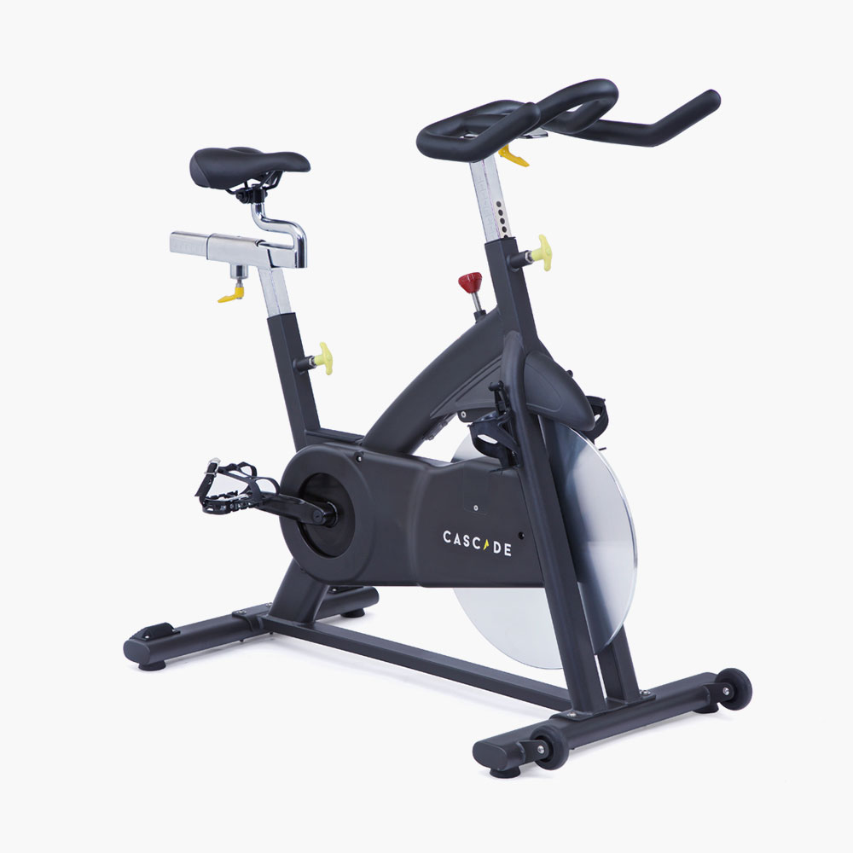
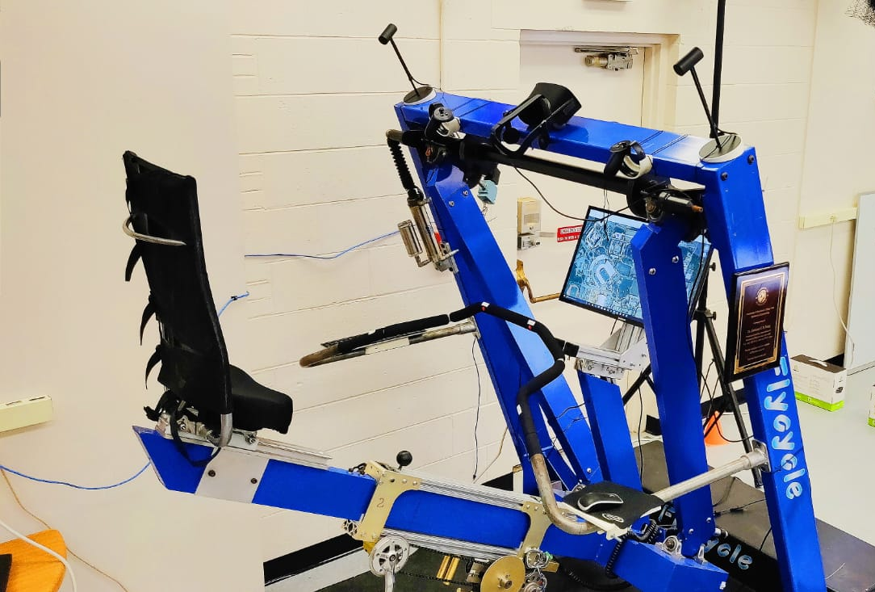
Phase 2B: Rehabilitation
The primary objective is to investigate the efficacy of the Flycycle in Stroke recovery.
We will compare the performance increase of patients undergoing rehabilitation from stroke between the Flycycle and standard stationary bikes.
We will collect and compare the evaluation of the patients for the Flycycle versus stationary bikes.

Slide 17
Phase 2B: Rehabilitation
The primary objective is to investigate the efficacy of the Flycycle in Stroke recovery.
We will compare the performance increase of patients undergoing rehabilitation from stroke between the Flycycle and standard stationary bikes.
We will collect and compare the evaluation of the patients for the Flycycle versus stationary bikes.
This project Phase 2B is in collaboration with Professor Anindo Roy at the University of Maryland, School of Medicine, in Baltimore.

Slide 18
Phase 2B: Rehabilitation
The following steps are required for investigating the Flycycle for Rehabilitation:
Install the second Flycyle at UMB
Perform exhaustive safety testing and analysis
Create study protocol in collaboration with Dr. Roy and Medical Doctors at UMB.
Submit human subject testing to Investigational Review Board (IRB)
Recruit patients for study
Perform study
Analyze data

Slide 19
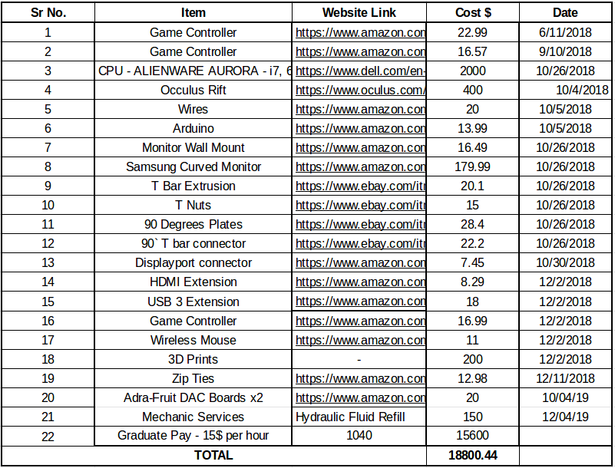
Budget So Far
Expense Sheet can be found here.

Slide 20
Budget Estimates for Phase 2
Phase 2A: Course Work
Phd Student Fellowship
1 month/year Salary Axel
Yearly small budget (~ $5k) for small Flycycle repairs, maintenance, and improvements.
Robotic lab manager support 1 month/year
Phase 2B: Rehabilitation
Notes: 2B Budget is in addition to Phase 2A
Budget is not yet reviewed and confirmed by Dr. Roy
PhD Student Fellowship
1 month/year Salary Dr. Roy
Study Coordinator (~ 30%)
Yearly small budget (~ $5k) for small Flycycle repairs, maintenance, and improvements.

Slide 21

Thank You!!

