Slide 1
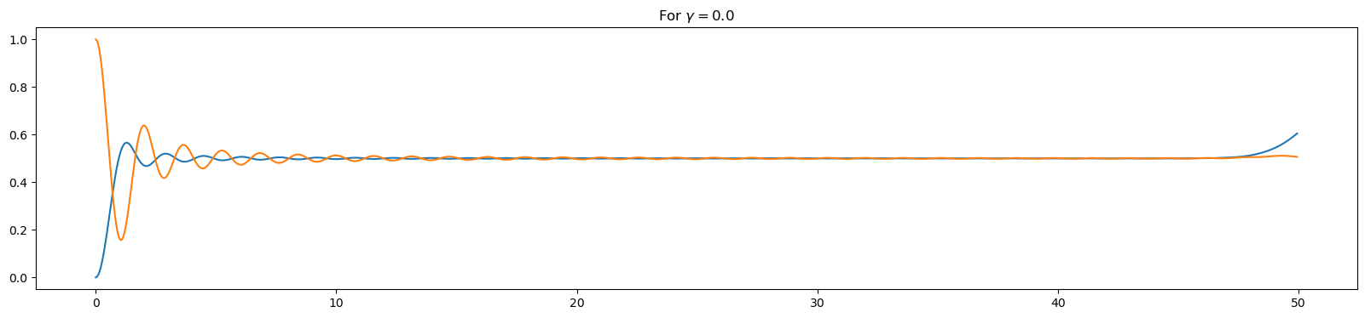
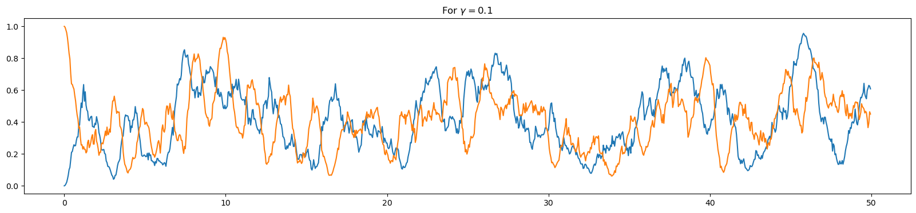
Variation of gamma for n0 and n1 :
L = 100 , dt = 0.05 for 1000 steps

Slide 2
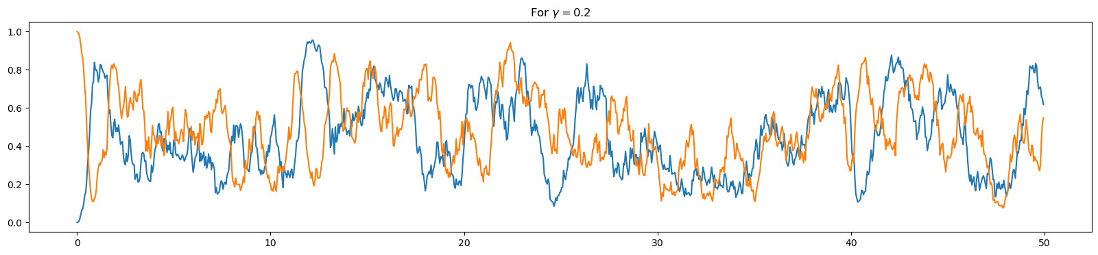
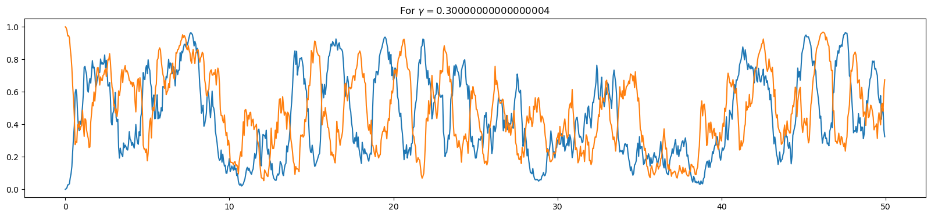

Slide 3
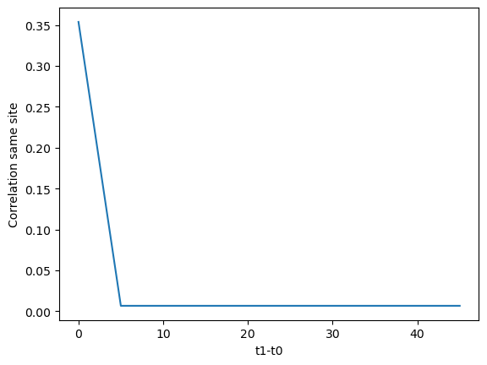
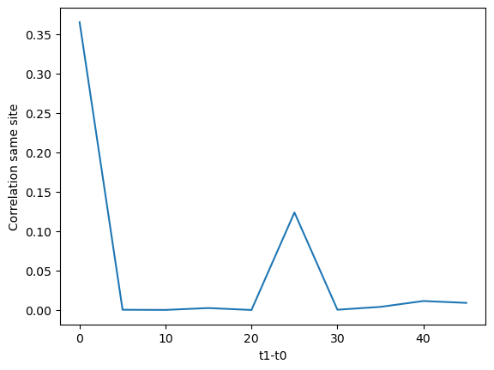
Variation of gamma for: n1*n1 (L = 50 , t0=10)
Gamma = 0
Gamma = 0.1

Slide 4
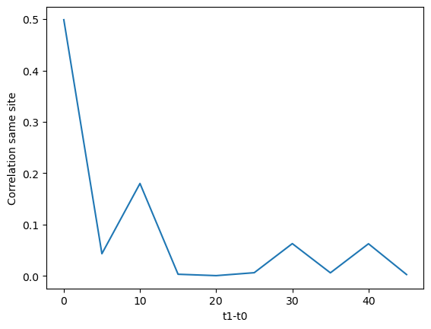
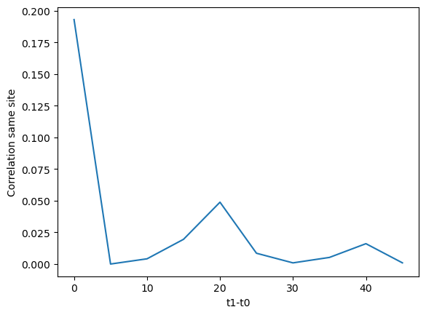
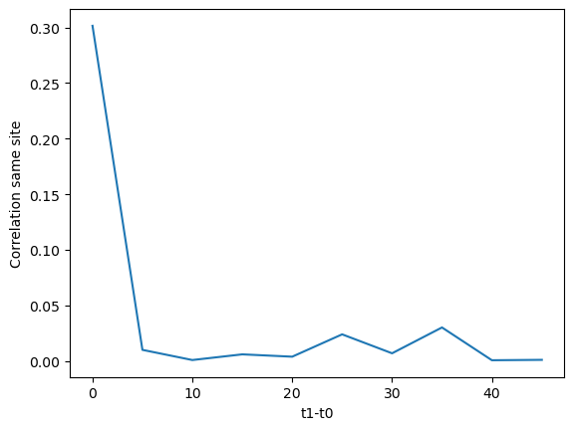
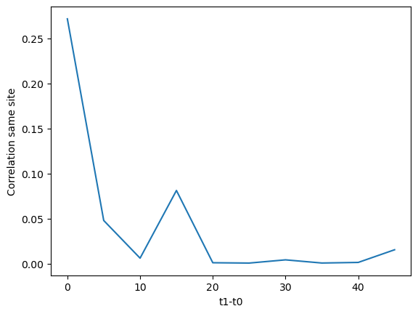
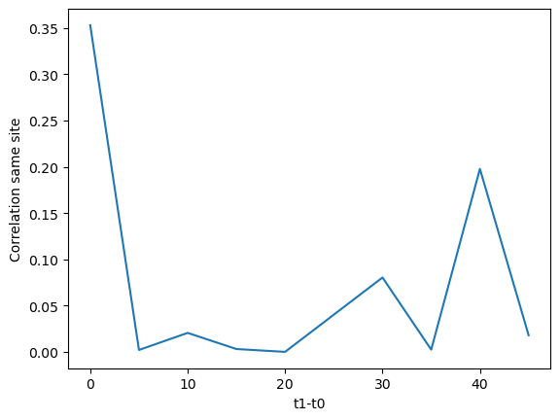
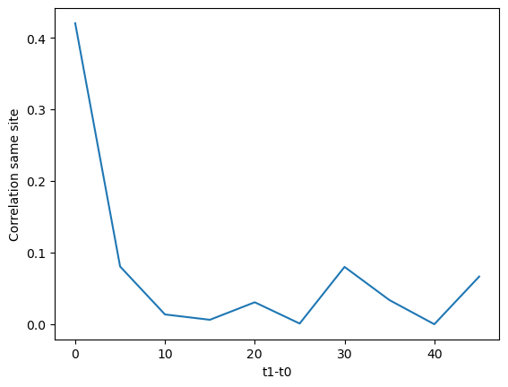
n1*n1 (L = 50 , t0=10, gamma = 0.1)

Slide 5
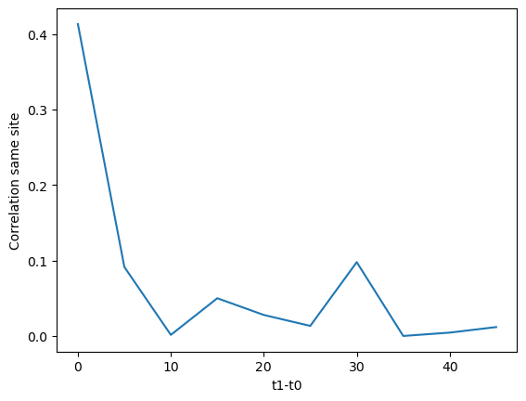
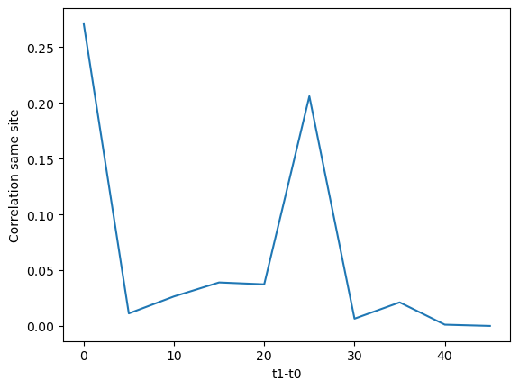
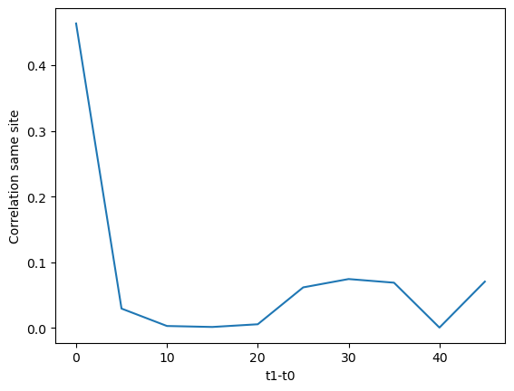
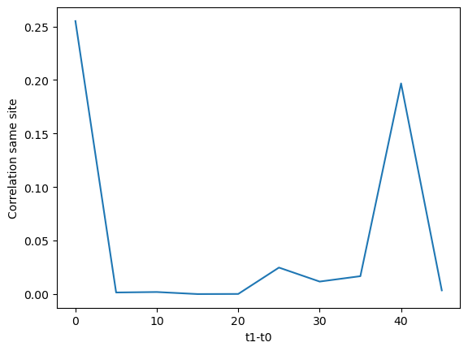
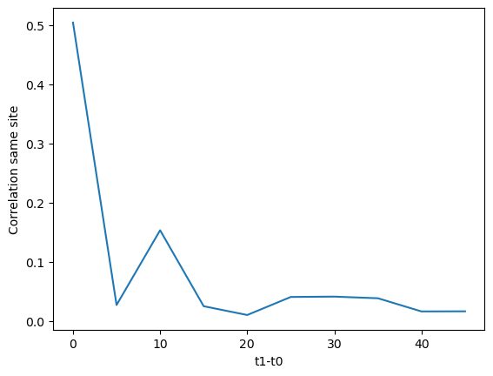
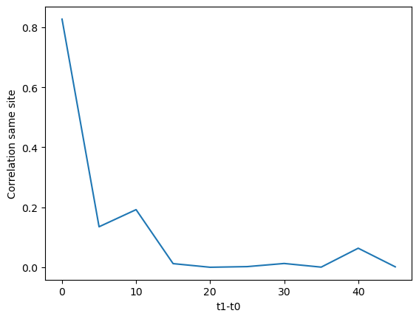
Gamma = 0.2
Gamma = 0.3
Gamma = 0.4
Gamma = 0.5
Gamma = 0.7
Gamma = 0.6

Slide 6
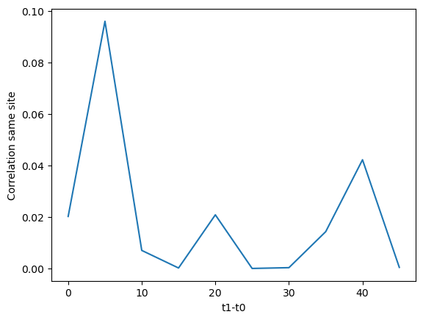
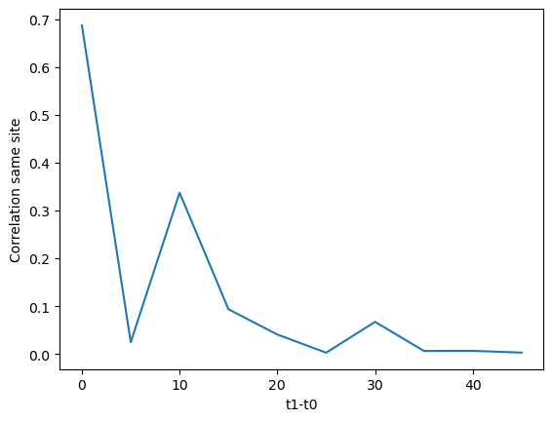
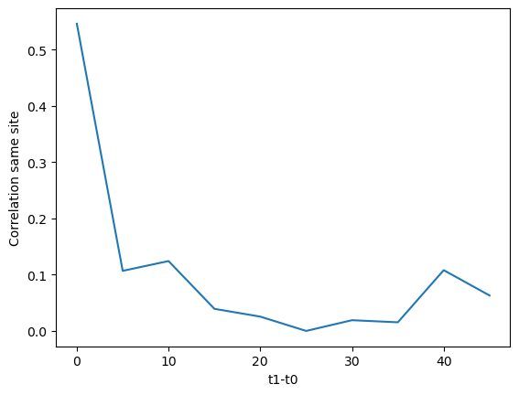
Gamma = 0.8
Gamma = 0.9
Gamma = 1

Slide 7
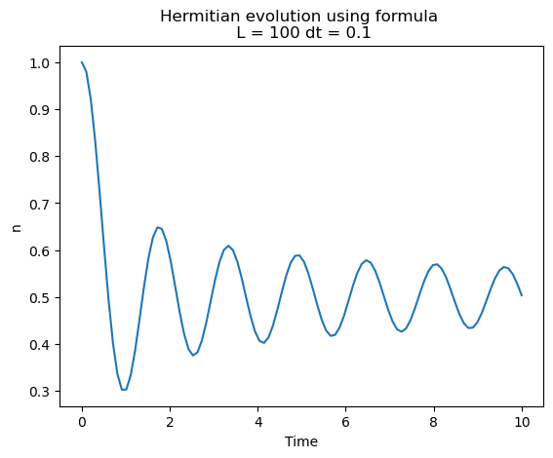
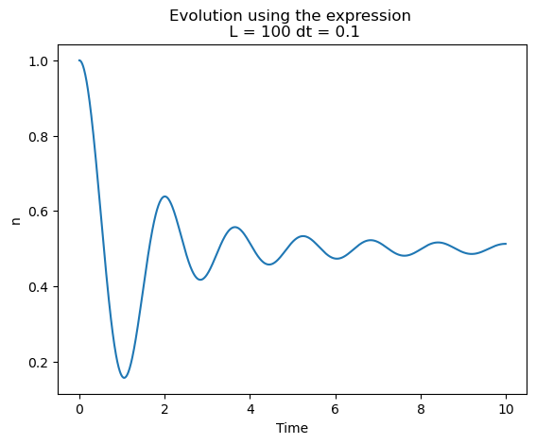
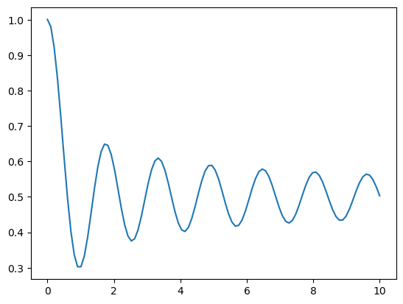
Hermitian Case and expression

Slide 8
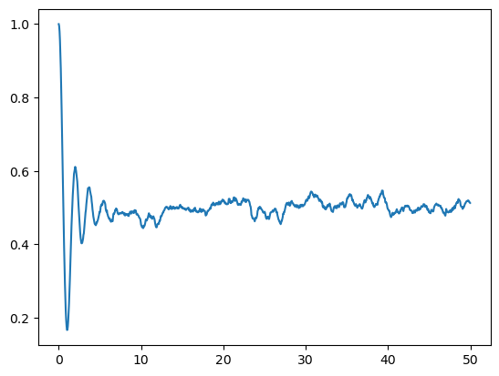
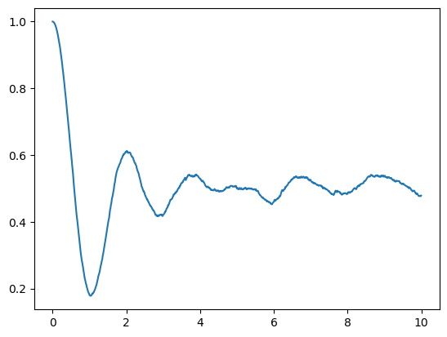
Gamma = 0.1 , L=100, dt = 0.05, dt = 0.01

Slide 9
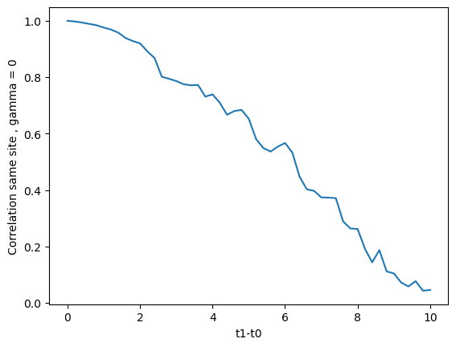
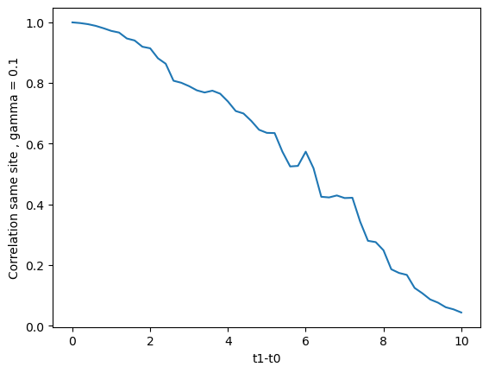
Correlation

Slide 10
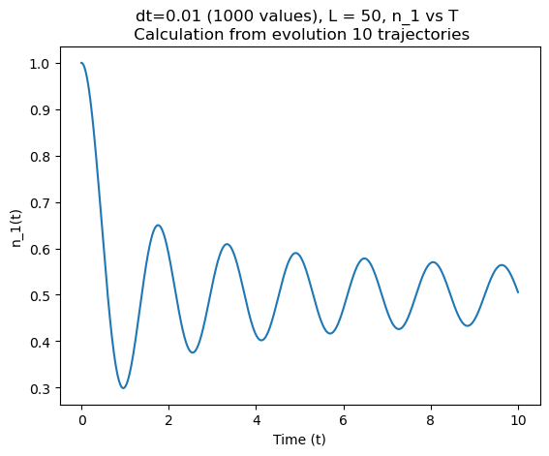
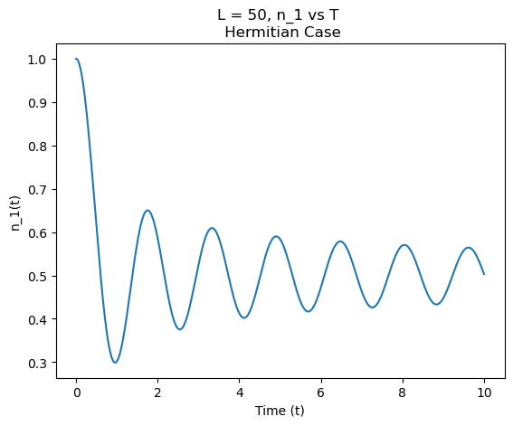
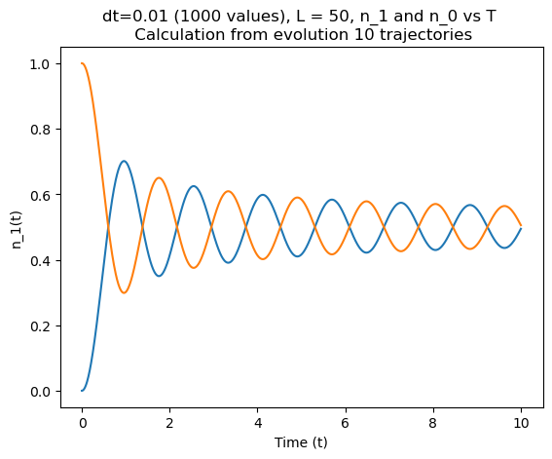
Hermitian Case and expression

Slide 11
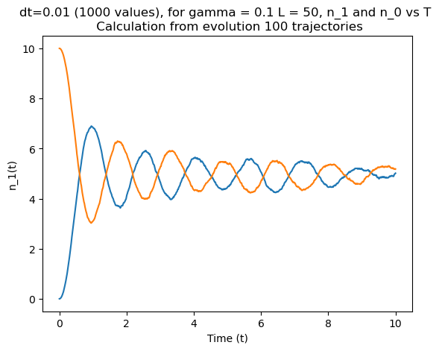
Hermitian Case and expression

Slide 12
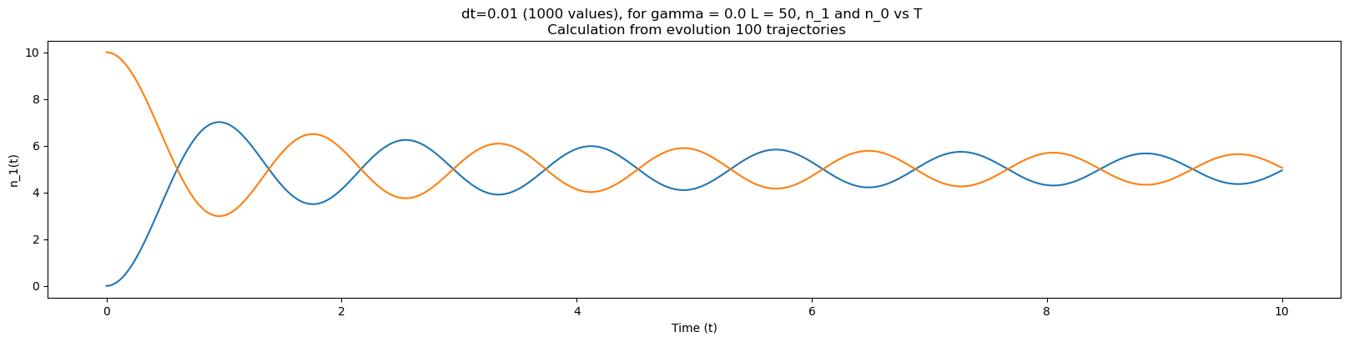
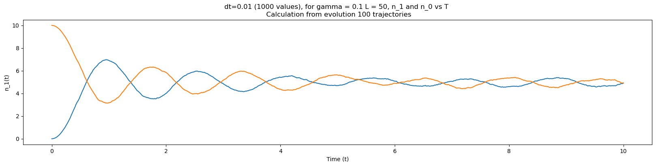

Slide 13
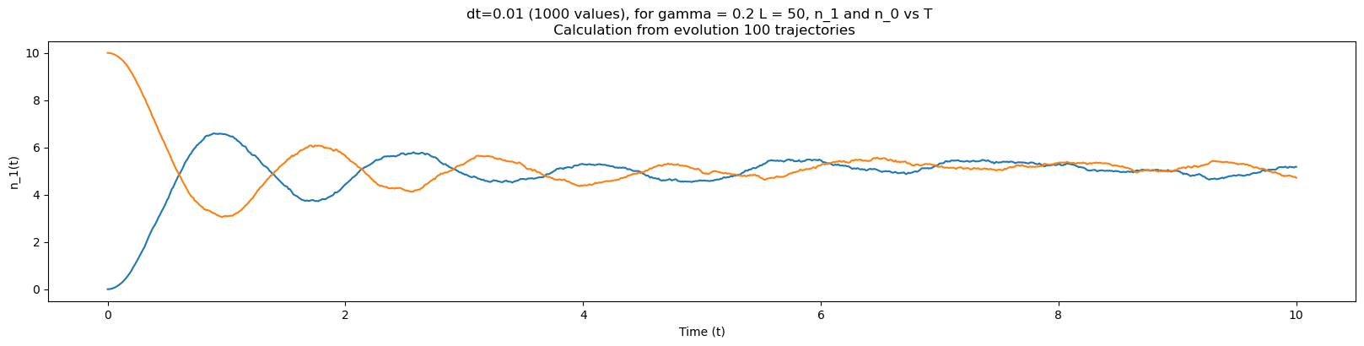
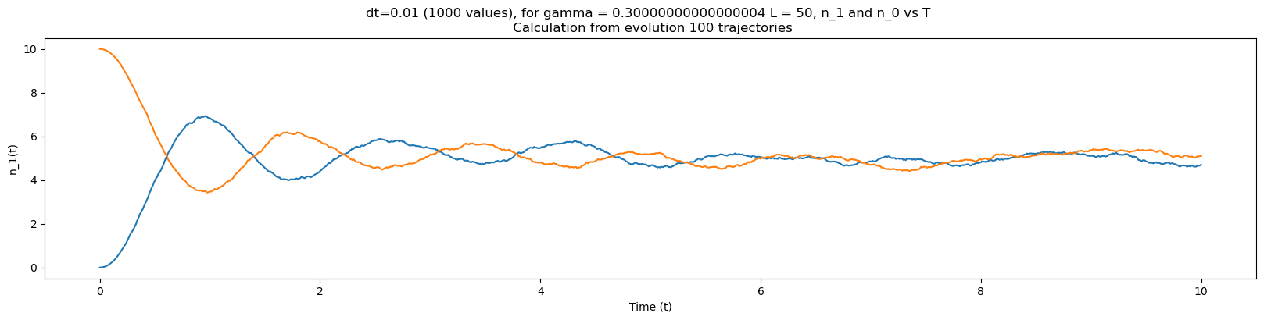

Slide 14
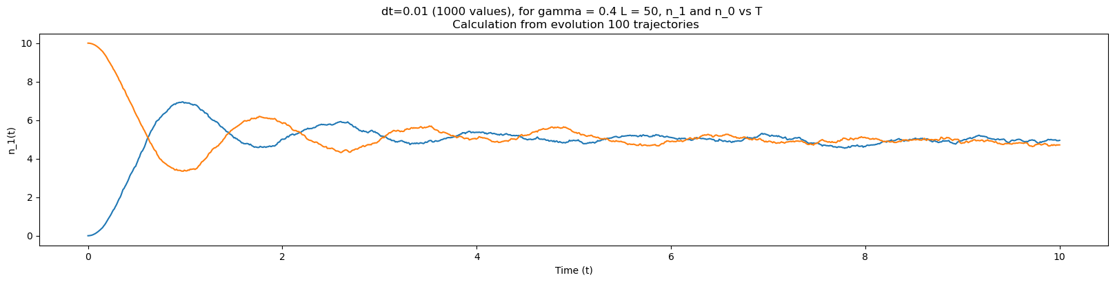
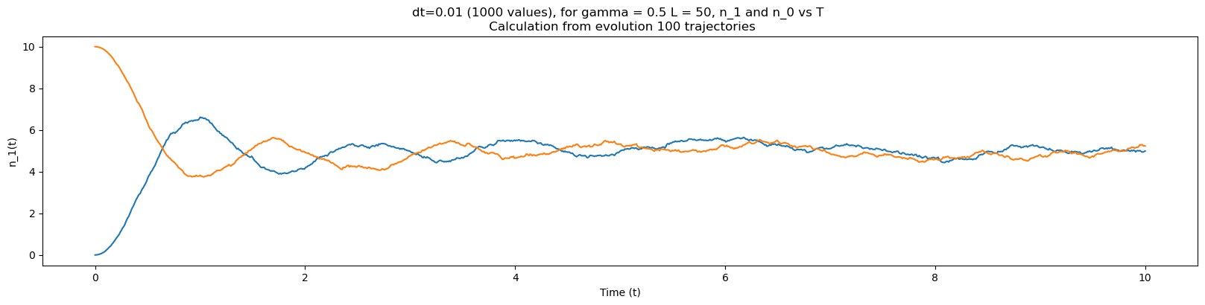
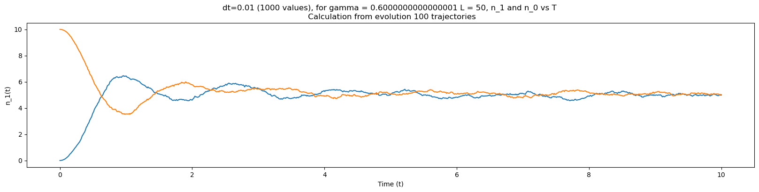

Slide 15
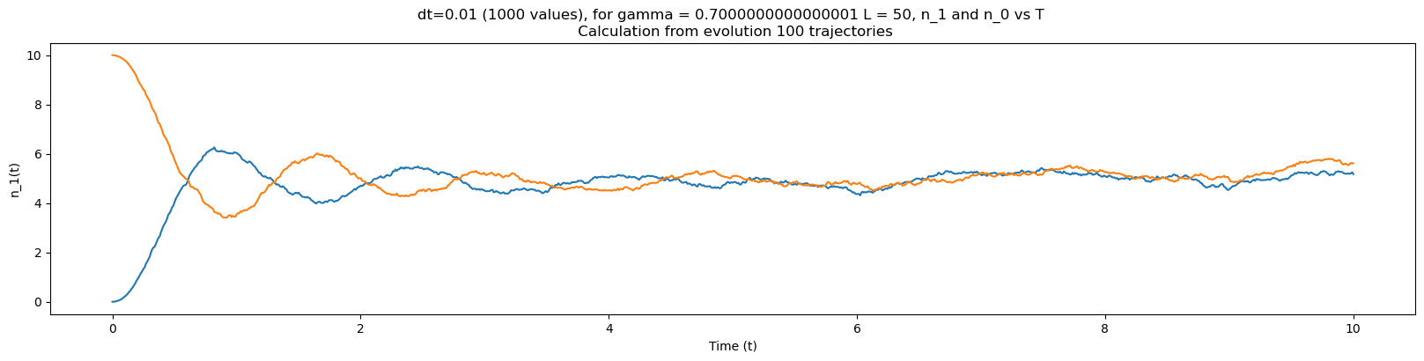
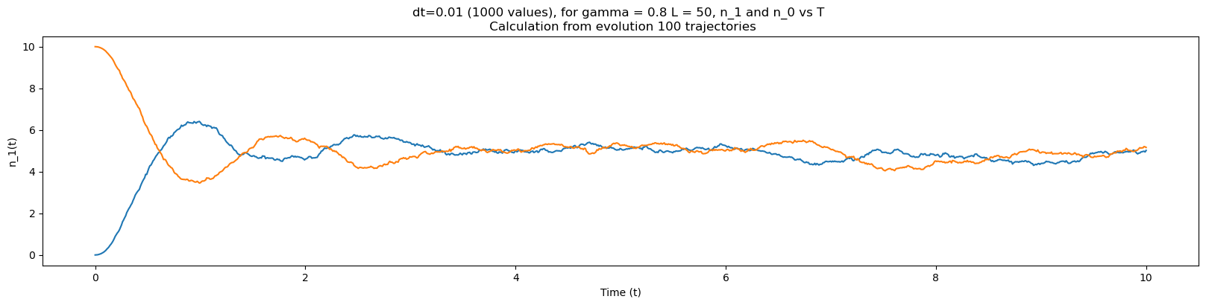
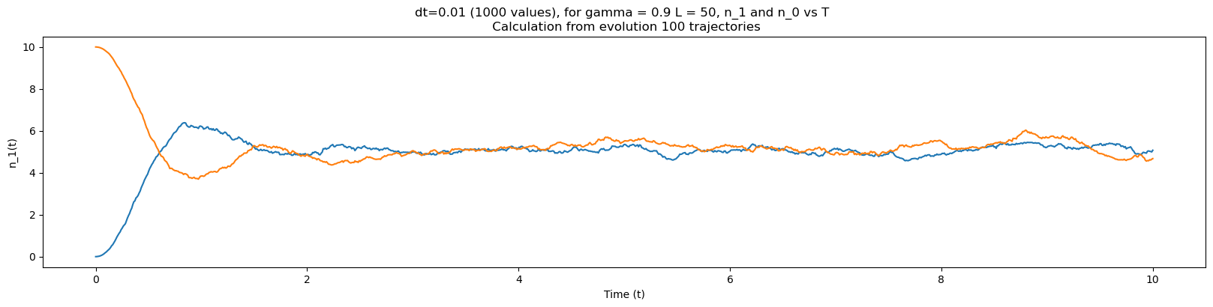

Slide 16
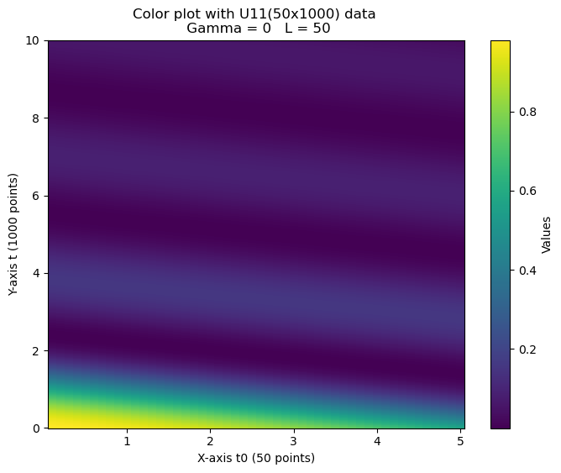
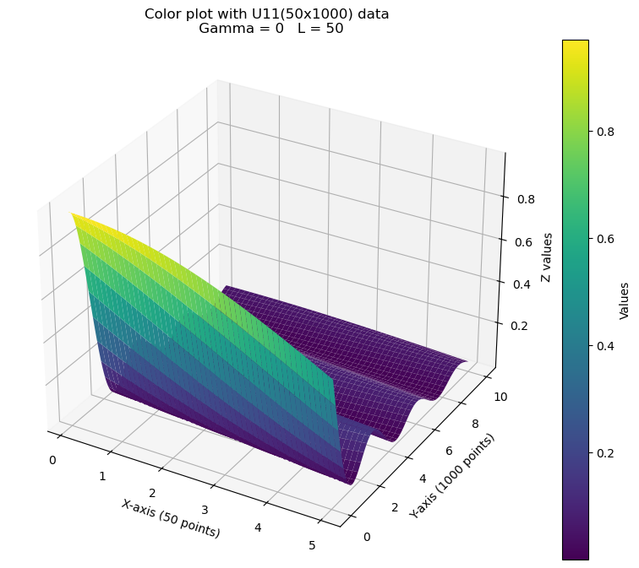
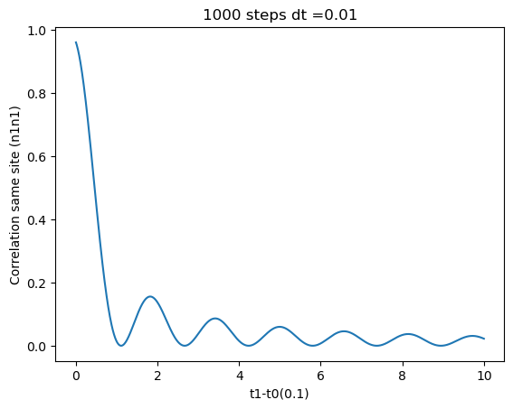
Correlation calculation
L =50 PBC gamma = 0

Slide 17
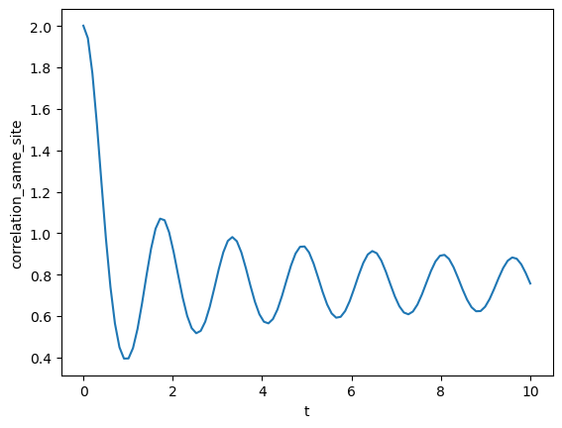
Correlation calculation for Hermitian
Gamma = 0

Slide 18
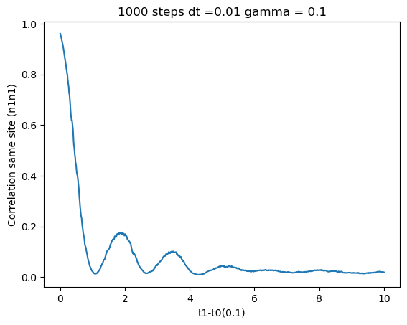
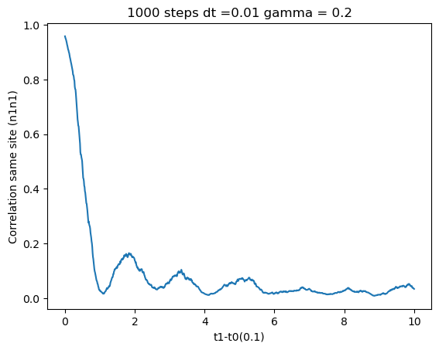
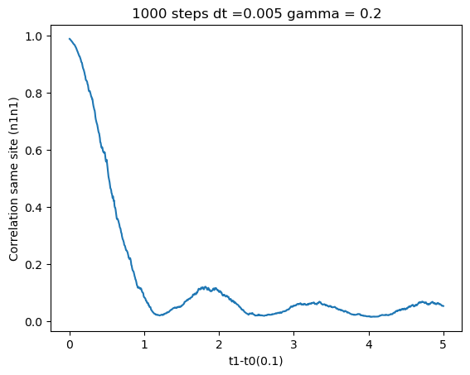
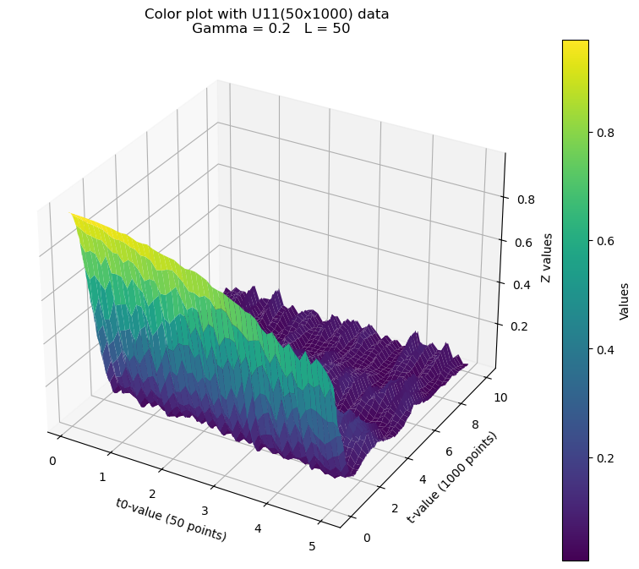

Correlation calculation

Slide 19





Slide 20

Hermitian Case and expression

Slide 21



Correlation calculation
20 sites
30 sites

Slide 22



Slide 23

[2.0330292040190874,
1.244630448303689,
0.7814307796401914,
0.4183029712298397,
0.4201406559357395,
0.3187210676138684,
0.13207402472589858]

Slide 24
[[2.039896940920768, 1.175964573525963, 0.7467710924232783, 0.5884340664154911, 0.4128053982800343, 0.32328301246010105, 0.1436138479924532], [2.6294565636984437, 1.4050757544277264, 0.8073549920599339, 0.500982239434552, 0.3279307855320123, 0.29292282299458383, 0.11061424570280368], [2.9864656880455476, 1.295163939154381, 0.7301154081024762, 0.5199220804773368, 0.3414695989298648, 0.3378688919402084, 0.1266485018471414], [3.1753012401429204, 1.1005743922685245, 0.5129008740393488, 0.5362004969155051, 0.2560829895887485, 0.28680596238085276, 0.09490698321359944]]

Slide 25



Slide 26



Slide 27



Slide 28



Slide 29



Slide 30




Slide 31





Slide 32



Slide 33


Slide 34


Slide 35


Slide 36


Slide 37

Gamma = 1

Slide 38



Slide 39




Gamma = 0 case
Hermitian case

Slide 40



Slide 41


Benchmarking
dt=0.143 i=1 j = 1
dt=0.144 i=1 j = 1

Slide 42


Benchmarking
dt=0.144 i=1 j = 2
dt=0.148 i=1 j = 2

Slide 43


i=1 j =2
i=1 j =1

Slide 44

i=1 j =2

Slide 45



Slide 46

Benchmarking
dt=0.1 i=1 j = 2

Slide 47



Slide 48


Slide 49

Sites = 50 , dt=0.01, trajectories = 10

Slide 50

Sites = 100 , dt=0.05, trajectories = 10

Slide 51

tf=10 L = 200 traj = 100

Slide 52

tf=100 L = 200 traj = 100

Slide 53




Slide 54


Entanglement Entropy Histogram

Slide 55



Entanglement Entropy Histogram L = 200, traj = 1000

Slide 56


Entanglement Entropy for 800 sites QSD

Slide 57






Slide 58

i=1,j=2 l =50

Slide 59


dt=0.01
dt=0.01

Slide 60


L =50 , dt = 0.5 traj = 20

Slide 61


Slide 62




Slide 63


Slide 64



Slide 65


Transposed and not transposed

