Slide 1
Evaluating Institutional Investor Restriction Policies
An Agent Based Model
Anirudh Thodupunuri, ICR 2026

Slide 2
The Housing Crisis
National Association of Realtors
Median First-Time Buyer Age: 40. An all time high.
Notes:
Post COVID-19 and the 2008 Financial Crisis, housing costs have exploded, american dream, unaffordable for first time buyers.

Slide 3


Who’s Buying Instead?
institutional investors own 589,000 single-family homes
Notes:
Institutional investors, with regard to housing, are large entities that pool capital in order to invest in real estate on behalf of their shareholders. These investors focus on multifamily apartment complexes and single family rental homes, with institutional portfolios representing 589,000 homes or roughly $3.9\%$ of the single family rental market. Out of concern that these investors outcompete first-time buyer families and lead to price growth, legislators have proposed restrictions on their activity.

Slide 4
Policy Response
Federal and local policies
  January 2026: Executive Order
  March 2026: Senate passes ROAD act
  March 2026: Oregon passes HB 4128
  Jul 2026: ROAD act becomes law
Notes:
On January 20, 2026, an executive order directed federal agencies to limit support for single family home sales to large institutional investors. In July 2026, the 21st Century ROAD to Housing act, widely considered to be one of the most significant pieces of federal housing legislation in decades, became law. This bipartisan legislation prohibits institutional investors from purchasing additional single family homes, though it includes certain exceptions (build-to-rent, for example). However, empirical evidence is unclear and different perspectives exist

Slide 5
Research Question:
Among policies restricting institutional investors, which maximizes first-time homeownership while minimizing distortions to market liquidity and rental supply?
Notes:
multidimensional,

Slide 6
Standard Models:
DSGE Models
ABMs
Representative Rational Agent
Heterogeneous agents
Failure to predict
Emergent dynamics
Notes:
Talk about why ABMs are good for housing market, past models have modeled global macroprudential policies

Slide 7

Study Region: Atlanta
Why Atlanta?
  High investor purchase share
  Weak tenant protections
  Invitation Homes, Progress Residential
Notes:
10-15% vs 3% national average

Slide 8
Model Overview
Agents:
Markets:
Outcomes:
Renters
First Time Buyers
Repeat Buyers
Small Landlords
Institutional Investors
Houses
Homeownership Rate
Rental Vacancy
+more!
Rental Market
Ownership Market
Notes:
10-15% vs 3% national average

Slide 9
Model Overview
Renters First Time Buyers Repeat Buyers
Small Landlords Institutional Investors Houses
Use equity from house
Mortgage ‘lock in’ effect
Work towards down payment
Savings
Access to FHA Loans
Income focused
Rent Stickiness
Capital focused
Algorithmic
Passive
Holds state
Notes:
10-15% vs 3% national average

Slide 10
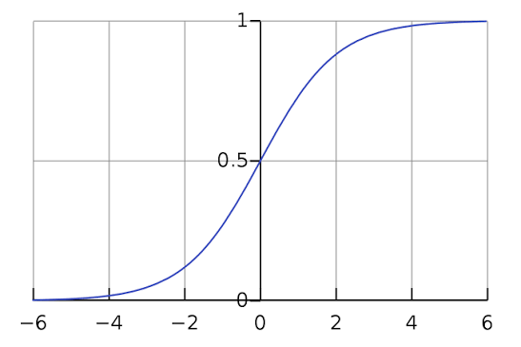
FTB Decision
First Time Buyer Decision Steps
Savings > Down payment?
No
Yes
Keep renting
Calculate Desired Price
Logistic Probability
Keep renting
Bids on ownership market
Notes:
10-15% vs 3% national average

Slide 11


Investor Decision
Mortgage Rate
+Rent Stickiness!
Notes:
expected yield

Slide 12
Monthly Cycle
Update Rates
Record Metrics
Update Expectations
Market Clears
Households Save
Investors Evaluate
Check Eligibility
Set prices
Owners decide to sell

Slide 13


Market Clearing
Sealed Bids
Buyers
✉️✉️✉️
match -> multiple bidders -> price increase -> random selection
Notes:
10-15% vs 3% national average

Slide 14
Calibration
Parameter | Atlanta Value | Source
Median Home Price 2019 | $248,717 | Zillow ZHVI
Median Monthly Rent 2019 | $1,308 | Zillow ZORI
Gross rental yield | 6.3% | ZHVI/ZORI ratio
Price-to-income Ratio | 3.03x | HMDA Data
Investor Purchase Share | 6.2% | HMDA Data
Owner-occupancy rate | 59.2% | ACS 2019
Notes:
10-15% vs 3% national average

Slide 15

Validation Approach
Seed Atlanta 2019
Seed 2019
Notes:
10-15% vs 3% national average

Slide 16
Validation Approach
Seed Atlanta 2019
Seed 2019
Validate Against Targets
Homeownership Rate
LTV/LTI Ratios
Annual Appreciation
Notes:
10-15% vs 3% national average

Slide 17
Validation Approach
Seed Atlanta 2019
Validate Against Targets
Homeownership Rate
LTV/LTI Ratios
Annual Appreciation
Policy Experiments
40 Seeds
150 months
60 months spin-up
Notes:
10-15% vs 3% national average

Slide 18
Policies
Access Restrictions
Financial Penalties
Waiting Period (60 days)
Ownership Cap Soft/Hard
Purchase Tax
Vacancy Tax
Progressive Port. Tax
Notes:
Waiting Period: Oregon, New York, other states
Ownership Cap: ROAD to housing
Purchase Tax: Netherlands, Sweden
Vacancy Tax: Vancouver, DC
Progressive port Tax - property/transfer taxes increased

Slide 19
Policy Implementation
Update Rates
Access Restrictions
Record Metrics
Update Expectations
Market Clears
Households Save
Financial Penalties
Investors Evaluate
Check Eligibility
Set prices
Owners decide to sell
Notes:
financial penalties leave the door open but make it expensive, access restrictions completely close the door

Slide 20
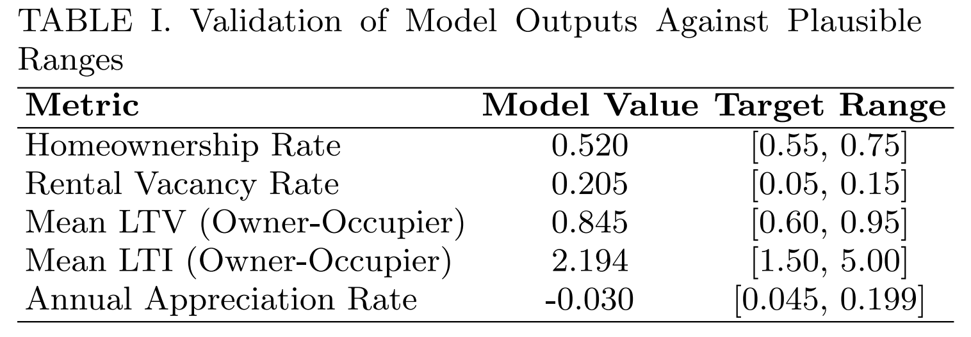



Baseline Validation
Notes:
Annual Appreciation may be lower because in real life, price decreases are more rapid in the simulation, versus real life external constraints (financing constraints) can stop people from repricing down, unknown seller behavior

Slide 21
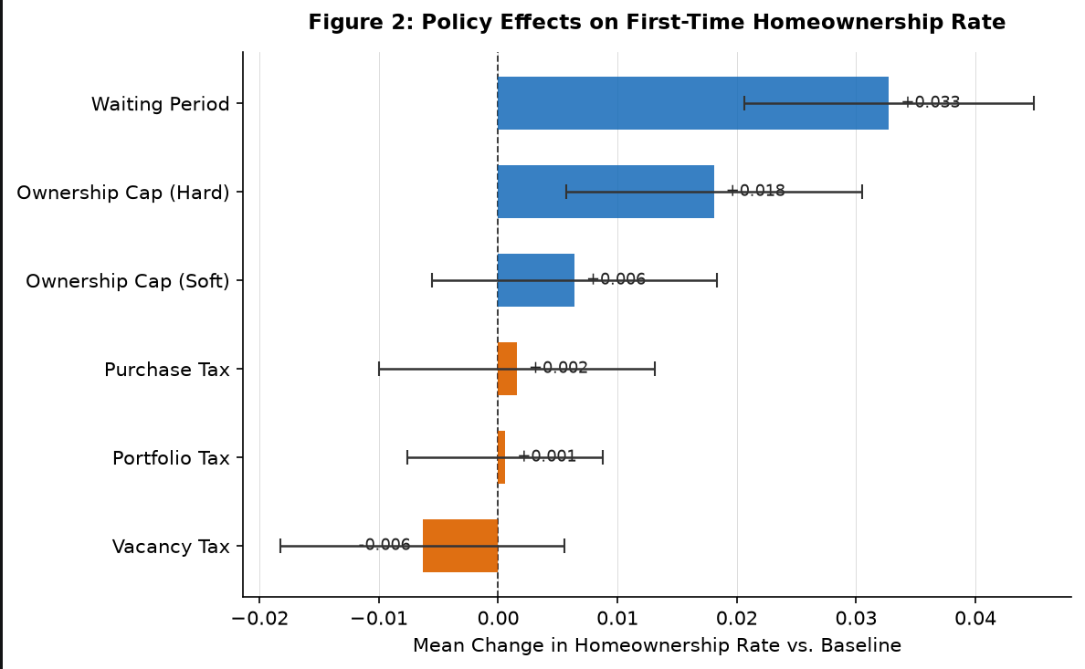
Primary Results

Slide 22
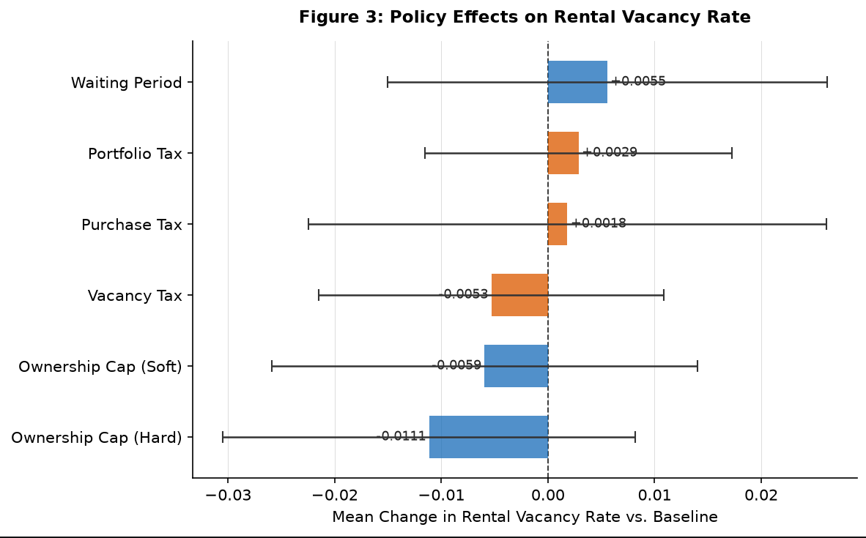
Primary Results

Slide 23
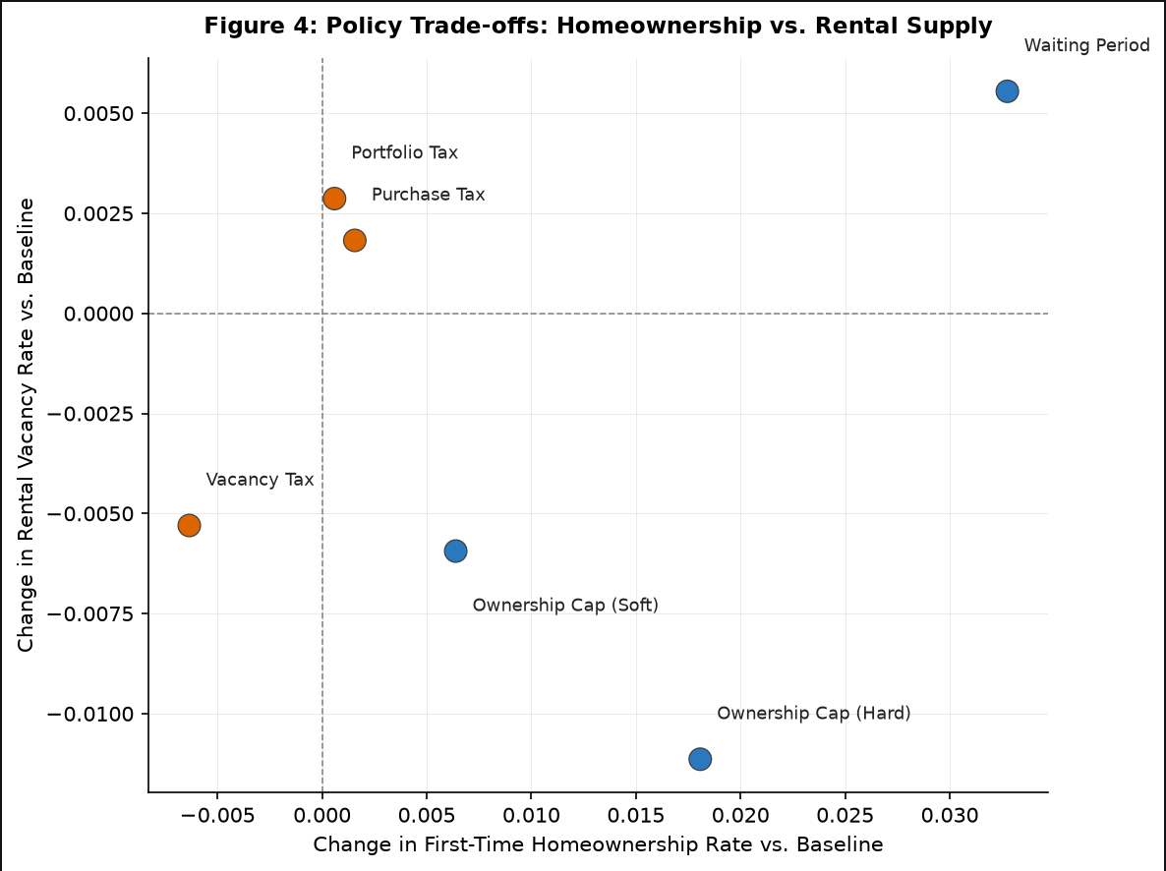
Primary Result
Notes:
As homeownership increases (homes that would have gone to investors goes to owner-occupants), the rental pool shrinks. Howeer, policies like ownership cap more aggressively stop investors and stop rental stock from growing, so the rental market contracts and vacancy decreases - price increases, landlords can jack up prices. Waiting period gives the best of both worlds.

Slide 24

Key Takeaways
Waiting Period most consistently improves first-time homeownership with minimal supply distortion
Financial penalties produce modest effects
The ROAD Act’s soft ownership cap may produce contractions in rental supply

Slide 25
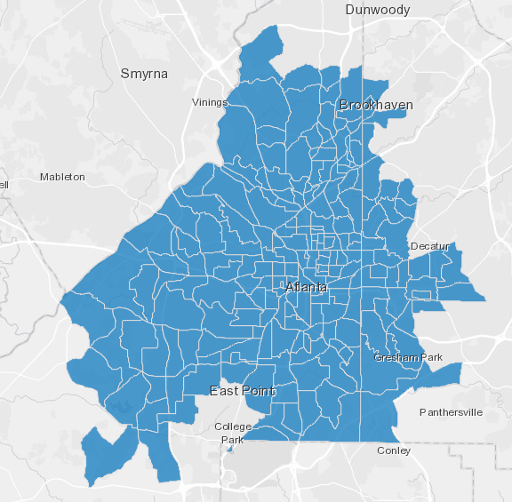
Limitations + Future Work
Limitations
  Single-tract
  Placeholder initialization
  Some arbitrary parameters
  Evasion
Future Work
  Multi-tract Atlanta with displacement
  PUMS Microdata sampling + sensitivity analysis
  Combined policies
  Longer run times

Slide 26
THANK YOU questions?

