Slide 1

Foundation Project : RATS (Resume Automated Tracking System)
Group 4 AMPBA-Batch-20
Presenter :
1) Anirudh Yadav
2) Sharath Paladugu
3) Sumit Mujumdar
4) Palash Gupta
5) Jyotisha Verma

Slide 2
Business Problem
The COVID-19 pandemic has led to job cuts and employee churn, which has increased the responsibility of HR teams to ensure employee retention while minimizing recruitment costs
Current Challenges
Manual approach of resume screening is time consuming and not effective
Complex ways of profile match and not a structured way due to new and advanced skillset need of the Organization
Recruitment and retention are time critical and cannot be delayed
Skills and Profiles are global now. It is tough to analyze and evaluate the global need and availability
Absence of the data driven approach, which not only assures the hiring but also brings in quality in recruitment

Slide 3
Business Objectives
Automated Resume filtering Solution
Realize Financial, Strategic, Technical and Operational ROI
Operational : Achieve and maintain the compliance and enhance the Quality
Strategic : Improve recruitment productivity and retention success rate
Technical : Data Driven Decisions, leveraging NLP
Financial : Minimize the recruitment cost
Financial: Reduction in recruitment cost after implementing an automated resume tracking system. Costs might be cost per hire, advertising expenses, PIR and interviewer time.
Strategic: Improvement in recruitment productivity and retention success rate through metrics like time to fill a position, quality of hire, and employee turnover rate.
Operational: Compliance enhancement and quality maintenance by monitoring adherence to legal requirements, accuracy of candidate assessments, and consistency in hiring processes.
Technical: Impact of data-driven decisions leveraging NLP by analysing improvements in candidate matching accuracy, diversity of hires, or other specific recruitment goals

Slide 4
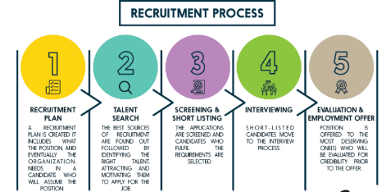
AS-IS Recruitment Process
Lengthy Hiring Procedures: 56% of recruiters say they can’t make good hires because of lengthy hiring procedures.
Talent Recruitment: 82% of Fortune 500 executives don’t believe that their companies recruit highly talented people.
Retention Strategies: 23% of managers and senior executives believe their current acquisition and retention strategies will work.
Attracting Top Talent: 76% of hiring managers say that attracting top talent is their greatest challenge.
Open Positions: 54% of employers currently have open positions for which they can’t find qualified candidates.
Long-term Open Positions: 35% of employers have positions that stay open for 12 weeks or longer.
75 Recruitment Statistics in HR & Hiring [Updated 2023] (adaface.com)

Slide 5
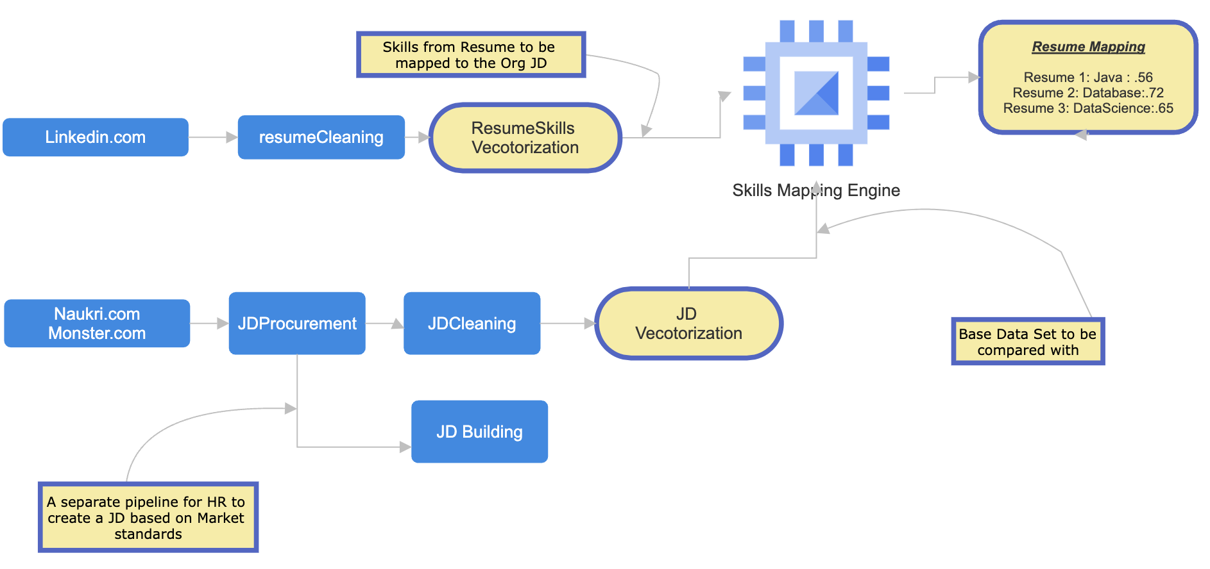
Proposed Solution
RATS: This application is built with intention to assist HR team to take informed decision while short listing the resume for a specific Job opening in the organization
Collating a vast corpus of Job-Descriptions/Job-Required-Skill from Job Portals
Collecting a Resumes for testing and mapping evaluation
We will be required to vectorize the data and store in memory
We need to find the similarity between organizations JD (which will be part of Master corpus) and skills in resume
Post the similarity value and let the HR dept take an informed call to shortlist the profile or not
Also, to assist HR for JD creation based on market trends
Prediction model to increase the confidence level of the offer acceptance and planning

Slide 6
Success Criteria
Business Success Criteria
Automated Resume filtering System in place
Access to larger candidate pool and higher quality hires
Technical Success Criteria
Resume being shortlisted should match profile by 60%
Job post and Profile matching to be 90% accurate from resume corpus
Economic Success Criteria
Pay parity can be captured while scraping and can be used to define PIR
Reduce the recruitment costs by 50% by saving man hours of HR and interview panel
Double the recruitment Success criteria, by shortlisting quality profiles
Opportunity to leverage the costs for Retention, by reusing the component for internal job postings
Solution to be scalable to access any talent pool
Tool can be internally extended as an IJP tool for job search for employees and reduce the hiring cost and increase retention
Extending the resume type being pdf , doc or HTML
Feasibility, legality & Challenges (PESTEL)
Partnerships are needed with the Job and recruitment portals for seamless access
Continuous training of the Model will be needed, due to the everchanging market needs and talent pools and tech stacks.
Fake Resume or profiles will be a challenge for current ML Model
Scaling the application will need higher and infra and robust testing methodology spanning across multiple domains
As the process gets matured, we might see reduction in headcount in HR teams
This will add to environmental impact

Slide 7
Model Evolution
Phase | Activities | References and links
Data Preparation | This phase involves collecting resumes and Job Description from various sources and storing them in a structured format. Technology Stack : Selenium, Python, Excel, Google Forms Data Source : Linkedin, Naukri.com, Surveys More Details | https://github.com/anirudhyadav/ISBG4FP1/blob/main/step1a_jd_dataprocurement.ipynb https://github.com/anirudhyadav/ISBG4FP1/blob/main/step1b_LinkedinScraper.ipynb
Modeling | This phase involves the below, Feature Extraction, Feature Selection, Data Splitting, NLP, prediction More Details | https://github.com/anirudhyadav/ISBG4FP1/blob/main/step1a_jd_dataprocurement.ipynb https://github.com/anirudhyadav/ISBG4FP1/blob/main/step1b_LinkedinScraper.ipynb
Evaluation | This phase involved the testing of the model on the test data and evaluating the performance More Details | https://github.com/anirudhyadav/ISBG4FP1/blob/main/step2_SimilarityLogic.ipynb https://github.com/anirudhyadav/ISBG4FP1/blob/main/step5_PredictionOfAcceptanceOfOffer.ipynb
Deployment | This Phase involves the deployment of the model into the respective environments. As we don’t have all the qualified environments, all codes are maintained in the GitHub repository and it’s a single environment. More Details
Monitoring and Maintenance | This phase is the continuous phase. Weekly Job portal scraping to be in place for latest skills and expanding to other Job websites for extended corpus DRIFT: Handling drift by reprocuring the JD data from job portals for latest corpus of tech skills required for a specific job type, and expanding to other job portals too More Details
Notes:
Data Collection: This step involves collecting resumes from various sources and storing them in a structured format. The sources can be job portals, social media platforms, or company websites. The resumes can be in different formats such as PDF, Word, or HTML. The goal is to collect as many resumes as possible to build a robust model.
Data Cleaning: In this step, irrelevant information such as images, tables, and charts are removed from the resumes. Also, any personal information such as name, address, and contact details are removed to ensure privacy. This step ensures that the data is consistent and ready for analysis.
Data Labeling: In this step, resumes are labeled based on the job requirements. For example, if the job requires a software engineer with experience in Java, then resumes with Java experience are labeled as relevant, and others are labeled as irrelevant. This step is crucial as it helps the machine learning algorithm to learn from the labeled data.
Data Preprocessing: In this step, the resumes are converted into a numerical format that can be used by machine learning algorithms. This includes techniques such as tokenization, stemming, and stop-word removal. Tokenization is the process of breaking down the text into individual words or phrases. Stemming is the process of reducing words to their root form. Stop-word removal is the process of removing common words such as “the,” “and,” and “a.” The goal is to convert the text data into a format that can be easily analyzed by the machine learning algorithms.
Feature Extraction: In this step, relevant features are extracted from the resumes such as skills, education, and experience. The goal is to identify the most important features that contribute to the classification of resumes. Techniques such as bag-of-words and term frequency-inverse document frequency (TF-IDF) are used to extract features from the text data.
Feature Selection: In this step, the most important features that contribute to the classification of resumes are selected. This helps to reduce the dimensionality of the data and improve the performance of the machine learning model. Techniques such as chi-squared test and mutual information are used for feature selection.
Data Splitting: In this step, the data is split into training and testing sets. The training set is used to train the machine learning model, and the testing set is used to evaluate the performance of the model.
Model Training: In this step, a machine learning model is trained on the training data. The goal is to build a model that can accurately classify resumes as relevant or irrelevant. Techniques such as decision trees, random forests, and support vector machines (SVMs) are commonly used for this task.
Model Evaluation: In this step, the performance of the machine learning model is evaluated on the testing data. The goal is to evaluate the accuracy of the model and identify areas for improvement. Techniques such as confusion matrix, precision, recall, and F1 score are used to evaluate the performance of the model.
Model Deployment: In this step, the machine learning model is deployed in a production environment. The goal is to use the model to automatically filter resumes and identify the most relevant candidates for the job.
-----------------------------------------------------------------
Data Collection: Collecting resumes from various sources such as job portals, social media platforms, or company websites. For example, scraping resumes from LinkedIn using the LinkedIn API.
Data Cleaning: Removing irrelevant information such as images, tables, and charts from the resumes. For example, using regular expressions to remove images and tables from the resumes.
Data Labeling: Assigning labels to the resumes based on the job requirements. For example, labeling resumes with Java experience as relevant and others as irrelevant.
Data Preprocessing: Converting the resumes into a numerical format that can be used by machine learning algorithms. For example, using the Natural Language Toolkit (NLTK) library in Python to tokenize the text data.
Feature Extraction: Extracting relevant features from the resumes such as skills, education, and experience. For example, using the bag-of-words model to extract features from the text data.
Feature Selection: Selecting the most important features that contribute to the classification of resumes. For example, using the chi-squared test to select the most important features.
Data Splitting: Splitting the data into training and testing sets. For example, using the train_test_split function from the scikit-learn library in Python.
Model Training: Training a machine learning model on the training data. For example, using the random forest algorithm to train the model.
Model Evaluation: Evaluating the performance of the model on the testing data. For example, using the confusion matrix to evaluate the performance of the model.
Model Deployment: Deploying the model in a production environment. For example, using a web application framework such as Flask to deploy the model.

Slide 8
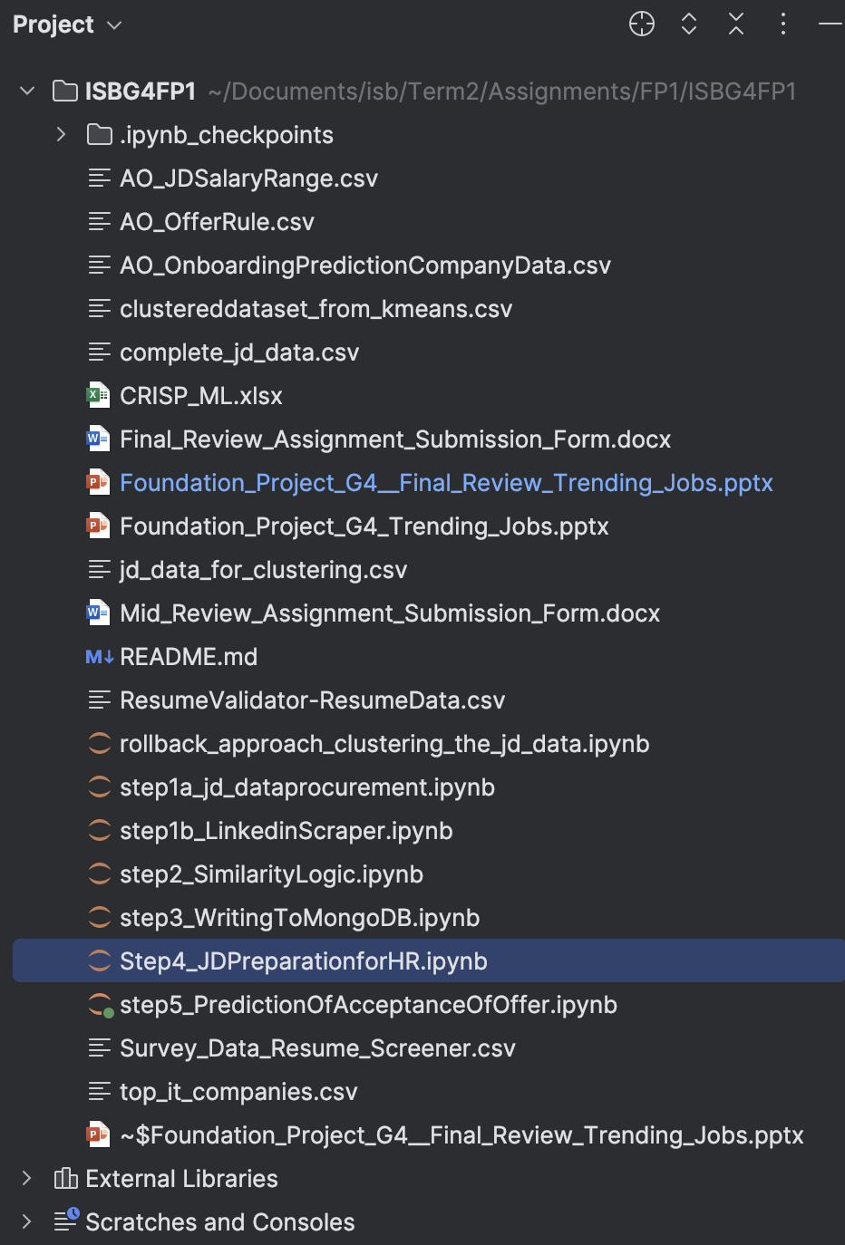
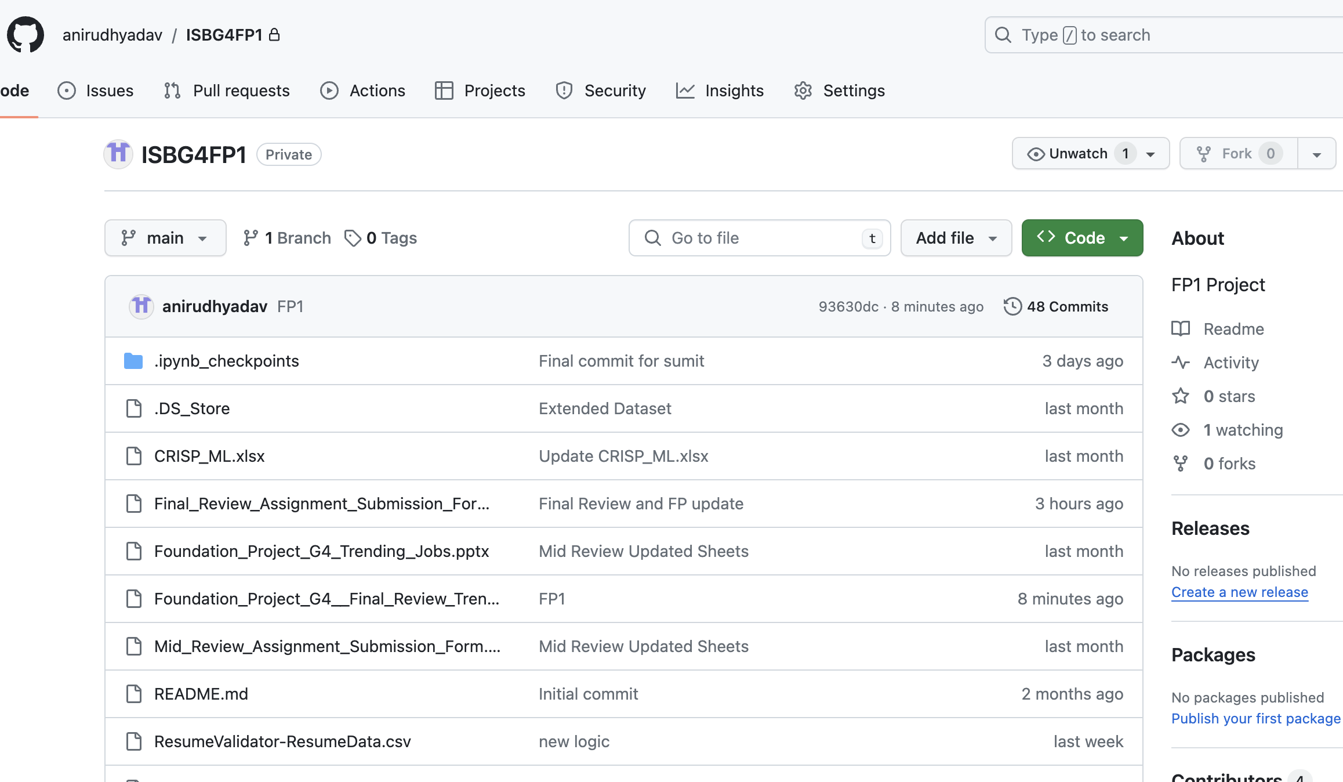
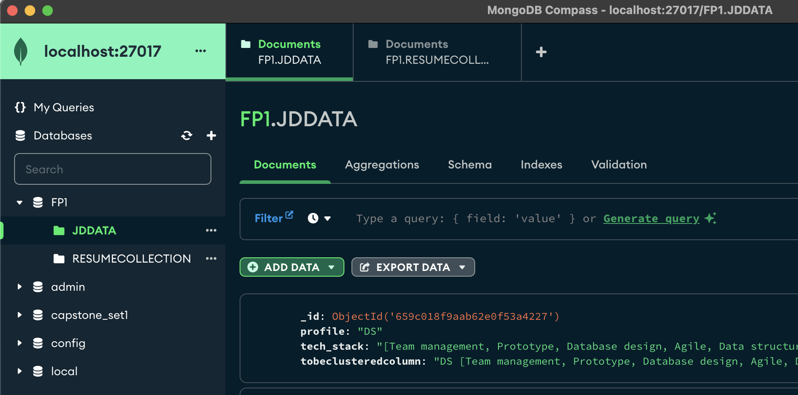
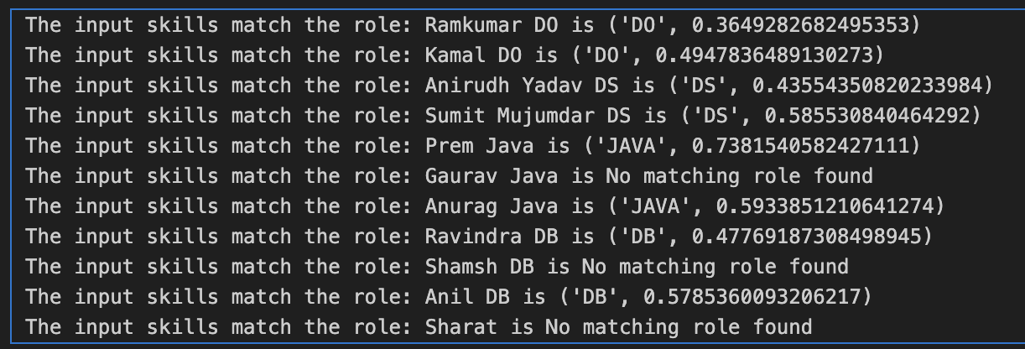
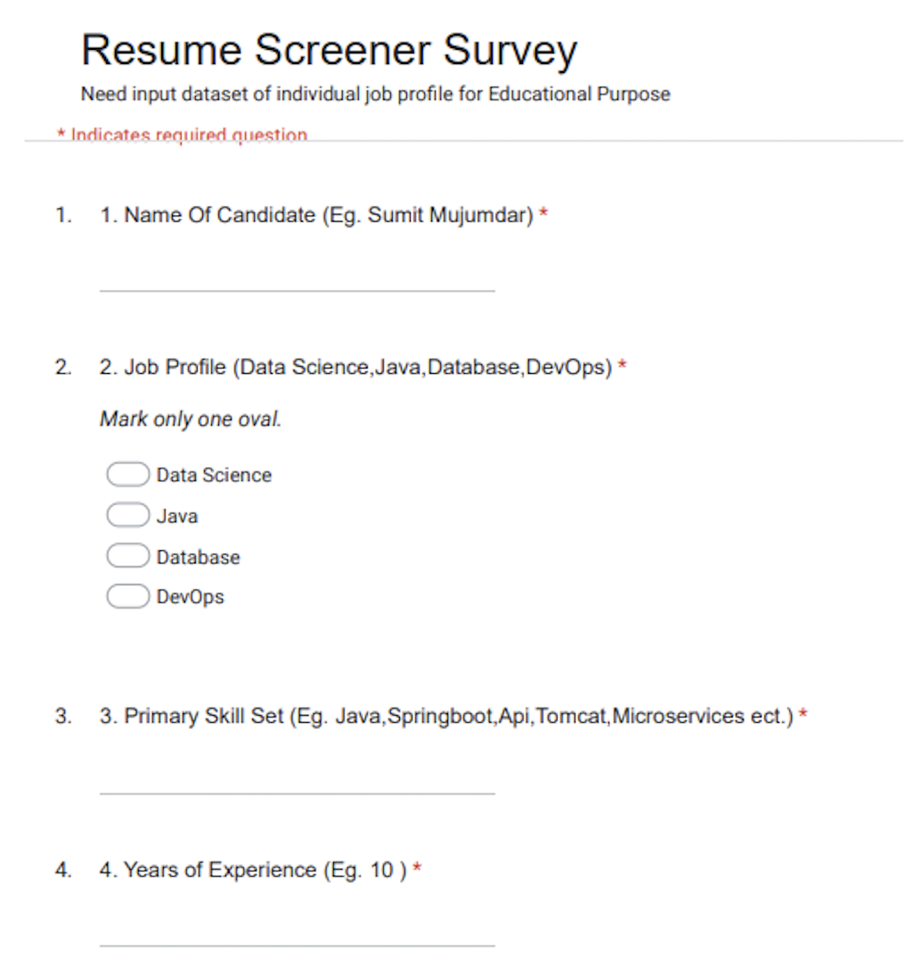
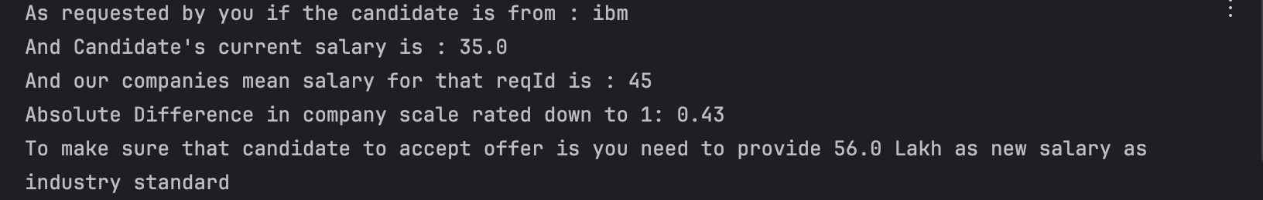
Tech Implementations
Code Set
Code Repository
Persisting in DB
Output for Resume Mapping
Resume Survey
Predicting the acceptance of offer
Tech Landscape:
NLP
Python MongoDB
Vectorization
GitHub
NLTK, SKLearn, Cosine Similarity

Slide 9
Annexure
GitHub Link : https://github.com/anirudhyadav/ISBG4FP1
Dataset used during FP1:
complete_jd_data.csv : Master dataset from Job portals
ResumeValidator-ResumeData.csv : Input profiles for mapping
All code files are placed on github, and files are sequenced as prefixed with step 1-5.

Slide 10
Caveats and WIP effort
Need to expand the selection criteria by including the Salary and Experience
Need to build a UI layer with backend API connectivity for better UX
Need to build an application layer to read the files from Database
Scoping internal job postings and using it for IJP requisition mapping

Slide 11

Thank You
Image Source :ladybird.beauty

Slide 12
Data Preparation
Data Collection: We collected resumes from multiple sources and stored them in a structured format. The sources for this activity were job portals (Naukri.com, Monster, etc), social media platforms (Linkedin, Glassdoor, etc). The resumes were in different formats such as PDF, Word and HTML. Candidates' details were collected through surveys, instead of scrapping the resumes from any job portal or social media platforms. Eventually, even if we would have scrapped the profiles, the data would have been cleaned to brought into the same structure as it was in Survey’s output.
Data Cleaning: Job description and Survey data that was extracted from web scraping and surveys was cleaned using regex and other methodologies . The required data from the Job descriptions and resumes were identified. NLTK library was used to clean up the data and extract the intended data set and corpus was prepared.
Data Preprocessing: We used techniques such as tokenization, stemming, and stop-word removal to get the data as required for the Model. With Tokenization we broke down the text into individual words or phrases. With Stemming we reduced the words to their root form. With Stop-word removal we removed common words such as “the,” “and,” and “a.” . The same technique was also used to remove the common skill sets across. The goal is to convert the text data into a format that can be easily analysed by the machine learning algorithms.
GO Back

Slide 13
Modeling
Literature research on similar problems : Study was done through multiple forums and internal group discussions to understand the availability of similar applications and typical usage. Also learning was done on the implementation methodologies to pick the right way. Focused group discussions were performed with multiple groups to understand the real problem statement in real world.
Feature Extraction: Relevant features are extracted from the Job Descriptions such as skills, education, and experience. From the Survey data from the candidates, the intended feature extraction is performed. The goal is to identify the most important features that contribute to the classification of resumes and Job IDs. Techniques such as bag-of-words and term frequency-inverse document frequency (TF-IDF) are used to extract features from the text data. CountVectorizer().fit_transform() method from sklearn library is used to generate and represent the text data in terms of a bag-of-words.
Feature Selection: The most important features that contribute to the classification of resumes/skills are selected. This will reduce the dimensionality of the data and improve the performance of the machine learning model.
Data Splitting: Data is split into training and testing sets. The training set was used to train the machine learning model, and the testing set is used to evaluate the performance of the model.
Model Training: Model is trained on the training data. The goal was to build a model that can accurately classify resumes/candidate details as relevant or irrelevant with a similarity score using cosine similarity technique.
Prediction : This is done based on the assumed data set. Which considers the Company performance index and the candidates expected salary and the skill sets. Once the candidate previous organization and expected salary fits into the JD sala range and our company index score, the probability of the candidate accepting offer is calculated.
GO Back

Slide 14
Evaluation
Model Evaluation: The performance of the machine learning model is evaluated on the testing data. The goal was to evaluate the accuracy of the model and identify areas for improvement. The model evaluation is done based on the labelled data set.
Both positive and negative test scenarios were tested to ensure that the model works fine in all scenarios
Model was tested with supplying delta data and retraining the model to check the behaviour
Model was tested for the accuracy of similarity score by randomly updating the training data set
Model was tested for Prediction
Model was tested for scalability with local data extraction
Model was evaluated for the defined success criteria by updating the training data set
Model was evaluated for the robustness of
GO Back

Slide 15
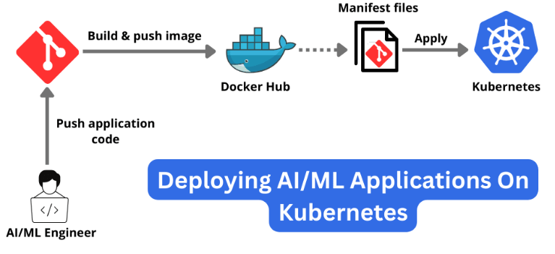
Deployment
Deployment is a cost intensive effort, so for the time being we have all the code repository in place and leveraged the local machines. But the expected target state in real world would be most probably onto the Cloud.
Deploy Any AI/ML Application On Kubernetes: A Step-by-Step Guide! - DEV Community
GO Back

Slide 16
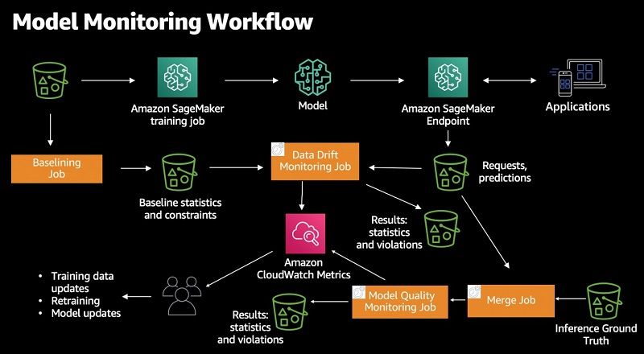
Monitoring and Maintenance
Monitoring in-production ML models at large scale using Amazon SageMaker Model Monitor | AWS Machine Learning Blog
GO Back

