Slide 1

Foundation Project : RATS (Resume Automated Tracking System)
Group 4 AMPBA-Batch-20
Presenter :
1) Anirudh Yadav
2) Sharath Paladugu
3) Sumit Mujumdar
4) Palash Gupta
5) Jyotisha Verma

Slide 2
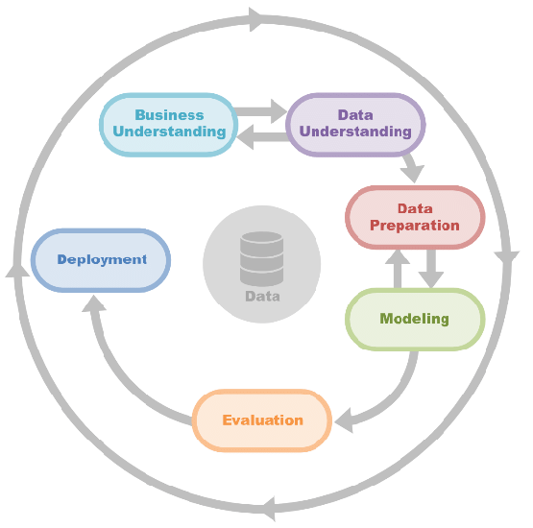
Business & Data Understanding
Business Problem :
Since company losing employees during COVID, Aim is to streamline hiring, minimize cost of Hiring Process to add bottom-line of The Company.
Business Objectives :
Minimize recruitment costs
Maximum success rate accepting offer
Success Criteria :
85% Accurate Profile Mapping with
cost minimization
Prediction of Churn Rate – High , Medium, Low
Legal Constraint :
Neutral Data Procurement such as Gender, Location etc
Image Source: ResearchGate

Slide 3
Data Collection and Preparation
Data Source :
LinkedIn Profile ( Resume Data Set )
Naukri.com
Data Management And Governance :
Maintain a Git repository for the corpus, ensuring version control of the code.
Data Sanctity maintained as it is procured from SOR
Data Description :
Identify keywords from JDs, including job titles, IT technologies, experience, location, salary range, and skills.
Persisting the Raw and Processed data into No SQL database
Image Source: ResearchGate

Slide 4
Modeling
ML Technology :
DBSCAN for Clustering, Text Analysis ,Classification Based on Cosine Similarity
Model Performance :
Regularly analyze for overfitting, fitting, or underfitting.
Implement necessary adjustments based on performance metrics.
Robustness :
Update the corpus to align with newer trends, addressing data drift.
Adapt clustering if emerging trends require new categorization.
Explain ability :
Clear Feature Documentations Ensure accurate mapping of features to respective clusters for precise categorization.
dx
Image Source: ResearchGate

Slide 5
Evaluation
At This Stage Model has been completely built with perspective of Data Analysis.
Validate Performance :
Split the data into Training And Testing sets.
Deploy scikit learn sampling with different model splits (80-20,70-30, 75-25).
ML – Success - Compare model results with defined success criteria.
Test data to simulate real-world variations and assess the Model’s sensitivity.
Economic Success – Reduce in Hiring cost leverage the spare amount for retention and saving on HR working hours
Business Success – Accurate profile shortlisting's with
Quality highring
Image Source: ResearchGate

Slide 6
Deployment
Define Inference Hardware and Deployment Strategy
Azure Machine Learning Studio - A powerful tool for building, deploying, and managing machine learning models in the Azure cloud infrastructure.
Model evaluation under production condition
Data Drift as Time passes the Accuracy of model will decrease this can be done Monitoring the model with respective to the Metrics defined.
Effective Logs – Robust Logging system to track
the model performance.
Authentication and Authorization of Users
to protect sensitive data
Accurate Documentation about Features Explanation
Like source of data, database column name etc
Image Source: ResearchGate

Slide 7
Monitoring and Maintenance
Monitoring hardware degradation requires regular health checks and upgrades
Alert mechanism for threshold breach of the CPU an Memory of the processor.
Alert Mechanism for Newer Sample Emerges in the system
Stay informed about system updates by implementing standard RFC’s , scheduling them strategically to minimize disruptions in the working model.
Alert Mechanism on Data Drift as Time passes the Accuracy of model will decrease this can be done Monitoring the model with respective to the Metrics defined.

Slide 8
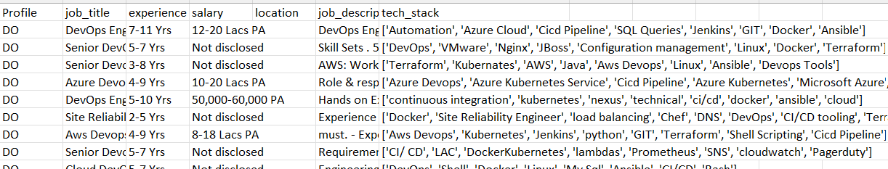
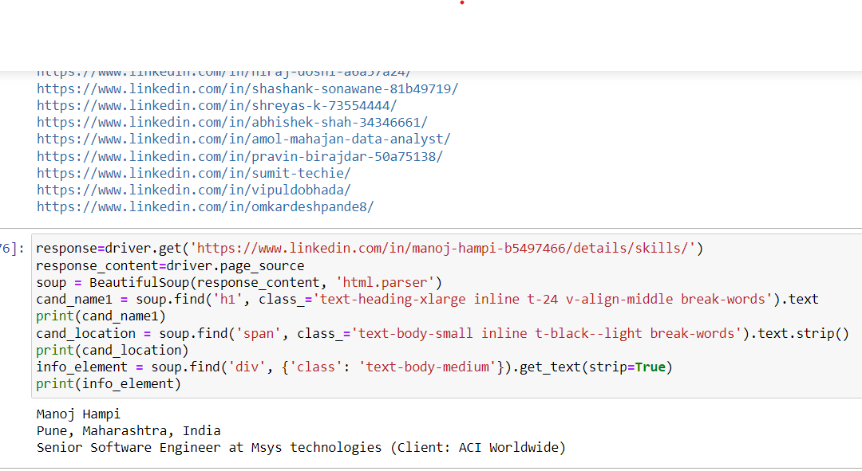
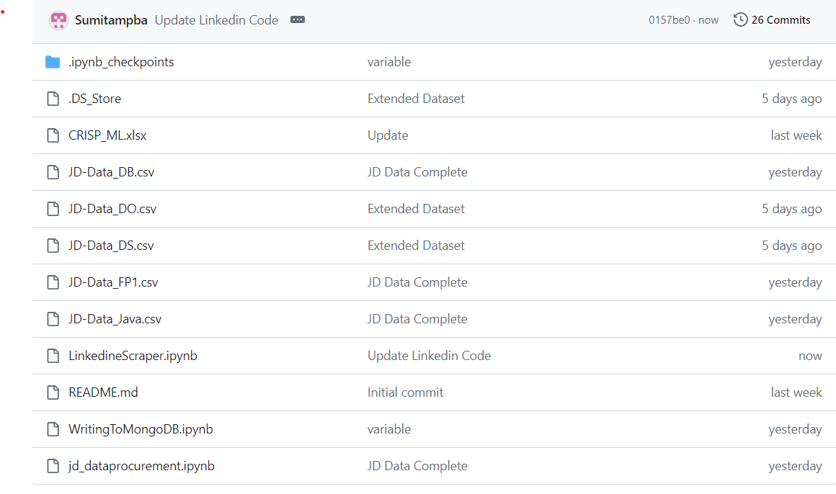
Achieved
Profile | Count of Profile
DB | 1240
DO | 920
DS | 686
Java | 1240
Grand Total | 4086
Naukri Scraper Code ~ 4K Data Scrap
Naukri Profile wise Scraped Data Counts
Linkedin Scraper Code
GitHub Repository Link:
https://github.com/anirudhyadav/ISBG4FP1
Back

Slide 9

Thank You
Image Source :ladybird.beauty

