Slide 1

Foundation Project : RATS (Resume Automated Tracking System)
Group 4 AMPBA-Batch-20
Presenter :
1) Anirudh Yadav
2) Sharath Paladugu
3) Sumit Mujumdar
4) Palash Gupta
5) Jyotisha Verma

Slide 2
Table Of Contents
Business Problem Statement
Proposed Solution
Solution Architecture
Data Preprocessing
Training Data
Identifying the Key Input Skills
Finding the Best Role with Input skills
Calculate the Cosine Similarity
Match The Role with Highest Cosine Similarity with Threshold Value
Evaluate The Data
Best Match of Job Description and Resume

Slide 3
Business Problem Statement
Business Problem :
To streamline the process for profile shortlisting based on organizations requirement and to replace it with a robust system which predicts the suitability of profile for the role.
Motivation :
The current Recruitment process is manual, and HR Team needs to handle 100’s of resumes on daily basis. Which requested of intervention of Automated system which can help to pick the ideal resumes as per given job profile in organization with a score.
Business Objectives :
Minimize recruitment costs: Which includes less manhours and market Point-In-Range for the job profile. To take informed call on Exp to CTC ratio
Maximum success rate accepting offer: This can be deduced with providing a years to number of organizations ratio, while doing text analysis in resumes.

Slide 4
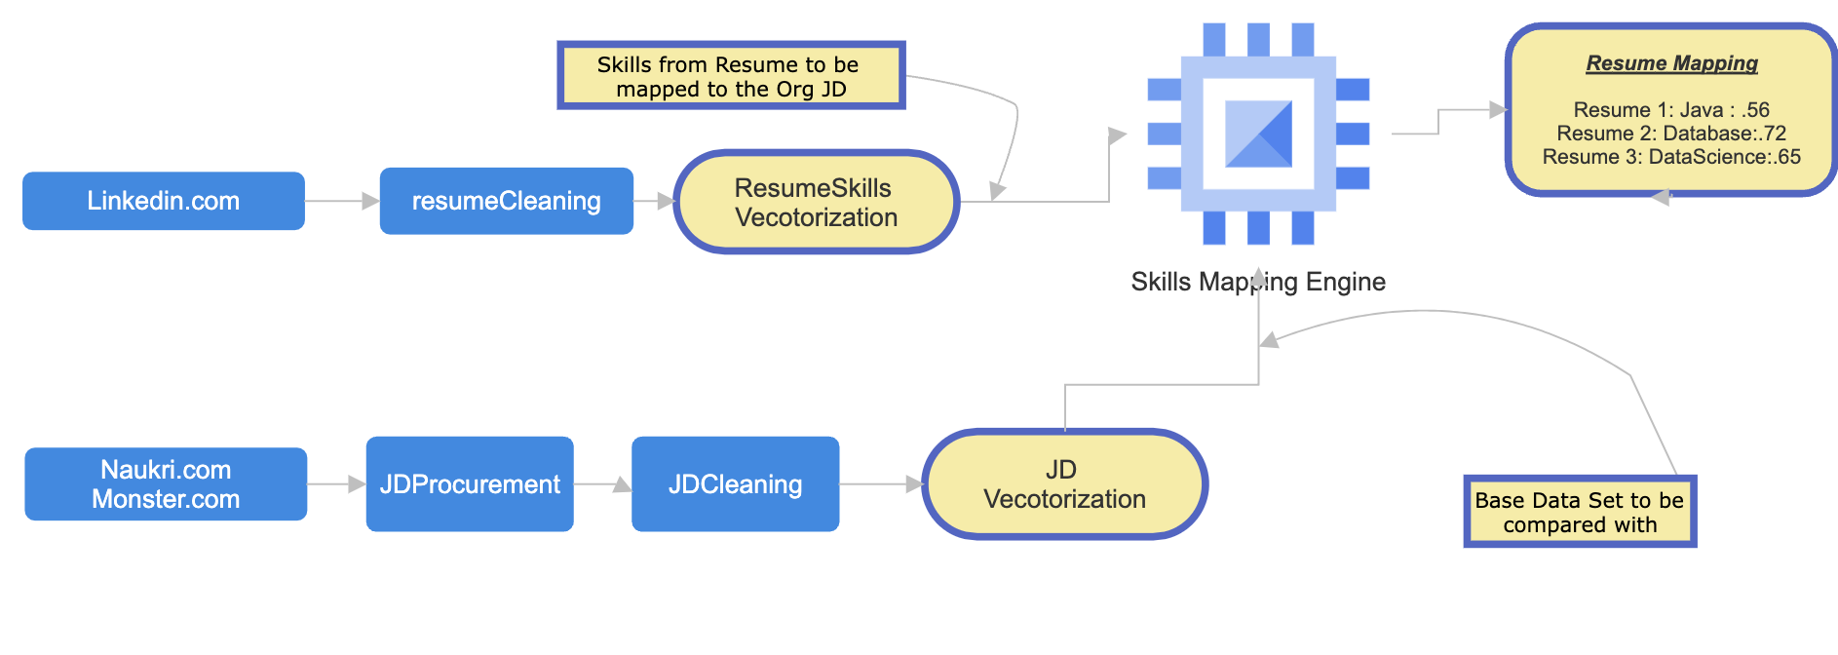
Proposed Solution
RATS: This application is built with intention to assist HR team to take informed decision while short listing the resume for a specific Job opening in the organization
We need a wireframe design as marked below, which addresses the problem statement discussed in earlier. In here we will proceed with following chain of events
Collating a vast corpus of Job-Descriptions/Job-Required-Skill from Job Portals
Collecting a Resumes for testing and mapping evaluation
We will be required to vectorize the data and store in memory
We need to find the similarity between organizations JD (which will be part of Master corpus) and skills in resume
Post the similarity value and let the HR dept take an informed call to shortlist the profile or not
Also to assist HR for JD creation based on market trends

Slide 5
Proposed Solution
Key Solution :The project Intent to scrape the profiles which are publicly available on various job portals and mapping the candidates profile with job description using similarity index score.
Key Words:
NLP
Cosine Similarity
Tf-Idf
Machine Learning
Key Features : NLP to extract relevant information from unstructured and wide ranging formats of resume
And rank applications by using input skills that uses vector space model and similarity check between the JD and Resume or Input skillset given by the candidate.
Path Breaking from Existing Solution : Recruiters reviews each resume manually with regards to Job description and then they categorize them to determine which job applications should be further called for Interview process.

Slide 6
Solution Architecture
Input Skills
Entity Classification
Data Segmentation
Tokenization
Feature Tagging
Summarized Format
Job Description
Vectorization
Cosine Similarity
K Means
Mapping of Candidate

Slide 7
Training Data
Collect Resumes for the Preparation of Data
Data Preprocessing
Read the CSV
Remove the Punctuations
Remove the Stop Words and conversion to Root Words
Remove extra spaces and Lines
Training Data
Data Preparation with Labels
Creating file with Parameters
Training Data

Slide 8
CODE EXPLANATION

Slide 9
Model Evolution

Slide 10
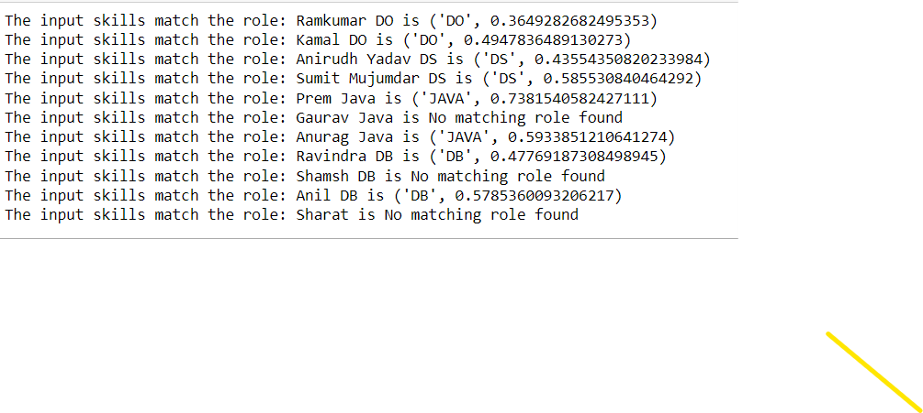
Resume Match…

Slide 11
Annexure

Slide 12

Thank You
Image Source :ladybird.beauty

