Slide 1

Foundation Project : RATS (Resume Automated Tracking System)
Group 4 AMPBA-Batch-20
Presenter :
1) Anirudh Yadav
2) Sharath Paladugu
3) Sumit Mujumdar
4) Palash Gupta
5) Jyotisha Verma

Slide 2
Table Of Contents
Business Problem Statement
Proposed Solution
Solution Architecture
Data Preprocessing
Training Data
Identifying the Key Input Skills
Finding the Best Role with Input skills
Calculate the Cosine Similarity
Match The Role with Highest Cosine Similarity with Threshold Value
Evaluate The Data
Best Match of Job Description and Resume

Slide 3
Business Problem Statement
Business Problem :
To streamline the process for profile shortlisting based on organizations requirement and to replace it with a robust system which predicts the suitability of profile for the role.
Motivation :
The current Recruitment process is manual, and HR Team needs to handle 100’s of resumes on daily basis. Which requested of intervention of Automated system which can help to pick the ideal resumes as per given job profile in organization with a score.
Business Objectives :
Minimize recruitment costs: Which includes less manhours and market Point-In-Range for the job profile. To take informed call on Exp to CTC ratio
Maximum success rate accepting offer: This can be deduced with providing a years to number of organizations ratio, while doing text analysis in resumes.

Slide 4
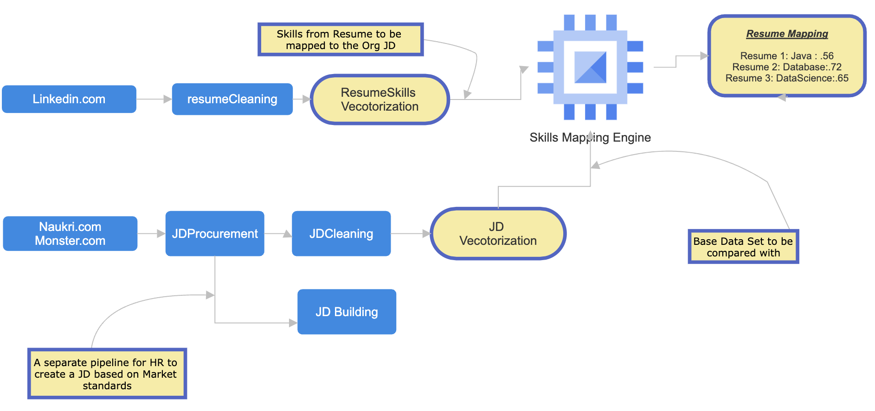
Proposed Solution
RATS: This application is built with intention to assist HR team to take informed decision while short listing the resume for a specific Job opening in the organization
We need a wireframe design as marked below, which addresses the problem statement discussed in earlier. In here we will proceed with following chain of events
Collating a vast corpus of Job-Descriptions/Job-Required-Skill from Job Portals
Collecting a Resumes for testing and mapping evaluation
We will be required to vectorize the data and store in memory
We need to find the similarity between organizations JD (which will be part of Master corpus) and skills in resume
Post the similarity value and let the HR dept take an informed call to shortlist the profile or not
Also, to assist HR for JD creation based on market trends

Slide 5
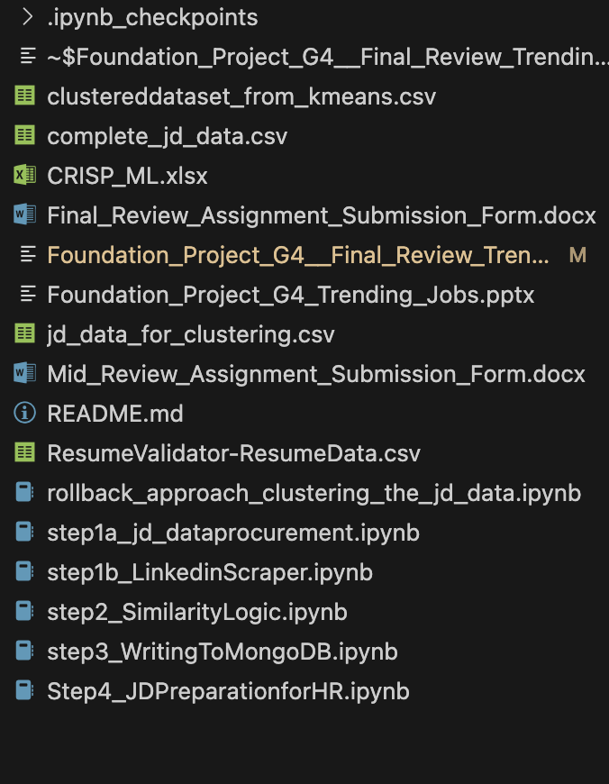
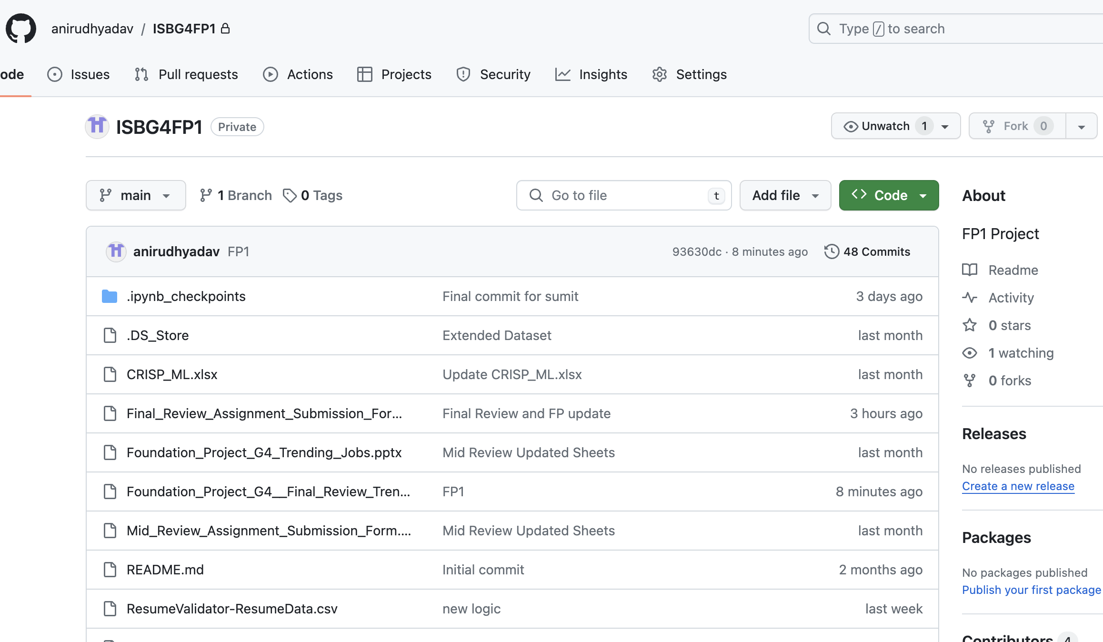
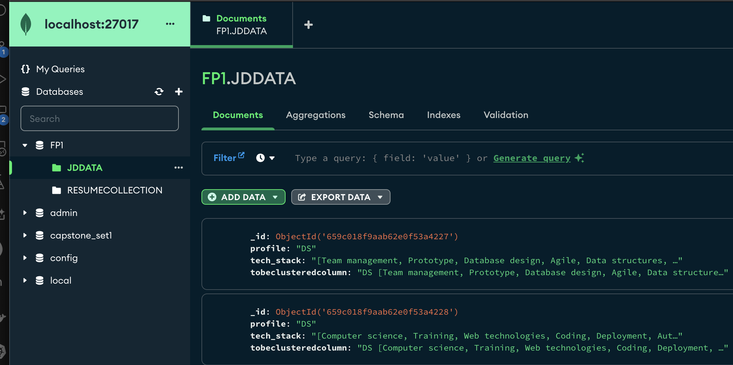
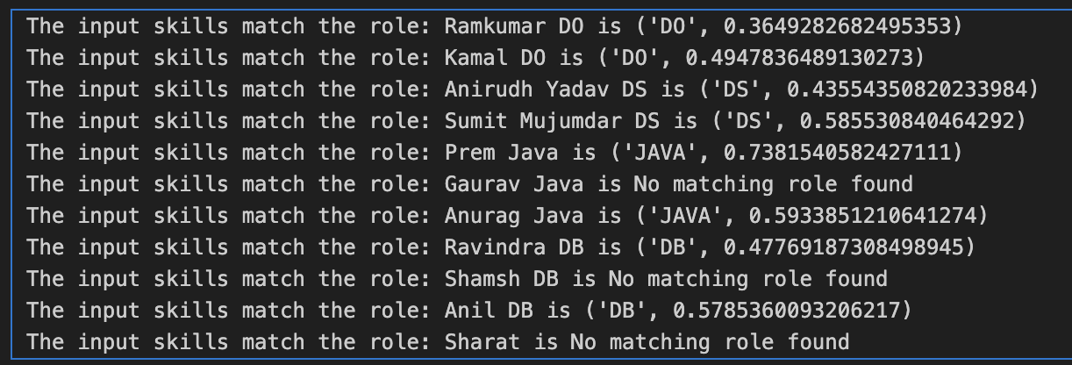
Tech Implementations
Code Set
Code Repository
Key Words:
NLP
Cosine Similarity
Python
Vectorization
MongoDB
GitHub
NLTK
SKLearn
Persisting in DB
Output

Slide 6
CRISP Alignment
DRIFT: Handling drift by reprocuring the JD data from job portals for latest corpus of tech skills required for a specific job type

Slide 7
Caveats and WIP effort
Need to expand the selection criteria by including the Salary and Experience
Need to build a UI layer with backend API connectivity for better UX
Need to build an application layer to read the files from Database

Slide 8

Thank You
Image Source :ladybird.beauty

Slide 9
Annexure
GitHub Link : https://github.com/anirudhyadav/ISBG4FP1
Dataset used during FP1:
complete_jd_data.csv : Master dataset from Job portals
ResumeValidator-ResumeData.csv : Input profiles for mapping
All code files are placed on github, and files are sequenced as prefixed with step 1-4.

