Slide 1

WELCOME
A PRESENTATION ON
BALLOON SHOOTER GAME

Slide 2


Team Members
Faria Ahmed
Abdullah Al Naim
Anisur Rahman
Ayesha Akter Siddiqa
ID:2125051087
ID:2125051052
ID: 2125051069
ID:2125051118

Slide 3
Table of contents
.Introduction
.Tools & Technology
Project Features
How It works
Graphics & Design
Code Section
Final Result
Conclusion

Slide 4
Introduction
A Python game where you burst balloons by clicking on them.
Burst as many balloons as possible to score points.

Slide 5
Tools & Technology
Programming Language: Python
Game Library: Pygame
Development Environment: Any Python IDE (e.g., PyCharm, VS Code)
System Requirements:
Python 3.x installed on the system
Pygame library installed via pip
e.

Slide 6
Project Features
Balloons float with random movements.
Players burst balloons by clicking on them.
Real-time score updates.
Game reset functionality.
Interactive and visually appealing interface
e.

Slide 7
How It Works
Balloons Movement:
Randomized floating based on trigonometric functions.
Burst Detection:
Checks mouse clicks within balloon boundaries.
Score Update:
Increases when balloons are successfully burst.
Game Reset:
Restarts game states and score.
.

Slide 8
Challenges Faced
Implementing Random Movement:
Used trigonometry for smooth animations.
Accurate Click Detection:
Developed robust collision detection logic.
Optimizing Gameplay:
Ensured smooth performance with multiple balloons on screen.

Slide 9
Graphics and Design
Balloon Appearance:
Balloons are drawn using pygame.draw.ellipse() with random colors.
A string is drawn using pygame.draw.line().
Mouse Pointer:
The pointer is drawn with lines forming a cross, changing color when over a balloon.
Background and Platform:
Background color: Light blue (lightBlue).
A dark gray platform is drawn at the bottom to represent the ground.

Slide 10
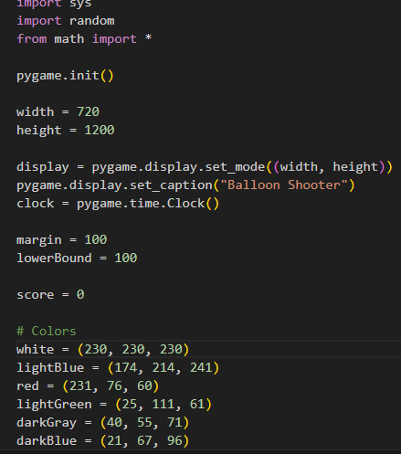
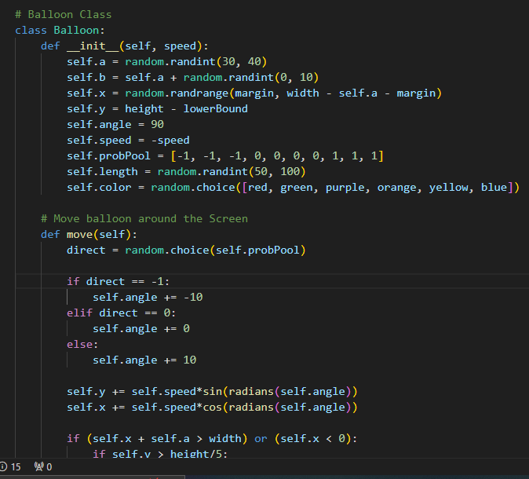
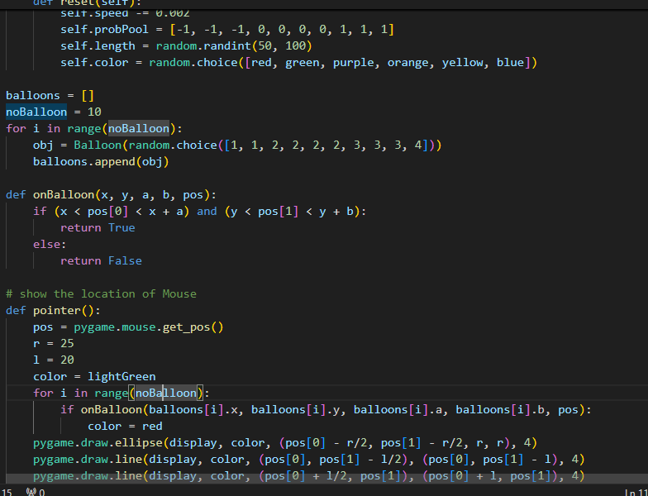
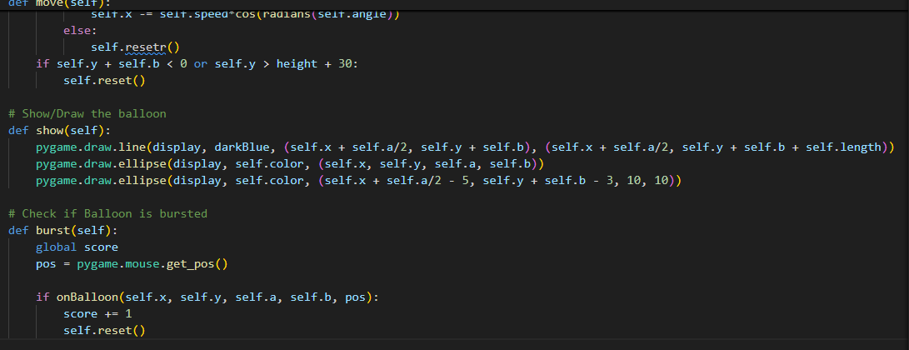
Code Section

Slide 11
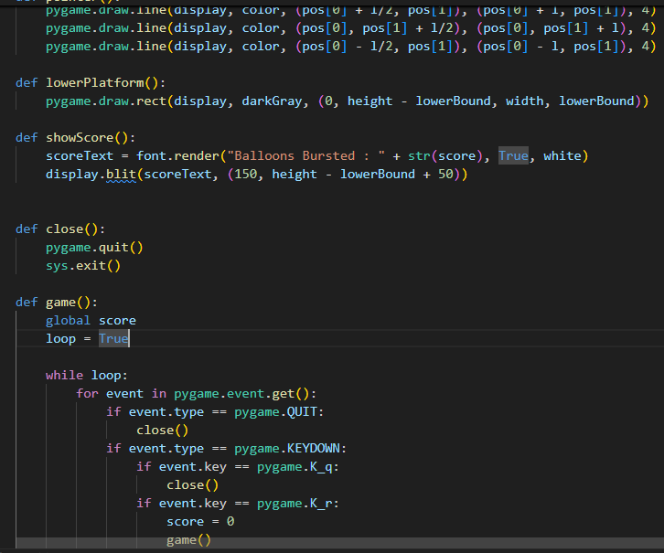
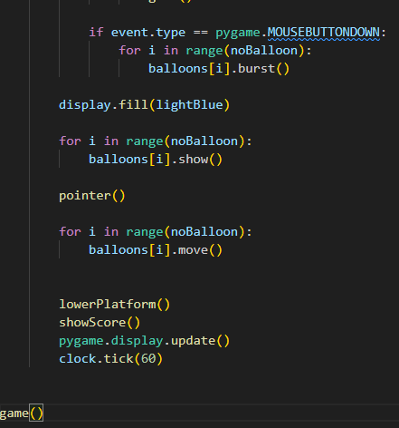
Code Section

Slide 12
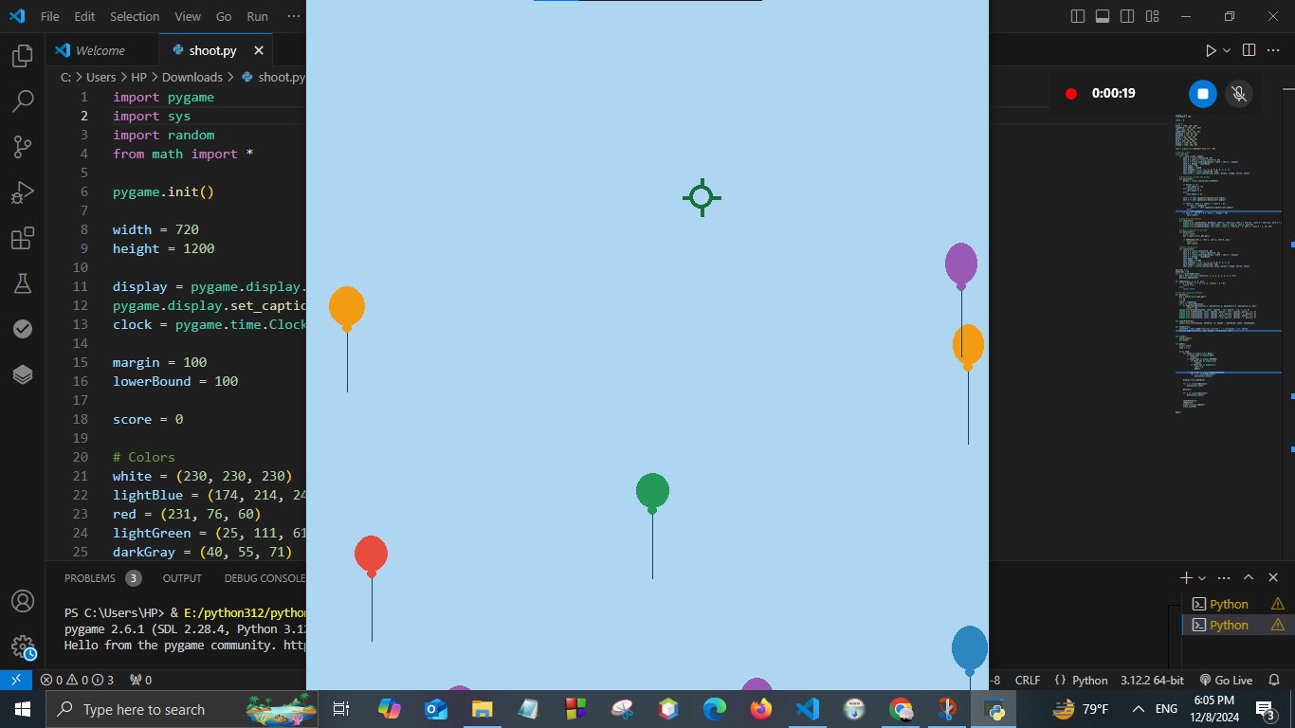
Final Result

Slide 13
Conclusion
The Balloon Shooter game is an interactive Python game using Pygame, where players pop balloons to earn points.
The game involves random balloon movement, user interactivity, and a dynamic scoring system.

Slide 14
Thank you

