Slide 1
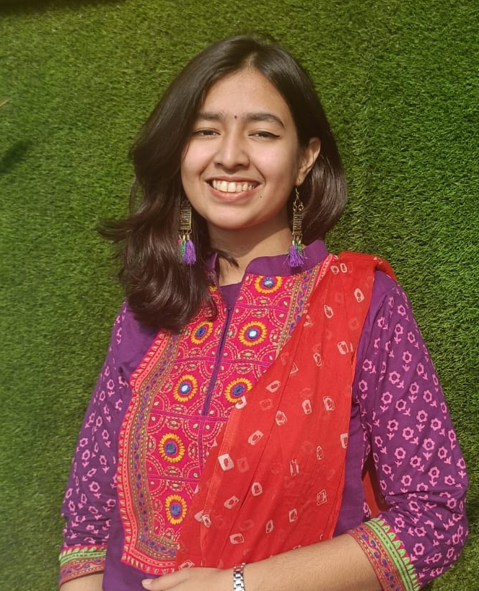
ANISA WALIDA
+8801721721030 | anisawalida206@gmail.com
Address : 9/9 , Iqbal Road, Mohammadpur ,
Dhaka – 1207
anisa-walida (github.com)
Others
Education
Marital Status Unmarried
Nationality Bangladeshi
Language Bangla English
Degree | Year | Institution
SSC | 2017 | Holy Cross School
HSC | 2019 | Holy Cross College
BSc in Computer Science and Engineering | Ongoing | Khulna University of Engineering & Technology
Projects
Technical Skills
Tax Consultant App
Flutter Project
Library Management
App
Desktop App, Java
Piper & Muse
Event Organizer Website using Laravel Framework
BookIsh
iOS App, Swift
Software Development
Desktop App
Android App – Flutter
iOS App - Swift
Web Development
Laravel Framework
Adobe Illustrator
Adobe Photoshop
Language Skill
C/ C++
Java
Python
References
Dr. K. M. Azharul Hasan
Professor
+88-02477733351~69
az@cse.kuet.ac.bd
Sunanda Das
Assistant Professor
+88-02477733351~69
sunanda@cse.kuet.ac.bd

