Slide 1
Web Analytics and Mining
By- Adiba Nisa

Slide 2
Topic-Twitter Stock Market Sentiment Analysis

Slide 3
What is Sentiment Analysis
It is basically the classification of polarity of a given text, sentence or phrase.
The goal is to identify if the if the expressed opinion in the text is positive, negative or neutral.

Slide 4
Why do we do Sentiment Analysis
Twitter is a popular microblogging website where each tweet is 140 characters.
Tweets are frequently used to express a tweeters emotions on some subject.
The challenge here is to gather all such data and summarize an overall sentiment on that topic.

Slide 5
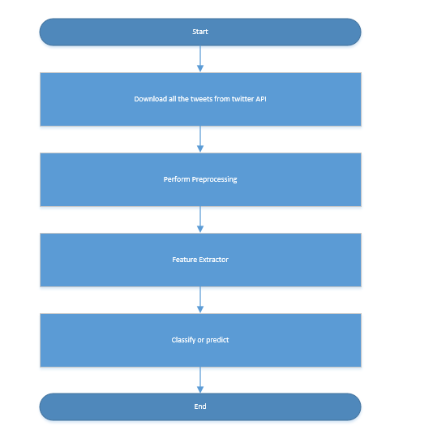
Classification of Tasks and Approach

Slide 6
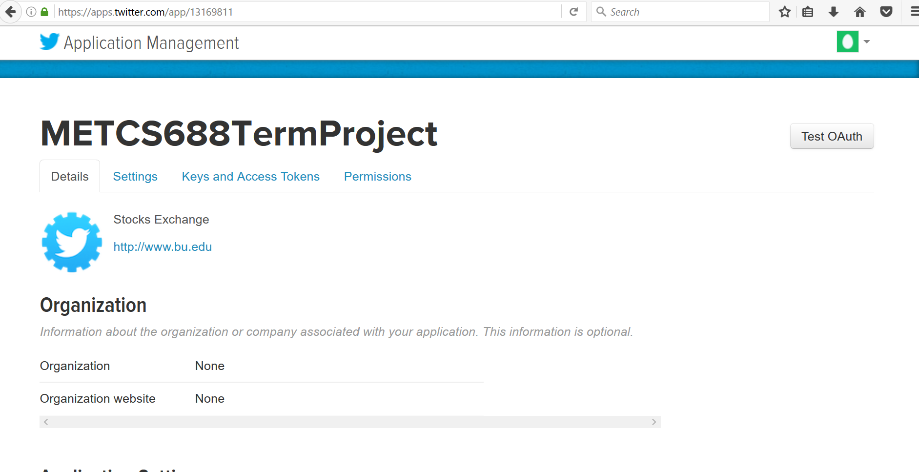
Download all the tweets from API

Slide 7
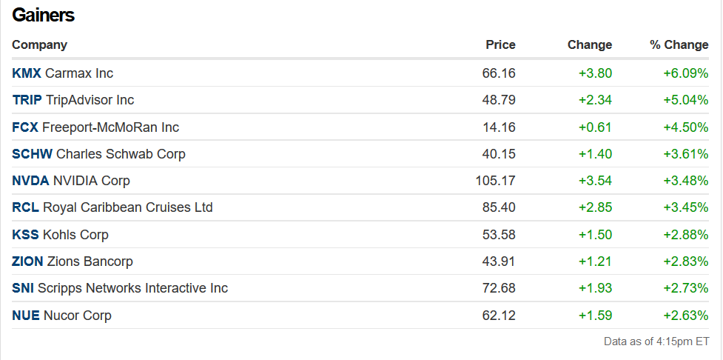
Top Gainers as on 20th Dec
Caramax Inc
TripAdvisor
Freeport-McMoRan Inc

Slide 8
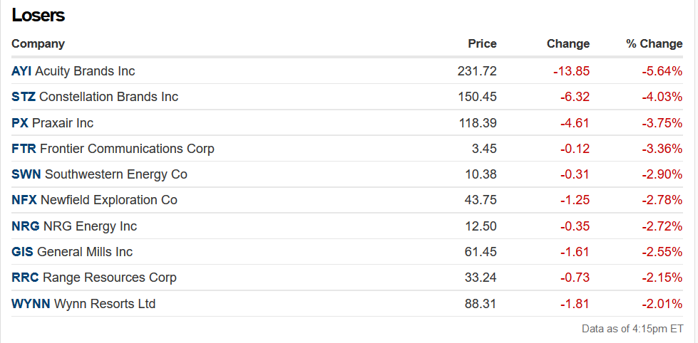
Top Losers as on 20th Dec
Acuity Brands Inc
Constellation Brands Inc
Praxair Inc

Slide 9
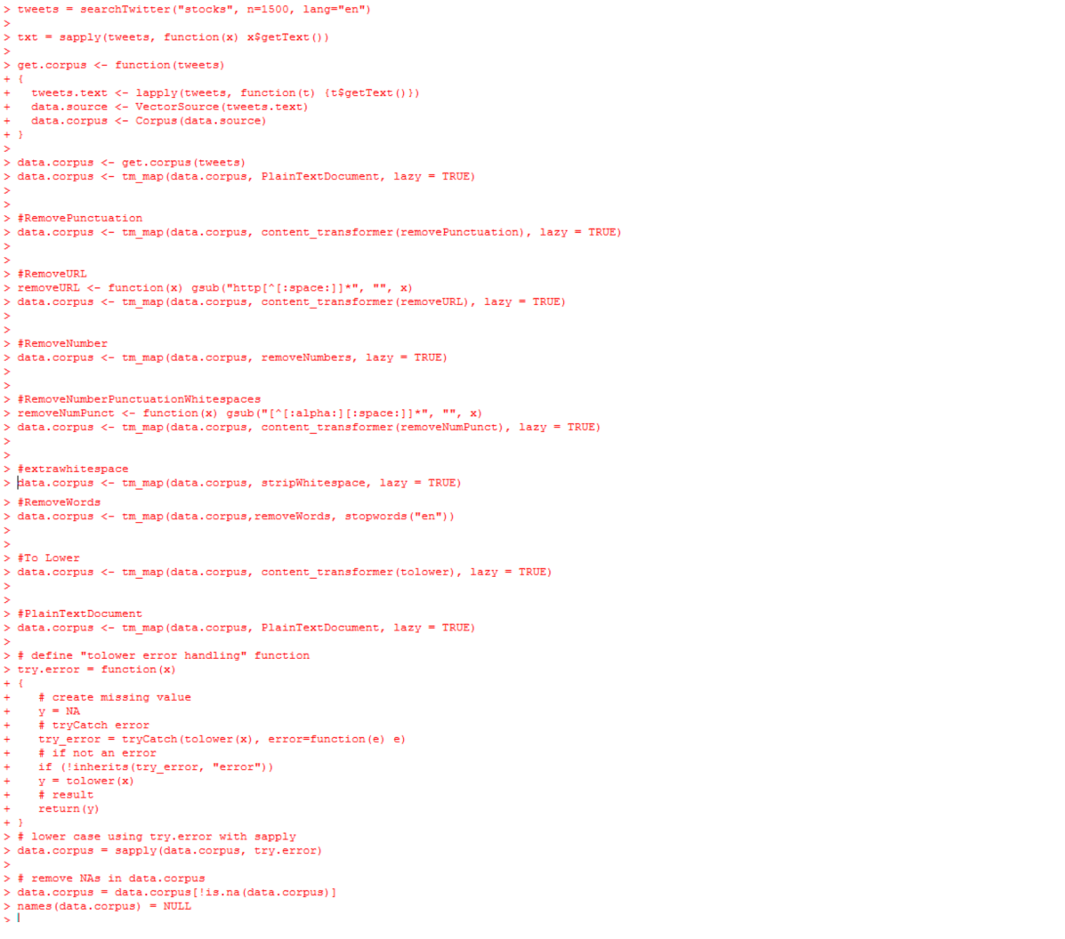
Pre Processing

Slide 10
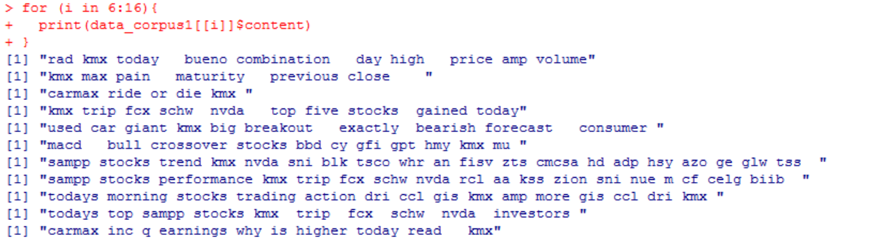
After Preprocessing

Slide 11
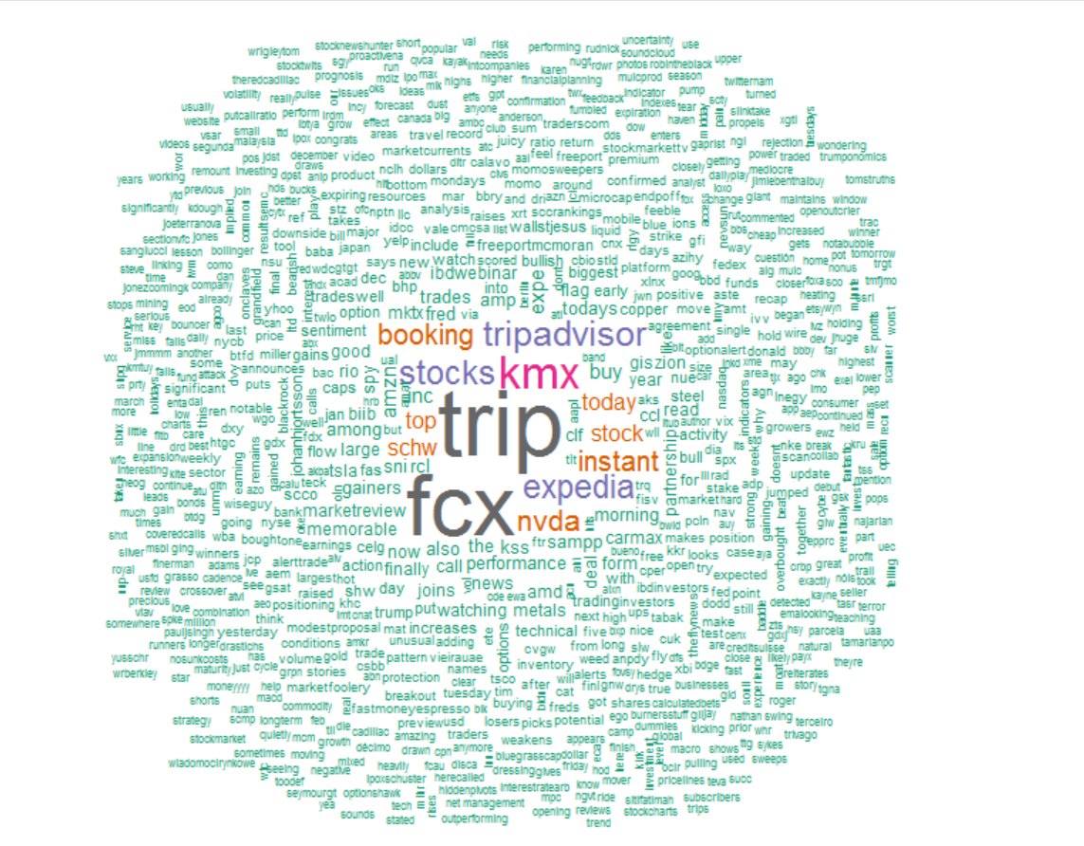
Word Cloud-Gainers

Slide 12
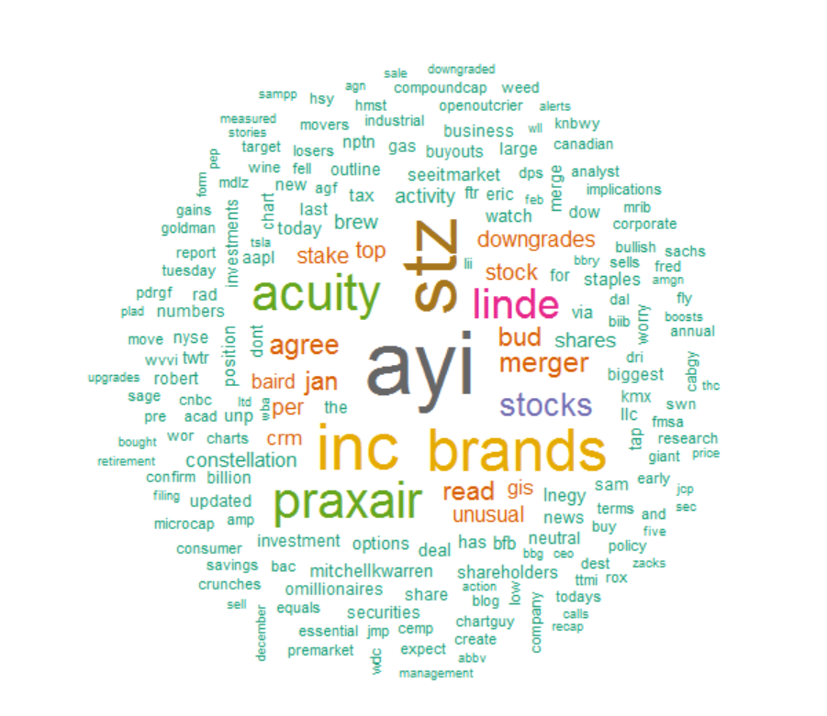
Losers Word Cloud

Slide 13
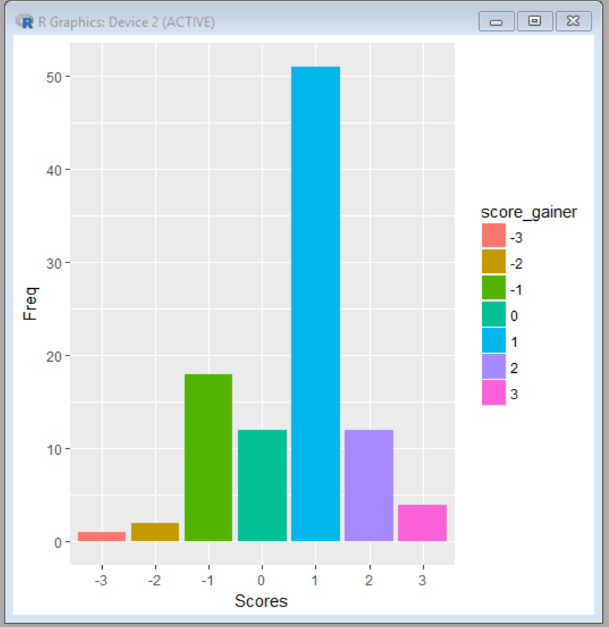
Gainers Plot-
More towards the positive side

Slide 14
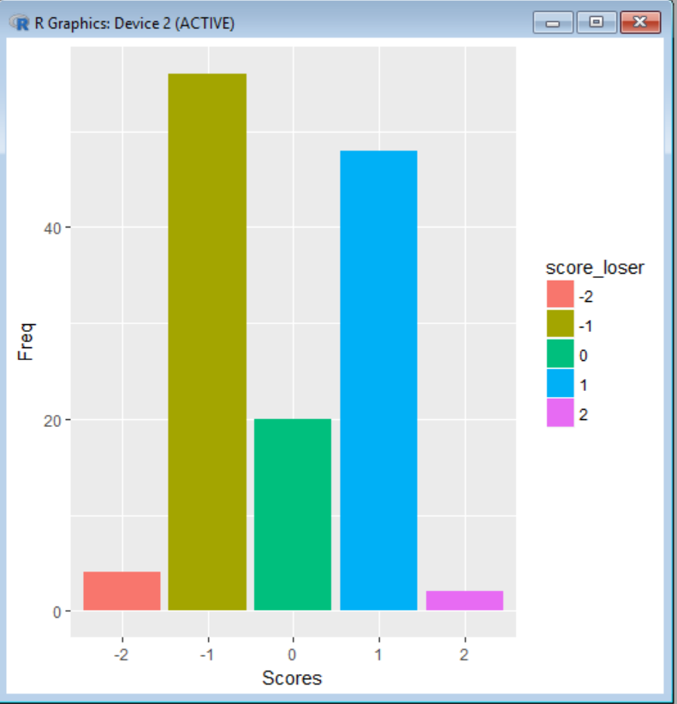
Losers Plot-
More towards the negative end

Slide 15
Observation
The sentiment score observed in the graph is positive which means that since the tweets have a positive sentiment for gainers.
The sentiment score observed for losers is negative which means that since the tweets of losers have a negative sentiment.

