Slide 1
Real World Topologies

Slide 2
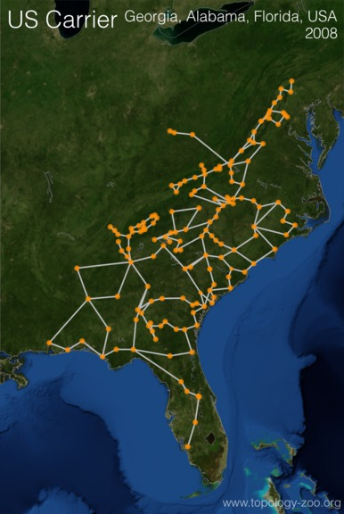

Slide 3
Inferred Real

Slide 4
Inferred Real

Slide 5
Inferred Real

