Slide 1
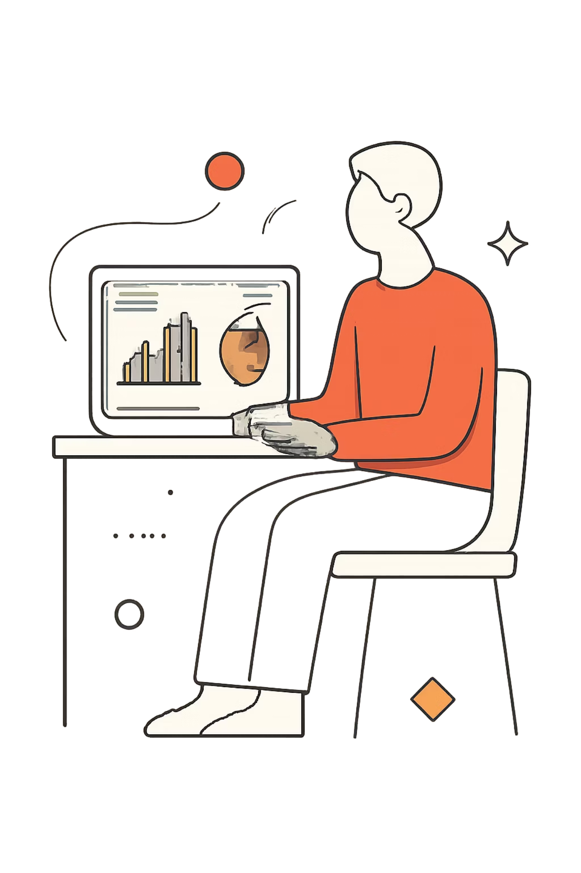
Customer Behaviour Analysis
Data project — Python, MySQL, Power BI
Prepared by: Anisa Shaikh · 7 July 2026

Slide 2
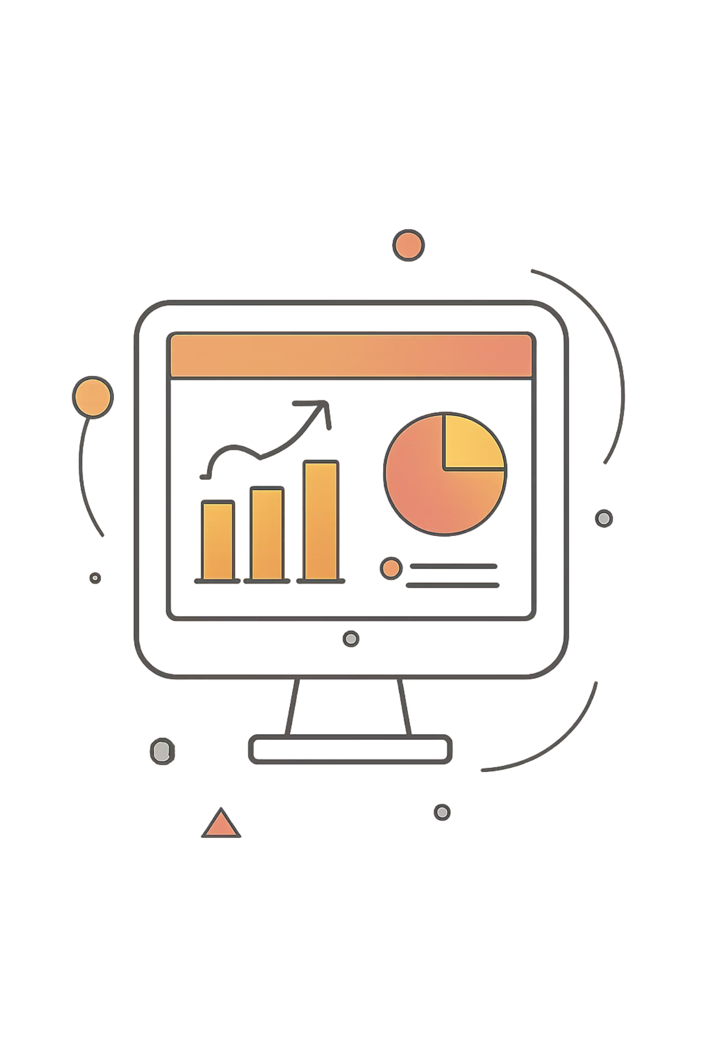
Business Problem & Objectives
Problem
Objectives
Large volumes of transaction data; insights hidden without analysis
Analyse behaviour · Identify top categories · Evaluate spending & subscriptions
Deliverable
Interactive business dashboard · Actionable insights

Slide 3
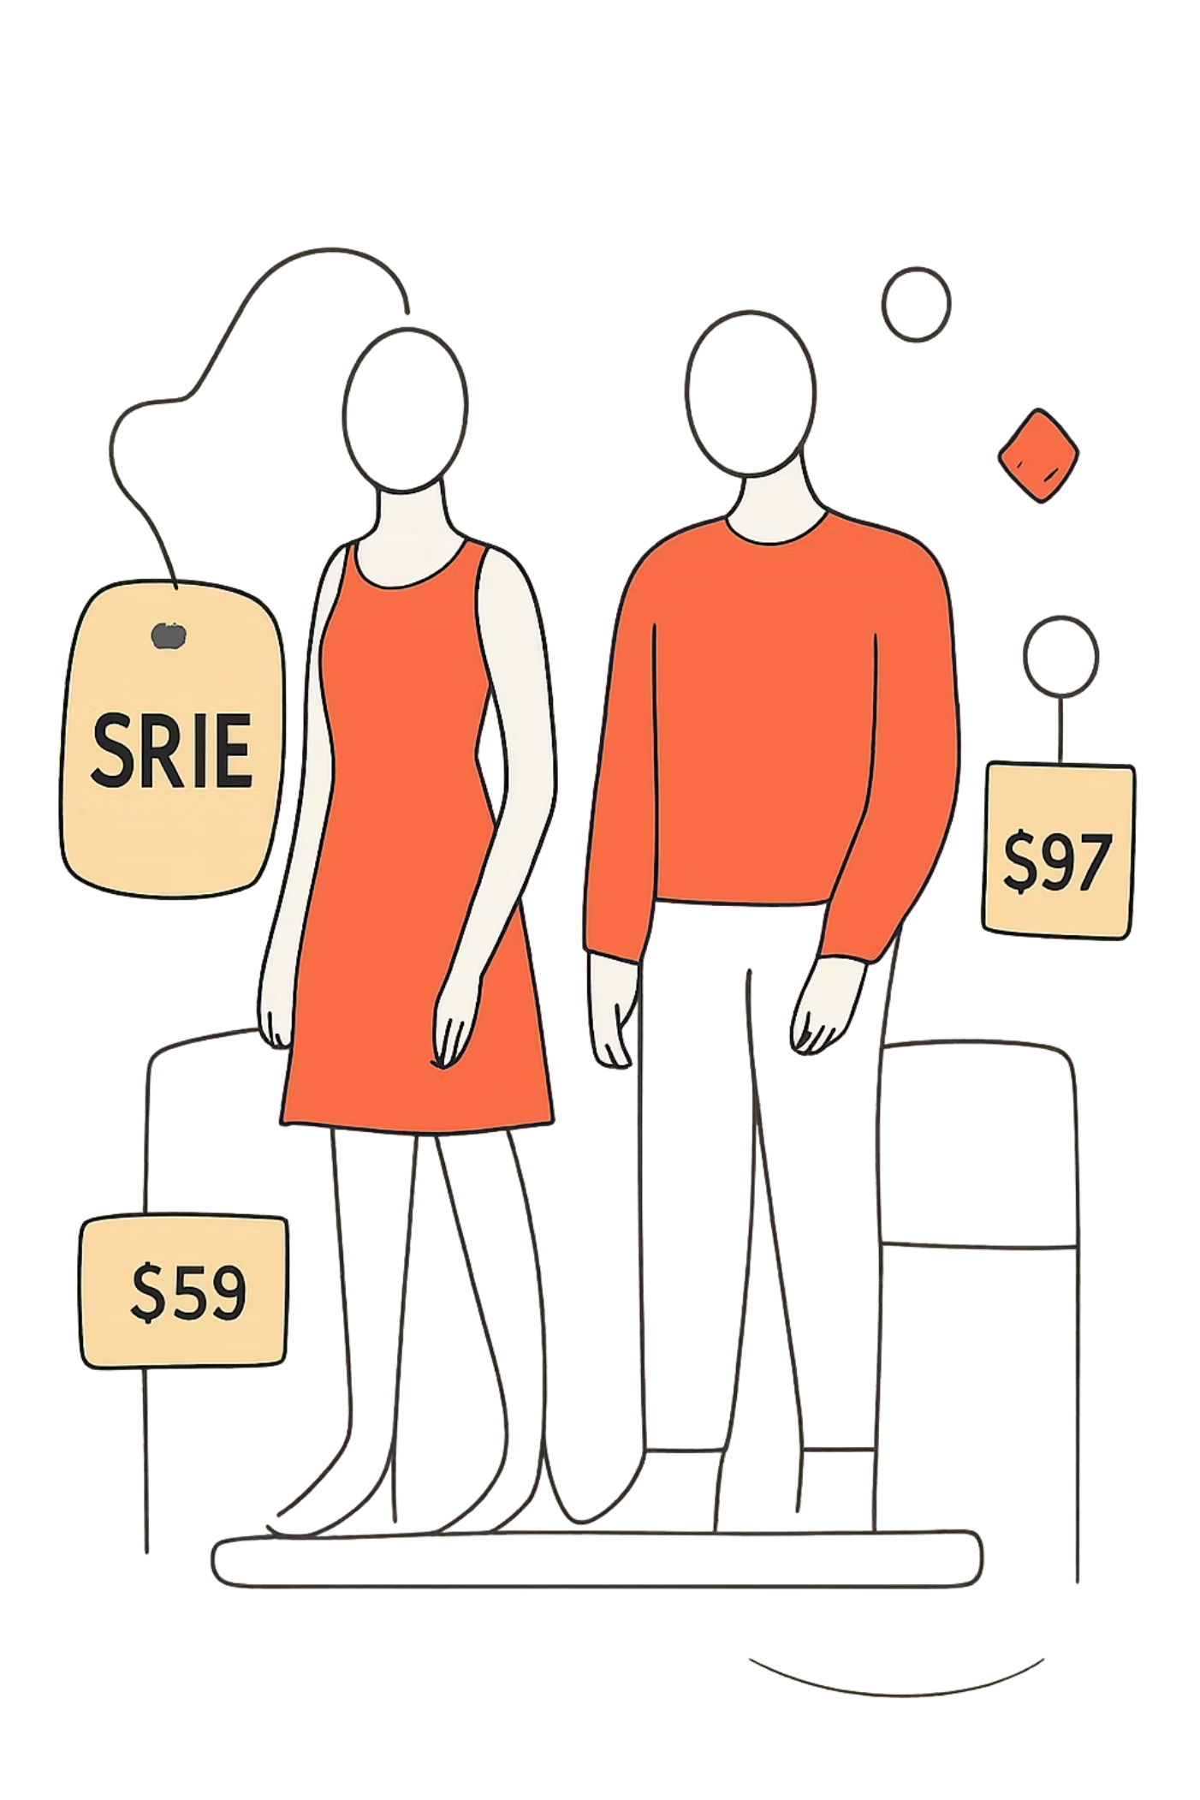

Top Insight: Clothing Leads Revenue
Revenue Leader
Business Impact
Clothing: highest revenue & sales volume
Keep clothing strategic: inventory, expand lines, focused marketing

Slide 4




Audience: Young Adults
Largest share of revenue · higher engagement & spending
Target marketing to this demographic
Promotions
Personalized offers & digital ads
Loyalty
Rewards to boost retention

Slide 5
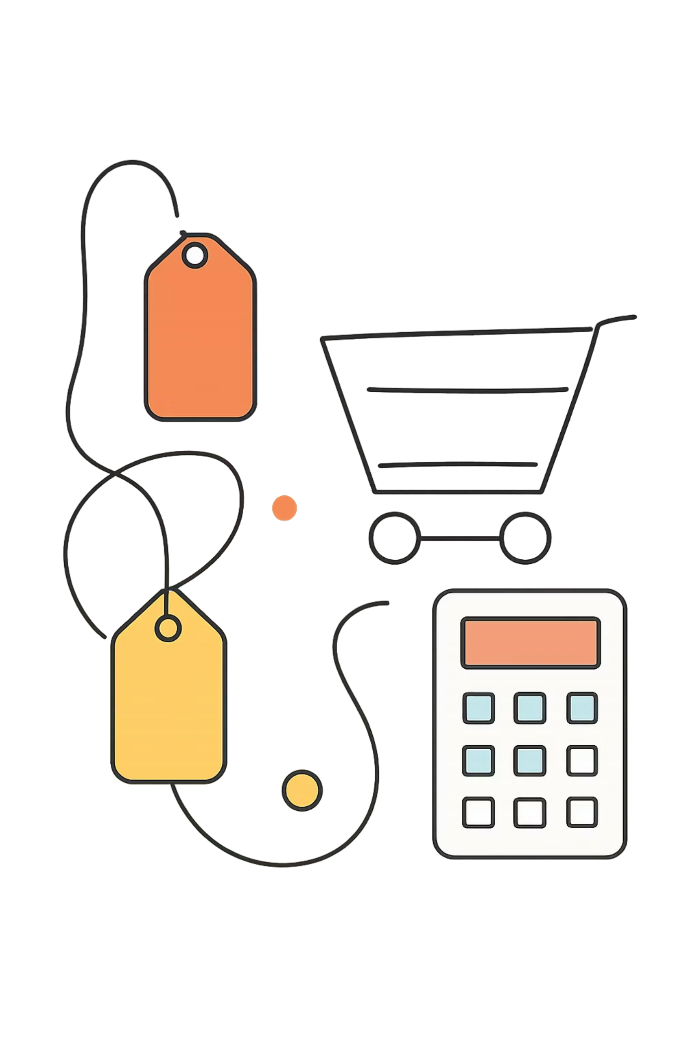
Spending Patterns
Average Basket
$59.8 average purchase — stable
Strategy
Increase purchase frequency: cross-sell, bundles, recommendations

Slide 6
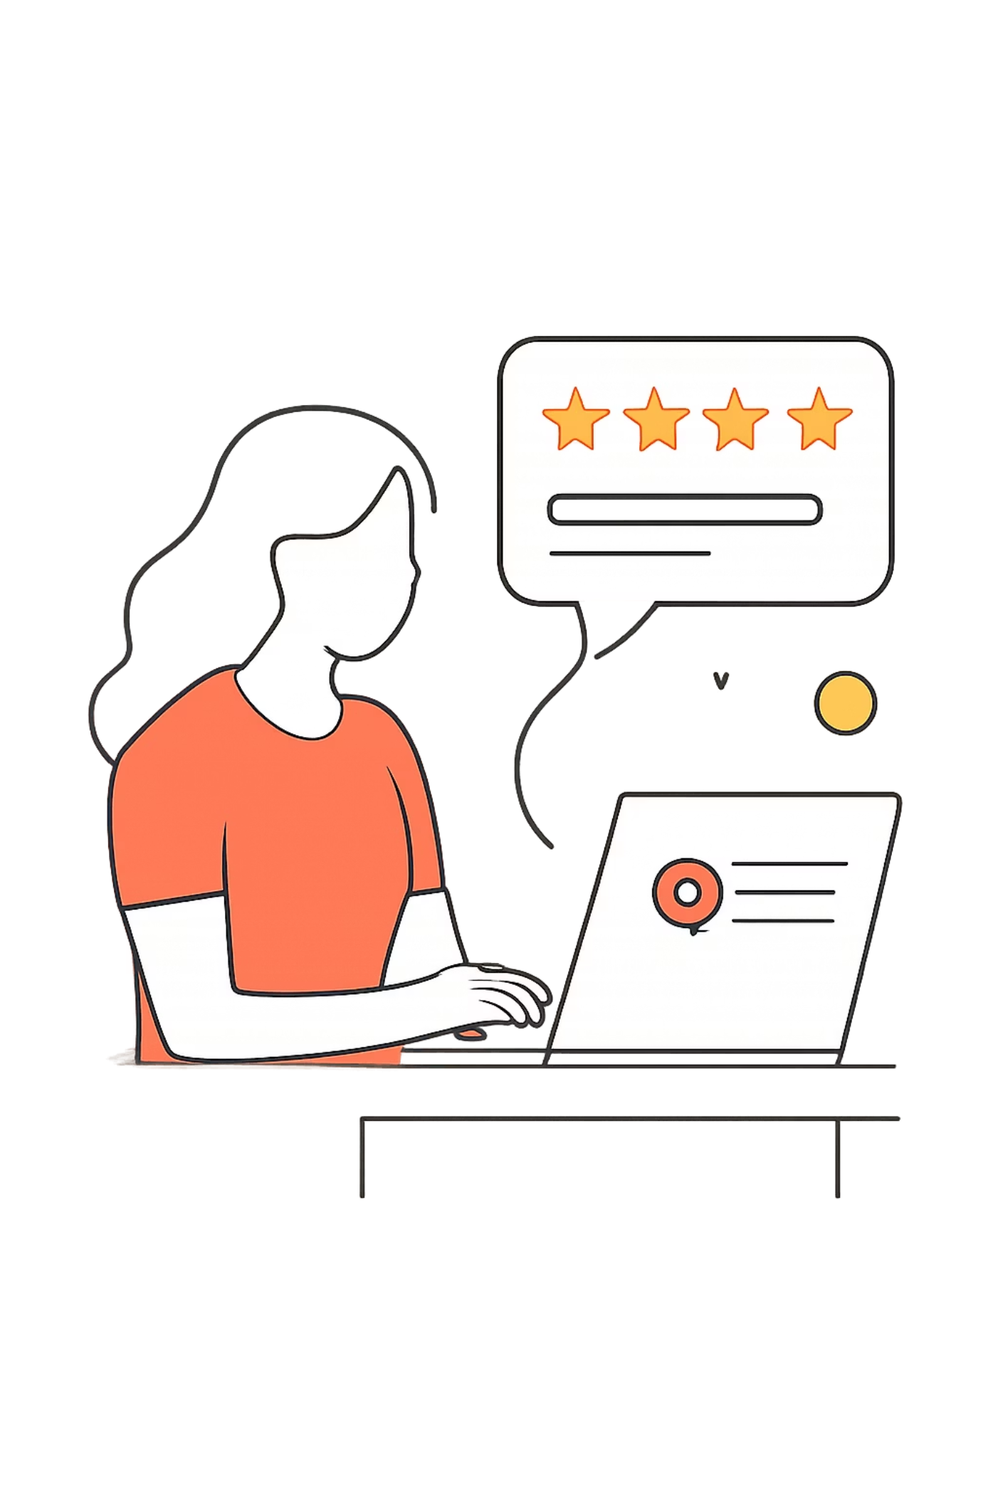
Customer Satisfaction
Average rating 3.75 / 5 — generally positive
Opportunity
Address low-rated products & service issues
Impact
Improved retention & repeat purchases

Slide 7
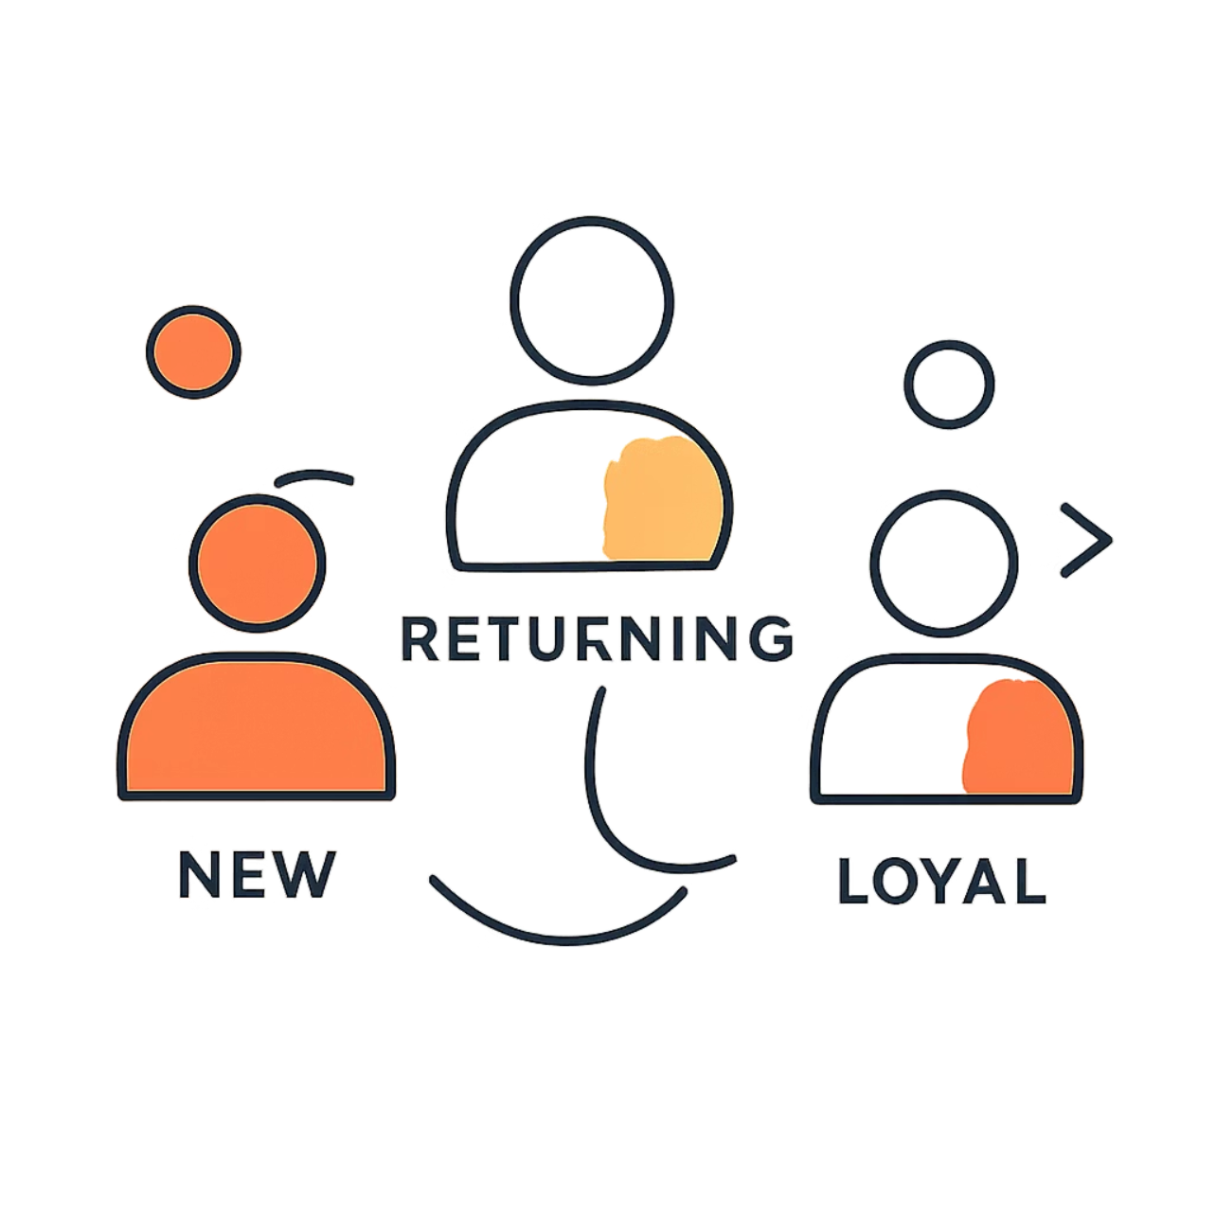
Customer Segmentation
New · Returning · Loyal
New
Returning
Welcome offers to drive repeat purchases
Personalized recommendations
Loyal
Exclusive rewards & early access

Slide 8
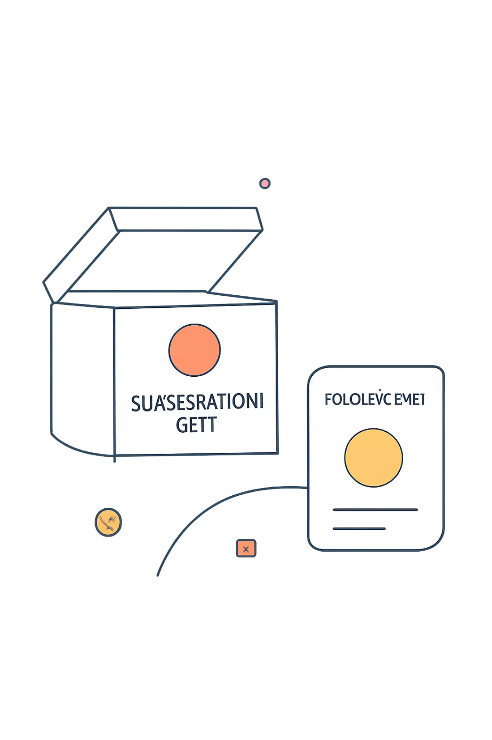

Subscription Analysis
Compare Subscribers
Recommendation
SQL compares subscribed vs non-subscribed purchasing behaviour
If subscribers buy more → expand benefits; otherwise redesign incentives

Slide 9
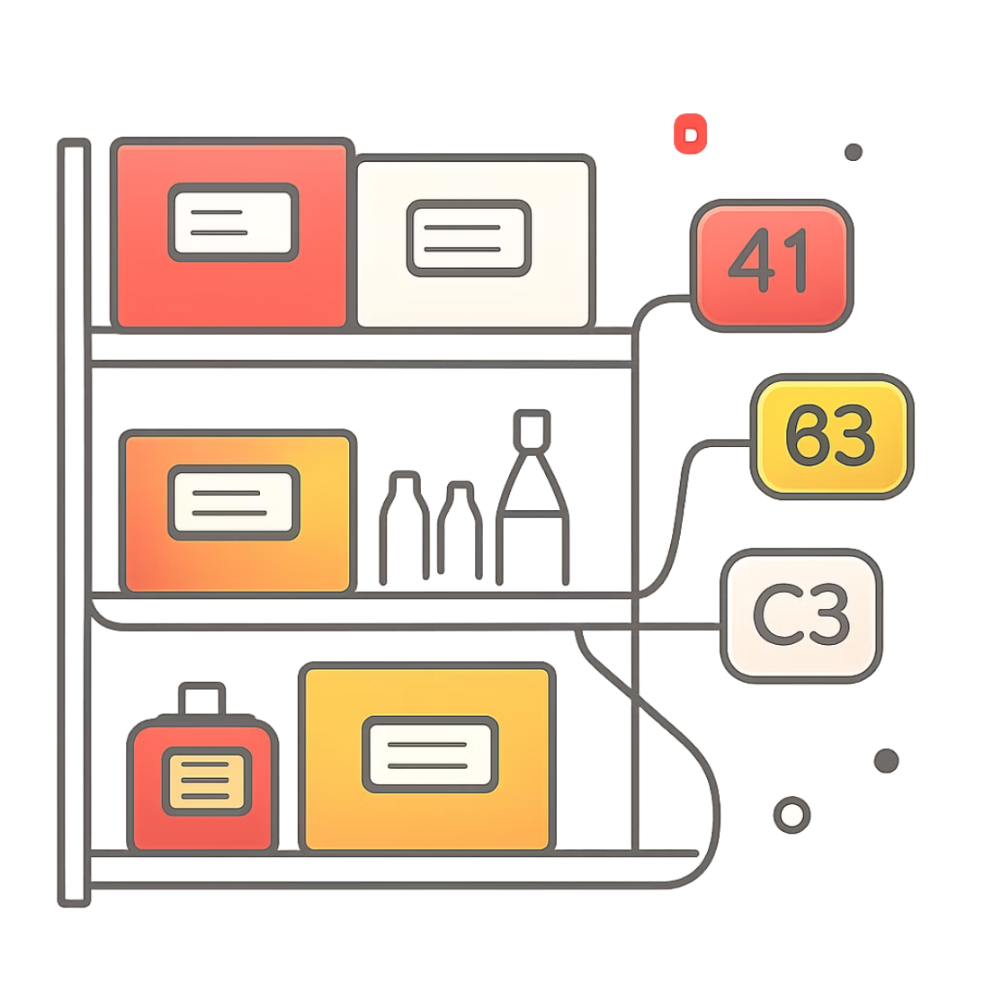

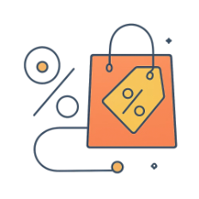
Product & Discount Insights
Top Sellers
Discount Effects
Allocate inventory & promote high-rated, high-selling items
Measure if discounts drive sales or cut margins; target effective promos

Slide 10
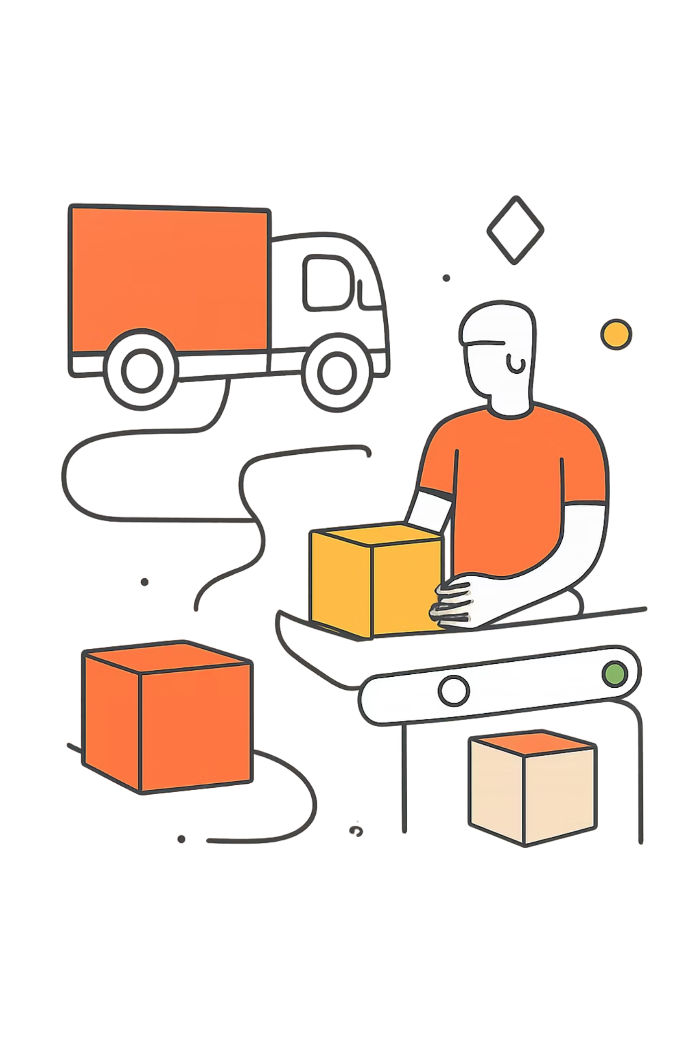
Shipping & Final Recommendations
Shipping Preferences
Business Recommendations
Compare average purchase by shipping method to optimize logistics
Focus investment on high-performing categories (Clothing)
Improve inventory availability & marketing for those categories
Leverage segmentation, subscriptions, and promo analysis to grow revenue

