Slide 1


Presentation on
Online Bus Ticket Management System
Prepared By
Anis Ahmmed
ID# 16103128
Program: BCSE
Supervised By
Rubayea Ferdows
Lecturer
Department Of Computer Science and Engineering
December 30, 2019

Slide 2
Contents
Organization Overview
Introduction
Objectives
Software Process Model
Requirement Engineering
Use Case Diagram
Function Point
Cost Estimation
Activity Diagram
Entity Relationship Diagram
Data Flow Diagram
Testing
Project Demonstration
Conclusion
December 30, 2019
2

Slide 3
Organizational Overview
Sanaz Corporation is a Web Design & Development company in Bangladesh. We have 4 years of experience in web design and development.
Our services consist of
Web Design
Software Development
E-commerce
Domain & Hosting
December 30, 2019
3

Slide 4
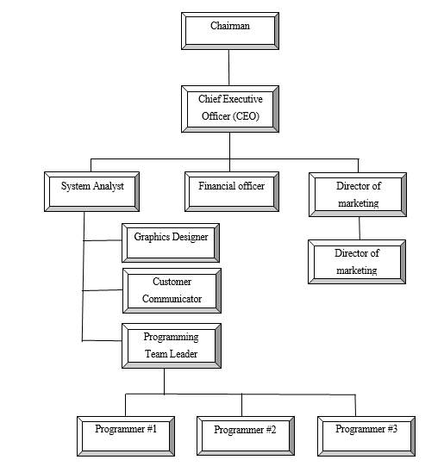
Organizational Structure
December 30, 2019
4

Slide 5
Introduction
This project can be used to manage Bus Ticket Booking system in online.
It can reserve seats, cancellation, and quick bookings.
It maintains customer details, Booking Information.
It is web based application.
December 30, 2019
5

Slide 6
General Objective
The general objective of this project is to use my institutional educational experience in the real life working environment by developing Online Bus Ticket Management System for Sanaz Corporation.
December 30, 2019
6

Slide 7
Specific Objectives
View Bus Information
Book tickets
Payment in Online
Get ticket invoice
Cancel Tickets
Print book tickets
Manage bus information
Manage Register Terminal
Information
Add, Update, Customer Details
Manage Booking tickets information
Search individual customer information
Generate Report
December 30, 2019
7

Slide 8
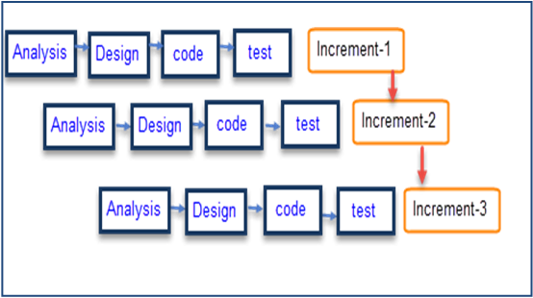
Software Process Model
Figure: Incremental Process Model
December 30, 2019
8

Slide 9
Why I Have Chosen This Model ?
In this model user can respond to each built.
It is flexible and less expensive to change requirements and scope.
Errors are easy to be identified.
Generates working software quickly and early during the software life cycle
December 30, 2019
9

Slide 10
Feasibility Study
Technical Feasibility
Economic Feasibility
Operational Feasibility
December 30, 2019
10

Slide 11
Requirement Engineering
User Requirements
System Requirements
Functional Requirements
Non-functional Requirements
December 30, 2019
11

Slide 12
User & System Requirements
Admin can create agent/customer
Admin can view agent/customer information
Admin can update customer information
Admin can delete individual customer information
Admin can search individual customer
Admin can view & print the customer details
Admin can add individual components information
Admin can register terminal for each bus
Admin can view register terminal information
Admin can add bus information
December 30, 2019
12

Slide 13
User & System Requirements Continue…
Admin can view & search bus information
Admin can update bus information
Admin can soft delete bus information
Customer need to do registration
Customer need to login
Customer can search ticket according to the demand
Customer can book ticket
Customer can give payment through online
Customer will get ticket invoice in his/her email
Admin can generate report of individual booked bus
December 30, 2019
13

Slide 14
Functional Requirements
Admin can maintain whole system.
Admin can add, view, search, update, & delete individual bus components information
Admin can add, view, search, update and delete bus information
Admin can create, view, search, update agent/customer information
Admin can create, view, update, & delete register terminal information
Admin can generate report and print report of individual booked bus information
Customer can search ticket according to the demand
Customer can book ticket
Customer can give payment in online
Customer will get ticket invoice through his/her email
Customer can print the booked ticket info
December 30, 2019
14

Slide 15
Non Functional Requirements
Admin can log in by using email and password.
Customer can log in by using email and password.
Only admin can maintain the whole system.
This system support only Windows 7/8/10
December 30, 2019
15

Slide 16
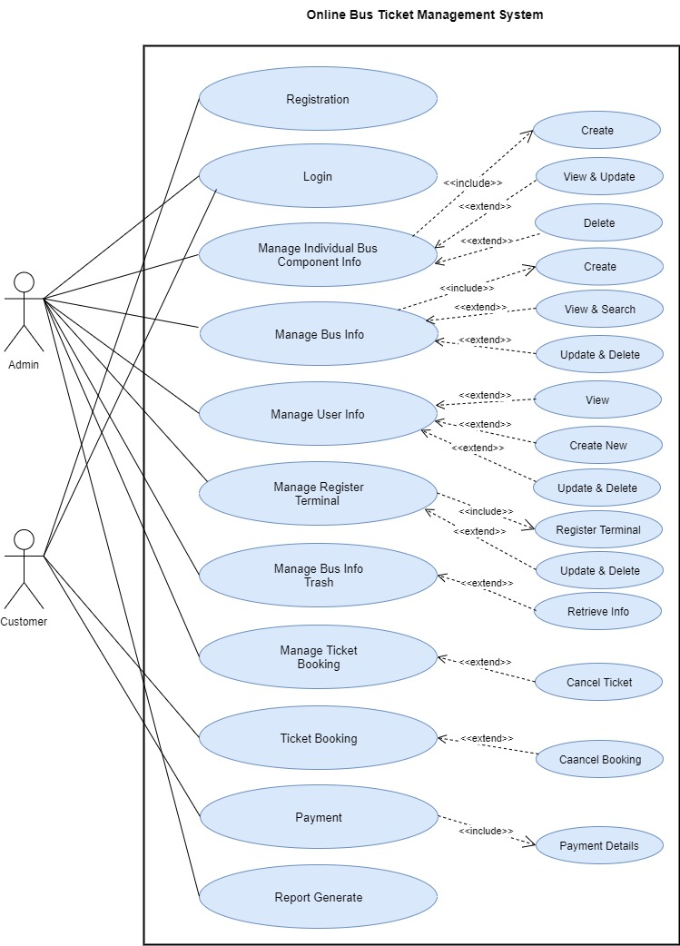
Use Case Diagram
December 30, 2019
16

Slide 17
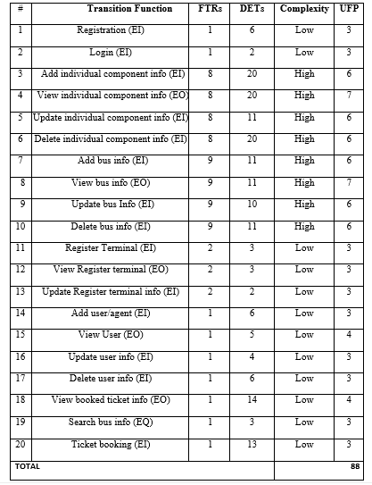
Identifying Complexity For Transaction Function
December 30, 2019
17

Slide 18
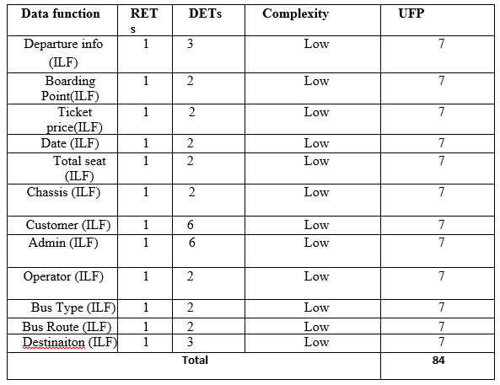
Identifying Complexity For Data Function
December 30, 2019
18

Slide 19
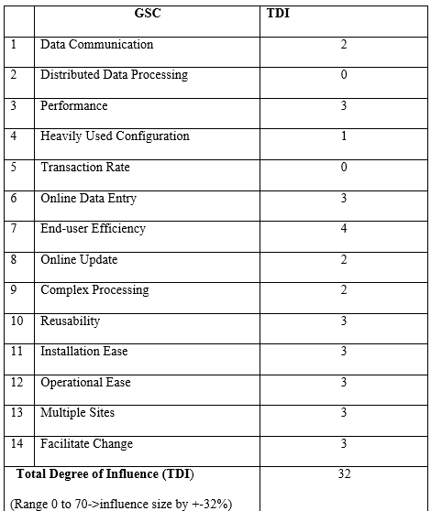
Performance & Environmental Impact
December 30, 2019
19

Slide 20
Final Calculation
Value adjustment factor (VAF) = (0.65+ (0.01* TDI))
= (0.65+ (0.01* 32))
= 0.97
UFP= UFP (Data function) + UFP (Transaction function)
= 88 + 84 = 172
AFP= UFP * VAF = 172 * 0.97 = 167 Approx.
Total time calculation frame = 167 * 15.5 [Productivity of PHP is 15.5] = 2588.5 per hour
= 2589 person hours / 7.5 hours
= 345 person days / 3 [person in a group]
= 115 days
= 3 months 25 days for three persons
Approximately 4 months required for three persons to finish the project.
December 30, 2019
20

Slide 21
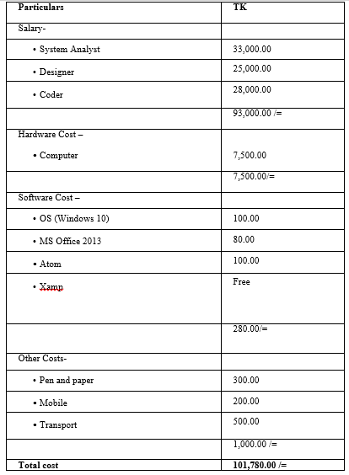
Cost Estimation
December 30, 2019
21

Slide 22
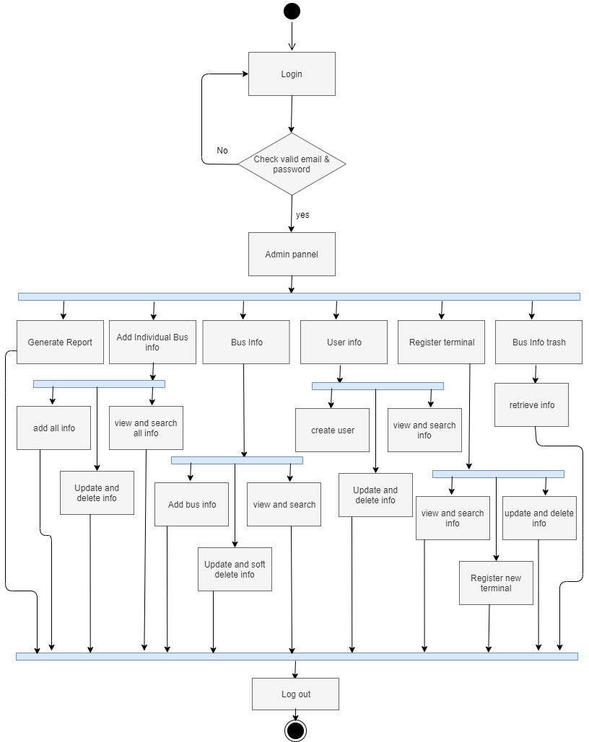
Activity Diagram For Admin
December 30, 2019
22

Slide 23
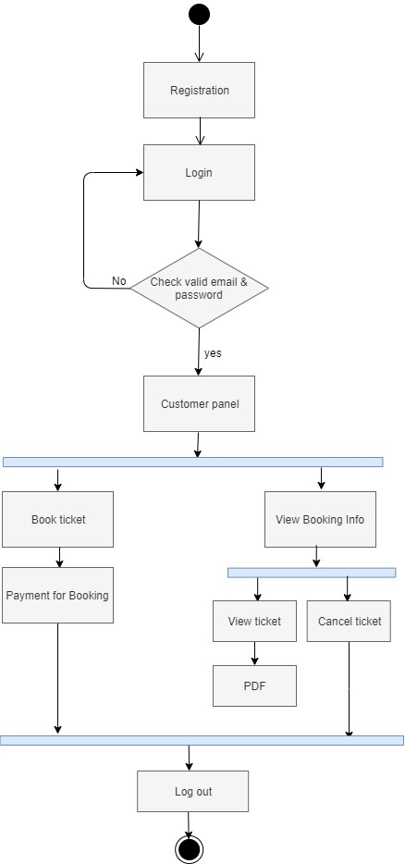
Activity Diagram For Customer
December 30, 2019
23

Slide 24
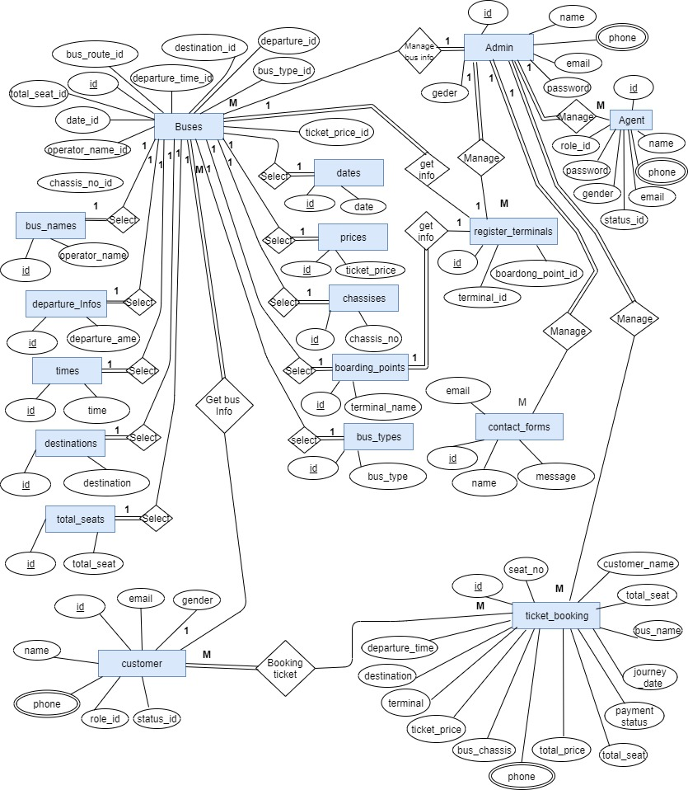
Entity Relationship Diagram
December 30, 2019
24

Slide 25
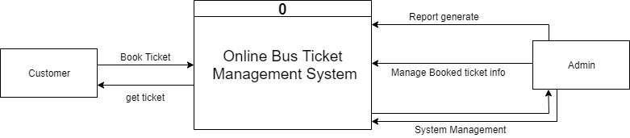
Context Level DFD
December 30, 2019
25

Slide 26
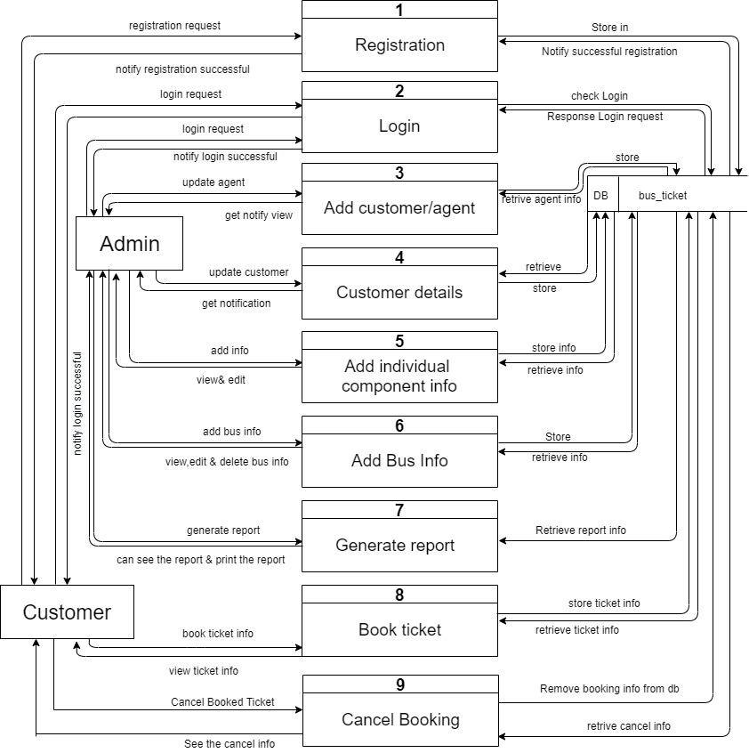
Level-1 DFD
December 30, 2019
26

Slide 27
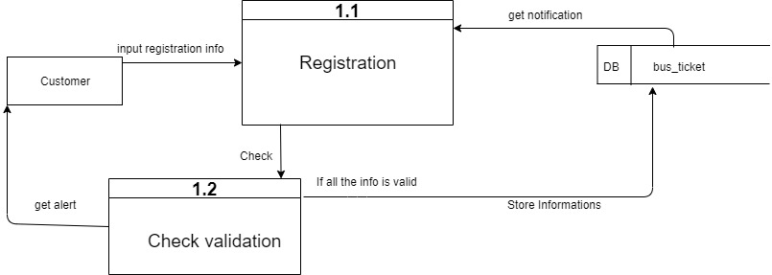
Level 2- Process 1 DFD
December 30, 2019
27

Slide 28
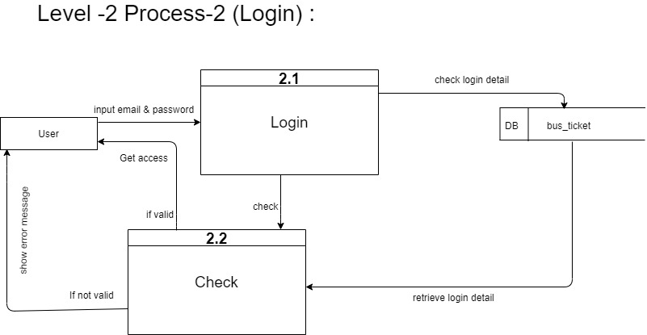
Level 2- Process 2 DFD
December 30, 2019
28

Slide 29
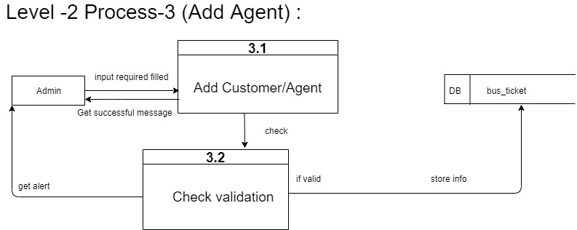
Level 2- Process 3 DFD
December 30, 2019
29

Slide 30
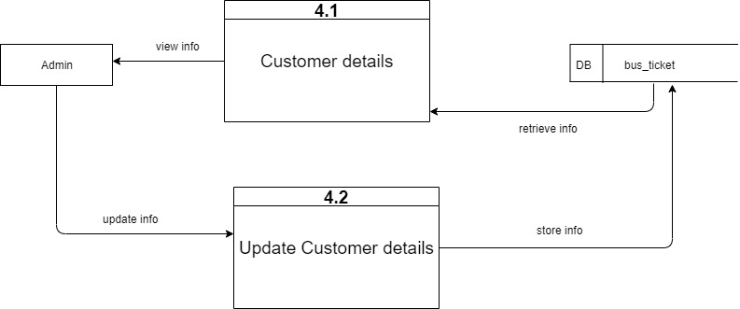
Level 2- Process 4 DFD
December 30, 2019
30

Slide 31
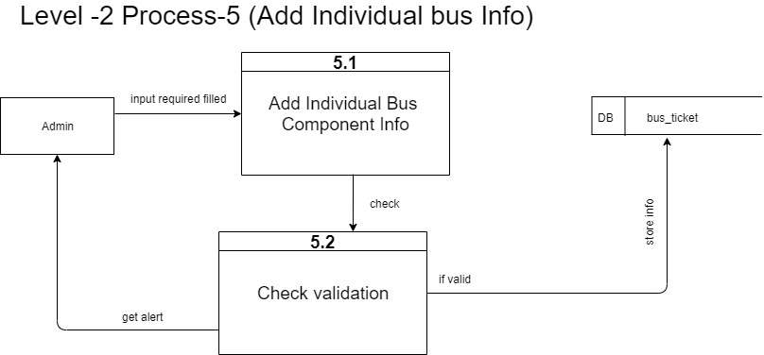
Level 2- Process 5 DFD
December 30, 2019
31

Slide 32
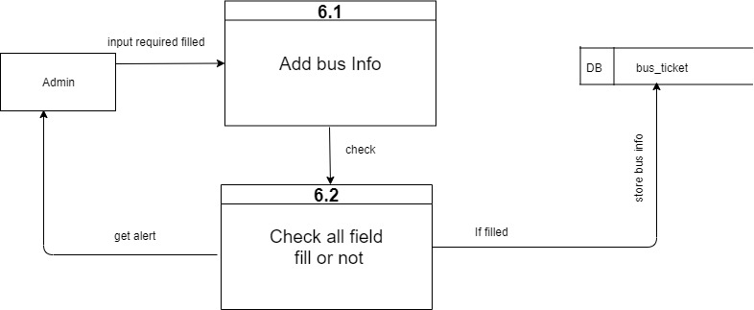
Level 2- Process 6 DFD
December 30, 2019
32

Slide 33
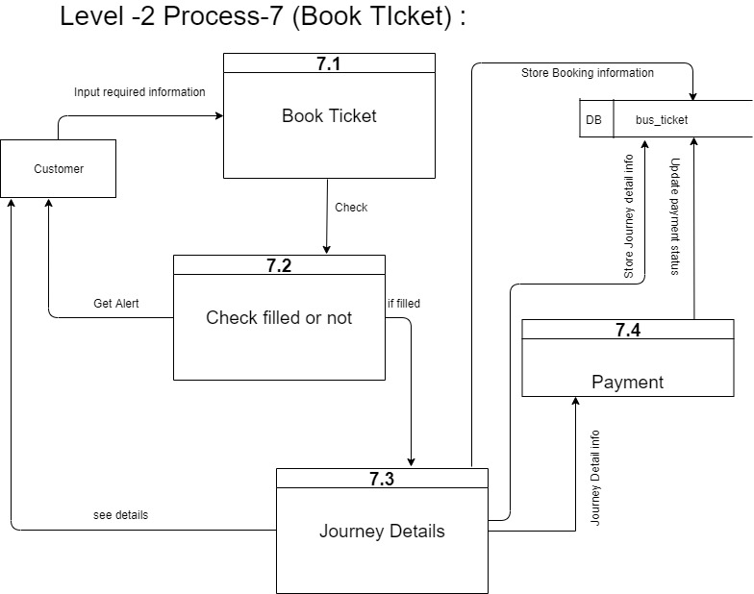
Level 2- Process 7 DFD
December 30, 2019
33

Slide 34
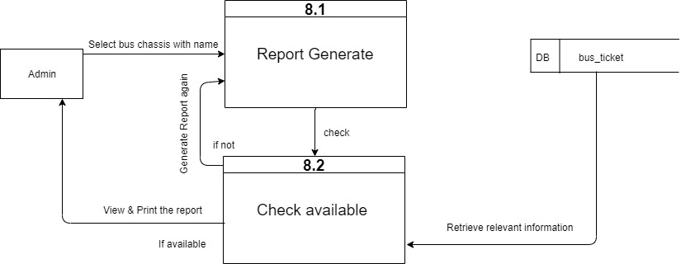
Level 2- Process 8 DFD
December 30, 2019
34

Slide 35
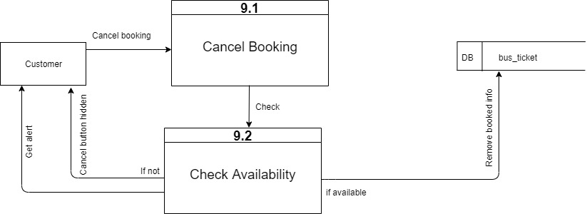
Level 2- Process 9 DFD
December 30, 2019
35

Slide 36
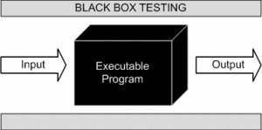
System Testing Methodology
Figure: Black Box Testing
December 30, 2019
36

Slide 37
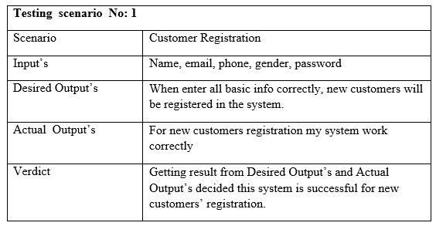
Testing Scenario
December 30, 2019
37

Slide 38

Let’s Visit The Website

Slide 39
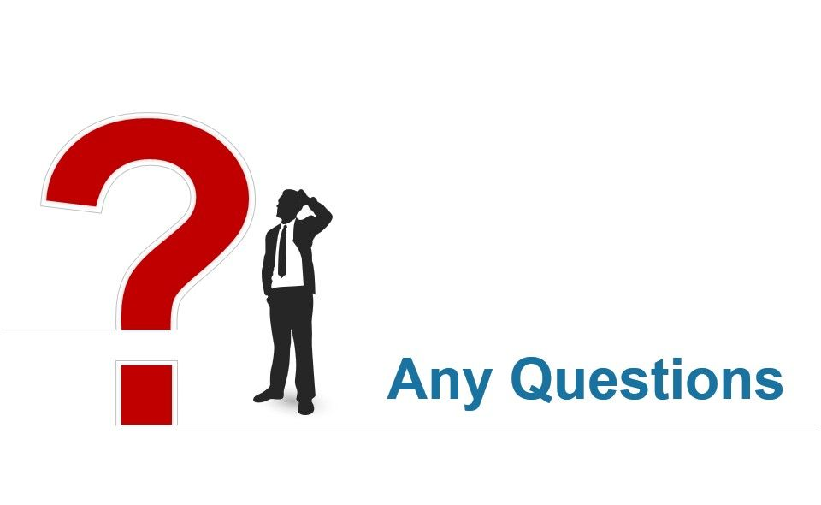
December 30, 2019
39

Slide 40

December 30, 2019
40

Slide 41
Thank You

