Slide 1
IDS-Moz progress meeting
19 December 2025

Slide 2
Outputs and Targeted Completion Dates - Q2-2025
Output | TCD | Status
1. Institute the technical expert advisory group, including IDM to assist with sample site selection | 30-01-2024 | Completed
2. SIS-COVE areas to be used for this project identified | 30-03-2024 | Completed
3. Areas for ES sample collection (wastewater points and latrines) selected | 30-03-2024 | Completed
4. Health facilities to be included in the sentinel and genomic surveillance selected | 30-03-2024 | Completed
5. Explicit plan on how data streams will be integrated and who will own and manage the data systems | 30-03-2024 | Completed
6. Draft operational plan for the current project | 30-06-2024 | Completed
7. Initial framework for IDS project implementation developed and approved by the stakeholders | 30-06-2024 | Completed not yet approved
8. Initial lab training for environmental, sentinel and genomic surveillance completed | 30-08-2024 | Completed
9. Site training for SIS-COVE, sentinel, and genomic surveillance conducted and sites ready to start the IDS implementation | 30-09-2024 | Completed
10. Surveillance Reports in the context of IDS finalized and released for policy decision | 30-04-2025 | Completed
11. Decision on adding additional priority pathogens in year 2 | 30-06-2025 | Pending
12. Preliminary findings on the barriers and facilitators for the implementation of IDS for the 4 components of the project after pilot implementation | 30-06-2025 | Pending
13. Final findings on the barriers and facilitators for the implementation of IDS for the 4 components of the project after pilot implementation | 30-09-2026 | Pending

Slide 3
Activities implemented (1/2)
1. Identification of water sources for
environmental sampling in Maputo
10 sites for collection of groundwater identified and samples tested- all negative
2. TAG meetings
WES TAG meeting held on 14 Nov
Community Surveillance TAG meeting held on 16 Dec
3. S.Typhi follow-up meetings
Initial post-training follow-up meeting held on 6 Nov
Troubleshooting meeting held on 4 Dec

Slide 4
Activities implemented (2/2)
4. New collaborations
Novel-T: sewage network and sample collection site selection
University of Virginia: wastewater cholera testing
NICD: quantification of INF/SCV, reagents for INFB, Measles detection training
Imperial: optimization of Polio protocol for wastewater samples
5. Potential exchange visits
Icddrd: International Centre for Diarrhoeal Disease Research, Bangladesh- wastewater mapping and sampling sites decision

Slide 5
SARS-CoV-2 and Influenza Surveillance Maputo

Slide 6
Significant increase on the positivity rate for INF: Wk42

Slide 7
No significant contribution of SCV2 on the overall Respiratory Infection Cases

Slide 8
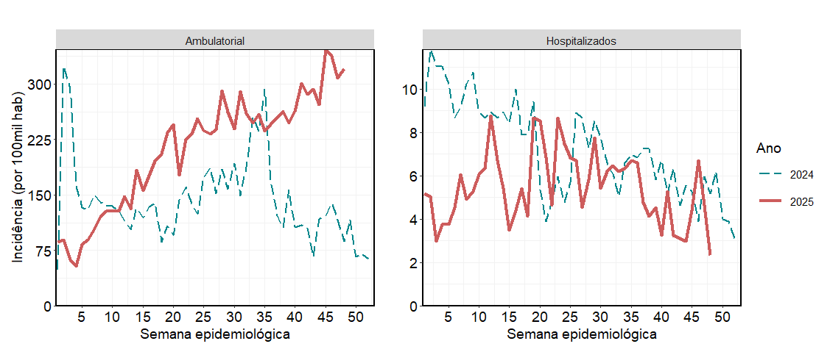
Acute Respiratory Syndrome Incidence
Continuous increase in the number of new cases of acute respiratory syndrome was observed in 2025 with no impact on hospital admissions
Notes:
A incidencia de IRAL mostrou uma tendencia crescent atingindo acima de 300 casos por cada 100 mil habitants nas semanas 45 e 46, enquanto que continua dentro do esperado.

Slide 9
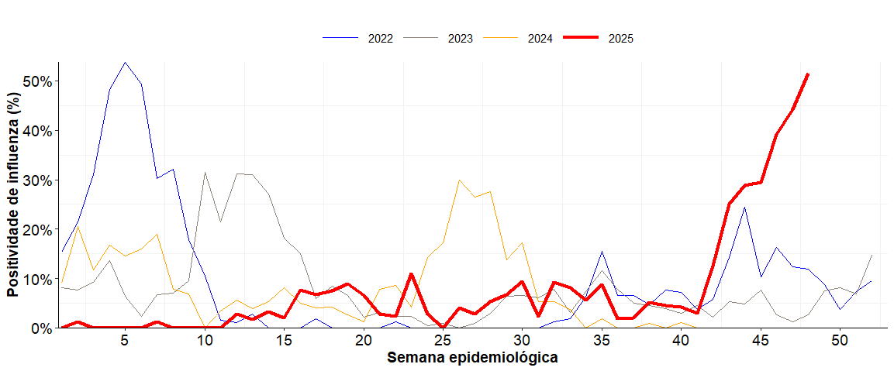
Positivity rate for INF: 2022-2025

Slide 10
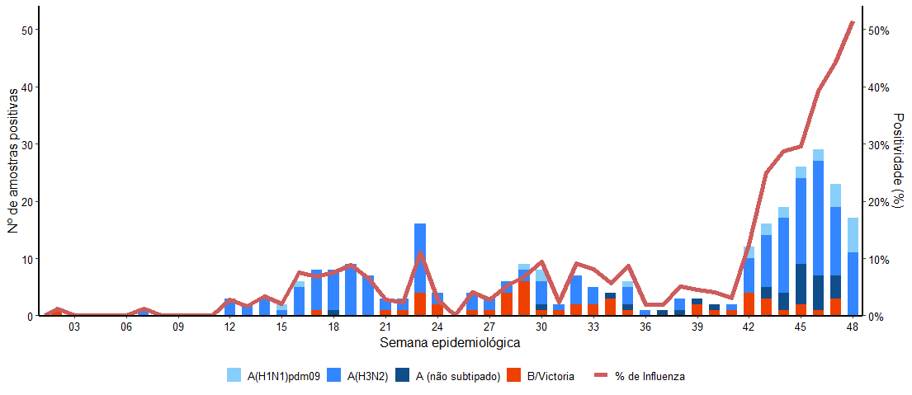
Distribution of INF Subtypes-2025
INFA (H3N2) Subclade K

Slide 11
Geografic distribution of INF cases

Slide 12
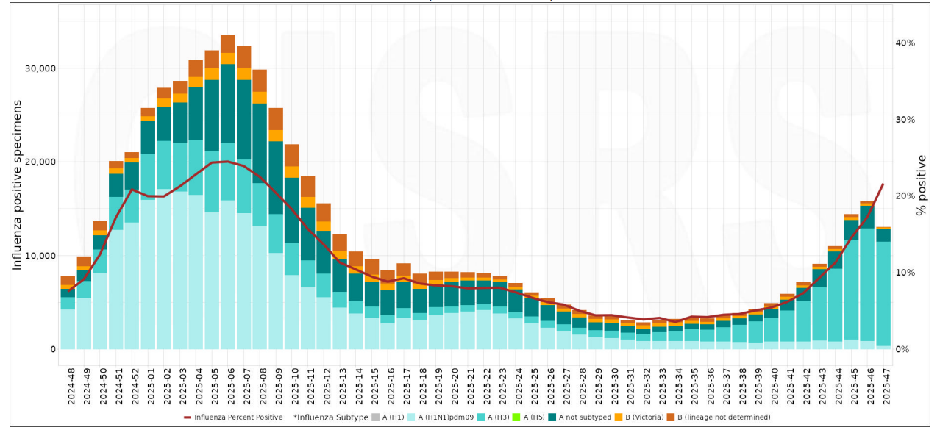
Global distribution of INF Subtypes Globally-2025

Slide 13
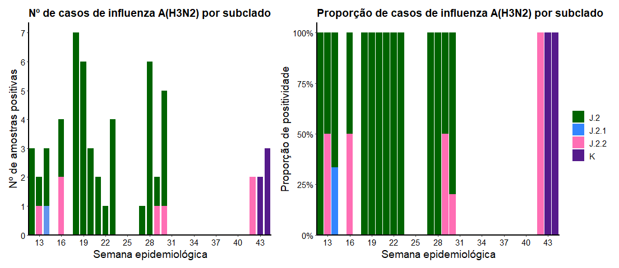
Genetic Sequencing INF-A (H3N2) in clinical samples-Subclades

Slide 14
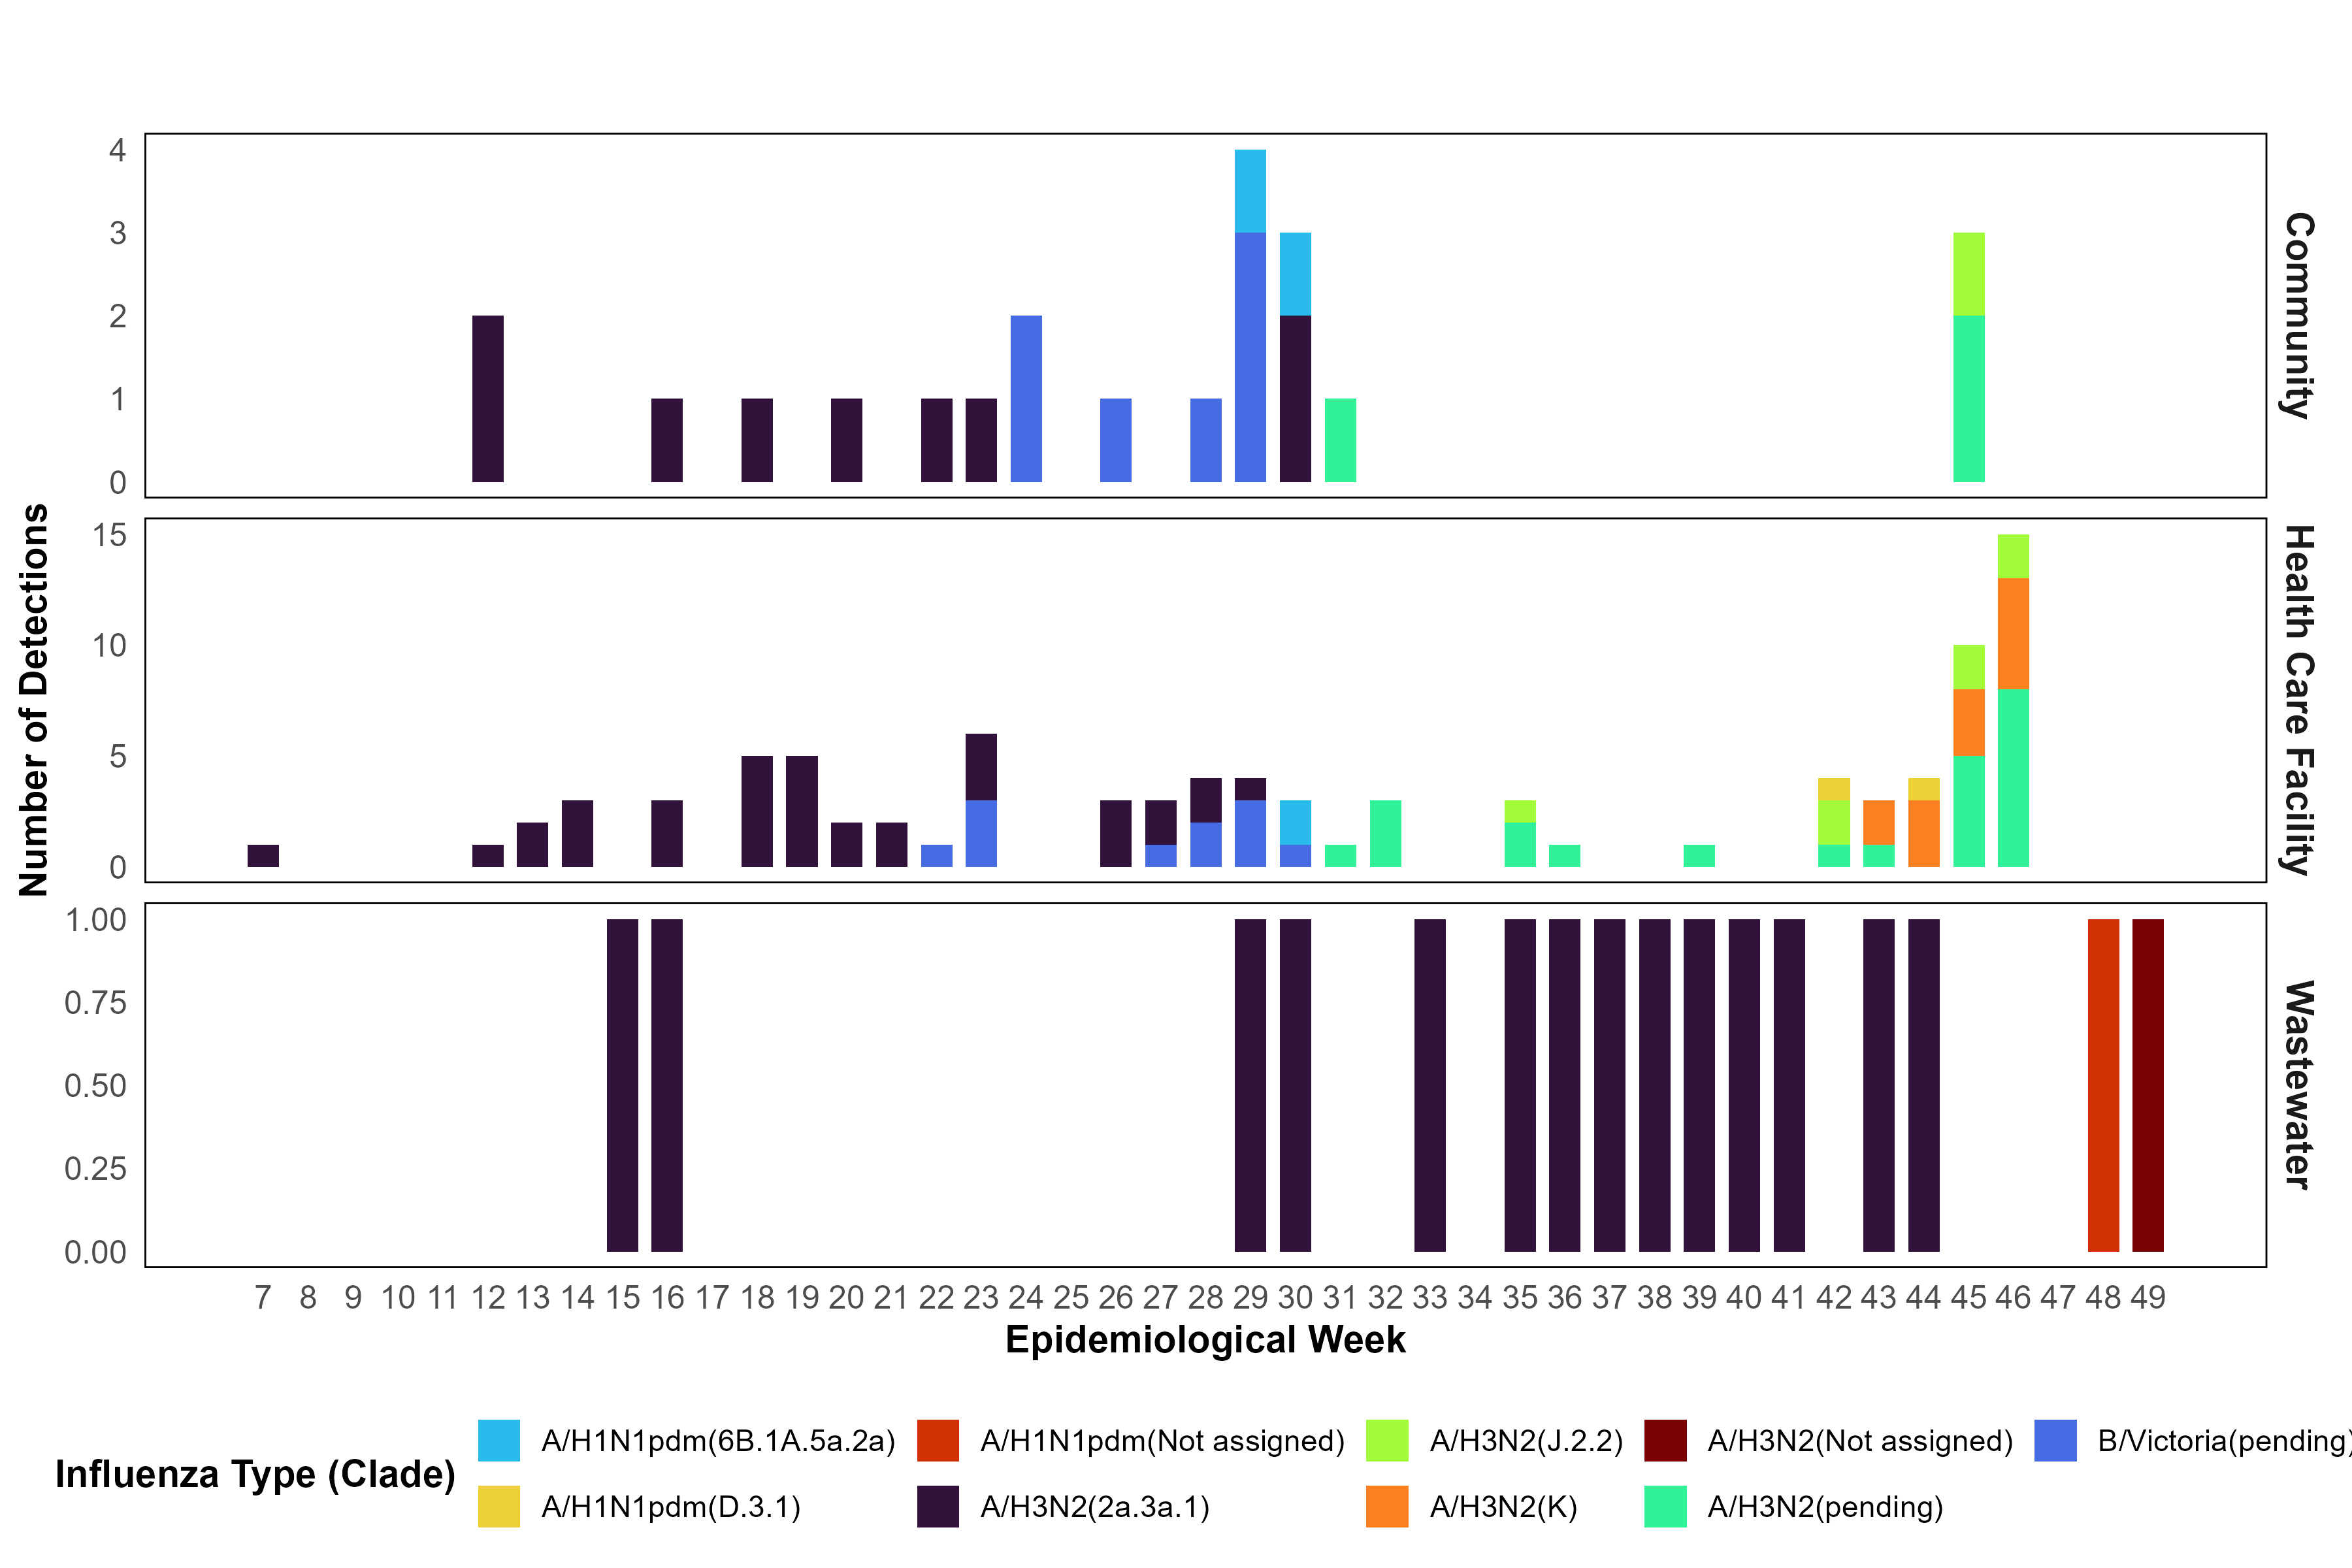
Influenza Genomic Surveillance - Combined Community, HF, and WW Maputo City

Slide 15
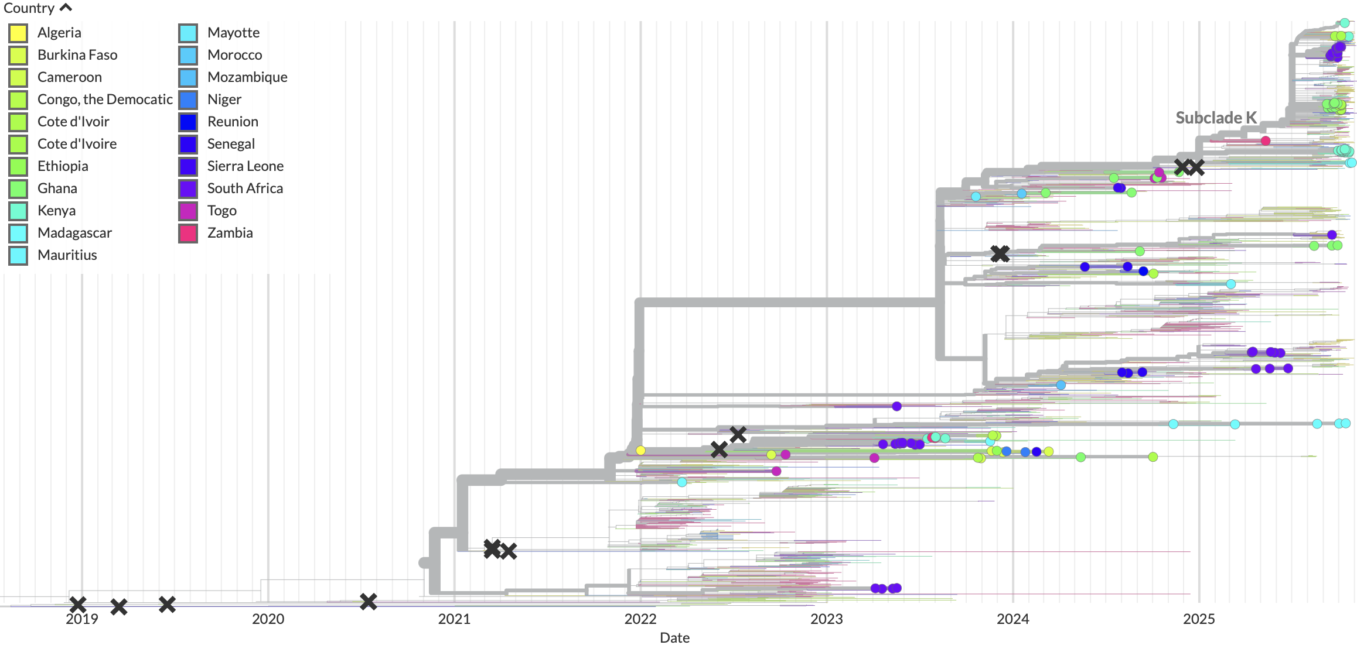
Tracking Influenza A H3N2/k Subclade: retrospectively
Phylogeny profile demonstrates all Mozambican H3N2 genomes fall outside subclade K
Mozambique
Retrospective check: on 84 Mozambicans genomes submitted on GISAID
Our samples fall outside Subclade K

Slide 16
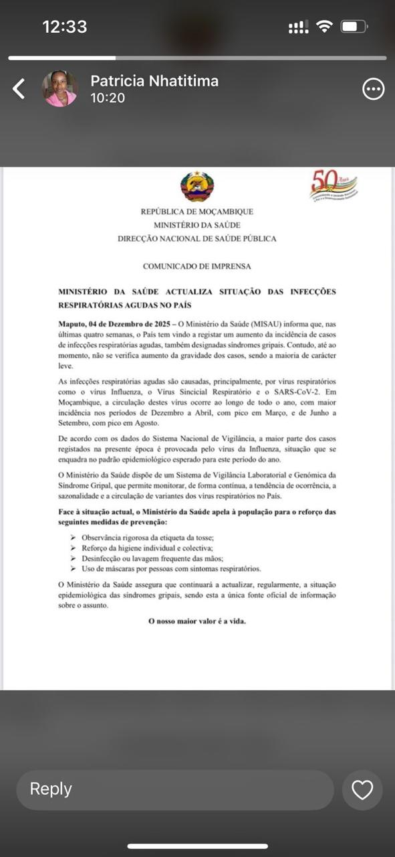
From Data to Action: INF-A Outbreak Response
CONTEXT
DATA
[Evidence Generation]
INTERPRETATION
[Risk Analysis]
COMUNICATION
[Evidence Translation]
ACTION
[Decision and response]
Increase in Influenza cases
From Week 42
Evidence Generation Mechanisms
Sentinel/Genomic Surveillance (IDS)
Other surveillance platforms
How were the data analyzed?
Integrated trend analysis
Identification of spatial patterns and clusters, indicating areas of higher transmission
Public health risk assessment to inform decision-making
Global, regional data
How was the evidence shared?
Operational coordination meetings with MOH
Technical briefings delivered to the MoH
Information sharing with provincial and municipal authorities
Official communication by the MoH through written communication
Decisions and responses activated
Activation of the Situation Room, involving central, provincial, and municipal levels
Coordinated response, including strengthened prevention and control measures

Slide 17
Cholera Surveillance
Tete

Slide 18
Cholera Outbreak declared on Sep 22 in Tete City
Outbreak Declaration

Slide 19
S. Typhi Surveillance
Maputo

Slide 20
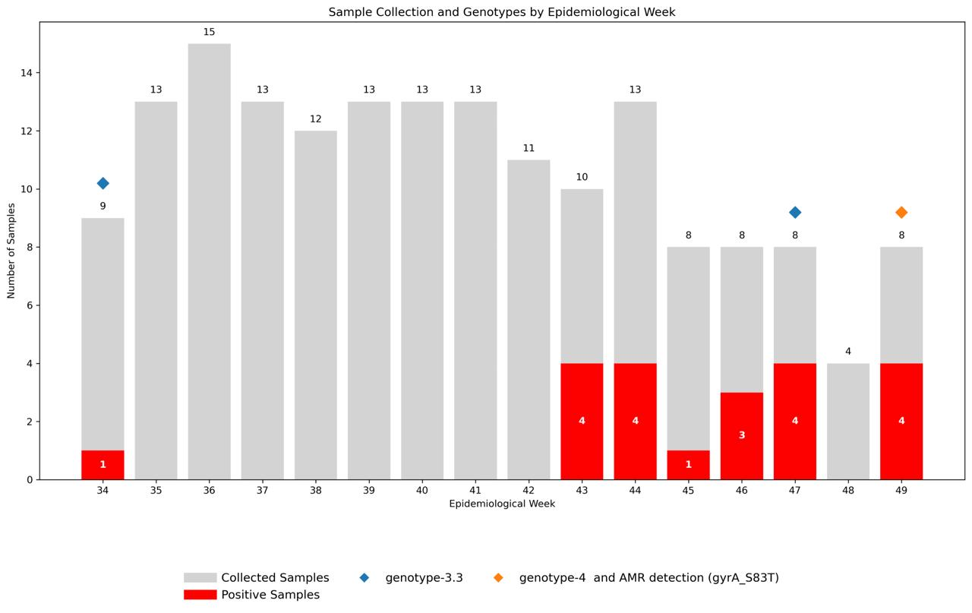
Salmonella typhi- Wastewater surveillance​ qPCR results week 34 - 49 – Maputo City
Sampling sites:
Weak 34 – ETAR (tanker truck)
Weak 43 – ETAR (sewage inlet), Tempestade (outfall)
Weak 44 – ETAR (sewage inlet), Tempestade (outfall)
Weak 45 – ETAR (tanker truck)
Weak 46 – Tempestade (outfall), ETAR (sewage inlet)
Weak 47 – ETAR (sewage inlet, tanker truck, sewage ditch)
Weak 49 – ETAR (sewage inlet and sewage ditch)
Troubleshooting

Slide 21
Genomic and AMR monitoring

Slide 22
Serosurvey Updates

Slide 23




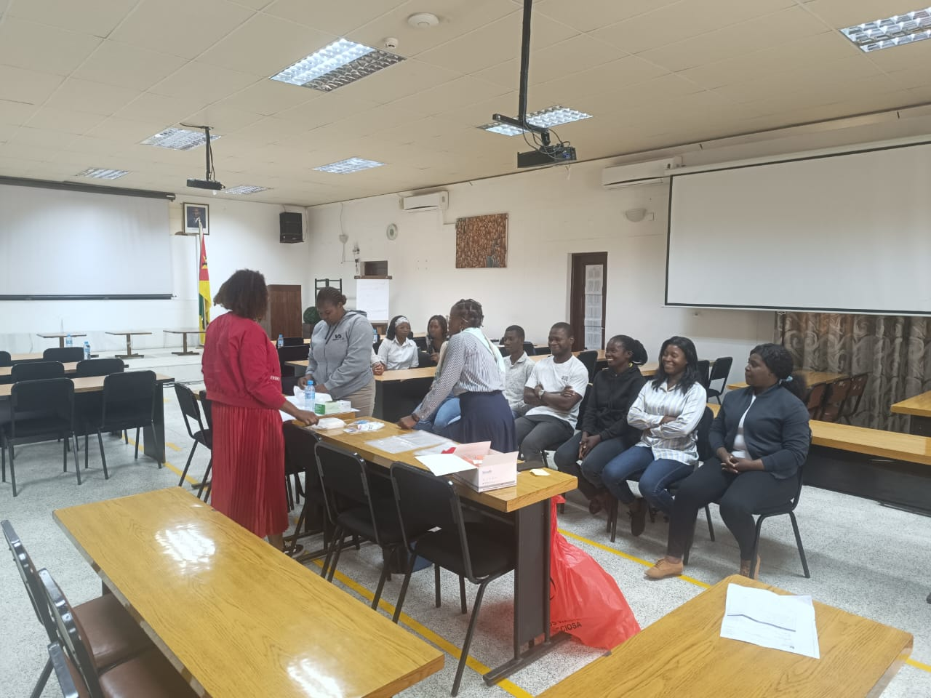
Serosurvey progress Timeline
FY25 Q4
Serosurvey trainers' training (TOT);
Training of community mobilizers (CSA);
In-person capacity-building (TOI) of field teams (Nurses and SISCOVE VASAs) for field entry and data collection.
FY26 Q4
Sample testing
Data analysis and Study report;
dissemination.
Planning
Training
Execution- Data Collection
Monitoring
FY25 Q2 & Q3
Sero-Survey IRB Approval;
On-site assessment of SIS-COVE community field teams and Clustres.
FY26 Q1, Q2 & Q3
Implementation of the Serosurvey Maputo City, Tete and Zambezia;
Start data collection in Maputo, Tete and Zambezia SIS-COVE community clusters.

Slide 24
Sample size
Total number of participants
5.679
631 by age group
631 by age group
631 by age group
Age Groups
6-59 months
5-17years
18-49years
1,893 participants
Maputo City
1,893 participants
Tete
1,893 participants
Zambezia

Slide 25
Luminex platform

Slide 26
Implementation Description Updates

Slide 28






Thank you
Obrigado
Descobrir Entender Informar

