Slide 1
(EE382M-11 Verification of Digital Systems)
Verification of
MESI Cache Coherency Controller
Team members – Anisa Aziz Qazi (aq3289)
Kamayani Rai (kr28735)
Sharukh Shaikh (sss3726)
Sruthi Somarouthu (ss78279)

Slide 2
Agenda
Motivation
System requirements & DUT
Implementation details
UVM Results
Formal Results

Slide 3
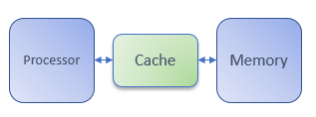
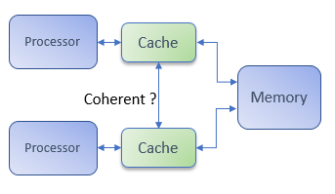
Motivation
Why is cache needed?
Processor is much faster than memory
Cache serves as a faster ( but smaller) memory which reduces the wastage of processor cycles
Problems in a bigger system:
Am I reading the correct (latest) data?
Is everyone else reading what I wrote?
In short : Is the data coherent !!
Solution:
Coherency protocols: MSI, MESI, MOSI, MOESI, MERSI, MESIF, etc.
Extensive verification needed to make sure that these protocols work correctly, else system is not reliable!

Slide 4
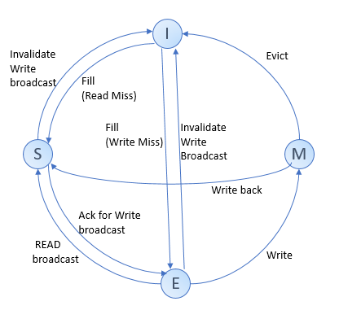
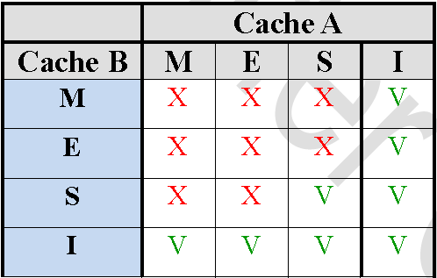
MESI protocol
Modified : I have modified the data and the copy in main memory is invalid
Exclusive : I am the sole owner of data and the copy in main memory is valid
Shared : Data is in cache of more than one processor and the one in main memory is valid
Invalid : Data in my cache is invalid

Slide 5
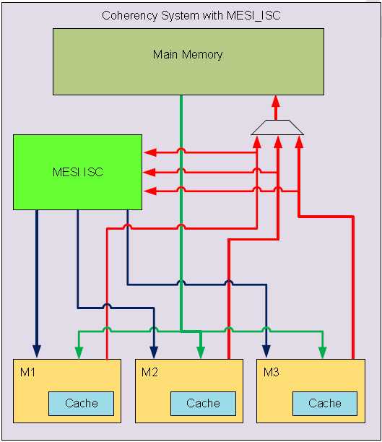
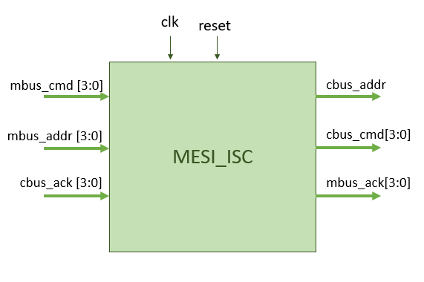
System Specification
Main Bus: i_Addr, i_Cmd, Ack
Coherency Bus: o_Addr, o_Cmd, i_Ack
Mbus_Cmd:
0 : NOP
1 : Write (Ack by main memory)
2 : Read (Ack by main memory)
3 : Write Broadcast (Ack by mesi_isc)
-> Others should Invalidate cache line
4 : Read Broadcast (Ack by mesi_isc)
-> Others should Evict the modified cache line or go to shared mode
Cbus_Cmd:
0 : NOP
1 : Write snoop
2 : Read snoop
3 : Enable Write
4 : Enable Read
Work to be done by MESI_ISC:
Convey the broadcast to other masters
Make sure caches are consistent
Enable the initiating master to Read/Write the memory

Slide 6
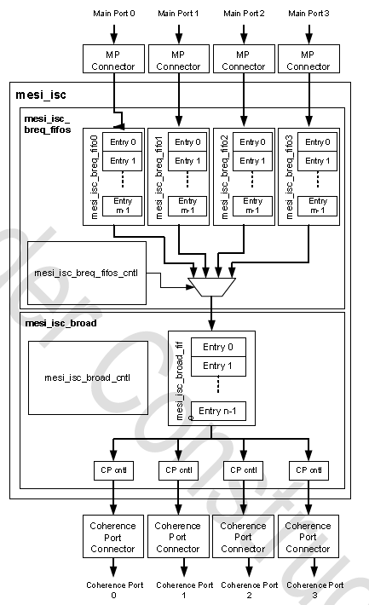
DUT (MESI_ISC)
BReq fifo size : 2
Broad fifo size : 4

Slide 7
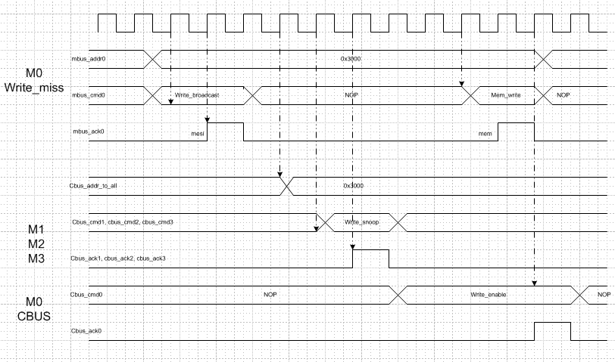
MESI ISC controller operation

Slide 8
Implementation

Slide 9
Approaches
UVM (simulation):
Driver development to mimic the masters
Subscriber to collect coverage
Assertions as checks
Tools:
Cadence NCSIM (simulation)
Cadence IMC – Incisive Metrics Centre (coverage)
Formal verification:
Assumptions to mimic masters
Cover points to get coverage
Assertions to check properties
Tools:
Jasper gold

Slide 10
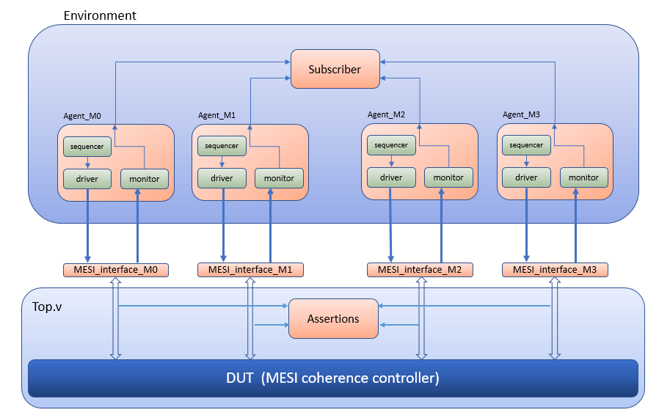
UVM Testbench

Slide 11
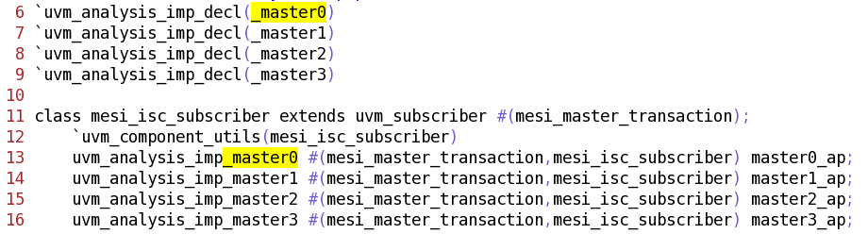
Issues faced
Driver has to drive as well as be responsive at the same time (to respond to snoops)
Subscriber has 4 analysis imports. So, needed to use 4 different write functions
Since all 4 monitors write to the subscriber at each clock, we had to figure out a way to get the correct coverage data .

Slide 12
Basic scenarios
Coherency controller will come into play when:
Write miss or Write hit to a shared location
Master gives Write Broadcast and wait for ISC to give ACK
ISC will give write snoop on all other masters and wait for them to invalidate their cache lines
ISC will enable to write from initiating master
Read miss
Master gives Read Broadcast and wait for ISC to give ACK
ISC will give read snoop on all other masters and wait for them to change their cache lines to shared / evict their cache lines
ISC will enable initiating master to read

Slide 13
Test plan
Test name | Test scenario | Checks (Assertions)
base_test | Creates config objects, randomizes & sets all the agent config handles via config_db | Write/Read broadcast should be acknowledged. ISC should not acknowledge non-broadcast commands Write/Read burst from one master should be followed by write/read snoops on all other masters ISC should give write/read enable only after receiving all 3 acknowledge Seq of snoop -> Ack on 3 masters should be immediately followed by write/read enable on 4th master
multiple_req_by_all_masters | Each master gives multiple read/write broadcast before the ISC processes a single broadcast req . Exercises FIFO full cases
simultaneous_brdcst_req_test | Multiple masters give request at the same time
single_master_read_write_brdcast_test | Basic test: randomly selected master gives write/read broadcast
other_masters_req_when_one_master_sends_read_write | Self explanatory
invalid_read_write_seq_test | Exception scenario just to see how DUT behaves when another master randomly gives read/write

Slide 14
UVM Results

Slide 15
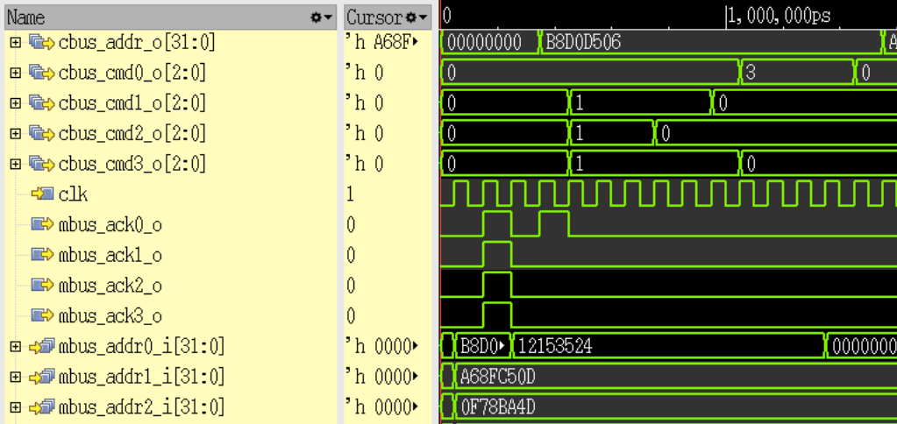
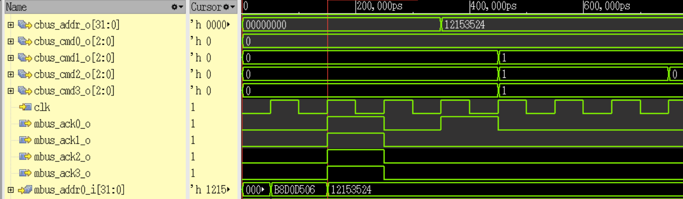
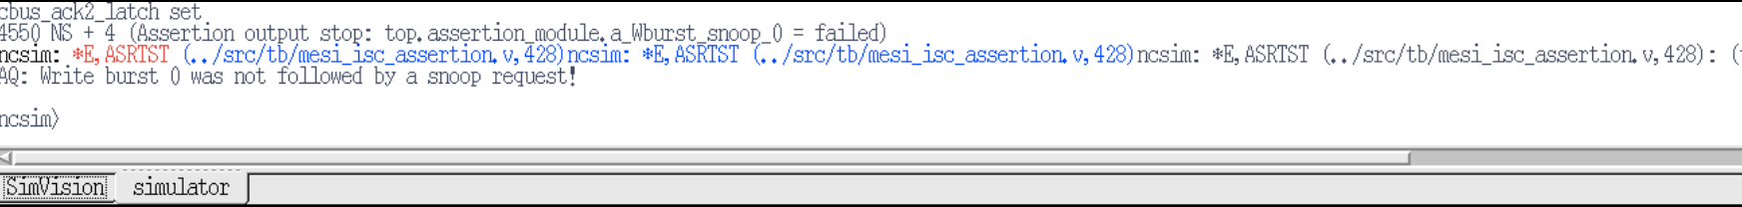
Bugs/Limitations of DUT

Slide 16
Coverage
Covered points:
MBus0/1/2/3.MCmd
MBus0/1/2/3.Ack
CBus0/1/2/3.Ack
CBus0/1/2/3.Cmd
M0/1/2/3.snoop_delay
Cross of all commands other than (READ/WRITE)
Simulataneous_write_broadcast_to_same_location
Cross of broadcast with snoop delays
Cross of MCmd and Ack

Slide 17
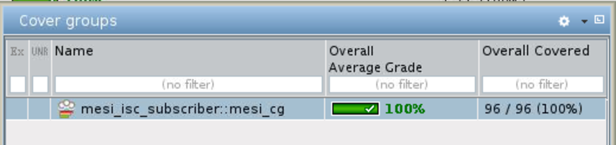
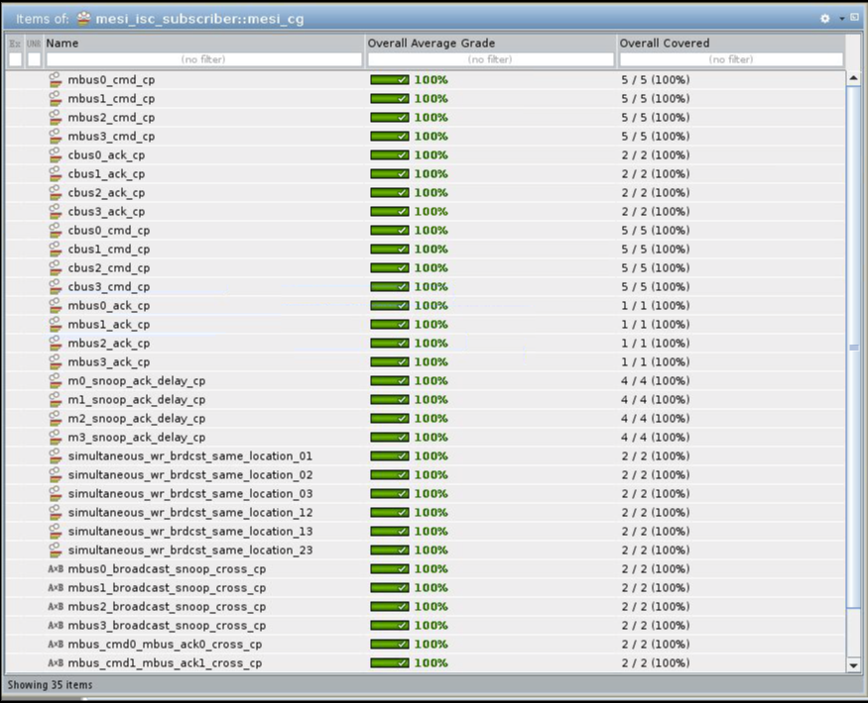
Coverage results

Slide 18
Jasper Results

Slide 19
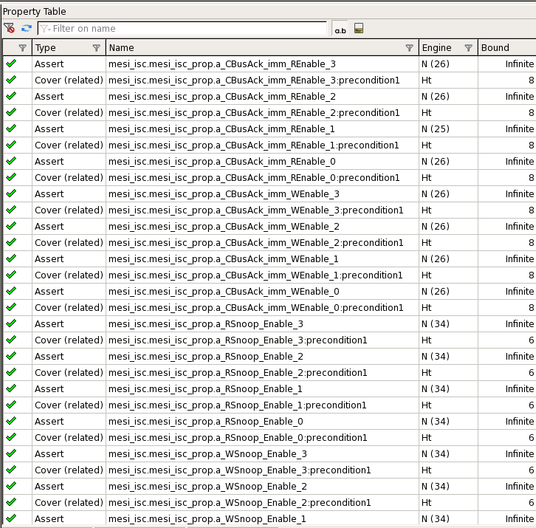
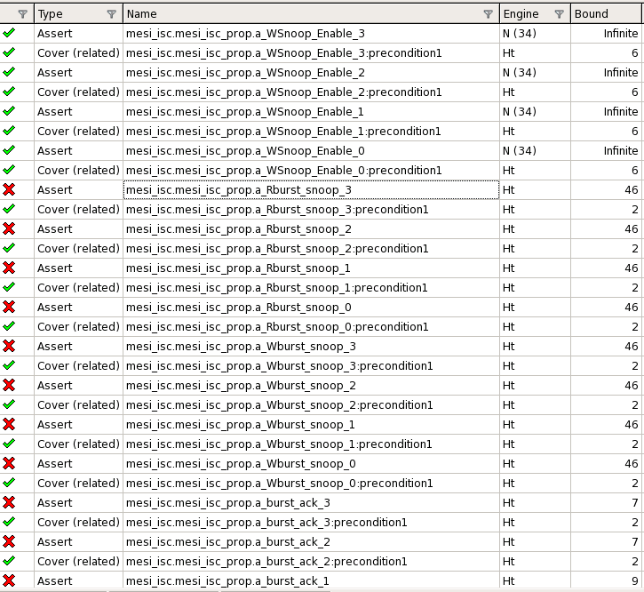
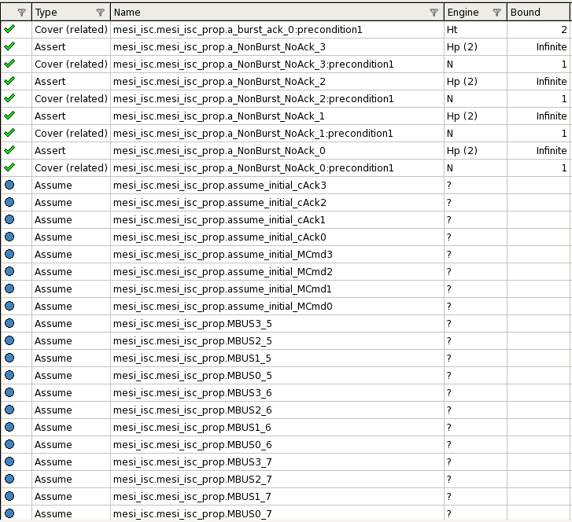
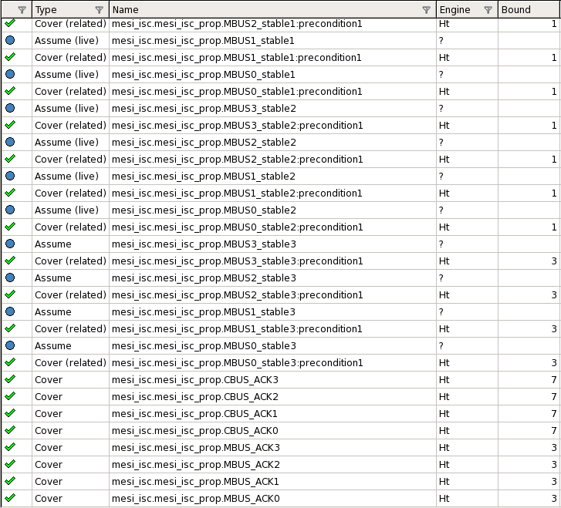

Slide 20
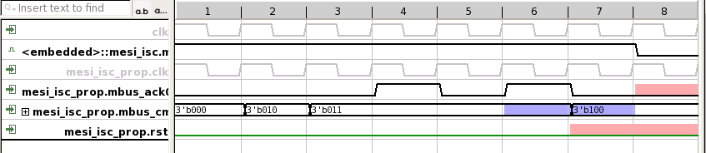
Jasper results(1)
Limiting case: Fifo full

Slide 21
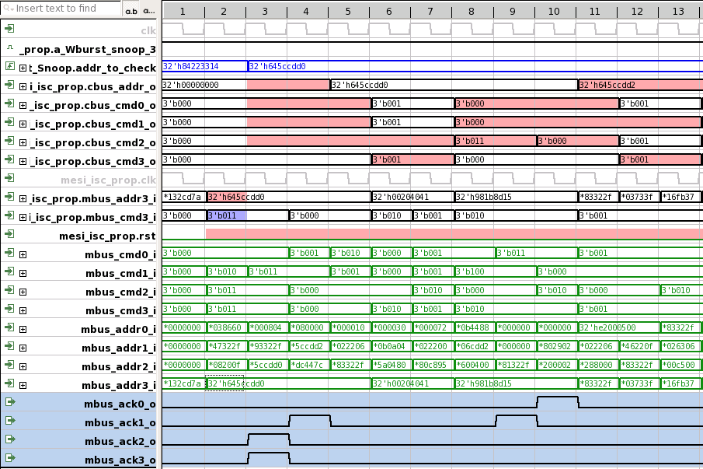
Jasper results(2)
Cbus2 should have received WSnoop, not cbus3
Not a bug in the case that is apparent.
When observed closely, mbus also had write broadcast and its addr changed to same value as mbus_addr3. Hence this is not bug w.r.t snoop commands. But, ISC gave a snoop for wrong addr!

Slide 22
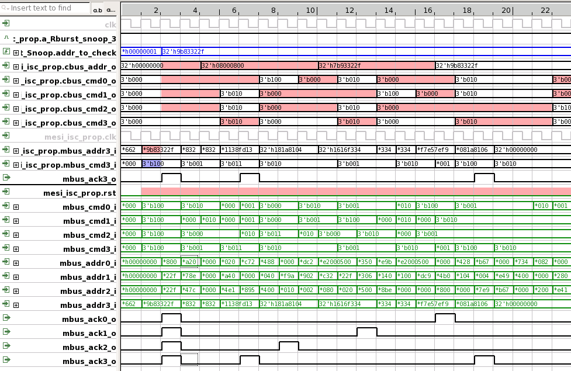
Jasper results(3)
Cbus2 should have received RSnoop, not cbus3
A case similar to previous but read snoop

Slide 23
Future work
UVM: Driver can be updated to have cache lines implemented. That was the checks can be written for data instead of assertions on protocol level.
Formal verification: Update the assumptions to eliminate false failures (if the specification specifies that addr can change as soon as acknowledge comes).
Complete system level verification (with real masters): Data consistency can be checked for.

Slide 24
Additional slides

Slide 25
Directory structure
Jasper_files
rtl (DUT files)
tb ( tb, assertion & jasper tcl files)
UVM_files
sim (run simulations from here, contains README.txt)
src
rtl (DUT files)
tb (Testbench files, UVM env files, assertion files)

Slide 26
Readme (Jasper)
cd Jasper_files/tb
jaspergold &
Source jasper_run.tcl

Slide 27
Readme (UVM)
cd UVM_files/sim
Update the path 'BASE_DIR' in Makefile
make clean
To run test in gui mode:
make run_test_gui TEST=<test_name>
To run regression tests:
make run_regress_1
5. Merging coverage: imc -batch
merge * -out all
6. Viewing coverage: imc &

Slide 28
List of UVM tests
multiple_req_by_all_masters
other_masters_req_when_one_master_sends_read_write
simultaneous_brdcst_req_test
single_master_read_write_brdcst_test
invalid_read_write_seq_test
constrained_config_addr_test

