Slide 1
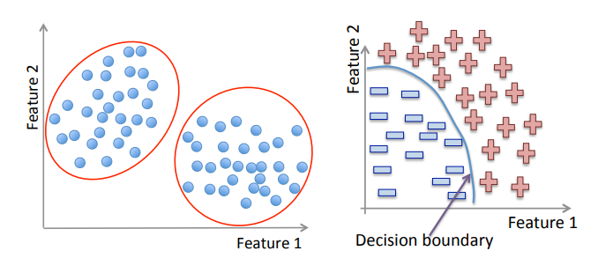
DATA Mining – Mini Project
TC - Naive-Bayes | SVM | DBSCAN
Anish Bhusal 072/BCT/505
Avishekh Shrestha 072/BCT/507
Ramesh Pathak 072/BCT/527
Saramsha Dotel 072/BCT/534

Slide 2
Classification Algorithms
TC1 - Naive-Bayes | SVM | KNN

Slide 3
Dataset Used
Wisconsin Breast Cancer Diagnostic Dataset
https://archive.ics.uci.edu/ml/machine-learning-databases/breast-cancer-wisconsin/

Slide 4
Dataset Description
Number of Instances: 699
Number of Attributes: 10
Data type of Attributes: Integer
Classification type: Binary

Slide 5
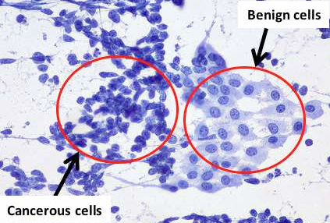

Attribute Information
1. Sample code number id number
2. Clump Thickness 1 - 10
3. Uniformity of Cell Size 1 - 10
4. Uniformity of Cell Shape 1 - 10
5. Marginal Adhesion 1 - 10
6. Single Epithelial Cell Size 1 - 10
7. Bare Nuclei 1 - 10
8. Bland Chromatin 1 - 10
9. Normal Nucleoli 1 - 10
10. Mitoses 1 - 10
11. Class (2 for benign, 4 for malignant)
Biopsy Image

Slide 6
Implementation and Results

Slide 7
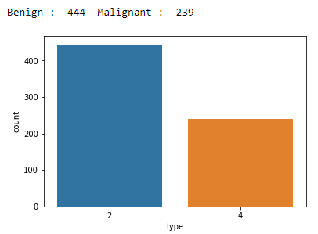
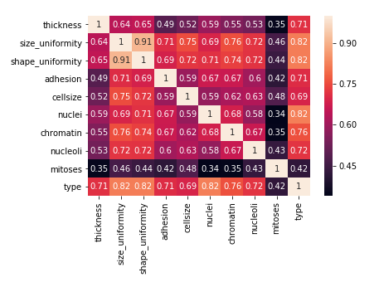
Exploratory Data Analysis

Slide 8
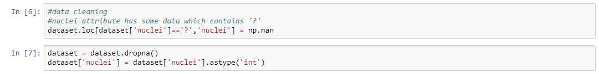
Data Cleaning

Slide 9
Data Normalization
Z-score Normalization (Optional*)

Slide 10
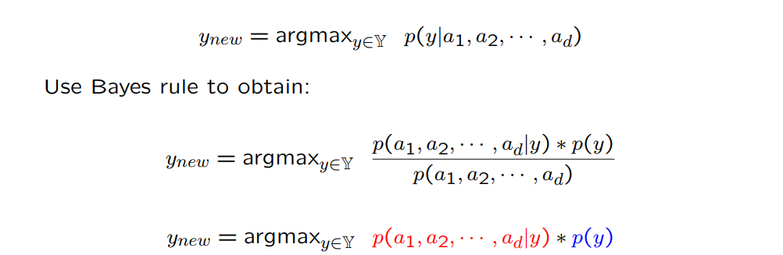
Naïve Bayes - Setting

Slide 11
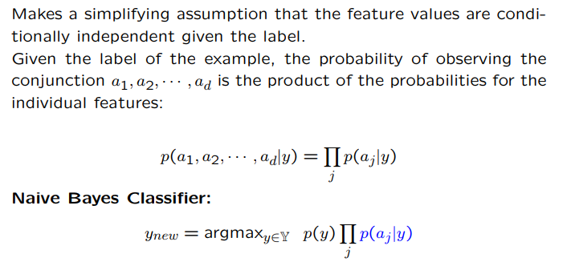

Naïve Bayes - Algorithm

Slide 12
Classification Report
Accuracy 0.98
Precision 0.99
Recall 0.98
F1-score 0.99
Confusion Matrix
Actual / Predicted | Positive | Negative
Positive | 108 | 3
Negative | 1 | 59

Slide 13
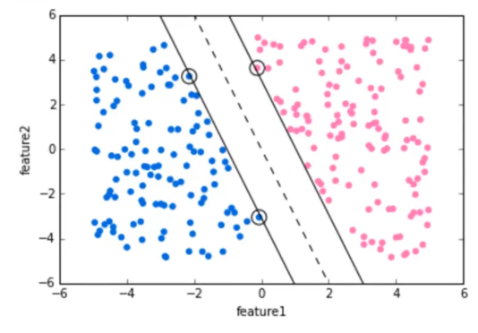
Support Vector Machines
Separating Hyperplane
The main essence of classifying data using SVM is to define a hyperplane in the feature space that divides the data with positive label from the data with negative label.
Support Vectors

Slide 14
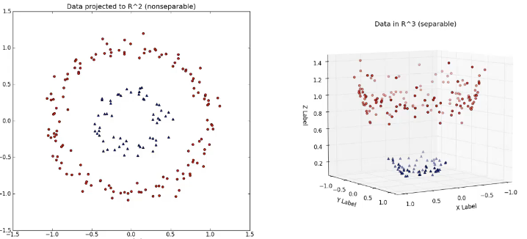
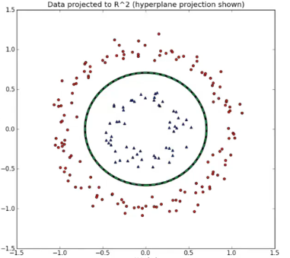
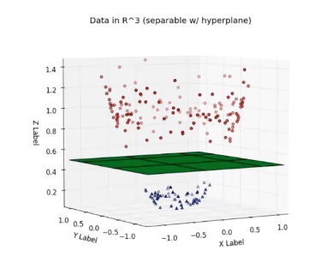
Can also used for non-linearly separable data using “Kernel”

Slide 15
The SMO Algorithm
SMO works by breaking the dual form into many smaller optimization problems which can be solved easily. The algorithm works as follows:
Two multiplier values ( α_{i} and α_{j} ) are selected out and their values are optimized while holding all other α values constant.
Once these two are optimized, another two are chosen and optimized over.
Choosing and optimizing repeats until the convergence, which is determined based on the problem constraints. Heuristics can be used to select the two α values to optimize over.

Slide 16
Regularization Parameter : (C=1.0)
Classification Report
Accuracy 95.609%
Precision 96%
Recall 96%
F1-Score 96%
Confusion Matrix
Actual / Predicted | Positive | Negative
Positive | 129 | 4
Negative | 5 | 67

Slide 17
Regularization Parameter : (C=2.0)
Classification Report
Accuracy 96.0975%
Precision 96%
Recall 96%
F1-Score 96%
Confusion Matrix
Actual / Predicted | Positive | Negative
Positive | 129 | 4
Negative | 4 | 68

Slide 18
Regularization Parameter : (C=10.0)
Classification Report
Accuracy 94.634%
Precision 95%
Recall 95%
F1-Score 95%
Confusion Matrix
Actual / Predicted | Positive | Negative
Positive | 128 | 5
Negative | 6 | 66

Slide 19
K Nearest Neighbor
Training Algorithm
Store all the Data (lazy learning/ instance based learning)
Prediction Algorithm
Calculate the distance from x to all points in your data
Sort the points in your data by increasing distance from x
Predict the majority label of the “k” closest points

Slide 20
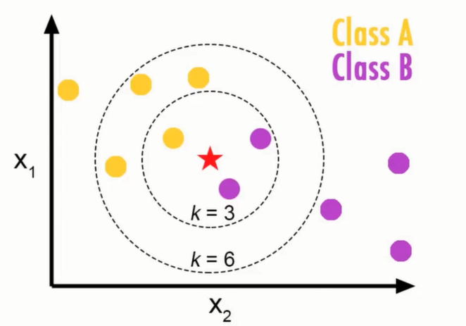
Choosing K will effect what class the new point is assigned to.

Slide 21
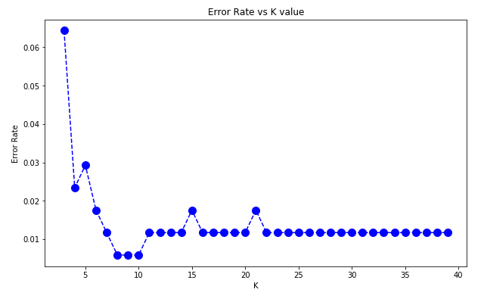
KNN – Elbow Method

Slide 22
Classification Report
Accuracy 0.99
Precision 0.98
Recall 1.00
F1-score 0.99
Confusion Matrix
Actual / Predicted | Positive | Negative
Positive | 111 | 0
Negative | 2 | 58

Slide 23
Clustering Algorithms
TC2 – DBSCAN | K Means

Slide 24
Why Density Based?
Partitioning and hierarchical methods have difficulty finding clusters of arbitrary shape, and are likely to include to noise in clusters.

Slide 25
DBSCAN Algorithm
Core Concepts:
Three types of points: core, boundary, noise
Eps: radius parameter
MinPts: neighbourhood density threshold

Slide 26
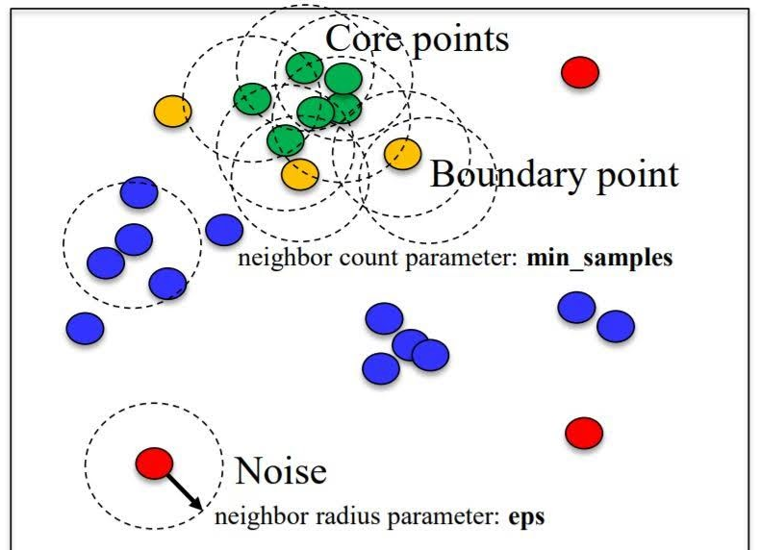
DBSCAN Algorithm
A point is core point if it has more than specified number of MinPts with Eps.
A boundary point is in the neighbourhood of core point.

Slide 27
DBSCAN Algorithm
do
randomly select an unvisited object p;
mark p as visited;
if the eps-neighborhood of p has at least MinPts objects
create a new cluster C, and add p to C;
let N be the set of objects in the eps-neighborhood of p;
for each point p' in N
if p' is unvisited
mark p' as visited;
if the eps-neighborhood of p' has at least MinPts points
add those points to N;
if p' is not yet a member of any cluster, add p' to C;
end for
output C;
else mark p as noise;
until no object is unvisited;

Slide 28
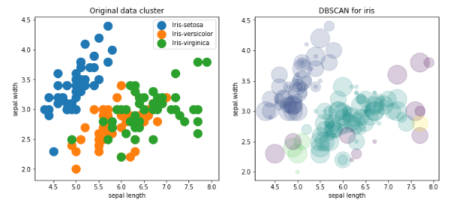
DBSCAN
Our Implementation on UCI ML: IRIS Dataset
Eps: 0.5
MinPts: 2
Silhouette Score: 0.3193

Slide 29
DBSCAN
Scikit Learn Implementation of this algorithm achieved Silhouette score of
0.1858 for Eps=0.5 and MinPts=2

Slide 30
The K Means Algorithm
Choose a number of Clusters "k"
Randomly assign each point to a cluster.
Until Cluster stops changing, repeat the following:
For each cluster, compute the cluster centroid by taking mean vector of points in the cluster.
Assign each data point to the cluster for which the centroid is the closest

Slide 31
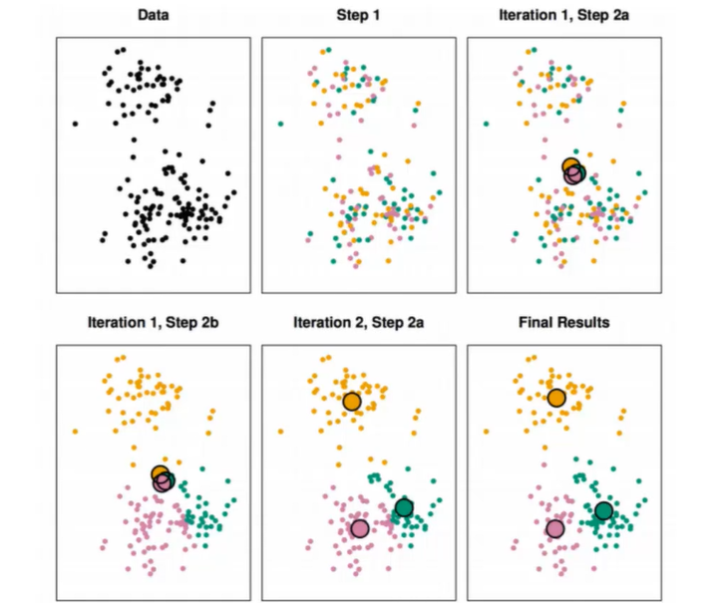

Slide 32
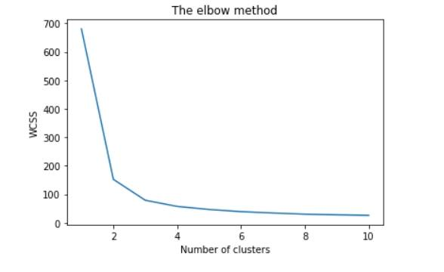
K Means Clustering – Elbow Method

Slide 33
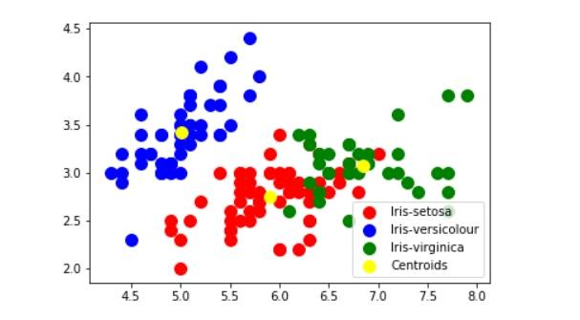
Scatter Plot

Slide 34
Silhouette Score
Implemented Algorithm : 0.4217
Sklearn : 0.55259

Slide 35


