Slide 1
Paris-Saclay University
A2 : Embedded Electronic Systems
Heterogeneous architecture for Big Data algorithms
Final presentation
Presented by:
DOU Yuhan
FORCIOLI Quentin
GHAOUI Mohamed Anis
TERRACHER Audrey
2020 February 03

Slide 2
TEAM
Software:
DOU Yuhan
TERRACHER Audrey
Hardware:
FORCIOLI QUENTIN
HLS and lead :
GHAOUI Mohamed Anis

Slide 3
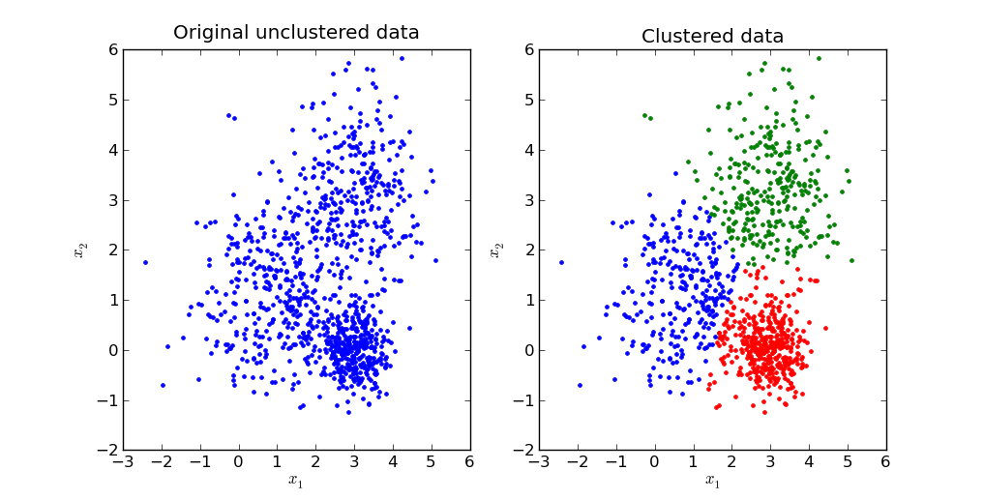
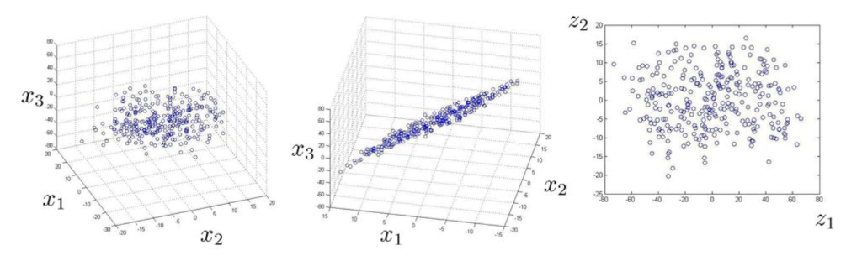
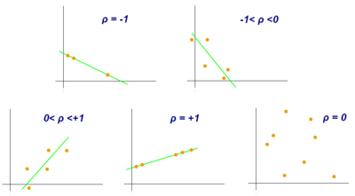
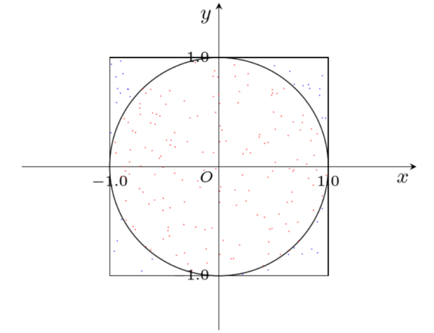
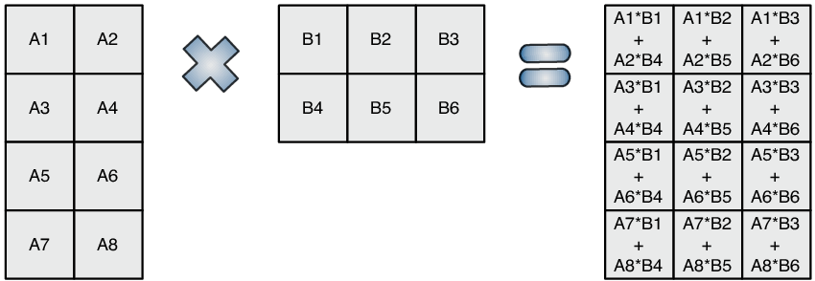
Our approach and algorithms chosen
K-Means
PCA/SVD
BMM
Pi Estimator
Pearson correlation

Slide 4
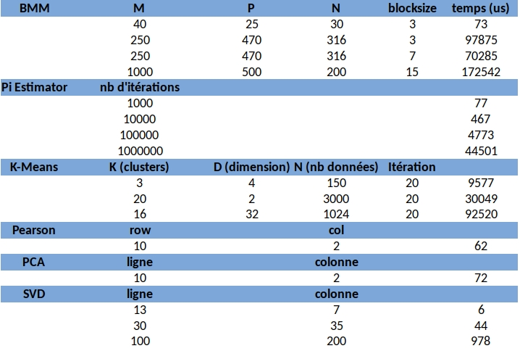
Software – PC Implementation

Slide 5
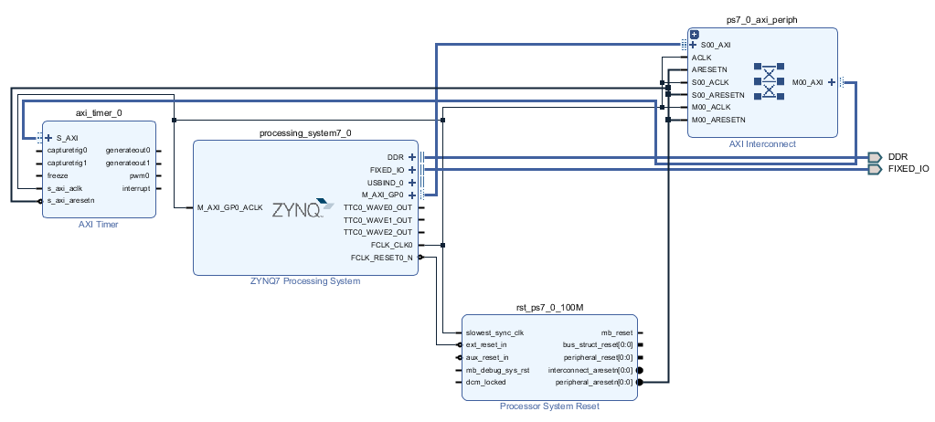
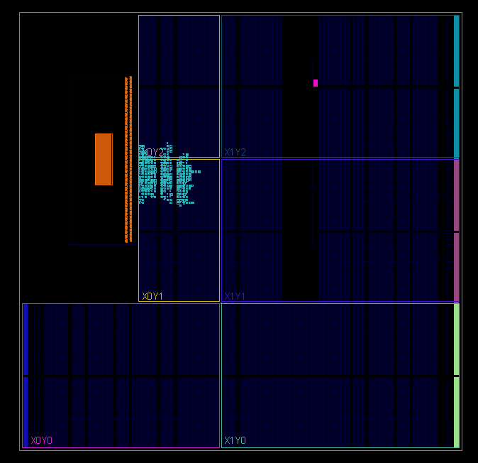
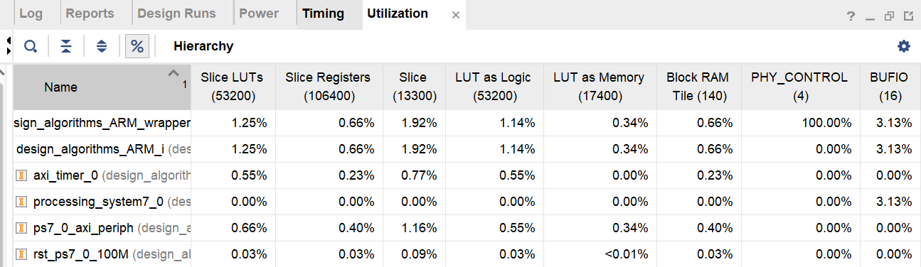
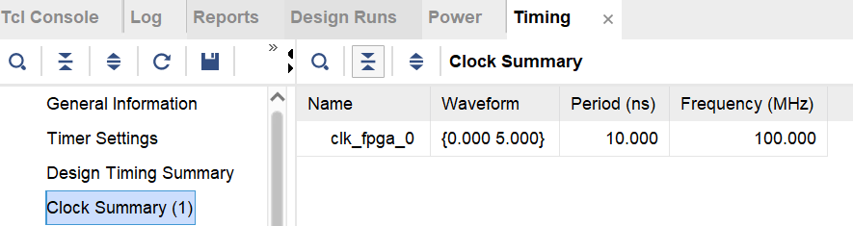
Software – ARM Implementation
Blocks design
Report

Slide 6
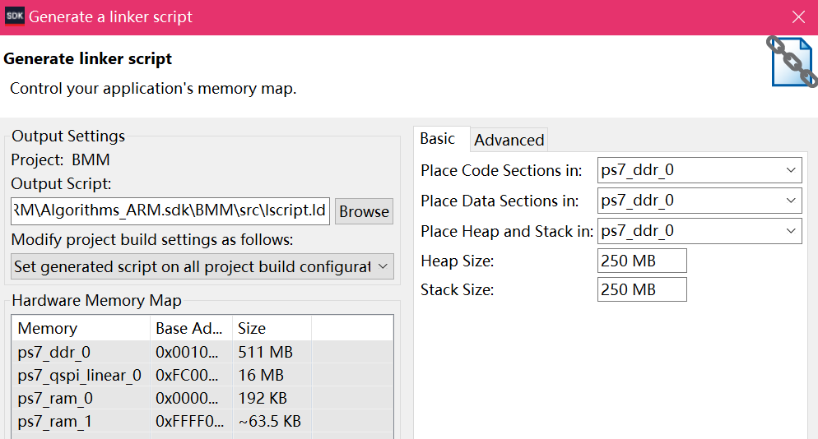
Software – ARM Implementation
Design on Vivado SDK
1/ Tools Chain : Xilinx ARM v7 GNU Toolchain
Generator : GNU make
2/ Modification of heap and stack sizes :
1 KB (default) → 250 MB

Slide 7
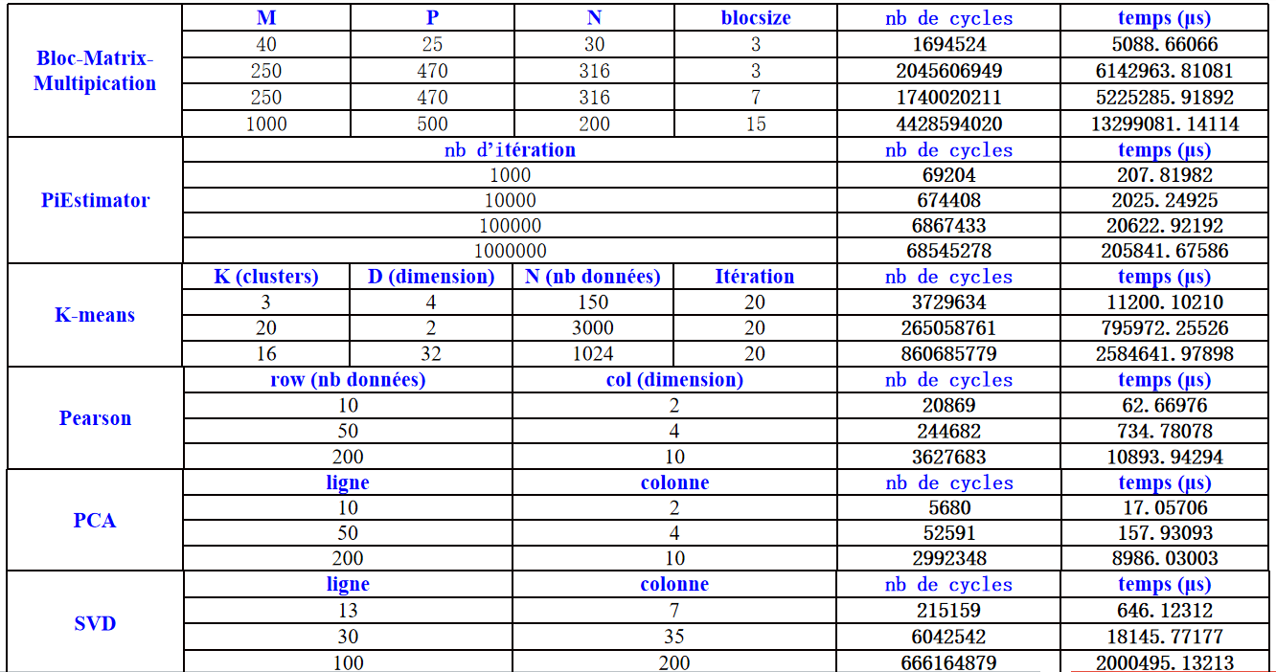
Software – ARM Implementation

Slide 8
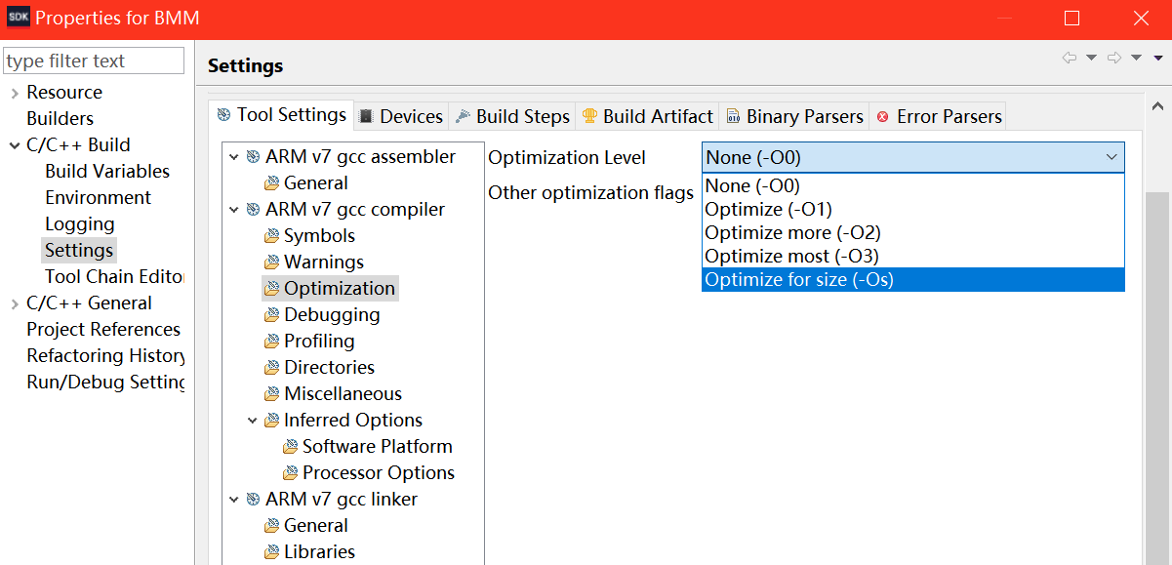
Software – ARM Implementation
Software optimization
Three main aspects :
1/ branches delays
2/ use of cache
3/ data dependencies
Optimization options for GNU :
- O0 : no optimization
- O1 : optimization on branches
- O2 : optimization at the registers and instruction level
- O3 : optimization at the highest level (eSIMD vectorization , “inline”...)
- Os : optimization on code size

Slide 9
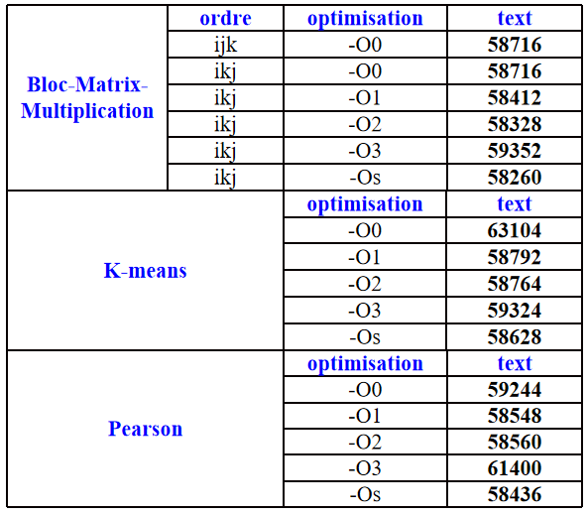
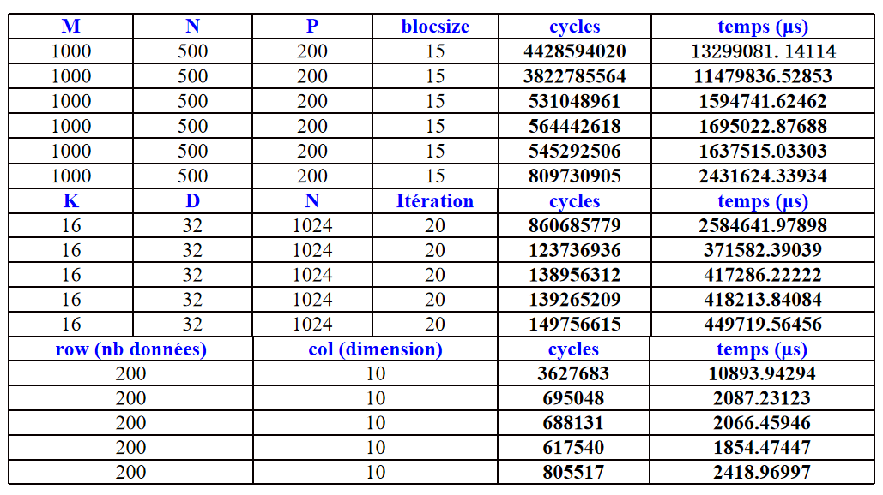
Software – ARM Implementation
Code size (segmentation “text”) Execution times

Slide 10
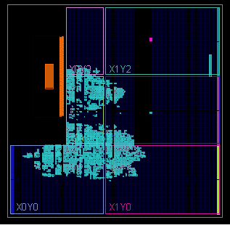
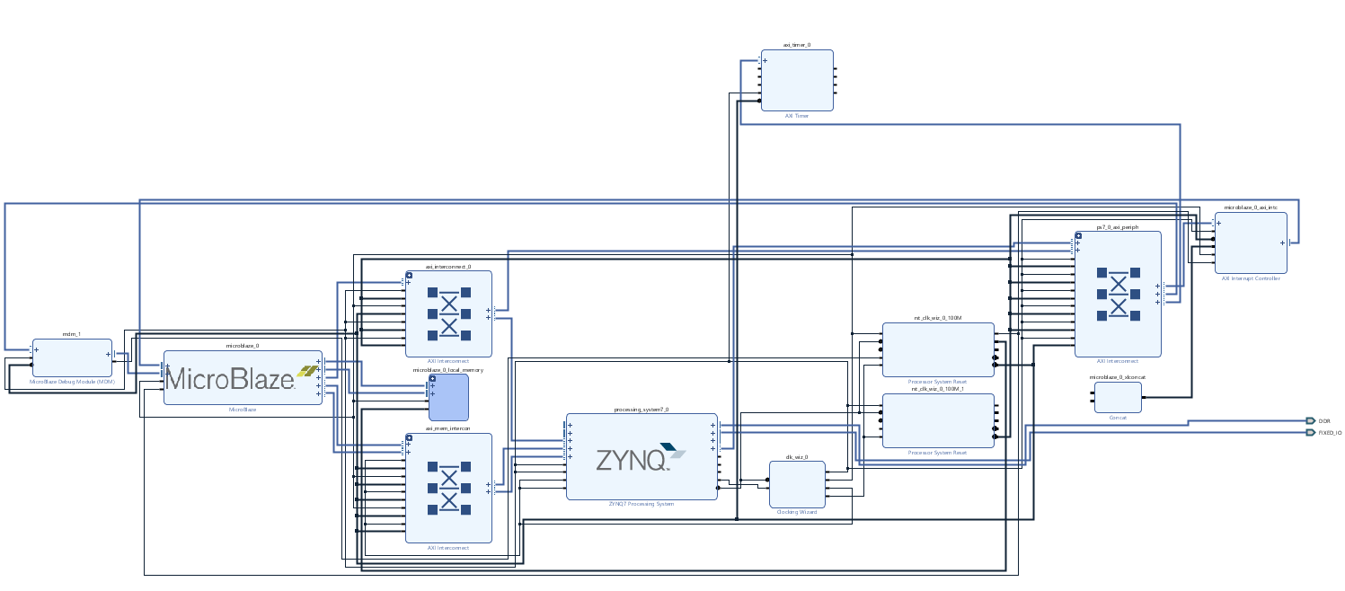
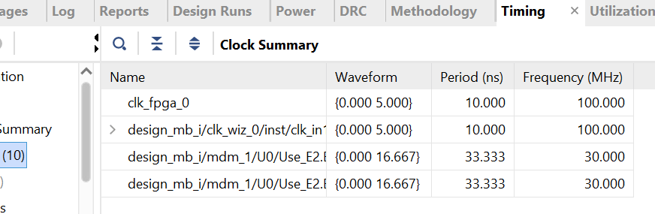
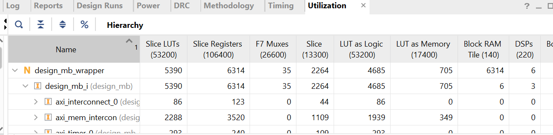
Software – Microblaze Implementation
Blocks design
Report

Slide 11
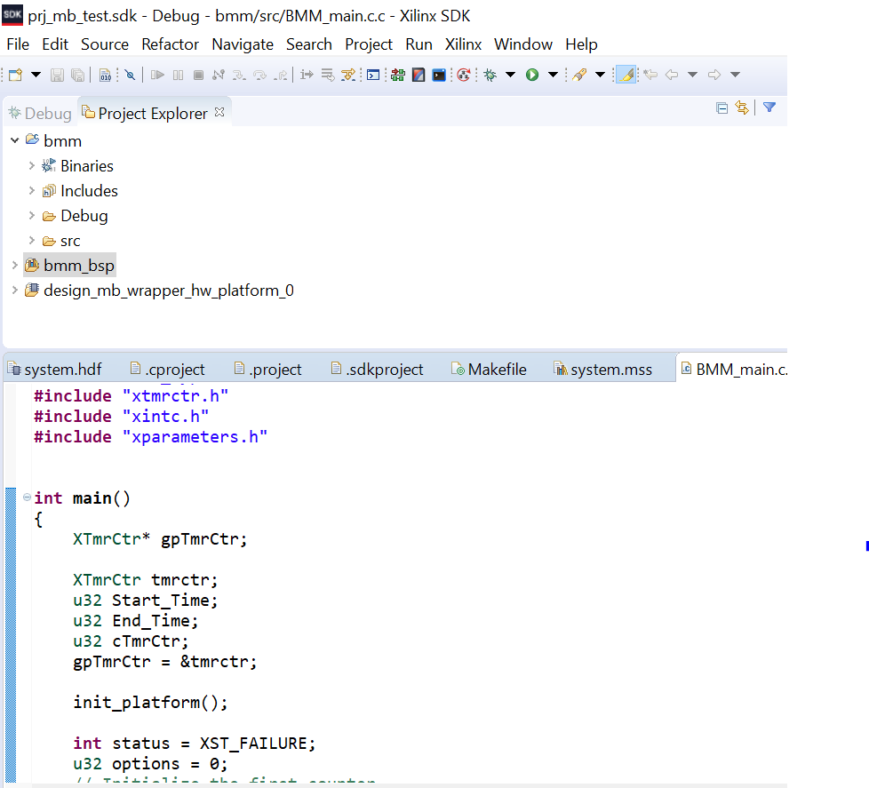
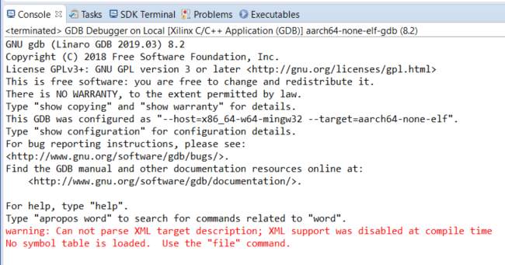
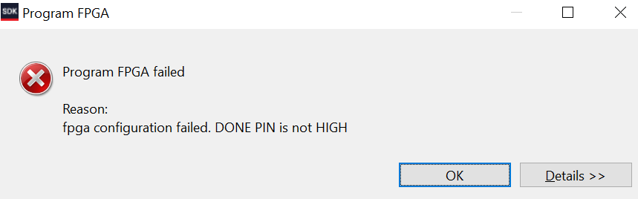
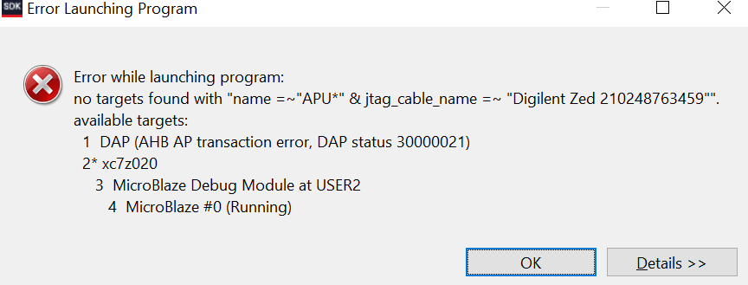
Software – Microblaze Implementation
Design on Vivado SDK
1/ Changes in libraries and functions used for timing :
xtime_l.h for ARM Implementation
xtmrctr.h for Microblaze Implementation
2/ Several bugs launching FPGA programming..

Slide 12
High – Level Synthesis
Reanalyse the algorithms
Translate software mechanisms to material ones
Implement Axi/Axilite interfaces
Manage and reshape memory
Automated material optimisations

Slide 13
High – Level Synthesis

Slide 14
Sythèse Haut Niveau (HLS)
Adaptation :
Intégration des implémentations logicielles
Correction et modification des programmes
Exploration des limites du trans-compilateur
Analyse de la « qualité » du code VHDL produit
Évaluation des critères de synthèse : surface et fréquence sur le FPGA

Slide 15
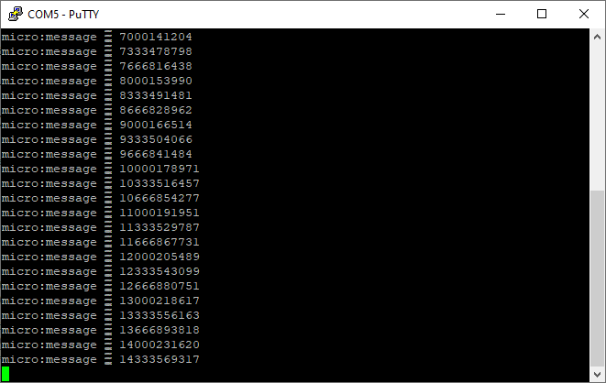
Architecture exploration
First design used by the SW team
2nd design using BRAM
3rd design with BRAM and HLS IP (still in development)

Slide 16
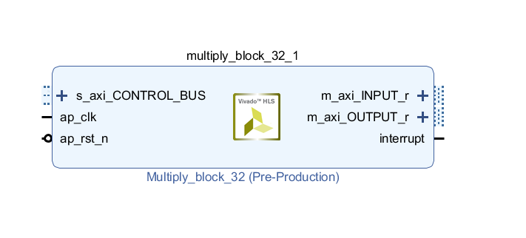
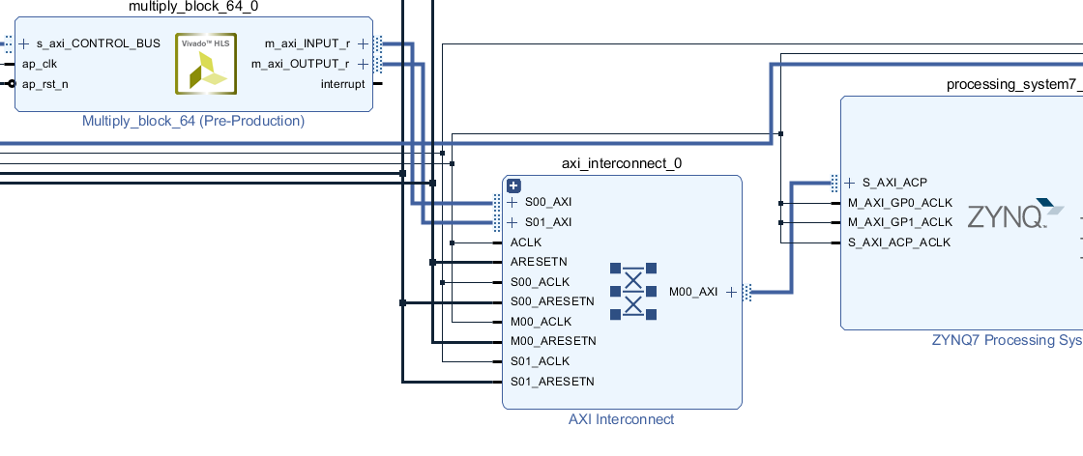
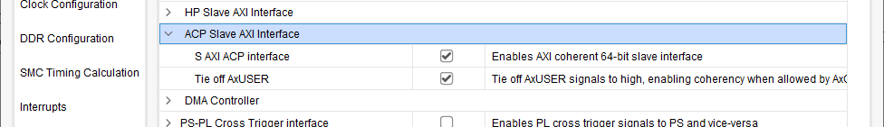
Interfacing Zynq to HLS IP
Using ACP port => Cache coherency
Having different clock domains

Slide 17
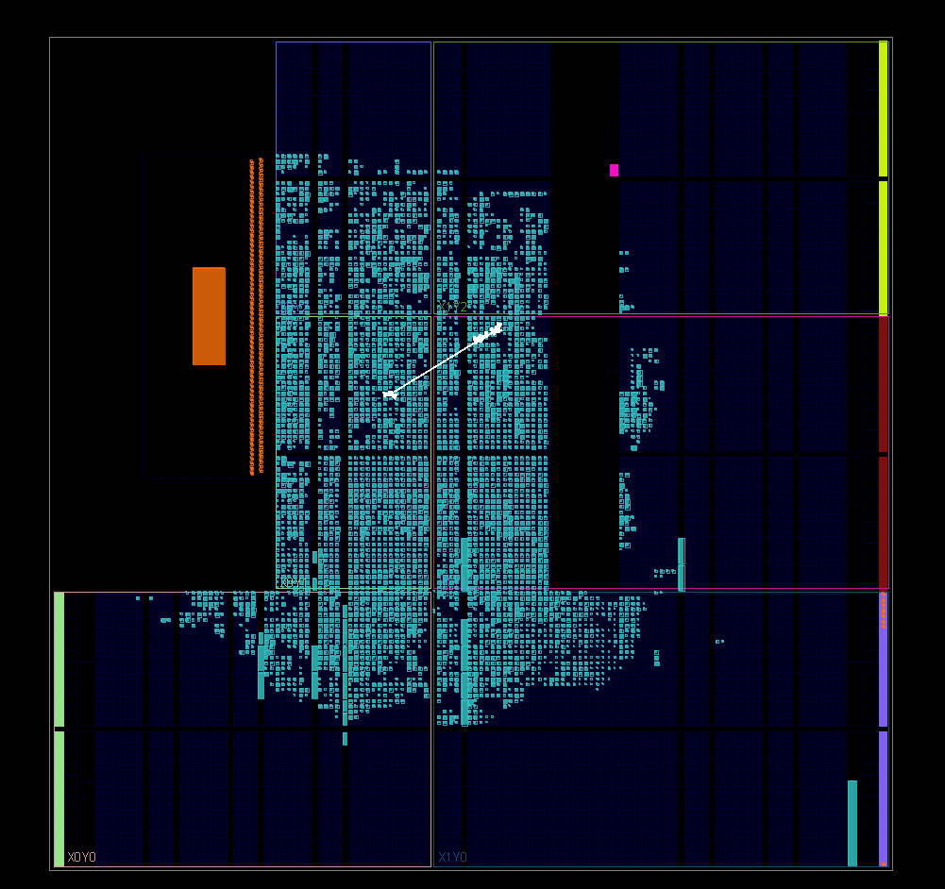
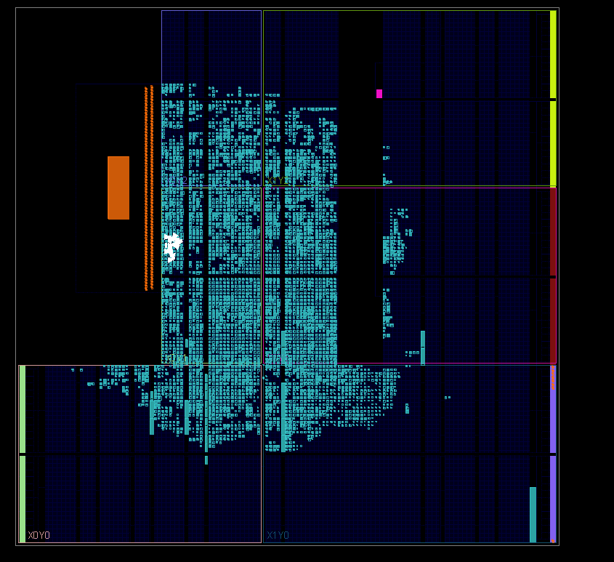
Improving clock with timing
Using Timing report to increase HLS clock frequency
Using more performance-oriented placement and synthesis strategies

Slide 18
Performance
First time @ 100MHZ
Test on MUL64:
AXI@180MHZ
HLS@131MHZ
Acceleration : 320%
IP | HW time (µs) | SW time (µs) | Improved clock | Improve HW times (µs) | Best acceleration
mul64 | 10280 | 26132 | 130MHZ | 7042 | 271%
mul32 | 2412 | 3282 | 125 MHZ | 1810 | 81%
pearson | 32 | 5 | 115 MHZ | 21 | -74%
kmeans | 1297 | 1527 | 120MHZ | 1082 | 41%

Slide 19
Future improvement
Using interruption instead of polling
A microblaze handle every task involving IP
Multi-microblazes multi-IPs.

Slide 20
Conclusion
Difficultés autour des environnements
Efforts pour un concept fonctionnel
Processus de développement en pipeline
Parallélisation des travaux
Solutions non évidentes
Projet en direction non précise

