Slide 1
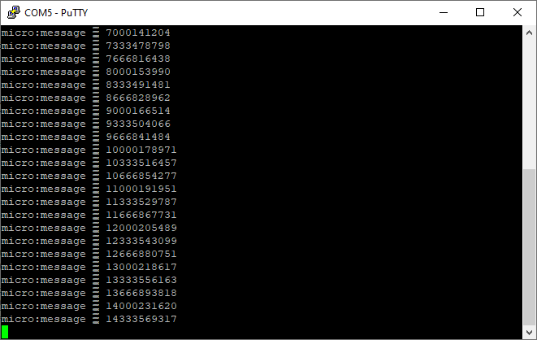
Architecture exploration
First design use by the SW team
2nd design using BRAM
3rd design with BRAM and HLS IP (still in development)
µblaze
HP
IC/DC
Zynq
AXI
DP
BRAM
GP

Slide 2
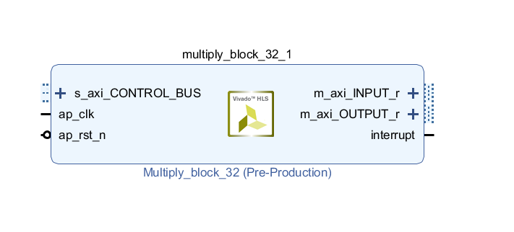
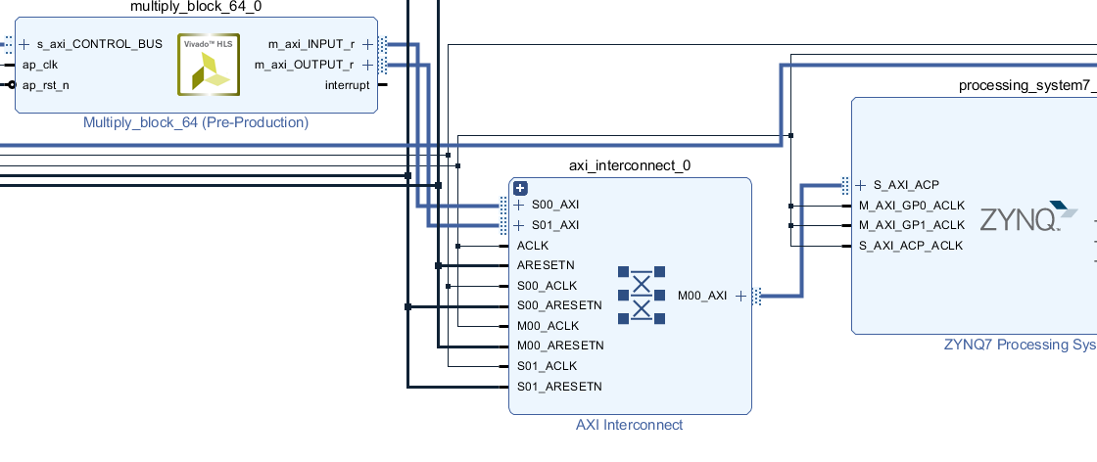
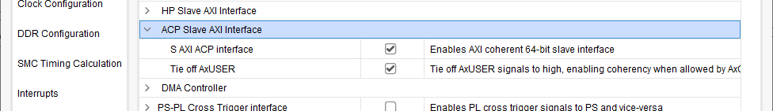
Interfacing Zynq to HLS IP
Using ACP port => Cache coherency
Having different clock domain

Slide 3
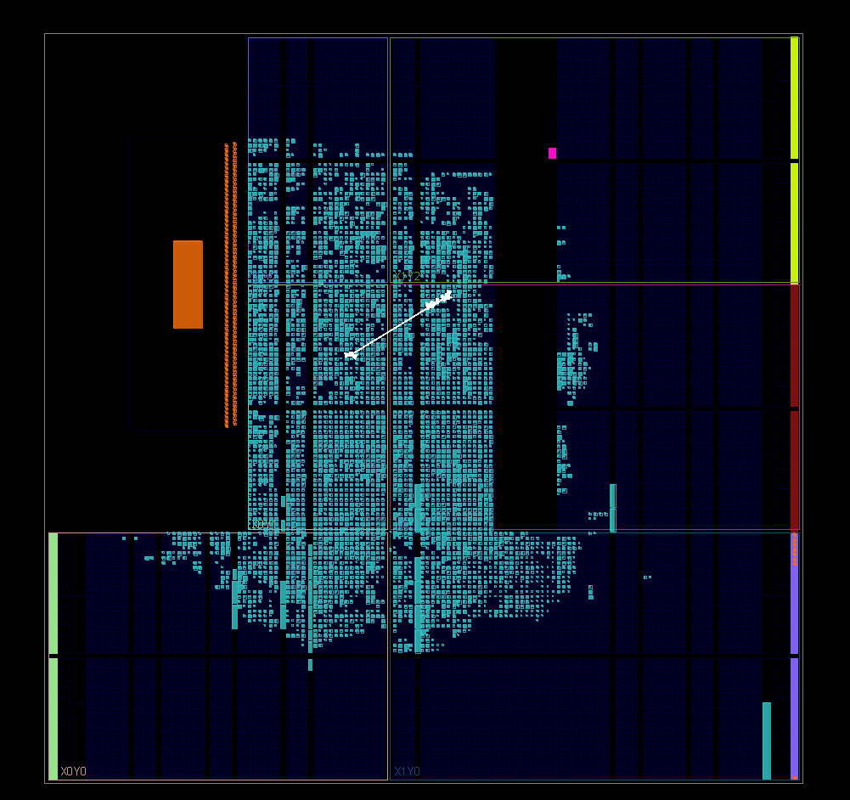
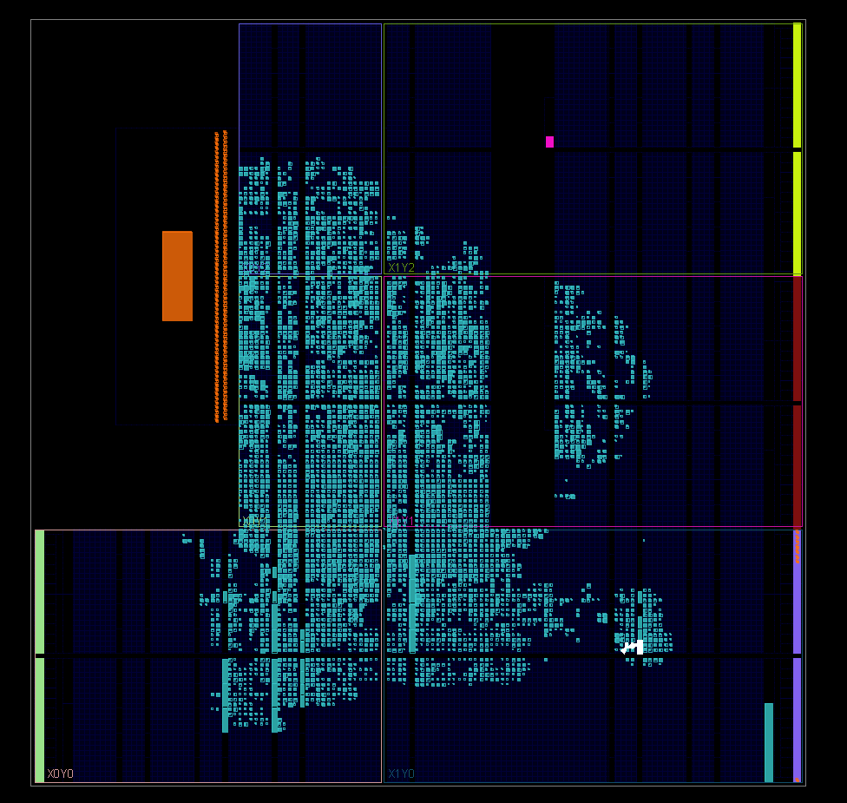
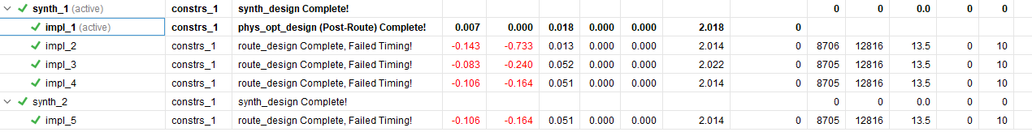
Timings-guided clock improvement
Using Timing report to increase HLS clock frequency
Using more performance-oriented placement and synthesis strategies

Slide 4
Performances
First time @ 100MHZ
Test on MUL64:
AXI@180MHZ
HLS@131MHZ
Acceleration : 320%
IP | HW time (µs) | SW time (µs) | Improved clock | Improve HW times (µs) | Best acceleration
mul64 | 10280 | 26132 | 130MHZ | 7042 | 271%
mul32 | 2412 | 3282 | 125 MHZ | 1810 | 81%
pearson | 32 | 5 | 115 MHZ | 21 | -74%
kmeans | 1297 | 1527 | 120MHZ | 1082 | 41%

Slide 5
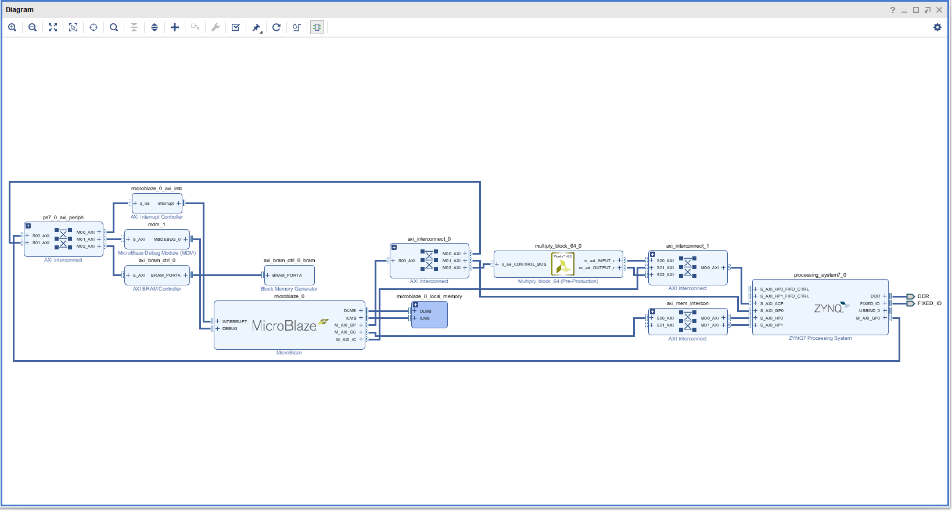
Future improvement
Using interruption instead of polling
A µblaze handles every task involving IP
HP
µblaze
Zynq
IC
DC
DP
AC
HLS
In/out

