Slide 1
Paris-Saclay University
A2 : Embedded Electronic Systems
Heterogeneous architecture for Big Data algorithms
Final presentation
Presented by:
DOU Yuhan
FORCIOLI Quentin
GHAOUI Mohamed Anis
TERRACHER Audrey
2020 February 03

Slide 2
TEAM
Software:
DOU Yuhan
TERRACHER Audrey
Hardware:
FORCIOLI QUENTIN
HLS and lead :
GHAOUI Mohamed Anis
Objective : Complete a full development cycle
2

Slide 3
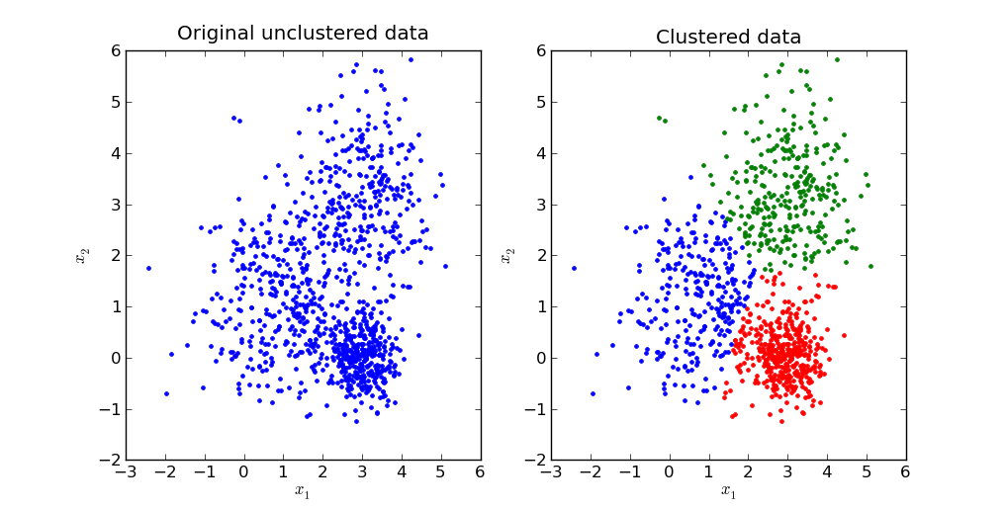
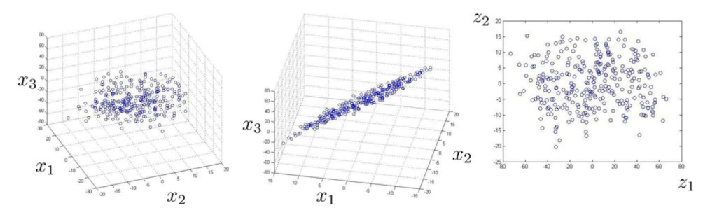
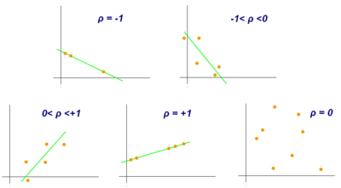
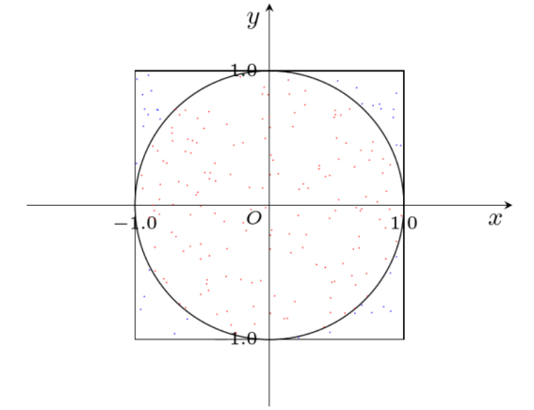
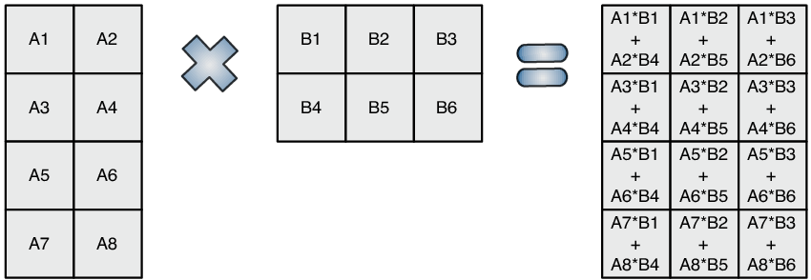
Our approach and algorithms chosen
K-Means
PCA/SVD
BMM
Pi Estimator
Pearson correlation
3

Slide 4
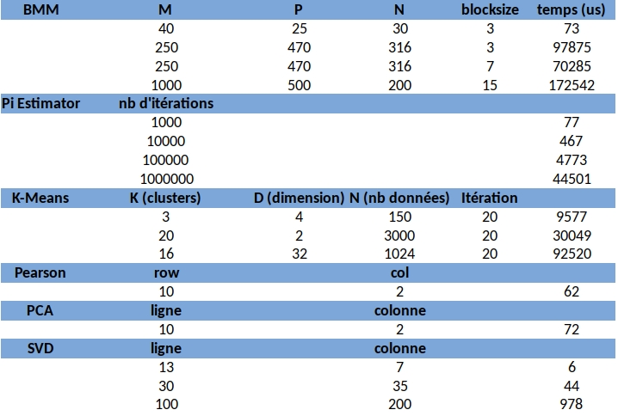
Software – PC Implementation
4

Slide 5
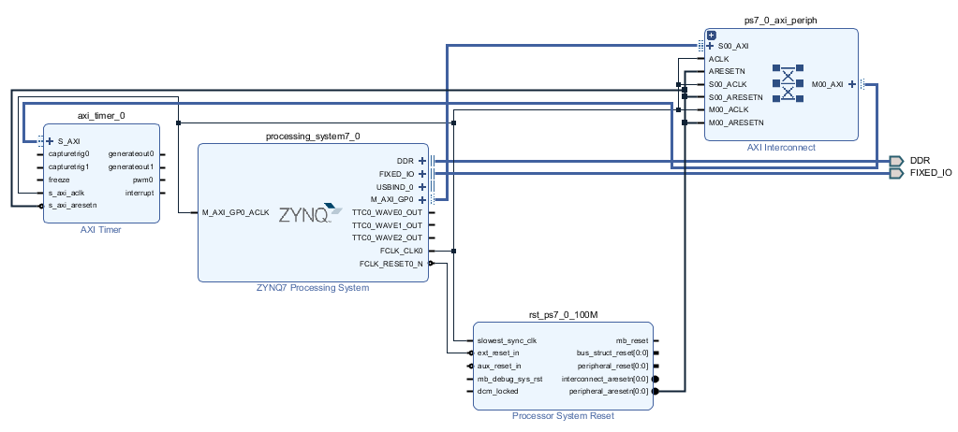
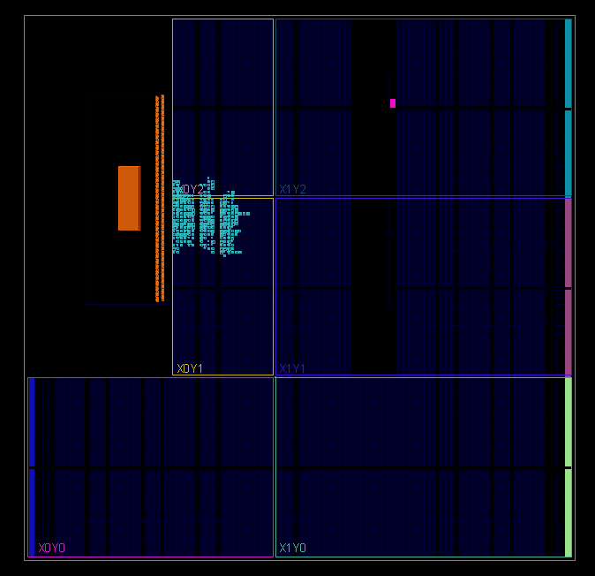
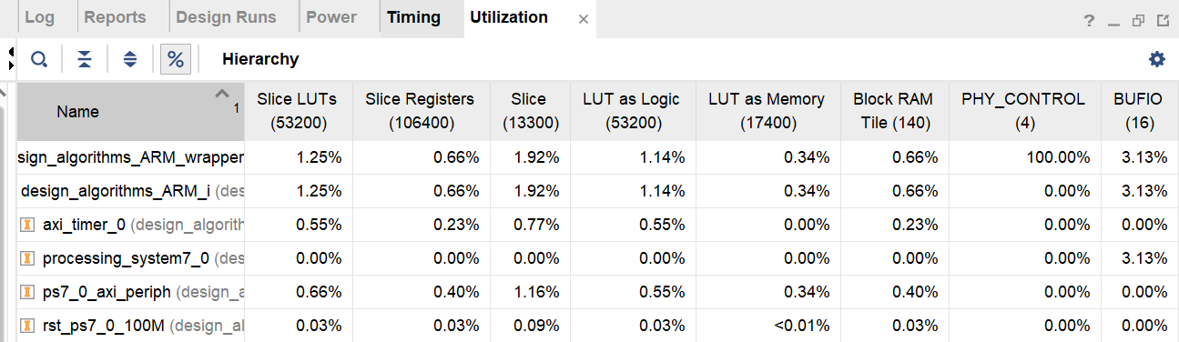
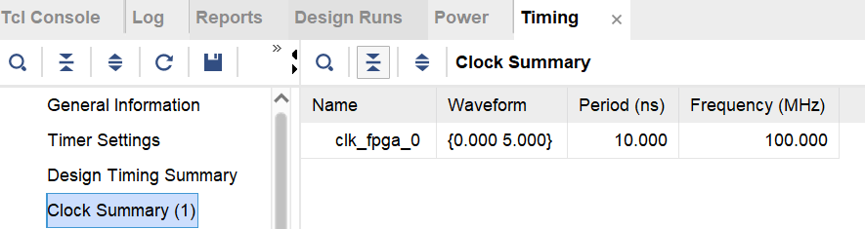
Software – ARM Implementation
Blocks design
Report
5

Slide 6
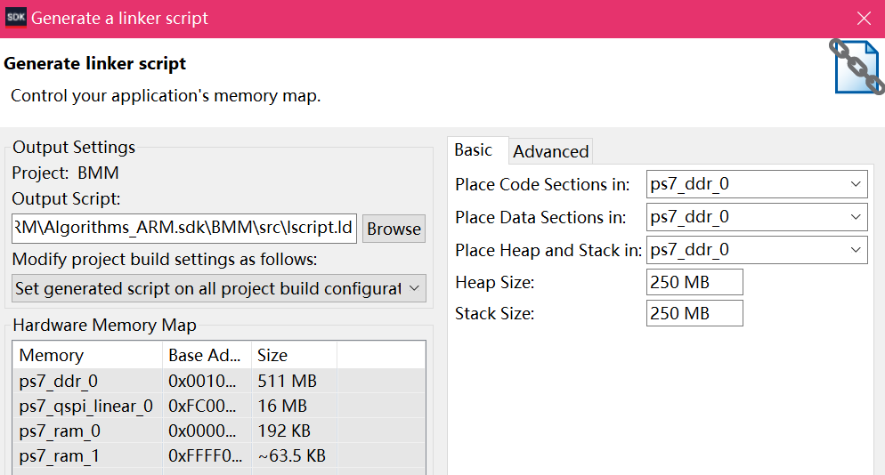
Software – ARM Implementation
Design on Vivado SDK
1/ Tools Chain : Xilinx ARM v7 GNU Toolchain
Generator : GNU make
2/ Modification of heap and stack sizes :
1 KB (default) → 250 MB
6

Slide 7
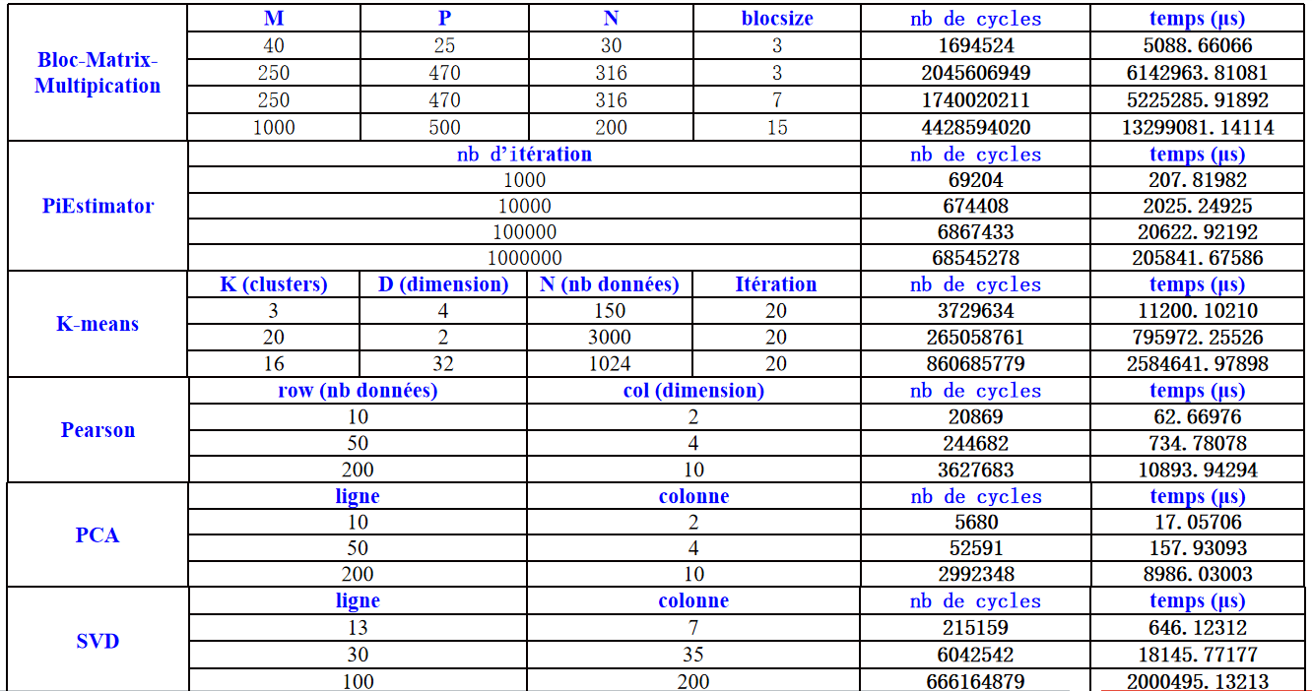
Software – ARM Implementation
7

Slide 8
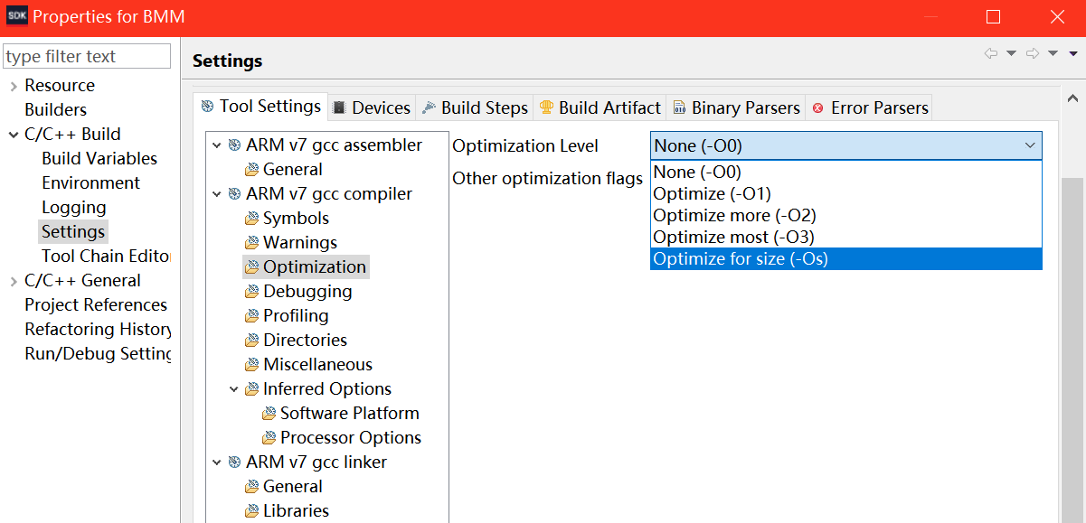
Software – ARM Implementation
Software optimization
Three main aspects :
1/ branches delays
2/ use of cache
3/ data dependencies
Optimization options for GNU :
- O0 : no optimization
- O1 : optimization on branches
- O2 : optimization at the registers and instruction level
- O3 : optimization at the highest level (eSIMD vectorization , “inline”...)
- Os : optimization on code size
8

Slide 9
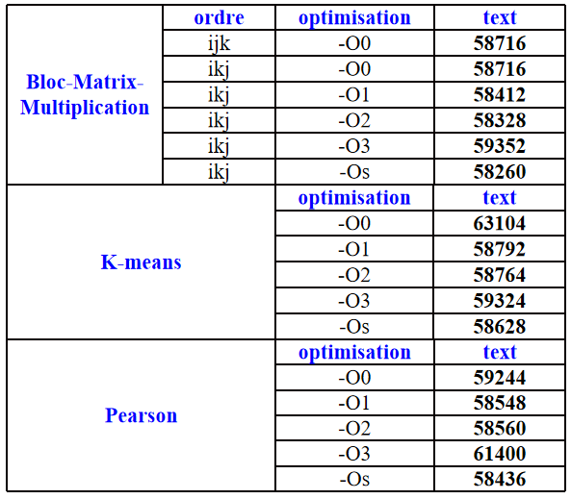
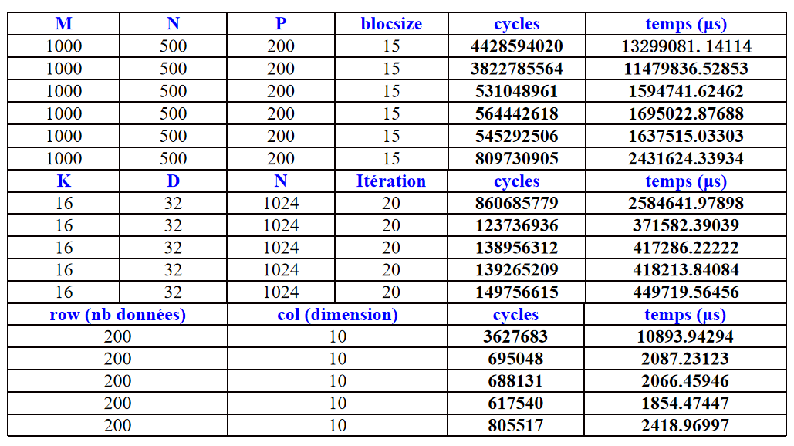
Software – ARM Implementation
Code size (segmentation “text”) Execution times
9

Slide 10
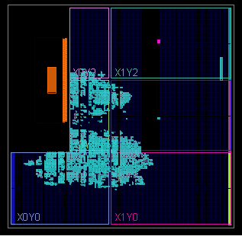
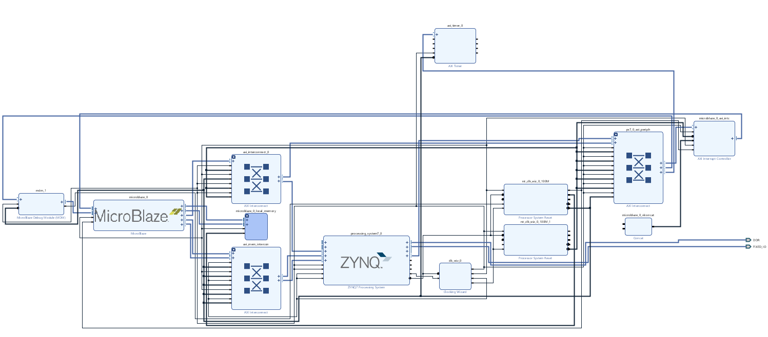
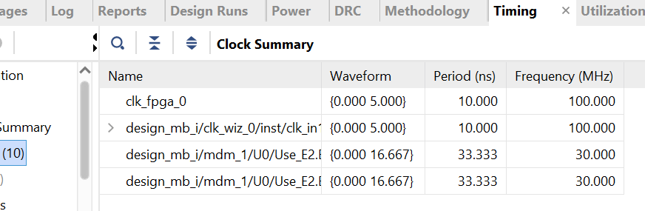
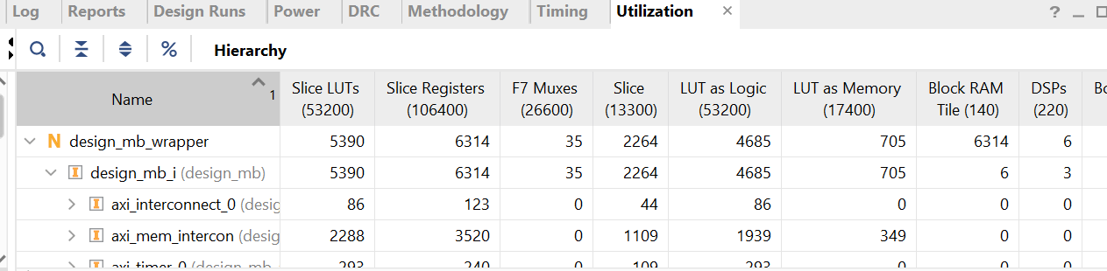
Software – Microblaze Implementation
Blocks design
Report
10

Slide 11
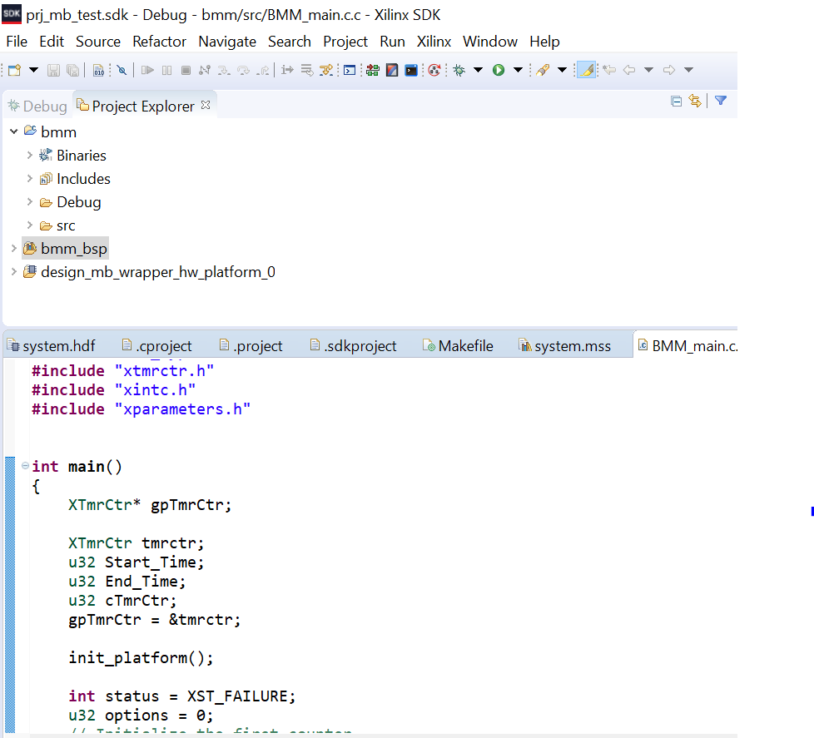
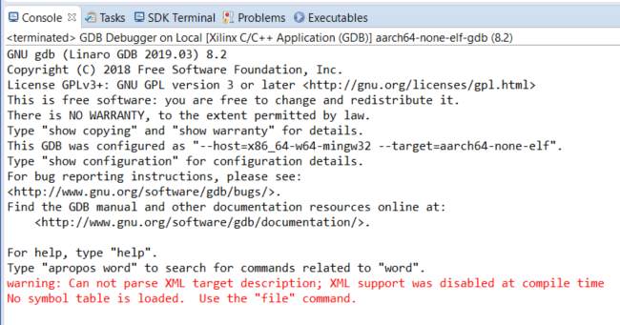
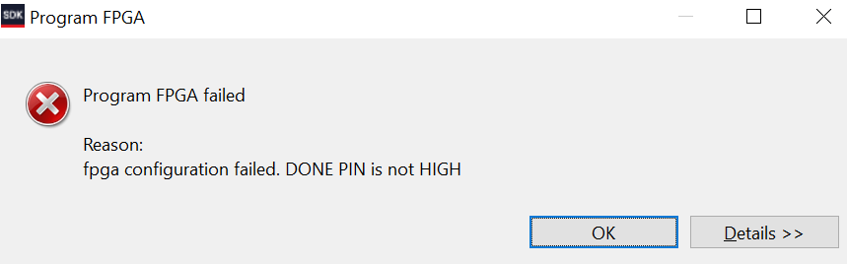
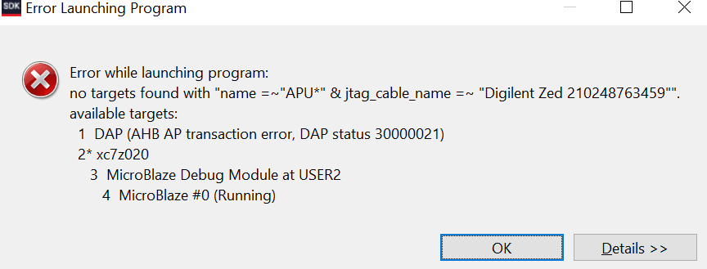
Software – Microblaze Implementation
Design on Vivado SDK
1/ Changes in libraries and functions used for timing :
xtime_l.h for ARM Implementation
xtmrctr.h for Microblaze Implementation
2/ Several bugs launching FPGA programming..
11

Slide 12
High – Level Synthesis
Reanalyse the algorithms
Directive usage to infer RTL blocks
Implement Axi/Axilite interfaces
Manage and reshape memory
Automated material optimisations
12

Slide 13
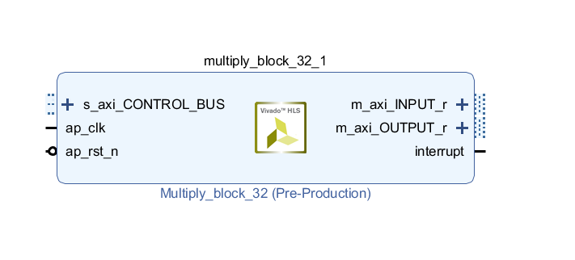
High – Level Synthesis
Control sequence conversion :
While (condition){
do_stuff();
}
For (n iterations){
do_stuff();
}
AXI/lite Interface directives :
Top-Level function : BUS CONTROL
Inputs
Outputs
Addresses managed by the CPU
13

Slide 14
High – Level Synthesis
Initialisation
Préparation
des
données
Initialisation
Perpare data
Initialisation
de l’algothime
Envoi
Send
IP HLS 1
IP HLS
Réception
test
Receive
Envoi
Fin
IP HLS 2
Reception
Fin
14

Slide 15
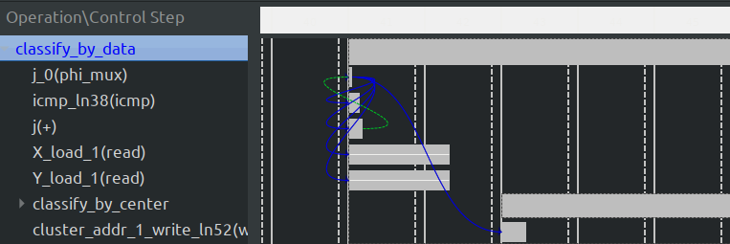
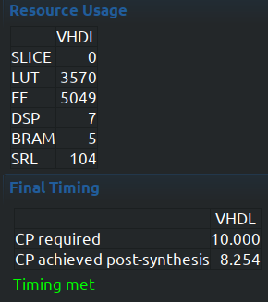
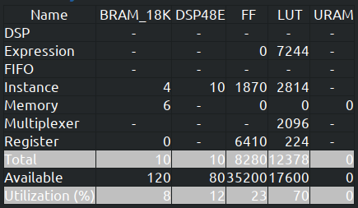
High – Level Synthesis : scheduler
Analyse dependencies
Minimise Initialisation interval
Respect timing and FPGA resources limits
If necessary : reshape the arrays
15

Slide 16
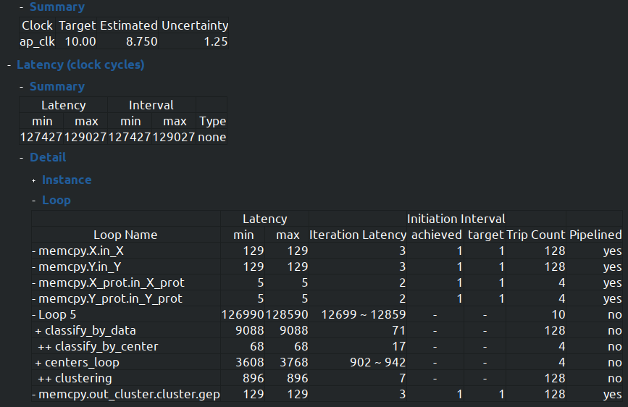
High – Level Synthesis : Synthesis
Not always necessary/possible to pipeline all the loops
HLS must respect time constraints
Optimisation can be very time/resource costly
16

Slide 17
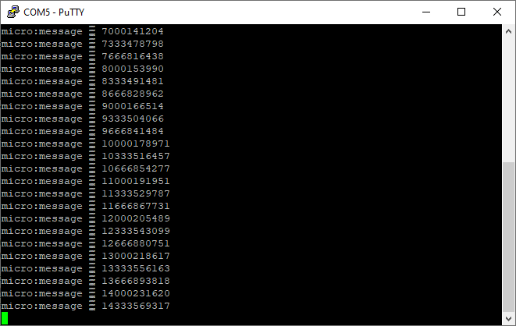
Architecture exploration
First design used by the SW team
2nd design using BRAM
3rd design with BRAM and HLS IP (still in development)
µblaze
HP
IC/DC
Zynq
AXI
DP
BRAM
GP
17

Slide 18
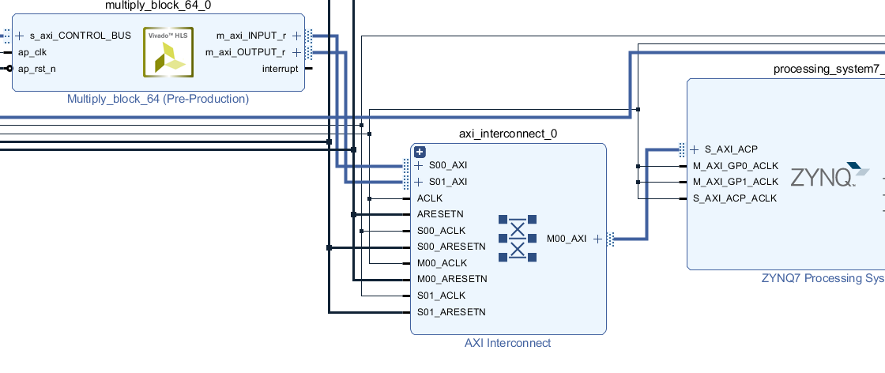
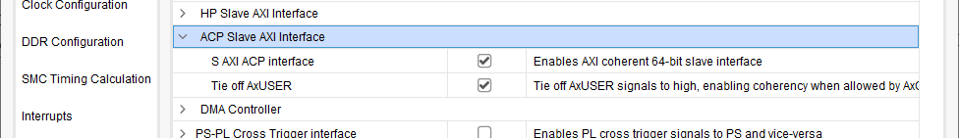
Interfacing Zynq to HLS IP
Using ACP port => Cache coherency
Having different clock domain
18

Slide 19
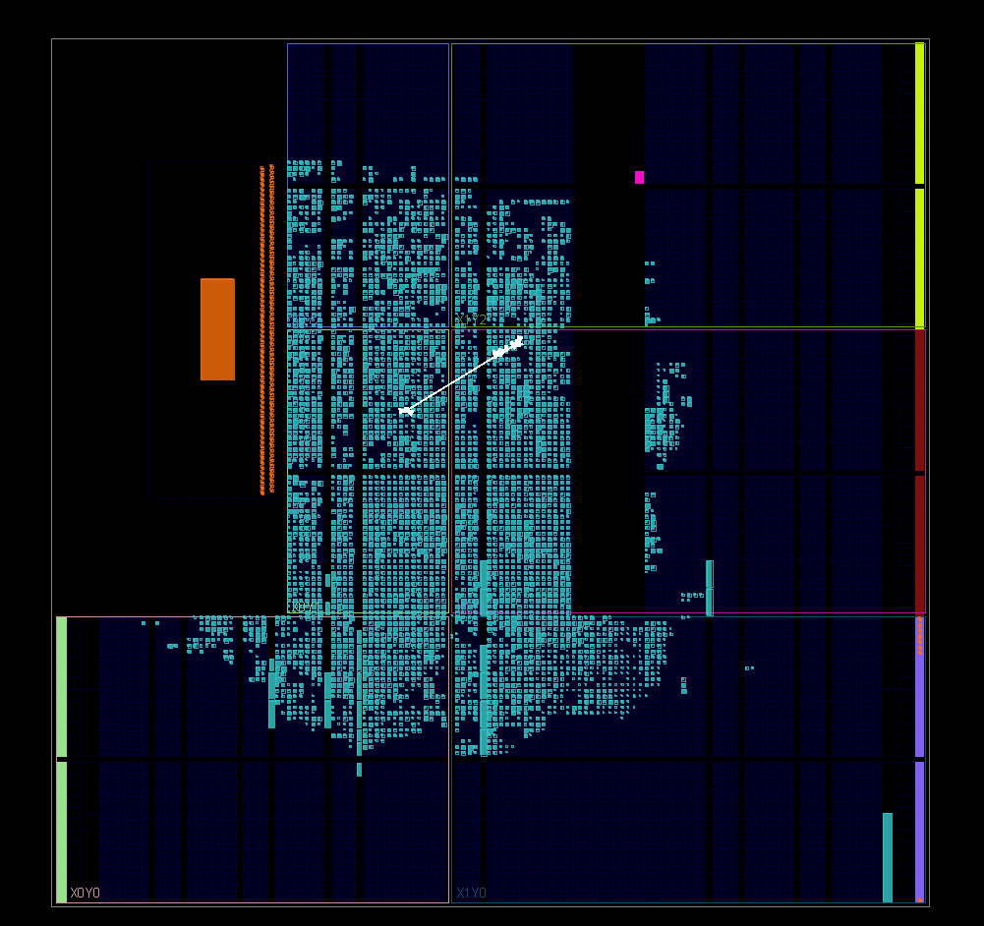
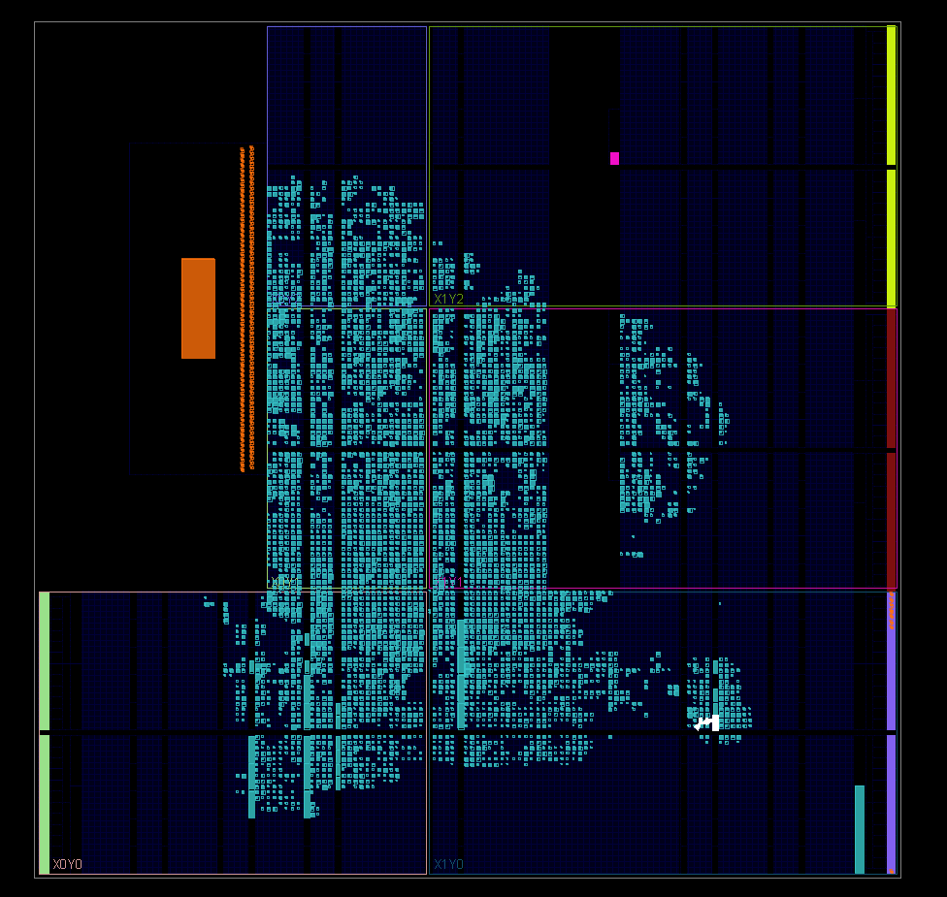
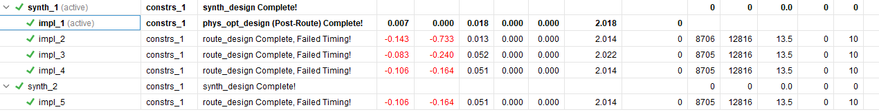
Timings-guided clock improvement
Using Timing report to increase HLS clock frequency
Using more performance-oriented placement and synthesis strategies
19

Slide 20
Performances
First time @ 100MHZ
Test on MUL64:
AXI@180MHZ
HLS@131MHZ
Acceleration : 320%
IP | HW time (µs) | SW time (µs) | Improved clock | Improve HW times (µs) | Best acceleration
mul64 | 10280 | 26132 | 130MHZ | 7042 | 271%
mul32 | 2412 | 3282 | 125 MHZ | 1810 | 81%
pearson | 32 | 5 | 115 MHZ | 21 | -74%
kmeans | 1297 | 1527 | 120MHZ | 1082 | 41%
20

Slide 21
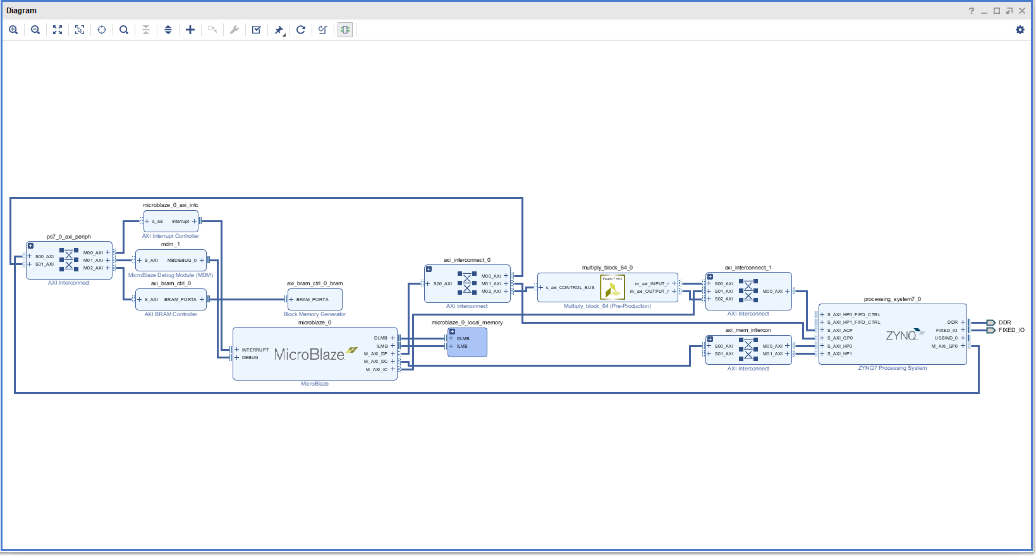
Future improvements
Using interruption instead of polling
A microblaze handles every task involving IP
Multi-microblazes multi-IPs.
HP
µblaze
Zynq
IC
DC
DP
AC
HLS
In/out
21

Slide 22
Conclusion
6 Algorithms implemented and tested
3 IP conceived and implemented
Multi-clock periods for a heterogeneous functionning
Development method is satisfying with room for improuvement
Set up the usage of automated development tools
Develop multi-microblazes multi-Ips
Maximise board usages
Completed a full development cycle : objective achieved
22

Slide 23
Conclusion
Thank you for you attention
23

