Slide 1
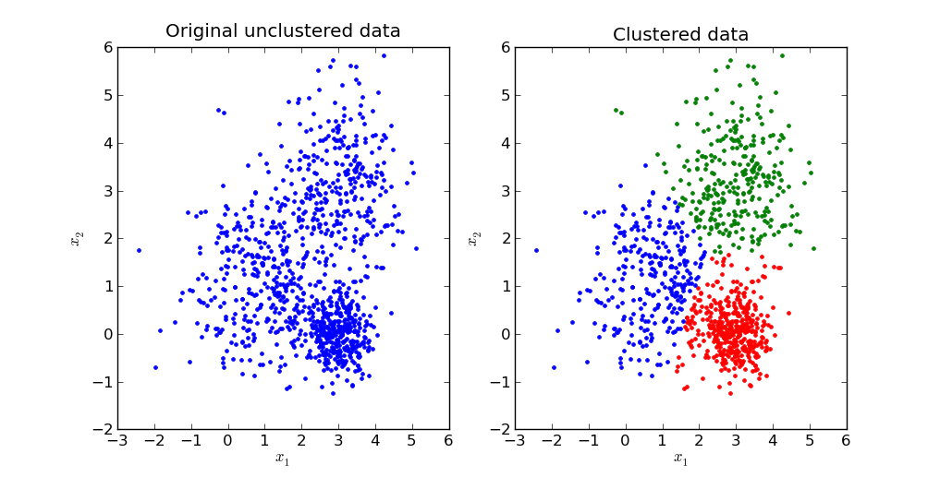
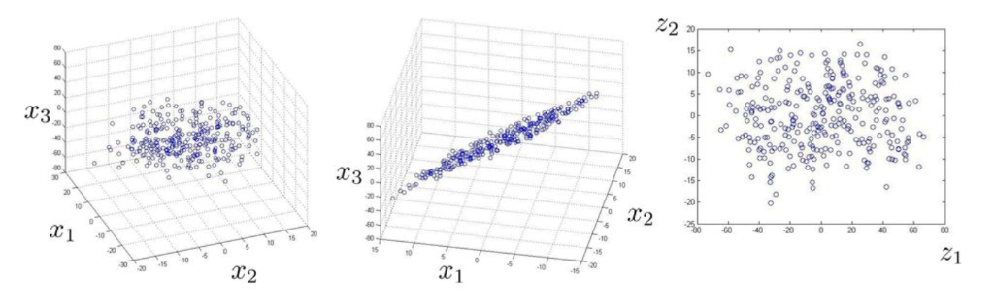
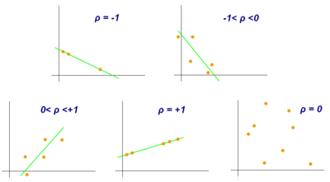
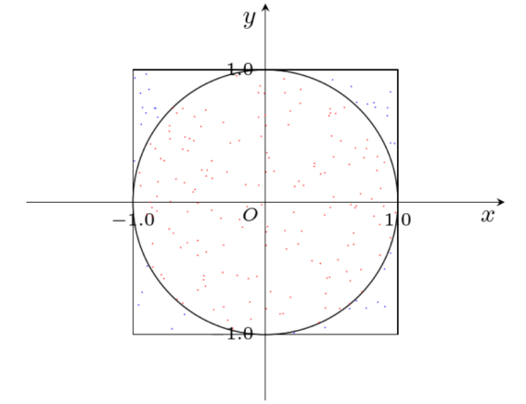
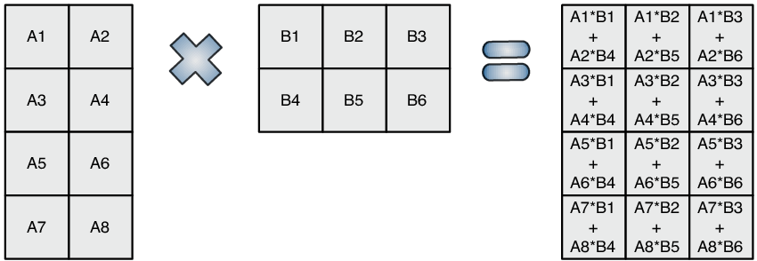
Our approach and algorithms chosen
K-Means
PCA/SVD
BMM
Pi Estimator
Pearson correlation

Slide 2
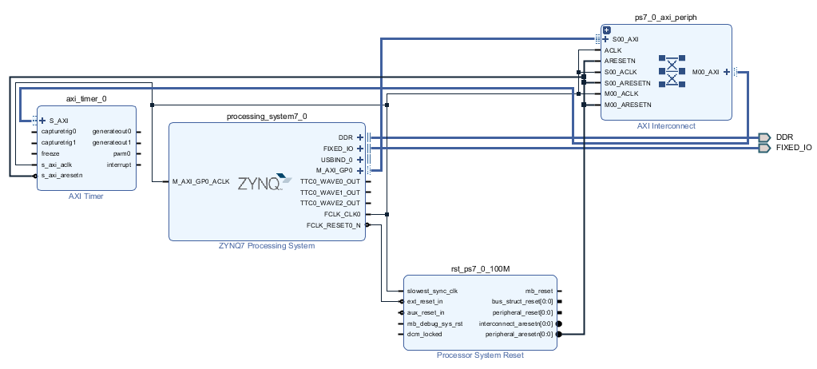
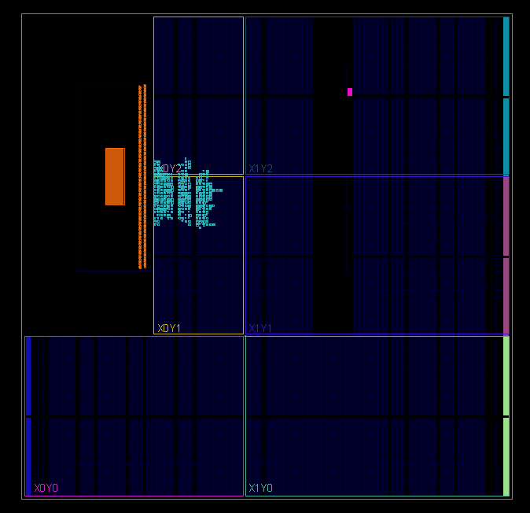
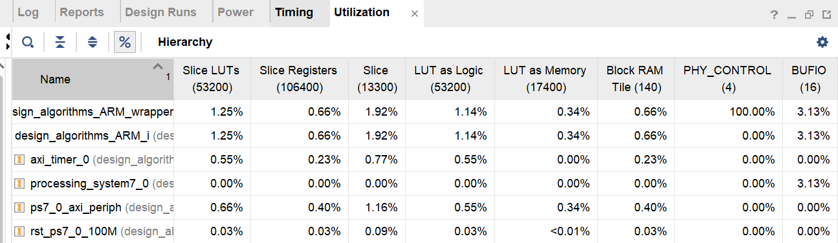
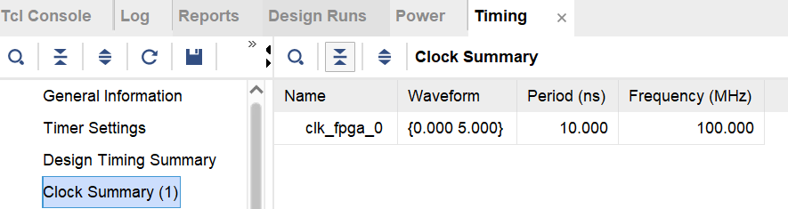
Software – ARM Implementation
Blocks design
Report

Slide 3
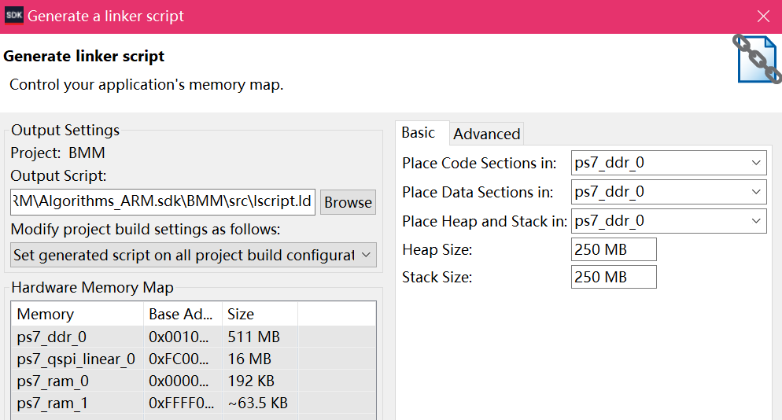
Software – ARM Implementation
Design on Vivado SDK
1/ Tools Chain : Xilinx ARM v7 GNU Toolchain
Generator : GNU make
2/ Modification of heap and stack sizes :
1 KB (par défaut) → 250 MB

Slide 4
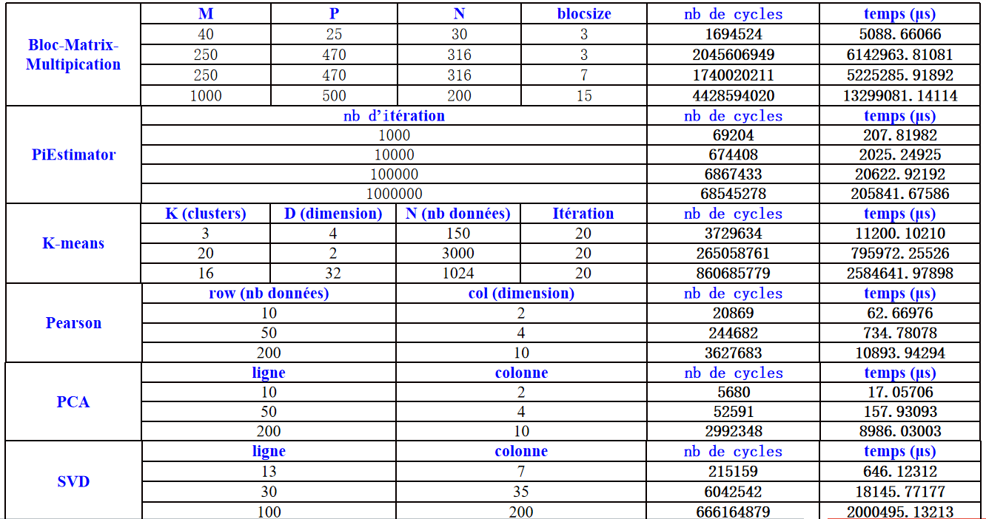
Software – ARM Implementation

Slide 5
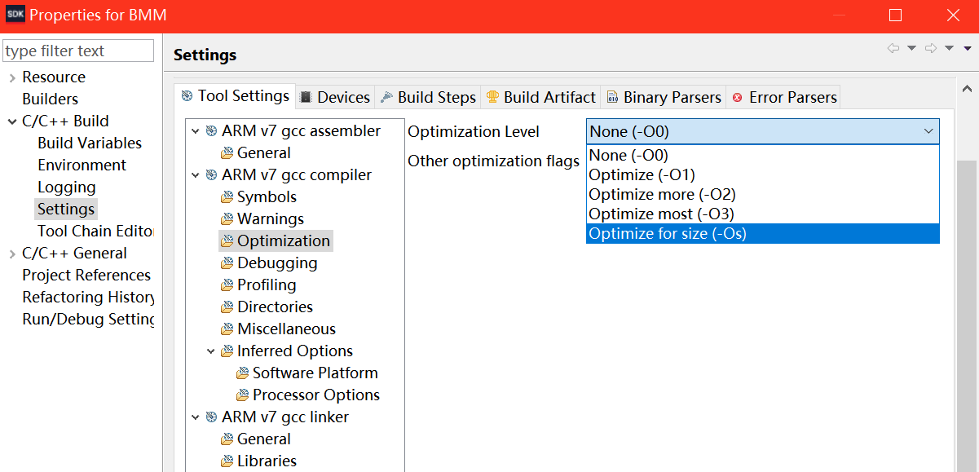
Software – ARM Implementation
Software optimization
Three main aspects :
1/ branches delays
2/ use of cache
3/ data dependencies
Optimization options for GNU :
- O0 : no optimization
- O1 : optimization on branches
- O2 : optimization at the registers and instruction level
- O3 : optimization at the highest level (eSIMD vectorization , “inline”...)
- Os : optimization on code size

Slide 6
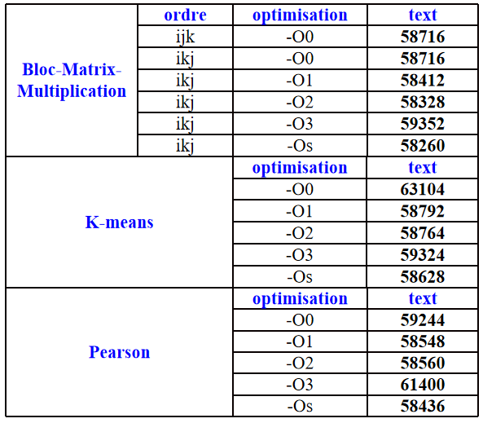
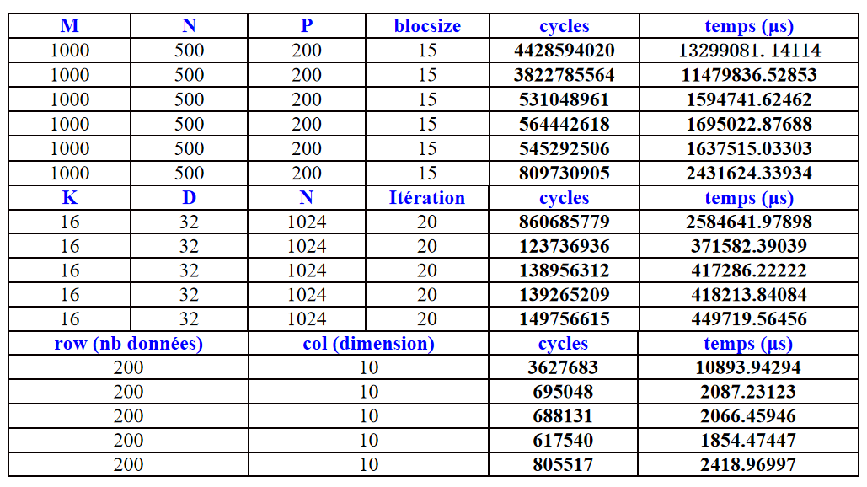
Software – ARM Implementation
Code size (segmentation “text”) Execution times

Slide 7
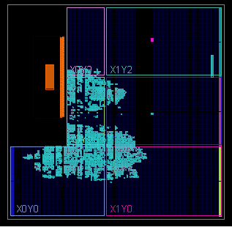
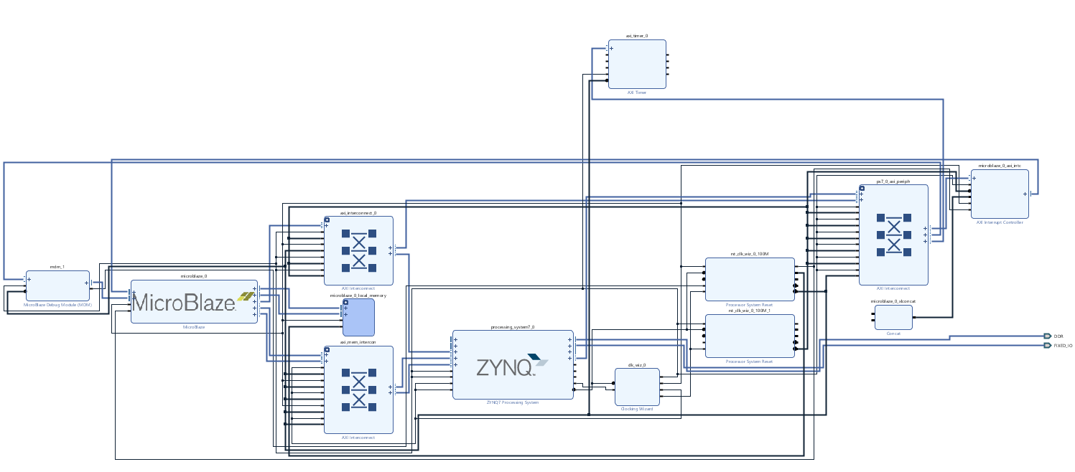
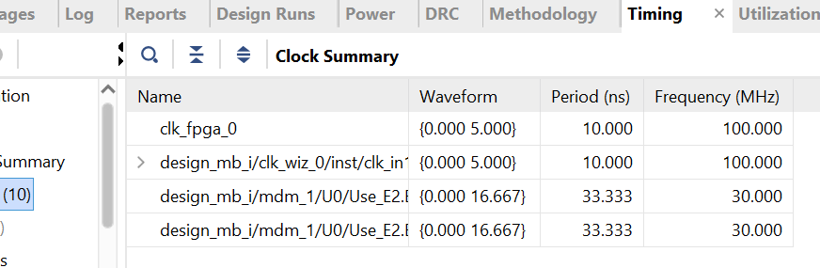
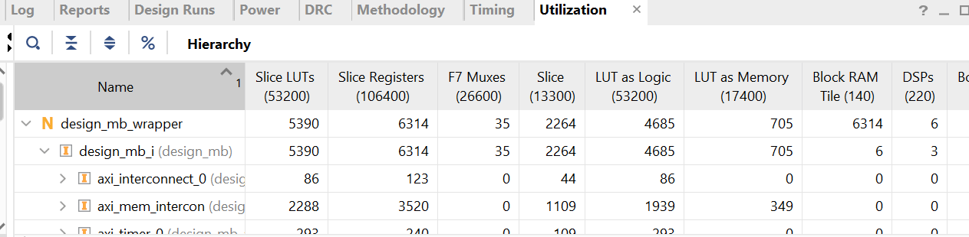
Software – Microblaze Implementation
Blocks design
Report

Slide 8
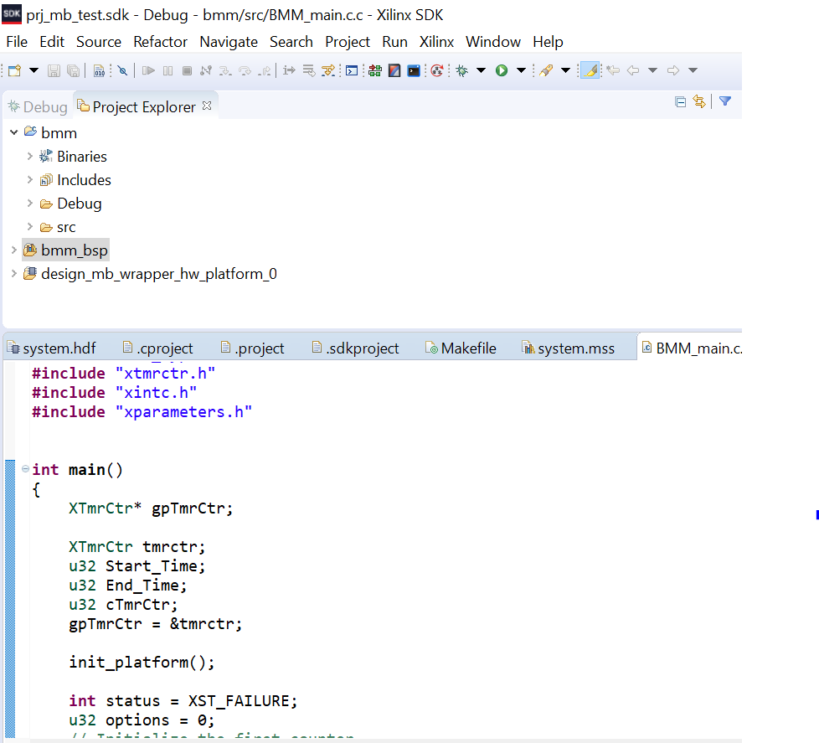
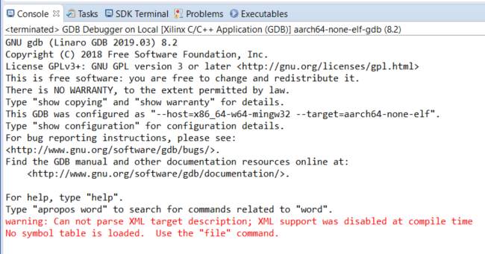
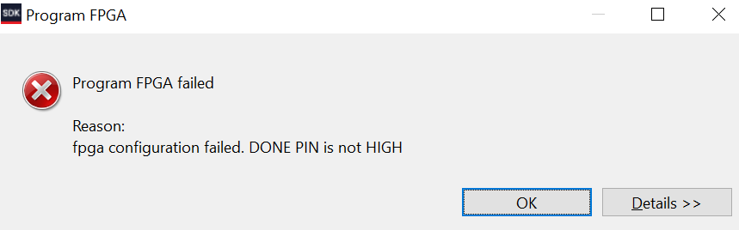
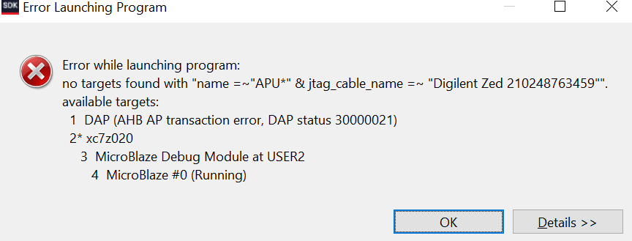
Software – Microblaze Implementation
Design on Vivado SDK
1/ Changes in librairies and functions used for timing :
xtime_l.h for ARM Implementation
xtmrctr.h for Microblaze Implementation
2/ Several bugs launching FPGA programmation...

