Slide 1
Food Delivery Application

Slide 2
Team Details
Anish Kumar
Shaurya Suman
Zinat Habiba
Manisha Bhakta

Slide 3
Table of contents
01.
02.
03.
About the project
Project Details
Tools used
04.
05.
06.
Project goals
Project demo
Conclusion

Slide 4
Our Application
Welcome to Food Swift, your go-to solution for convenient and delicious food delivery. With our intuitive interface and robust features, we connect customers with a diverse range of restaurants, offering seamless ordering and timely delivery.
FOOD SWIFT

Slide 5
What we are working on?
Encryption
Authentication
Online food
Encrypting Customer details
To keep user details saved for future references
GUI Interface for users to order food

Slide 6
About the project
01.

Slide 7
About
the project
1. User-friendly Interface: An intuitive and easy-to-navigate interface for seamless user experience.
2. Restaurant Selection: Browse through a wide selection of restaurants based on cuisine.
3. Menu Exploration: View detailed menus with prices and description.
4. Payment Options: Choose from various payment options including online payment and COD.
5. Authentication: User log in gets authenticated against the previously saved encrypted data.
6. Encryption: Customer details are encrypted using substitution encryption.
7. Order History: View past orders for easy reordering and order tracking.

Slide 8
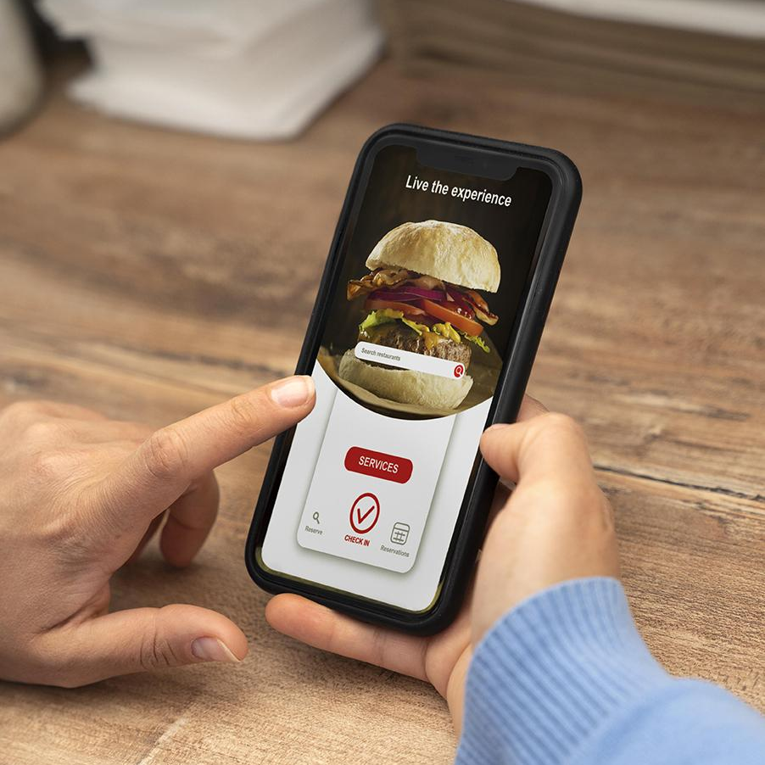
Now
A very simple GUI interface to use.
The encryptionn used is pretty straight-forward but effictive.
As of now our app uses a local data base to store details.

Slide 9
Future
A Better UI design, with more options to order, track and cancel options.
Use of a Data Base management system like SQLite.
A better encryption and authentication system.

Slide 10
Project Details
02.

Slide 11
Major requirements
Optimized Performance
Storing Data
Encryption
GUI
To optimize insertion and deletion operation, we used Linked List instead of Arrays.
To store data of user as well as customer, we used Strings and File I/O.
For a Graphical User Interface, We have used JAVA Swing library.
We have used file system for storing data so in order to protect user information, a substitution encryption is used

Slide 12
Why Linked List ?
Efficient Insertions and Deletions: Linked lists excel at insertions and deletions, especially in the middle of the list. Unlike arrays, which may require shifting elements to accommodate insertions or deletions, linked lists only require updating pointers, resulting in more efficient operations.
No Wasted Memory: Linked lists only use as much memory as necessary for storing elements, whereas arrays may waste memory if they are allocated with a larger size than needed.
Easy Expansion: Linked lists can easily expand by adding new nodes, whereas arrays may require resizing and copying elements to a larger array, which can be inefficient.
Support for Variable-Length Data: Linked lists can store data of variable lengths efficiently, while arrays require a fixed size for all elements.
Dynamic Data Structures: Linked lists are dynamic data structures that can grow or shrink in size during program execution, providing more flexibility in managing data.

Slide 13
Performance Test
Complexity Analysis
Size of Application
Time for Search
64 kb
O(n)
Time for Insertion
Way of storing data
O(1)
.txt

Slide 14
Tools Used
03.

Slide 15



Software Stack
JAVA Programming Language
Substitution Encryption
Linked List Data Structure

Slide 16
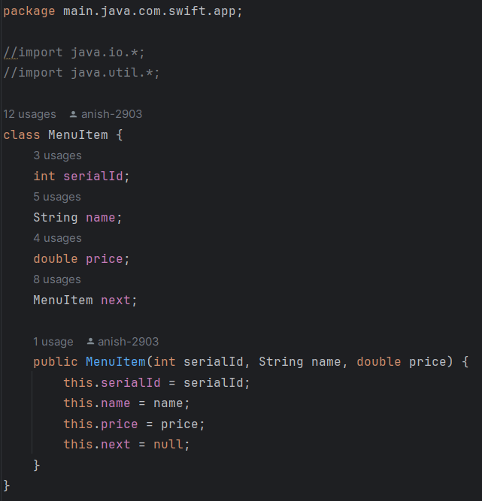
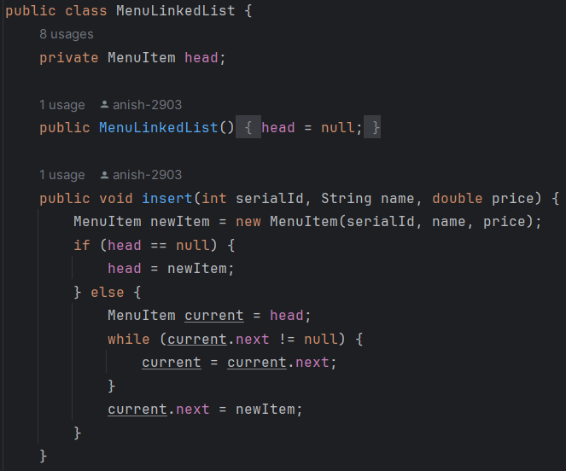
Linked List Class
MenuItem Class
Constructor and Insert method

Slide 17
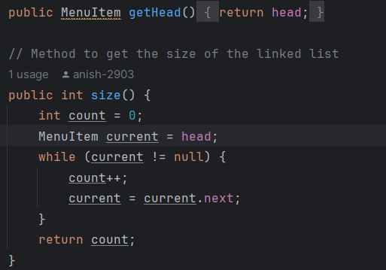
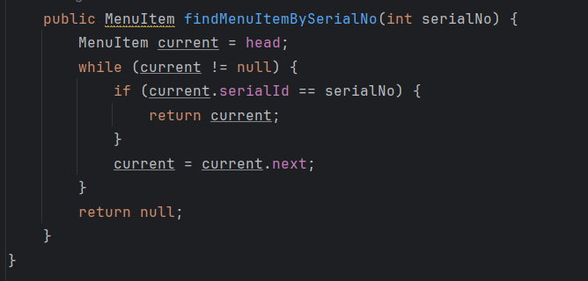
Linked List Class
Method to get the head pointer of linked list and size of linked list
Method to find menu item from it’s serial no

Slide 18
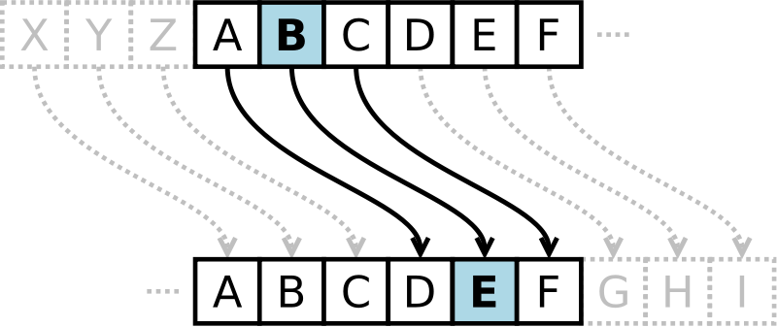
Substitution Encryption
Substitution encryption is a method of encoding messages by replacing each letter in the message with another letter or symbol according to a predefined key or rule.
For example, in a simple substitution cipher, each letter in the alphabet is replaced by another letter.
If we have the following key:
Original: ABCDEFGHIJKLMNOPQRSTUVWXYZ
Cipher: !@#$%^&*()_+~`-=[]{}|;:',.<>?/
Using this key, the word "SECRET" would be encrypted as "!@#%^&".

Slide 19
Project Goals
04.

Slide 20
Project goals
Goal 1
Goal 2
Goal 3
Working Food delivery system that is taking orders, saving data.
Use of necessary data structure for optimized performance.
Encrypting data and authentication.

Slide 21
Project Demo
05.

Slide 22
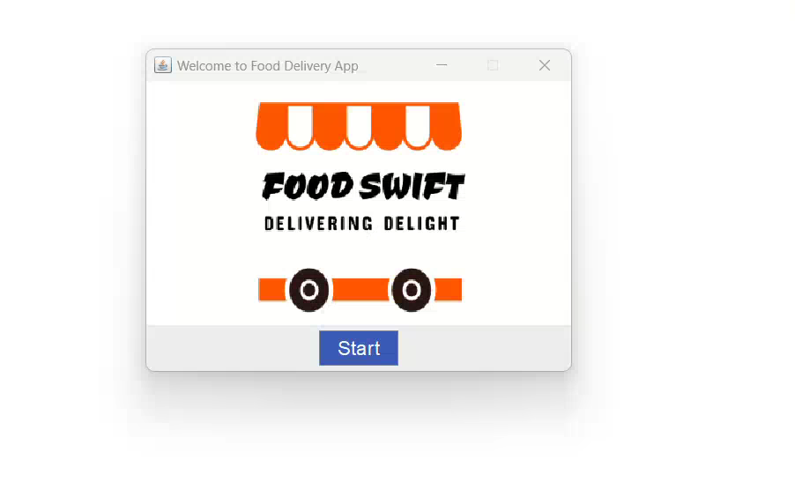
Sneak peek
Take a Quick Tour
Previewing Our Food Delivery App in Action

Slide 23
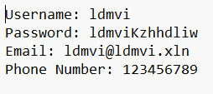
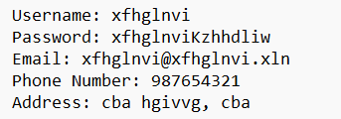
Encryption in action
Owner Data File
Customer Data File
The login data provided by both owners and customers is securely stored in a file using a substitution encryption method. This technique involves replacing specific letters with different characters, enhancing the security of the stored information. Notably, phone numbers are stored without encryption for ease of access and retrieval.

Slide 24
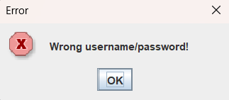
Authentication in action
But data is encrypted, how will I log in ?
Upon subsequent login attempts, users are required to provide the same username and password previously used for authentication. Failure to input the correct credentials will prompt the appearance of a window indicating an authentication failure, prompting the user to re-enter their login information. This process ensures secure access to the system by verifying the user's identity with each login attempt.
Users are relieved of the burden of managing encryption details, as they simply need to input the same username and password originally provided. The application's backend seamlessly handles the decryption of data stored in the file and authenticates it against the user's input.

Slide 25
Conclusion
In conclusion, our food delivery app offers a seamless and convenient solution for both owners and customers alike. Through its user-friendly interface and robust backend functionality, the app streamlines the process of ordering food and managing menus. Owners can easily add and update menu items, while customers enjoy a hassle-free ordering experience. With features such as secure login authentication and efficient data encryption, the app prioritizes user privacy and security

Slide 26

Thank you!
Do you any questions ?
You can access the full source code on Github

