Slide 1
Confidential Radiology AI
IBM Z DATATHON 2026 · THEME: AI SECURED
An AI score on a chest X-ray, without trusting the people who run the server.
Secure chest X-ray inference on IBM Z · Team Revolution
Anish Mall (Team Leader) · Sourav Kumar · Aashi Soni · Ayush Kesarwani · Gobinath
Notes:
Open with the one-sentence promise. Optional: play the first 10 seconds of the film as the hook.

Slide 2
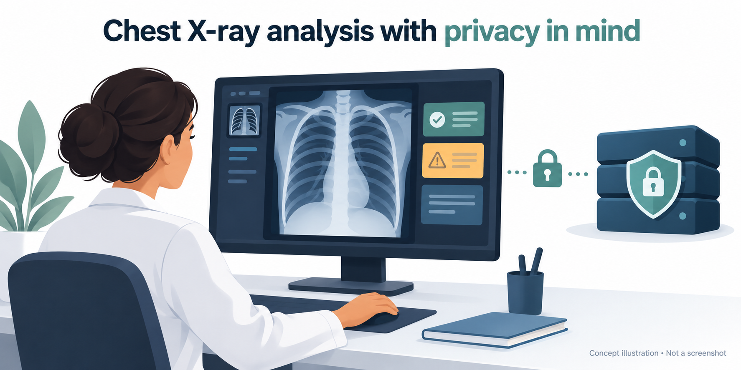
Hospitals want AI to read chest X-rays but cannot let outside servers see the scans
MOTIVATION
VISUAL PLACEHOLDER
Chest X-ray or persona illustration
film_frame_20s.jpg or a chest X-ray image
>240 M
people affected by US health-data breaches reported to HHS in 2024. Public figure, not ours.
Dr. Meera, head of radiology. She wants an AI second opinion, but compliance blocks every outside AI service that must read the scan.
Most common
imaging study worldwide is the chest X-ray, so the exposure risk applies at very large scale. Public figure.
Notes:
Start with someone everyone can picture. Dr. Meera wants the AI; compliance says no. The numbers show why caution is rational.

Slide 3
Scans stay encrypted on disk and in transit, but the AI needs them readable in memory
THE GAP
AT REST
IN TRANSIT
IN USE (AI RUNNING)
Encrypted
Encrypted
Plaintext
Disk is protected
Network is protected
Server memory holds the scan
Whoever controls the server can read the scan at that moment, and the scan may carry burned-in names and dates.
Administrator
Compromised host
Memory dump
Notes:
The audience should leave this slide seeing one red lock. Everything we build targets that single moment.

Slide 4
Our question: can a hospital get an AI score without trusting whoever runs the server?
RESEARCH QUESTION
Hypothesis. If the image is readable in exactly one verified place, then all three outcomes below should hold.
1
Tampering is refused
2
The math is unchanged
3
Nothing extra leaks
Any changed code, model, or data gets no key.
Secure and plain paths agree on the score.
Only five signed fields leave the guest.
Evidence: 11 of 11 attacks refused (§5)
Evidence: Δ 0.0000, max 1.55e-5 (§6)
Evidence: schema crai.result.v1 (§4)
Notes:
This is the contract with the audience. Every result later in the talk maps to one of these three cards.

Slide 5
Existing options either leave the gap open or cost far more time
LANDSCAPE
Approach | Protects data in use? | Time or effort cost | Where trust sits
Disk + TLS encryption | No. Decrypts in server memory | None | Server operator
Homomorphic encryption | Yes | About 88 to 92 s per image (published), vs milliseconds in the clear | Mathematics
Typical confidential-compute demo | Input only; the output often shows the X-ray | Low | Hardware
Our pipeline | Yes, inside a verified guest (isolation simulated here) | About 23 ms security overhead, measured | Hardware policy + hospital key broker
Published FHE figure is for full forward passes; ours is measured on a z17.
Notes:
Position honestly. FHE is a valid comparison point, not a strawman: it protects data in use but costs seconds.

Slide 6
Our idea: the image is readable in exactly one place
OUR IDEA
1
Verify before unlocking
2
Analyse inside only
3
Return a minimal, signed answer
The key is released only to a guest whose code and model hashes match policy.
Decrypt, score, and wipe, all inside that guest.
Five fields. No image, no patient id, no heatmap.
Pattern: IBM Secure Execution + attestation-gated key release (Confidential Containers / Trustee). Hybrid AI: ResNet-50 features, a calibrated head, and IBM Granite for explanations.
Notes:
Three rules, in order. Rule 1 is the gate, rule 2 is the room, rule 3 is the exit.

Slide 7
One study passes four checkpoints before any pixel is read
ARCHITECTURE
PACS vault
Key broker + attestation
Trusted guest
Signed result
PACS verifies
Ciphertext only. AES-256-GCM, per-study key, study id as AAD.
Holds the KEK, nonce, policy.json, issues a 60 s token.
Hashes itself and the model. Decrypt, ResNet-50, wipe.
Five fields, signed with a key the token approved.
Checks token and signature.
guest_image_hash a88f10a1…
model_hash c64992e8…
token expires in 60 s
key wrapped to this guest only
Reference: notebook §1 to §3 · crai/pipeline.py
Notes:
Walk left to right. The guest in the middle is the only place the image exists in plaintext.

Slide 8
Only the verified guest ever sees pixels; everyone else sees ciphertext or hashes
TRUST BOUNDARIES
Actor | Sees | Never sees
Host / administrator | Ciphertext, sizes, timing | Pixels, keys, results
Attestation broker | Guest evidence, policy hashes | Any image content
Trusted guest | Plaintext study, only here | Other studies after wipe
PACS / hospital | Signed probability + hashes | Pixels, patient ids, heatmaps
Network observer | Encrypted traffic | Plaintext of any kind
TRUSTED COMPUTING BASE
Small guest image
One hash-pinned model
Outbound connections blocked
Every response checked
Key exists only after attestation
Notes:
This is the honest threat model. The guest code is trusted, so we keep it small.

Slide 9
A frozen, hash-pinned ResNet-50 means swapping the model withholds the key
THE MODEL
1
TorchXRayVision backbone
DETAILS
resnet50-res512-all, loaded big-endian on s390x
Pure-PyTorch port, since no torchvision wheel exists for s390x
Swap the model, no key is released
IBM Granite explains results on the host side
Research prototype, not a diagnostic device
2
Calibrated head
Logistic regression + Platt scaling on frozen features
3
Hash in the policy
Model file SHA-256 is checked at attestation
Notes:
The model hash is part of policy, so model integrity is a security property, not only an accuracy one.

Slide 10
Patient-level splits keep evaluation honest
DATA AND EVALUATION
RSNA Pneumonia Detection Challenge (Kaggle)
DICOM to 512×512 PNG, never uploaded externally
Split by patient id, not by image
Demo uses 20 held-out studies
Metrics: AUROC, sensitivity and specificity at a fixed threshold, calibration
Caveat: the backbone was pre-trained on data that includes RSNA, so numbers will be optimistic.
Notes:
Be upfront: accuracy has not been measured. This slide is for the RSNA result once the run finishes.

Slide 11
The key is released only to a guest whose code and model match policy
KEY RELEASE
SIMULATION
Trusted guest
Attestation + key broker
PACS vault
1 Evidence: guest hash, model hash, two public keys, single-use nonce
2 Check policy, issue a signed 60 s token
3a Match: key re-wrapped to this guest only
3b Any mismatch: refusal, reason logged
4 Decrypt, score, wipe. Return the signed five-field result
Simulated: measurement is self-reported here. On real Secure Execution the Ultravisor signs it.
Notes:
Introduce the mechanism before the attack results. Message 3b is the one every later test exercises.

Slide 12
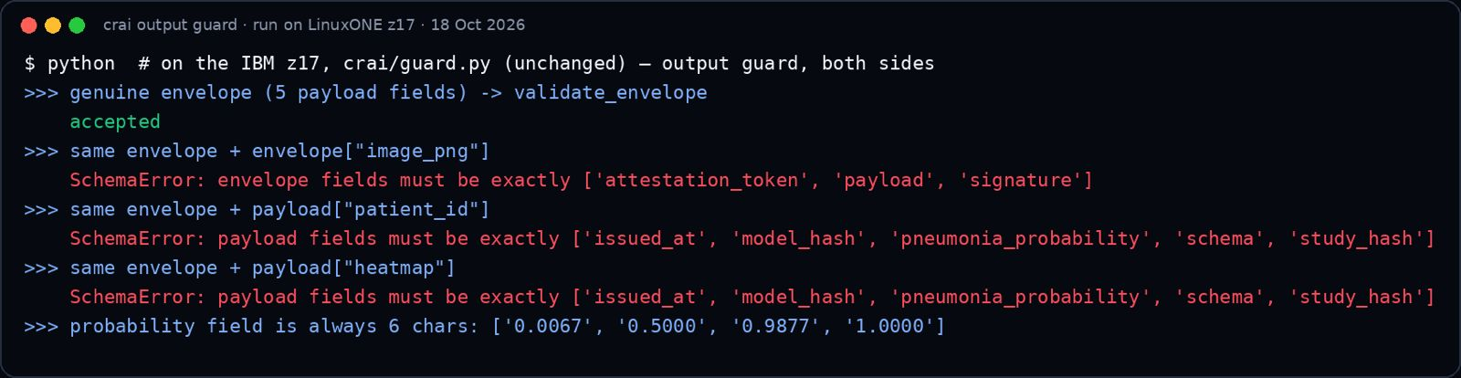
Only five fields leave the guest, signed, and anything extra is rejected
OUTPUT GUARD
crai.result.v1
WHAT MAKES IT SAFE
{
"schema": "crai.result.v1",
"study_hash": "…",
"model_hash": "…",
"pneumonia_probability": 0.0067,
"time": "…"
}
Ed25519 signature from the key the token approved
Extra fields such as image_png or patient_id are rejected on both sides
Hash-chained audit log: no pixels, keys, or patient ids; edit one line and the chain breaks
Token-bucket rate limit per client
VISUAL PLACEHOLDER
Rejected-output screenshot
attack_crop.jpg
Notes:
Treat the response as part of the attack surface. The guard rejects extra fields on both sides.

Slide 13
To test the claim we attack the system eleven ways and expect a named refusal each time
HOW TO READ THE EVIDENCE
1 Attack
2 System responds
3 Pass = refusal
For example: flip one byte of the model file.
Attestation compares hashes, then the broker decides.
No key, no pixels, and a reason in the log.
Attacks 1 to 7
Extra tests E1 to E4
Model, guest code, ciphertext, tag, token, stored data, output fields
Replay, request flood, audit-log edit, network egress
Notes:
Introduce the data before showing it, so the table that follows reads at a glance.

Slide 14
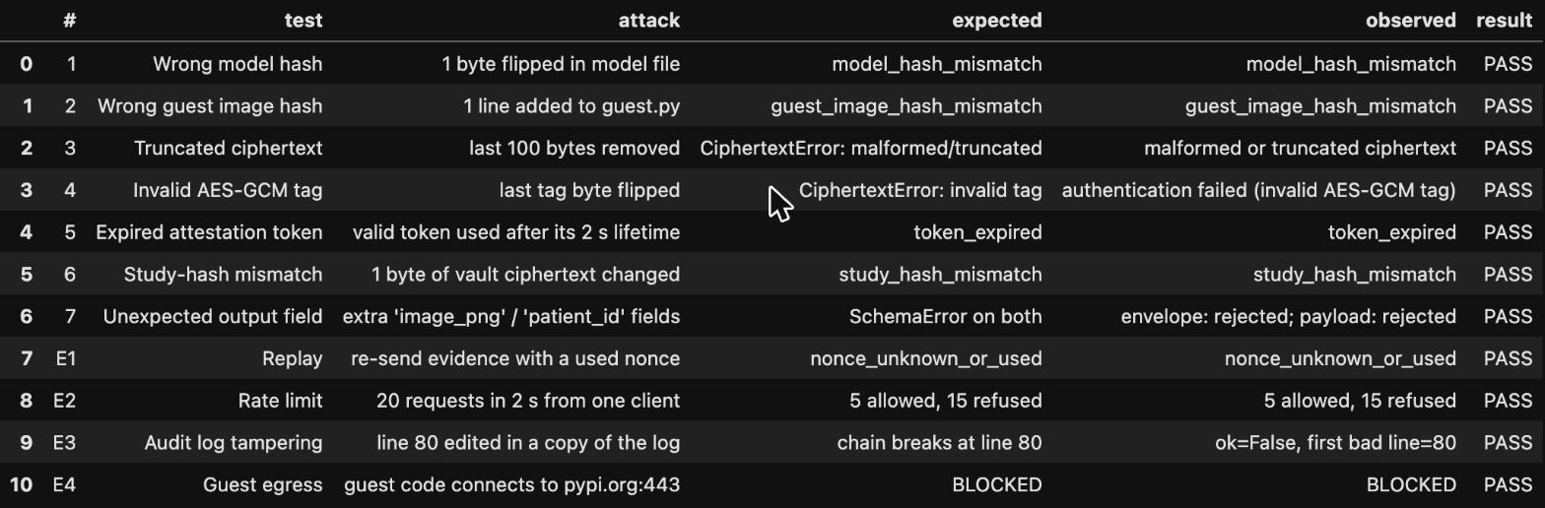
All eleven attacks were refused, each with a named reason
RESULT: ATTACKS
# | Attack | Observed
1 | Flip 1 byte of the model file | model_hash_mismatch
2 | Add 1 line to the guest code | guest_image_hash_mismatch
3 | Truncate the ciphertext | malformed / truncated
4 | Flip the AES-GCM tag | authentication failed
5 | Use a token after it expires | token_expired
6 | Alter stored ciphertext | study_hash_mismatch
7 | Add image_png / patient_id to output | rejected on both levels
E1 | Replay old evidence | nonce_unknown_or_used
E2 | 20 requests in 2 s | 5 allowed, 15 refused
E3 | Edit one audit-log line | chain breaks at that line
E4 | Guest connects to the internet | BLOCKED
VISUAL PLACEHOLDER
Real notebook output
tests_table.jpg
Reference: notebook §5 · crai/security_tests.py
Notes:
Read it as eleven independent ways to break the claim, and eleven refusals. Every row is rerunnable from the notebook.

Slide 15
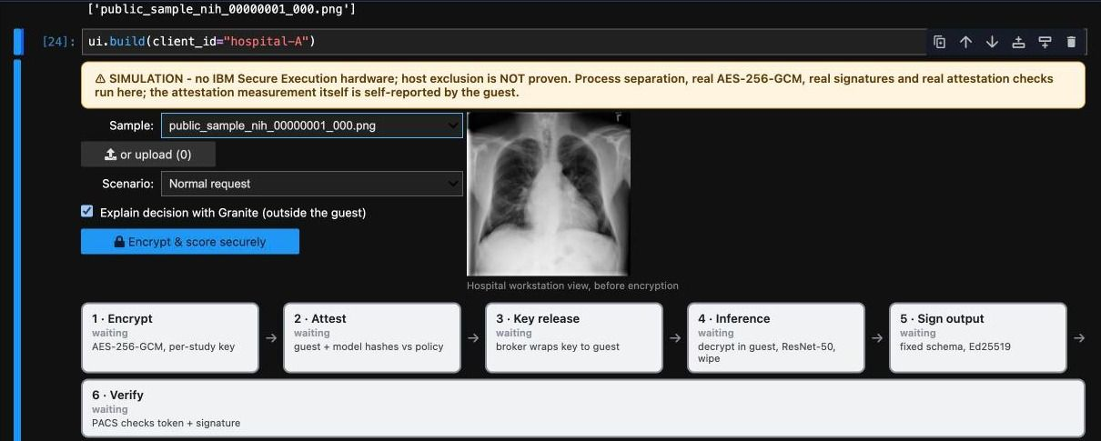
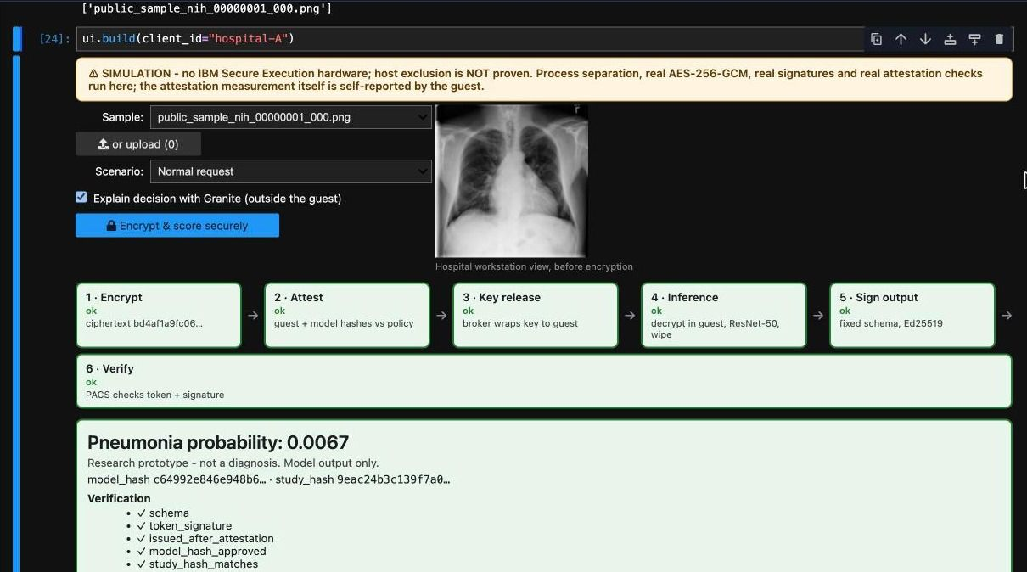
A normal scan is scored in seconds while the host sees only ciphertext
RESULT: LIVE DEMO
SIMULATION
VISUAL PLACEHOLDER
Before: pick a scan
demo_normal.jpg
VISUAL PLACEHOLDER
After: six stages green
demo_result.jpg
Pick a scan → Encrypt & score securely → six stages go green → Pneumonia probability: 0.0067
Notebook §6 · crai/ui.py. The simulation banner stays visible in the screenshots.
Notes:
Now show the same pipeline succeeding. Optional: play film 1:32 to 1:49 instead of a live run.

Slide 16
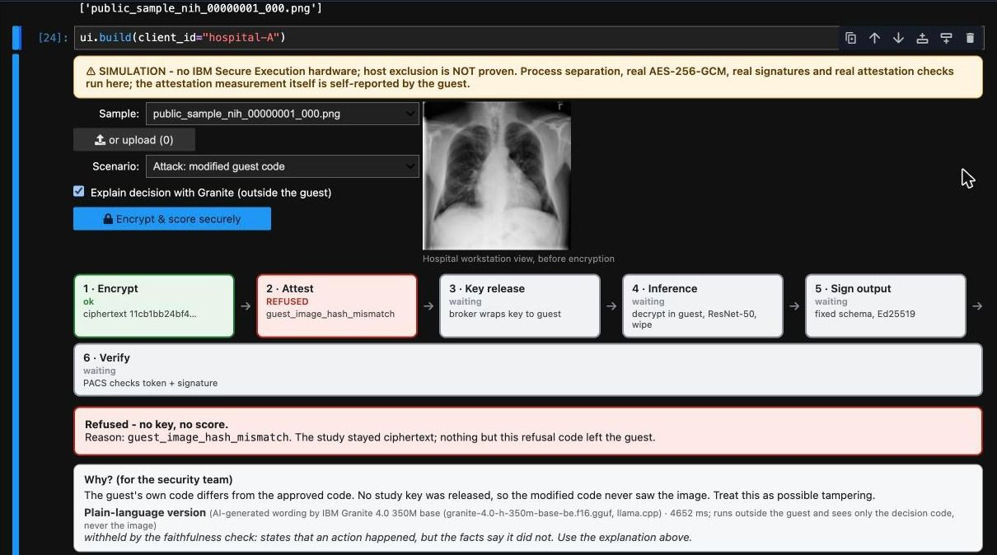
Add one line to the guest code and the same button is refused
RESULT: ATTACK LIVE
SIMULATION
VISUAL PLACEHOLDER
Refused at the attest stage
attack_refused.jpg
THE ATTACK
open('/tmp/leak.bin','wb').write(buf)
Attest stage returns guest_image_hash_mismatch
No key, so no pixels
Granite’s plain-language text is shown or withheld by the faithfulness check
Notes:
The same button, a tampered guest. This is the moment the claim becomes visible.

Slide 17
Security adds about 23 milliseconds to a roughly 2.5 second request
RESULT: COST
Δ 0.0000
secure vs plain probability. Max difference 1.55e-5, tolerance 1e-4, on 1 public sample image.
~2.5 s vs ~1.0 s
secure request vs plain inference. The rest is fresh process + model load.
Reference: notebook §6, §6b, §4b
Notes:
Answer the obvious objection: does the protection slow the AI down? Measured on our z17, nothing estimated.

Slide 18
Telum cuts inference time by about two to three times with almost no change in probability
RESULT: TELUM
WHAT WE MEASURED
Batch 8: about 2.1 to 3.6× faster
Probabilities move only ≈0.0004 to 0.0006
TF port + IBM zDNN plugin
Secure guest still runs on CPU, not Telum
Reference: notebook §6b
Notes:
Why IBM Z matters: the accelerator is real and measured. Be clear that the secure guest does not use it yet.

Slide 19
Granite explains results in plain language, and a faithfulness check can withhold the text
RESULT: EXPLANATIONS
350M
5 to 7 s
1 of 3
IBM Granite 4.0 350M, run with llama.cpp on s390x
per explanation; model load takes about 1 to 2.6 s
explanations withheld by the faithfulness check in our run
Granite runs on the host side and never sees the image. A faithfulness check decides whether each explanation is shown or withheld.
Notes:
Explanations are an extra layer. Because it runs host side, it never needs the image.

Slide 20
On our IBM z17 the models and crypto ran for real, while host isolation is simulated
PLATFORM
RAN FOR REAL
NOT ON OUR SERVER
z17 (machine type 9175), 3 vCPUs, about 7.3 GB RAM
RHEL 10.2, s390x big-endian, NNPA (Telum) present
CPU inference; AES-GCM, Ed25519, X25519 via PyCryptodome
Telum via ibm-zdnn-plugin; Granite via llama.cpp
Secure Execution: simulated and labelled
Crypto Express and any CPACF claim
Podman: Containerfiles written, not run
Production shape: Secure Execution guest + Trustee attestation + Crypto Express KEK + Telum inference
Notes:
Separate what is real from what is simulated before anyone else does.

Slide 21
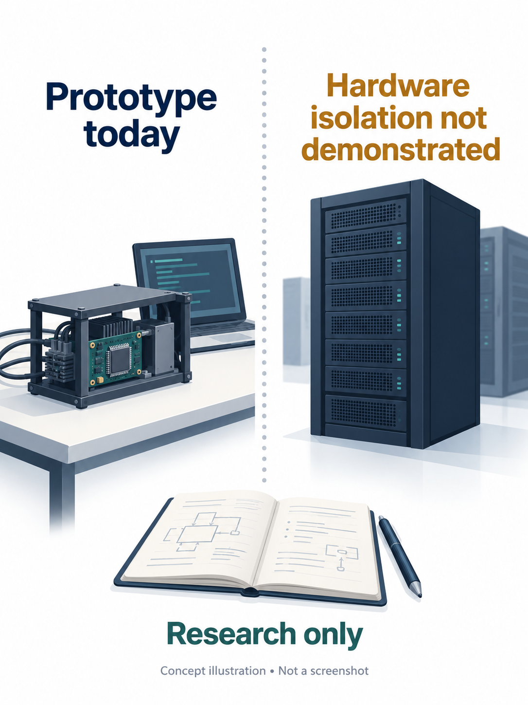
What we did not prove is written on every screen, not hidden in an appendix
LIMITS
SIMULATION
No Secure Execution on our server: host exclusion is simulated and labelled
VISUAL PLACEHOLDER
Honesty slide visual
film_frame_160s.jpg
1
Attestation is self-reported here; real IBM Z signs it with the Ultravisor
2
Master key is a chmod-600 file, not an HSM; no CPACF claim; guest runs on CPU
3
Python cannot guarantee no image copy remains; side channels are out of scope
4
Accuracy inherits a pre-training overlap with RSNA
5
Notes:
Credibility comes from naming limits first. Each of these is already labelled in the demo.

Slide 22
Scans stay protected while the AI runs, which helps six groups at once
IMPACT
1
Hospitals
2
Radiologists
3
Patients
Can use outside AI at all
A score plus proof of which model made it
Protected in use, not only at rest
4
Hospital security
5
Model developers
6
Regulators
Reviewable logs and rerunnable tests
Deploy without seeing the data
A concrete privacy-preserving pattern
The same design carries to CT, MRI, and any hash-approved model.
Notes:
Return to Dr. Meera: this is what changes for her hospital and for everyone around the scan.

Slide 23
Six steps take this prototype from simulation to real Secure Execution
NEXT STEPS
1
2
3
Run the guest as an IBM Secure Execution guest with pvattest + Trustee
Move the KEK to Crypto Express; use CPACF protected keys
Put the secure guest on the Telum path; list offloaded operators
4
5
6
Keep a long-running attested guest per session to cut latency
Run a clean accuracy control and external validation
Enforce network policy inside the Secure Execution image
Notes:
Each step removes one item from the limits slide.

Slide 24
The image is readable in one place, and we can prove which code saw it
11 / 11
Δ 0.0000
23 ms
attacks refused
secure vs plain score
security overhead
Team Revolution
Anish Mall (Team Leader) · Sourav Kumar · Aashi Soni · Ayush Kesarwani · Gobinath
Notes:
Close by repeating the single theme and the three proof points. Optional closing frame: film_frame_172s.jpg.

Slide 25
Every number in this deck traces to a notebook section and a code file
BACKUP A REPRODUCIBILITY
Section | What it covers | Code
§0 | Platform check | deploy/
§1 to §3 | Pipeline, encryption, attestation, key broker | crai/pipeline.py, crypto.py, attestation.py, broker.py
§2 | Model and calibrated head | crai/model.py, train.py
§4, §4b | Output guard, audit log, Granite | crai/guard.py, audit.py
§5 | Eleven security tests | crai/security_tests.py
§6, §6b | Demo UI, secure vs plain, Telum | crai/ui.py
§7 | RSNA data and split | crai/data.py
Notes:
For Q&A. Point to the notebook when asked how a number was produced.

Slide 26
Each study has its own key, and the key is wrapped to one verified guest
BACKUP B CRYPTOGRAPHY
AT REST
AT KEY RELEASE
AES-256-GCM, fresh data key per study
Study id bound as AAD
Data key wrapped under the broker’s KEK
Evidence: guest hash, model hash, X25519 and Ed25519 public keys, single-use nonce
Signed 60 s token from the attestation service
Broker re-wraps the data key to the guest’s X25519 key (HKDF)
Any mismatch ends in refusal with a logged reason
Notes:
For Q&A on how keys move.

Slide 27
Four questions we expect, with answers we can defend
BACKUP C ANTICIPATED QUESTIONS
Is this real Secure Execution?
How accurate is the model?
No. Host exclusion is simulated and labelled. Policy logic is the same; on real IBM Z the Ultravisor signs the measurement.
Not measured yet. The backbone’s pre-training overlaps RSNA, so any number will be optimistic.
Why not homomorphic encryption?
What does security cost?
Published full forward passes take about 88 to 92 s per image, against milliseconds in the clear.
About 23 ms of a roughly 2.5 s secure request, measured on our z17.
Notes:
Rehearse these. Wait for the full question, repeat it, then answer.

