Slide 1

PERSONAL LOAN
MANAGEMENT SYSTEM
A secure, traceable loan lifecycle built with Java, React JWT and Spring Boot
Presented by Anish Das and Sweta Kumari
Notes:
INTERVIEW SPEAKER NOTES
Open with the business problem: PLMS digitizes the complete personal-loan journey. State clearly that the case study uses synthetic credit data and simulated money movement. Then explain that the presentation covers business flow, architecture, implementation logic, security, failure handling and testing.
[Sources]
- PLMS_Full_Stack_Case_Study_Complete.pdf, training reference, pages cited in slide content.
- Visual on this slide was generated with Microsoft Copilot.

Slide 2
1. Business problem and project scope
What the platform solves and what the training baseline intentionally excludes
Business objectives
In scope
Out of scope
• End-to-end digital loan lifecycle
• Role-separated operational queues
• Traceable decisions and audit history
• Configurable policies and fees
• Authentication and customer profile
• Applications, eligibility and documents
• Approval, simulated disbursement
• EMI, repayment, reports and audit
• Real credit-bureau integration
• Real bank/payment settlement
• Automatic regulatory certification
• Universal lending policy
Core design principle
Build one vertical slice at a time: authenticate the customer, validate ownership, submit an application, assess eligibility, verify evidence, decide, disburse safely, calculate EMI, record repayment and audit every critical event.
Source: Case study pp. 2–4
Notes:
INTERVIEW SPEAKER NOTES
Explain the scope boundary before technology. The system is a training-grade personal-loan platform. It is not production underwriting, and it does not move real money. The design goal is to demonstrate secure APIs, role segregation, resource ownership, configurable policy, resilience and auditability.
[Sources]
- PLMS_Full_Stack_Case_Study_Complete.pdf, training reference, pages cited in slide content.

Slide 3
2. Users, roles and separation of duties
Each role has a narrow responsibility; the backend is always authoritative
CUSTOMER
LOAN OFFICER
CREDIT ANALYST
Own profile, applications, documents, schedule and repayments
Review assigned cases and record recommendations
Run or inspect authorized credit assessments
DOC VERIFIER
LOAN APPROVER
FINANCE / ADMIN
Verify, reject or request document resubmission
Make final decision with maker-checker enforcement
Simulate funding, reports, audit and configuration
Never rely only on hidden UI buttons. Spring Security roles plus service-level ownership and assignment checks protect every API.
Source: Case study pp. 3–4
Notes:
INTERVIEW SPEAKER NOTES
Describe the difference between authentication and authorization. Authentication proves identity. Authorization verifies the role and the specific resource. For example, a CUSTOMER may call the application API only when the application customerId equals the authenticated subject. Maker-checker prevents the same staff member from recommending and finally approving a case when the policy is enabled.
[Sources]
- PLMS_Full_Stack_Case_Study_Complete.pdf, training reference, pages cited in slide content.

Slide 4

3. Complete end-to-end loan workflow
The story to use when the interviewer asks, “Explain the business flow”
Register → Profile → Product → Draft → Submit → Eligibility → Credit → Documents → Approval → Disbursement → EMI → Repayment → Closure
Source: Case study pp. 6–8, 29–30
Notes:
INTERVIEW SPEAKER NOTES
Walk through the flow in sequence. A customer registers, logs in, completes the profile, selects an active loan product, creates a draft and submits it. Submission snapshots product terms. Eligibility evaluates versioned rules and may call a synthetic credit provider. Documents are uploaded privately and verified. A loan officer recommends, a different approver decides, finance simulates disbursement, the backend generates the EMI schedule, repayments are recorded and closure is allowed only after all dues and unknown transactions are resolved.
[Sources]
- PLMS_Full_Stack_Case_Study_Complete.pdf, training reference, pages cited in slide content.
- Visual on this slide was generated with Microsoft Copilot.

Slide 5
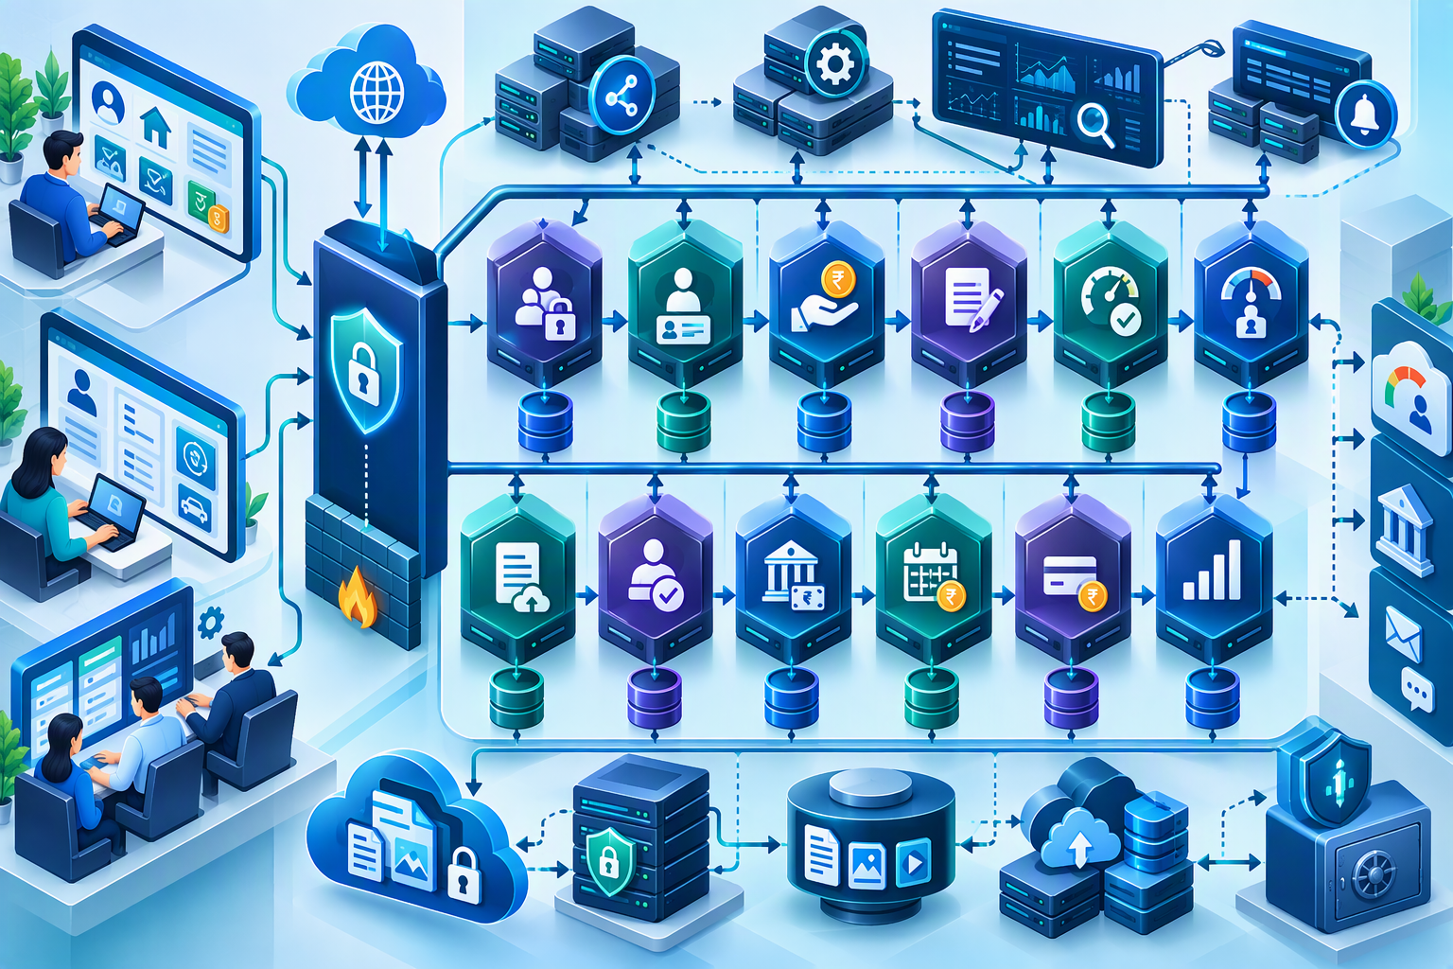
4. System architecture and service boundaries
Gateway-led microservices with service-owned data and explicit integration contracts
Entry and discovery
• React web client
• Spring Cloud Gateway
• Eureka registry
Service integration
• OpenFeign for synchronous calls
• Stable IDs, APIs and events
• No cross-schema foreign keys
Reliability and visibility
• Resilience4j timeouts/circuit breaker
• Actuator, metrics and health checks
• Correlation IDs and structured logs
Source: Case study pp. 4–7
Notes:
INTERVIEW SPEAKER NOTES
Explain that the Gateway is the single entry point. Services register with Eureka. OpenFeign provides declarative service-to-service calls. Each service owns its schema, so one service never directly updates another service’s tables. Remote references are stable IDs. Resilience4j protects unreliable dependencies, and correlation IDs connect one business request across logs.
[Sources]
- PLMS_Full_Stack_Case_Study_Complete.pdf, training reference, pages cited in slide content.
- Visual on this slide was generated with Microsoft Copilot.

Slide 6
5. Core backend modules
Logical separation first; distributed deployment only where justified
Auth
Customer
Product
Application
Eligibility
Users, roles, JWT, refresh sessions
Profile, employment, income
Terms, rates, fees, policy version
Draft, submit, snapshot, status history
Versioned rules and outcomes
Credit
Documents
Approval
Loan Account
Reporting
Synthetic provider assessment
Private file metadata and review
Evidence, recommendation, decision
Disbursement, EMI, repayment
Notifications, reports and audit
Practical training deployment: combine Eligibility + Application, Credit + Eligibility, and EMI + Repayment while keeping package and data boundaries clear.
Source: Case study p. 5
Notes:
INTERVIEW SPEAKER NOTES
If asked why not create twelve deployables immediately, say that microservices add network, deployment and observability complexity. For a training implementation, related modules can share a Spring Boot application while preserving clean packages, interfaces and ownership. Split later only when scalability, team ownership or release independence justifies it.
[Sources]
- PLMS_Full_Stack_Case_Study_Complete.pdf, training reference, pages cited in slide content.

Slide 7
6. Application state machine
State guards make the loan lifecycle predictable and auditable
APPROVED
DISBURSEMENT PENDING
ACTIVE
DRAFT
SUBMITTED
UNDER REVIEW
REJECTED
RETURNED
CLOSED
Guard examples
Conflict handling
History
• Only DRAFT can be submitted
• Only APPROVED can be disbursed
• CLOSED blocks payment changes
• Invalid transition → HTTP 409
• @Version detects stale updates
• One terminal decision succeeds
• Persist every transition
• Actor, timestamp and reason
• Do not overwrite prior decisions
Source: Case study pp. 7–9
Notes:
INTERVIEW SPEAKER NOTES
Explain that application status is not a free-form string update. The domain or service layer validates permitted transitions. An invalid action returns 409 Conflict. @Version supports optimistic locking, so simultaneous approval attempts do not produce two final decisions. Every transition is appended to status and audit history.
[Sources]
- PLMS_Full_Stack_Case_Study_Complete.pdf, training reference, pages cited in slide content.

Slide 8
7. API design and request flow
Versioned REST endpoints, clear ownership, consistent status codes
Capability | Representative endpoint | Access | Result
Auth | POST /api/v1/auth/login | Public | Token pair
Application | POST /api/v1/applications | CUSTOMER | Create DRAFT
Submit | POST /applications/{id}/submit | Owner | Snapshot + SUBMITTED
Eligibility | POST /eligibility/evaluations | Internal/staff | Rules + outcome
Documents | POST /api/v1/documents | Owner | Multipart upload
Decision | POST /applications/{id}/decision | APPROVER | Approve/reject/return
Disbursement | POST /loan-accounts/{id}/disbursements | FINANCE | Idempotent transfer
Repayment | POST /api/v1/repayments | Owner/system | Payment + receipt
400 validation | 401 unauthenticated | 403 forbidden | 404 concealed/not found | 409 state/idempotency conflict | 413/415 upload errors | 429 throttled
Source: Case study pp. 10–12
Notes:
INTERVIEW SPEAKER NOTES
Use this slide to demonstrate API fluency. APIs are versioned under /api/v1. Controllers validate DTOs and delegate to services. The authenticated customer ID comes from the security principal, not the request body. Errors use one safe shape with timestamp, HTTP status, code, message, correlation ID and field errors.
[Sources]
- PLMS_Full_Stack_Case_Study_Complete.pdf, training reference, pages cited in slide content.

Slide 9
8. Eligibility and synthetic credit logic
Eligibility is an assessment, not the final approval decision
Rule inputs
Possible outcomes
Worked example
• Product amount and tenure limits
• Monthly income
• Existing obligations
• Employment type and duration
• Estimated EMI / affordability
• Required documents
• Synthetic credit status
• ELIGIBLE
• NOT_ELIGIBLE
• MANUAL_REVIEW
• PENDING_PROVIDER
Each rule stores policy version, result, reason code and evaluation time.
Income = ₹85,000
Existing obligations = ₹12,000
Estimated EMI = ₹9,964.29
Affordability = (12,000 + 9,964.29) / 85,000 ≈ 25.84%
Pass/review/fail remains configurable.
Source: Case study pp. 25–26
Notes:
INTERVIEW SPEAKER NOTES
Explain the rule engine as deterministic and versioned. Each rule produces a result and safe reason. The illustrative affordability ratio is 25.84 percent, but the case study does not prescribe a universal approval threshold. If the synthetic credit provider times out, the result becomes pending or manual review. The system never fabricates a negative score.
[Sources]
- PLMS_Full_Stack_Case_Study_Complete.pdf, training reference, pages cited in slide content.

Slide 10
9. Document verification and approval logic
Private evidence, controlled review and maker-checker enforcement
UPLOAD
VALIDATE
STORE
VERIFY
AGGREGATE
DECIDE
Owner, category, file
Size, type, content
Private object + metadata
Accept / reject / resubmit
Eligibility + credit + docs
Approve / reject / return
Document controls
Approval controls
Audit evidence
• Browser MIME is never trusted
• Safe filename and checksum
• Version history for resubmission
• Authorized short-lived retrieval
• Reason required for rejection
• Evidence completeness check
• Role and assignment verification
• Product amount/tenure limits
• Maker-checker validation
• Optimistic state/version guard
• Actor and timestamp
• Decision and reason code
• Policy version
• Correlation ID
• Sensitive comments redacted
Source: Case study pp. 6, 16–17, 24–26
Notes:
INTERVIEW SPEAKER NOTES
Explain that files are not stored as public URLs. The Document Service stores a private object reference and metadata, validates content server-side and keeps every document version. The Approval Service gathers authorized summaries from application, eligibility, credit and documents. Final approval checks role, state, evidence and maker-checker before persisting an immutable decision.
[Sources]
- PLMS_Full_Stack_Case_Study_Complete.pdf, training reference, pages cited in slide content.

Slide 11

10. Security model: JWT, roles and ownership
Defense in depth from login to object-level authorization
Token lifecycle
Short access token; hashed refresh token; rotation and revocation; replay detection
JWT validation
Signature, issuer, audience, expiry and trusted authorities
Authorization
Role check + customer ownership + staff assignment + maker-checker
Data protection
Password hashing, TLS, private files, secret management and redacted logs
Source: Case study pp. 6, 23–26
Notes:
INTERVIEW SPEAKER NOTES
State that JWT alone is not enough. The Gateway or service validates the token, but business services still verify ownership and assignment. Refresh tokens are stored as hashes and rotated atomically. Logout revokes the refresh session; immediate access-token invalidation needs a denylist or token-version strategy. Sensitive values never appear in logs.
[Sources]
- PLMS_Full_Stack_Case_Study_Complete.pdf, training reference, pages cited in slide content.
- Visual on this slide was generated with Microsoft Copilot.

Slide 12
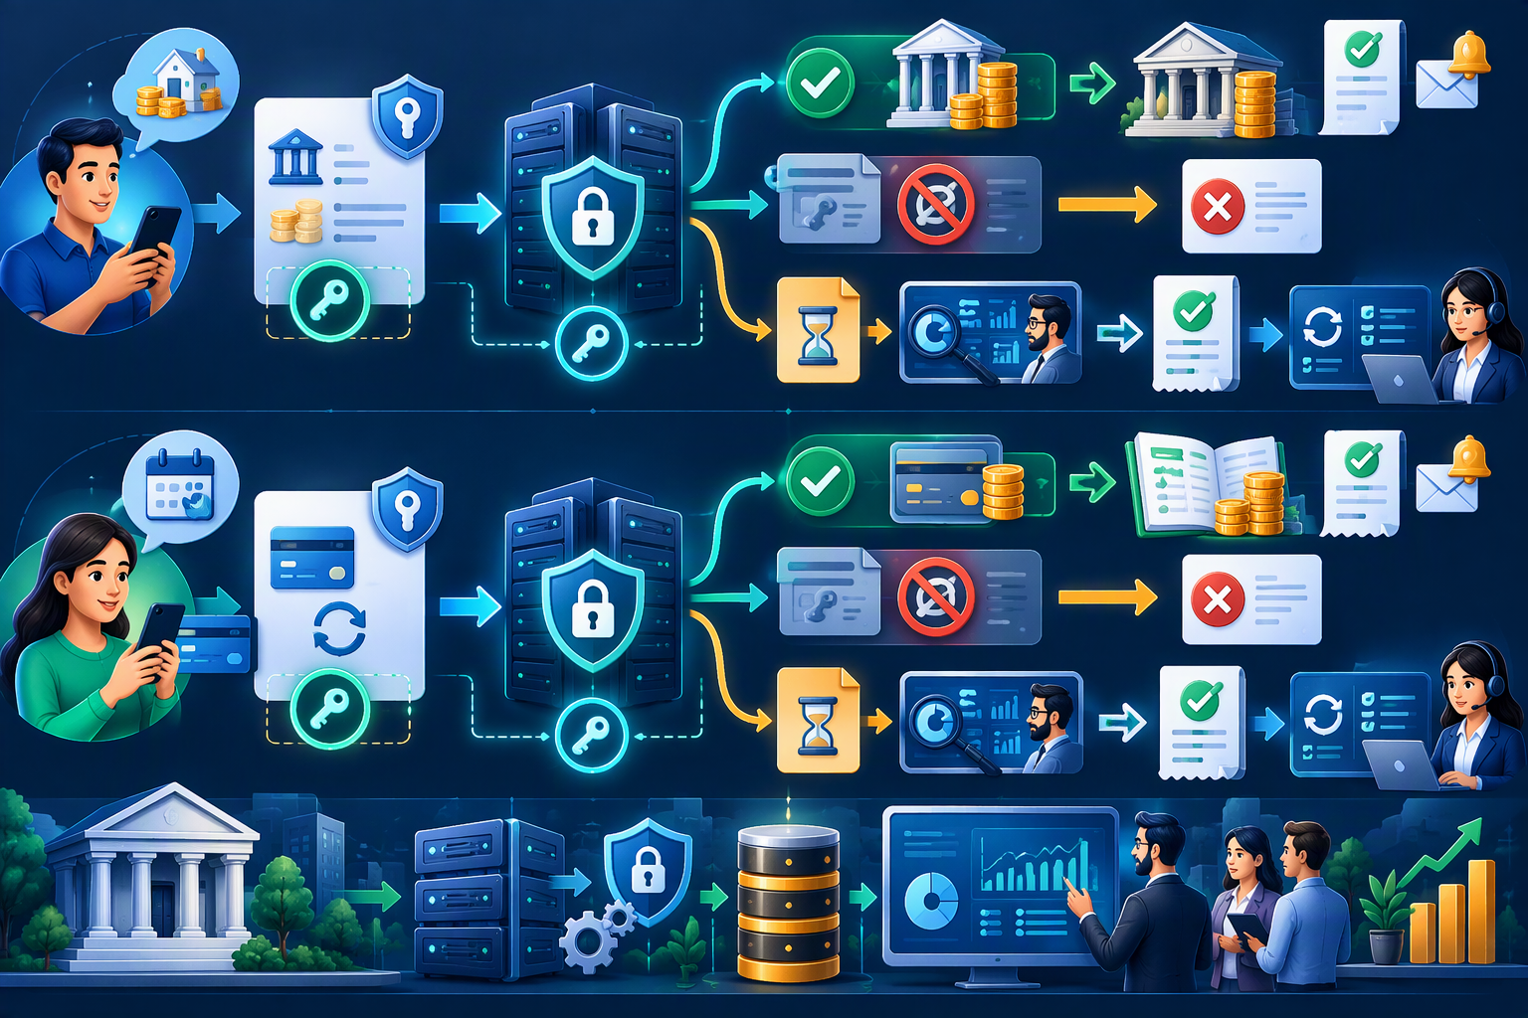
11. Disbursement and repayment: idempotency and reconciliation
Money-like operations must remain safe when clients retry or networks time out
1. Reserve key
Persist the unique idempotency key before calling the adapter.
2. Record outcome
Store SUCCESS, FAILED or UNKNOWN with transaction reference.
3. Safe retry
Repeated key returns the original operation, not a duplicate.
4. Reconcile unknown
Query the reference before retry; failed payment never reduces principal.
Source: Case study pp. 6–8, 18, 26–27
Notes:
INTERVIEW SPEAKER NOTES
Use a concrete timeout example. The adapter may complete the transfer but the response can be lost. If the client blindly retries, duplicate funding or payment could occur. The backend reserves an idempotency key, stores the transaction reference and returns the existing result for duplicate requests. UNKNOWN is not treated as failure; it is reconciled before retry.
[Sources]
- PLMS_Full_Stack_Case_Study_Complete.pdf, training reference, pages cited in slide content.
- Visual on this slide was generated with Microsoft Copilot.

Slide 13
12. EMI calculation and amortization
Backend decimal arithmetic is the source of truth
Principal
Rate
Tenure
EMI = P × r × (1 + r)ⁿ
───────────────
(1 + r)ⁿ − 1
₹300,000
Approved amount
12% annually
r = 1% monthly
36 months
Reducing balance
Installment | Interest | Principal | EMI | Closing balance
1 | ₹3,000.00 | ₹6,964.29 | ₹9,964.29 | ₹293,035.71
2 | ₹2,930.36 | ₹7,033.94 | ₹9,964.29 | ₹286,001.77
3 | ₹2,860.02 | ₹7,104.28 | ₹9,964.29 | ₹278,897.50
Use BigDecimal with explicit scale and rounding. Adjust the final installment for rounding residue so the ending balance becomes zero.
Source: Case study pp. 25–26
Notes:
INTERVIEW SPEAKER NOTES
Explain P as principal, r as monthly rate and n as tenure. For ₹300,000 at 12 percent for 36 months, the displayed EMI is about ₹9,964.29. Use BigDecimal rather than double, define rounding explicitly and use the generated amortization schedule as the source of truth. The final installment may absorb the small rounding residue.
[Sources]
- PLMS_Full_Stack_Case_Study_Complete.pdf, training reference, pages cited in slide content.

Slide 14
13. Persistence, transactions and concurrency
Data integrity is enforced through constraints, transaction boundaries and immutable history
Key entities
Database rules
Spring/JPA logic
• users / roles / refresh_tokens
• customer_profile
• loan_product
• loan_application
• eligibility / credit
• document_metadata
• loan_decision
• loan_account / EMI / repayment
• audit_event
• DECIMAL for amounts and rates
• Unique normalized email
• Unique idempotency key
• Unique transaction reference
• Unique account + installment
• Effective product dates
• Indexed status and due date
• DTOs, not entity exposure
• @Transactional for local changes
• @Version optimistic locking
• State history append-only
• No cascading across services
• Migrations with Flyway/Liquibase
Source: Case study pp. 8–9, 23–25
Notes:
INTERVIEW SPEAKER NOTES
Describe a local transaction example: a confirmed repayment record, its allocations and the installment status must update atomically inside the Loan Account service. Across multiple services, do not pretend one database transaction exists. Use durable state transitions or a saga/process manager. Optimistic locking detects stale approval or account updates.
[Sources]
- PLMS_Full_Stack_Case_Study_Complete.pdf, training reference, pages cited in slide content.

Slide 15
14. Failure handling and resilience
Technical failures are translated into safe business states
Failure | Technical response | Business behavior
Credit provider timeout | 3s time limit; circuit breaker | PENDING_PROVIDER / MANUAL_REVIEW
Duplicate submission | Idempotency key / state guard | Return existing submission or 409
Concurrent approval | @Version + terminal-state check | One decision succeeds; other gets conflict
Disbursement timeout | Store UNKNOWN + reference | Reconcile before retry
Repayment failure | Persist failed attempt | EMI remains unpaid; principal unchanged
Invalid document | Allow-list and content validation | Reject with 413/415 or safe reason
Retries are bounded and used only for transient failures when the operation is idempotent or protected by an idempotency key.
Source: Case study pp. 7, 24–27
Notes:
INTERVIEW SPEAKER NOTES
Emphasize that resilience is not only a library configuration. The business needs an explicit state for uncertainty. A credit outage routes to manual review. A disbursement timeout becomes UNKNOWN. Validation and authorization errors are never retried. Circuit breakers prevent cascading failure, while bounded retries are limited to safe transient conditions.
[Sources]
- PLMS_Full_Stack_Case_Study_Complete.pdf, training reference, pages cited in slide content.

Slide 16
15. Testing strategy
Prove the happy path, security boundaries and failure behavior
UNIT
INTEGRATION
CONTRACT
Eligibility rules, EMI rounding, state transitions
SecurityFilterChain, repositories, constraints, transactions
Feign clients, payload compatibility and error shapes
SECURITY
RESILIENCE
END-TO-END
Cross-customer access, role checks, token replay
Timeouts, circuit breaker and malformed provider responses
Register → submit → assess → approve → repay → close
Essential test case: Customer A requests Customer B’s application ID → 403 or concealed 404, no data leakage, security event audited.
Source: Case study p. 27
Notes:
INTERVIEW SPEAKER NOTES
Explain that a finance workflow cannot be accepted with only happy-path controller tests. Unit tests verify deterministic rules. Integration tests verify database and security behavior. Contract tests protect service boundaries. Security tests explicitly change resource IDs. Resilience tests simulate timeouts and malformed responses. End-to-end tests verify the full state progression and audit trail.
[Sources]
- PLMS_Full_Stack_Case_Study_Complete.pdf, training reference, pages cited in slide content.

Slide 17

16. Delivery and operations
From source code to a repeatable, observable deployment
Local environment
Docker Compose, MySQL 8, Eureka, Gateway and Spring Boot services
CI/CD
Compile → tests → scans → image build → test deploy → smoke test → approval
Observability
Actuator, readiness/liveness, metrics, latency, errors and circuit state
Operational safety
Secrets outside Git, controlled migrations, backups, restore tests and rollback
Source: Case study pp. 28–29
Notes:
INTERVIEW SPEAKER NOTES
Describe Docker Compose as sufficient for the initial capstone. Jenkins runs compile, unit tests, integration tests, static analysis, dependency and container scans, packaging, deployment and smoke tests. Production-like operation requires external secrets, TLS, network segmentation, monitored health checks, controlled database migrations, backups and a rollback plan.
[Sources]
- PLMS_Full_Stack_Case_Study_Complete.pdf, training reference, pages cited in slide content.
- Visual on this slide was generated with Microsoft Copilot.

Slide 18
17. My contribution and interview close
A concise, realistic ownership statement for a Java backend role
“My primary contribution was the Java Spring Boot backend. I worked on REST APIs, DTO validation, service-layer business rules, JPA persistence, MySQL integration, JWT authorization and consistent exception handling. I focused on the customer and loan-application workflow, including draft creation, submission, state transitions, eligibility orchestration, document status and approval integration. I also handled reliability concerns such as optimistic locking, idempotency, circuit-breaker behavior and auditable error handling. Financial calculations use BigDecimal, and critical APIs are covered by unit, integration, security and workflow tests.”
Remember
Demonstrate
Close
Explain what you personally implemented, not every component in the architecture.
Use one technical example: state guard, duplicate payment or credit timeout.
Summarize business value: secure, traceable and failure-aware loan processing.
Source: Derived from the complete PLMS case study
Notes:
INTERVIEW SPEAKER NOTES
Deliver the contribution statement naturally and adjust it to match the work you actually completed. Close by saying that the project demonstrates more than CRUD: it combines business workflow, authorization, data consistency, financial precision, resilience, auditability and automated testing. Invite the interviewer to select any module for a deeper explanation.
[Sources]
- PLMS_Full_Stack_Case_Study_Complete.pdf, training reference, pages cited in slide content.

