Slide 1
MA252 Project
Convex Hull
Akshat Gupta (180123002)
Anish Kumar (180123003)
IIT Guwahati

Slide 2
Summary:
Aim
What is Convex Hull?
Existing Techniques
Papers Discussed
Chan’s Method
Sharif’s Method
Conclusion
References

Slide 3
Aim:
To construct the convex hull of a set of n points in 2 dimensions by improving upon the already existing techniques.
What is Convex Hull?
Smallest convex polygon P for which each point in Q (set of n points) is either on the boundary of P or in its interior.
Various applications such as:
Shape Analysis
Image Processing
Medical Simulations
Avoiding Collisions of Cars on Roads

Slide 4
Existing Techniques:
Graham’s Scan, proposed by Ronald Graham in 1972 with running time O(nlog n).
Jarvis’ March, a.k.a. Gift-Wrapping, created independently by D.R. Chand & S.S. Kapur in 1970 and R.A. Jarvis in 1973 with Running time O(nh).
Quick Hull proposed by Jonathan Greenfield in 1990 which uses divide and conquer algorithm with running time O(n log n).
Papers Discussed-
Muhammad Sharif’s (2011) - “A new approach to compute convex hull”.
T.M. Chan (1996) - “Optimal output sensitive convex hull algorithms in two and three dimensions”

Slide 5
Chan’s Method
An output sensitive algorithm
Speeds up Jarvis’ March and gift wrapping method by using grouping.
Jarvis’ March computes the h vertices of the convex hull one at a time by a sequence of h wrapping steps. A wrapping step can be done faster if the points are pre-processed.

Slide 6
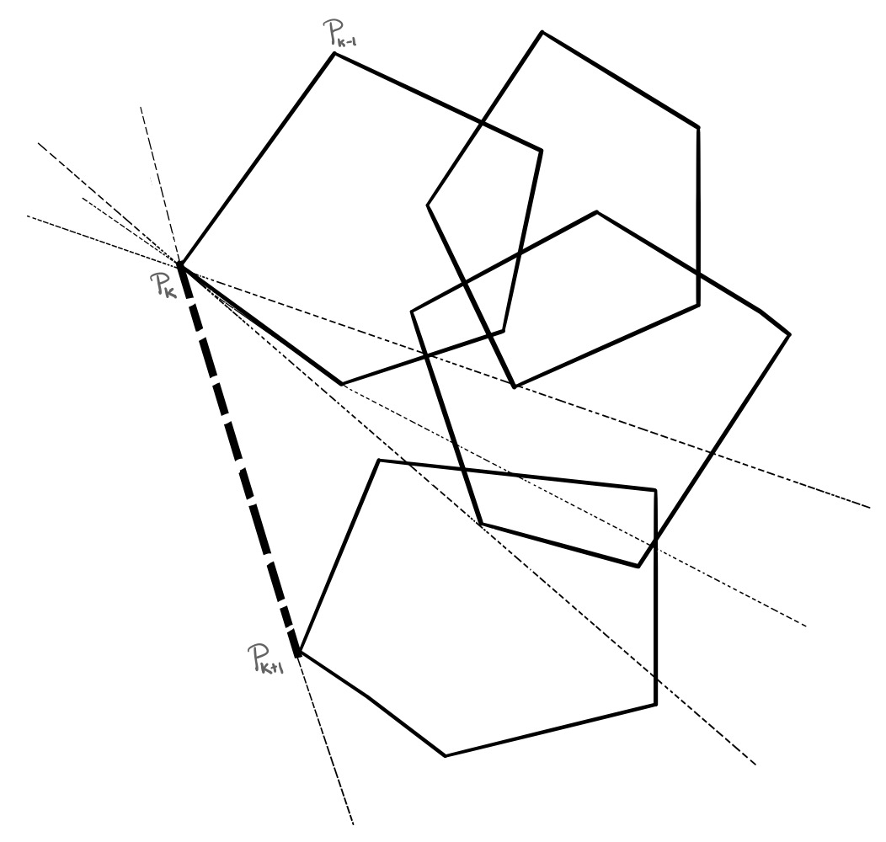
Chan’s Algorithm - 1
Choose a parameter m between 1 and n and partition Q into ([n/m]+1) groups each of size at most m.
Compute convex hull of each group in O(m log m) time by Graham’s Scan.
This gives us [n/m]+1 possibly overlapping convex polygons each with at most m vertices, after a pre-processing time of O((n/m) (m log m)) = O(n log m).

Slide 7
Chan’s Algorithm - 2
4. Now, a wrapping step can be done by scanning all [n/m]+1 polygons and computing tangents or supporting lines of the polygons. Finding tangent takes logarithmic time for a convex polygon by binary or Fibonacci search, so the time required for a wrapping step is O((n/m) log m). As h wrapping steps are needed to compute the hull, total time of the algorithm becomes O(n logm + h ((n/m)logm)) = O(n (1+h/m) logm)
5. By guessing the value of h using a sequence of Hs, the running time of the algorithm comes out to be O(n log h).

Slide 8
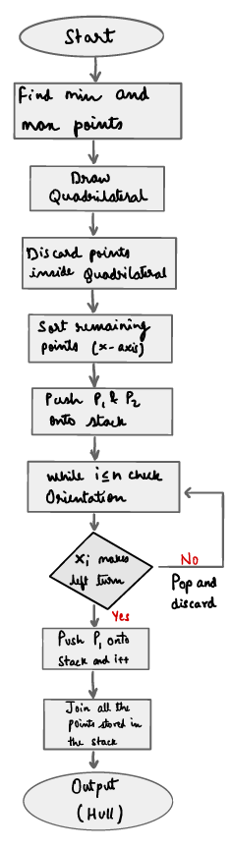
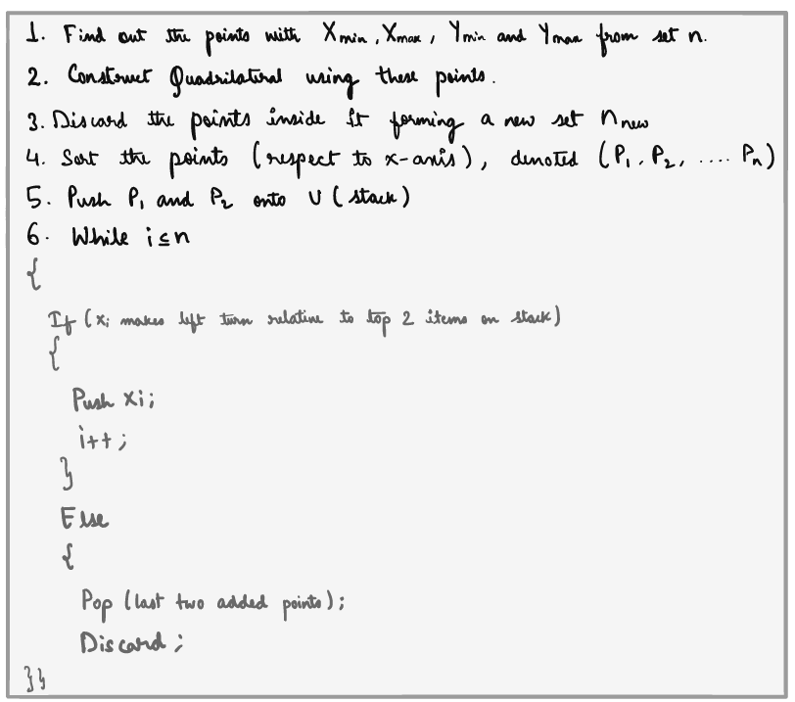
Sharif’s Method-
*Above algorithm & flowchart is a part of Muhammad Sharif’s research paper describing his new technique

Slide 9
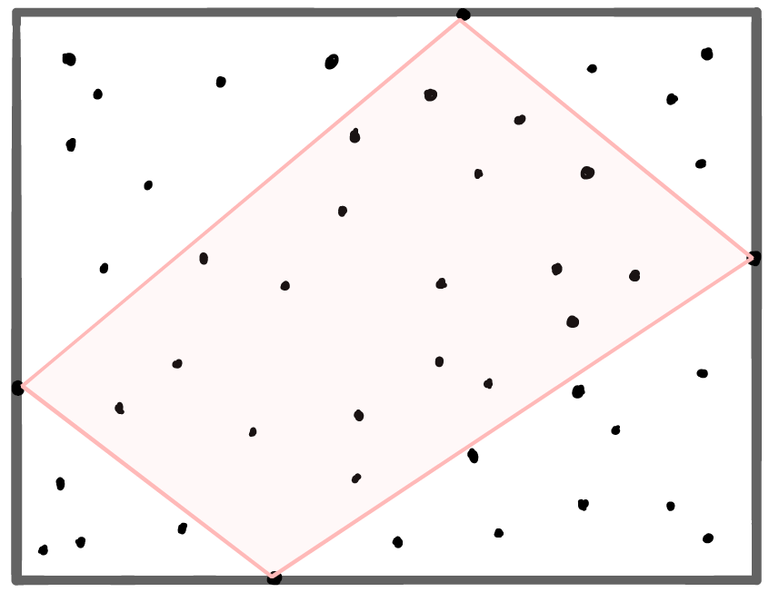
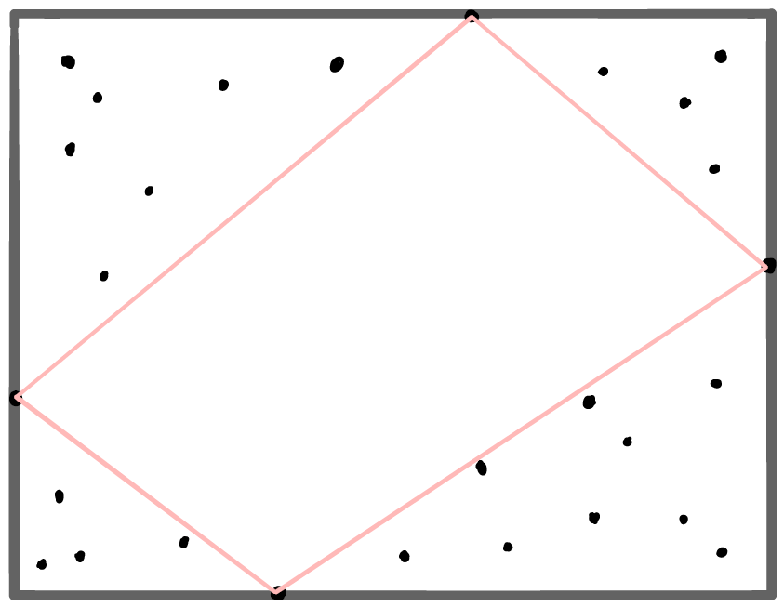
Figures showing new method-
These two steps are a part of Quick hull method
1
2
Ymax
Xmax
Xmin
Ymin
Using quick hull initial step form a quadrilateral with Xmin, Ymin, Xmax and Ymax points
Discard the points inside quadrilateral

Slide 10
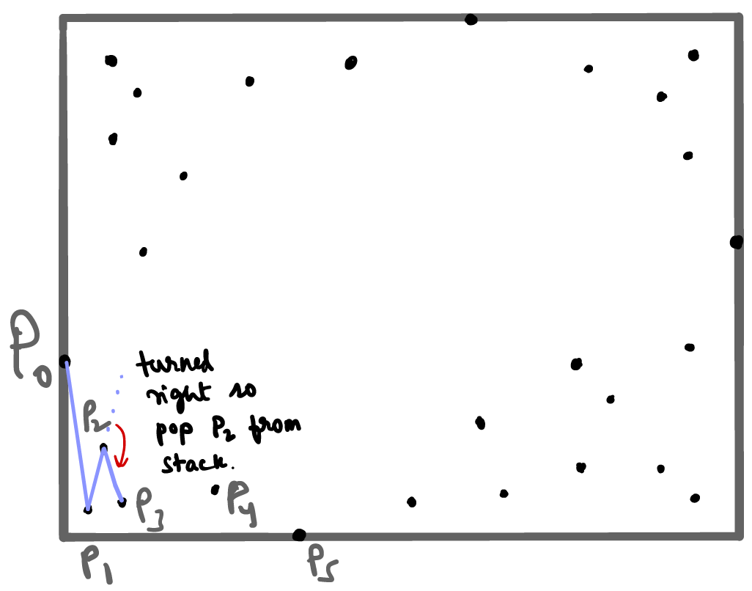
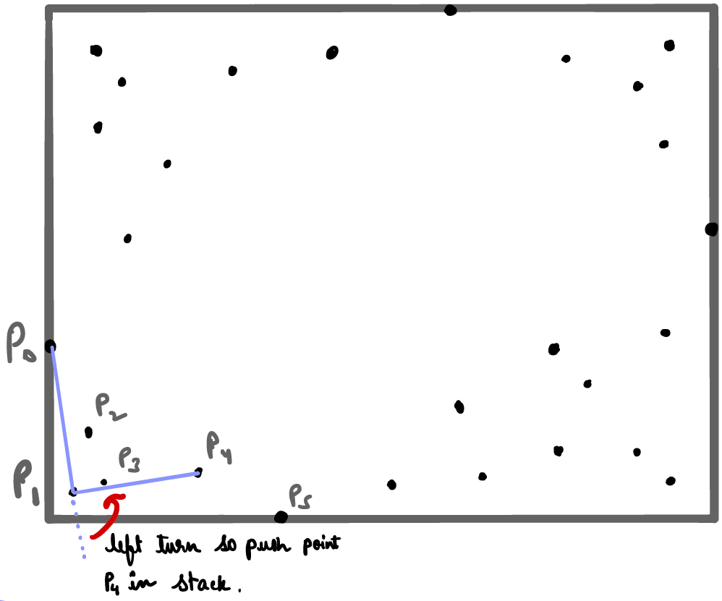
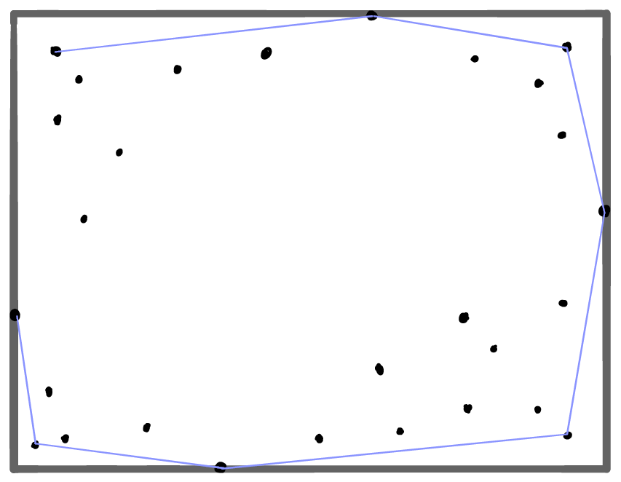
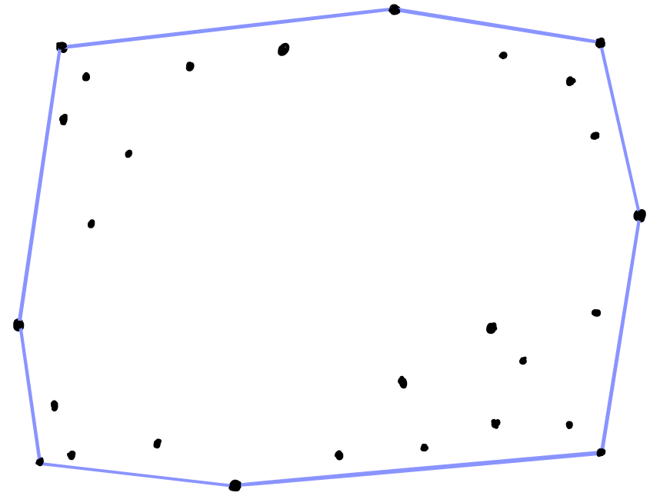
3.
All these steps are a part of Graham’s Scan
4.
Pop point P₂ as orientation of line P₁P₂ with P₂P₃ is negative
Push P4 into the stack as it made positive orientation.
5.
6.
convex hull completed

Slide 11
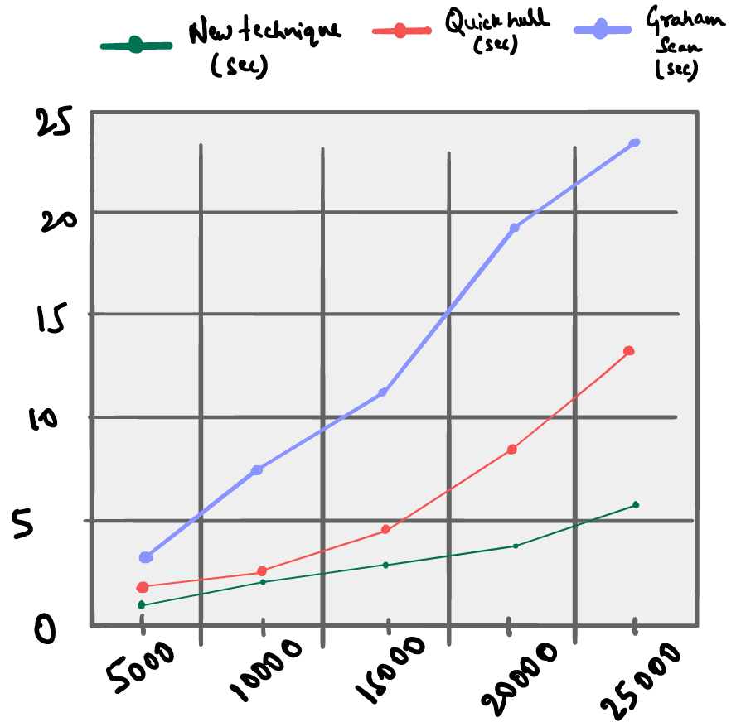
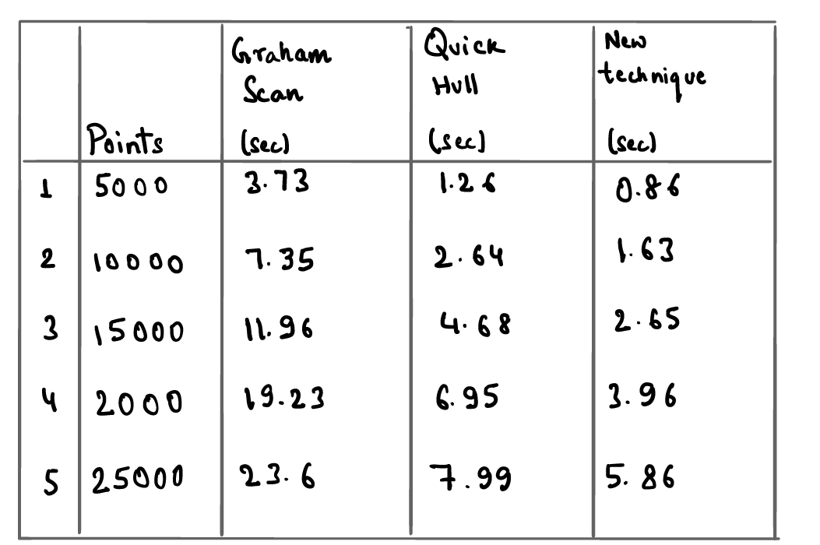
Analysis of technique with the help of graph & table:
Time in sec.
No. of points
*Above table & graph is part of Muhammad Sharif’s research paper showing how fast his proposed technique is.

Slide 12
CONCLUSION:
The above two techniques, which are modifications and improvements on some already existing techniques, perform faster than any of the individual methods. Both the techniques attempt to discard as many useless points as possible before applying the pre-existing methods.
Chan’s method speeds up Jarvis’ March and gift wrapping method by using grouping. While Jarvis’ March constructs the convex hull in O(nh) time, Chan’s method improves it to O(n log h).
Sharif’s method uses Quick Hull’s initial steps to remove unnecessary points and then apply Graham’s Scan to a much smaller set of points, thereby speeding up the process.

Slide 13
REFERENCES:
[1] R.L. Graham (1972): “An efficient algorithm for determining the convex hull of a finite planar set”
[2] D. R. Chand and S. S. Kapur. An algorithm for convex polytopes. J. Assoc. Comput. Mach., 17:78-86, 1970.
[3] R. A. Jarvis. On the identification of the convex hull of a finite set of points in the plane. Inform. Process. Lett., 2:18-21, 1973.
[4] Greenfield, Jonathan Scott (1990): “A proof for a Quick Hull Algorithm”
[5] T.M. Chan (1996): “Optimal output-sensitive convex hull algorithms in two and three dimensions”
[6] Muhammad Sharif (2011): “A new approach to compute convex hull”
[7] T.H. Cormen, C.E. Leiserson, R.L. Rivest and C. Stein: “Introduction to Algorithms”

Slide 14
THANK YOU!

